Slide 1
File System
Performance
Characterization
Linux I/O path we analyze
Applications / Benchmarks
VFS + dentry / inode path
Page cache / Direct I/O
ext4 vs XFS vs btrfs
Operating Systems term project presentation
ext4 | XFS | btrfs
Block layer + loop device
Ningzichang (225040142) · Xiawen (225040124)
ext4
XFS
btrfs
Main question: how do file-system design choices change throughput, latency, and CPU behavior?
Operating Systems · Topic 14
1
Notes:
Opening slide: frame the project as a file-system characterization study and mention that both members will present. [Sources] - /mnt/data/6004329ce54d43cf9110d5551d98acbe.png - /mnt/data/fs_report_revised.tex

Slide 2
Project Motivation & Objectives
WHY THIS TOPIC MATTERS
Why it is interesting
The same hardware can behave very differently under ext4, XFS, and btrfs.
The differences come from real kernel mechanisms: journaling, extent allocation, page cache, and copy-on-write.
This topic combines mandatory benchmarks with subsystem-level explanation, which fits an OS project well.
Three designs, three trade-offs
ext4
balanced default
strong general-purpose behavior
XFS
extent-based design
expected to excel on deep direct I/O
btrfs
copy-on-write + checksum
richer features, more write overhead
What we set out to do
Use dd, fio, and sysbench to measure sequential/random I/O, latency, and CPU usage.
Test mount-parameter tuning and custom workloads.
Explain why the ranking changes across workloads instead of only listing numbers.
Operating Systems · Topic 14
2
Notes:
Motivation plus presenter split. Make clear that each member covers a distinct section. [Sources] - /mnt/data/fs_report_revised.tex - /mnt/data/6004329ce54d43cf9110d5551d98acbe.png

Slide 3
Key Kernel Components Analyzed
SUBSYSTEM VIEW
What we analyzed
Linux I/O path in this experiment
VFS path: pathname lookup, dentries, and inode operations.
Page cache / writeback versus direct I/O behavior.
ext4 journaling (JBD2) and journaling modes.
XFS allocation groups, extent trees, and logging.
btrfs copy-on-write, tree updates, checksumming, and compression.
dd · fio · sysbench
VFS
Page cache
Direct I/O
ext4
XFS
btrfs
Interpretation focus
Block layer + scheduler + loop-backed image
How in-place update vs. COW changes write cost.
Why buffered and direct I/O can lead to different conclusions.
Which design is best for random write-heavy workloads.
Characterization project, not a kernel-patching project.
Operating Systems · Topic 14
3
Notes:
Explain that we analyze kernel subsystems through controlled workloads, even without editing kernel source code. [Sources] - /mnt/data/fs_report_revised.tex - /mnt/data/00_setup_env.sh - /mnt/data/02_benchmark_fio.sh - /mnt/data/03_benchmark_sysbench.sh - /mnt/data/04_advanced_mount.sh - /mnt/data/05_custom_workload.sh

Slide 4
Design & Implementation
BENCHMARK HARNESS
Key fio settings
What we built
1 fio --rw=randrw --bs=4k --iodepth=32 --size=256M \ 2 --runtime=30 --time_based --rwmixread=70 \ 3 --ioengine=libaio --direct=1 --group_reporting
A reproducible shell-script harness that creates three loop-backed file systems in the same VM.
Separate scripts for setup, baseline benchmarks, mount tuning, and custom workloads.
CSV / JSON outputs that feed the report figures and presentation charts.
direct=1 removes page-cache effects for the main fio tests.
4 KB + iodepth 32 stresses random I/O and queue handling.
70/30 mix approximates a database-like read/write pattern.
Setup env
loop files ·
format · mount
Baseline
dd · fio · sysbench
Advanced
mount tuning · custom
Outputs
CSV / JSON ·
plots · report
Operating Systems · Topic 14
4
Notes:
Use this slide to show that the implementation work is in automation and workload design. [Sources] - /mnt/data/00_setup_env.sh - /mnt/data/01_benchmark_dd.sh - /mnt/data/02_benchmark_fio.sh - /mnt/data/03_benchmark_sysbench.sh - /mnt/data/04_advanced_mount.sh - /mnt/data/05_custom_workload.sh

Slide 5
Experimental Setup & Methodology
HOW WE TESTED
Environment
Workloads
Fairness controls
OS
Ubuntu in KVM VM
dd
sequential read/write, 4 KB / 64 KB / 1 MB
Same 2 GB image size and same VM for all file systems.
drop_caches before each run.
fio uses direct=1 so the core comparison is not dominated by page cache.
Same runtime and same I/O sizes across file systems.
Kernel
6.17.0-14-generic
fio
1 MB sequential; 4 KB random; 70/30 mix; latency
CPU
Intel Core Ultra 5 225H, 3 cores
sysbench
buffered seq/rand/mixed file I/O, 30 s
Memory
21 GiB
Advanced
mount tuning + small files + large file + DB-like mix
Limitation
Absolute bandwidth is inflated by the VM + loop-backed setup, so we focus on relative trends.
Storage
3 loop devices, 2 GB each
Tools
fio 3.36 · sysbench 1.0.20 · dd
Operating Systems · Topic 14
5
Notes:
Talk through the environment quickly and then emphasize fairness controls and the VM limitation. [Sources] - /mnt/data/fs_report_revised.tex - /mnt/data/00_setup_env.sh - /mnt/data/01_benchmark_dd.sh - /mnt/data/02_benchmark_fio.sh - /mnt/data/03_benchmark_sysbench.sh - /mnt/data/粘贴的文本 (1)(3).txt

Slide 6
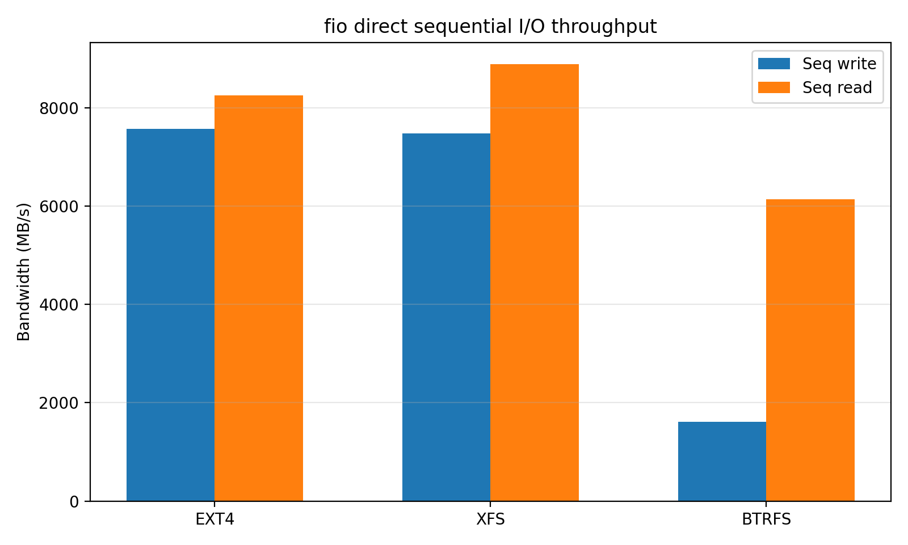
Results I — Sequential Throughput
DIRECT + BLOCK-SIZE EFFECTS
Main takeaways
ext4 and XFS are almost tied on direct sequential write: 7.57 vs 7.48 GB/s.
XFS is slightly ahead on direct sequential read, but ext4 remains very close.
btrfs drops to 1.61 GB/s on direct sequential write, showing the cost of extra write-path work.
In dd, ext4 benefits the most from larger block sizes, especially on reads.
Interpretation
Long sequential writes reward designs with efficient extent allocation and less copy-on-write overhead.
Operating Systems · Topic 14
6
Notes:
Explain the direct sequential chart first, then use dd as supporting evidence for block-size sensitivity. [Sources] - /mnt/data/fio_results.csv - /mnt/data/dd_results.csv - /mnt/data/fio_seq_bw.png - /mnt/data/fs_report_revised.tex

Slide 7
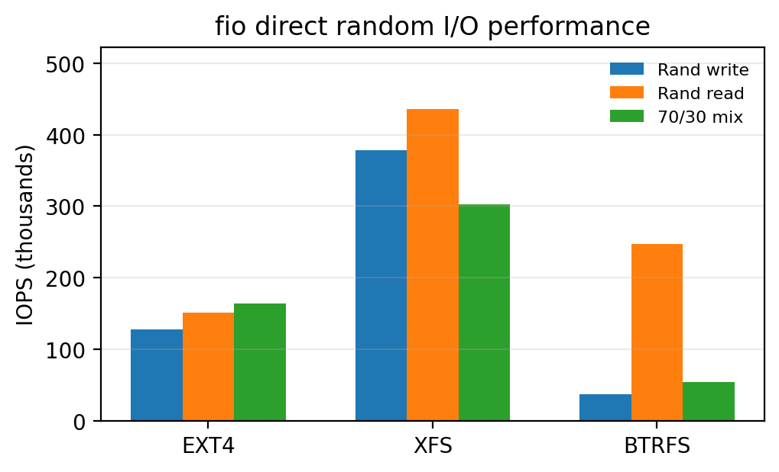
Results II — Random I/O, Latency, and CPU
WHERE THE DESIGNS DIVERGE
Average write latency (μs)
ext4
4.8
XFS
4.85
btrfs
18.52
What matters most here
XFS dominates 4 KB direct random read and write, so it is the strongest choice for database-like direct I/O.
ext4 remains competitive and balanced, but it does not scale as far as XFS in these deep random tests.
btrfs random write is the weak spot: 37k IOPS and 18.5 μs average write latency.
Low btrfs user CPU during random write suggests the bottleneck is storage-side work, not user-space compute.
Operating Systems · Topic 14
7
Notes:
Spend the most time on this slide. It is the clearest evidence for why XFS leads on direct random I/O and why btrfs struggles on random writes. [Sources] - /mnt/data/fio_results.csv - /mnt/data/fio_random_iops.png - /mnt/data/fs_report_revised.tex

Slide 8
Results III — Buffered I/O and Custom Workloads
CACHE EFFECTS AND APPLICATION PATTERNS
Buffered sysbench throughput (MiB/s)
DB-like mixed workload (2 threads, IOPS)
Insight
The page cache boosts buffered throughput for all file systems, but it does not erase the design trade-offs. btrfs still collapses on write-heavy random workloads, while ext4 and XFS stay strong.
Operating Systems · Topic 14
8
Notes:
Use the left chart to explain why buffered benchmarks look so different from direct I/O. Then use the right chart to show that write-heavy random patterns still separate the file systems clearly. [Sources] - /mnt/data/fs_report_revised.tex - /mnt/data/custom_workload_results.csv - /mnt/data/sysbench_results.csv

Slide 9
Advanced Options — Mount Tuning
WHAT TUNING CAN AND CANNOT FIX
Representative random-write IOPS
What tuning teaches us
ext4 data=journal sharply reduces write IOPS, showing the cost of stronger write-ordering guarantees.
XFS changes only slightly across the tested options, so its defaults are already strong in this environment.
btrfs space_cache=v2 helps a little, but compression does not help these mostly random workloads.
Bottom line
Mount options matter, but they change the ranking less than the core file-system design does.
Operating Systems · Topic 14
9
Notes:
This slide is useful for the “advanced options” requirement in grading. Make the point that tuning can shift performance, but it does not erase the fundamental design trade-offs. [Sources] - /mnt/data/04_advanced_mount.sh - /mnt/data/mount_tuning_results.csv - /mnt/data/fs_report_revised.tex

Slide 10
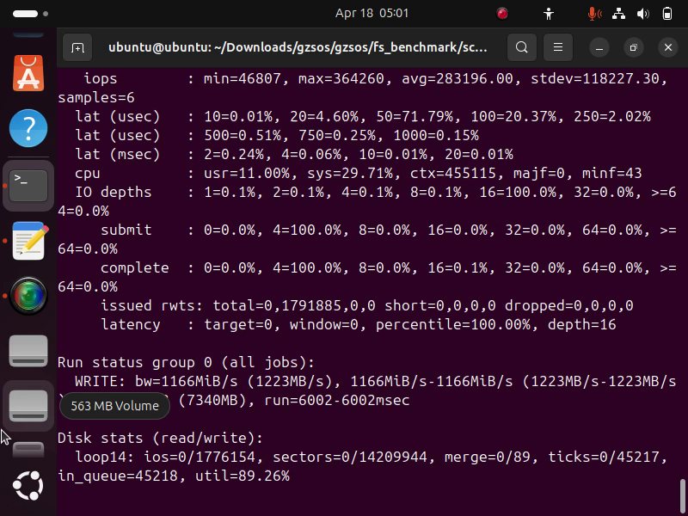
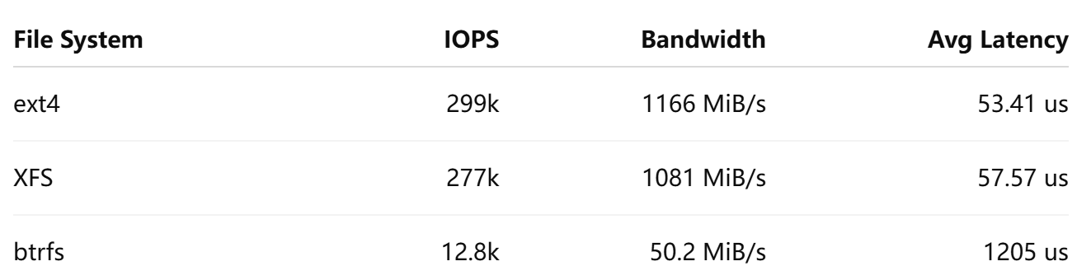
Live Demo: Reduced fio 4K Random-Write Test
CLOSING
Demo Steps
Live Demo
1
Verify that ext4, XFS, and btrfs are mounted
2
Run a reduced fio random-write test for 6 seconds on each file system
3
Compare IOPS, bandwidth, and latency with the full-report trend
Demo Results
The short in-class demo reproduces the main trend of the full benchmark suite: ext4 and XFS remain strong under direct random writes, while btrfs shows much higher write overhead.
Operating Systems · Topic 14
10
Notes:
Closing slide. Keep the conclusion crisp, then explain the live demo flow if the class expects it. [Sources] - /mnt/data/fs_report_revised.tex - /mnt/data/00_setup_env.sh - /mnt/data/02_benchmark_fio.sh

Slide 11
Key Findings, Challenges, and Insights
WHAT WE LEARNED
ext4
Balanced default, strong overall consistency, and best metadata-heavy deletion result.
Challenges
VM + loop devices distort absolute throughput numbers.
Small-file shell loops include process overhead, not only file-system overhead.
Buffered and direct benchmarks can tell different stories, so interpretation matters.
XFS
Best direct random-I/O performer and the strongest choice for database-like or queue-depth-sensitive workloads.
btrfs
Feature-rich but random-write-expensive: snapshots, checksums, and COW are valuable, but they cost throughput.
Practical recommendation
General Linux default → ext4
Random-write / database-like workload → XFS
Snapshots / checksum / admin features first → btrfs
Operating Systems · Topic 14
11
Notes:
Use this slide to transition from detailed numbers to the take-home message. This is also a good place to anticipate likely Q&A. [Sources] - /mnt/data/fs_report_revised.tex - /mnt/data/fio_results.csv - /mnt/data/custom_workload_results.csv - /mnt/data/mount_tuning_results.csv

Slide 12
Conclusion and Q&A
CLOSING
Conclusion
The most important lesson is that file-system design choices are visible in workload-specific ways.
Final ranking: ext4 = balanced, XFS = best for direct random I/O, btrfs = features over random-write speed.
Thank you — Questions?
Operating Systems · Topic 14
12
Notes:
Closing slide. Keep the conclusion crisp, then explain the live demo flow if the class expects it. [Sources] - /mnt/data/fs_report_revised.tex - /mnt/data/00_setup_env.sh - /mnt/data/02_benchmark_fio.sh

