Slide 1
Kernel-Level Data Deduplication
An in-line block deduplication target built as a Linux kernel module
CSC5031 Operating Systems · Topic 15
王哲宇 · 225040125
Live demo · Performance evaluation · Q&A

Slide 2
Agenda
1. Motivation
Why deduplication matters today
P3-5
2. Background
CAS, granularity, Linux block I/O
P6-8
3. Design
Architecture & key decisions
P9-13
4. Implementation
Kernel API walk-through
P14-19
5. Live Demo
2 live + 1 pre-recorded
P20-22
6. Evaluation
fio benchmarks + dedup ratios
P23-25
7. Challenges & Insights
Six debugging stories, key takeaways
P26-27
8. Summary & Q&A
Wrap-up + 10-minute discussion
P28
CSC5031 Operating Systems · Topic 15 · 王哲宇 · 225040125
2 / 28

Slide 3
Motivation: Data Redundancy is Everywhere
Modern storage workloads hide enormous amounts of duplicate data.
Virtual machines
10 Ubuntu VMs share the same /bin/bash, kernel, libc — same bytes
stored 10 times. Industry typical dedup ratio: 6-15×.
Backup snapshots
Daily full backups of an unchanging filesystem — identical blocks
copied every day. Without dedup, capacity grows linearly with time.
Container images
Hundreds of containers built FROM the same base layer — Docker
deduplicates at file level, but block-level catches more.
CSC5031 Operating Systems · Topic 15 · 王哲宇 · 225040125
3 / 28

Slide 4
Why It Hurts: Capacity, Cost, Endurance
▸ Capacity — extra TBs of SSD/HDD bought for the same logical data
▸ Cost — datacentre $/GB scales linearly without dedup
▸ Endurance — SSD flash cells wear out by Program/Erase cycle count
▸ write amplification = (host bytes written) × (dedup factor)
▸ Bandwidth — duplicate blocks consume scarce I/O queue depth
★ Goal of in-line dedup
Detect duplicate 4-KiB blocks BEFORE they hit the disk —
share one physical copy across all logical references.
Net effect: less I/O, less wear, less storage.
CSC5031 Operating Systems · Topic 15 · 王哲宇 · 225040125
4 / 28

Slide 5
Project Scope (Topic 15 Requirements)
MANDATORY
ADVANCED (BONUS)
Kernel-level interception
✓ Device-Mapper bio target
LZ4 compression
✓ MISS, 7/8 threshold
Async (workqueue)
✓ both reads & writes
Hash fingerprint (SHA-256)
✓ Kernel Crypto API
Collision handling
✓ memcmp verification
Hash → physical block map
✓ DECLARE_HASHTABLE + LBN map
Reference counting
✓ atomic_t per entry
In KERNEL space
✓ no FUSE / no userspace
Block recycling
✓ free-list LIFO, O(1)
Realistic fs (ext4)
✓ io_hints + 4 KiB align
All mandatory items + 6 advanced items implemented and tested.
33 / 33 functional tests pass · ext4 mounts and survives I/O · 7 fio benchmarks complete.
CSC5031 Operating Systems · Topic 15 · 王哲宇 · 225040125
5 / 28

Slide 6
Background: Content-Addressable Storage
Traditional Storage
Content-Addressable Storage (Dedup)
File A
File B
File A
File B
Block 100 [data X]
Block 101 [data X]
Block 100 [data X] ref_count = 2
Disk: 8 KiB used
Disk: 4 KiB used (50% saved)
Mindset shift: «Where do I write this?» → «Do I already have this?»
Address blocks by their content hash, not by their position on disk.
CSC5031 Operating Systems · Topic 15 · 王哲宇 · 225040125
6 / 28

Slide 7
Choosing the Right Granularity
Trade-off: smaller granularity = more savings but more CPU & metadata.
Level | Saving | CPU cost | Metadata RAM | Verdict
File-level | Low | Very low | Tiny | Misses most dups
Block-level (4 KiB) | High | Moderate | 32 MiB / 1 TiB | ★ Sweet spot
Block-level (8 KiB) | Med-high | Low | 16 MiB / 1 TiB | Dilutes savings
Block-level (1 KiB) | V. high | High | 128 MiB / 1 TiB | Hash storm
Variable / byte | Maximum | Extreme | Huge | Backup-only
We chose 4 KiB:
• Matches Linux PAGE_SIZE → page cache friendly
• Matches ext4 / xfs default block size → no realignment
• 32-byte SHA-256 fingerprint per block → 0.78% metadata overhead
CSC5031 Operating Systems · Topic 15 · 王哲宇 · 225040125
7 / 28

Slide 8
Where in the Stack? — Linux Block I/O
Application (dd, fio, ext4 user)
Three candidate intercept points
VFS — Virtual File System
(a) fs/buffer.c
Page Cache
Per-fs; misses direct I/O; invasive
ext4 / xfs / btrfs
Block Layer (bio submission)
(b) Page cache hooks
Buffered I/O only; misses O_DIRECT
Device Mapper Framework
★ dm-dedup (this project)
★ Our intercept point
bio level, per 4 KiB
(c) bio layer (DM)
Block Layer (bio remap)
Catches ALL I/O, no fs changes — chosen ★
loop / NVMe / SCSI driver
Backing Device (/dev/loop0, SSD …)
CSC5031 Operating Systems · Topic 15 · 王哲宇 · 225040125
8 / 28

Slide 9
System Architecture
User process / Filesystem (write/read 4 KiB)
dm_target.map() → dedup_map()
Async workqueue dispatch
WRITE PATH
READ PATH
1. SHA-256 fingerprint
1. LBN → physical block lookup
2. Hash index lookup (bucket lock)
2. submit_bio_wait() raw read
3a HIT → memcmp → ref_inc
3. If compressed: LZ4 decompress
3b MISS → LZ4 compress → write
4. Copy into bio page · bio_endio
Backing Device (loop / NVMe)
CSC5031 Operating Systems · Topic 15 · 王哲宇 · 225040125
9 / 28

Slide 10
Design ① — DM Target vs fs/buffer.c
Approach A: Modify fs/buffer.c
Approach B: Device Mapper ★ Our Choice
Application
Application + ext4/xfs/raw
VFS / page cache
VFS / page cache
ext4 only
←★ Hook
block layer (bio)
(xfs / btrfs / O_DIRECT bypassed)
DM target (our module)
←★ Hook
Dimension | Modify fs/buffer.c | Device Mapper target
Filesystem Support | ext2/3/4 only | Universal block device
O_DIRECT Traffic | Bypassed | Fully captured at bio
Dev Iteration | Rebuild + reboot | rmmod / insmod, ~5 s
Crash Impact | Full kernel panic | Only the target fails
Industry Precedents | None | dm-cache / crypt / vdo
Conclusion: Both DM and fs/buffer.c intercept the same bios, but DM is more universal, stable, and iteratable.
CSC5031 Operating Systems · Topic 15 · 王哲宇 · 225040125
10 / 28

Slide 11
Design ② — Hash & Collision Handling
Why SHA-256?
Zero-trust verify on every HIT
▸ Cryptographically strong → collision ≈ 2⁻¹²⁸
▸ HW-accelerated on ARMv8-CE & x86 SHA-NI
▸ Native in linux/crypto.h
▸ 32-byte digest fits one cache line
if (entry = lookup(fingerprint)) {
/* speculative ref_inc */
ref_inc(entry);
unlock();
if (memcmp(stored, new) == 0)
return HIT; /* dedup */
ref_dec(entry); /* rollback */
write_as_new(); /* collision! */
}
Why memcmp anyway, when SHA-256 is collision-resistant?
• Defence in depth — even cryptographic hashes have been broken (MD5, SHA-1).
• Hardware bit-flips can corrupt the stored block; memcmp catches them.
• Cost: one synchronous 4-KiB read per HIT. Worth it for correctness.
CSC5031 Operating Systems · Topic 15 · 王哲宇 · 225040125
11 / 28

Slide 12
Core Kernel Data Structures
hash_index — DECLARE_HASHTABLE, 65 536 buckets
free_list — LIFO recycling
...
#0
#1
#2
#3
#4
#5
#6
#7
#0
#1
#2
#3
dedup_entry fingerprint (32 B) physical_block ref_count (atomic) flags / clen
dedup_entry fingerprint (32 B) physical_block ref_count (atomic) flags / clen
dedup_entry fingerprint (32 B) physical_block ref_count (atomic) flags / clen
Reclaimed physical blocks
O(1) reuse on next MISS
lbn_index — logical block → physical block
dedup_lbn_entry logical_block physical_block fingerprint (snapshot)
#0
#1
#2
#3
#4
#5
#6
#7
CSC5031 Operating Systems · Topic 15 · 王哲宇 · 225040125
12 / 28

Slide 13
I/O Flows: Write Path · Read Path
Write Path Sequence
Read Path Sequence
1
WRITE bio (4 KiB)
1
READ bio (4 KiB)
2
queue to workqueue
2
queue to workqueue
3
compute SHA-256
4
lookup hash_index
3
lookup LBN index
Hot path HIT → no I/O
5
HIT → memcmp verify
4
not mapped → zero-fill, return
Two-phase FP snapshot prevents UAF
6
HIT-OK: ref_inc, return
5
snapshot phys_block + fingerprint
7
MISS: alloc block
6
lookup hash_entry → flags / clen
8
LZ4 compress (~1.6 KiB)
Cold path MISS → write
9
submit_bio_wait (write)
7
compressed: read raw + decompress
10
insert dedup_entry + LBN
8
uncompressed: read directly
11
ref_dec old mapping
9
bio_endio
12
bio_endio
CSC5031 Operating Systems · Topic 15 · 王哲宇 · 225040125
13 / 28

Slide 14
Implementation ① — bio Interception
dedup_map() is the entry point for every bio reaching our target.
static int dedup_map(struct dm_target *ti, struct bio *bio)
{ // DM 入口回调
struct dedup_target *dt = ti->private; // 设备上下文
struct dedup_work *dw;
if (bio_sectors(bio) == 0) // flush 请求
return DM_MAPIO_REMAPPED; // 直接透传
if (!bio_is_4k_aligned(bio)) { // 校验 4 KiB 对齐
bio_io_error(bio); // 不对齐报错
return DM_MAPIO_SUBMITTED;
}
/* 必须异步: 在 map() 同步等 I/O 会死锁 bio 提交链 */
dw = kmalloc(sizeof(*dw), GFP_NOIO); // GFP_NOIO 防递归
dw->dt = dt; dw->bio = bio; // 打包 work
INIT_WORK(&dw->work,
bio_data_dir(bio) == WRITE
? dedup_bio_async_write // 写路径
: dedup_bio_async_read); // 读路径
queue_work(dt->wq, &dw->work); // 丢入 workqueue
return DM_MAPIO_SUBMITTED; // 我接管了
}
CSC5031 Operating Systems · Topic 15 · 王哲宇 · 225040125
14 / 28

Slide 15
Implementation ② — SHA-256 via Crypto API
/* 一次性初始化: 在 dedup_ctr() 申请算法句柄 */
dt->tfm = crypto_alloc_shash("sha256", 0, 0); // 选硬件加速实现
/* 每 4 KiB 块计算一次, 运行在 workqueue 线程 */
int dedup_compute_hash(struct dedup_target *dt,
struct page *page, // bio 数据页
u8 fingerprint[DEDUP_HASH_LEN]) // 32B 指纹
{
SHASH_DESC_ON_STACK(desc, dt->tfm); // 描述符放栈上
void *data = kmap_atomic(page); // 临时映射页
int ret;
desc->tfm = dt->tfm; // 绑定算法句柄
ret = crypto_shash_digest(desc, data, // 一次算 SHA-256
DEDUP_BLOCK_SIZE, fingerprint);
kunmap_atomic(data); // 配对解除映射
return ret;
}
On ARMv8 (Apple M-series → UTM Ubuntu), the kernel uses ARMv8-CE SHA instructions automatically.
Measured cost: ~3 μs per 4 KiB block — negligible vs sub-bandwidth I/O.
CSC5031 Operating Systems · Topic 15 · 王哲宇 · 225040125
15 / 28

Slide 16
Implementation ③ — Hash Index + Bucket Lock
65 536 buckets, one spinlock per bucket → near-linear scaling under contention
/* dedup.h */
#define DEDUP_HASH_INDEX_BITS 16
#define DEDUP_NR_BUCKETS (1 << 16) // 65 536 桶, 分散冲突
struct dedup_target {
DECLARE_HASHTABLE(hash_index, DEDUP_HASH_INDEX_BITS); // 内核哈希表
spinlock_t *hash_lock; // 每桶一把锁, 避免全局瓶颈
/* ... */
};
/* 查找后带锁返回: 调用方负责 spin_unlock */
struct dedup_entry *
dedup_index_lookup_locked(struct dedup_target *dt,
const u8 *fp, // 输入指纹
unsigned long *flags_out) // 回传 IRQ flags
{
u32 bucket = dedup_hash_bucket(fp); // 前 4 字节选桶
spin_lock_irqsave(&dt->hash_lock[bucket], *flags_out); // 禁中断加锁
/* hash_for_each_possible(...) 遍历桶链对比 32B 完整指纹 */
}
CSC5031 Operating Systems · Topic 15 · 王哲宇 · 225040125
16 / 28

Slide 17
Implementation ④ — Refcount & Cleanup
Garbage-collect the old physical block only AFTER the new write commits.
/* HIT 或新写完成后, 旧映射的引用必须递减 */
if (had_old_mapping)
dedup_old_ref_dec(dt, old_fingerprint); // 先建新再减旧
/* 查找 → 原子递减 → 归零则释放物理块 */
void dedup_old_ref_dec(struct dedup_target *dt, const u8 *fp)
{
struct dedup_entry *e =
dedup_index_lookup_locked(dt, fp, &flags); // 持锁返回
if (!e) goto out; // 已被释放
if (atomic_dec_and_test(&e->ref_count)) { // 原子减 1
sector_t pb = e->physical_block; // 记下物理块
hash_del(&e->hnode); // 摘除索引
spin_unlock_irqrestore(&dt->hash_lock[bkt], flags); // 解锁
kmem_cache_free(dt->entry_cache, e); // 还 slab
dedup_store_free_block(dt, pb); // 物理块入 free_list
return;
}
spin_unlock_irqrestore(...); // 仅解锁
}
CSC5031 Operating Systems · Topic 15 · 王哲宇 · 225040125
17 / 28

Slide 18
Implementation ⑤ — LZ4 Compression on MISS
Compress unique blocks before writing. Skip if savings < 12.5 %.
/* 每次调用独立申请 workspace ——
* 共用 dt->lz4_workspace 会被并发踩踏, -3238 静默损坏 */
workspace = kmalloc(LZ4_MEM_COMPRESS, GFP_NOIO); // 每次 16 KiB
compressed = LZ4_compress_default(src, dst, 4096, // 压 4 KiB
DEDUP_LZ4_MAX_COMPRESSED, // 上限
workspace); // 临时 buf
kfree(workspace); // 用完即释
/* 收益 >= 12.5% 才采用, 否则存原始数据 */
if ((u32)compressed >= 4096 * 7 / 8) // 不划算
return -ENOSPC; // 回退
entry->flags = DEDUP_FLAG_COMPRESSED; // 读路径据此解压
entry->compressed_len = compressed; // 记录长度
Why per-call workspace? — LZ4_compress_default uses scratch memory inside it.
Sharing across N CPUs corrupts internal state. Trade-off: 16 KiB × N workers — acceptable for 4-KiB I/O.
CSC5031 Operating Systems · Topic 15 · 王哲宇 · 225040125
18 / 28

Slide 19
Implementation ⑥ — Recycling & /proc Stats
Block recycling — list_head LIFO
/proc/dedup_stats live output
sector_t dedup_store_alloc_block(struct dedup_target *dt)
{
spin_lock_irqsave(&dt->alloc_lock, flags); // 分配锁
if (!list_empty(&dt->free_list)) { // 优先复用
n = list_first_entry(&dt->free_list, // LIFO
struct dedup_free_node, list); // 缓存友好
list_del(&n->list); // 摘下
pb = n->phys_block; // 取块号
kmem_cache_free(dt->free_node_cache, n); // 还 slab
dt->free_list_count--;
} else { // 空闲表空
pb = dt->next_free_block++; // 顺序水位线
}
spin_unlock_irqrestore(...);
return pb; // O(1) 分配
}
$ cat /proc/dedup_stats
Write requests: 4 784 # 写请求
Read requests: 2 408 # 读请求
Dedup hits: 4 660 # 命中
Dedup misses: 120 # 未命中
Hash collisions: 0 # 真冲突
Refcount increments: 4 660 # ref+1
Refcount decrements: 34 # ref-1
Blocks freed: 15 # 释放物理块
Blocks recycled: 9 # free_list 复用
Compress success: 110 # 压缩有效
Compress skipped: 10 # 跳过
Free list size: 6 # 当前空闲块
Dedup ratio: 39.83 : 1
Space saving: 97 %
CSC5031 Operating Systems · Topic 15 · 王哲宇 · 225040125
19 / 28

Slide 20
Demo ① LIVE · Load + 33 / 33 Tests
● LIVE
Commands I will type on stage
Expect to see
# 一键脚本 (trap 自动 cleanup)
$ bash ~/CUHKSZ/OS/presentation/\
live_demo.sh --demo 1
# 手动:
$ sudo modprobe lz4_compress
$ sudo insmod ~/kernel_dedup/dm_dedup.ko
$ lsmod | grep dedup
$ cat /proc/dedup_stats | head -5
$ cd ~/kernel_dedup
$ sudo bash scripts/test_basic.sh \
2>&1 | tail -15
▸ dm_dedup 16384 0
▸ /proc/dedup_stats prints
▸ ==== TEST RESULTS ====
▸ Total: 33 / 33 passed
▸ Failed: 0
Fallback (if live fails)
Pre-recorded video at
presentation/videos/demo1.mp4
— I'll switch to it if anything
behaves unexpectedly.
CSC5031 Operating Systems · Topic 15 · 王哲宇 · 225040125
20 / 28

Slide 21
Demo ② LIVE · ext4 on dm-dedup
● LIVE
Commands I will type on stage
Live snapshots
# 一键 (单 terminal · 每写一文件一次快照)
$ bash ~/CUHKSZ/OS/presentation/live_demo.sh \
--single-term --demo 2
# 或者手动:
$ sudo dd if=/dev/zero of=/tmp/d.img \
bs=1M count=256 status=none
$ LOOP=$(sudo losetup -f --show /tmp/d.img)
$ S=$(sudo blockdev --getsz $LOOP)
$ echo "0 $S dedup $LOOP 0" | \
sudo dmsetup create dedup_live
$ sudo mkfs.ext4 -q /dev/mapper/dedup_live
$ sudo mount /dev/mapper/dedup_live /mnt/dedup_live
$ for i in 1..5; do \
sudo dd if=/dev/zero of=/mnt/dedup_live/f_$i \
bs=4K count=100; \
sync && cat /proc/dedup_stats; \
done
after file_1
writes=100 hits=0
after file_2
writes=200 hits=100 ratio=2:1
after file_3
writes=300 hits=200 ratio=3:1
after file_5
writes=500 hits=400 ratio=5:1
saving=80 %
Optional · 2nd terminal
$ watch -n 0.5 cat \
/proc/dedup_stats
→ counter ticks live
Fallback: videos/demo2.mp4
CSC5031 Operating Systems · Topic 15 · 王哲宇 · 225040125
21 / 28

Slide 22
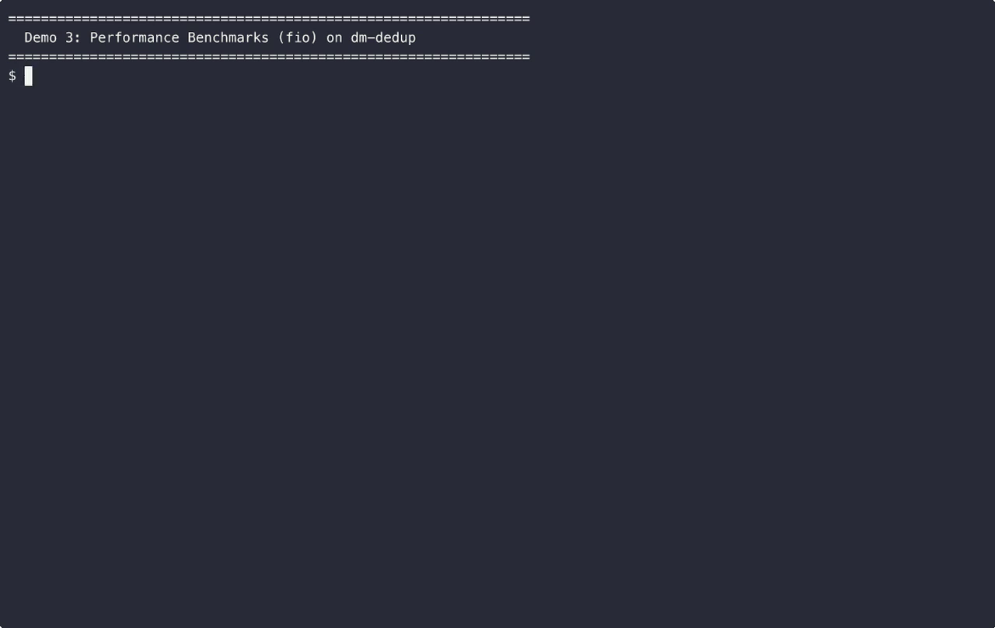
Demo ③ fio Benchmarks · Pre-recorded
▶ PRE-RECORDED
What you see
▸ 3 fio workloads:
▸ 1. Unique random
▸ (worst case)
▸ 2. Zero-fill
▸ (best case)
▸ 3. 50 % dedup
▸ (realistic)
▸ Bandwidth + IOPS
▸ /proc/dedup_stats
Why not live?
Each fio run = 8s × 3
= ~24s of dead air.
Live on VM available
on request.
CSC5031 Operating Systems · Topic 15 · 王哲宇 · 225040125
22 / 28

Slide 23
Evaluation Setup
Component | Value
Host machine | Apple Silicon Mac (M-series)
Hypervisor | UTM (QEMU virtualisation)
Guest OS | Ubuntu Server 26.04 LTS, ARM64
Guest kernel | Linux 7.0.0-14-generic
Guest resources | 4 vCPU, 4 GB RAM, 30 GB disk
Backing store | /dev/loop0 over a 1 GiB file
Block size | 4 KiB (DEDUP_BLOCK_SIZE)
Hash table | 65 536 buckets, per-bucket spinlock
Benchmark tool | fio 3.41 (libaio engine, direct=1)
Functional tests | scripts/test_basic.sh — 33 cases
Each fio workload runs 15 s × 4 KiB blocks × iodepth 32 × direct I/O.
Reported numbers are job-aggregated bandwidth, IOPS, mean & p99 latency.
CSC5031 Operating Systems · Topic 15 · 王哲宇 · 225040125
23 / 28

Slide 24
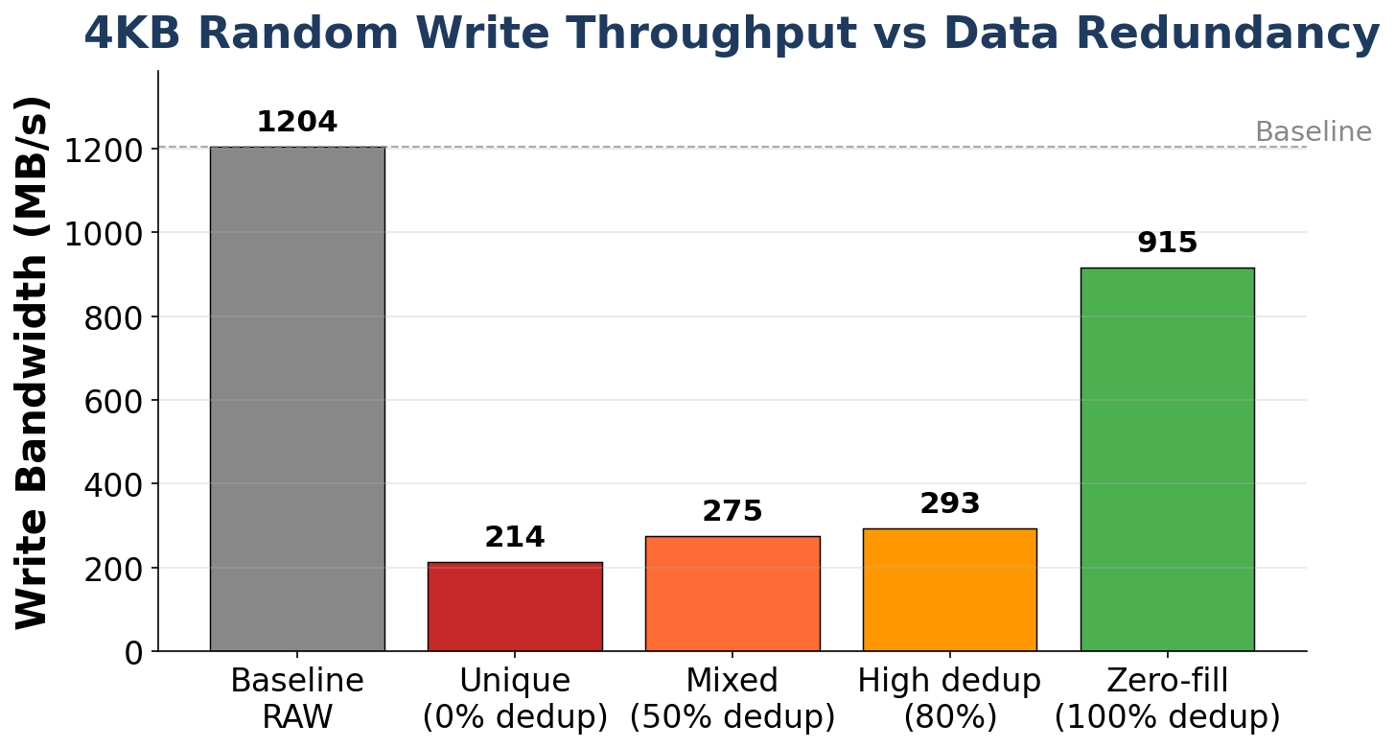
Throughput by Workload Redundancy
Take-aways
▸ Baseline: ~1 200 MB/s (raw loop)
▸ Worst (unique): 214 MB/s ↳ SHA-256 + write dominates
▸ Mixed 50 %: 275 MB/s (~+28 %)
▸ High dedup 80 %: 293 MB/s
▸ Zero-fill 100 %: 915 MB/s ↳ ~76 % of raw, no I/O on HITs
▸ Throughput scales with redundancy
CSC5031 Operating Systems · Topic 15 · 王哲宇 · 225040125
24 / 28

Slide 25
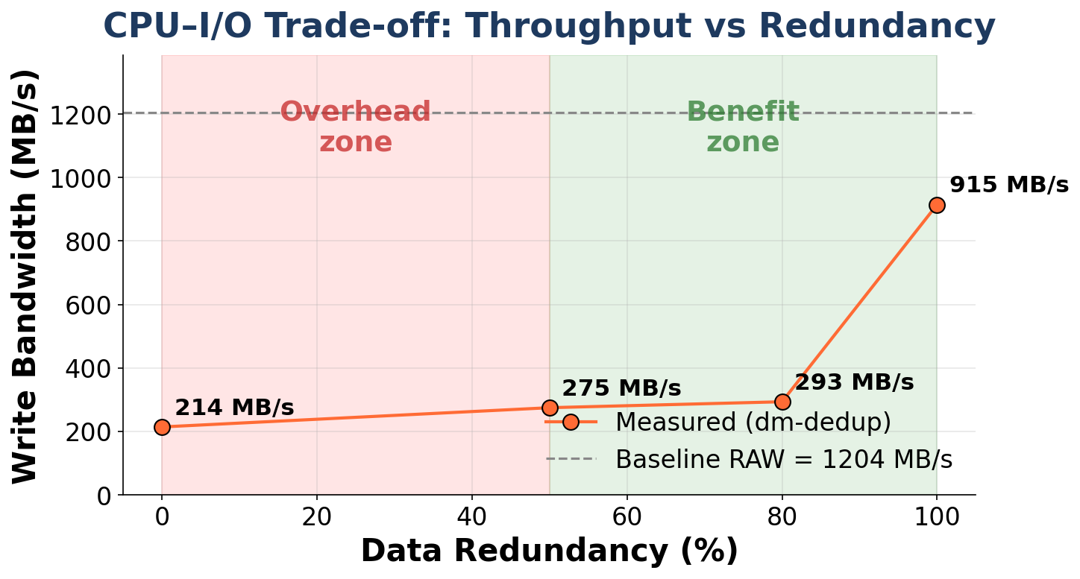
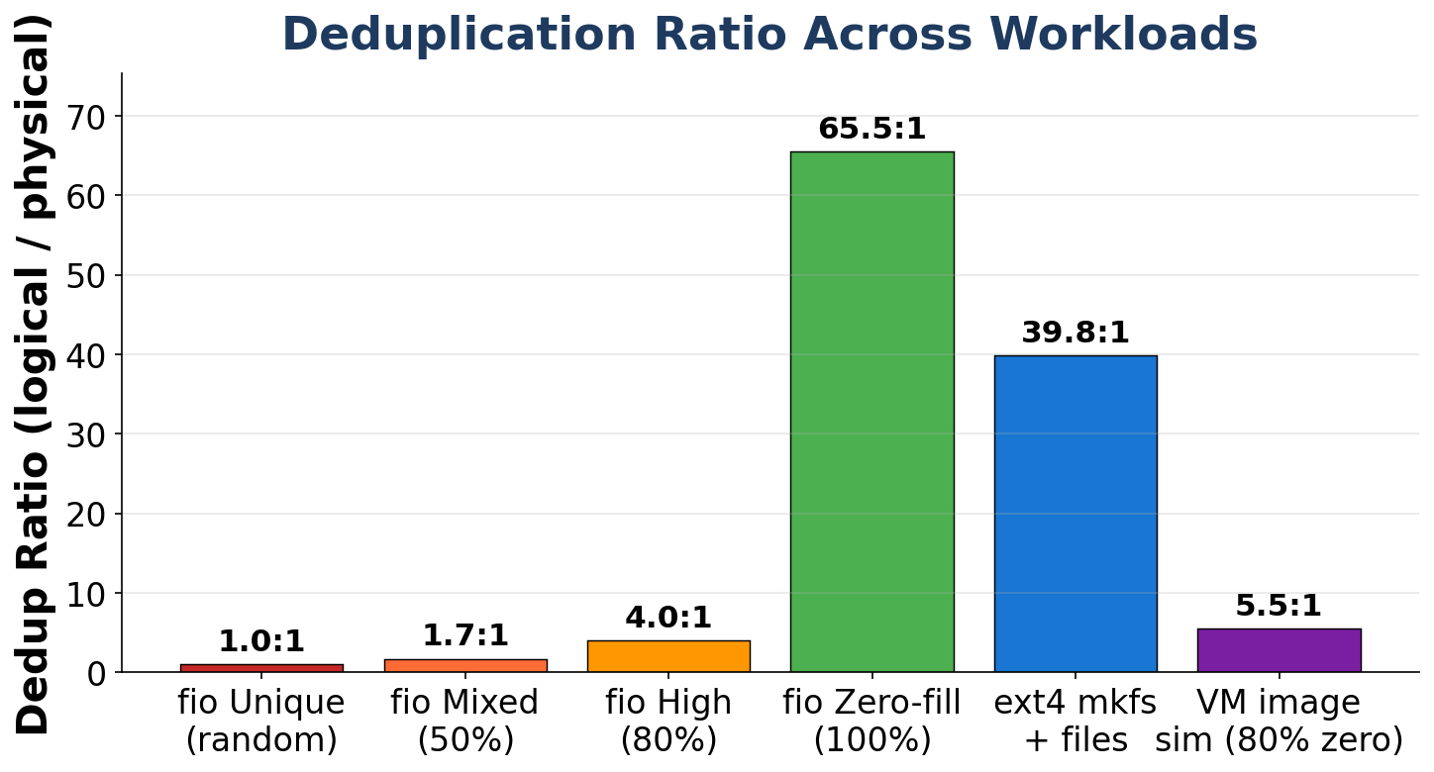
CPU–I/O Trade-off & Dedup Ratios
Two halves of the same story:
• Left — performance vs redundancy (overhead < 50 % < benefit).
• Right — measured dedup ratios across 6 real workloads, peaking at 65× on zero-fill.
CSC5031 Operating Systems · Topic 15 · 王哲宇 · 225040125
25 / 28

Slide 26
Challenges — 6 Real Debugging Stories
① Read path deadlock
② Concurrent LZ4 corruption
[CRITICAL]
[CRITICAL]
Problem: submit_bio_wait() in dm_map() blocks the bio dispatcher.
Problem: Workers shared one workspace → silent -3238 errors.
Fix: Pushed reads to workqueue, mirroring write path.
Fix: Per-call kmalloc workspace, no contention.
③ ext4 1024-byte superblock
④ PDE_DATA → pde_data
[DESIGN]
[API]
Problem: fs mount issued sub-4-KiB I/O → rejected by target.
Problem: Linux 5.17+ renamed the macro; build broke on 7.0.
Fix: Implemented io_hints — advertise 4 KiB min I/O.
Fix: Trivial rename; ifdef fallback for older kernels.
⑤ bio_add_page warn_unused
⑥ ARM64 format for LZ4_MEM
[API]
[API]
Problem: Modern bio API requires checking returned bytes.
Problem: Macro is unsigned long; %d → -Werror=format=.
Fix: Every call now compares against DEDUP_BLOCK_SIZE.
Fix: Cast to (unsigned long) and use %lu.
CSC5031 Operating Systems · Topic 15 · 王哲宇 · 225040125
26 / 28

Slide 27
Key Insights, Limitations, Future Work
Insights
Limitations / Future Work
▸ CPU–I/O trade-off is real & quantifiable
▸ SHA-256 cost vanishes at 80 %+ dedup
▸ Lock granularity matters: per-bucket spinlock → near-linear scaling
▸ Async ⇒ correctness, not only speed (avoids deadlock)
▸ Metadata volatile — lost on rmmod
▸ → Future: journal + persistent superblock
▸ Per-LBN serialisation absent
▸ → Future: RW-lock per LBN bucket
▸ Compression static (LZ4, 7/8 threshold)
▸ → Future: adaptive zstd
▸ No cross-device dedup
▸ → Future: shared global index
CSC5031 Operating Systems · Topic 15 · 王哲宇 · 225040125
27 / 28

Slide 28
Summary
▸ Production-style Device-Mapper target — kernel only, no FUSE
▸ All mandatory + 6 advanced items verified (33 / 33 tests)
▸ Correct CPU–I/O trade-off behaviour with real fio numbers
▸ Survived 6 debugging episodes — stable on Linux 7.0 series
Questions?
Source: /Users/wangzheyu/CUHKSZ/OS/kernel_dedup

