Slide 1
GPU SHARING IN THE CLOUD：
Interception Mechanisms, Efficiency, and Isolation
Yuwei Xu
The Chinese University of Hong Kong, Shenzhen
Notes:
Our question is how to turn a GPU into a resource that a cloud platform can share effectively. We examine three connected design steps: obtaining transparent control over GPU requests, using that control to recover capacity without excessive interference, and expanding the control boundary to manage a broader set of tenant behaviors. TGS, Orion, and Krypton provide the mechanisms and evidence for this argument.
Source: The three papers listed on the References slide; connecting argument developed for this presentation.

Slide 2
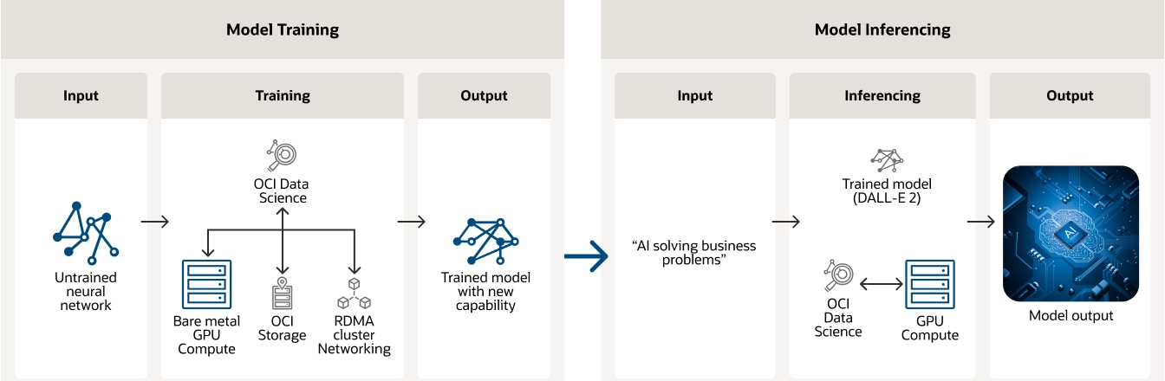
APPLICATION: GPU WORKLOADS
Training and inference on cloud infrastructure
Training learns a model from data.
Inference uses the model for vision, language, or recommendation services.
Training and inference workflow. Source: Oracle.
Notes:
Training updates model parameters using data. Inference applies a trained model to new inputs. These workloads support applications such as image recognition and recommendations. The workflow image illustrates these general roles; it does not describe the experiments in the three papers or imply that all workloads run concurrently on the same GPU.
Text sources: NVIDIA Deep Learning Inference Platform, https://www.nvidia.com/en-us/deep-learning-ai/inference-platform/; NVIDIA Deep Learning, https://developer.nvidia.com/deep-learning. Figure source: Oracle AI Infrastructure, https://www.oracle.com/ai-infrastructure/ . Original image: https://www.oracle.com/a/ocom/img/rc24-training-and-inferencing-deep-learning.png . Crop: upper workflow, with the explanatory paragraphs below omitted.

Slide 3
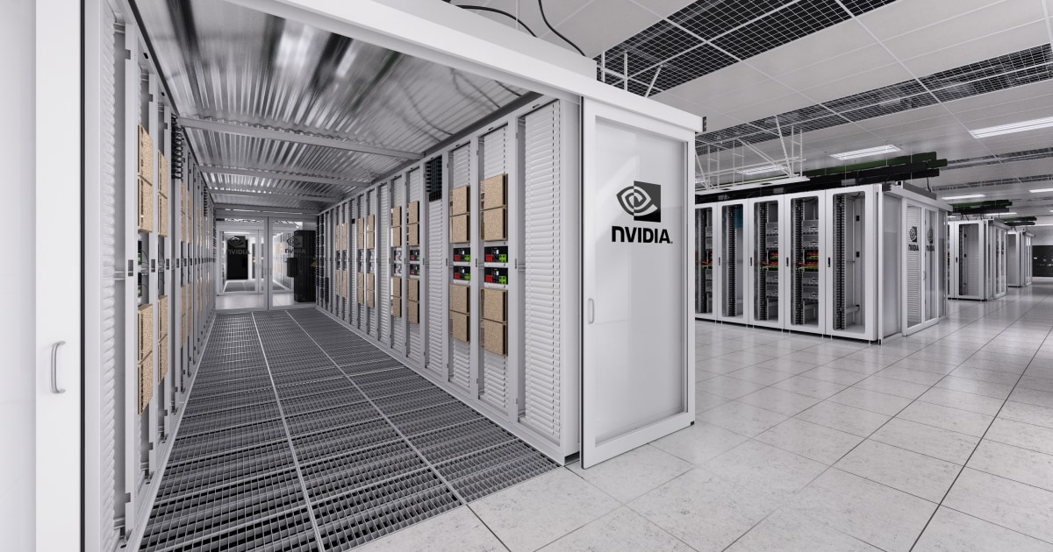
APPLICATION: SHARED EXECUTION
A foreground service and a background job
Foreground: inference needs predictable response time.
Background: training or batch inference can use spare capacity.
Jobs can use separate containers and different frameworks.
The platform should protect foreground performance while sharing.
Notes:
This is the running cloud-sharing scenario for the presentation. A foreground service has a latency target. Background work can wait or slow when foreground demand increases. The papers also evaluate other combinations, including training alongside training. The data-center image provides general infrastructure context, rather than a photograph of an evaluated testbed.
Sources: TGS Sections 1–2, https://www.usenix.org/conference/nsdi23/presentation/wu; Orion Section 1, https://doi.org/10.1145/3627703.3629578. Image source: NVIDIA Data Center, https://www.nvidia.com/en-us/data-center/ . Original image: https://www.nvidia.com/content/dam/en-zz/solutions/data-center/home/data-center-og.jpg .

Slide 4
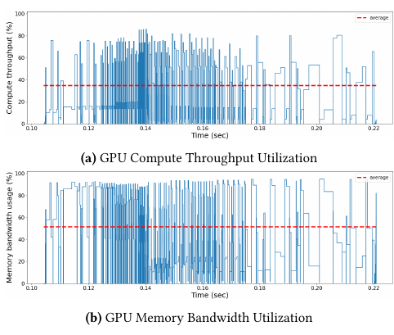
PROBLEM: UNUSED CAPACITY
An allocated GPU can still have idle resources
A GPU kernel is a unit of work submitted to the device.
Resource demand changes across kernels and requests.
One busy resource can leave other resources idle.
Exclusive allocation keeps that spare capacity unavailable to other jobs.
Orion, Figure 1. Compute and memory use during training.
Notes:
The common opportunity is unused capacity inside an allocated GPU. A kernel executes on the GPU, and different kernels stress different resources. Memory capacity is the amount of data that fits on the device. Memory bandwidth is the rate at which kernels move data. A job can fit in memory while still leaving compute or bandwidth idle at particular times. The Orion figure illustrates changing compute and memory-bandwidth use in one MobileNetV2 training iteration. This observation motivates the shared problem; the Orion section later focuses on how to choose kernel overlap.
Sources: TGS Sections 1–2, https://www.usenix.org/conference/nsdi23/presentation/wu; Orion Sections 1 and 3 and Figure 1, PDF p. 1, https://doi.org/10.1145/3627703.3629578. Common-problem framing is our synthesis.

Slide 5
PROBLEM: RESOURCE CONTENTION
Recover spare capacity while meeting job targets
Compute: kernels compete for execution resources.
Memory bandwidth: concurrent traffic can slow both jobs.
Memory capacity: aggregate demand may exceed device memory.
Asynchrony: GPU work continues after CPU submission.
Common goal: increase useful work while controlling performance impact.
Notes:
Placing a second job on the GPU does not automatically turn spare capacity into useful progress. Jobs can compete for execution resources, memory bandwidth, and memory capacity. Submission is asynchronous, so a CPU queue can become empty while previously submitted kernels still run. We assess useful sharing against a stated foreground target, such as inference latency or training throughput, together with useful background progress. p99 latency is the latency below which 99% of measured requests fall.
Sources: TGS Sections 2.3 and 4, https://www.usenix.org/conference/nsdi23/presentation/wu; Orion Sections 1, 3, and 5, https://doi.org/10.1145/3627703.3629578; Krypton Section 2, https://www.usenix.org/conference/atc25/presentation/zhang-shulai. The common objective and grouping are our synthesis.

Slide 6
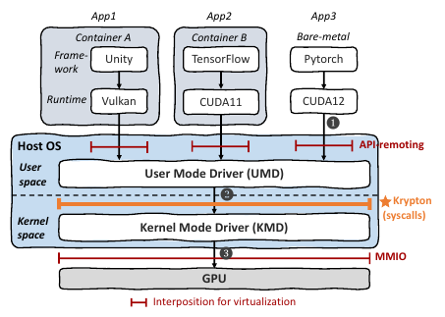
PROBLEM: CONTROL AND ISOLATION
Interception links scheduling policy to enforceable limits
Transparency: preserve application interfaces.
Coverage: control submissions and allocations.
Accounting: measure actual resource use.
Isolation: contain interference and faults.
Krypton, Figure 1. GPU stack and interception boundaries.
Notes:
The shared underlying problem is to recover GPU capacity transparently while meeting performance targets and constraining the effect of one tenant on another. A scheduling decision needs both information about resource demand and a control point that can enforce it. The figure locates runtime APIs, the user-mode driver, the host kernel driver, and the GPU. A GPU kernel is a device program, whereas host kernel space belongs to the operating system. Our argument connects three design steps: TGS establishes transparent control, Orion improves decisions about kernel overlap, and Krypton broadens enforcement coverage. These are complementary dimensions of the common problem, not a claim that each paper directly extends the previous implementation or provides identical guarantees.
Sources: TGS Sections 3–4, https://www.usenix.org/conference/nsdi23/presentation/wu; Orion Sections 5 and 7, https://doi.org/10.1145/3627703.3629578; Krypton Sections 1–3 and Figure 1, PDF p. 2, printed p. 1003, https://www.usenix.org/conference/atc25/presentation/zhang-shulai. Connecting argument is our synthesis.

Slide 7
TGS
Transparent GPU Sharing in Container Clouds for Deep Learning Workloads
Bingyang Wu and Zili Zhang, Peking University; Zhihao Bai, Johns Hopkins University; Xuanzhe Liu and Xin Jin, Peking University
Notes:
We organize the presentation around these questions. TGS supplies the starting point: application-transparent sharing. Orion shows why the characteristics of individual kernels matter when deciding which work to overlap. Krypton makes us examine which operations the sharing layer actually controls. Each step expands our answer to the same cloud resource-management problem. The two questions describe different design dimensions: precise scheduling and broad enforcement coverage.
Source: Our synthesis of the three papers; detailed mechanisms and evidence follow.

Slide 8
TGS (1/10)
Problem: sharing containerized training
Training containers use independent framework versions.
The production training job needs stable throughput.
Opportunistic training may exceed remaining GPU memory.
Compute throttling and memory placement must work together.
Notes:
TGS applies the common sharing problem to deep-learning training in container clouds. It distinguishes a protected production training job from an opportunistic training job. The opportunistic job must not occupy memory that production will need later, and framework memory pools can reserve more memory than their actively used data. This is why TGS couples submission control with transparent memory management.
Source: TGS Sections 1–3 and 4.2, PDF pp. 2–5 and 7–8, https://www.usenix.org/conference/nsdi23/presentation/wu.

Slide 9
TGS (2/10)
Motivation: training progress provides feedback
Training iterations repeat similar GPU operations.
Kernel arrival rates can reveal changes in production progress.
Rate feedback avoids framework-specific iteration counters.
Managed memory lets background data move as demand grows.
Notes:
The TGS training setting suggests mechanisms more specific than a generic utilization counter. Repeated iterations make production kernel arrival rates a useful proxy for training progress in the evaluated setting. Feedback can regulate the background submission rate without reading framework-specific iteration state. CUDA managed memory also gives the system a way to move background data between device and host memory while keeping application-visible addresses stable. This motivates the four method slides that follow.
Source: TGS Sections 4.1–4.2 and 5, PDF pp. 5–8, https://www.usenix.org/conference/nsdi23/presentation/wu.

Slide 10
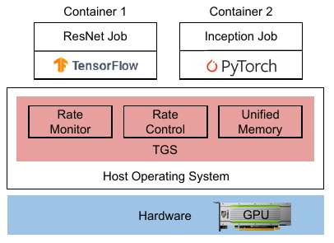
TGS (3/10)
Method: a transparent sharing layer
Intercept requests from containers.
Monitor production progress.
Regulate background submissions.
Manage device and host memory together.
TGS, Figure 1. TGS architecture.
Notes:
The architecture gives TGS two control mechanisms. For computation, production submissions pass through with lightweight monitoring while opportunistic submissions may be delayed. For memory, allocation calls are redirected to managed memory so data can move between device and host memory. Containers retain separate GPU contexts in the prototype. The shared GPU still appears as a regular device to the application, while the platform changes how requests consume resources underneath.
Source: TGS (/Users/juvenxu/Documents/Project/CUHKSZ/Visualization/TGS.pdf), Sections 3 and 5, PDF pp. 4-5 and 8; Figure 1, PDF p. 2.
Publication: https://www.usenix.org/conference/nsdi23/presentation/wu

Slide 11
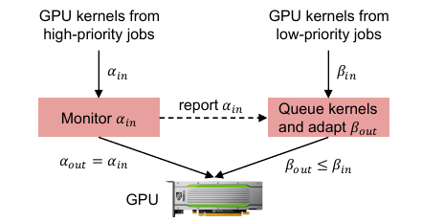
TGS (4/10)
Method: feedback through submission rates
Measure the production baseline rate.
Monitor the current production rate.
Adjust background kernel submissions.
Keep production progress near its baseline.
TGS, Figure 2. Adaptive rate control.
Notes:
Training iterations generate recurring dependent GPU work. If contention delays completion, subsequent dependent work also arrives more slowly. TGS uses this relationship to estimate production progress. Its implementation counts CUDA blocks associated with launch calls, rather than treating every kernel launch as equal-sized work. Production work is monitored without being held in the opportunistic queue. The controller changes the rate at which background work is released, using a moving average to smooth the feedback signal.
Source: TGS (/Users/juvenxu/Documents/Project/CUHKSZ/Visualization/TGS.pdf), Section 4.1, PDF pp. 5-7, printed pp. 72-74; implementation details in Section 5, PDF p. 8.
Publication: https://www.usenix.org/conference/nsdi23/presentation/wu

Slide 12
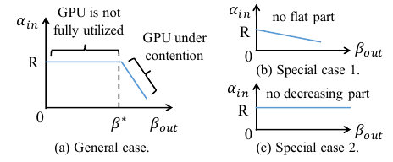
TGS (5/10)
Method: adapting the background rate
Increase the rate while production is stable.
Reduce it when contention appears.
Use additive increase and multiplicative decrease.
Update the baseline when the workload changes.
TGS, Figure 3. Production and background submission rates.
Notes:
The general curve has a region where background work can increase without slowing production, followed by a region where the jobs compete. TGS seeks the transition between them. Its algorithm includes slow start, additive increase, multiplicative decrease, and baseline remeasurement after a sufficiently large production-rate change. The curve also covers two special cases: the production job already saturates the relevant resources, or background demand is too small to cause contention. The convergence argument assumes stable jobs during profiling and convergence.
Source: TGS (/Users/juvenxu/Documents/Project/CUHKSZ/Visualization/TGS.pdf), Section 4.1 and Algorithm 1, PDF pp. 6-7, printed pp. 73-74.
Publication: https://www.usenix.org/conference/nsdi23/presentation/wu

Slide 13
TGS (6/10)
Method: transparent memory sharing
Redirect allocations to CUDA managed memory.
Keep application-visible addresses unchanged.
Prefer GPU memory for production data.
Move background data to host memory when needed.
Notes:
TGS uses managed memory as an indirection mechanism. Applications continue allocating what appears to be GPU memory, while the runtime can place pages in GPU or host memory. Placement preferences prioritize production pages, and background pages can be evicted when necessary. This also helps with frameworks that reserve large pools before actively using all their pages. Unified memory connects device and host memory for each application; it does not mean that separate tenants share one unprotected address space. Separate contexts remain part of TGS's fault-containment design.
Source: TGS (/Users/juvenxu/Documents/Project/CUHKSZ/Visualization/TGS.pdf), Sections 3, 4.2, and 5, PDF pp. 5 and 7-8, printed pp. 72 and 74-75. This method is described in text; no original standalone memory-mechanism figure is required.
Publication: https://www.usenix.org/conference/nsdi23/presentation/wu

Slide 14
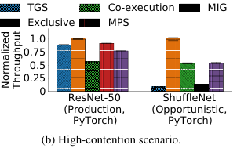
TGS (7/10)
Experiment: protecting production progress
ResNet-50 production with ShuffleNet background.
Production throughput: 89.2% of exclusive execution with TGS.
Unmanaged co-execution retains 57%.
The background job continues making progress.
TGS, Figure 4(b). Production protection under contention.
Notes:
This experiment isolates the rate controller by keeping the combined memory footprint within device capacity. ResNet-50 uses batch size 24, and ShuffleNet uses batch size 64. Throughput is normalized separately for each job against its exclusive execution. The paper reports a 10.8% production throughput reduction with TGS; 89.2% is the equivalent retained-throughput value. The objective is useful background progress with a controlled production impact. This sharing result is distinct from the separate experiment measuring the overhead of rate monitoring alone.
Source: TGS (/Users/juvenxu/Documents/Project/CUHKSZ/Visualization/TGS.pdf), Section 6.1, PDF pp. 9-10, printed pp. 76-77; Figure 4(b), PDF p. 9. Retained throughput is calculated as 100% - 10.8%.
Publication: https://www.usenix.org/conference/nsdi23/presentation/wu

Slide 15
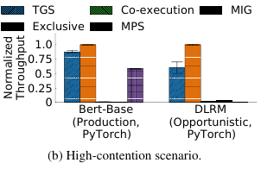
TGS (8/10)
Experiment: memory oversubscription
BERT-Base production with DLRM background.
Their memory demand exceeds GPU capacity.
Production throughput reduction: 12.3%.
Background throughput: 15x the evaluated MPS baseline.
TGS, Figure 5(b). Sharing oversubscribed GPU memory.
Notes:
The high-contention memory experiment uses BERT-Base with batch size 4 and DLRM with batch size 256. It tests the combination of rate control and memory placement priorities. The MPS and co-execution comparisons were modified to use unified memory because their original configurations did not support oversubscription. The result therefore demonstrates the value of prioritizing managed-memory placement together with compute control. The 15x finding belongs to this particular model pair and baseline configuration.
Source: TGS (/Users/juvenxu/Documents/Project/CUHKSZ/Visualization/TGS.pdf), Section 6.2, PDF pp. 10-11, printed pp. 77-78; Figure 5(b), PDF p. 9.
Publication: https://www.usenix.org/conference/nsdi23/presentation/wu

Slide 16
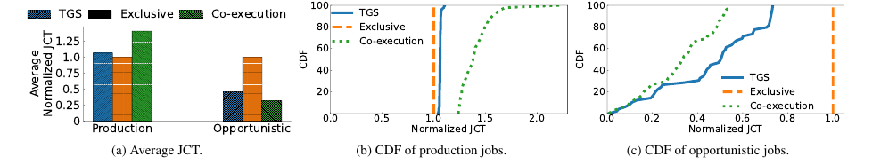
TGS (9/10)
Experiment: job completion under mixed demand
100 training jobs, equally split by priority.
Normalized completion time: production 1.06, background 0.48.
TGS, Figure 6. Normalized job completion time.
Notes:
The experiment combines several DNN models with running times drawn from a Microsoft training trace and uses fast-forwarding. The important benefit is reduced waiting: background jobs begin using spare resources before production jobs finish. TGS keeps production completion time close to exclusive execution while reducing opportunistic completion time. These are average normalized job completion times, rather than p99 inference latencies. A separate phase-change experiment in Figure 9 shows the controller reallocating capacity as ESPnet2 alternates between GPU-heavy and CPU-heavy phases.
Source: TGS (/Users/juvenxu/Documents/Project/CUHKSZ/Visualization/TGS.pdf), Section 6.3, PDF p. 11, printed p. 78; Figure 6, PDF p. 10. Dynamic adaptation: Section 6.5 and Figure 9, PDF p. 12.
Publication: https://www.usenix.org/conference/nsdi23/presentation/wu

Slide 17
TGS (10/10)
Takeaway: transparent control enables sharing
Applications keep their programming interfaces.
Rate control and memory placement work together.
The prototype uses temporal sharing.
Next: exploit capacity left idle during individual kernels.
Notes:
TGS establishes the feasibility of transparent, priority-aware resource sharing. Its controller already operates on kernel submissions; the next question concerns the resource characteristics used to make those decisions. The paper's discussion states that its implementation uses time sharing. Orion investigates the opportunity to overlap carefully chosen kernels with complementary resource demands. We are extending the design question from controlling how much background work enters the device to selecting which background work can run alongside the foreground.
Source: TGS (/Users/juvenxu/Documents/Project/CUHKSZ/Visualization/TGS.pdf), Section 7, PDF p. 14, printed p. 81; Orion (/Users/juvenxu/Documents/Project/CUHKSZ/Visualization/Orion.pdf), Sections 3-4, PDF pp. 4-5. Transition is our synthesis.
Publication: https://www.usenix.org/conference/nsdi23/presentation/wu

Slide 18
ORION
Orion: Interference-aware, Fine-grained GPU Sharingfor ML Applications
Foteini Strati, Xianzhe Ma, and Ana Klimovic, ETH Zurich

Slide 19
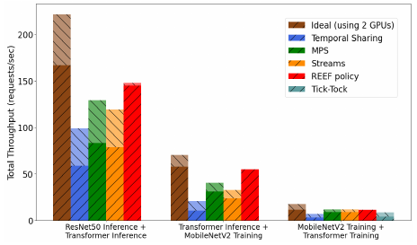
ORION (1/10)
Problem: protecting inference during kernel overlap
Foreground inference shares with background ML work.
Background kernels can delay newly arriving requests.
Strong throttling can waste overlap opportunities.
Admission must consider individual kernel behavior.
Orion, Figure 2. Foreground and background throughput.
Notes:
After TGS establishes transparent control, the next question is which background work to admit. Orion specializes this question to fine-grained ML execution, including latency-sensitive inference. Existing sharing approaches trade foreground protection against background progress. A submission-rate limit alone does not select complementary pairs of kernels. Figure 2 compares the aggregate throughput and foreground/background contributions of evaluated co-location techniques. The connection to TGS is our design argument, rather than a claim that Figure 2 directly evaluates the TGS prototype.
Source: Orion Sections 1 and 5 and Figure 2, PDF pp. 2 and 6–7, https://doi.org/10.1145/3627703.3629578.

Slide 20

ORION (2/10)
Motivation: complementary kernels overlap better
Conv2d + Conv2d: 0.98x speedup.
BN2d + BN2d: 1.08x speedup.
Conv2d + BN2d: 1.41x speedup.
Kernel profiles help select useful overlap.
Orion, Table 2. Kernel-pair overlap experiment.
Notes:
Orion motivates scheduling with an empirical kernel-pair example. Its Table 2 reports the concurrent speedup relative to sequential execution: 0.98x for two Conv2d kernels, 1.08x for two BN2d kernels, and 1.41x for Conv2d with BN2d. The complementary pair provides a reason to profile resource demand before admitting background work. These values describe this experiment rather than a general speedup guarantee for all compute/memory pairs.
Source: Orion Section 3 and Table 2, PDF pp. 4–5, https://doi.org/10.1145/3627703.3629578.

Slide 21
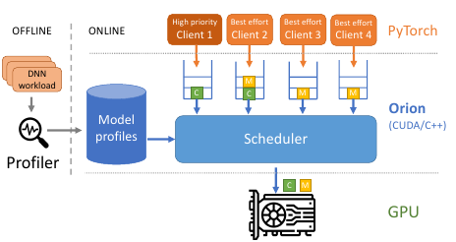
ORION (3/10)
Method: queue operations before submission
Intercept operations into client queues.
Load offline kernel profiles.
Submit foreground work promptly.
Select background work for separate streams.
Orion, Figure 5. Orion architecture.
Notes:
Orion combines interception with a policy informed by offline profiling. The prototype wraps CUDA runtime operations and selected cuDNN and cuBLAS functions, and then controls when queued operations are submitted. In the evaluated prototype, client applications and the scheduler run as threads in the same process. The paper also discusses an extension to separate processes using a concurrent-access mechanism such as MPS. These implementation choices establish the context for the later discussion of trust and isolation.
Source: Orion (/Users/juvenxu/Documents/Project/CUHKSZ/Visualization/Orion.pdf), Sections 5 and 5.3, PDF pp. 5-8, printed pp. 1079-1082; Figure 5, PDF p. 6.
Publication: https://doi.org/10.1145/3627703.3629578

Slide 22
ORION (4/10)
Method: profile what scheduling needs
Compute or memory intensity.
Kernel duration and required SM resources.
Foreground request or iteration duration.
Use these profiles for online admission.
Notes:
Orion uses Nsight Compute and Nsight Systems during an offline profiling phase. Its scheduler needs to know whether kernels have complementary resource demands, whether a best-effort kernel is small enough, and how much background execution may already be outstanding. It also needs a baseline duration for the high-priority task. The evaluated workloads fit together in device memory; the prototype assumes placement has already satisfied that condition. Memory swapping is a complementary mechanism discussed by the authors rather than the focus of these experiments.
Source: Orion (/Users/juvenxu/Documents/Project/CUHKSZ/Visualization/Orion.pdf), Sections 5.1.3, 5.2, and 6.5, PDF pp. 7-8 and 13, printed pp. 1081-1082 and 1087.
Publication: https://doi.org/10.1145/3627703.3629578

Slide 23
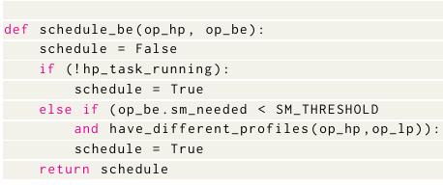
ORION (5/10)
Method: select suitable background kernels
Admit work when the foreground is idle.
Otherwise, prefer complementary profiles.
Check the kernel's resource requirements.
Preserve each client's execution order.
Orion, Listing 1. Background-kernel admission rule.
Notes:
The scheduler first handles high-priority work. For a best-effort kernel, it checks whether execution is suitable given the current foreground kernel and the background kernel's resource requirements. The main overlap rule combines opposite resource profiles with an SM-demand threshold. Kernels with unknown profiles receive a special optimistic treatment because they are typically short in the evaluated workloads. Multiple best-effort clients are served round-robin. Stream order preserves each client's dependencies while the hardware handles eligible concurrent execution.
Source: Orion (/Users/juvenxu/Documents/Project/CUHKSZ/Visualization/Orion.pdf), Section 5.1.1, PDF p. 6, printed p. 1080; Listing 1, PDF p. 7.
Publication: https://doi.org/10.1145/3627703.3629578

Slide 24
ORION (6/10)
Method: limit outstanding background work
Running kernels cannot be interrupted by stream priority.
Too much submitted work can delay the foreground.
Track completion with CUDA events.
Default duration threshold: 2.5% of the foreground baseline.
Notes:
Resource complementarity is useful, but a long queue of submitted background work can still delay the foreground. Orion therefore limits admission based on estimated outstanding duration and uses CUDA events to observe completion without a blocking synchronization. The 2.5% value is an empirically chosen control parameter relative to a foreground request or iteration baseline. It is not a universal bound on end-to-end slowdown. The policy works through admission and available stream mechanisms without assuming software can preempt a kernel already executing in the evaluated setting.
Source: Orion (/Users/juvenxu/Documents/Project/CUHKSZ/Visualization/Orion.pdf), Sections 5.1.1-5.1.2 and 6.4, PDF pp. 6-7 and 13, printed pp. 1080-1081 and 1087.
Publication: https://doi.org/10.1145/3627703.3629578

Slide 25
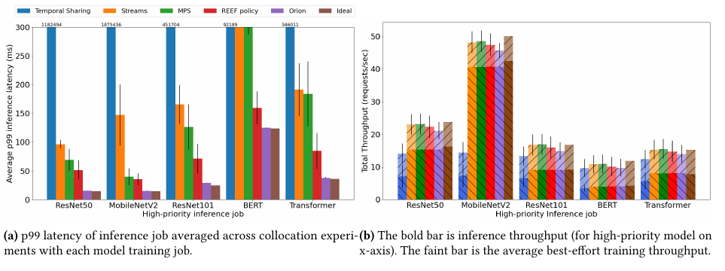
ORION (7/10)
Experiment: inference alongside training
Foreground inference shares a V100 GPU with training.
Average p99 latency stays within 14% of dedicated execution.
Orion, Figure 7. Inference-training results with Poisson arrivals.
Notes:
The evaluation uses a V100-16GB GPU, PyTorch 1.12, and CUDA 10.2. Figure 7 shows Poisson-arrival experiments; the companion Figure 6 uses the Apollo trace. The paper reports the 14% average p99-latency result for its inference-training evaluation, rather than a worst-case guarantee for every pair. Its Ideal latency reference is foreground execution on a dedicated GPU. The stacked throughput bars show foreground requests and background training iterations; they illustrate simultaneous progress and should not be interpreted as a common unit of application value.
Source: Orion (/Users/juvenxu/Documents/Project/CUHKSZ/Visualization/Orion.pdf), Sections 6.1 and 6.2.1, PDF pp. 8-10, printed pp. 1082-1084; Figure 7, PDF p. 10.
Publication: https://doi.org/10.1145/3627703.3629578

Slide 26
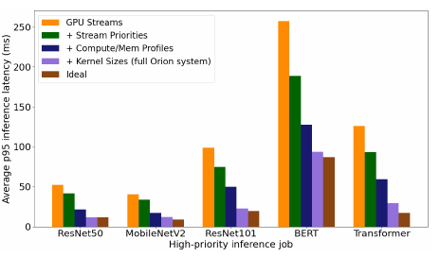
ORION (8/10)
Experiment: which scheduling decisions matter?
Streams provide concurrency.
Priorities favor the foreground.
Resource profiles improve selection.
Kernel-size checks complete the policy.
Orion, Figure 14. Scheduling ablation: p95 latency.
Notes:
The ablation tests the mechanism behind the result. It adds scheduling components to a stream-based implementation and measures the change in foreground tail latency. The resource-profile and size checks both contribute substantial improvements, supporting the claim that informed admission matters beyond exposing concurrency. Figure 14's vertical axis is average p95 inference latency, whereas the preceding and following experiment slides use p99. Interception overhead is evaluated separately and remains below 1% in the paper's dedicated-execution tests; offline profiling cost is reported separately as well.
Source: Orion (/Users/juvenxu/Documents/Project/CUHKSZ/Visualization/Orion.pdf), Sections 6.4-6.5 and Figure 14, PDF pp. 12-13, printed pp. 1086-1087.
Publication: https://doi.org/10.1145/3627703.3629578

Slide 27
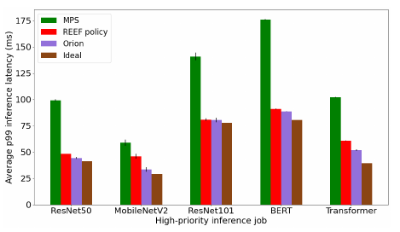
ORION (9/10)
Experiment: five clients on an A100
One foreground and four background clients.
Inference requests follow Poisson arrivals.
Foreground p99 latency stays within 9% of dedicated execution in these tests.
The policy works beyond two clients.
Orion, Figure 13. Five-client experiment: p99 latency.
Notes:
This experiment checks another GPU architecture and a larger sharing group. Each foreground model is evaluated while the other four models generate best-effort inference work. Figure 13 compares Orion with MPS and the implemented REEF policy, and its error bars summarize three repeated runs. This evidence supports the policy's applicability to the tested five-client setting. It remains a per-GPU evaluation with specific models and arrival rates, rather than evidence for arbitrary tenant counts or every cloud workload.
Source: Orion (/Users/juvenxu/Documents/Project/CUHKSZ/Visualization/Orion.pdf), Section 6.3, PDF p. 12, printed p. 1086; Figure 13, PDF p. 13.
Publication: https://doi.org/10.1145/3627703.3629578

Slide 28
ORION (10/10)
Takeaway: resource awareness improves sharing
Profiles reveal useful overlap opportunities.
Size and duration checks protect the foreground.
Orion assumes clients share a trust domain.
Next: enforce resource boundaries for independent tenants.
Notes:
Orion advances the efficiency part of our argument: the scheduler needs to know which resources a kernel uses and how much work it may leave outstanding. Its security discussion also gives us a precise boundary. The system assumes a shared trust domain and does not claim secure isolation between untrusted clients. We now extend the running example to independently controlled tenants. This changes the required coverage of resource enforcement as well as the scheduling policy, which motivates our analysis of Krypton.
Source: Orion (/Users/juvenxu/Documents/Project/CUHKSZ/Visualization/Orion.pdf), Section 7, "Security," PDF p. 13, printed p. 1087; Krypton (/Users/juvenxu/Documents/Project/CUHKSZ/Visualization/Krypton.pdf), Section 2.2, PDF p. 4. Transition is our synthesis.
Publication: https://doi.org/10.1145/3627703.3629578

Slide 29
KRYPTON
Efficient Performance-Aware GPU Sharing with Compatibility and Isolation through Kernel Space Interception
Shulai Zhang, Ao Xu, Quan Chen, Han Zhao, and Weihao Cui, Shanghai Jiao Tong University; Zhen Wang, Yan Li, and Limin Xiao, Lenovo; Minyi Guo, Shanghai Jiao Tong University

Slide 30
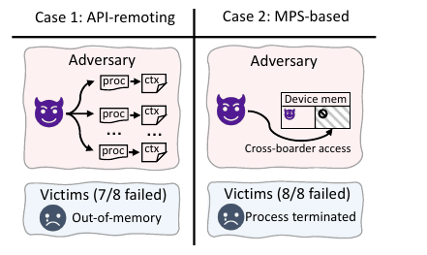
KRYPTON (1/10)
Problem: implicit allocations and shared fault domains
Creating a GPU context also consumes memory.
48 adversarial processes cause 7 of 8 TGS victims to fail.
A memory error affects 8 of 8 victims in the tested MPS setup.
Accounting and fault boundaries both matter.
Krypton, Figure 3. Resource exhaustion and fault propagation.
Notes:
Orion makes useful overlap more precise, but its clients share a trust domain. Krypton asks what an independent tenant can do outside the normal runtime-API control path. Context creation consumes implicit device memory. In the reported attack, 48 processes lead to failures for 7 of 8 TGS victim workloads. The MPS experiment separately shows fault propagation to 8 of 8 victims in the tested setup. Allocation accounting and context/fault boundaries are distinct requirements. The source figure summarizes both tests.
Source: Krypton Section 2.2 and Figure 3, PDF p. 4, https://www.usenix.org/conference/atc25/presentation/zhang-shulai.

Slide 31
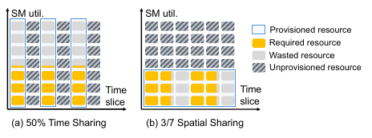
KRYPTON (2/10)
Motivation: one target, multiple resource configurations
One throughput target can admit several space and time shares.
MIG offers fixed spatial configurations.
Time sharing can leave SM resources unused.
Krypton combines partitions and time shares to reduce fragments.
Krypton, Figure 6. Unused capacity in time and space.
Notes:
Krypton adds an allocation problem to the enforcement problem. A job can often meet a throughput target under more than one spatial partition and time-share combination. MIG supplies fixed hardware partitions, while time sharing introduces another dimension for allocating work. Figure 6 illustrates unused capacity under separate temporal and spatial allocation choices. Krypton therefore combines lower interception, feedback, and packing of isolated GPU shares. SM means streaming multiprocessor, the GPU unit that executes groups of threads.
Source: Krypton Sections 2.3 and 3 and Figure 6, PDF pp. 5–10, https://www.usenix.org/conference/atc25/presentation/zhang-shulai.

Slide 32
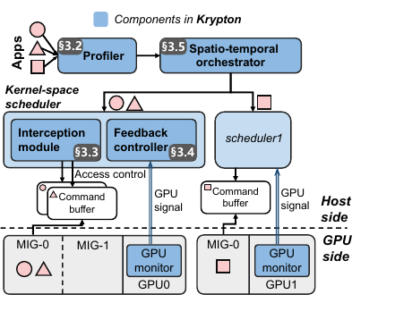
KRYPTON (3/10)
Method: allocate an isolated GPU share
IGPU: spatial resources, time share, and memory.
Profile allocations that meet each target.
Control submission and memory requests.
Pack allocations onto GPU devices.
Krypton, Figure 7. Krypton architecture.
Notes:
An IGPU is Krypton's resource-allocation abstraction. On the A100, MIG supplies the spatial partition, while the scheduler manages time and memory. The profiler explores feasible configurations, and the orchestrator chooses how to combine them. For example, the paper's Transformer-XL training case cannot fit in a 1g.5gb instance, but can meet its 2-rps target with approximately 48% of the time on a 3g.20gb instance. Spatial choices are planned offline; the online feedback controller adjusts temporal usage within the selected configuration.
Source: Krypton (/Users/juvenxu/Documents/Project/CUHKSZ/Visualization/Krypton.pdf), Sections 3.1-3.2, PDF pp. 6-7, printed pp. 1007-1008; Figures 7-8.
Publication: https://www.usenix.org/conference/atc25/presentation/zhang-shulai

Slide 33
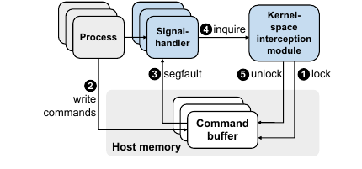
KRYPTON (4/10)
Method: control submission and account for memory
Locate each application's command buffers.
Lock buffer access outside its submission window.
Block writes until submission is allowed.
Count explicit and implicit memory allocations.
Krypton, Figure 9. Command-buffer access control.
Notes:
Krypton marks command-buffer pages read-only when submission is disabled. An attempted write raises a fault handled by a user-space signal handler, which waits until the kernel module authorizes submission again. Memory-related system calls are also intercepted, including requests arising during context creation; requests exceeding the provisioned quota return an error. Applications retain separate GPU contexts. The implementation combines a kernel module with user-space helpers, including a preloaded library. Buffer locking controls future submissions; it does not instantly interrupt a GPU kernel that is already running.
Source: Krypton (/Users/juvenxu/Documents/Project/CUHKSZ/Visualization/Krypton.pdf), Sections 3.3.1-3.3.2, PDF pp. 7-8, printed pp. 1008-1009; implementation in Section 4, PDF p. 10.
Publication: https://www.usenix.org/conference/atc25/presentation/zhang-shulai

Slide 34
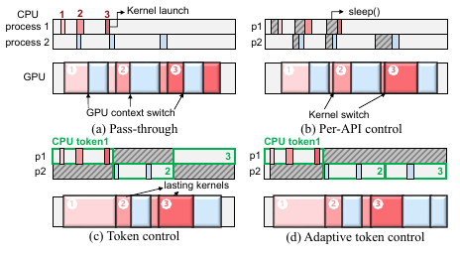
KRYPTON (5/10)
Method: use GPU-time feedback
A CPU window differs from actual GPU time.
Submitted kernels can run beyond the window.
Compare measured GPU use with the quota.
Compensate applications receiving too little time.
Krypton, Figure 10. CPU submission windows and GPU execution.
Notes:
This revisits the asynchronous-execution issue introduced with TGS, now in the context of allocating GPU time among isolated applications. Fixed host-side tokens can yield inaccurate GPU shares because long-running submitted work crosses token boundaries. Krypton uses monitoring feedback to compensate in later allocations. The selection rule compares observed utilization with quota, using NVML or DCGM according to the device mode. The relevant utilization signal estimates time with GPU activity; it is distinct from Orion's compute-throughput and memory-bandwidth resource profiles. The default token length is 100 ms, with other lengths evaluated for latency-sensitive cases.
Source: Krypton (/Users/juvenxu/Documents/Project/CUHKSZ/Visualization/Krypton.pdf), Section 3.4 and Algorithm 1, PDF pp. 8-9, printed pp. 1009-1010.
Publication: https://www.usenix.org/conference/atc25/presentation/zhang-shulai

Slide 35
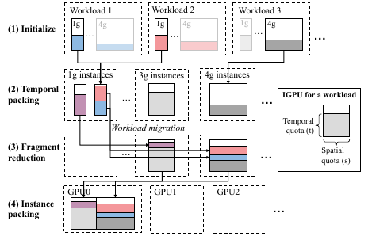
KRYPTON (6/10)
Method: pack resources in space and time
Choose an initial feasible configuration.
Combine matching instances in time.
Reduce remaining resource fragments.
Pack MIG instances onto physical GPUs.
Krypton, Figure 12. Resource-packing stages.
Notes:
The orchestrator searches for a deployment that uses fewer GPUs while meeting application targets. It first chooses small feasible instances, then combines temporal shares. It can move a workload to a larger planned instance when the resulting time-share combination reduces fragmentation, while also checking memory capacity. Finally, it packs the spatial instances onto devices. These migrations are steps in offline planning, rather than repeated live migrations during the search. Krypton does not dynamically resize a running MIG partition as part of this method.
Source: Krypton (/Users/juvenxu/Documents/Project/CUHKSZ/Visualization/Krypton.pdf), Section 3.5.1, PDF p. 9, printed p. 1010; Figure 12, PDF p. 10; MIG reconfiguration scope in Section 7, PDF p. 14.
Publication: https://www.usenix.org/conference/atc25/presentation/zhang-shulai

Slide 36
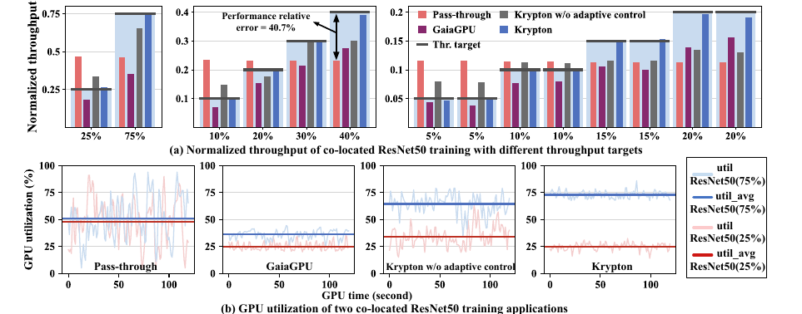
KRYPTON (7/10)
Experiment: tracking throughput targets
2, 4, or 8 ResNet-50 training jobs share an A100.
Average target error: 21.6% without adaptive control, 3.0% with it.
Krypton, Figure 16. Feedback and throughput-target accuracy.
Notes:
This experiment isolates the contribution of feedback control using ResNet-50 training with batch size 32. It compares pass-through execution, GaiaGPU, Krypton without adaptive control, and the full system. The two-application time series also shows the observed shares approaching the intended 25% and 75% levels. These are throughput-target and GPU-time-allocation results, rather than p99 latency guarantees. They support the method's central claim that observed device usage is needed to correct host-side submission control.
Source: Krypton (/Users/juvenxu/Documents/Project/CUHKSZ/Visualization/Krypton.pdf), Section 5.4, PDF p. 12, printed p. 1013; Figure 16, PDF p. 13.
Publication: https://www.usenix.org/conference/atc25/presentation/zhang-shulai

Slide 37
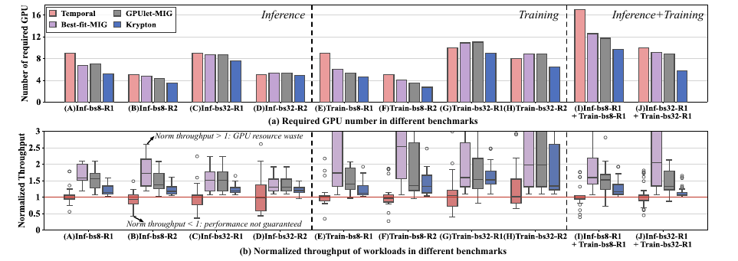
KRYPTON (8/10)
Experiment: fewer GPUs for the same targets
Ten cases cover inference, training, and mixed jobs.
GPU reduction: 32.1% vs. Temporal, 23.1% vs. Best-fit-MIG, 20.5% vs. GPUlet-MIG.
Krypton, Figure 13. GPU requirements and achieved throughput.
Notes:
The inference-only and training-only cases contain 20 workloads, and the mixed cases contain 40. Figure 13 pairs resource requirements with normalized throughput, where one corresponds to the assigned performance target. Values below one indicate under-service; consistently large values above one can indicate excess allocation. The reported reductions are aggregate comparisons against the named baselines in these deployment cases. The 32.1% value refers specifically to Temporal, rather than to every comparator. GPUlet-MIG is the authors' isolation-oriented adaptation of GPUlet.
Source: Krypton (/Users/juvenxu/Documents/Project/CUHKSZ/Visualization/Krypton.pdf), Sections 5.1-5.2, PDF pp. 10-12, printed pp. 1011-1013; Figure 13, PDF p. 11.
Publication: https://www.usenix.org/conference/atc25/presentation/zhang-shulai

Slide 38
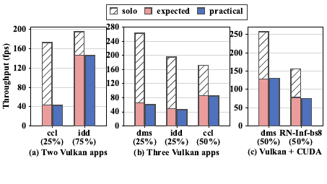
KRYPTON (9/10)
Experiment: sharing beyond CUDA
Test two or three Vulkan applications.
Also test Vulkan together with CUDA.
Average throughput error remains below 3.4%.
These tests use time sharing.
Krypton, Figure 15. Vulkan and mixed-runtime results.
Notes:
This experiment tests the lower interception boundary across different software interfaces. It includes graphics workloads and a combination of Vulkan rendering with CUDA inference. The chart compares solo, expected, and observed throughput. Because the evaluated Vulkan setting does not use MIG spatial sharing, the experiment demonstrates runtime compatibility through temporal control. It supports the tested CUDA/Vulkan combinations and configurations; the broader coverage diagram is an architectural motivation rather than an exhaustive compatibility test of every GPU runtime.
Source: Krypton (/Users/juvenxu/Documents/Project/CUHKSZ/Visualization/Krypton.pdf), Section 5.3 and Figure 15, PDF p. 12, printed p. 1013; platform configuration in Tables 1-2, PDF p. 10.
Publication: https://www.usenix.org/conference/atc25/presentation/zhang-shulai

Slide 39
KRYPTON (10/10)
Takeaway: enforce and allocate together
Lower interception expands resource coverage.
Separate contexts and memory accounting address different risks.
Feedback and packing improve allocation efficiency.
MIG spatial choices stay fixed during execution.
Notes:
Krypton completes our design argument by combining broader enforcement with performance-aware allocation. Its mechanisms specifically address the submission, memory-accounting, and context boundaries discussed earlier. Temporal feedback adapts online, while spatial MIG configurations are selected through planning and are not resized live. The paper separately evaluates latency sensitivity to token length, showing that throughput control and request latency require different checks. These stated boundaries let us connect the isolation mechanism to the performance evidence without treating either as a universal security or latency guarantee.
Source: Krypton (/Users/juvenxu/Documents/Project/CUHKSZ/Visualization/Krypton.pdf), Sections 3, 5.5, and 7, PDF pp. 6-9 and 12-14, printed pp. 1007-1010 and 1013-1015. Integration into the common argument is our synthesis.
Publication: https://www.usenix.org/conference/atc25/presentation/zhang-shulai

Slide 40
CONTROL PRECISION AND COVERAGE
Two dimensions connect the three papers
Precision: how closely scheduling follows resource demand.
Coverage: which operations the platform can constrain.
Orion strengthens kernel-level scheduling decisions.
Krypton expands the resource-enforcement boundary.
Notes:
These two dimensions are the analytical framework we derive from the papers. Precision helps identify useful overlap and protect foreground progress. Coverage determines whether the intended resource budget accounts for the operations a tenant can actually perform. The dimensions should be evaluated together. Moving interception lower can broaden enforcement, while higher-level kernel profiles remain useful for scheduling decisions. The three systems therefore provide evidence for complementary design requirements; their results do not establish a single ranking on one common benchmark.
Source: Our synthesis, based on TGS (/Users/juvenxu/Documents/Project/CUHKSZ/Visualization/TGS.pdf), Sections 3-5; Orion (/Users/juvenxu/Documents/Project/CUHKSZ/Visualization/Orion.pdf), Sections 5 and 7; and Krypton (/Users/juvenxu/Documents/Project/CUHKSZ/Visualization/Krypton.pdf), Sections 2-3.

Slide 41
APPLYING THE FRAMEWORK
Return to the same foreground and background jobs
Cooperative jobs need submission and memory control.
Complementary kernels benefit from informed overlap.
Independent tenants need enforceable resource budgets.
LLM serving also needs memory-capacity and latency checks.
Notes:
These are design considerations illustrated through our running example, rather than a combined implementation or a new experiment. For ordinary training jobs, TGS shows how transparent sharing can recover capacity. Orion adds evidence for resource-aware overlap, while Krypton motivates broader enforcement for independently controlled tenants. Connecting the argument to LLM inference requires workload-specific validation. Orion discusses LLM serving as future investigation, including its memory demands. TGS includes a GPT training case, and Krypton discusses profiling for LLM serving, but the selected experimental results do not establish an end-to-end multi-tenant LLM serving result across all three systems.
Source: Our application of the framework. LLM scope: Orion (/Users/juvenxu/Documents/Project/CUHKSZ/Visualization/Orion.pdf), Section 7, PDF p. 14, printed p. 1088; TGS (/Users/juvenxu/Documents/Project/CUHKSZ/Visualization/TGS.pdf), Section 6.8, PDF p. 13, printed p. 80; Krypton (/Users/juvenxu/Documents/Project/CUHKSZ/Visualization/Krypton.pdf), Sections 3.2 and 7, PDF pp. 7 and 14, printed pp. 1008 and 1015.

Slide 42
CONCLUSIONS
A connected answer to the GPU-sharing problem
TGS establishes transparent control.
Orion improves sharing through kernel awareness.
Krypton extends enforcement and allocation.
Effective sharing needs precise scheduling and enforceable boundaries.
Notes:
We began with one resource-management problem: sharing a GPU while controlling how tenants affect each other. The papers supply three connected answers. Interception makes requests manageable; resource-aware scheduling turns spare capacity into useful work; accounting and execution boundaries support stronger resource guarantees. Our contribution is the connected analysis of these requirements and their relationship to the interception boundary. This gives us a concrete way to reason about shared GPU designs under different workload and trust assumptions.
Source: Our concluding synthesis of the three papers.

Slide 43
REFERENCES
Three core papers
Wu et al. Transparent GPU Sharing in Container Clouds for Deep Learning Workloads. NSDI 2023.
Strati et al. Orion: Interference-aware, Fine-grained GPU Sharing for ML Applications. EuroSys 2024.
Zhang et al. Efficient Performance-Aware GPU Sharing with Compatibility and Isolation through Kernel Space Interception. USENIX ATC 2025.
Notes:
All paper-specific mechanisms, figures, and numerical results are attributed to these sources. The connecting design argument and the analysis framework are developed for this presentation.
Source: - TGS: local PDF (/Users/juvenxu/Documents/Project/CUHKSZ/Visualization/TGS.pdf) | official publication page (https://www.usenix.org/conference/nsdi23/presentation/wu).
- Orion: local PDF (/Users/juvenxu/Documents/Project/CUHKSZ/Visualization/Orion.pdf) | DOI (https://doi.org/10.1145/3627703.3629578).
- Krypton: local PDF (/Users/juvenxu/Documents/Project/CUHKSZ/Visualization/Krypton.pdf) | official publication page (https://www.usenix.org/conference/atc25/presentation/zhang-shulai).

