Slide 1
VIRTUALIZATION TECHNIQUES COURSE PRESENTATION
Confidential Virtualization: From CPU Isolation to GPU Acceleration
Empirical Analysis of AMD SEV-SNP, Intel TDX, and Confidential GPU Computing
Presenter: Sirui Li

Slide 2
Outline
01 / OVERVIEW
1. Introduction & Roadmap
2. Paper 1: CVM Foundations (POMACS '24)
Evolution from application enclaves to heterogeneous Confidential VMs.
Empirical analysis of AMD SEV-SNP and Intel TDX architectures.
3. Paper 2: Non-CC GPU Passthrough (Waseda '25)
4. Paper 3: Confidential H100 GPUs (IBM '25)
Design challenges of legacy GPU passthrough in SEV-SNP vs. TDX.
LLM batch inference and model swapping on native GPU TEEs.

Slide 3
Introduction – Why Confidential Virtualization?
02 / BACKGROUND
Table1 Paradigm Shift: Enclaves vs. CVMs.
Dimension | App Enclave (SGX) | Confidential VM
Isolation Boundary | User-space process | Full Virtual Machine
Code Modification | SDK / App redesign | Unmodified binaries
TCB Footprint | Small (App + CPU) | Large (Guest OS + FW)
Cloud Deployment | High friction | Seamless lift-and-shift
Untrusted Cloud Host: Hypervisor, host OS, and BIOS are excluded from TCB.
Enclave Limitations: Intel SGX requires code refactoring and suffers limited memory.
Lift-and-Shift CVMs: Hardware-isolated VMs run unmodified OS and legacy applications.
AI & GPU Demand: Protecting proprietary LLM weights requires extending TEEs to GPUs.

Slide 4
Introduction – Research Roadmap
03 / ROADMAP
STAGE 1: CPU CVM BASELINE
STAGE 2: LEGACY GPU BRIDGE
STAGE 3: NATIVE GPU TEE
1. Misono et al. (2024)
2. Sato et al. (2025)
3. Ibarra et al. (2025)
CPU & Memory Isolation in SEV-SNP and TDX.
Non-CC GPU Passthrough via Selective PTE Decryption.
Confidential H100 GPU LLM Serving & Swapping.
Dimension | Stage 1: CPU CVM (Paper 1) | Stage 2: Legacy GPU (Paper 2) | Stage 3: Native CC-GPU (Paper 3)
Hardware Scope | AMD EPYC & Intel Xeon CPUs | CVM + Pre-Hopper GPUs | CVM + NVIDIA H100 TEE
DMA Path | Software Bounce Buffer (swiotlb) | Selective Page-Flip (C-bit / MapGPA) | Encrypted Bounce Buffer + SPDM
Core Bottleneck | VMEXITs, Memory Acceptance | TDX Hypervisor Mediation | Encrypted Model Loading Delay

Slide 5
Paper 1: Confidential VMs Explained (1/2)
04 / PAPER 1: CVM FOUNDATIONS
Table 2 Terminology & Architectural Comparison
Feature | AMD SEV-SNP | Intel TDX
Root of Trust | AMD Secure Processor (ASP) | TDX Module (SEAM Mode)
Encryption Mode | AES-128 XTS (C-bit in PTE) | AES-128 XTS + MAC (HKID)
Integrity Table | Reverse Map Table (RMP) | PAMT + Secure EPT + MAC
Exception Type | VC (VMM Comm. Exception) | VE (Virtualization Exception)
Hypercall Instruction | VMGEXIT (via GHCB) | TDCALL / SEAMCALL
Intra-VM Isolation | 4-Level VMPL (SVSM) | TD Partitioning (L1/L2 VM)
Motivation & Problems
Same Abstraction: Both vendors offer hardware-isolated VMs.
Divergent Designs: Different microarchitectures, ABIs, and TCBs.
Evaluation Gap: Lack of unified empirical comparison on real hardware.
Key Contributions
Microarchitectural Review: Deep dive into SEV-SNP vs. TDX.
Empirical Benchmarks: Boot, VMEXIT, Memory, Compute, and I/O.
Security Audit: TCB LoC measurement and 58 CVE analysis.

Slide 6
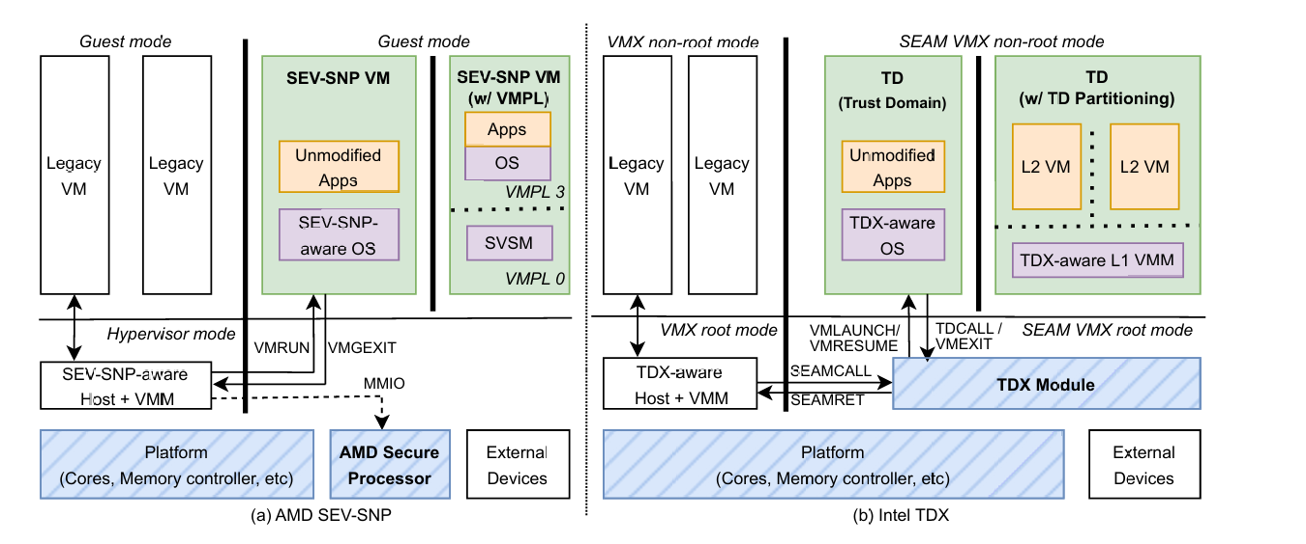
CVMs Explained – System Architecture (1/2)
05 / PAPER 1: ARCHITECTURE
AMD SEV-SNP (Left)
Dedicated Co-processor: On-die ARM ASP manages keys and RMP.
VMGEXIT + GHCB: Guest shares state explicitly with untrusted host.
VMPL 0–3: Orthogonal privilege rings enable Secure VM Service Module.
Intel TDX (Right)
SEAM CPU Mode: Software TDX Module runs in SEAM root mode.
TDCALL / SEAMCALL: TDX Module mediates all host-guest transitions.
Fig.1. The architecture of AMD SEV-SNP (left) and Intel TDX (right)
TD Partitioning: Supports nested L2 VMs inside Trust Domain.

Slide 7
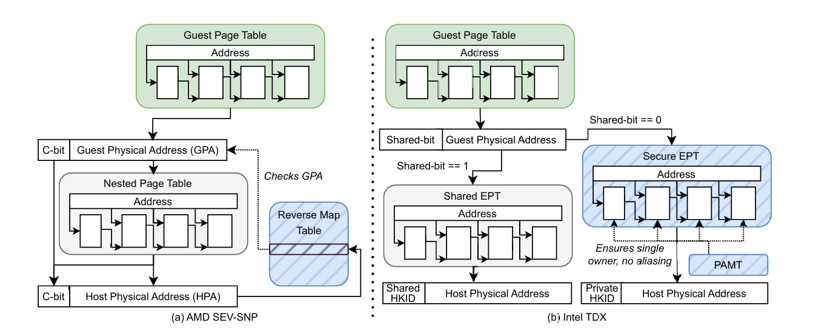
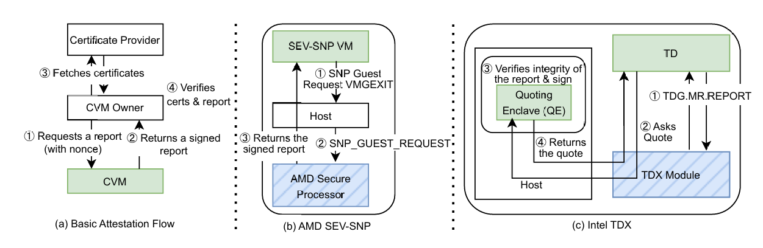
CVMs Explained – Memory & Attestation (2/2)
06 / PAPER 1: MEMORY & TRUST
Memory Translation & Integrity
SEV-SNP C-bit & RMP: Guest PTE sets C-bit; hardware checks Reverse Map Table for 1-to-1 GPA-HPA mapping.
TDX Dual EPT & PAMT: Shared-bit routes to Shared EPT or TDX-managed Secure EPT; 28-bit MAC prevents Rowhammer.
Fig.2. Memory Translation Flow
Remote Attestation Primitives
SEV-SNP (6.19 ms): ASP signs report directly with hardware VCEK key.
Intel TDX (2.75 ms): TDX Module MACs report; external SGX Quoting Enclave signs quote.
Fig.3. Remote Attestation Flow

Slide 8
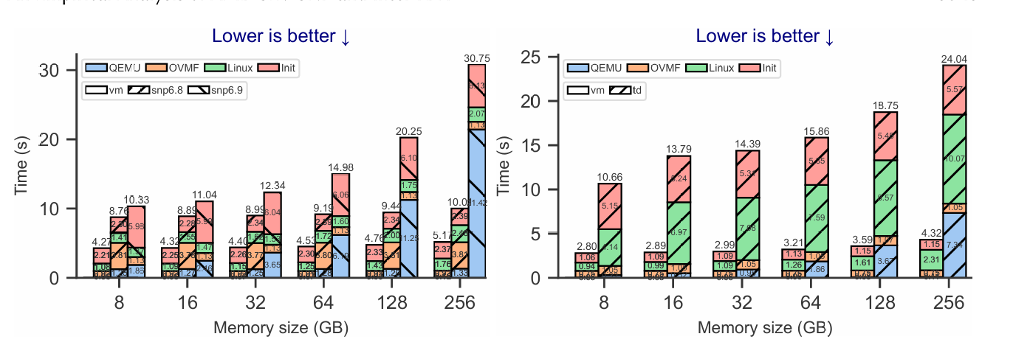
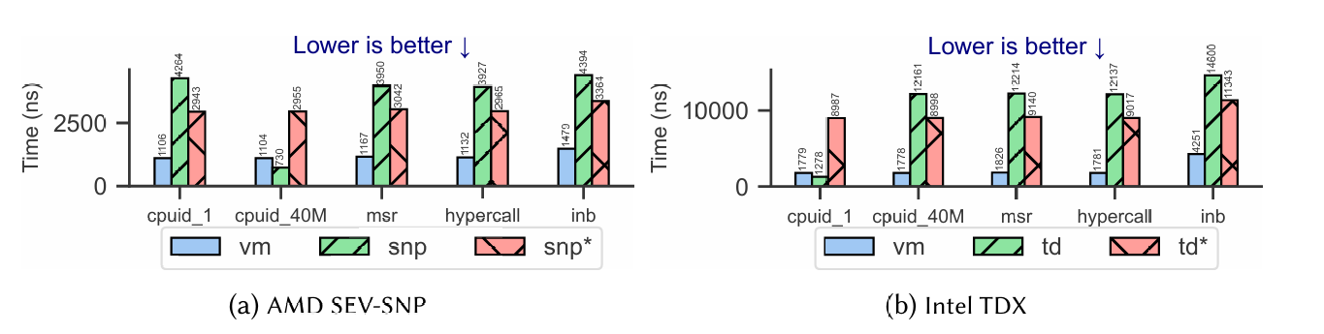
CVMs Explained – Boot, VMEXIT & Memory
07 / PAPER 1: MICROBENCHMARKS
Slow Boot Time (64 GB): +231% on SEV-SNP (kernel 6.9) and +394% on TDX due to pre-launch memory separation.
Costly VMEXITs: +240% latency on SEV-SNP vs. +472% on TDX (TDX Module intervention cost).
Fig4 Linux Direct Boot Time
Memory Acceptance Tax: Initial 32 GB mmap incurs +59% (SNP) and +92% (TDX) overhead; eliminated on reuse.
Bandwidth Overhead: Continuous encryption costs 7.29% (SNP) and 4.06% (TDX) in Phoronix suite.
Fig.5. VMEXIT Instruction Latency

Slide 9
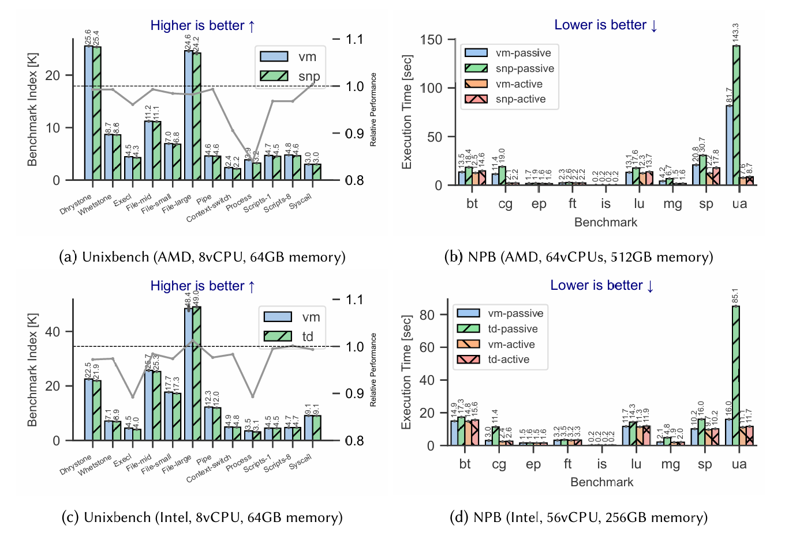
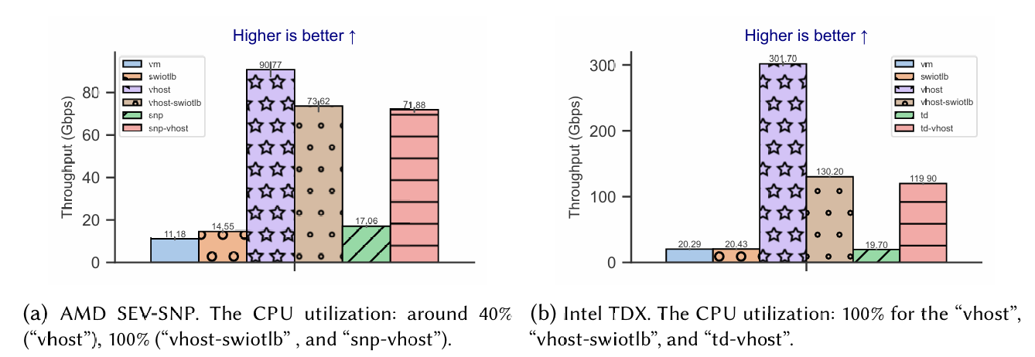
CVMs Explained – Compute & Network I/O
08 / PAPER 1: MACROBENCHMARKS
vCPU-Sleep (HLT) Penalty: Thread synchronization triggers frequent HLT VMEXITs, causing up to 431% slowdown in NPB (ua on TD).
Halt Polling Mitigation: Guest-side polling reduces NPB overhead to 5.9%–12.2% at higher CPU usage.
Bounce Buffer Tax (TCP): Untrusted DMA requires copying via swiotlb, causing up to 60% throughput drop on iperf3 TCP.
Fig.6. Unixbench & NPB Passive vs. Active
Low-CPU I/O (UDP): Dominated by HLT VMEXITs (81% drop); recovered via idle polling.
Fig.7. iperf3 TCP Bounce Buffer Overhead

Slide 10
CVMs Explained – Security Analysis (TCB & CVEs)
09 / PAPER 1: SECURITY
Table 3 Software TCB Sizes and Disclosed CVEs up to June
Component / Metric | AMD SEV-SNP | Intel TDX
Guest Linux 6.8 TCB | 2,307 KLoC (13 MB) | 2,304 KLoC (13 MB)
Guest Firmware (OVMF/TDVF) | 206 KLoC (4.0 MB) | 764 KLoC (4.0 MB)
Platform Firmware (ASP/TDX Mod) | 29 KLoC (93 KB) | 45 KLoC
Host-to-Guest CVEs | 25 (SNP) / 13 (SEV-ES) | 9 (TDX)
Guest-to-Host & Host-to-Host | 8 total CVEs | 0 CVEs
Key Security Takeaways
Massive Guest TCB: Over 2.3M LoC in Linux kernel + 206K–764K LoC in UEFI firmware.
81% Host-to-Guest CVEs: 47 of 58 disclosed CVEs involve malicious host attacking guest.
54% Firmware Bugs: 31 CVEs reside in ASP firmware or TDX Module.
39% Validation Misses: Unchecked VMM inputs (MMIO, PIO, interrupts like Heckler/WeSee).

Slide 11
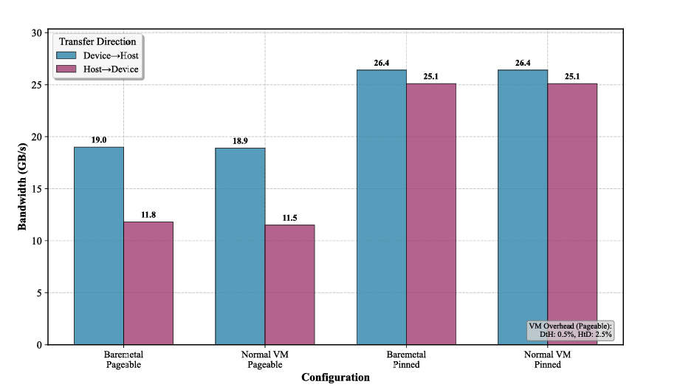
Paper 2: Non-CC GPU Passthrough in Intel TDX
10 / PAPER 2: LEGACY GPU BRIDGE
Sato et al., Waseda University (2025)
Motivation & Problem
Pre-Hopper Installed Base: Only H100 supports native CC; legacy GPUs lack encrypted DMA.
Selective DMA Decryption: Non-CC GPUs require unencrypted shared memory regions for DMA.
Baseline Penalty: Pageable memory transfers lose 25–50% bandwidth (11.5–19.0 GB/s) vs. pinned DMA (25.8 GB/s) due to bounce buffers.
Fig.8. GPU Data-Transfer Performance on TDX-Capable Intel Xeon Hosts (Pageable vs. Pinned)

Slide 12
GPU Passthrough – SEV-SNP vs. Intel TDX
11 / PAPER 2: PAGE-STATE TRANSITIONS
Intel TDX: Hypervisor-Mediated Conversion
AMD SEV-SNP: Guest-Controlled "Page-Flip"
1. S-Bit Hint Only: Real encryption state owned by TDX Module in Secure-EPT.
1. Clear C-Bit: Guest sets C=0 directly in its own PTE.
2. PVALIDATE: Guest instruction updates RMP entry in-place.
2. MapGPA VMCALL: Guest exits to hypervisor to remap page as shared.
3. Zero VMEXITs: Microsecond latency; no hypervisor intervention.
3. Page Accept: Guest issues TDG.MEM.PAGE.ACCEPT when reclaiming.
Result: Achieves 22.0 GB/s (only 18% overhead vs. 26.9 GB/s bare-metal).
Result: Mandatory 2 VMEXITs per conversion; strict security penalizes streaming DMA.

Slide 13
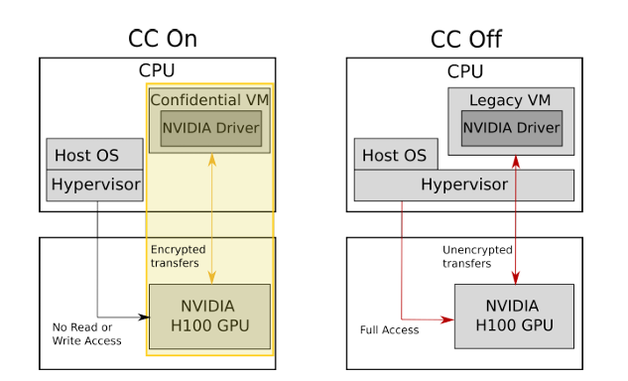

Paper 3: Performance of Confidential H100 GPUs
12 / PAPER 3: NATIVE GPU TEE
Martínez Ibarra et al., Univ. of Murcia & IBM Research (2025)
NVIDIA H100 CC Architecture
End-to-End TEE: Combines CPU CVM with H100 hardware root-of-trust, secure boot, and attestation.
Encrypted PCIe Transfers: Hypervisor has zero read/write access to GPU memory or DMA transfers.
[PASTE PAPER FIGURE HERE]
Research Problem: Relaxed batch LLM inference requiring active model swapping on a single H100 (80 GB) under SLA constraints.
"
Fig.9. Confidential Computing with NVIDIA H100 (CC On vs. CC Off)

Slide 14
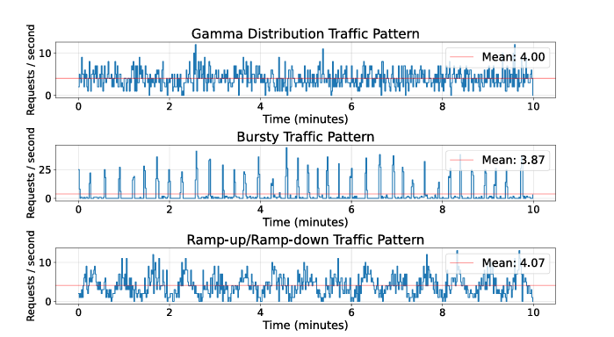
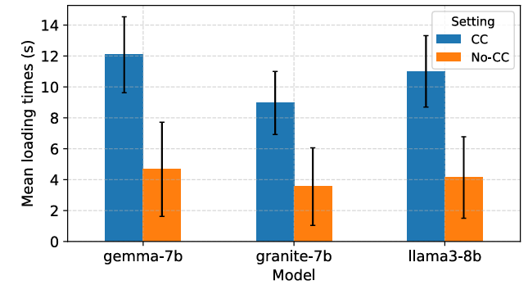
Confidential GPUs – Setup & Model Load Profiling
13 / PAPER 3: METHODOLOGY
Models & Traffic Patterns (SLAs: 40s, 60s, 80s)
3 LLMs: Llama-3.1-8B (16 GB), Gemma-7B (17 GB), Granite-7B (27 GB).
3 Traffic Patterns: Gamma, Bursty, and Ramp-up/Ramp-down (Mean: 4 req/s).
4 Schedulers: BestBatch (OBS), BestBatch+Timer, SelectBatch+Timer (dynamic size), Best+Partial+Timer.
Fig.10. Input Traffic Distributions
Key Bottleneck: Model loading in CC mode takes ~2.5x longer (e.g., 14s vs. 5s for Granite-7B) due to CPU-GPU encryption.
[PASTE PAPER FIGURE HERE]
Fig.11. Model Loading Times: CC vs. No-CC

Slide 15
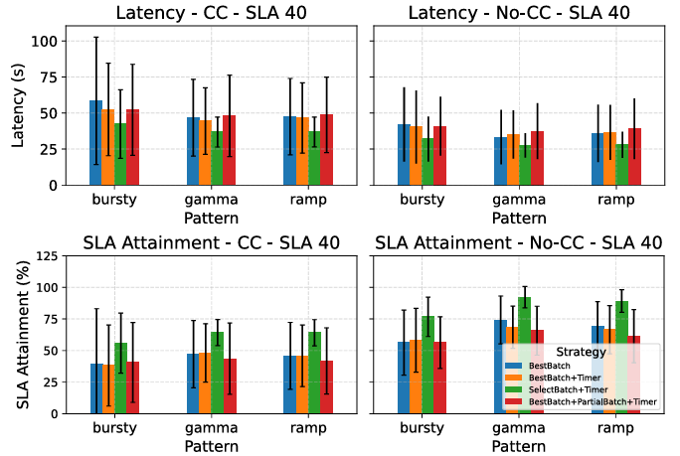
Confidential GPUs – Latency, Throughput & Utilization
14 / PAPER 3: EVALUATION
Latency & SLA Attainment: No-CC latency is 20–30% lower; SLA-40 attainment is 70% (No-CC) vs. 50% (CC).
Scheduler Trade-off: SelectBatch+Timer achieves lowest latency & highest SLA attainment; BestBatch maximizes throughput.
Throughput Gap: No-CC surpasses CC by 45–70%; pure GPU execution speed is identical—gap is purely model-loading tax.
GPU Utilization: ~50% higher in No-CC (~45% vs. ~30% in CC); GPU sits idle during encrypted PCIe model swaps.
Fig.12. Latency & SLA Attainment

Slide 16
Summary of Contributions & Q&A
15 / Conclusion
2. Non-CC GPU Passthrough ('25)
3. Confidential H100 GPUs ('25)
1. CVMs Explained (TUM '24)
Encrypted PCIe model swapping causes 20–30% higher latency; dynamic batching (SelectBatch+Timer) best meets SLAs.
Low compute overhead (4–7%), but severe penalties on boot, HLT VMEXITs (431%), and bounce-buffer I/O (60%).
SEV-SNP guest C-bit flip achieves near-native DMA (18% cost); Intel TDX requires 2 hypervisor VMEXITs per page conversion.
Future Direction: Hardware-level TDISP / PCIe IDE (Intel TDX-Connect & AMD SEV-TIO) to eliminate bounce buffers and unify CPU-GPU TEEs.
Thank you for listening! | Questions & Discussion

