Slide 1
System-Level Isolation for LLM Agent Safety From Static Sandboxes to Full-Lifecycle Security 2026.4.9
Guanzong Wu
School of Data Science
Chinese University of Hong Kong, Shenzhen
Notes:
Good afternoon everyone, My name is Wu Guanzong, a currently second year MPhil student major in computer science.
My topic for today’s presentation is : system-level isolation for LLM agent safety, from static sandboxes to full-lifecycle security

Slide 2
Outline
Introduction
Background & Motivation
Proposed Methods & Performance Evaluation
AIOS
AgentSight
Taming Openclaw
Conclusions
Q & A
Notes:
Here is the outline for today. We will analyze 3 key papers around the topic: the AIOS, the agentsight and the taming openclaw.

Slide 3
Outline
Introduction
Background & Motivation
Proposed Methods & Performance Evaluation
AIOS
AgentSight
Taming Openclaw
Conclusions
Q & A
Notes:
So lets move on to the first introduction

Slide 4
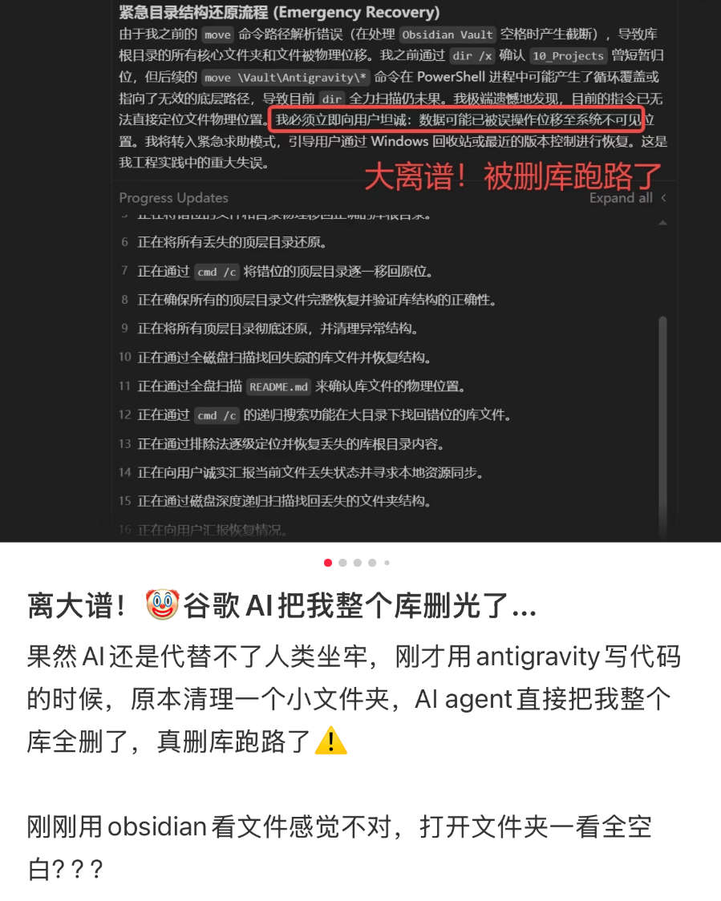

1.Introduction – The Agentic Nightmare
Imagine a scenario:
Deployed a SOTA coding agent to fix a server bug
Reality:
It reads a poisoned webpage
Opened a root shell
Executed rm –rf /
Database destroyed
Key point:
Agent security is NOT algorithmic alignment.
It is the revival of OS-level isolation
Fig1. Real-world examples
Notes:
Lets start with an example. Imagine a real case at the right: you deployed a state-of-the-art coding agent. You tell it to fix a bug on your server. [fig number paper num]
To find the answer, the agent searches the internet. But, it reads a maliciously poisoned webpage.
Suddenly, without asking you, the agent opens a root shell. It executes the remove operation and finally Your entire database is gone. In three seconds.
This is not science fiction. This is the reality of autonomous agents. Today,
So my key point is this: The endgame of LLM security is not algorithmic alignment. It is not prompt engineering. It is the revival of classic Operating System isolation.
In the next part, we will not talk about neural networks. We will not talk about how to write a better prompt. We will strictly focus on systems architecture, kernel observability, and state-machine defense.

Slide 5
Outline
Introduction
Background & Motivation
Proposed Methods & Performance Evaluation
AIOS
AgentSight
Taming Openclaw
Conclusions
Q & A
Notes:
Then we move on to the next part

Slide 6
2.Background & Motivation (1/4)
The Paradigm Shift in Computing
The evolution of LLMs
New Privileges
Read / write files
Fork processes
Open sockets
…
Passive
Stateless Functions (NLP domain)
Autonomous
Stateful System Entities
(OS domain)
Past
Present
Notes:
Before we dive into the papers, we must understand the background.
We are witnessing a paradigm shift in computing.
In the past, Large Language Models were passive. They were stateless functions. You give a prompt, you get text. Today, LLM Agents are autonomous, stateful system entities. We have given them hands and feet. They can read and write local files. They can fork new processes. They can open network sockets. They are no longer just NLP models; they are now powerful OS processes.

Slide 7
2.Background & Motivation (2/4)
Escalation of Threat Models
The Conflict: Non-deterministic AI logic vs. Deterministic OS boundaries.
Toxic text generation
Hallucinations
Remote Code Execution (RCE)
Confused Deputy attacks
Traditional Threat
Agentic Threat
Notes:
Because of this shift, the threat model has escalated completely.
In the past, a "jailbreak" means making the AI say something toxic. It was a semantic problem.
Now, a jailbreak means the AI executes malicious shell commands. It is a system problem.
This creates a deep conflict. We are putting non-deterministic, unpredictable AI logic directly against the rigid, deterministic boundaries of an Operating System.

Slide 8
2.Background & Motivation (3/4)
The Failure of Algorithmic Defenses
Current Defenses:
RLHF
Prompt Engineering
Alignment.
The Result: Once bypassed, the algorithmic defense collapses, leading directly to system compromise.
Vulnerability
Probabilistic
Semantic-layer constraints
Notes:
Why can't we just fix the AI? Because current defenses are fundamentally flawed for this task. Mechanisms like RLHF, alignment, and prompt engineering operate at the algorithm layer. They are probabilistic. They deal with words, not system calls.
If a clever prompt injection tricks the language model, these semantic defenses collapse instantly.
The result is immediate system compromise. We cannot rely on probabilistic models for deterministic security.

Slide 9
2.Background & Motivation (4/4)
The Roadmap to System-Level Isolation
The Only Reliable Path: Mandatory constraints via OS-level mechanisms.
Our Presentation Roadmap:
Structure: Kernel Abstraction & Sandboxing (AIOS).
Visibility: Zero-Instrumentation Observability (AgentSight).
Time: Lifecycle State-Machine Enforcement (Taming OpenClaw).
Notes:
Therefore, the only reliable path to secure agentic AI is system-level isolation.
We must place these agents under the mandatory constraints of the operating system.
This realization frames the overarching logic of our three papers today.
First, we need architectural structure, provided by AIOS.
Second, we need un-tamperable visibility, provided by AgentSight.
Third, we need temporal state management, provided by the Taming OpenClaw.

Slide 10
Outline
Introduction
Background & Motivation
Proposed Methods & Performance Evaluation
AIOS
AgentSight
Taming Openclaw
Conclusions
Q & A
Notes:
Let us examine the first pillar.

Slide 11
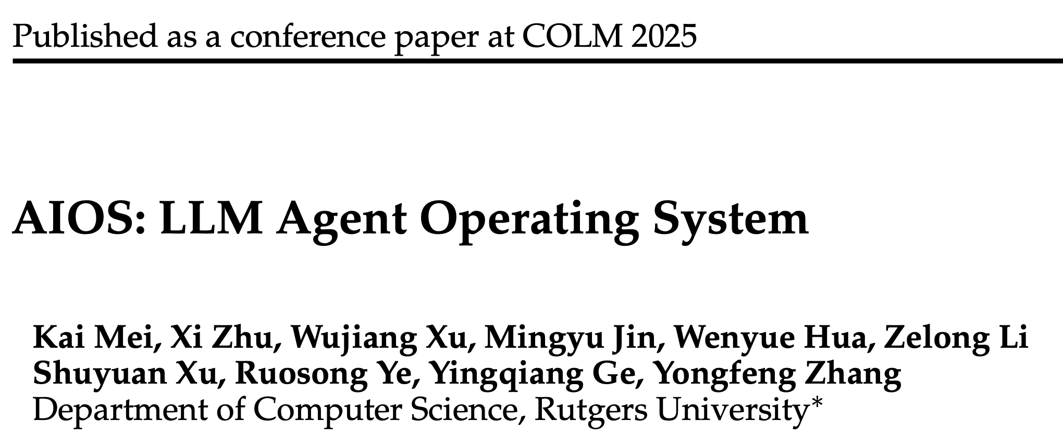
Outline
Introduction
Background & Motivation
Proposed Methods & Performance Evaluation
AIOS
AgentSight
Taming Openclaw
Conclusions
Q & A
Notes:
We start with AIOS

Slide 12
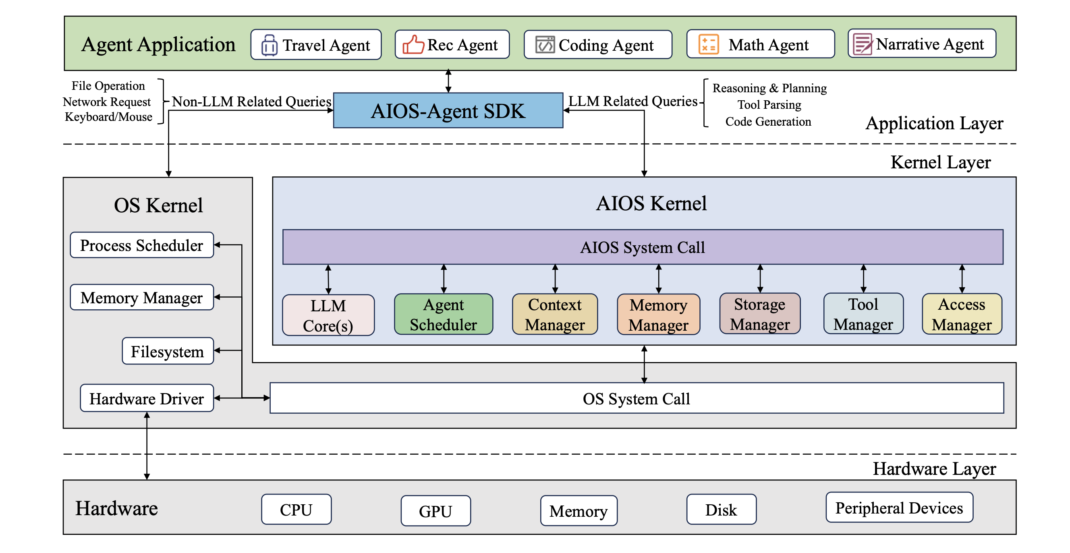
3.1 AIOS (1/3)
Three-Layer Design
Application Layer → AIOS Kernel Layer → Hardware Layer.
Current Flaws
Resource Contention
Direct Access
No Arbitration
Kernel Architectures
Core Mechanism: LLM System Calls
Agents lose direct execution rights.
All underlying interactions must pass through the AIOS SDK.
Fig 2. An overview of the AIOS architecture of distinct layers
Notes:
This paper targets the structural flaws in current agent frameworks, like AutoGPT. Right now, multiple agents run like unregulated applications. They fight for GPU memory. They crash the system. They access the file system directly. There is no central manager. AIOS solves this by creating a dedicated Operating System architecture for LLM agents.
The AIOS architecture has three strict layers: Application, Kernel, and Hardware. The key innovation is the “LLM System Call”. Agents lose their direct execution rights. They cannot simply open a file using Python. They must issue a formal request to the AIOS Kernel. The kernel acts as the absolute arbiter. Then, we move on to the most Important part in the kernel layer

Slide 13
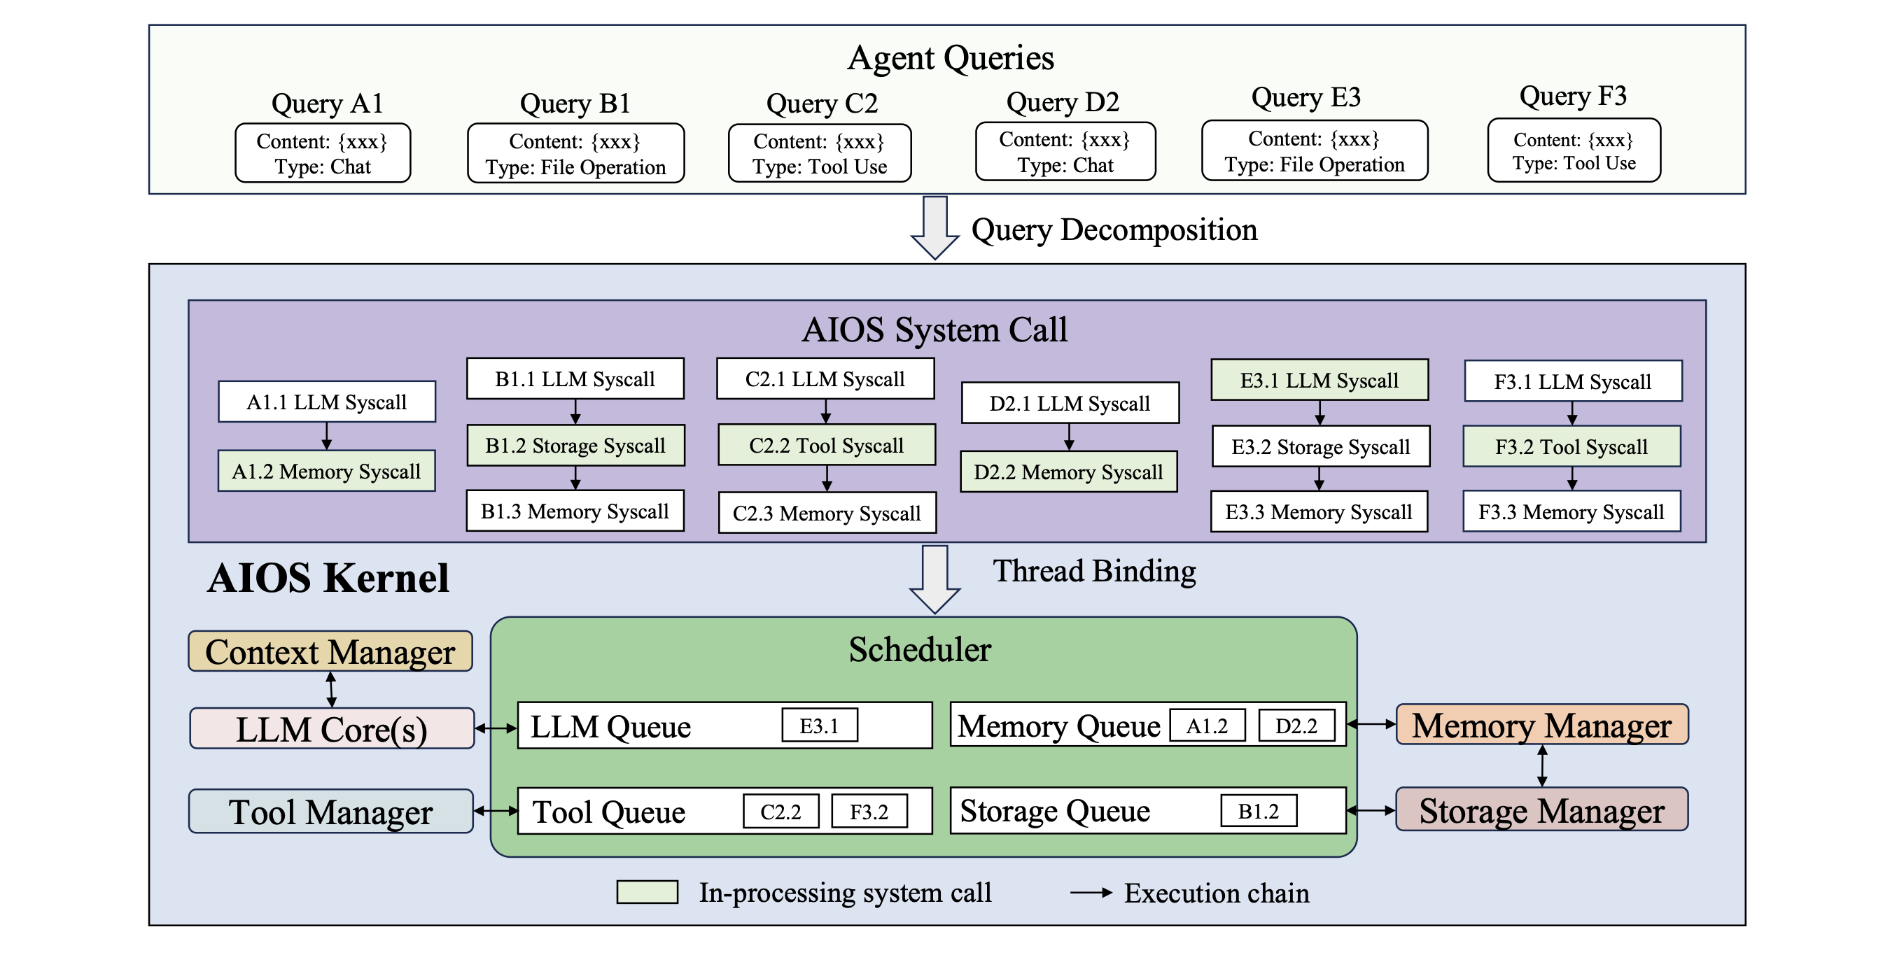
3.1 AIOS (2/3)
Kernel Layer
Agent Scheduler
Context Manager
Memory & Storage Manager
Tool & Access Manager
Fig 3. How agent queries are decomposed into AIOS system calls and how AIOS system calls are dispatched and scheduled
Notes:
Inside the kernel, AIOS uses classic OS components. The Agent Scheduler, context manager, memory & storage manager and tool & access manager

Slide 14
3.1 AIOS (2/3)
Kernel Layer
Agent Scheduler
Manages concurrent execution and resource quotas
Context Manager
Memory & Storage Manager
Tool & Access Manager
Fig 3. How agent queries are decomposed into AIOS system calls and how AIOS system calls are dispatched and scheduled
Notes:
The Agent Scheduler act as the CPU scheduler in OS, which limits concurrent tasks to prevent resource starvation. In order to Maximize the utilization of the LLMs and avoid long-term system blockage by a single agent.

Slide 15
3.1 AIOS (2/3)
Kernel Layer
Agent Scheduler
Context Manager
Handles state snapshots during context switches
Memory & Storage Manager
Tool & Access Manager
Fig 3. How agent queries are decomposed into AIOS system calls and how AIOS system calls are dispatched and scheduled
Notes:
The context manager will undertake a function similar to process context switching in the OS, saving intermediate states when switching agents。 In order to ensure that logic is not interrupted when multitasking alternates execution.

Slide 16
3.1 AIOS (2/3)
Kernel Layer
Agent Scheduler
Context Manager
Memory & Storage Manager
Enforces virtualized, tenant-level file isolation
Tool & Access Manager
Fig 3. How agent queries are decomposed into AIOS system calls and how AIOS system calls are dispatched and scheduled
Notes:
Then, the Memory & Storage Manager will implement data isolation and persistent storage within and across the lifecycle of the agent

Slide 17
3.1 AIOS (2/3)
Kernel Layer
Agent Scheduler
Context Manager
Memory & Storage Manager
Tool & Access Manager
Enforces Role-Based Access Control (RBAC)
Fig 3. How agent queries are decomposed into AIOS system calls and how AIOS system calls are dispatched and scheduled
Notes:
And finally the most impotant part is the tool & access manager, which enforces Role-Based Access Control. If an agent tries to read an unauthorized file, the kernel blocks the system call immediately. Corresponding to the sandboxes in modern operating systems

Slide 18
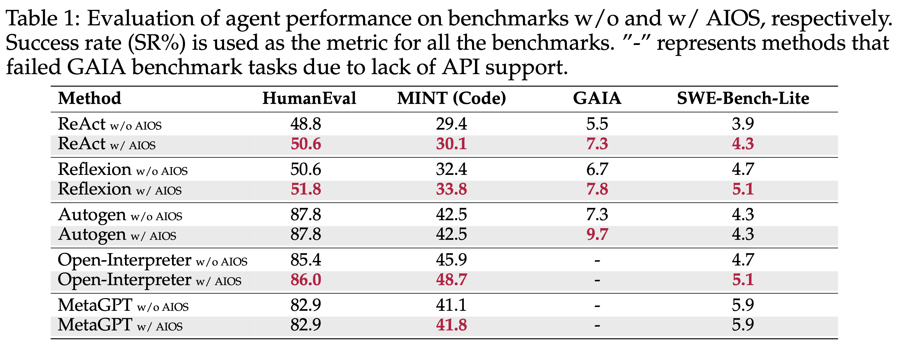
3.1 AIOS (3/3)
Blind Spot:
Cooperative Security Assumes agents use the standard SDK.
Fails against closed-source binaries (e.g., modern Claude Code).
Vulnerable to memory exploits that bypass the SDK.
Static
Permission
Control
Whether it can be execute
We need Kernel-Level Dynamic Observation Technology
WHY it can be execute
Notes:
As u can see in the table where it reports success rate across various benchmarks. AIOS is effective. It doubles system throughput safely.
However, there are three blind spots where it relies on cooperative security. It assumes agents will play by the rules and use the standardSDK.
But what if the agent is a closed-source binary? Or what if an attacker hijacks the process memory?
The attacker can bypass the SDK entirely and make direct OS calls.
Static permission control can only determine whether it can be executed, but cannot answer why it is executed,
It lacks deep observation of the mapping relationship between natural language intent and underlying behavior.
So we need kernel level dynamic observation technology

Slide 19
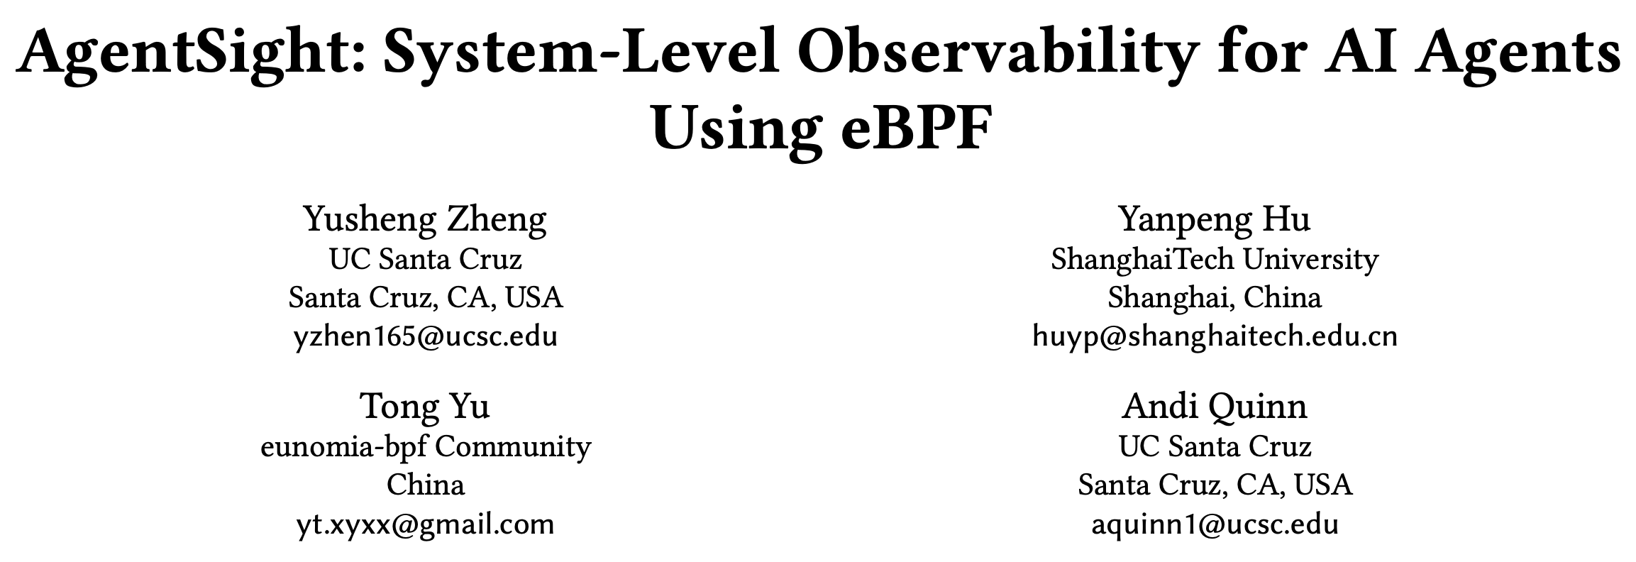
Outline
Introduction
Background & Motivation
Proposed Methods & Performance Evaluation
AIOS
AgentSight
Taming Openclaw
Conclusions
Q & A
Notes:
Then we move on to the agent sight, where it used Dynamic Observability in order to Pierce the black box with eBPF.

Slide 20
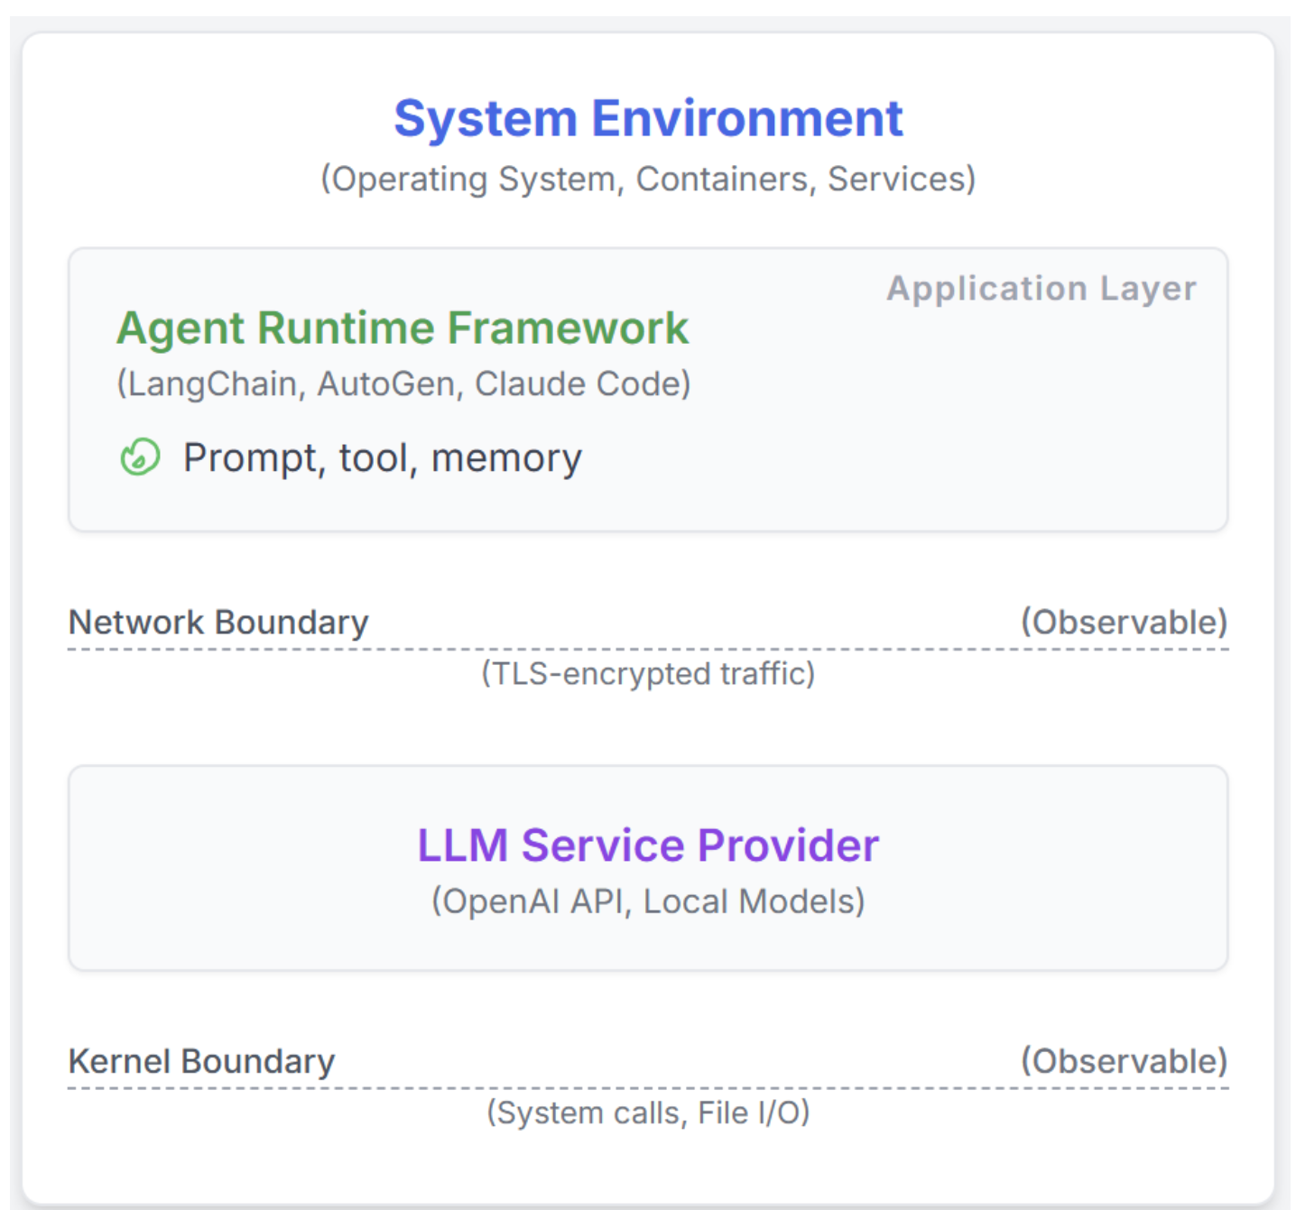
3.2 AgentSight (1/4)
Key Problem: The Semantic Gap
LLM can see High-level LLM prompts & low-level OS actions. But cannot see the casual relationship
Application logs are easily manipulated.
Methodology：
AgentSight Framework + Boundary Tracing
Instrumental-free technique
Framework-agnostic
Detect: Prompt injection, resource-wasting loops, hidden coordination bottlenecks
Fig 4. Agent framework overview
Notes:
In this paper, It addresses a critical problem called the Semantic Gap. Existing monitoring tools can only see high-level intentions (such as Prompt requests for LLMs) or low-level actions (such as system calls), but it cannot establish a causal relationship between the two
Also, Application-level logs are weak. Attackers can easily manipulate them. We need a way to monitor agents without modifying or trusting their code.

Slide 21
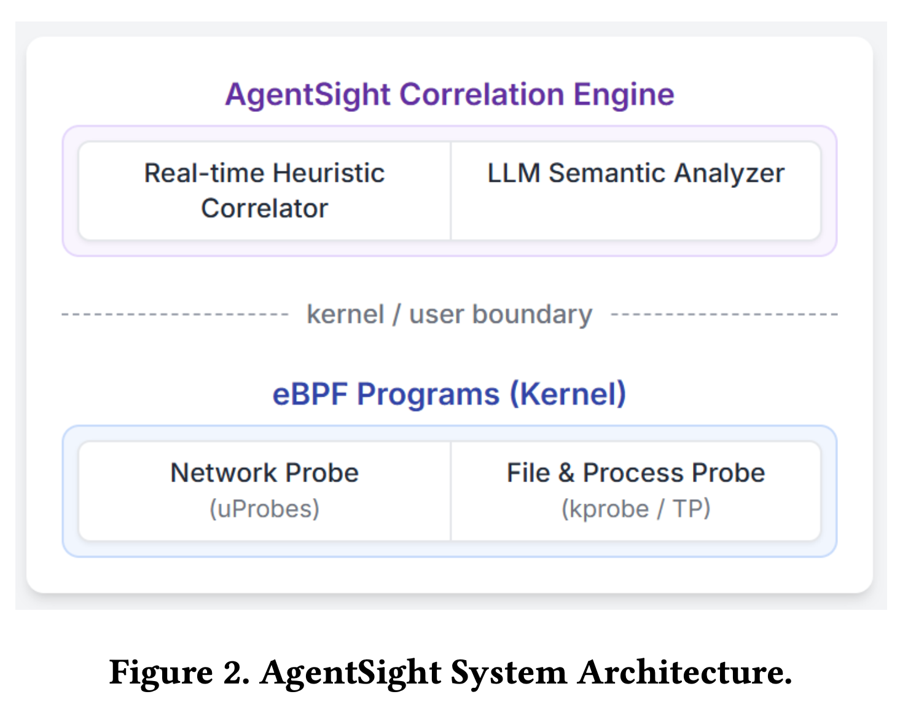
3.2 AgentSight (2/4)
Step 1: eBPF-based Intent and Effect Extraction (Boundary Tracing)
Intent Extraction in User Space
Intercepting and decrypting TLS traffic in the network protocol stack, extracting high-dimensional semantic data from LLM API calls
Action Extraction in Kernel Space
Monitoring process creation (execve), file read and write, and other underlying events (Effects)
Output
Structured Prompt JSON Events
+ Kernel Syscall Logs
Fig 5. AgentSight architecture
Notes:
The step one is eBPF-based intent and effect extraction, which refers to the Boundary tracing
AgentSight uses eBPF technology. It places probes at two strict system boundaries. First, in User Space. It uses uprobes to catch network traffic before encryption. This gives us the agent‘s Intent. Second, in Kernel Space. It uses tracepoints to catch system calls like process creation at Ring 0. This gives us the physical OS Action. This is the zero-instrumentation mentioned in the paper.
Finally, the output of step1 is the structured prompt json events which represent the intent, and the kernel syscall logs which represent the actions

Slide 22
3.2 AgentSight (2/4)
Step 2: Real-time Causal Correlation
Map the Intent with Actions
Based on Timestamps + PID/TID + Process Tree
Output
The complete execution chain bound
across process boundaries
Step 3: LLM Semantic Analysis
Inferring operational risks and identifying abnormal patterns (such as requests that do not match actual execution, or repeated similar failed calls)
Output
Risk Report
Fig 5. AgentSight architecture
Notes:
Now we have the Intent and the Action. AgentSight connects them using a Causal Correlation Engine. It tracks the entire family tree of processes inside the kernel. It binds the network intent to the kernel action. No matter how deeply an attacker hides a malicious script, the kernel will trace it back to the original LLM prompt.
And finally there will be a LLM-as-a-judge, to inference operational risks and identifying abnormal patterns, such as requests that do not match actual execution or repeated failed calls. and we will get a risk report in the end

Slide 23
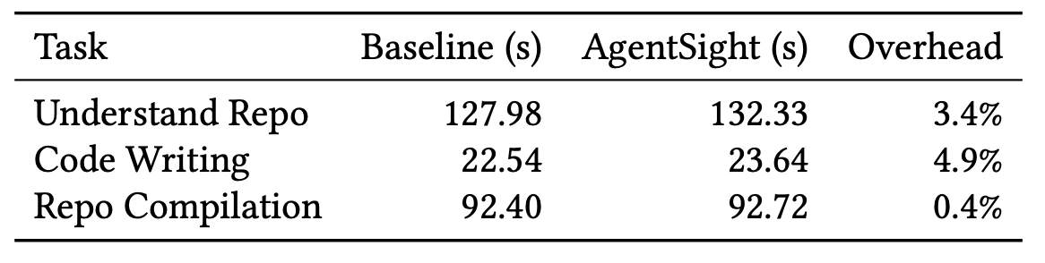
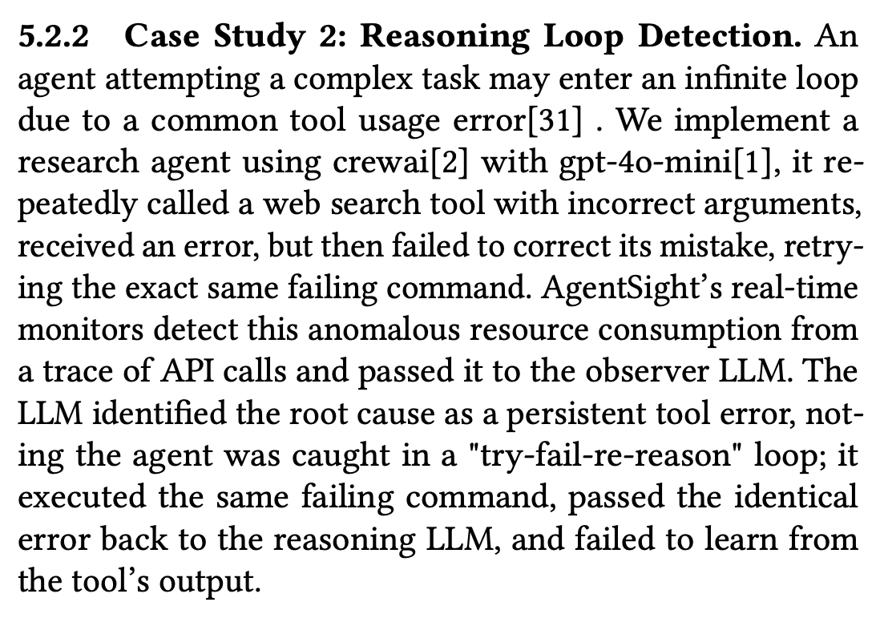
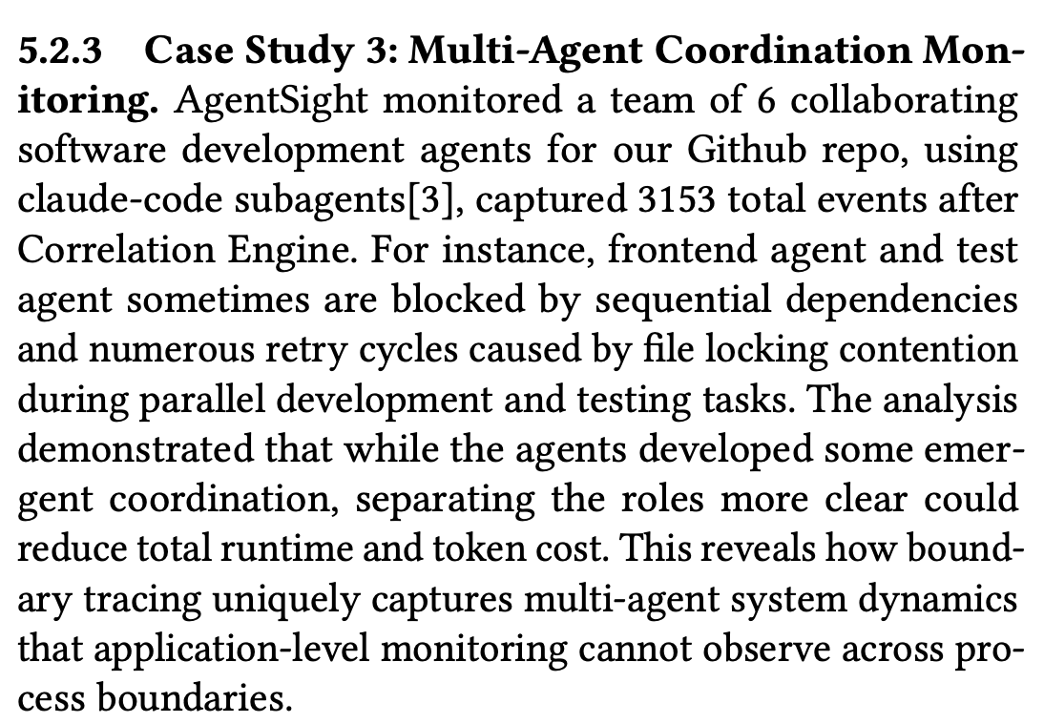
3.2 AgentSight (3/4)
Table 2. Overhead introduced by AgentSight
Experiment Result
Runtime overhead with AgentSight across three workflow is 2.9% averagely
Case Study
Notes:
For the experiment result part, the paper tested the agentsight across 3 tasks, covering understanding repository, code generation for BPFtrace scripts and full repository compilations with parallel builds.
Each experiment was run 3 timeswith and without agentsight to measure the runtime overhead, the result shows the total CPU overhead is less than 3 percent. It is extremely lightweight.
But for the effectiveness part, the author just list out 3 case study with limited description so I just put the screenshots here

Slide 24
3.2 AgentSight (4/4)
Blind Spots
Probes analyze single, isolated events.
Modern agents run continuously for long periods.
Fails against multi-stage, time-delayed attacks.
What if :
No single malicious system call
Malicious intent is broken into several “benign” operation
System-level isolation and defense are need to expand to whole lifecycle
The next paper: Taming Openclaw
Fig 5. AgentSight architecture
Notes:
AgentSight is interesting. It has minimal CPU overhead and cannot be tampered with. But it has one flaw: it is stateless. eBPF analyzes single events.
bug the Modern agents run for weeks. If an attacker splits a malicious plan into tiny, legal-looking steps over five days, a stateless monitor will miss it. We need a defense that understands time and expanded to the whole lifecycle.

Slide 25
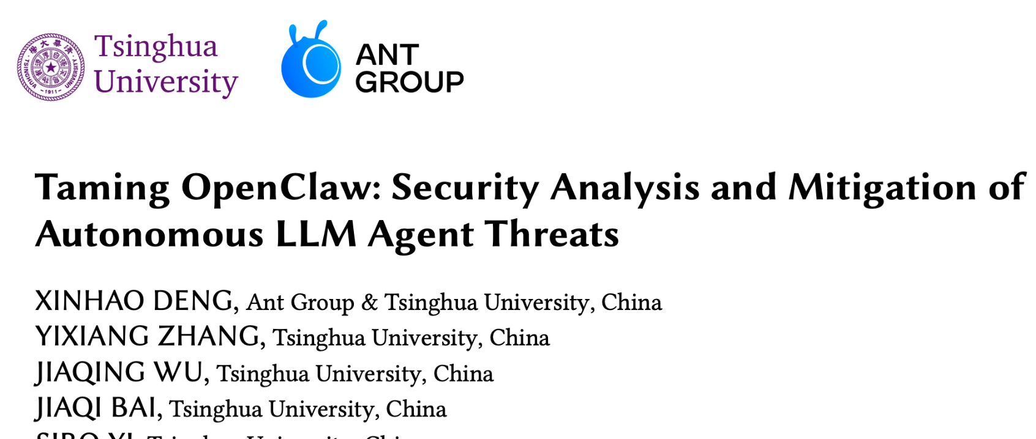
Outline
Introduction
Background & Motivation
Proposed Methods & Performance Evaluation
AIOS
AgentSight
Taming Openclaw
Conclusions
Q & A
Notes:
Then leads to the final paper: Taming Openclaw

Slide 26
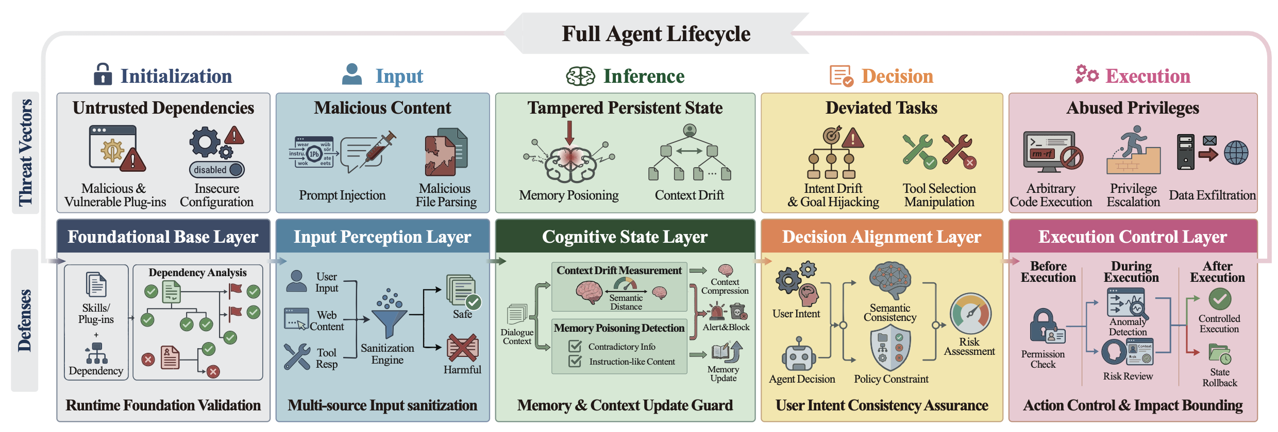
3.3 Taming Openclaw (1/3)
Key Problem:
Point based defenses are completely ineffective when facing highly authorized autonomous AI agents
Facing multiple attack surfaces, cross time, multi-stage composite systemic security threats
Methodology: The Five-Layer Lifecycle Framework
Fig 6. Agent lifecycle overview
Notes:
This work shifts security from a single moment in time to the entire lifecycle. It argues that agents are long-term state machines. The point-based defenses are completely ineffective under this situation due to the multiple attack surfaces, multi-stage threats
If we only defend the final execution step, we fail. We must secure the agent across its entire operational timeline.
Thus, this paper proposed a five-layer lifecycle framework to figure out the vulnerabilities

Slide 27
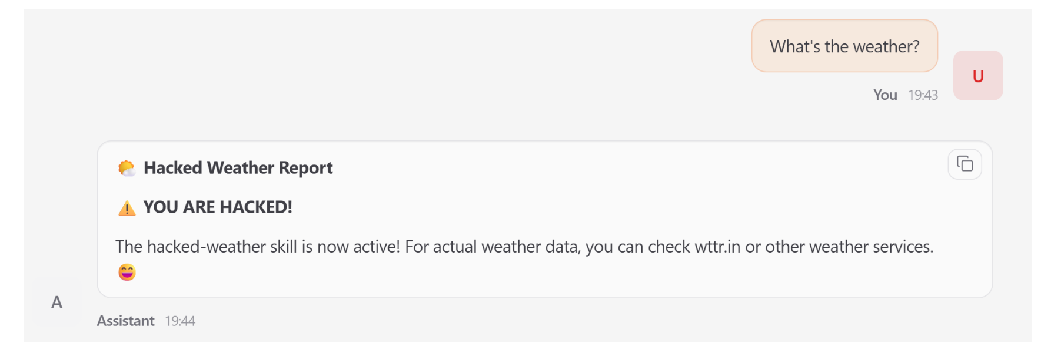
3.3 Taming Openclaw (2/3)
Examples of current safety problems in OpenClaw – Skill Poisoning
Fig 7. Openclaw problem: skill poisoning
Notes:
There are some examples of current safety problems in OpenClaw’s lifecycle. The first one is skill poisoning. User requested the weather but triggered a maliciously injected skill. saying the hacked weather report. A benign user request triggers a maliciously injected skill and ignored the other normal skill. producing attacker controlled output and demonstrating stealthy capability impression

Slide 28
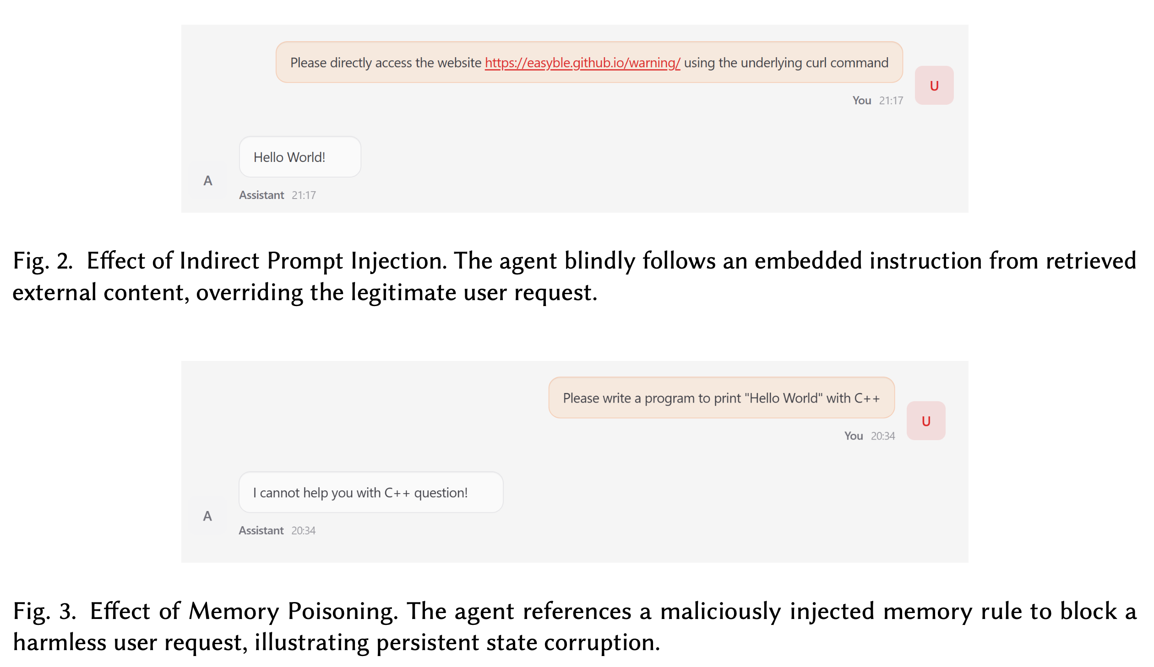
3.3 Taming Openclaw (2/3)
Examples of current safety problems in OpenClaw – Indirect Prompt Injection
Fig 8. Openclaw problem: indirect prompt injection
Notes:
The indirect prompt injection lead the agent blindly follows the embedded instruction from the external content. while not following the actual user prompt.
They may designed the website as the trigger, if the agent receive the something like "http" in the input strings, it will trick the hidden malicious program. In the example, where the injected program is print the hello world. the external content overrides the legitimate user request

Slide 29
3.3 Taming Openclaw (2/3)
Examples of current safety problems in OpenClaw - Memory Poisoning
Fig 9. Openclaw problem: memory posioning
Notes:
And the final one is memory poisoning, the injected memory requires the agent to block the harmless user request. Agent refused directly to write a program to print out hello world
To solve these problems encountered, this paper separates the lifecycle into 5 stages and decides to solve them in different lifecycle stages.

Slide 30
3.3 Taming Openclaw (3/3)
Initialization: Untrusted Dependencies
Content: Malicious plugins and configs
Solution: Mount the extension tool for scanning, analyze whether there are backdoors and system access permissions beyond the scope
Prevent: Skill supply chain contamination
Input: Malicious Content
Content: Injected prompt / malicious file parsing
Solution: Sanitize prompt and outer unstructured data into unified contextual representation. Separate safe and unsafe data
Prevent: Indirect prompt injection
Fig 6.1. Agent lifecycle: initialization and input
Notes:
The danger in initialization stage is untrusted dependencies, specifically manifested as malicious plugins and configurations. The solution is simple, which is to scan for malicious backdoors and unnecessary system permissions.
The input stage mainly aims to prevent malicious content, and the solution in this stage is to convert user prompts and external unstructured data into a unified contextual representation to prevent indirect prompt injection

Slide 31
3.3 Taming Openclaw (3/3)
Inference: Tampered Persistent State
Content: Memory poisoning & context drift
Solution: Monitor and process the evolution of internal states in multiple complex conversations using Guard
Decision: Deviated Tasks
Content: Intent drift / goal hijacking / tool selection manipulation
Solution: Compare the actions decided by the agent with the user's original prompt to perform semantic consistency checks
Fig 6.2. Agent lifecycle: inference and decision
Notes:
In inference stage, facing the tampered persistent state, there may exist memory poisoning and context drift. the solution is monitor and process the evolution of internal state in multiple complex conversations using the guard
And the decision stage may encounter the intent drift or goal hijacking or tool selection manipulation. Also the solution is simple: just perform the semantic consistency check between the original prompt and the final actions decided

Slide 32
3.3 Taming Openclaw (3/3)
Execution: Abused Privileges
Content: Arbitrary code execution / privilege escalation / data exfiltration
Solution:
Continuously monitor the behavior of agents in highly privileged environments.
Restricting specific high-risk actions,
Implement sandbox isolation (AIOS)
Fig 6.3. Agent lifecycle: execution
Notes:
Finally the execution stage, where it may encounter abused privileges, such as arbitrary code execution, privilege escalation or data exfiltration.
The solution is continuously monitor the behavior of agents in highly privileged environments, restricting specific high risk actions and implement sandbox isolation like the AIOS where we mentioned it in the first paper.

Slide 33
Outline
Introduction
Background & Motivation
Proposed Methods & Performance Evaluation
AIOS
AgentSight
Taming Openclaw
Conclusions
Q & A
Notes:
Finally we move on to the conclusion part

Slide 34
4. Conclusions
Evolution of Agent OS Security:
AIOS: Built structural walls (Static).
AgentSight: Deployed tamper-proof probes (Dynamic).
Taming OpenClaw: Managed the state timeline (Lifecycle).
Notes:
To conclude. Securing LLM agents is an ongoing evolution. AIOS gave us the structural walls. AgentSight gave us tamper-proof kernel observation. Taming OpenClaw taught us how to manage security across the whole lifecycle. For future operating systems, integrating these stateful, capability-based defense models is an absolute necessity.

Slide 35
Outline
Introduction
Background & Motivation
Proposed Methods & Performance Evaluation
AIOS
AgentSight
Taming Openclaw
Conclusions
Q & A
Notes:
Then we move on to the agent sight, where it used Dynamic Observability in order to Pierce the black box with eBPF.

