Slide 1
From Docker to Kubernetes
A History of Container Management
Shuyuan ZHANG
1

Slide 2
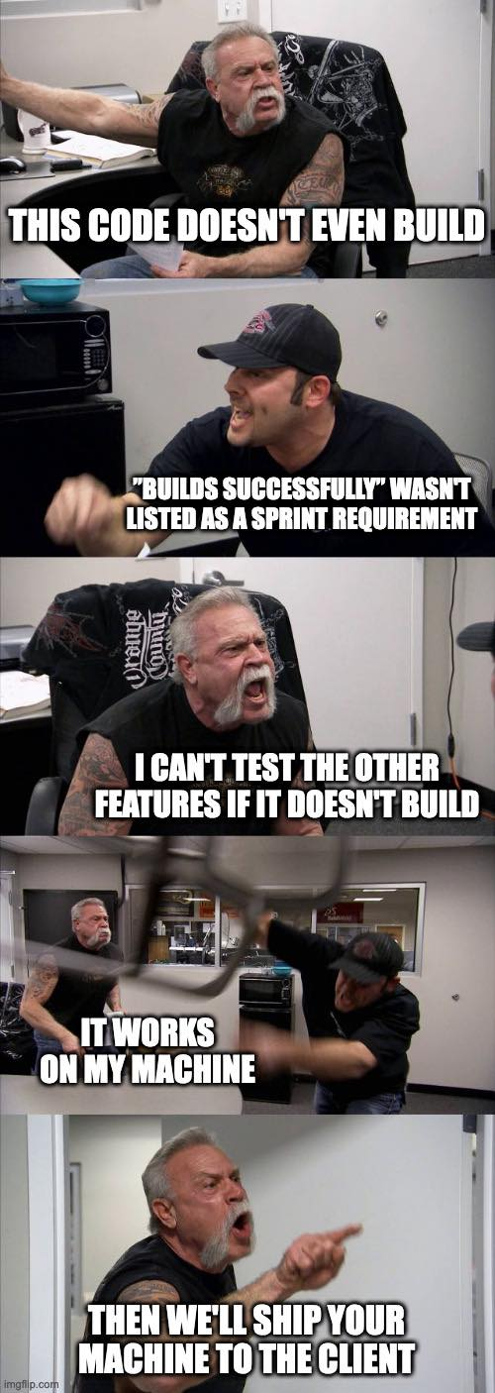
Why do we need containers?
The dependency hell and “it works on my machine”
2
Notes:
Ship your machine -> ships the virtual machine

Slide 3



Standardization, Orchestration, and Optimization
Solving the problem on a single machine:
Docker: Lightweight Linux containers for consistent development and deployment
Managing containers over a cluster:
Borg, Omega and Kubernetes
Ongoing challenges to improve scheduling efficiency over managed container clusters
Kubernetes scheduling: Taxonomy, ongoing issues and challenges
Merkel, D. (2014). Docker: Lightweight Linux containers for consistent development and deployment. Linux Journal, 2014(239), 2–9.
Burns, B., Grant, B., Oppenheimer, D., Brewer, E., & Wilkes, J. (2016). Borg, Omega, and Kubernetes. Communications of the ACM, 59(5), 50–57.
Carrión, C. (2022). Kubernetes scheduling: Taxonomy, ongoing issues and challenges. ACM Computing Surveys, 55(7), 1-37.
3

Slide 4
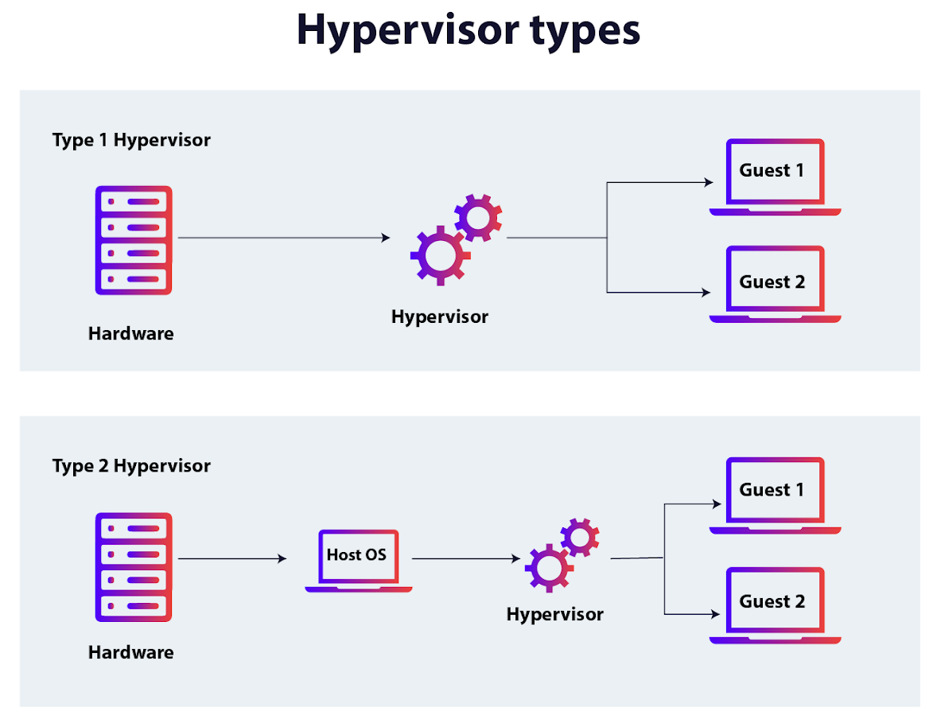
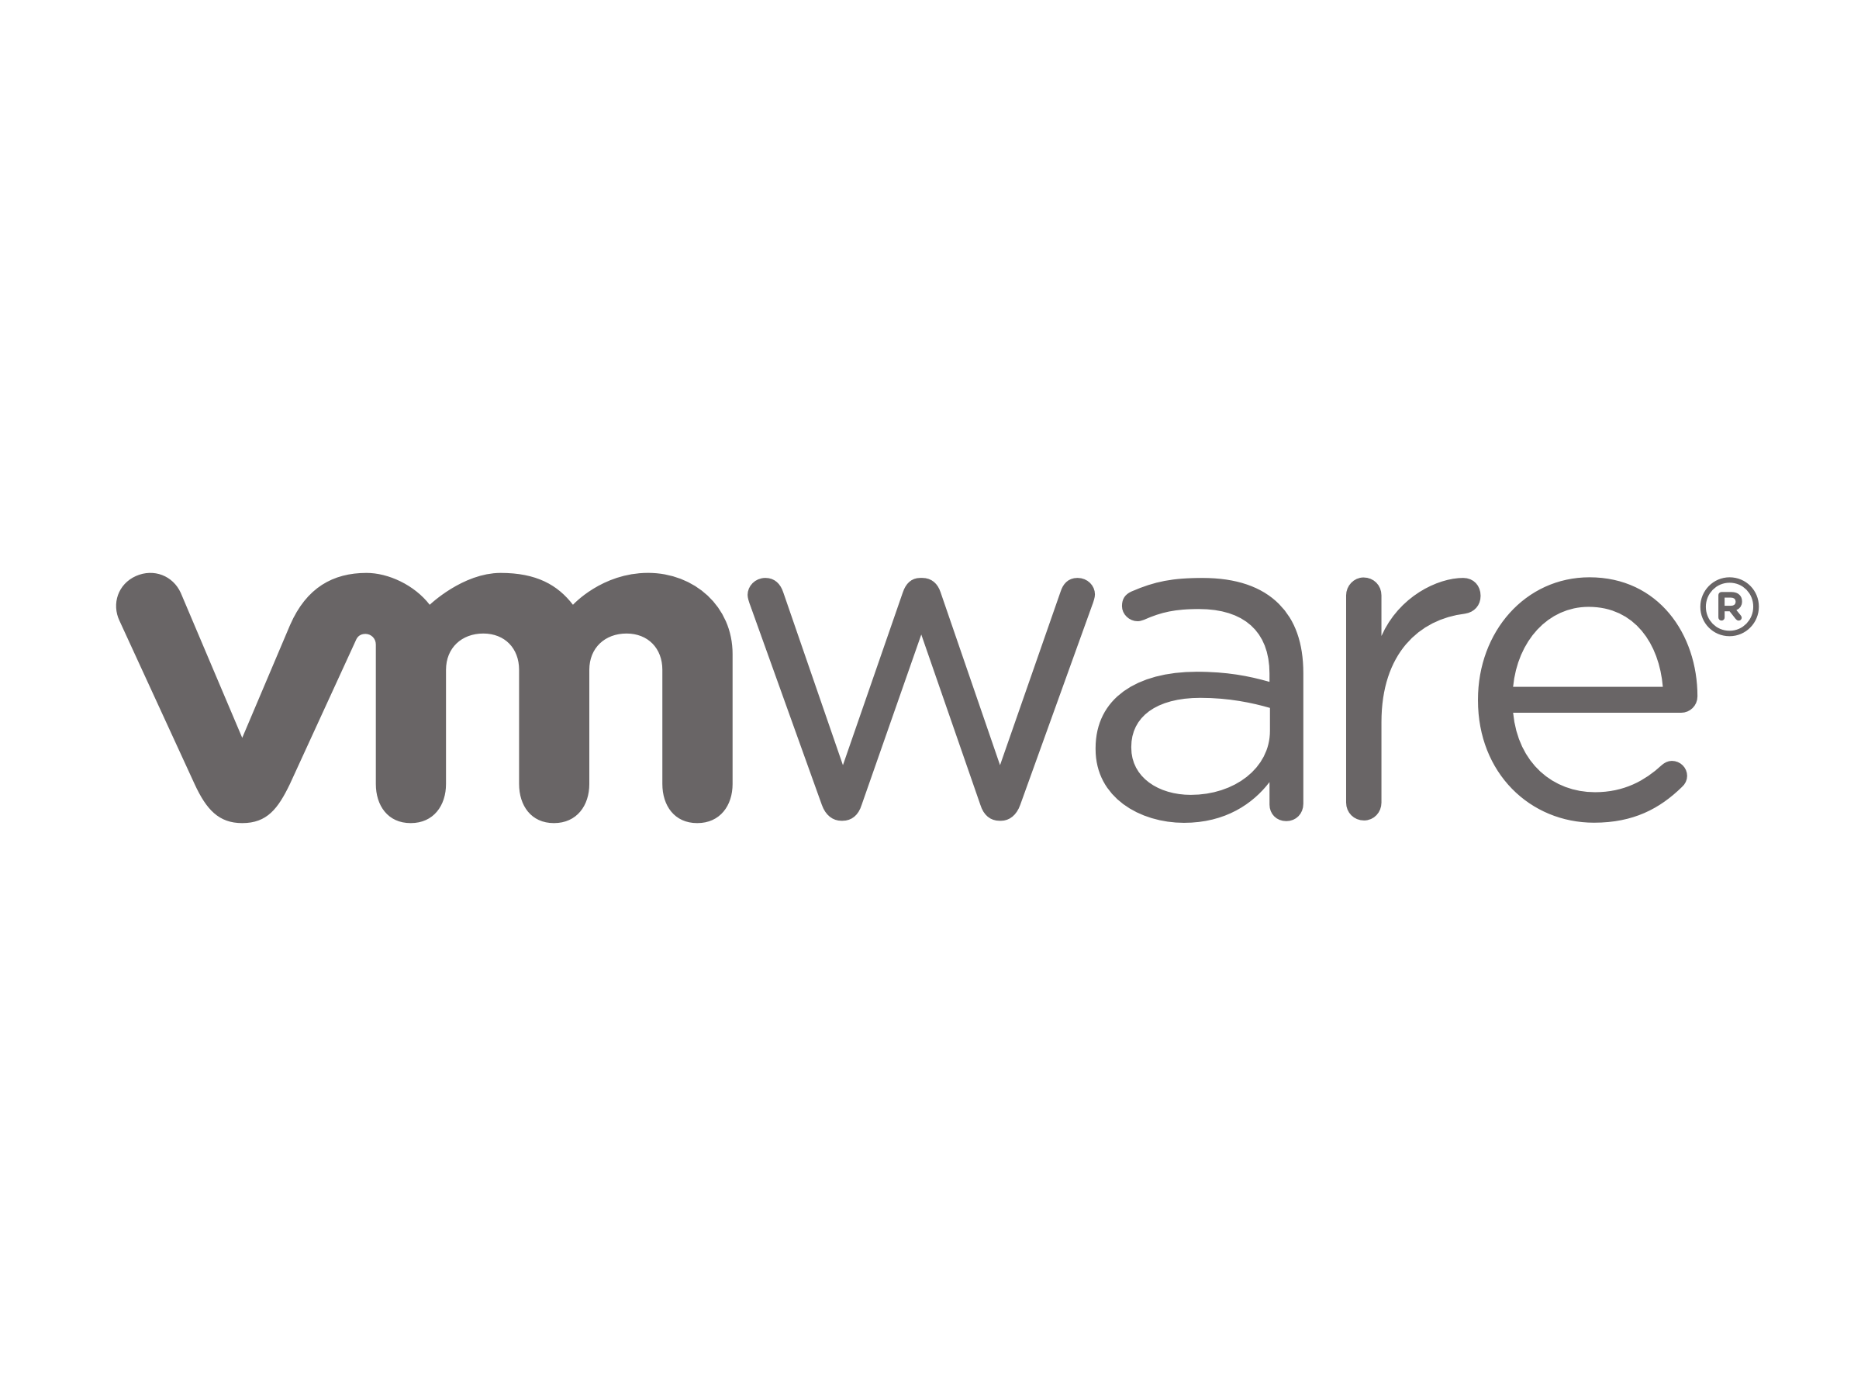

Containers vs. Virtual Machines
VM virtualizes the hardware
Stronger Isolation 🫣
Multiple VM = Multiple OS 🤯
Containers virtualizes the OS
Only one host OS needed 😀
Spin up and shutdown just like applications
Fig. A
Figure by AppViewX
Merkel, D. (2014). Docker: Lightweight Linux containers for consistent development and deployment. Linux Journal, 2014(239), 2–9.
4
Notes:
The easiest way to get away from dependency hell is running virtual machines with full isolation of dependencies
Hypervisors: make siloed slices of hardware available
type 1: runs directly on bare metal of the hw. eg. VMware ESX
type 2: runs as an additional layer of software within a guest os. Oracle VirtualBox, VMware Server
containers make available protected portions of the OS

Slide 5
Key Ingredients (by 2014 and v0.7)
LinuX Containers (LXC) for kernel-level namespace isolation
Control Groups (cgroup) for resource auditing and limiting
Advanced Multi-Layered Unification Filesystem (AuFS)
base image copy-on-write
versioning as diff of changes
Merkel, D. (2014). Docker: Lightweight Linux containers for consistent development and deployment. Linux Journal, 2014(239), 2–9.
5
Notes:
Namespace isolation: mnt, pid, network, interprocess, hostname, user, cgroup
Cgroup: a view of system resources like cpu and mem usage

Slide 6
Key Ingredients Updates
LXC -> containerd (daemon) / runc (low-level worker that handles namespaces and cgroups)
Dependency on another project
No longer specific to Linux
Open Container Initiative industry standard
AuFS -> overlay2 (OverlayFS)
Native to Linux Kernel
Copy-on-Write with less overhead
6

Slide 7
Bring Together Ingredients
Isolated namespaces tricks the process into thinking it has its own network and process tree
cgroups enforces limits on what the process can use
Union Filesystem provides an isolated, highly efficient root file system
On the user side:
Dockerfile → Docker Client (cli/desktop) → Docker Daemon (dockerd)
7

Slide 8
Milestone
Lightweight virtualization packaging and deployment of applications, on a single node
If the kernel goes down, containers won’t survive
How to deploy more containers across more servers for reliability?
Merkel, D. (2014). Docker: Lightweight Linux containers for consistent development and deployment. Linux Journal, 2014(239), 2–9.
8

Slide 9

e’s Road to K8s and lessons learned
Borg: Google’s first large-scale cluster management driven by growing demand
Omega: a principled offspring of Borg with better scheduling
Kubernetes: imperative vs declarative, decoupling and “Pods”
Burns, B., Grant, B., Oppenheimer, D., Brewer, E., & Wilkes, J. (2016). Borg, Omega, and Kubernetes. Communications of the ACM, 59(5), 50–57.
9
Notes:
Reference the paper and borg/omega/k8s’ own paper too maybe

Slide 10
e’s Reasoning on Containers
Better resource utilization = lower compute cost
Flexible reclaiming of idle resources
Easier and faster deployments of applications to consume reclaimed resources
Easier management over large clusters = lower maintenance cost
Application-oriented infra vs. machine-oriented
Improved reliability through automated monitoring and self-healing
Burns, B., Grant, B., Oppenheimer, D., Brewer, E., & Wilkes, J. (2016). Borg, Omega, and Kubernetes. Communications of the ACM, 59(5), 50–57.
10
Notes:
High-priority jobs often reserve more power than they use to handle spikes. Containers allow the system to "reclaim" that idle power and give it to batch processes.
Because the "unit of management" is the container, the system can easily spin up 100 more instances of an app across the fleet without the developer needing to worry about which specific machines have space or the right OS version.

Slide 11
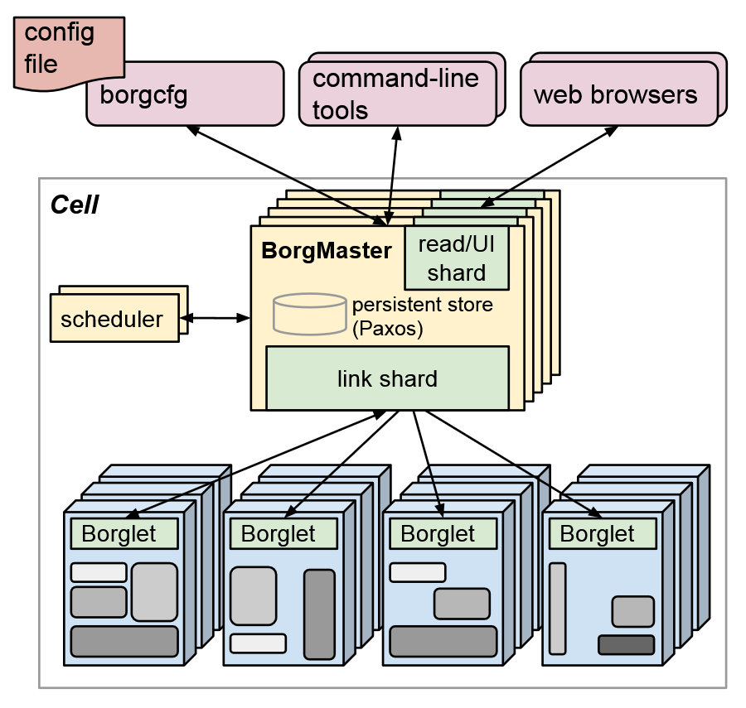
Borg: Architecture
Cell: collection of machines as a single unit
Borgmaster: centralized controller of a cell
Handles client requests
Maintains system state
Schedules tasks onto machines
Replicated for fault tolerance
Borglet: local agent on single machine (node)
Starts, stops, monitors tasks
Reports machine state back to Borgmaster
Fig. B
Fig. B: Figure 1, Abhishek Verma, Luis Pedrosa, Madhukar Korupolu, David Oppenheimer, Eric Tune, and John Wilkes. 2015. Large-scale cluster management at Google with Borg. In Proceedings of the Tenth European Conference on Computer Systems (EuroSys '15). Association for Computing Machinery, New York, NY, USA, Article 18, 1–17. https://doi.org/10.1145/2741948.2741964
11
Notes:
Large-scale cluster management at Google with Borg

Slide 12
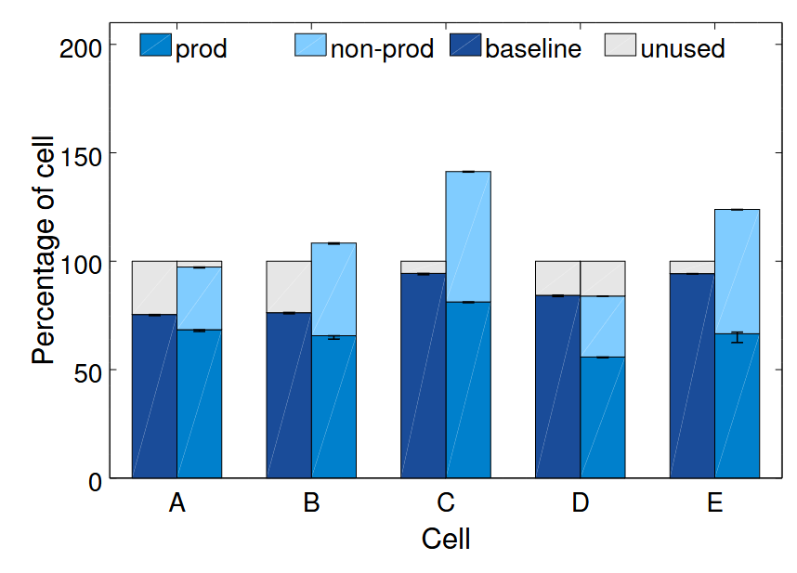
Borg: How it saves money
Actively mix two types of workloads:
Prod: latency-sensitive, high-priority, user-facing services
E.g. Google Search, Gmail
Non-Prod: lower-priority
E.g. MapReduce jobs
Monitoring of failures and automatic rescheduling
Fig. C
Fig. C: Figure 5a, Abhishek Verma, Luis Pedrosa, Madhukar Korupolu, David Oppenheimer, Eric Tune, and John Wilkes. 2015. Large-scale cluster management at Google with Borg. In Proceedings of the Tenth European Conference on Computer Systems (EuroSys '15). Association for Computing Machinery, New York, NY, USA, Article 18, 1–17. https://doi.org/10.1145/2741948.2741964
12
Notes:
Non-Prod jobs use up spare CPU and memory resources reserved for Prod jobs
Isolation, specifically resource management through cgroups
Percentage: number of machines that would be needed to run the workload in a single cell

Slide 13
Borg: Lessons
Problems:
Cannot manage a multi-job service as a single entity – burdens on the “user” side (developers)
DSL becomes too complex – slows down running new tasks
Takeaways:
Nested containers: outer ones manage resources, inner ones isolate environments
Master as “Kernel”: central core state manager as an API, other components can build on top of it
Deep visibility into the cluster for easier debugging when jobs didn’t run
Abhishek Verma, Luis Pedrosa, Madhukar Korupolu, David Oppenheimer, Eric Tune, and John Wilkes. 2015. Large-scale cluster management at Google with Borg. In Proceedings of the Tenth European Conference on Computer Systems (EuroSys '15). Association for Computing Machinery, New York, NY, USA, Article 18, 1–17. https://doi.org/10.1145/2741948.2741964
13
Notes:
The spec has about 230 params

Slide 14
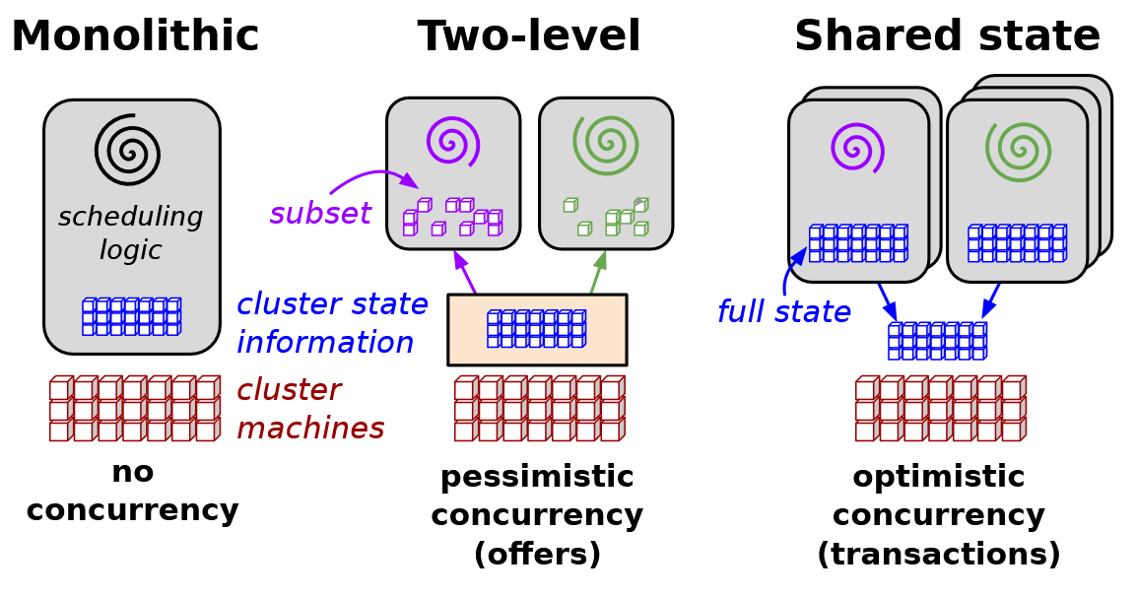
Omega: Design
The shift to shared-state scheduling and optimistic concurrency control
Independent and parallel schedulers for resource allocation:
Access to a private copy of full cluster state
Compete for available resources (optimistic)
In conflict:
Transaction fails
Scheduler resynchronize its state
Benefits:
Supports specialized schedulers
Better utilization of idle resources
Fig. D
Fig. D: Figure 1, Abd-El-Malek, M., & Wilkes, J. Omega: flexible, scalable schedulers for large compute clusters.
14
Notes:
Real world exp shows conflict rate is low

Slide 15
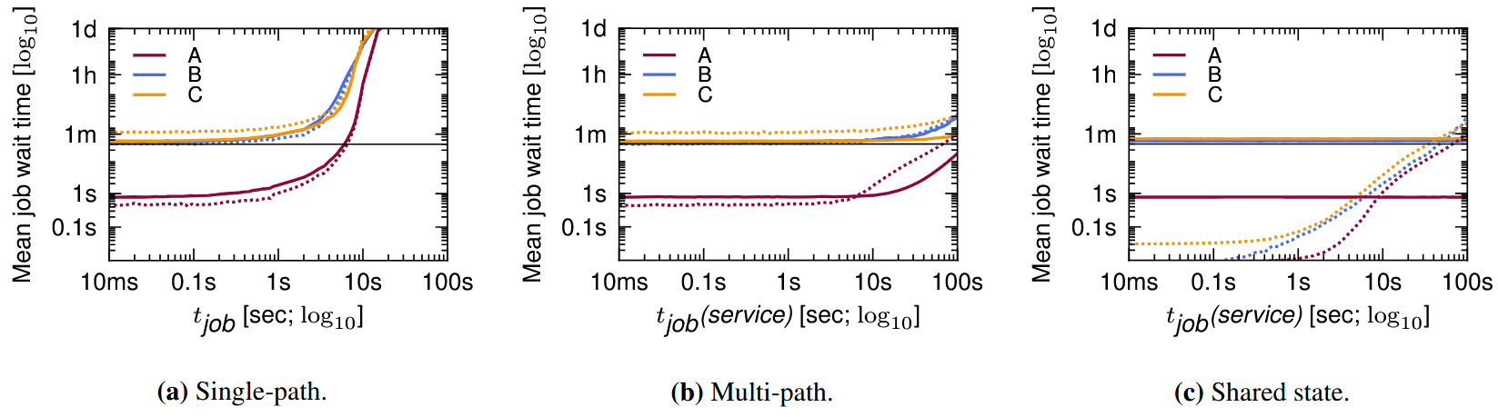
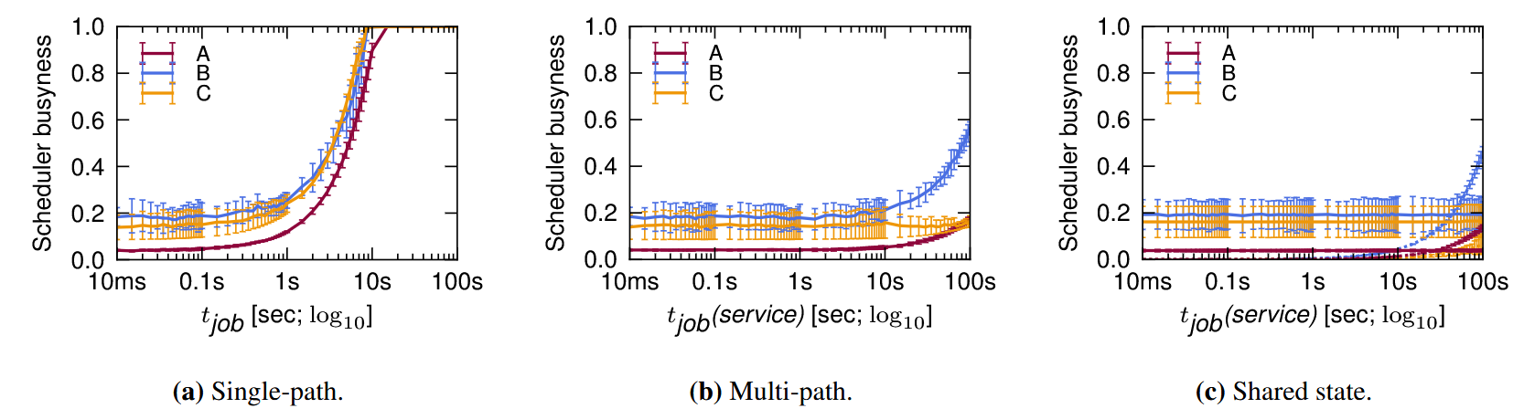
Omega: Experiments
Fig. E
Fig. E: Figure 5 and 6, Abd-El-Malek, M., & Wilkes, J. Omega: flexible, scalable schedulers for large compute clusters.
15
Notes:
Single path baseline: serial monolithic scheduler with the same decision time for batch and service jobs
Multi-path: monolithic scheduler with a fast code path for batch jobs, still schedules only one job at a time
Scheduler decision time = t_job (per job overhead) + time to place each task * number of tasks
Lines: batch jobs and service jobs (dashed)
Horizontal bar: service level objective
Single path: as long as the scheduling is quick (t_job is low), but scales linearly until a point where the scheduler cannot keep up, for both busyness and job waiting time
Multi path: both decrease, since the majority of tasks are batch jobs (they only vary service job t_job), but can still get stuck behind slower service job scheduling. Cannot scale
Omega (shared state): comparable with multi-path, and no more blocking since batch jobs and service jobs are independent

Slide 16
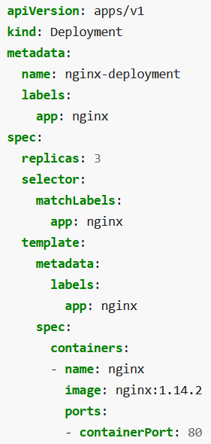
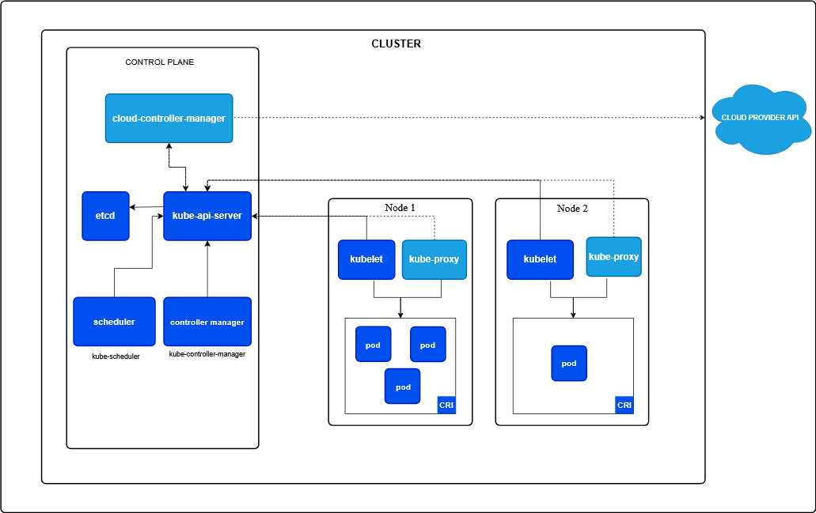
: the open-source synthesis
Built on top of Google’s lessons from Borg and Omega
Fig. F
Fig. F: Figure 1, https://kubernetes.io/docs/concepts/architecture/
16
Notes:
Control Plane as the brain:
Every components and the user talk to the kube-apiserver to get anything done
etcd: consistent, high-availability key-value storage that trakcs cluster state
kube-scheduler decides which Nodes each Pod should live on
kube-controller-manager: the logic behind the scene, runs the controller that regulate the system state (e.g. in charge of self-healing)
Worker Nodes as the muscle:
kubelet: agent on each node, ensures containers on indeed running on the pod as instructed
Container runtime: software that actually runs containers.
Pods: i.e. nested containers from Borg, manages the resources, then containers inside manages env and runs isolated processes
Kube-proxy: handles network rules on nodes, allow containers to talk to each other and the outside world

Slide 17
: declarative, and labels
Example deployment YAML
Fig. F
YAML: https://kubernetes.io/docs/concepts/workloads/controllers/deployment/
17
Notes:
You submit the yaml to the API server
The controller manager notices the state mismatch (0 vs 3 replica)
Scheduler finds healthy nodes with enough resources
Kubelet on the nodes pulls the image and launches pods
When node fails, automatic recreate pods on a different healthy node

Slide 18
e’s Updated View on Containers
On the Standardization side:
Containers should encapsulate ALL dependencies for full decoupling from host OS
Uniform API (Borg vs K8s)
On the Orchestration side:
Containers (the applications) as the primary “key” for load balancing / telemetry operations instead of the machines
Group related process together for better composability and robustness
Decoupling of manager components
Reconciliation control loops based on state monitoring and via autonomous collaboration between entities (instead of centralized monolithic orchestrator)
Burns, B., Grant, B., Oppenheimer, D., Brewer, E., & Wilkes, J. (2016). Borg, Omega, and Kubernetes. Communications of the ACM, 59(5), 50–57.
18
Notes:
Now we have the base problem “solved”, we can continue to improve the efficiency of such systems

Slide 19
Kubernetes Scheduling: Taxonomy, Ongoing Issues, and Challenges
We need more than a scheduler that “finds empty nodes” for tasks
Quality of Service (QoS)
Latency
Resource utilization
Energy consumption, etc.
Fig. G
Burns, B., Grant, B., Oppenheimer, D., Brewer, E., & Wilkes, J. (2016). Borg, Omega, and Kubernetes. Communications of the ACM, 59(5), 50–57.
19

Slide 20
Kubernetes Scheduling: Ongoing Issues with the default schedulers
Resource Fragmentation
The default greedy, pod-by-pod allocation strategy leads to suboptimal bin-packing and wasted capacity across the cluster
The “Computing Continuum”
Assumption of a homogeneous cloud environment does not hold in Edge/Fog computing where network bandwidth, location and device capabilities vary wildly
Overhead of Complex Solvers:
Exact mathematical solvers provide optimal placements, but too slow for large-scale, highly dynamic clusters.
Asynchronous Communication Gaps:
Loosely coupled K8s API can lead to temporary “Denial of Resources” when the scheduler act on stale node-availability data
Burns, B., Grant, B., Oppenheimer, D., Brewer, E., & Wilkes, J. (2016). Borg, Omega, and Kubernetes. Communications of the ACM, 59(5), 50–57.
20
Notes:
Bin packing: you have a set of items, each with a a specific weight of size, and a collection of bins with a fixed capacity. The goal is to pack every item into the fewest number of bins possible. NP-hard

Slide 21
Kubernetes Scheduling: Taxonomy of existing scheduling techniques
A multi-dimensional taxonomy:
By Objective: optimizing for resource utilization, energy efficiency, latency, or cost reduction
By Workload Type: general microservices, AI/ML training, data-heavy batch jobs, or IoT/Edge deployments
By Architectural Integration: utilizing K8s extension points, building custom external schedulers, or running multiple schedulers in parallel
By Algorithm: greedy, heuristics, constraint solvers, or ML/RL-based
Burns, B., Grant, B., Oppenheimer, D., Brewer, E., & Wilkes, J. (2016). Borg, Omega, and Kubernetes. Communications of the ACM, 59(5), 50–57.
21

Slide 22
Examples: Workload Type & Architectural Integration
AI/ML training and big data workloads require “all-or-nothing” execution
If a model needs 8 GPUs to run, starting the job with only 2 wastes time and money
Kube-batch & Volcano implement “Gang Scheduling”:
Queue and group interdependent pods together
Volcano added better GPU support for AI tasks
Burns, B., Grant, B., Oppenheimer, D., Brewer, E., & Wilkes, J. (2016). Borg, Omega, and Kubernetes. Communications of the ACM, 59(5), 50–57.
22

Slide 23
Examples: Architectural Integration & Algorithm
Default scheduler scores nodes individually – not scalable to thousands of nodes
Poseidon integrates Firmament, a graph-based scheduling engine
The whole cluster as a flow network graph
Instead of pod-by-pod scoring, a Min-Cost Max-Flow algorithm is run once
Mathematically optimal placements at massive scale
Burns, B., Grant, B., Oppenheimer, D., Brewer, E., & Wilkes, J. (2016). Borg, Omega, and Kubernetes. Communications of the ACM, 59(5), 50–57.
23

Slide 24
Examples: Workload Type & Algorithm
Static rules of traditional schedulers cannot adapt to highly dynamic environments
E.g. Cloud-to-Edge Continuum: network bandwidth and node availability change unpredictably
RLSK: Job scheduler driven by Reinforcement Learning
Predict future resource contention and migrate or schedule pods proactively
Burns, B., Grant, B., Oppenheimer, D., Brewer, E., & Wilkes, J. (2016). Borg, Omega, and Kubernetes. Communications of the ACM, 59(5), 50–57.
24

Slide 25
Kubernetes Scheduling: Challenges and future directions
AI-Driven Orchestration:
From static rules to predictive scheduling that anticipates workload spikes and node failures
Holistic Metrics:
Expanding scheduling criteria beyond simple CPU/Memory requests to include network I/O, storage performance and carbon footprint metrics
Federated Scheduling
Cross-cluster and multi-cloud scheduling to manage workloads across the globe
Burns, B., Grant, B., Oppenheimer, D., Brewer, E., & Wilkes, J. (2016). Borg, Omega, and Kubernetes. Communications of the ACM, 59(5), 50–57.
25
Notes:
DLSS…

Slide 26
Kubernetes Scheduling: Takeaways
Kubernetes has a highly extensible arch
But out-of-box scheduling is insufficient for highly specialized, heterogeneous, or massive-scale environments
Customizing the scheduler involves trade-offs between decision speed (throughput) and placement quality (efficiency)
Burns, B., Grant, B., Oppenheimer, D., Brewer, E., & Wilkes, J. (2016). Borg, Omega, and Kubernetes. Communications of the ACM, 59(5), 50–57.
26

Slide 27
Standardization, Orchestration, and Optimization
Solving the problem on a single machine:
Docker: Lightweight Linux containers for consistent development and deployment
Managing containers over a cluster:
Borg, Omega and Kubernetes
Ongoing challenges to improve scheduling efficiency over managed container clusters
Kubernetes scheduling: Taxonomy, ongoing issues and challenges
Merkel, D. (2014). Docker: Lightweight Linux containers for consistent development and deployment. Linux Journal, 2014(239), 2–9.
Burns, B., Grant, B., Oppenheimer, D., Brewer, E., & Wilkes, J. (2016). Borg, Omega, and Kubernetes. Communications of the ACM, 59(5), 50–57.
Carrión, C. (2022). Kubernetes scheduling: Taxonomy, ongoing issues and challenges. ACM Computing Surveys, 55(7), 1-37.
27

Slide 28
References
Merkel, D. (2014). Docker: Lightweight Linux containers for consistent development and deployment. Linux Journal, 2014(239), 2–9.
Burns, B., Grant, B., Oppenheimer, D., Brewer, E., & Wilkes, J. (2016). Borg, Omega, and Kubernetes. Communications of the ACM, 59(5), 50–57.
Carrión, C. (2022). Kubernetes scheduling: Taxonomy, ongoing issues and challenges. ACM Computing Surveys, 55(7), 1-37.
Abhishek Verma, Luis Pedrosa, Madhukar Korupolu, David Oppenheimer, Eric Tune, and John Wilkes. 2015. Large-scale cluster management at Google with Borg. In Proceedings of the Tenth European Conference on Computer Systems (EuroSys '15). Association for Computing Machinery, New York, NY, USA, Article 18, 1–17.
Malte Schwarzkopf, Andy Konwinski, Michael Abd-El-Malek, and John Wilkes. 2013. Omega: flexible, scalable schedulers for large compute clusters. In Proceedings of the 8th ACM European Conference on Computer Systems (EuroSys '13). Association for Computing Machinery, New York, NY, USA, 351–364.
28

