Slide 1
From MicroVMs to Userspace MicroKernels Rethinking Isolation Boundaries in Cloud-Native Systems 2026.04.16
Cheng Li
School of Data Science
Chinese University of Hong Kong, Shenzhen
Notes:
Good afternoon everyone, My name is Li Cheng, and my topic for today’s presentation is: From MicroVMs to Userspace MicroKernels: Rethinking Isolation Boundaries in Cloud-Native Systems.

Slide 2
Outline
Introduction
Background & Motivation
Proposed Methods & Performance Evaluation
Firecracker
SURE
LITESHIELD
Conclusions
Q & A
Notes:
This is today’s outline and I will analyze 3 papers about this topic: the Firecracker, the SURE and the LITESHIELD.

Slide 3
Outline
Introduction
Background & Motivation
Proposed Methods & Performance Evaluation
Firecracker
SURE
LITESHIELD
Conclusions
Q & A
Notes:
So lets first move on to the introduction.

Slide 4
1.Introduction
Mainstream Technologies in Taday’s Cloud-Native Stack
Virtual Machines
Containers
Kubernetes / orchestration
Microservices
Serverless / FaaS
Monoliths
Microservices
FaaS
Notes:
Lets briefly review the mainstream cloud-native stack first.
In practice, today’s cloud platforms combine virtual machines, containers, orchestration frameworks, microservices, and serverless execution.
They are rarely built from just one abstraction. Instead, they are layered systems.
At the lower level we still have hardware, virtualization, and virtual machines. On top of that we have containers and container runtimes. Then orchestration systems such as Kubernetes which manage deployment and scaling. At the application level, many systems are built as microservices, and some of these workloads are expressed through serverless or Function-as-a-Service platforms.

Slide 5
Outline
Introduction
Background & Motivation
Proposed Methods & Performance Evaluation
Firecracker
SURE
LITESHIELD
Conclusions
Q & A
Notes:
Then we move on to the next part: backgroud and motivation.

Slide 6
2.Backgroud & Motivation (1/3)
Cloud-Native System Targets
Cloud-native systems want strong isolation, fast startup, high density, and low latency
Traditional solutions force tradeoffs between security and efficiency
Central question: where should isolation boundaries be defined to achieve better security and efficiency?
Strong Isolation
Fast Startup
Low Latency
High Density
Notes:
In cloud-native systems, the ideal isolation substrate needs to satisfy several requirements at the same time.
It must provide strong isolation for multi-tenancy, fast startup for elastic scale-out, high density for cost efficiency, and low-latency communication for microservice chains.
But in reality, these goals often conflict with one another.
Traditional solutions force tradeoffs between security and efficiency, so there is a central question: where should isolation boundaries be defined to achieve better security and efficiency?

Slide 7
2.Background & Motivation (2/3)
How Serverless and Microservices Were Commonly Built
Functions and services were commonly built in containers
In public clouds, containers were often further protected by VMs
Communication relied on kernel networking and virtual switches
The combined overhead becomes significant
Client
VM Boundary
Service A
App
Service B
DB
Service C
...
Kernel Networking / TCP/IP Stack / vSwitch
Notes:
A very common pattern in cloud-native systems was the following: services or functions were packaged in containers, and in public clouds those containers were often placed inside VMs for stronger tenant isolation. Communication between services relied on traditional kernel networking.
This deployment model made a lot of sense historically. Containers were lightweight and easy to manage, while virtual machines gave stronger isolation. But the downside is that once a request travels through a chain of functions or microservices, it repeatedly crosses many software layers.
So there is a problem that not any single mechanism is bad. The problem is composition. Cloud-native systems compose many individually reasonable mechanisms, but the combined overhead becomes significant.

Slide 8
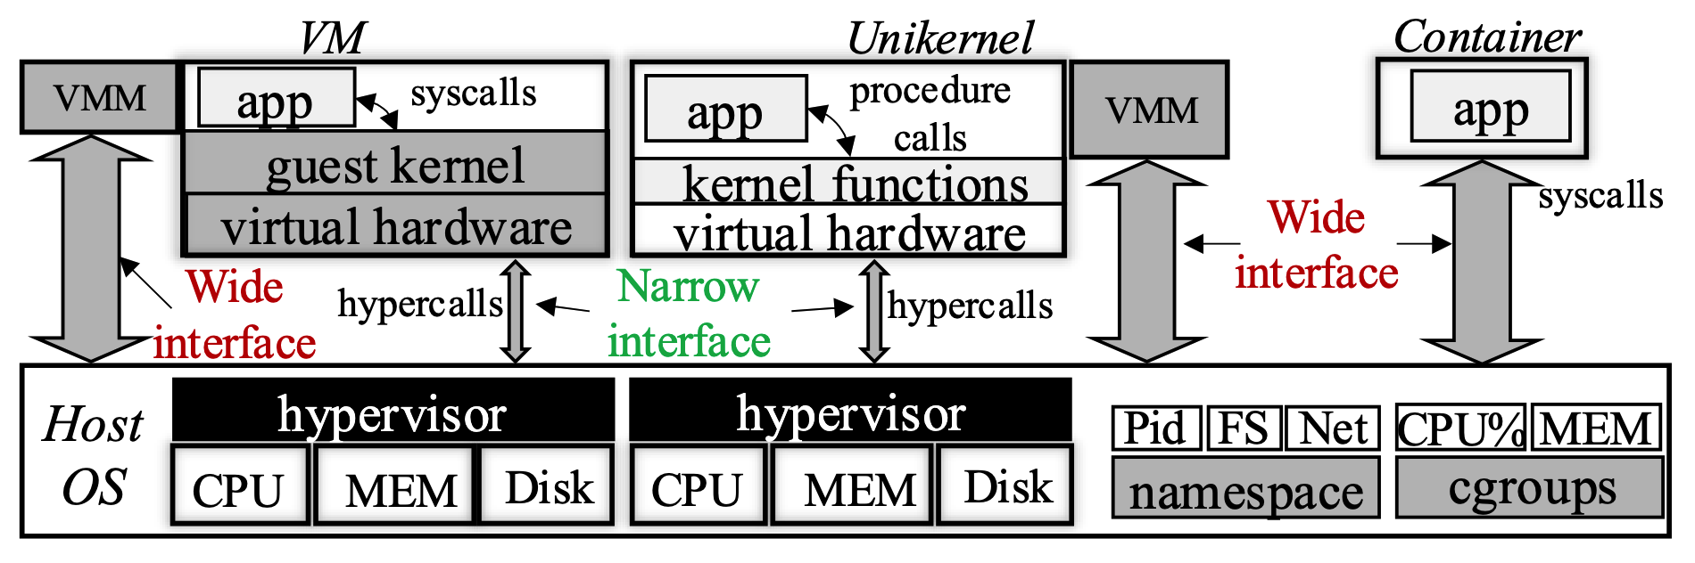
2.Background & Motivation (3/3)
Security Perspective
Containers are lightweight, but expose a wide host-kernel interface
Syscall filtering improves security, but reduces compatibility
VMs provide stronger isolation, but increase the TCB
Unikernels reduce footprint, but raise single-address-space concerns
Fig 1. Comparisons of three representative isolation architectures
Notes:
From a security perspective, existing cloud-native systems already faced a series of difficult tradeoffs.
Containers are lightweight, but they rely on a shared host kernel, which means the host-kernel interface becomes part of the attack surface. Syscall filtering and similar techniques can shrink that surface, but they often create compatibility problems because it is difficult to know in advance exactly which syscalls a real application needs.
Virtual machines solve part of this problem by moving the isolation boundary to a hardware virtualization layer. That gives a stronger security boundary, but the trusted computing base becomes larger because we need to keep guest kernels, hypervisors, and device emulation logic. Unikernels can reduce footprint and simplify the guest side, but then another problem appears: because everything lives in one address space, internal isolation becomes harder.

Slide 9
Outline
Introduction
Background & Motivation
Proposed Methods & Performance Evaluation
Firecracker
SURE
LITESHIELD
Conclusions
Q & A
Notes:
To address these problems, lets start with firecracker.

Slide 10
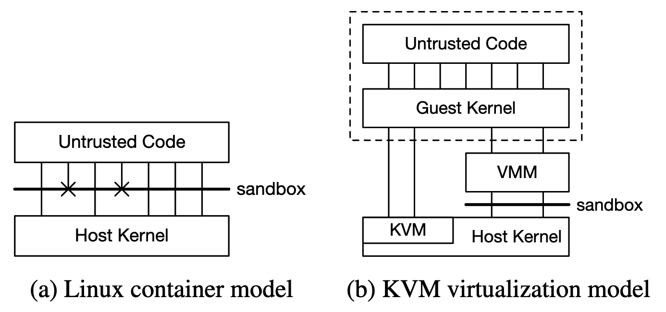
3.1 Firecracker (1/4)
Firecracker: Making VM Isolation Practical for Serverless
Strong isolation is needed for public serverless
Containers expose a security-compatibility tradeoff
Firecracker targets:
isolation
density
performance
compatibility
fast switching
soft allocation
Fig 2. The security model of Linux containers and KVM-style virtualization
Notes:
Firecracker starts from a production problem rather than a purely academic one. It was designed by AWS to support running large numbers of serverless workloads from many customers on shared hardware, without accepting the security limitations of plain containers.

Slide 11
3.1 Firecracker (1/4)
Firecracker: Making VM Isolation Practical for Serverless
Strong isolation is needed for public serverless
Containers expose a security-compatibility tradeoff
Firecracker targets:
isolation
density
performance
compatibility
fast switching
soft allocation
Large Attack Surface
Fig 2. The security model of Linux containers and KVM-style virtualization
Notes:
The paper argues that containers force a difficult tradeoff: if we restrict the kernel interface for security, we risk breaking compatibility with real applications; if we keep compatibility broad, we expose a larger attack surface.

Slide 12
3.1 Firecracker (1/4)
Firecracker: Making VM Isolation Practical for Serverless
Strong isolation is needed for public serverless
Containers expose a security-compatibility tradeoff
Firecracker targets:
isolation
density
performance
compatibility
fast switching
soft allocation
Large Attack Surface
Heavyweight Virtualization
Fig 2. The security model of Linux containers and KVM-style virtualization
Notes:
And Firecracker does not present virtualization as an academic preference. It presents virtualization as the practical way to get both strong isolation and broad compatibility. But the challenge is that traditional virtualization is too heavy for serverless. So Firecracker’s real goal is to make virtual machines practical for serverless to achieve stronger isolation and better performance.

Slide 13
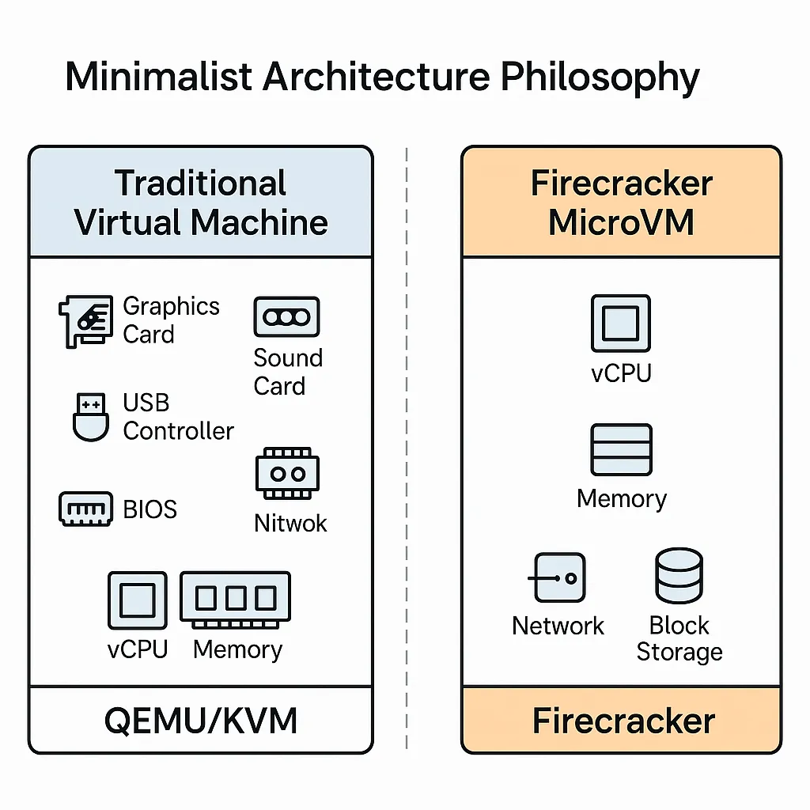
3.1 Firecracker (2/4)
Design Philosophy: Keep KVM, Replace QEMU
Keep hardware-assisted virtualization via KVM
Replace QEMU with a minimalist VMM
One process per MicroVM
Specialization over feature completeness
Firecracker supports
virtio net, virtio block, serial, REST API
Firecracker excludes
BIOS, PCI, legacy devices, VM migration
Fig 3. Philosophy of minimal virtualization
Notes:
The design philosophy of Firecracker is highly deliberate. It keeps KVM (Kernel-based virtual machine) because KVM gives a mature and hardware virtualization substrate. What it rejects is the idea that a serverless platform should depend on a large, feature-complete VMM (Virtual Machine Monitor) like QEMU. So Firecracker replaces QEMU with a much smaller implementation focused only on the features needed for container and serverless workloads.
Firecracker is not merely an optimization of existing virtualization. It is a statement that specialization can be a security strategy and a performance strategy at the same time. By implementing much less, Firecracker both reduces attack surface and shortens the path to fast startup and low memory overhead.
Firecracker is notable not only for what it includes, but for what it refuses to include. It supports only a very small set of devices and features that are relevant to typical serverless workloads. It excludes BIOS support, PCI, legacy device emulation, and VM migration.

Slide 14
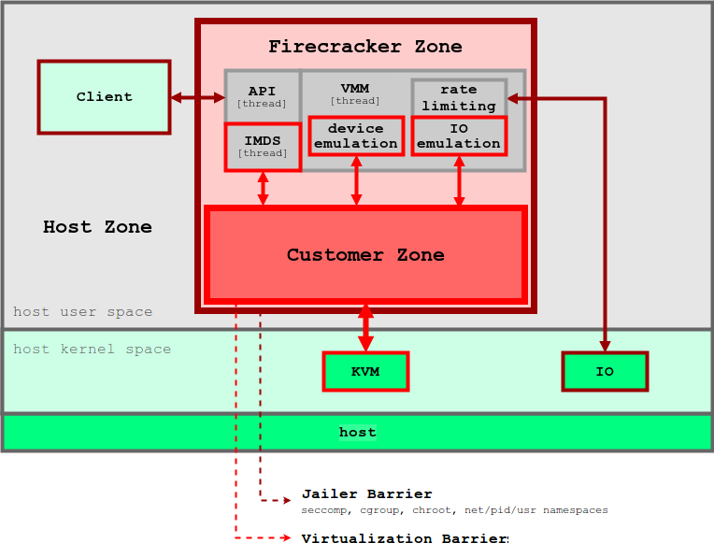
3.1 Firecracker (3/4)
Firecracker inside AWS Lambda
The MicroVM becomes the slot-level security boundary
Each workers runs many MicroVM-based slots
A MicroManager controls Firecracker processes
Slot reuse and pre-booted pools reduce scale-up cost
Fig 4. Firecracker architecture
Notes:
This is where Firecracker becomes especially convincing, because the paper does not stop at the VMM design. It shows how Firecracker is used inside AWS Lambda. Each MicroVM effectively becomes the slot-level security boundary. Workers can run many MicroVM-based slots, and the surrounding system manages placement, slot reuse, and a pool of pre-booted MicroVMs.
What I think is important here is that Firecracker is not presented as a standalone research prototype. It is a production isolation primitive. That matters because it changes how we interpret its design decisions. For example, the REST API and the one-process-per-VM model are not just engineering choices; they reflect operational priorities like lifecycle control and safe integration into a large-scale serverless control plane.

Slide 15
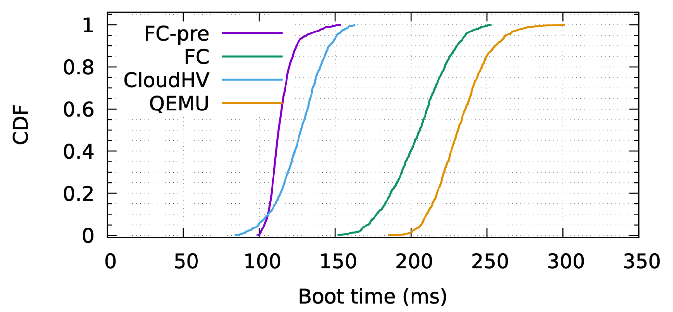
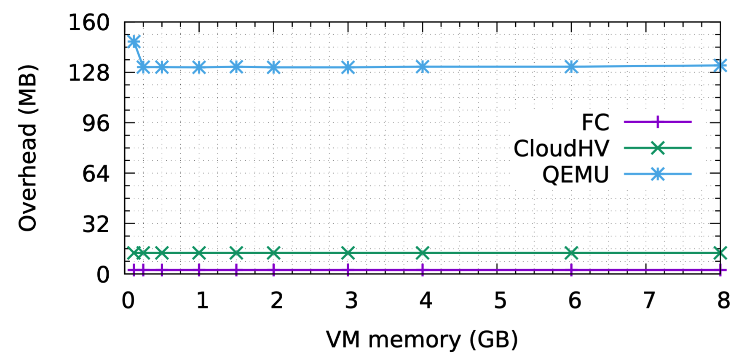
3.1 Firecracker (4/4)
Key Results and Takeaway
< 5 MB memory overhead
< 125 ms boot to application node
150 MicroVM/s per host
Used in Lambda and Fargate in production
Fig 5. Firecracker performance
Notes:
The results explain why Firecracker had such a strong impact. The paper reports less than five megabytes of memory overhead, boot to application code in less than 125 milliseconds, and up to 150 MicroVM creations per second per host. These numbers show that virtualization can become light enough to participate in serverless-scale operations. The paper also makes it clear that Firecracker is already used in Lambda and Fargate in production, which gives the evaluation additional practical weight.
My takeaway is that Firecracker solves the first major problem in this space: it makes virtual machine isolation practical enough that public serverless platforms do not have to choose between strong isolation and usable efficiency. At the same time, I would also say that Firecracker mainly solves the outer sandbox problem. It does not yet solve the communication path or the internal trust structure inside the sandbox. That is exactly where SURE begins.

Slide 16
Outline
Introduction
Background & Motivation
Proposed Methods & Performance Evaluation
Firecracker
SURE
LITESHIELD
Conclusions
Q & A
Notes:
Then we move on to the SURE, which means Secure Unikernels that are Rapid and Efficient.

Slide 17
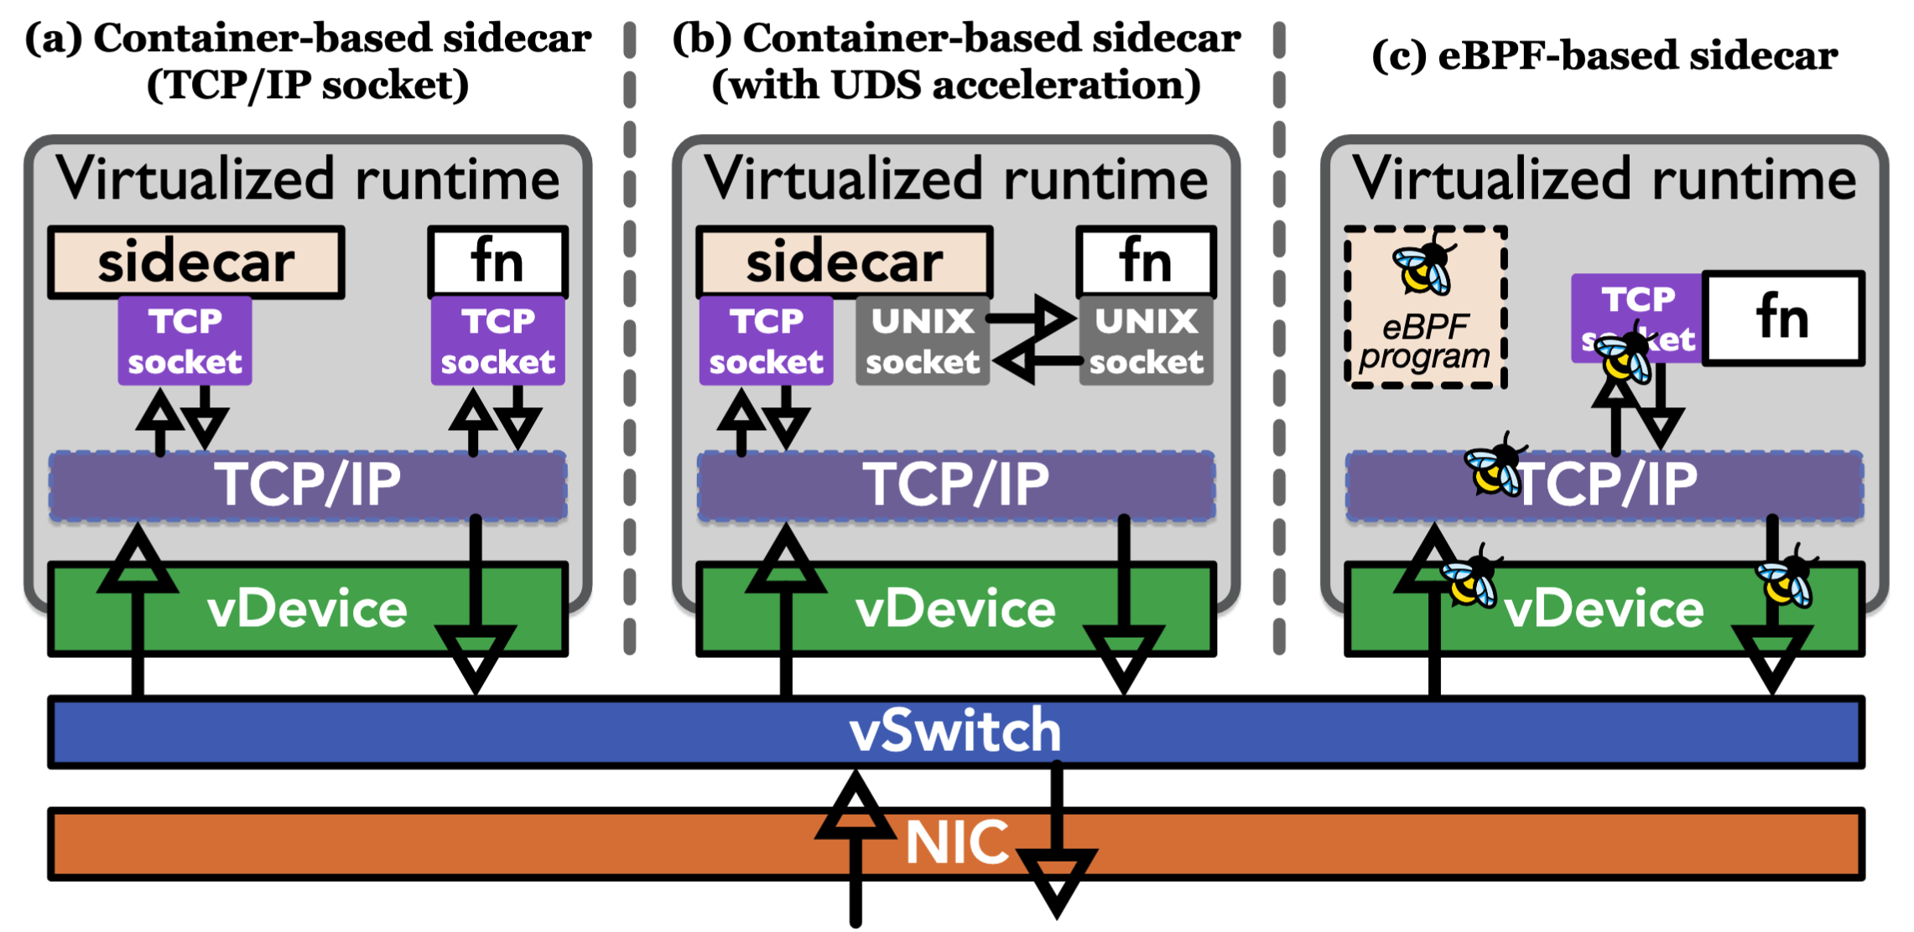
3.2 SURE (1/6)
SURE Starts From
Current serverless platforms still suffer from:
cold starts
kernel-based inter-function networking
heavyweight sidecars
insufficient intra-unikernel isolation
A naive unikernel alone is not enough
Fig 6. An abstract diagram of serverless support for loosely coupled microservices
Notes:
SURE shifts the focus to a different bottleneck. Its argument is that even if we make the sandbox lightweight, serverless systems still suffer from major overhead in the communication path. Cold starts remain important, but it is no longer the whole story. Kernel-based inter-function networking is still expensive and heavyweight sidecars still add overhead. And if we use a unikernel, we also have to deal with the fact that trusted runtime components and user code may live in the same address space.
It says that serverless efficiency depends on the entire runtime and data-plane design.

Slide 18
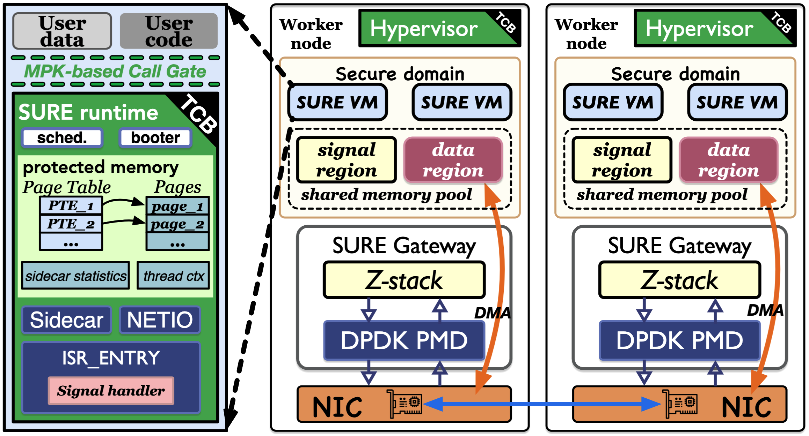
3.2 SURE (2/6)
SURE System Overview
One function = one SURE VM
Distributed zero-copy communication
SURE gateway for consolidated protocol processing
Library-based sidecar
MPK-based call gate (Intel’s Memory Protection Keys)
Fig 7. SURE architecture
Notes:
This slide shows the overall architecture of SURE. Each function runs as an individual unikernel-based VM, which means SURE still preserves a VM-style function-level sandbox. But unlike a simple unikernel approach, SURE redesigns almost everything around the function. It adds a distributed zero-copy data plane, a per-node gateway, a library-based sidecar, and MPK-based call gates to protect sensitive runtime components and data.
SURE does not abandon strong external isolation. It still uses a VM-based boundary for each function. But inside and around that boundary, it optimizes the communication and control path. This is what makes SURE interesting: it is not choosing between security and performance. It is trying to co-design them.

Slide 19
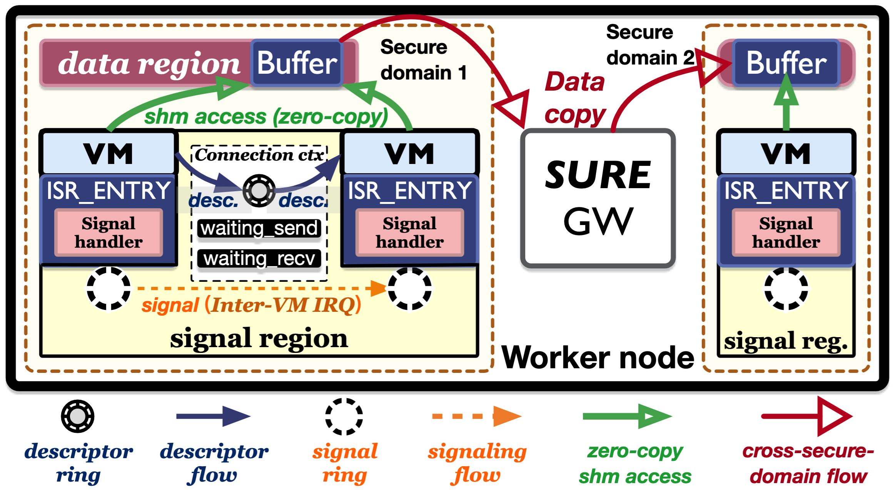
3.2 SURE (3/6)
Distributed Zero-Copy Data Plane
Intra-node: shared-memory zero-copy communication
Cross-domain on the same node: gateway-mediated transfer
Cross-node: Z-stack + SURE gateway
Reliable delivery with connection contexts, descriptor rings, signaling rings, and back-pressure
Fig 8. Intra-node data plane in SURE
Notes:
This is one of the central technical ideas in SURE. When two functions are co-located and trusted, SURE uses shared memory to enable zero-copy communication. When communication crosses security domains or nodes, the SURE gateway mediates the transfer, and Z-stack extends the design into userspace TCP/IP processing. The system also adds connection contexts, signaling rings, and back-pressure to support reliable and ordered communication.
SURE is not satisfied with an intra-node optimization. Many previous designs make zero-copy communication look impressive, but only within one machine. SURE argues that real cloud-native workloads are distributed and that cross-node communication cannot be ignored. So it tries to extend zero-copy thinking beyond the node boundary.

Slide 20
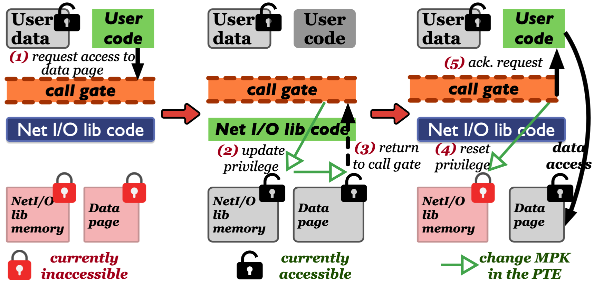
3.2 SURE (4/6)
Rethinking Isolation Inside the Unikernel
Unikernels remove the kernel-userspace boundary
But trusted runtime modules and user code share one address space
SURE uses Intel MPK to protect:
shared-memory pages
sidecar state
sensitive TCB components
MPK-based call gates provide controlled access
Fig 9. Secure isolation in SURE
Notes:
This is security part of SURE. Unikernels are fast because they eliminate the conventional kernel-userspace boundary, but the downside is that trusted components of the runtime and untrusted user code share the same address space. SURE uses Intel MPK to protect sensitive memory pages and introduces call gates so that user code can interact with protected runtime functionality in a controlled way.

Slide 21
3.2 SURE (5/6)
MPK-Based Call Gate for Safe Buffer Access in SURE
User code cannot directly access protected data pages
A request to access a shared-memory buffer must go through the MPK-based call gate
The call gate temporarily enables privileged access
The runtime then retags the corresponding data page
After the request is served, privileged access is revoked
Fig 9. Secure isolation in SURE
Notes:
SURE’s MPK isolation is not just a lightweight memory-protection trick. It is a full execution protocol inside the unikernel. When user code is running, all protected pages are inaccessible. If user code needs to access privileged runtime functionality, such as NetIO library, it must go through an MPK-based call gate. The call gate temporarily enables access to protected pages, switches execution to a protected stack, and invokes the privileged TCB function. If a message buffer is transferred to the user, SURE does not copy the data. Instead, it dynamically retags the corresponding page from protected to unprotected by updating the MPK key in the page table entry. After returning to user mode, protected memory is locked again, but the transferred buffer remains accessible.

Slide 22
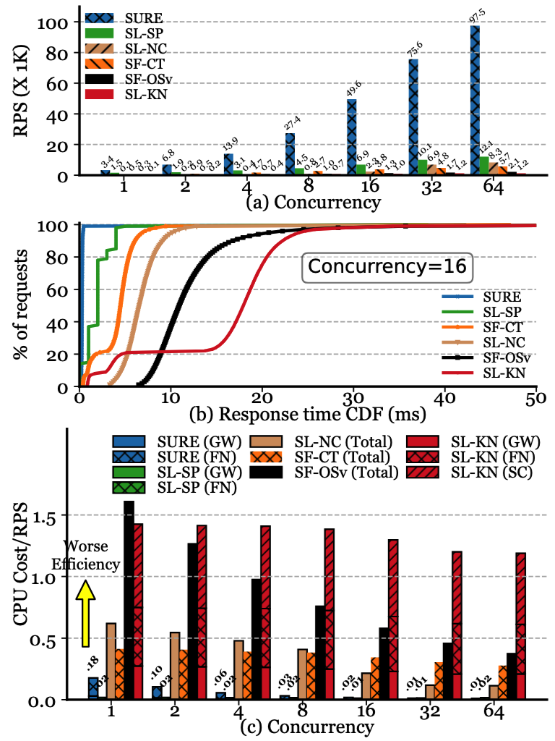
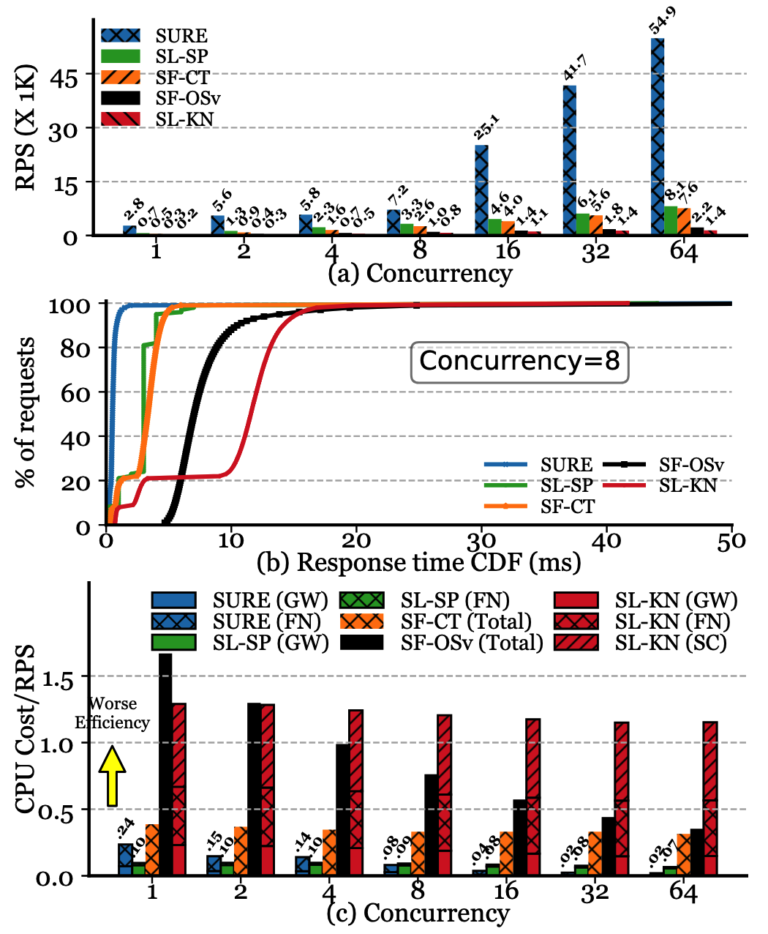
3.2 SURE (6/6)
Performance
Low-tens-of-microseconds intra-node latency
Strong throughput scaling under concurrency
> 100 ×️ CPU-cycle savings
16 ×️ improvements over individual sidecars
Up to 79 x throughput improvement over Knative
Fig 10. SURE performance
Notes:
These results show that SURE’s ideas are not just architectural abstractions. The paper reports low tens-of-microseconds latency for intra-node communication, better throughput scaling under concurrency, more than 100 times CPU-cycle savings, and a 16 times improvement relative to an individual userspace sidecar. At the application level, it reports up to 79 times throughput improvement over Knative, which is a serverless framework based on Kubernetes.
I think the right way to interpret these numbers is not simply ‘SURE is faster’. The deeper point is that the data plane and the service-mesh path can dominate serverless performance. Once those parts are redesigned, the gains can be dramatic.

Slide 23
Outline
Introduction
Background & Motivation
Proposed Methods & Performance Evaluation
Firecracker
SURE
LITESHIELD
Conclusions
Q & A
Notes:
Then we move on to the last paper: LITESHIELD.

Slide 24
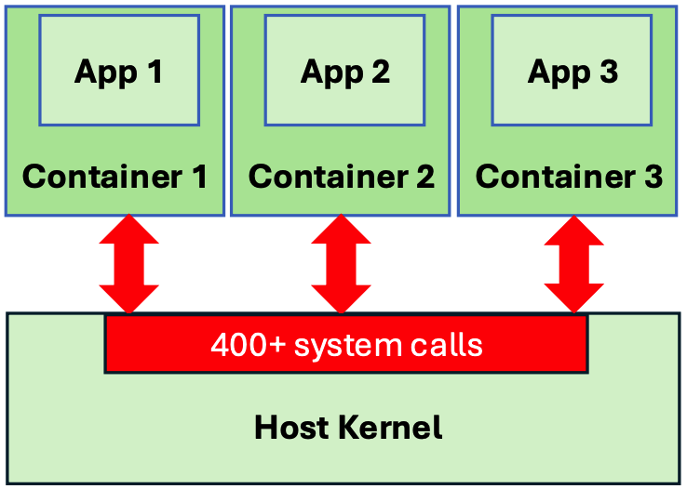
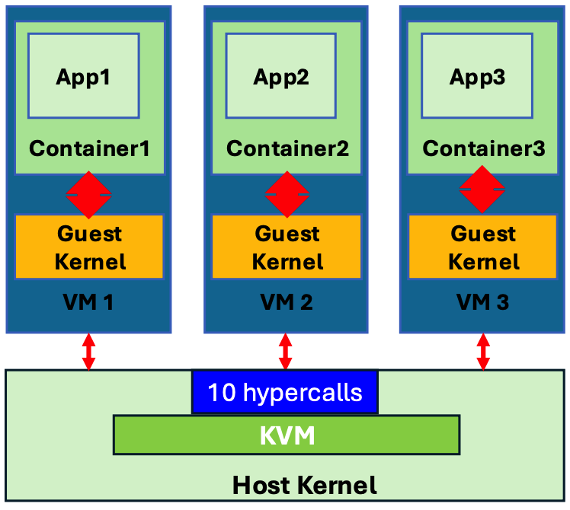
3.3 LITESHIELD (1/5)
LITESHIELD Asks a More Radical Question
Containers are lightweight, but expose a wide host-kernel interface
VMs are stronger, but keep guest kernels and hypervisors
Cloud-native microservices amplify sandbox overhead
Can system services move into userspace μkernel services?
Fig 11. Security isolation of containers and VMs
Notes:
LITESHIELD starts from a more radical position than the previous two papers. Instead of asking how to make virtualization lighter, it asks whether we should preserve the conventional guest-kernel structure at all.
LITESHIELD treats cloud-native applications as a reason to revisit the basic user/kernel decomposition. Because microservices are small, numerous, and short-lived, the overhead of conventional isolation mechanisms becomes more painful. So the paper asks whether system services can be broken apart and rehosted as userspace microkernel services.

Slide 25
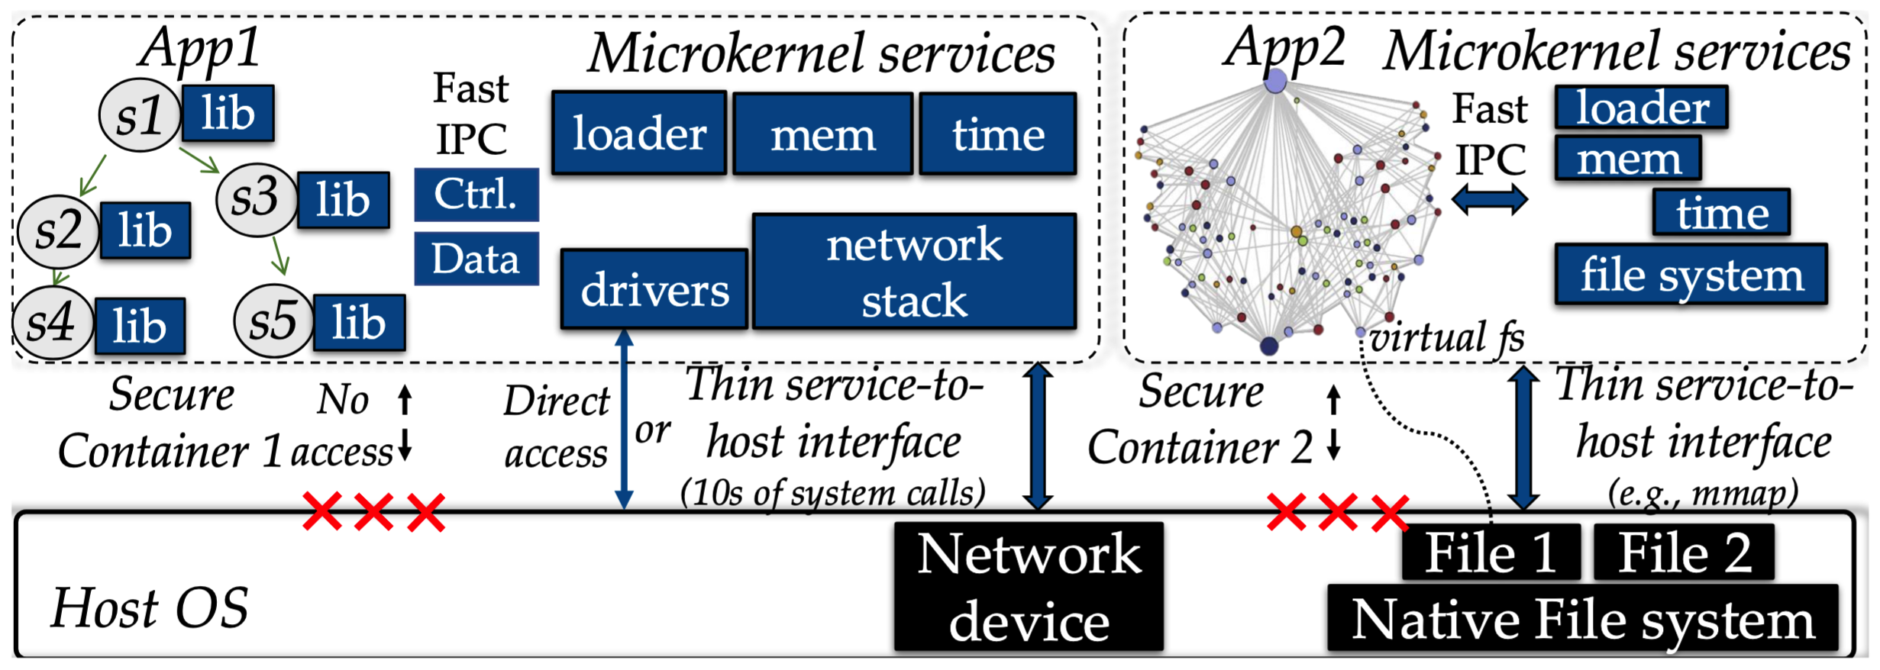
3.3 LITESHIELD (2/5)
Architecture
Guest applications act as clients
Core services:
IPC
syscall arbitration
loader / memory / time
Composable services:
networking
filesystem
drivers
Goal: a thin user-to-host interface
Fig 12. Architecture of LITESHIELD
Notes:
This slide shows the architecture of LITESHIELD. Guest applications are treated as clients, while the system functions they need are provided by a set of userspace microkernel services. Some of these are core services that every application depends on, such as IPC or syscall arbitration. Others are composable services, such as networking or filesystems, which can be tailored or replaced more flexibly.
LITESHIELD’s goal is not only to move services to userspace for modularity. It is to shrink the exposed interface to the host kernel while also opening the door to more specialized userspace implementations. So the paper is simultaneously about isolation, performance, and service composition.

Slide 26
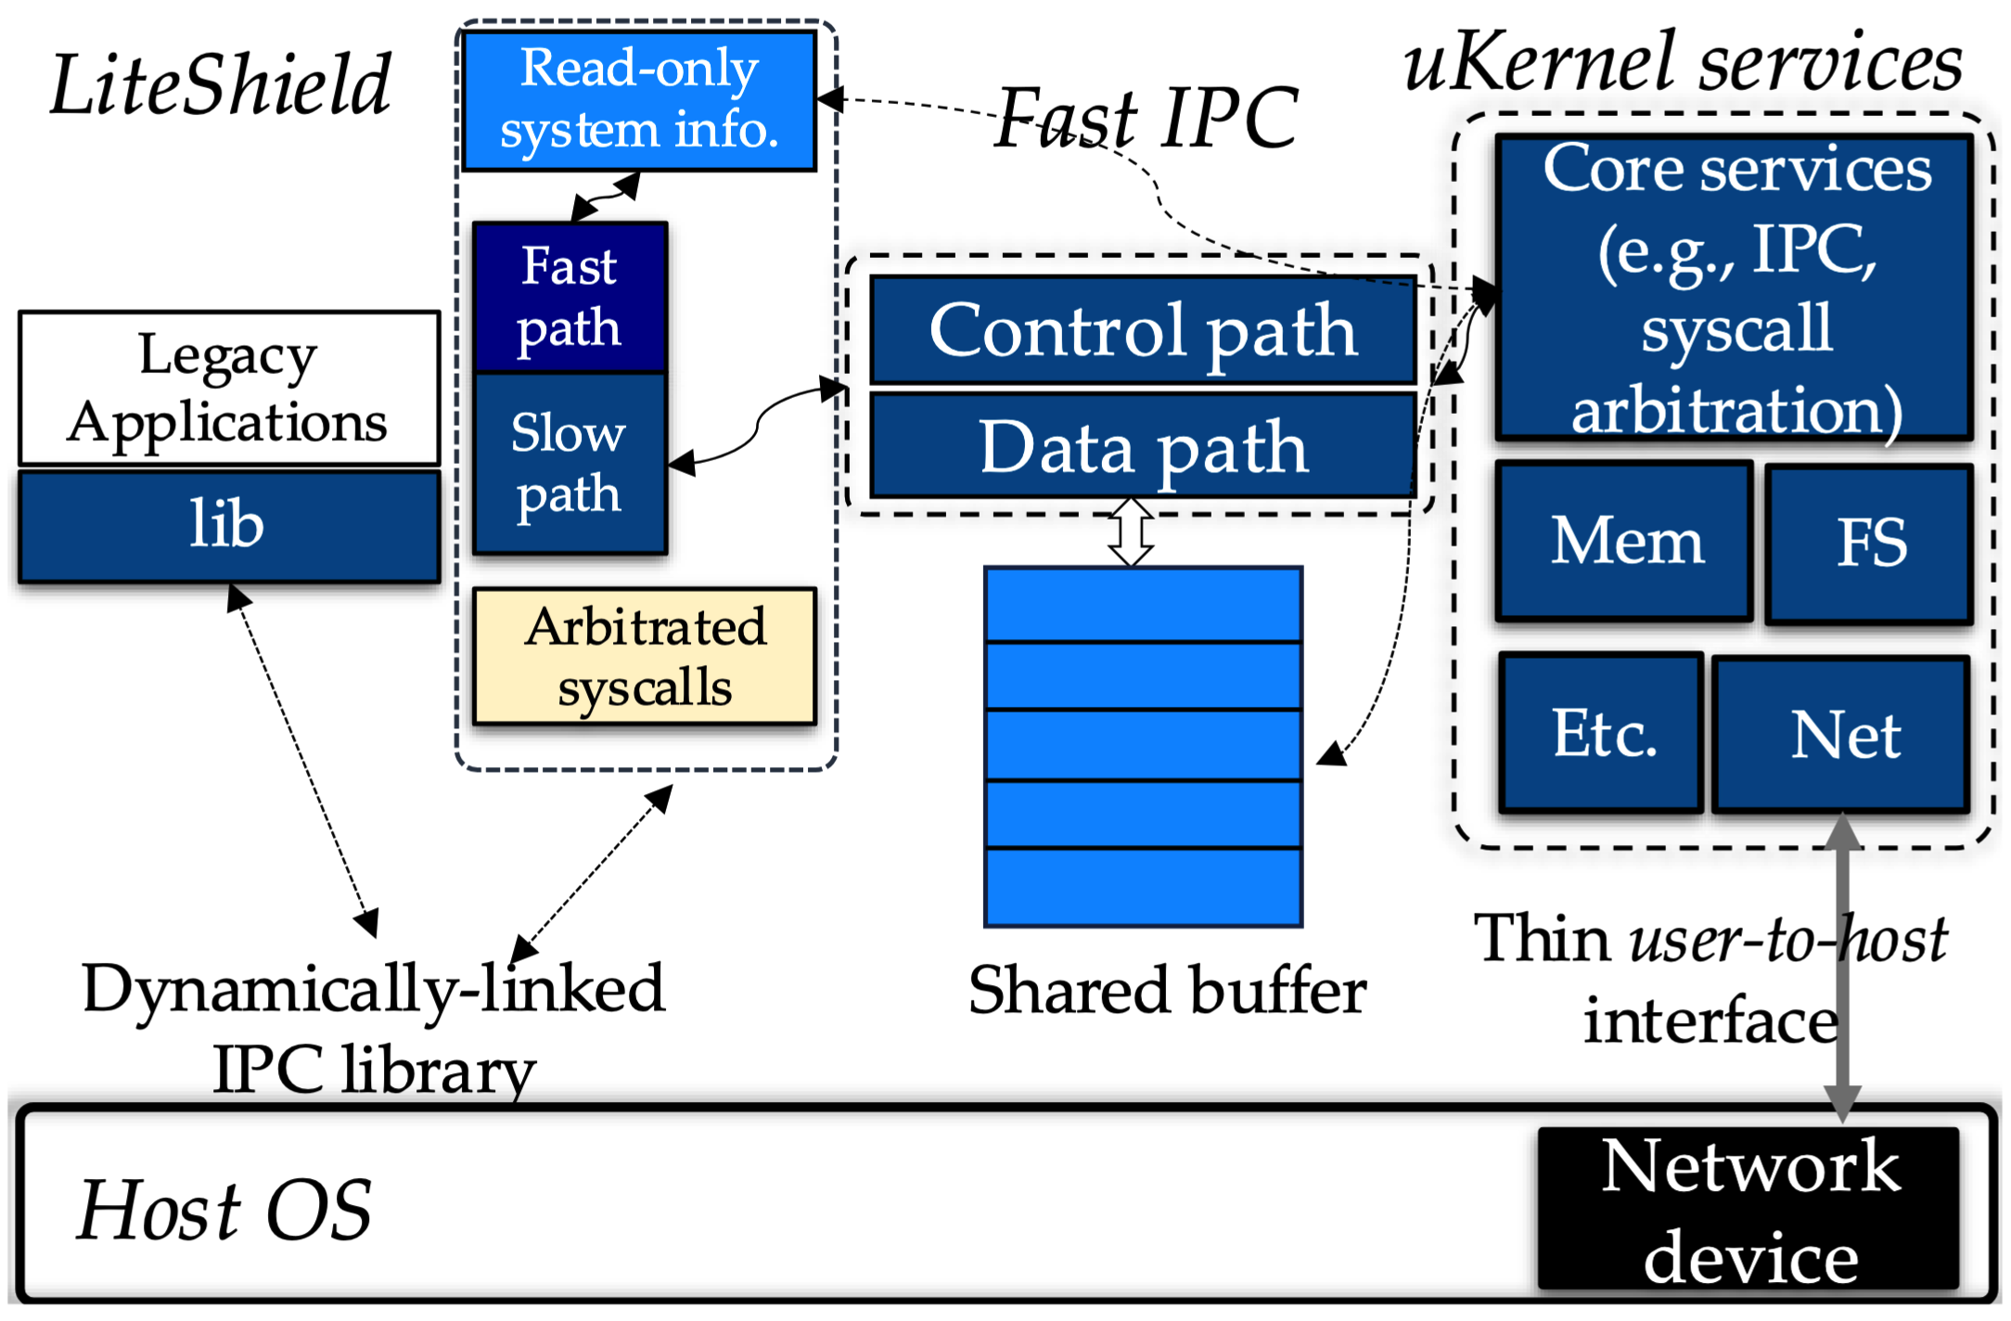
3.3 LITESHIELD (3/5)
Fast IPC and Legacy Compatibility
Guest applications have no direct host-kernel access
Delegable syscalls are redirected via fast shared-memory IPC
Legacy applications are supported through:
LD_PRELOAD
libsyscall_intercept
No binary modification is required
Fig 13. Fast userspace inter-process communication
Notes:
This slide explains how LITESHIELD tries to remain practical. Direct host-kernel access from guest applications is blocked. Instead, delegable syscalls are intercepted and redirected to userspace services through a shared-memory IPC. At the same time, the system tries hard to preserve compatibility with legacy applications by combining LD_PRELOAD and libsyscall_intercept, so that many existing binaries can be supported without modification.
This is a very important design choice, because it shows that LITESHIELD is not just proposing a new OS philosophy. It is trying to remain relevant to real cloud workloads.

Slide 27
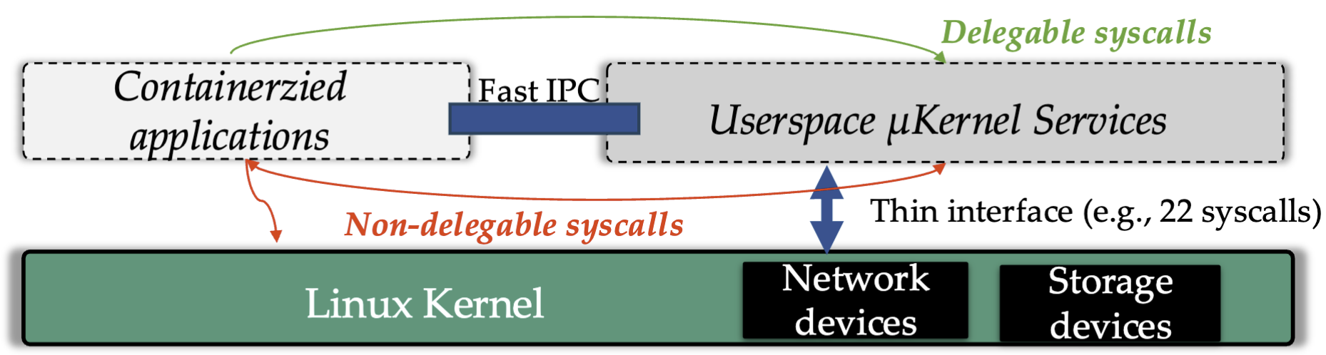
3.3 LITESHIELD (4/5)
Delegable vs. Non-Delegable Syscalls
Delegable syscalls
redirected to userspace μkernel services
Non-delegable syscalls
executed in the same process context
trapped and validated via ptrace-based arbitration
Fig 14. Delegable vs. non-delegable syscalls
Notes:
LITESHIELD separates syscalls into two classes. Delegable syscalls and non-delegable syscalls. Delegable syscalls can be redirected to userspace microkernel services. Non-delegable syscalls, such as some process-management or memory-management operations, still need to execute in the context of the original process. For those, LITESHIELD uses ptrace-based arbitration, so the syscall is trapped, monitored, and validated before it is allowed to continue.
This is the key engineering compromise of the system. LITESHIELD wants a new boundary, but it also wants compatibility with unmodified Linux. The delegable versus non-delegable split is how it balances those goals.

Slide 28
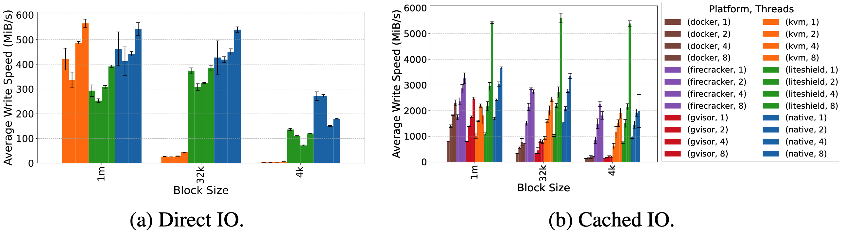
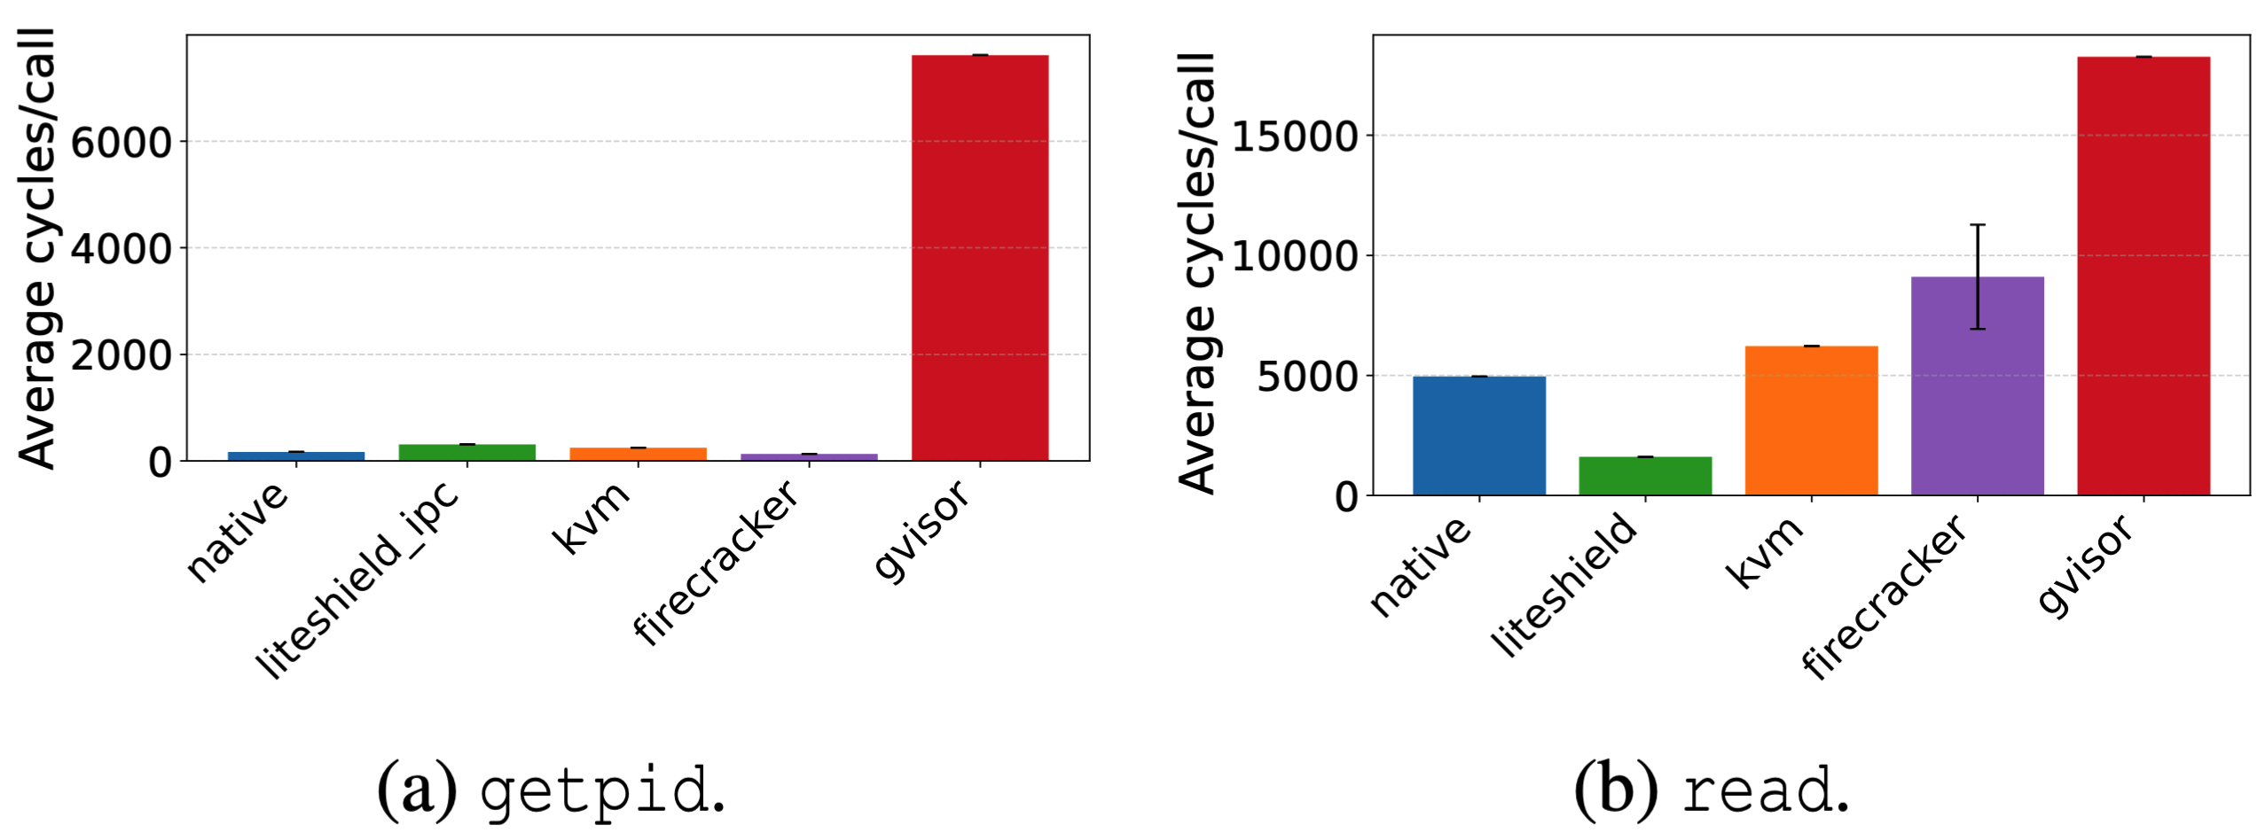
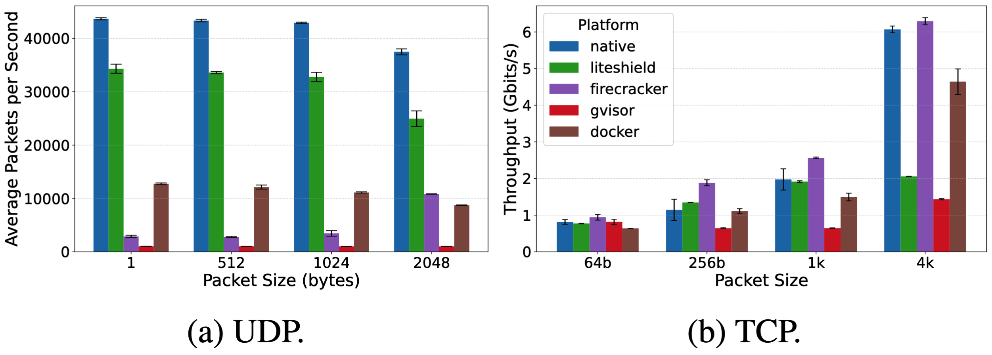
3.3 LITESHIELD (5/5)
Performance
Syscall: surpasses native performance
Network performance remains competitive
Comparable performance for IO with native setups and better than other approaches
Fig 15. IO performance
Fig 16. Syscall lantency comparison
Fig 17. Network performance comparison
Notes:
In performance terms, LITESHIELD compares with several established isolation approaches. For simple syscall paths such as getpid, it performs much better than virtual machines. For more complex operations such as read, it can outperform VM-based approaches because it avoids VM exits and uses specialized userspace services. The network path is also competitive. The main cost appears in ptrace-based arbitration, which adds around 15 to 35 microseconds for non-delegable syscalls. Also, it has comparable performance for IO with native setups and better than other approaches.
LITESHIELD is strongest as an architectural proof of concept. It shows that decomposing system services into userspace components can produce a thin and reasonably fast isolation substrate.

Slide 29
Outline
Introduction
Background & Motivation
Proposed Methods & Performance Evaluation
Firecracker
SURE
LITESHIELD
Conclusions
Q & A

Slide 30
4. Conclusions
Isolation Boundary in Cloud-Native Systems
Firecracker: making VM-level isolation practical for serverless.
SURE: pushes isolation to the data plane and protected runtime inside the unikernel.
LITESHIELD: moves the boundary further down to the interface between applications and userspace μkernel services.
Isolation in cloud-native systems is no longer tied to a single layer; it is increasingly a question of where the boundary should be placed for the best balance of security, efficiency, and compatibility.
Notes:
In conclusion, I think each paper can be summarized by one sentence about where it places the isolation boundary. Firecracker places the boundary at a minimal MicroVM, making VM-level isolation light enough for serverless deployment. SURE keeps that outer VM-style boundary, but argues that real serverless performance and security also depend on isolating the data plane and trusted runtime modules inside the unikernel. LITESHIELD goes further and redefines the boundary between the application and the operating-system functionality itself, by moving many traditional guest-kernel services into userspace microkernel services.

Slide 31
Outline
Introduction
Background & Motivation
Proposed Methods & Performance Evaluation
Firecracker
SURE
LITESHIELD
Conclusions
Q & A

