Slide 1
Course Introduction
Andy Wang
COP 5611
Advanced Operating Systems

Slide 2
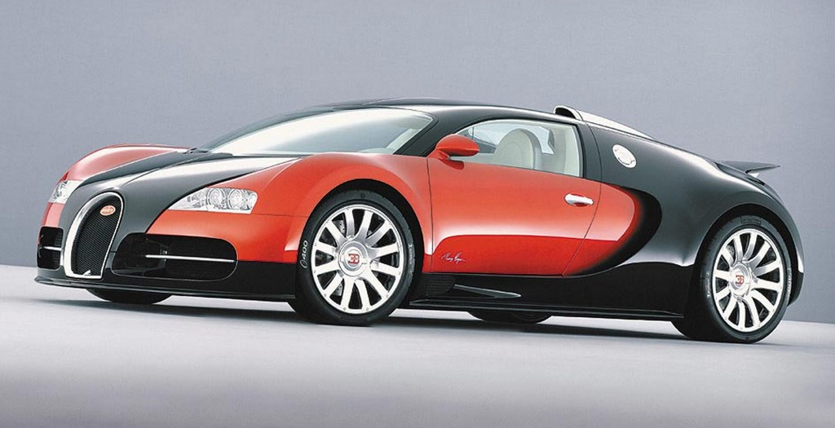
A Few Words on “Design”

Slide 3
A Few Words on “Design”
Bugatti
  1,000 horse power
  254 MPH
  4 turbos
  10 radiators
  Ceramic brakes
  Fuel tank with only enough capacity to last for 12 minutes
    Or tires will melt

Slide 4
History of OS: Change!
 |  | 1980 | 2015 | Factor
Speed | CPU | 1 MIPS | 24K MIPS | 1.5 x 10⁵
 | Memory | 500 ns | 0.6 ns | 5.0 x 10³
 | Storage | 18 ms | 30 μs | 6.0 x 10³
 | Network | 300 b/sec | 100 Gb/sec | 3.6 x 10⁸
Capacity | Memory | 64 KB | 128 GB | 2.0 x 10⁶
 | Disk | 1 MB | 10 TB | 4.0 x 10⁷
Cost | Per MIP | $100K/MIP | $0.0076/MIP | 1.3 x 10⁴
Other | Address bits | 8 | 64 | 8
 | Users/machine | 10s | 0.01 | 1.0 x 10⁻³

Slide 5
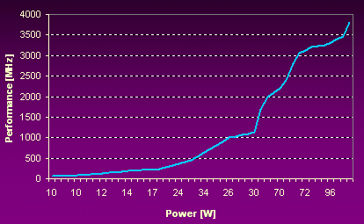
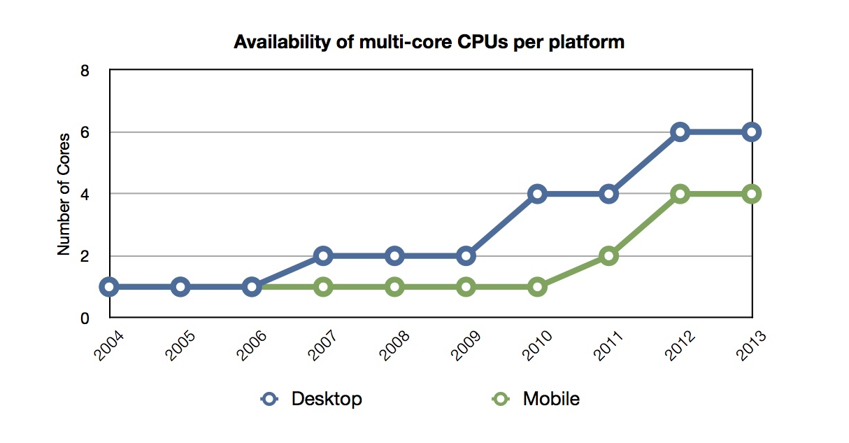
Multicore Trend

Slide 6
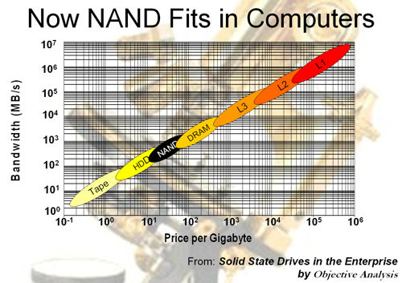
Flash Taking Over Disks

Slide 7
Changing Roles of the OS
What OS does depends on available hardware and software
And on changing uses of machines
And on changing expectations of users

Slide 8
Course Emphasis
Advanced background
Major concepts and design principles
Well-known systems

Slide 9
Course Structure
Prelude to advanced OS concepts
File systems
Interprocess communications
Computer organizations
Distributed operating systems
Security
Current topics

Slide 10
Prelude to Adv OS Concepts
Single-processor operating system
Process management
Synchronization
Memory management
File systems and device support
Network and communication support
Security

Slide 11
Single-Processor OS
Purposes
  Clean virtual machine
  Hardware independence
  Resource sharing and management
  Long term data storage
  Protection, security, accounting
  Real time support, parallelism, human interface

Slide 12
Some Deep Questions
How do we organize the OS?
  For development, evolution, performance, and security?
How do we design a distributed OS?
How do we use multi-processor machines effectively?

Slide 13
Process Management
Thread:
Address space:
Process:

Slide 14
Process Management
Thread: A sequential execution stream
Address space: Chunks of memory and everything needed to run a program
Process: An address space + thread(s)

Slide 15
Some Deep Questions
How do processes communicate and share states efficiently and securely on the same machine? Across multiple machines?
How do we improve the computing process model?

Slide 16
Process Scheduling
Provides the illusion of multiple processes running at the same time on a single processor
Context switching: changing the attention of the processor
  Involves saving and restoring states
  Necessary to cross kernel boundary

Slide 17
Some Deep Questions
How do we achieve fairness, high throughput, and responsiveness at the same time?
How do we reduce or avoid the cost of context switching?

Slide 18
Synchronization
Provides correct execution or coordinating threads in the face of arbitrary context switching

Slide 19
Synchronization Concepts
Atomic actions: all or nothing
Mutual exclusion: one thread in the critical section at a time
Semaphores: atomic, counter-based locks
Deadlock: circular waiting on resources

Slide 20
Some Deep Questions
How do systems achieve agreement across multiple machines?
How do you represent the notion of time and the ordering of events across multiple machines?

Slide 21
Memory Management
Virtual memory: provides the illusion of infinite physical memory
Swapping: moves processes to disk as necessary
Paging: allows processes to run with only the active pages in memory
Assumptions: scarcity of memory and locality of reference

Slide 22
Some Deep Questions
How do we coordinate machines to share memory?
How can we simplify memory management as memory becomes abundant?

Slide 23
File Systems
File: data + attributes
File system services:
  Organization
  Naming
  Access
  Synchronization
  Protection and security

Slide 24
Some Deep Questions
How do we make different file systems work together, even across machines?
How do we provide consistency, availability, and reliability to copies of a file across multiple machines?
How do we handle very large data sets?

Slide 25
Device Caching
I/O devices tend to be a lot slower than memory speed
Caching: stores extra data in memory in hope of near-term reuse

Slide 26
Some Deep Questions
How do we coordinate the memory resources across machines to enhance performance?
How do we handle new devices with new characteristics?

Slide 27
Homework 1
Submit in class and online
  A recent photo
  Your favorite quote
This counts as one paper critique
Email me your project team information + team name + team leader

