Slide 1
Fast Crash Recovery in RAMCloud
Diego Ongaro, Stephen M. Rumble,
Ryan Stutsman, John Ousterhout,
and Mendel Rosenblum
Stanford University

Slide 2
Overview
RAMCloud: General purpose storage in RAM
Low latency: 5-10 µs remote access
Large scale: 10,000 nodes, 100 TB to 1 PB
Key Problem: RAM’s lack of durability
Durability: Pervasive log structure, even in RAM
Uses inexpensive disk-based replication
RAM performance by eliminating synchronous disk writes
Availability: Fast crash recovery in 1 to 2 s
Recovers 35 GB to RAM in 1.6 s using 60 nodes
Leverages the scale of the cluster
Balances work evenly across hosts
Avoids centralized control
Notes:
Volatility makes RAM-based storage hard to use.
RAMCloud provides durable storage for the cost of cache.
Our goal is to make RAM-based storage as easy-to-use as disk-based storage.

Slide 3
RAMCloud Architecture
Up to 100,000 Application Servers
App
App
App
…
App
Library
Library
Library
Library
Coordinator
Datacenter Network
Masters expose RAM as Key-Value Store
Master
Master
Master
…
Master
Backup
Backup
Backup
Backup
Backups store data from other Masters
Up to 10,000 Storage Servers

Slide 4
Durability & Availability
Requirements
Retain high performance
Minimum cost, energy
Replicate in RAM of other masters?
3x system cost, energy
Still have to handle power failures

Slide 5
The RAMCloud Approach
1 copy in RAM
Backup copies on disk/flash: durability ~ free!
Problem: Synchronous disk writes too slow
Pervasive log structure, even in RAM
Problem: Data is unavailable on crash
Fast Crash Recovery in 1 to 2 s
Fast enough that applications won’t notice

Slide 6
Durability with RAM performance
write
Master
Backups

Slide 7
Durability with RAM performance
write
Master
Backups

Slide 8
Durability with RAM performance
Backups buffer update
No synchronous disk write
write
Master
Backups

Slide 9
Durability with RAM performance
Backups buffer update
No synchronous disk write
Master
Backups

Slide 10
Durability with RAM performance
Backups buffer update
No synchronous disk write
Bulk writes in background
Must flush on power loss
Master
Backups

Slide 11
Durability with RAM performance
Backups buffer update
No synchronous disk write
Bulk writes in background
Must flush on power loss
Pervasive log structure
Even RAM is a log
Log cleaner
Master
In-memory Log
Backups

Slide 12
Durability with RAM performance
Backups buffer update
No synchronous disk write
Bulk writes in background
Must flush on power loss
Pervasive log structure
Even RAM is a log
Log cleaner
Hashtable, key → location
Master
Hashtable
In-memory Log
Backups

Slide 13
Fast Crash Recovery
What is left when a Master crashes?
Log data stored on disk on backups
What must be done to restart servicing requests?
Replay log data into RAM
Reconstruct the hashtable
Recover fast: 64 GB in 1-2 seconds
Key to fast recovery: use system scale

Slide 14
Recovery without Scale
Recovery Master
Masters backed up to 3 Backups
Each backup stores entire log
Problem: Disk bandwidth
64 GB / 300 MB/sec ≈ 210 seconds
Solution: more disks (more backups)
Backups
Crashed
Master

Slide 15
Solution: Scatter Log Data
Each log divided into 8MB segments
Master chooses different backups for each segment (randomly)
Segments scattered across all servers in the cluster
Crash recovery:
All backups read from disk in parallel
64 GB / (1000 backups * 100 MB/s/backup) = 0.6 seconds
Recovery Master
Crashed
Master
~1000 Backups

Slide 16
Problem: Network bandwidth
Second bottleneck: NIC on recovery master
64 GB / 10 Gbits/second ≈ 60 seconds
CPU and memory bandwidth a limitation
Solution: more recovery masters
Spread work over 100 recovery masters
60 seconds / 100 masters ≈ 0.6 seconds

Slide 17
Solution: Partitioned Recovery
Divide each master’s data into partitions
Recover each partition on separate Recovery Master
Partitions based on key ranges, not log segment
Eliminates need for idle, empty Recovery Masters
Recovery Masters
Crashed Master
Backups

Slide 18
Partitioning During Recovery
Backups receive a partition list at the start of recovery
Backups load segments from disk and partition log entries
Each recovery master replays only relevant log entries
To Master
Recovering
‘a’ to ‘m’
To Master
Recovering
‘n’ to ‘z’
Partition | Key Range
 | ‘a’ to ‘m’
 | ‘n’ to ‘z’
a
d
c
j
z
r
q
p
z
a
r
q
d
p
c
j
Segment
Segment

Slide 19
Issues Harnessing Scale
Balancing work evenly
Parallel work is only as fast as the slowest unit
Avoiding centralized control
Centralized control eventually becomes a bottleneck
Nodes often work without perfect/global knowledge

Slide 20
Balancing Partitions
Problem: Balancing work of each recovery master
Recovery will be slow if a single Master is given
Too much data
Too many objects
Solution: Profiler tracks density of key ranges
Done locally on each master
Balance size and number of objects per partition

Slide 21
Segment Scattering
Backups
Problem: Balancing time reading data across disks
Recovery is slow if just one Backup is slow
Solution: Use similar approach to [Mitzenmacher 1996]
Choose candidate Backups randomly
Select the “best”
Minimize worst-case disk read time
Master

Slide 22
Detecting Incomplete Logs
Problem: Ensure entire log is found during recovery
Centrally cataloging segments for each log expensive
Solution: Self-describing log
Masters record catalog of log segments in segments
Coordinator talks to each Backup at start of recovery
Finds most recent catalog
Can detect if all copies of most recent catalog are lost

Slide 23
Experimental Setup
Cluster Configuration
60 Machines
2 Disks per Machine (100 MB/s/disk)
Mellanox Infiniband HCAs (25 Gbps, PCI Express limited)
5 Mellanox Infiniband Switches Two layer topology Nearly full bisection bandwidth
Approx. for datacenter networks in 3-5 years
5.2 µs round trip from 100 B read operations

Slide 24
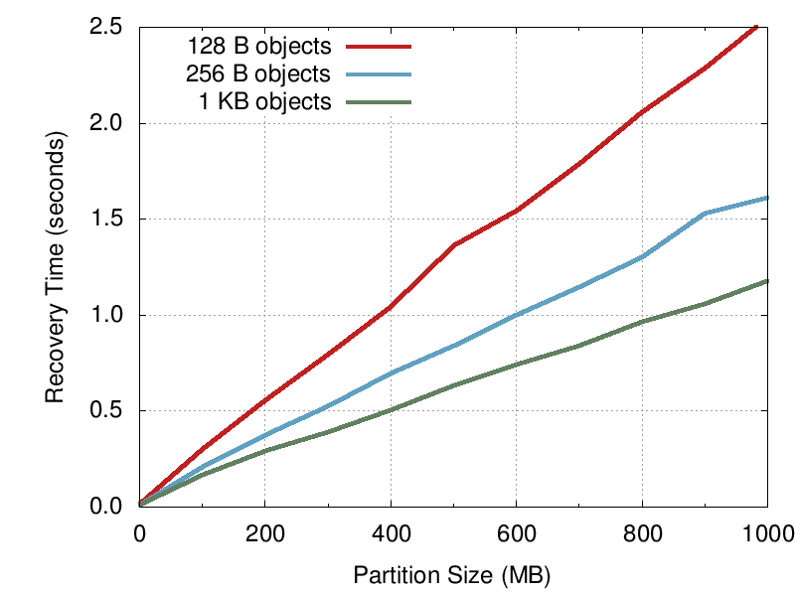
How much can a Master recover in 1s?
400 MB
800 MB

Slide 25
How well does recovery scale?
X
Crashed
Master
Recovery
Master
600 MB
600 MB
6 Backups

Slide 26
How well does recovery scale?
X
Crashed
Master
2 Recovery
Masters
1200 MB
600 MB
600 MB
12 Backups

Slide 27
How well does recovery scale?
X
20 Recovery
Masters
Crashed
Master
11.7 GB
600 MB
600 MB
600 MB
600 MB
600 MB
600 MB
600 MB
600 MB
600 MB
600 MB
600 MB
600 MB
600 MB
600 MB
600 MB
600 MB
600 MB
600 MB
600 MB
600 MB
120 Backups

Slide 28
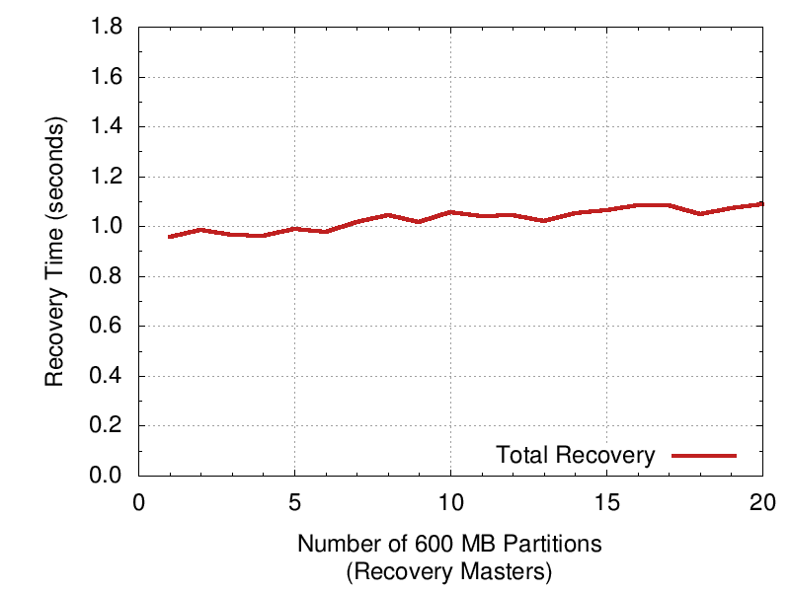
How well does recovery scale?
1 Recovery Master
6 disks: 600 MB/s
Recovered: 600 MB
20 Recovery Masters
120 backups: 11.7 GB/s
Recovered: 11.7 GB

Slide 29
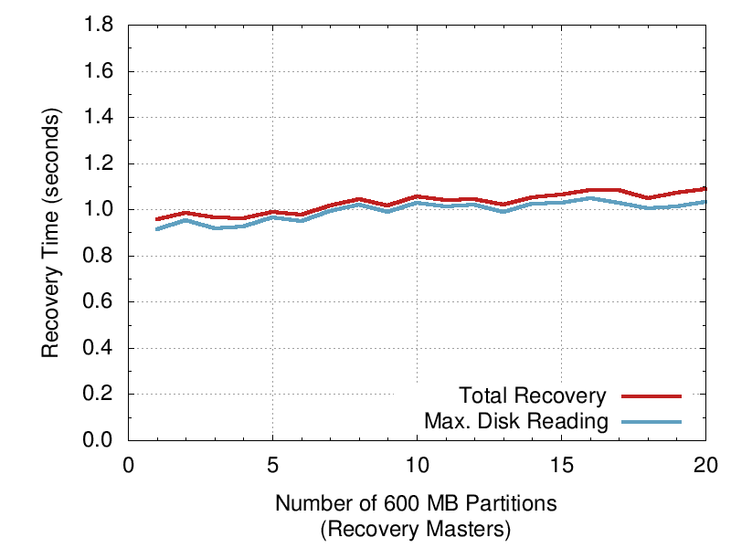
How well does recovery scale?
1 Recovery Master
6 disks: 600 MB/s
Recovered: 600 MB
20 Recovery Masters
120 backups: 11.7 GB/s
Recovered: 11.7 GB
Total recovery time tightly tracks straggling disks

Slide 30
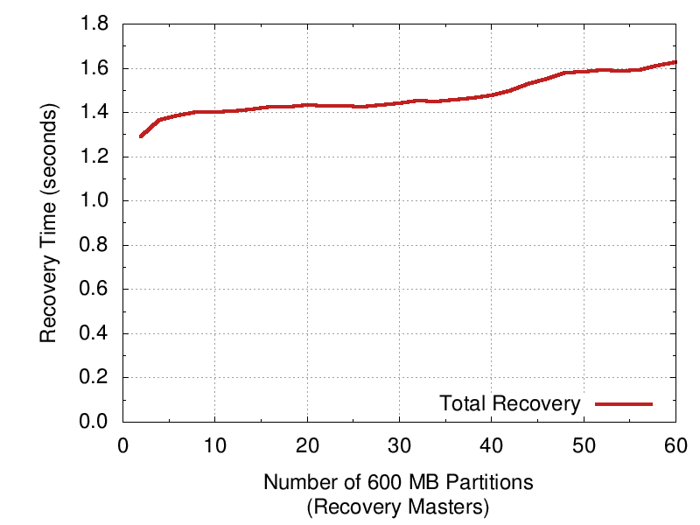
Flash Allows Higher Scalability
60 Recovery Masters
120 SSDs: 31 GB/s
Recovered: 35 GB
2x270 MB/s SSDs per recovery master
(vs. 6x100 MB/s disks per recovery master)

Slide 31
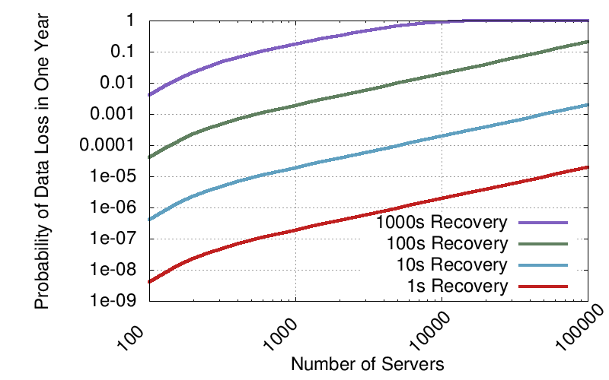
Fast Recovery Improves Durability
GFS (SOSP ‘03)
3-Copies on Disk
RAMCloud with
1-Copy in RAM
2-Copies on Disk
Assumptions:
2 failures/server/year
Failures are independent
Failures lose all contents of both RAM and disk
Replication factor 3

Slide 32
Related Work
Log-structured Filesystem (LFS)
RAMCloud keeps log in-memory and on disk
More efficient cleaner; cleans from RAM instead of disk
memcached
Apps must deal with backing store and consistency
Reduced performance from misses, cold caches
Bigtable + GFS
Primarily disk based
Scatters across disks for durability
Bigtable uses a logging approach on GFS
Stores indexes, eliminates need for replay on recovery

Slide 33
Conclusions
Pervasive log structure
Fast writes, inexpensive
Fast crash recovery in 1 to 2 s
Recovers 35 GB to RAM in 1.6 s using 60 nodes
Leverages the scale of the cluster
Potential Impact
Easy to harness performance of RAM at scale
5-10 µs access time
100 TB to 1 PB
As durable and available as disk
Enable a new class data-intensive applications

Slide 34
Questions?
ramcloud.stanford.edu

Slide 36
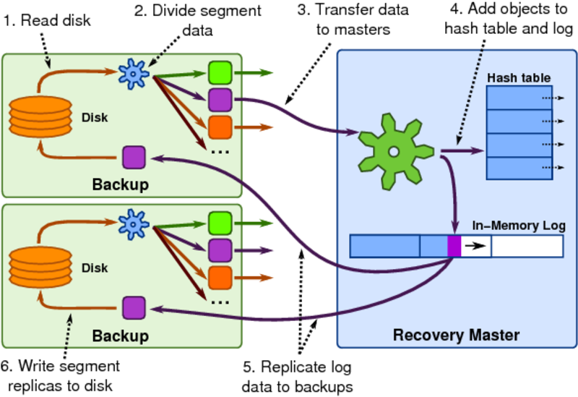
Recovery Flow

