Slide 1
File System Extensibility
Andy Wang
COP 5611
Advanced Operating Systems

Slide 2
Outline
File system extensibility
Non-disk file systems

Slide 3
File System Extensibility
No file system is perfect
So the OS should make multiple file systems available
And should allow for future improvements to file systems

Slide 4
FS Extensibility Approaches
Modify an existing file system
Virtual file systems
Layered and stackable FS layers

Slide 5
Modifying Existing FSes
Make the changes to an existing FS
  Reuses code
  But changes everyone’s file system
  Requires access to source code
  Hard to distribute

Slide 6
Virtual File Systems
Permit a single OS to run multiple file systems
Share the same high-level interface
OS keeps track of which files are instantiated by which file system
Introduced by Sun

Slide 7
4.2 BSD
File
System
/
A

Slide 8
4.2 BSD
File
System
/
B
NFS
File
System

Slide 9
Goals of VFS
Split FS implementation-dependent and -independent functionality
Support important semantics of existing file systems
Usable by both clients and servers of remote file systems
Atomicity of operation
Good performance, re-entrant, no centralized resources, “OO” approach
No static variables; good for multithreaded sharing

Slide 10
Basic VFS Architecture
Split the existing common Unix file system architecture
  Normal user file-related system calls above the split
  File system dependent implementation details below
I_nodes fall below
open()and read()calls above

Slide 11
VFS Architecture Diagram
System Calls
V_node Layer
FAT64
4.2 BSD File System
NFS
Thumb Drive
Hard Disk
Network

Slide 12
Virtual File Systems
Each VFS is linked into an OS-maintained list of VFS’s
  First in list is the root VFS
Each VFS has a pointer to its data
  Which describes how to find its files
Generic operations used to access VFS’s

Slide 13
V_nodes
The per-file data structure made available to applications
Has public and private data areas
Public area is static or maintained only at VFS level
No locking done by the v_node layer

Slide 14
BSD vfs
rootvfs
vfs_next
vfs_vnodecovered
…
vfs_data
mount BSD
mount
4.2 BSD File System
NFS

Slide 15
BSD vfs
rootvfs
vfs_next
vfs_vnodecovered
…
vfs_data
create root /
v_node /
v_vfsp
v_vfsmountedhere
…
v_data
i_node /
mount
4.2 BSD File System
NFS

Slide 16
BSD vfs
rootvfs
vfs_next
vfs_vnodecovered
…
vfs_data
create dir A
v_node /
v_node A
v_vfsp
v_vfsmountedhere
…
v_data
v_vfsp
v_vfsmountedhere
…
v_data
i_node /
mount
i_node A
4.2 BSD File System
NFS

Slide 17
BSD vfs
NFS vfs
rootvfs
vfs_next
vfs_vnodecovered
…
vfs_data
vfs_next
vfs_vnodecovered
…
vfs_data
mount NFS
v_node /
v_node A
v_vfsp
v_vfsmountedhere
…
v_data
v_vfsp
v_vfsmountedhere
…
v_data
i_node /
mount
i_node A
mntinfo
4.2 BSD File System
NFS

Slide 18
BSD vfs
NFS vfs
rootvfs
vfs_next
vfs_vnodecovered
…
vfs_data
vfs_next
vfs_vnodecovered
…
vfs_data
create dir B
v_node /
v_node A
v_node B
v_vfsp
v_vfsmountedhere
…
v_data
v_vfsp
v_vfsmountedhere
…
v_data
v_vfsp
v_vfsmountedhere
…
v_data
i_node /
mount
i_node A
i_node B
mntinfo
4.2 BSD File System
NFS

Slide 19
BSD vfs
NFS vfs
rootvfs
vfs_next
vfs_vnodecovered
…
vfs_data
vfs_next
vfs_vnodecovered
…
vfs_data
read root /
v_node /
v_node A
v_node B
v_vfsp
v_vfsmountedhere
…
v_data
v_vfsp
v_vfsmountedhere
…
v_data
v_vfsp
v_vfsmountedhere
…
v_data
i_node /
mount
i_node A
i_node B
mntinfo
4.2 BSD File System
NFS

Slide 20
BSD vfs
NFS vfs
rootvfs
vfs_next
vfs_vnodecovered
…
vfs_data
vfs_next
vfs_vnodecovered
…
vfs_data
read dir B
v_node /
v_node A
v_node B
v_vfsp
v_vfsmountedhere
…
v_data
v_vfsp
v_vfsmountedhere
…
v_data
v_vfsp
v_vfsmountedhere
…
v_data
i_node /
mount
i_node A
i_node B
mntinfo
4.2 BSD File System
NFS

Slide 21
Does the VFS Model Give Sufficient Extensibility?
VFS allows us to add new file systems
But not as helpful for improving existing file systems
What can be done to add functionality to existing file systems?

Slide 22
Layered and Stackable File System Layers
Increase functionality of file systems by permitting composition
  One file system calls another, giving advantages of both
Requires strong common interfaces, for full generality

Slide 23
Layered File Systems
Windows NT is an example of layered file systems
File systems in NT ~= device drivers
Device drivers can call one another
Using the same interface

Slide 24
Windows NT Layered Drivers Example
user-level process
user mode
kernel mode
system services
I/O
manager
file system
driver
multivolume
disk driver
disk driver

Slide 25
Another Approach:
Stackable Layers
More explicitly built to handle file system extensibility
Layered drivers in Windows NT allow extensibility
Stackable layers support extensibility

Slide 26
Stackable Layers Example
File System
Calls
File System
Calls
VFS Layer
VFS Layer
Compression
LFS
LFS

Slide 27
How Do You Create a Stackable Layer?
Write just the code that the new functionality requires
Pass all other operations to lower levels (bypass operations)
Reconfigure the system so the new layer is on top

Slide 28
User
File System
Directory
Layer
Directory
Layer
Compress
Layer
Encrypt
Layer
UFS
Layer
LFS
Layer

Slide 29
What Changes Does Stackable Layers Require?
Changes to v_node interface
  For full value, must allow expansion to the interface
Changes to mount commands
Serious attention to performance issues

Slide 30
Extending the Interface
New file layers provide new functionality
  Possibly requiring new v_node operations
Each layer needs to deal with arbitrary unknown operations
Bypass v_node operation

Slide 31
Handling a Vnode Operation
A layer can do three things with a v_node operation:
  1. Do the operation and return
  2. Pass it down to the next layer
  3. Do some work, then pass it down
The same choices are available as the result is returned up the stack

Slide 32
Mounting Stackable Layers
Each layer is mounted with a separate command
  Essentially pushing new layer on stack
Can be performed at any normal mount time
  Not just on system build or boot

Slide 33
What Can You Do With Stackable Layers?
Leverage off existing file system technology, adding
  Compression
  Encryption
  Object-oriented operations
  File replication
All without altering any existing code

Slide 34
Performance of Stackable Layers
To be a reasonable solution, per-layer overhead must be low
In UCLA implementation, overhead is ~1-2%/layer
  In system time, not elapsed time
Elapsed time overhead ~.25%/layer
  Application dependent, of course

Slide 35
Additional References
FUSE (Stony Brook)
  Linux implementation of stackable layers
Subtle issues
  Duplicate caching
    Encrypted version
    Compressed version
    Plaintext version

Slide 36
File Systems Using Other Storage Devices
All file systems discussed so far have been disk-based
The physics of disks has a strong effect on the design of the file systems
Different devices with different properties lead to different FSes

Slide 37
Other Types of File Systems
RAM-based
Disk-RAM-hybrid
Flash-memory-based
Network/distributed
  discussion of these deferred

Slide 38
Fitting Various File Systems Into the OS
Something like VFS is very handy
Otherwise, need multiple interfaces for different file systems
  With VFS, interface is the same and storage method is transparent
Stackable layers makes it even easier
  Simply replace the lowest layer

Slide 39
In-core File Systems
Store files in memory, not on disk
  Fast access and high bandwidth
  Usually simple to implement
  Hard to make persistent
  Often of limited size
  May compete with other memory needs

Slide 40
Where Are In-core File Systems Useful?
When brain-dead OS can’t use all memory for other purposes
For temporary files
For files requiring very high throughput

Slide 41
In-core FS Architectures
Dedicated memory architectures
Pageable in-core file system architectures

Slide 42
Dedicated Memory Architectures
Set aside some segment of physical memory to hold the file system
  Usable only by the file system
Either it’s small, or the file system must handle swapping to disk
RAM disks are typical examples

Slide 43
Pageable Architectures
Set aside some segment of virtual memory to hold the file system
  Share physical memory system
Can be much larger and simpler
More efficient use of resources
Examples: UNIX /tmp file systems

Slide 44
Basic Architecture of Pageable Memory FS
Uses VFS interface
Inherits most of code from standard disk-based filesystem
  Including caching code
Uses separate process as “wrapper” for virtual memory consumed by FS data

Slide 45
How Well Does This Perform?
Not as well as you might think
  Around 2 times disk based FS
  Why?
Because any access requires two memory copies
  1. From FS area to kernel buffer
  2. From kernel buffer to user space
Fixable if VM can swap buffers around

Slide 46
Other Reasons Performance Isn’t Better
Disk file system makes substantial use of caching
Which is already just as fast
But speedup for file creation/deletion is faster
  requires multiple trips to disk

Slide 47
Disk/RAM Hybrid FS
Conquest File System
http://www.cs.fsu.edu/~awang/conquest

Slide 48
Observations
Disk is cheaper in capacity
Memory is cheaper in performance
So, why not combine their strengths?

Slide 49
Conquest
Design and build a disk/persistent-RAM hybrid file system
Deliver all file system services from memory, with the exception of high-capacity storage

Slide 50
User Access Patterns
Small files
  Take little space (10%)
  Represent most accesses (90%)
Large files
  Take most space
  Mostly sequential accesses
Except database applications

Slide 51
Files Stored in Persistent RAM
Small files (< 1MB)
  No seek time or rotational delays
  Fast byte-level accesses
  Contiguous allocation
Metadata
  Fast synchronous update
  No dual representations
Executables and shared libraries
  In-place execution

Slide 52
Memory Data Path of Conquest
Conventional file systems
Conquest Memory Data Path
Storage requests
Storage requests
IO buffer
management
Persistence
support
IO buffer
Battery-backed
RAM
Persistence
support
Small file and metadata storage
Disk
management
Disk

Slide 53
Large-File-Only Disk Storage
Allocate in big chunks
  Lower access overhead
  Reduced management overhead
No fragmentation management
No tricks for small files
  Storing data in metadata
No elaborate data structures
  Wrapping a balanced tree onto disk cylinders

Slide 54
Sequential-Access Large Files
Sequential disk accesses
  Near-raw bandwidth
Well-defined readahead semantics
Read-mostly
  Little synchronization overhead (between memory and disk)

Slide 55
Disk Data Path of Conquest
Conventional file systems
Conquest Disk Data Path
Storage requests
Storage requests
IO buffer
management
IO buffer
management
IO buffer
Battery-backed
RAM
IO buffer
Small file and metadata storage
Persistence
support
Disk
management
Disk
management
Disk
Disk
Large-file-only file system

Slide 56
Random-Access Large Files
Random access?
  Common def: nonsequential access
  A movie has ~150 scene changes
  MP3 stores the title at the end of the files
Near Sequential access?
  Simplify large-file metadata representation significantly

Slide 57
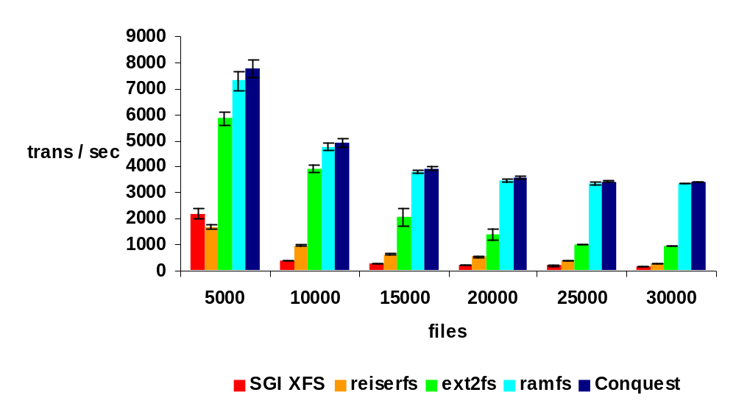
PostMark Benchmark
ISP workload (emails, web-based transactions)
Conquest is comparable to ramfs
At least 24% faster than the LRU disk cache
250 MB working set
with 2 GB physical RAM

Slide 58
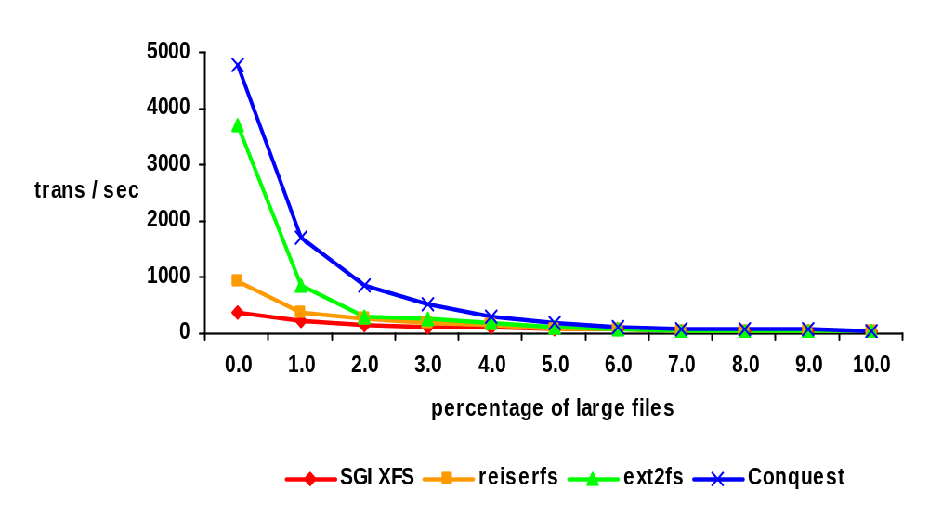
PostMark Benchmark
When both memory and disk components are exercised, Conquest can be several times faster than ext2fs, reiserfs, and SGI XFS
10,000 files,
3.5 GB working set
with 2 GB physical RAM
<= RAM
> RAM

Slide 59
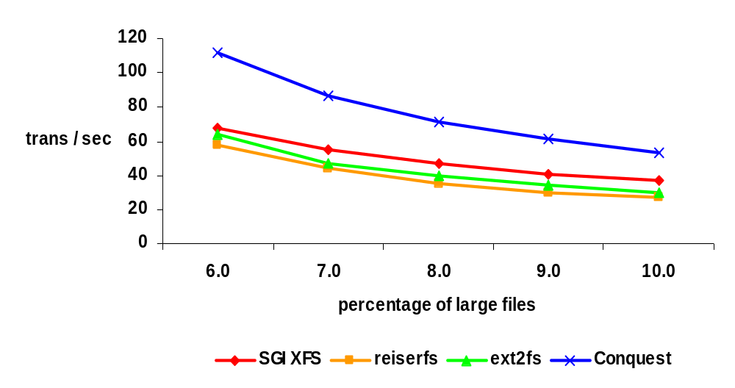
PostMark Benchmark
When working set > RAM, Conquest is 1.4 to 2 times faster than ext2fs, reiserfs, and SGI XFS
10,000 files,
3.5 GB working set
with 2 GB physical RAM

Slide 60
Flash Memory File Systems
What is flash memory?
Why is it useful for file systems?
A sample design of a flash memory file system

Slide 61
Flash Memory
A form of solid-state memory similar to ROM
  Holds data without power supply
Reads are fast
Can be written once, more slowly
Can be erased, but very slowly
Limited number of erase cycles before degradation (800 – 100,000)

Slide 62
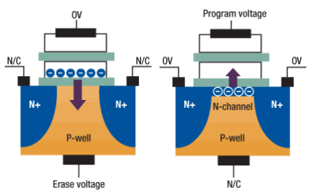
Physical Characteristics

Slide 63
NOR Flash
Used in cellular phones and PDAs
Byte-addressable
  Can write and erase individual bytes
  Can execute programs
Mostly replaced by DRAM + NAND flash

Slide 64
NAND Flash
Used in digital cameras and thumb drives
Page-addressible
  1 flash page ~= 1 disk block (1-4KB)
  Cannot run programs
Erased in flash blocks
  Consists of 4 - 64 flash pages
  May not be atomic

Slide 65
Writing In Flash Memory
If writing to empty flash page (~disk block), just write
If writing to previously written location, erase it, then write
While erasing a flash block
  May access other pages via other IO channels
  Number of channels limited by power (e.g., 16 channels max)

Slide 66
Implications of Slow Erases
The use of flash translation layer (FTL)
  Write new version elsewhere
  Erase the old version later

Slide 67
Implications of Limited Erase Cycles
Wear-leveling mechanism
  Spread erases uniformly across storage locations

Slide 68
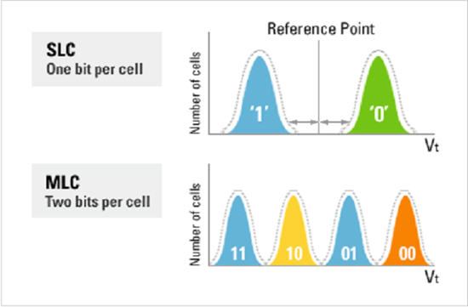
Multi-level cells
Use multiple voltage levels to represent bits

Slide 69
Implications of MLC
Higher density lowers price/GB
Need exponential number of voltage levels to for linear increase in density
Maxed out quickly

Slide 70
Performance Characteristics
 |  | Samsung SSD 970 Pro
Read | Latency | 2 μs/4KB
 |  | 3500 MB/s
Write | Latency | 2 μs/4KB
 | Bandwidth | 2300 MB/s
Power | Active | 5.2W
 | Idle | 30 mW
Cost |  | $0.5/GB
Notes:
2015 v-nand 512GB http://www.samsung.com/us/computer/memory-storage/MZ-V5P512BW
http://www.samsung.com/us/business/oem-solutions/pdfs/V-NAND_technology_WP.pdf
Micron JS28F256M29EWxx,
Micron MT29F2G08ABAEAH4,
http://search.digikey.com/scripts/dksearch/dksus.dll
http://www.samsung.com/global/system/business/semiconductor/product/2007/6/11/NANDFlash/SLC_LargeBlock/8Gbit/K9F8G08U0M/ds_k9f8g08x0m_rev10.pdf
Micron nor 2012
http://www.micron.com/parts/nor-flash/parallel-nor-flash/pc28f00bm29ewha?pc={9A9BFAD5-DEE0-49F7-ACE8-ED039D2582D6}
Bandwidth 1MB/s
Erase
http://www.alibaba.com/showroom/nor-flash-price.html
$0.1 for 4MB, $25/GB
http://www.mt-system.ru/sites/default/files/docs/samsung/k9f1g08u0f_1.0.pdf
https://www.samsung.com/semiconductor/global.semi.static/Samsung_NVMe_SSD_970_PRO_Data_Sheet_Rev.1.0.pdf

Slide 71
Pros/Cons of Flash Memory
Small and light
Uses less power than disk
Read time comparable to DRAM
No rotation/seek complexities
No moving parts (shock resistant)
Expensive (compared to disk)
Erase cycle very slow (4.5ms)
Limited number of erase cycles

Slide 72
Flash Memory File System Architectures
One basic decision to make
  Is flash memory disk-like?
  Or memory-like?
Should flash memory be treated as a separate device, or as a special part of addressable memory?

Slide 73
Journaling Flash File System (JFFS)
Treats flash memory as device
  As opposed to directly addressable memory
Motivation
  FTL effectively is journaling-like
  Running a journaling file system on the top of it is redundant

Slide 74
JFFS1 Design
One data structure—node
LFS-like
  A node with a new version makes the older version obsolete
Many nodes are associated with an i-node

Slide 75
i-node Design Issues
An i-node contains
  Its name
  Parent’s i-node number (a back pointer)

Slide 76
Ext2 Directory
data block location
data block location
file1
file1
file i-node location
file1 i-node number
file1
file2
data block location
file i-node location
file2 i-node number
index block location
index block location
index block location
i-node

Slide 77
JFFS Directory
file1
Implications
  No intermediate directories to modify when adding files
  Need scanning at mount time to build a FS in RAM
  No hard links
file1
file i-node location
parent’s i-node number
data block location
data block location
data block location
index block location
index block location
index block location
i-node

Slide 78
Node Design Issues
A node may contain data range for an i-node
  With an associated file offset
  Use version stamps to indicate updates

Slide 79
Garbage Collection
Merge nodes with smaller data ranges into fewer nodes with longer data ranges

Slide 80
Garbage Collection
Problem
  A node may be stored across a flash block boundary
Solution
  Max node size = ½ flash block size

Slide 81
JFFS1 Limitations
Always garbage collect the oldest block
  Even if the block is not modified
No data compression
No hard links

Slide 82
JFFS2 Wear Leveling
For 1/100 occasions, garbage collect an old clean block

Slide 83
JFFS2 Data Compression
Problems
  When merging nodes, the resulting node may not compress as well
  May not be portable due to differences in compression libraries
  Does not support mmap, which requires page alignment

Slide 84
Problems with version-stamp-based updates
Dead blocks are determined at mount time (scanning occurs)
If a directory is detected to be deleted, scanning needs to restart, since its children files are deleted as well

Slide 85
Problems with version-stamp-based updates
Truncate, seek, and append…
  Old data may show through holes within a file…
A hack
  Add nodes to indicate holes

Slide 86
Additional References
UBIFS (JFFS3)
BTRFS
F2FS
TableFS (LSM)
BetrFS (B^{ᵋ} Tree)
NOVA
DevFS

