Slide 1
F2FS: A File System for Flash Storage

Slide 2
Introduction
NAND flash memory is broadly used
However, NAND flash has the following limitations
Erase before write
Limited write cycles per erase block
NAND flash does not work well with random writes
Can cause internal fragmentations and degrade sustained SSD performance
Random write patterns are common
Facebook mobile app (150% more random than sequential writes)
WebBench (70% more random than sequential writes)
Due to the use of SQLite

Slide 3
Main F2FS Design Points
Based on LFS
Use zone > section > segment units
Allocate storage in segments
Clean in sections
Aligned with FTL operational units

Slide 4
Main F2FS Design Points
Use node address table <node ID, address> to solve the wandering tree problem
LFS appends data <data> and index block <index block, data address>
It’s index map block <index map, index block address> also needs to be updated
Instead, index block and index map store data node ID and index block node ID
Only the node address table needs to be updated

Slide 5
Main F2FS Design Points
Multi-headed logging
Separate hot and cold data
Runs multiple log segments concurrently
Appends data and metadata to separate log segments
Exploits parallelism
Adaptive logging
Use append to convert random writes into sequential ones
When the storage is near full, use threaded logging
Fsync acceleration and roll-forward recovery

Slide 6
On-Disk Layout
F2FS splits a volume into six areas
Superblock
Checkpoint
Segment information table (SIT) contains validity bitmap
Node address table (NAT) for nodes stored in the main area
Segment summary area (SSA) stores parent inode number and its node/data offsets
Main area stores 4KB blocks
A node contains indices of data blocks
Data block contains directory or file data

Slide 7
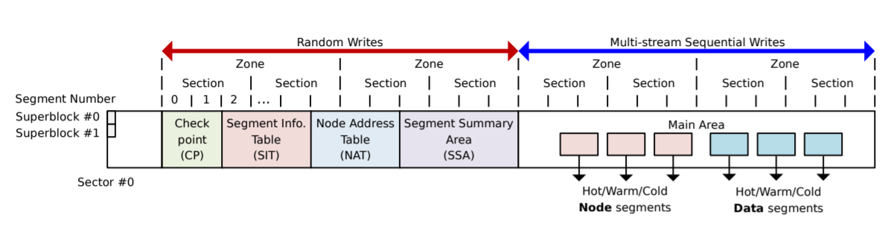
On-Disk Layout

Slide 8
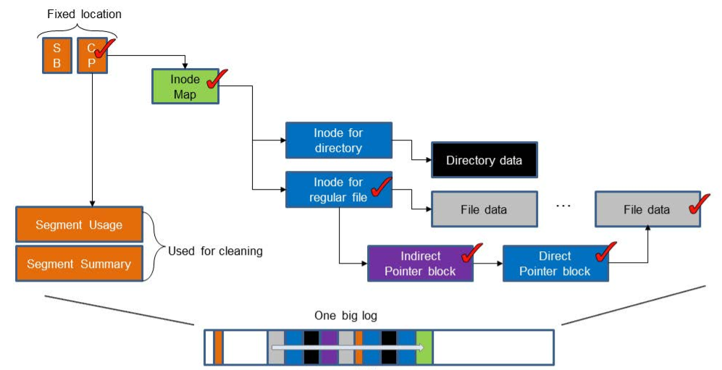
LFS Update

Slide 9
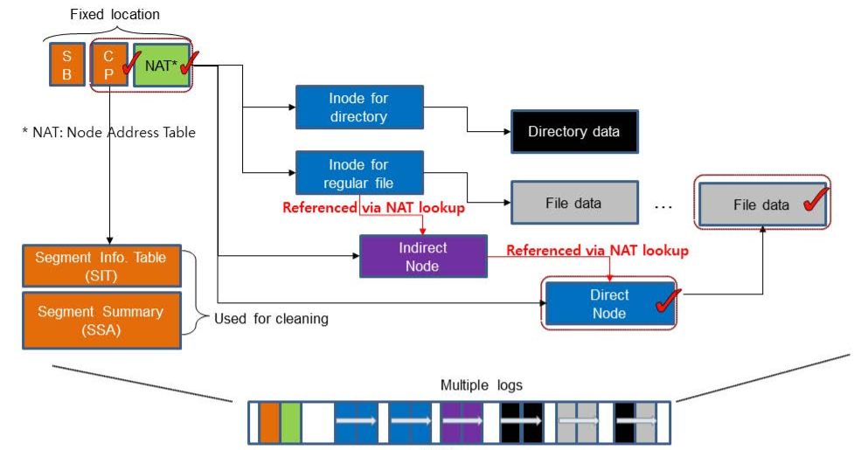
F2FS Update with Node Translation Table

Slide 10
Directory Structure
4KB directory entries
Bitmap with <slot, name> pairs
Slot contains hash value, inode number, file length, file type
A directory file uses multi-level hash tables

Slide 11
Multi-head Logging
Maintains six log areas
Three levels of temperatures
Hot, warm, and cold
Type | Temperature | Objects
Node | Hot | Direct node blocks for directories
 | Warm | Direct node blocks for files
 | Cold | Indirect node blocks
Data | Hot | Directory entry blocks
 | Warm | Data blocks
 | Cold | Data blocks moved by cleaning Multimedia file data

Slide 12
Cleaning
Foreground
Background
Triggered when not enough space
Picks sections with the fewest valid segments
Migrate immediately
Triggered periodically
Uses cost-benefit policy
Also considers the age of sections
Lazy migration
Merges segments and leaves them in memory

Slide 13
Fsync optimization
Write data blocks and their direct node blocks only
Excluding other node or metadata blocks
Leverage checkpoints to recover

Slide 14
Performance
Compared to ext4
3x for iozone
2x for SQLite

