Slide 1
Lightweight Virtualization for Serverless
From MicroVM Design to Fast Snapshot Restore
2026.11.12
Cheng Li
School of Data Science
Chinese University of Hong Kong, Shenzhen
1

Slide 2
Outline
Introduction
Background & Motivation
Proposed Methods & Performance Evaluation
  Firecracker
  Fireworks
  Sabre
Conclusions
Q & A
2

Slide 3
Outline
Introduction
Background & Motivation
Proposed Methods & Performance Evaluation
  Firecracker
  Fireworks
  Sabre
Conclusions
Q & A
3

Slide 4
1. Introduction
How can a VM become ready for useful work quickly?
Design decision | Paper | Cost addressed
Build a smaller VM | Firecracker · NSDI 2020 | VMM overhead
Save initialized state | Fireworks · EuroSys 2022 | Repeated initialization
Restore saved memory | Sabre · OSDI 2024 | Snapshot I/O and decompression
Common foundation: Fireworks and Sabre both use Firecracker.
4

Slide 5
Outline
Introduction
Background & Motivation
Proposed Methods & Performance Evaluation
  Firecracker
  Fireworks
  Sabre
Conclusions
Q & A
5

Slide 6
2. Background & Motivation (1/3)
Short requests make provisioning costs hard to amortize.
Isolation
Elasticity
Useful work
Many tenants share a host.
Each function needs a protection boundary.
Bursts need new instances.
Keeping every function warm consumes RAM.
A booted guest still needs its runtime and function state.
The target is the first completed request under a VM isolation boundary.
6

Slide 7
2. Background & Motivation (2/3)
A snapshot makes initialized state reusable across invocations.
VM state
Saved snapshot
Saved CPU and device state
lets the VM resume execution.
Restored MicroVM
Guest
kernel
Language
runtime
Function
code
Guest memory
Saved pages hold the kernel,
runtime, and prepared function.
Guest physical memory
7

Slide 8
2. Background & Motivation (3/3)
The lifecycle choice determines which costs recur.
Invocation path | What remains available | Main cost
Cold boot | Executable images | Boot and initialization
Warm reuse | A running instance | Idle memory
Snapshot restore | Saved VM and memory state | Storage and memory restoration
The design must account for both instance creation and state restoration.
8

Slide 9
Outline
Introduction
Background & Motivation
Proposed Methods & Performance Evaluation
  Firecracker
  Fireworks
  Sabre
Conclusions
Q & A
9

Slide 10
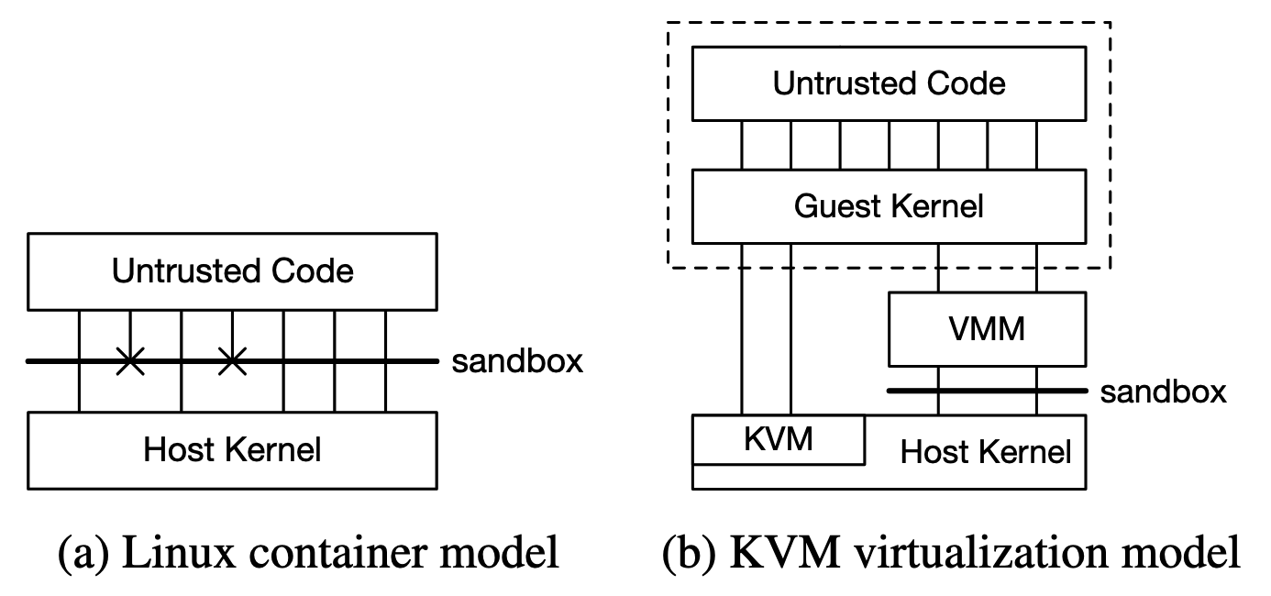
3.1 Firecracker (1/4)
A separate guest kernel provides the isolation boundary.
KVM isolates guest execution
Each MicroVM runs a guest kernel.
Containers share the host kernel.
The VMM needs protection too
A jailer limits privileges.
Seccomp restricts host interfaces.
Figure 1. Container and KVM isolation models.
10

Slide 11
3.1 Firecracker (2/4)
A serverless sandbox needs fewer devices than a general-purpose VM.
Included in the design | Omitted or reduced
virtio network and block devices | USB and GPU emulation
Serial console and minimal legacy support | Large legacy device model
Small Rust VMM, one process per MicroVM | General-purpose feature breadth
A narrow API for VM configuration | Unneeded VM management features
Smaller scope lowers per-instance overhead and the amount of VMM code.
11

Slide 12
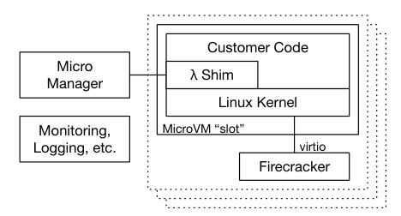
3.1 Firecracker (3/4)
A production worker combines MicroVM slots with lifecycle management.
Warm capacity
Retain initialized state for reuse.
Absorb bursts with prepared capacity.
Provisioning policy also affects latency and idle memory.
Figure 2. Firecracker in AWS Lambda.
12

Slide 13
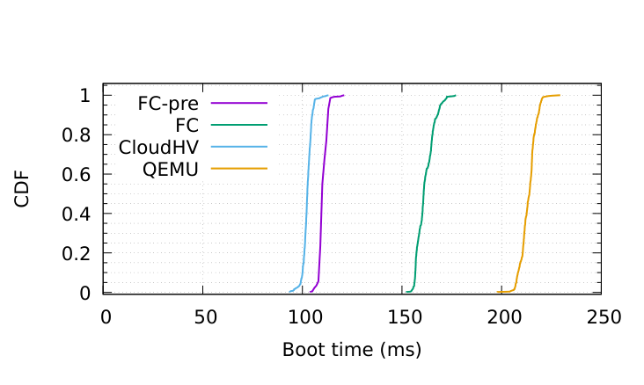
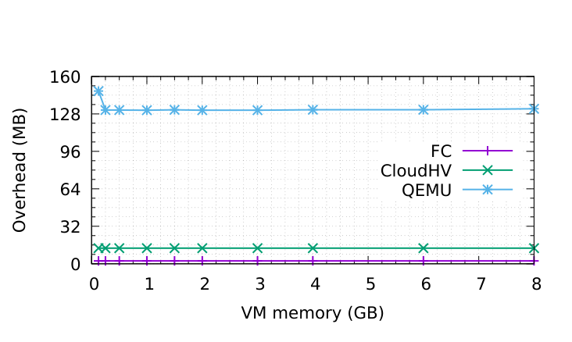
3.1 Firecracker (4/4)
Low VMM overhead makes large numbers of isolated instances practical.
Figure 3. MicroVM boot time.
Figure 4. VMM memory overhead.
FC-pre excludes process creation and API setup.
About 3 MB VMM overhead, excluding guest RAM.
13

Slide 14
Outline
Introduction
Background & Motivation
Proposed Methods & Performance Evaluation
  Firecracker
  Fireworks
  Sabre
Conclusions
Q & A
14

Slide 15
3.2 Fireworks (1/6)
A later snapshot can preserve work that an OS snapshot misses.
Snapshot point | State ready for reuse
After guest boot | Guest kernel
After runtime loading | Kernel and language runtime
After JIT compilation | Runtime and compiled function code
Fireworks moves preparation into installation and saves post-JIT state.
15

Slide 16
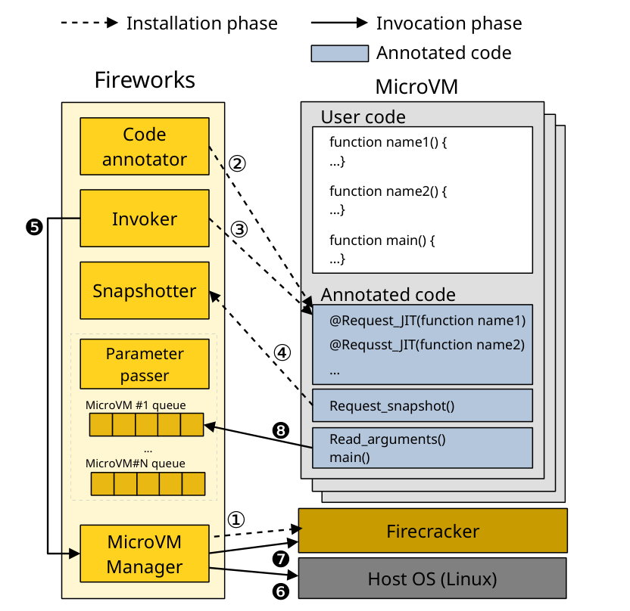
3.2 Fireworks (2/6)
Installation pays for preparation so invocation can start from saved state.
Installation
Initialize the VM and runtime.
Trigger JIT, then capture the snapshot.
Invocation
Restore saved state and set up I/O.
Read new arguments and execute.
Node.js uses V8. Python uses Numba.
Figure 5. Fireworks architecture.
16

Slide 17
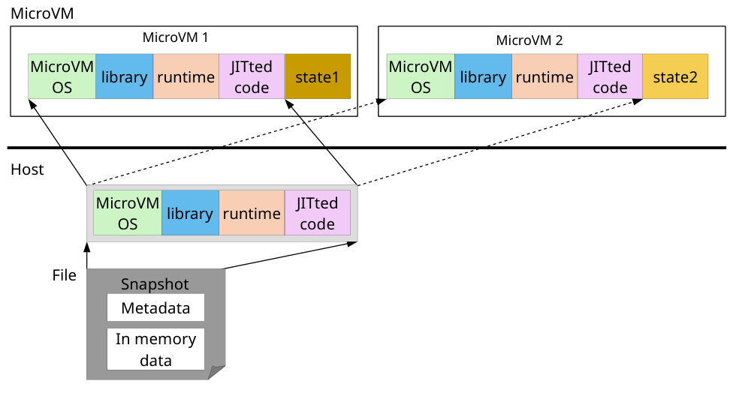
3.2 Fireworks (3/6)
Copy-on-write lets identical instances reuse unchanged snapshot pages.
Shared until written
MAP_PRIVATE maps the snapshot.
Writes create private copies.
Reuse includes code
Compiled code can remain shared across instances.
Figure 6. Sharing post-JIT snapshot pages.
17

Slide 18
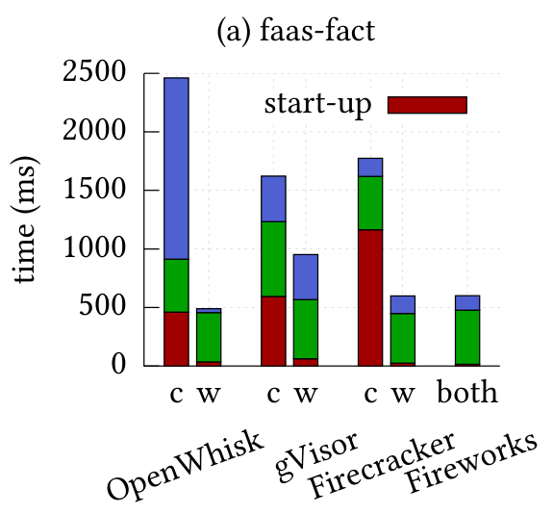
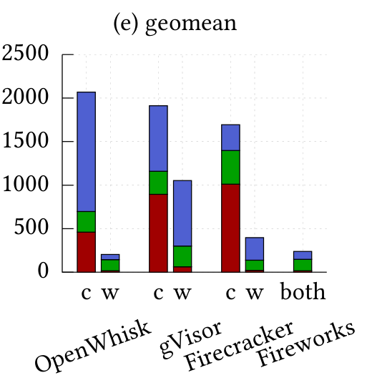
3.2 Fireworks (4/6)
Node.js latency breakdown shows where the improvement comes from.
Red: startup
Green: execution
Blue: other work
c = cold
w = warm
both = Fireworks
Startup decreases.
Execution still matters.
Figure 7. Node.js invocation latency.
18

Slide 19
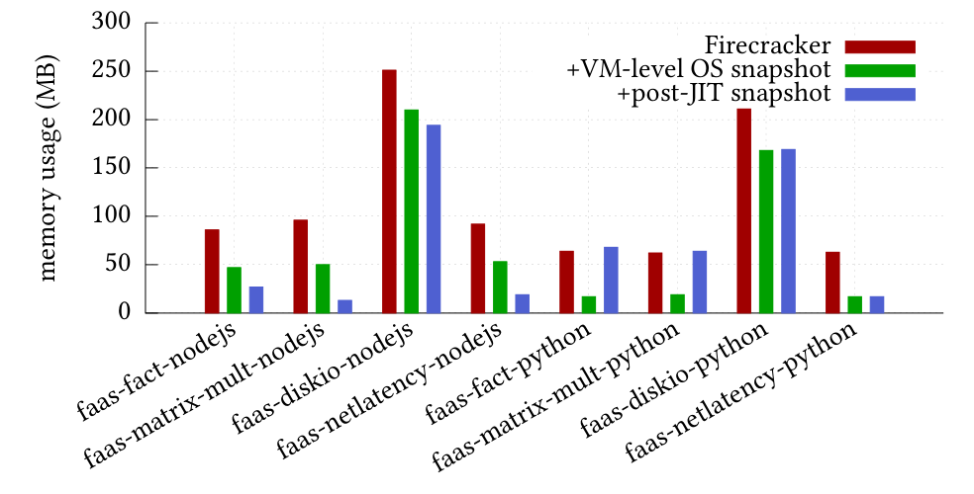
3.2 Fireworks (5/6)
Ten concurrent MicroVMs run the same function in this experiment.
Node.js
Post-JIT state can improve sharing.
Python / Numba
Duplicated compilation modules limit additional savings.
Figure 8. Memory use per MicroVM.
19

Slide 20
3.2 Fireworks (6/6)
Snapshot reuse trades repeated computation for saved state.
More state can save more work
Saved pages still cost I/O
Later capture avoids runtime preparation, but preserves more assumptions.
Storage reads and memory population remain on the restore path.
What happens when the snapshot is compressed?
Fewer bytes to read, plus decompression work to perform.
20

Slide 21
Outline
Introduction
Background & Motivation
Proposed Methods & Performance Evaluation
  Firecracker
  Fireworks
  Sabre
Conclusions
Q & A
21

Slide 22
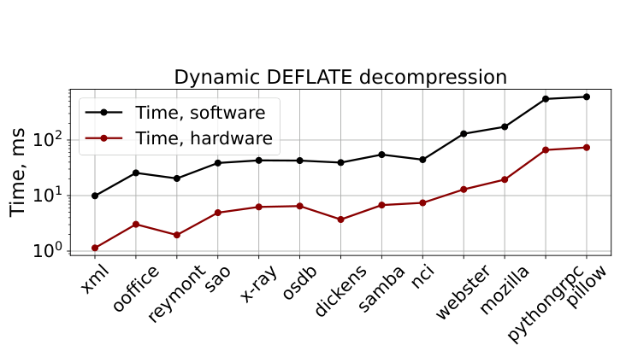
3.3 Sabre (1/5)
Fast compressed restore requires affordable decompression.
The bottleneck can move
Fewer bytes reduce storage traffic.
Software decompression adds CPU work.
Hardware changes the trade-off
Intel IAA accelerates DEFLATE.
Sabre overlaps I/O and decompression.
Figure 9. Software and IAA decompression.
22

Slide 23
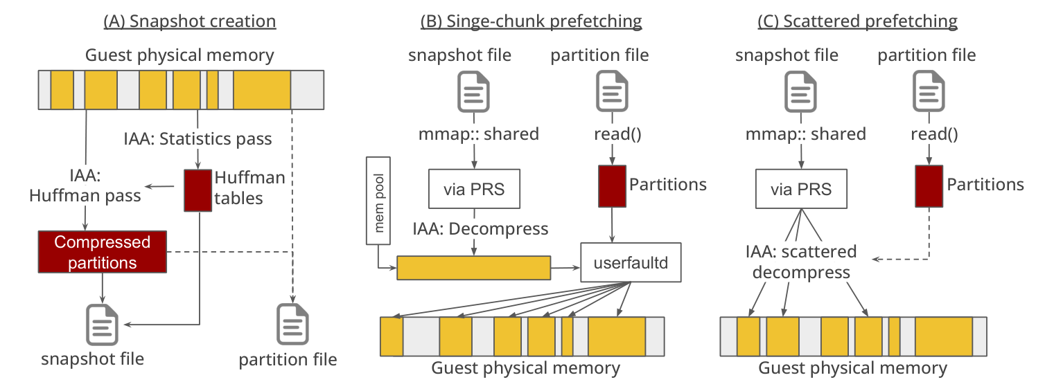
3.3 Sabre (2/5)
Page metadata connects compressed storage to guest-memory destinations.
Figure 10. Sabre snapshot creation and restore.
Capture: compress saved pages and record their locations.
Restore: overlap reads and decompression, then populate guest memory.
23

Slide 24
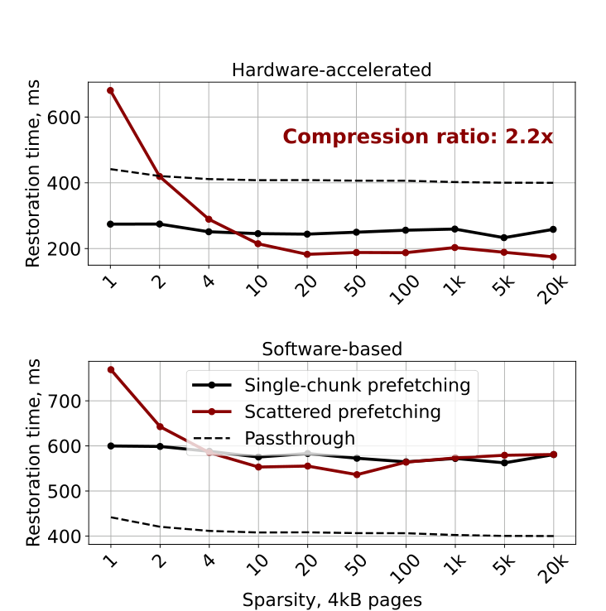
3.3 Sabre (3/5)
Fewer copies do not guarantee faster restoration.
Single-chunk output
Decompress into a buffer, then copy.
Useful for fragmented page sets.
Scattered output
Decompress toward final destinations.
Useful for large, coarse regions.
Figure 11. Effect of page layout.
24

Slide 25
3.3 Sabre (4/5)
The page set determines both compression and placement costs.
Property | Firecracker Diff snapshot | Recorded working set
Pages selected | Dirty pages | Pages touched by the function
Typical layout | Larger, coarser regions | More fragmented regions
Favored restore path | Scattered destinations | Single-chunk buffer
Mean compression ratio | 2.5× | 3.2×
Ratios describe snapshot-file size. Working-set mean excludes the synthetic python-list outlier.
25

Slide 26
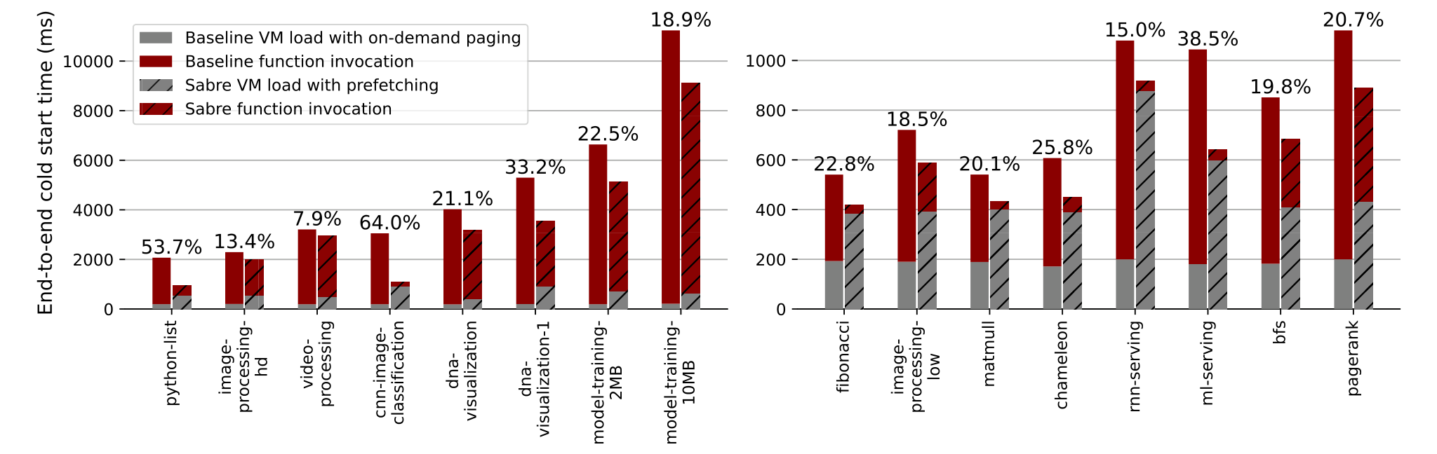
3.3 Sabre (5/5)
End-to-end improvement varies with the workload and baseline.
Figure 12. End-to-end cold-start latency.
Baseline: on-demand paging. Sabre changes prefetching and compressed restoration together.
26

Slide 27
Outline
Introduction
Background & Motivation
Proposed Methods & Performance Evaluation
  Firecracker
  Fireworks
  Sabre
Conclusions
Q & A
27

Slide 28
4. Conclusions (1/2)
Lightweight creation and fast restoration address different remaining costs.
Dimension | Firecracker | Fireworks | Sabre
Main decision | VMM scope | Snapshot point | Restore path
Reusable resource | VM substrate | Initialized runtime and compiled code | Compressed memory image
Main trade-off | Fewer features | Preparation and state assumptions | I/O savings and decompression cost
Cost left to address | Guest initialization | Memory restoration | Function execution
Joint design opportunity: choose the saved state and its restore path together.
28

Slide 29
4. Conclusions (2/2)
State capture and restoration should be designed together.
Firecracker makes isolation affordable
A small VMM reduces the per-instance cost.
Fireworks preserves useful preparation
The snapshot point determines which work an invocation can skip.
Sabre makes saved memory cheaper to restore
Compression helps when the restore path handles its costs efficiently.
29

Slide 30
Outline
Introduction
Background & Motivation
Proposed Methods & Performance Evaluation
  Firecracker
  Fireworks
  Sabre
Conclusions
Q & A
30

