Slide 1
GPU communication systems: Collective Communication from Libraries to Hardware 2026.1.22
Haoran Kong
School of Data Science
Chinese University of Hong Kong, Shenzhen

Slide 2
Outline
Introduction (3 min)
Background & Motivation (11 min)
Proposed Methods & Performance Evaluation (24 min)
MSCCL++ (8 min)
syCCL (8 min)
NCCLX (8 min)
Conclusions (2 min)
Q & A (5 min)

Slide 3
Outline
Introduction (3 min)
Background & Motivation (11 min)
Proposed Methods & Performance Evaluation (24 min)
MSCCL++ (8 min)
syCCL (8 min)
NCCLX (8 min)
Conclusions (2 min)
Q & A (5 min)

Slide 4
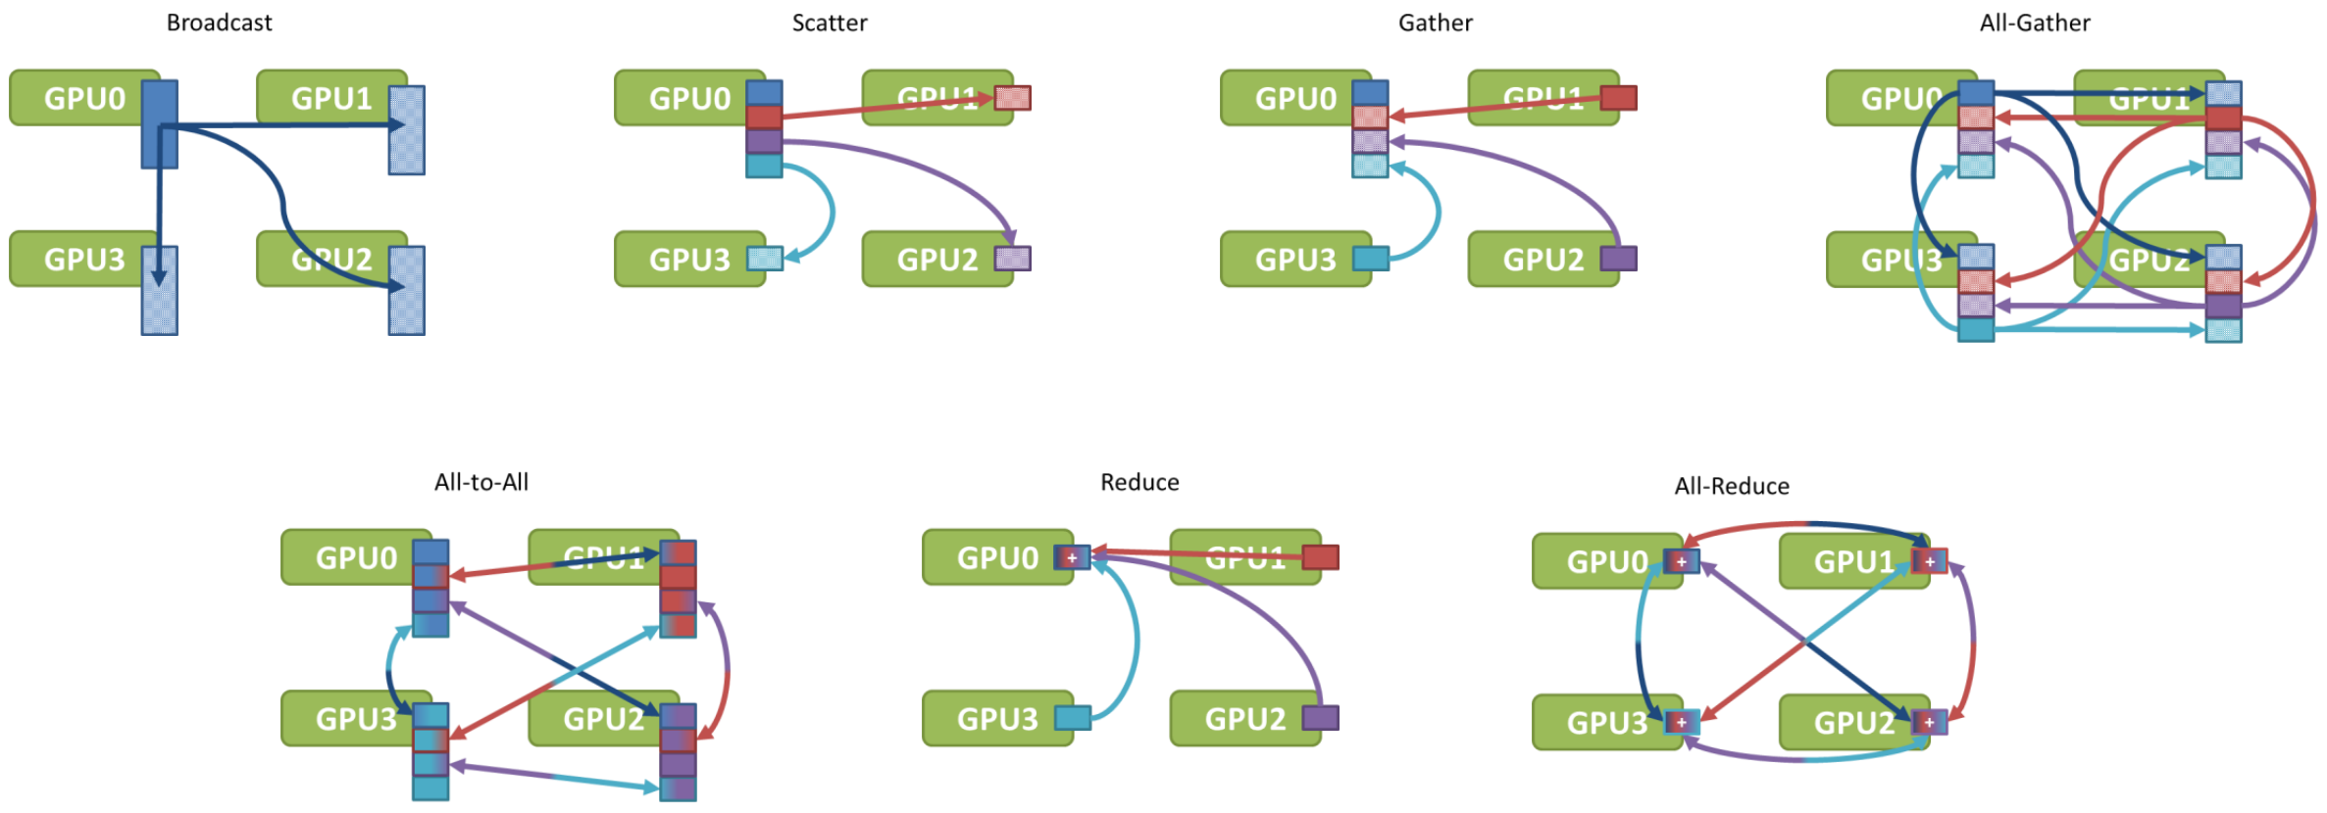
Introduction – CCL (1/3)
What is CCL?
A Collective Communication Library (CCL) is a specialized set of software tools that allows multiple processors (CPUs or GPUs) to talk to each other efficiently.

Slide 5
Introduction – CCL (2/3)
Why use CCL?
ML workloads are going distributed
Larger and larger training scale (All-reduce, Reduce-scatter, All-gather)
Massive expert parallelism in MoE (All to All like)
Collectives are central to scalability in a variety of key applications:
Parallel FFT (Transposition is all-to-all)
Molecular Dynamics (All-reduce)
Graph Analytics (All-to-all)
While various solutions—including NCCL, MPI, and DeepEP—address different layers of this challenge, this discussion focuses specifically on GPU-directed CCLs.

Slide 6
Introduction – CCL (3/3)
How CCLs work?
Core Idea: a battle between algorithmic efficiency and hardware constraints
At its heart, a CCL must balance two competing goals:
High Throughput: Maximizing the volume of data moved by saturating every available lane of the network.
Low Latency: Minimizing the "handshake" time between devices, which is critical for small-message synchronization in modern AI.
Scaling requires topology-aware implementation.
While many assume a simple "Fat Tree" network architecture, real-world systems are often much more complex.
A CCL must adapt its routing to the specific physical layout of the cluster.

Slide 7
Outline
Introduction (3 min)
Background & Motivation (11 min)
Proposed Methods & Performance Evaluation (24 min)
MSCCL++ (8 min)
syCCL (8 min)
NCCLX (8 min)
Conclusions (2 min)
Q & A (5 min)

Slide 8
Background & Motivation (1/4)
Challenges of CCL for multi-GPU systems:
While NVIDIA’s NCCL remains the industry benchmark, it encounters several critical bottlenecks as we scale to next-generation workloads:
Inefficient Initialization: Connection setup is often slow, and the library occasionally fails to identify the mathematically optimal communication topology for complex clusters.
Small-Message Latency: High overhead per message makes NCCL inefficient for the fine-grained communication patterns.
Resource Contention: NCCL statically reserves a significant number of Streaming Multiprocessors (SMs), leading to suboptimal GPU resource utilization and 'stealing' compute power from the actual kernels.

Slide 9
Background & Motivation (2/4)
Solution: The Evolution of NCCL (v2.27 & v2.28)
The latest advancements in NCCL , targeting small-message latency and resource contention, address some fundamental bottlenecks of distributed scaling.
Four Features codesigned with hardware:
SHARP: In-Network Reduction Offloading
GPU-Initiated Networking (GIN) & Device-side APIs
Symmetric Memory Support: Identical virtual address buffers across multiple GPUs
Copy Engine-Based Collectives: Zero-SM Involvement

Slide 10
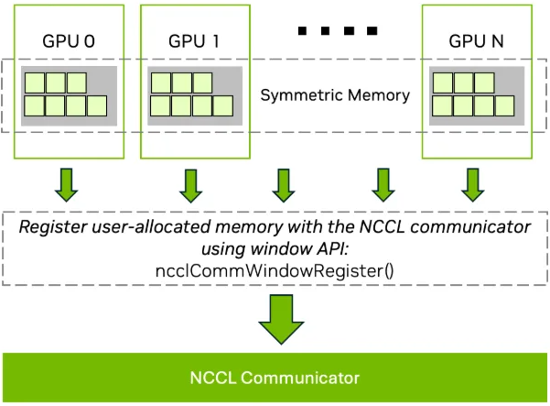
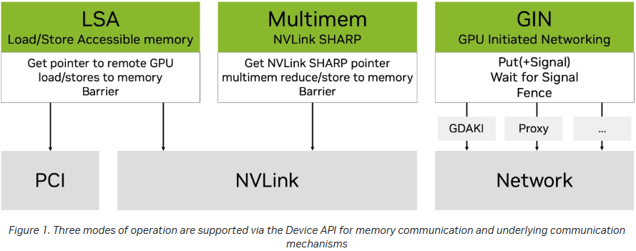
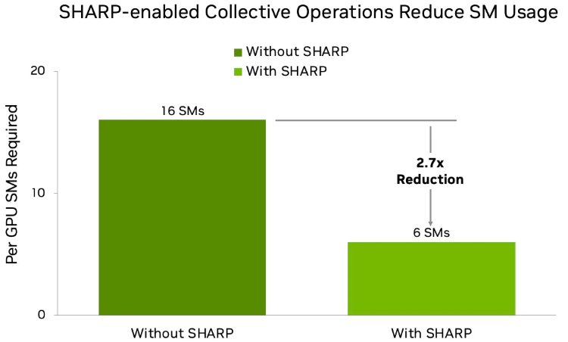
Background & Motivation (3/4)
Solution: The Architectural Evolution of NCCL
Symmetric Memory enables highly optimized, direct-access memory patterns. This streamlines data routing and serves as the foundation for the observed 9x reduction in small-message latency.
By bypassing the host-driven control path, GPU Initiated Networking eliminates the costly CPU-to-GPU handshake. This transition to autonomous, device-level orchestration drastically reduces overhead.
NCCL leverages In-Network Computing (SHARP) and dedicated Copy Engines to offload reduction and data-movement tasks. By migrating these operations from general-purpose SMs to specialized hardware, the system reclaims vital compute cycles and achieves true hardware-level overlap between communication and computation without resource contention.

Slide 11
Background & Motivation (4/4)
New problem encountered: The "Implementation Gap"
The Hardware-Software Friction: Cutting-edge AI applications are being developed over fast-evolving, heterogeneous, nascent hardware. Achieving peak communication performance currently mandates writing custom, low-level code from scratch, which is time-consuming and prone to technical debt.
The Rigidity of Current Standards: Existing open-source CCLs (such as NCCL) rely on fixed schedules and cannot adjust to varying topology and model requirements.
The 100K-GPU Bottleneck: As LLMs scale to clusters with over 100,000-GPU clusters, traditional collective communication methods encounter fundamental throughput and latency bottlenecks, limiting both efficient training and practical deployment.
How to improve?
Develop a reusable, high-level communication library that abstracts hardware complexity.
Implement efficient search strategies to explore the vast space of communication sub-demands.
Other solutions …

Slide 12
Outline
Introduction (3 min)
Background & Motivation (11 min)
Proposed Methods & Performance Evaluation (24 min)
MSCCL++ (8 min)
syCCL (8 min)
NCCLX (8 min)
Conclusions (2 min)
Q & A (5 min)

Slide 13
Outline
Introduction (3 min)
Background & Motivation (11 min)
Proposed Methods & Performance Evaluation (24 min)
MSCCL++ (8 min)
syCCL (8 min)
NCCLX (8 min)
Conclusions (2 min)
Q & A (5 min)

Slide 14
MSCCL++ (1/6)
There are various communication channels:
CPU-GPU: PCIe, NVLink-C2C
Intra-node: NVLink, xGMI,
Inter-node: RDMA (IB, RoCE)
Portability and Performance: MSCCL++ provides a reusable lib
a primitive interface provides a minimal hardware abstraction
higher-level portable interfaces and specialized implementations
MSCCL++ fundamentally rethinks GPU communication abstractions to address the limitations of existing libraries (like NCCL) in the face of rapidly evolving AI hardware and specialized workloads.

Slide 15
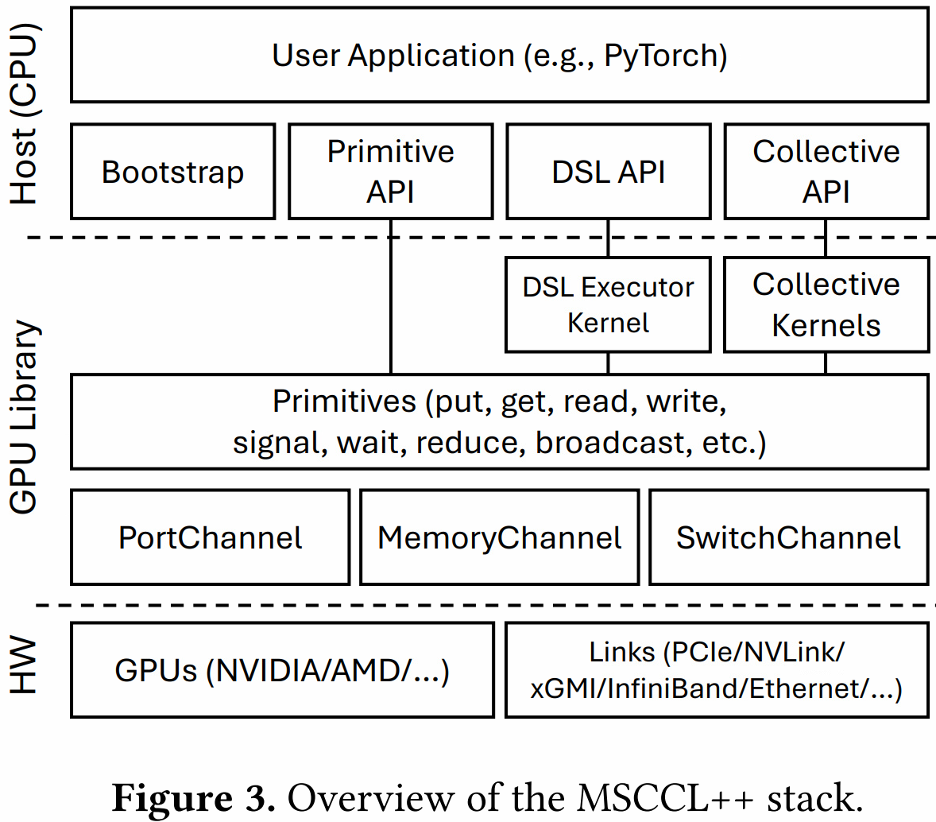
MSCCL++ (2/6)
Architecture Overview
MSCCL++ are building with an abstraction for various communication channels.
PortChannel: DMA engines on GPUs or RDMA NICs.
MemoryChannel: peer-to-peer memory access over NVLink / xGMI.
SwitchChannel: interconnection-switch-enabled multimem memory.

Slide 16
MSCCL++ (3/6)
Architecture Overview
All MSCCL++ primitives are defined as a method of a channel.
put: asynchronously transfers data from one GPU to another.
signal and wait: synchronize data transfer between GPUs.
flush: ensures the completion of preceded data transfer.

Slide 17
MSCCL++ (4/6)
Key ideas: ML workloads move fast! Separate high-level abstractions and optimizations from primitive hardware abstractions.
Application developers optimize and fine-tune by enabling precise control of the hardware
Library developers support new hardware features by only providing a shallow layer of abstraction over it
Basically, they are building a reusable communication library with an abstraction for various communication channels.

Slide 18
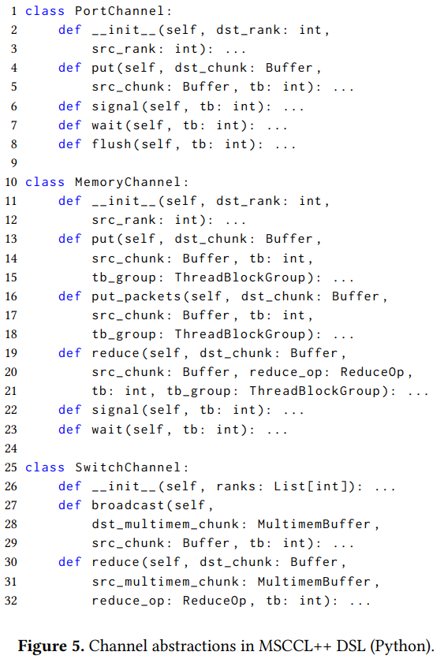
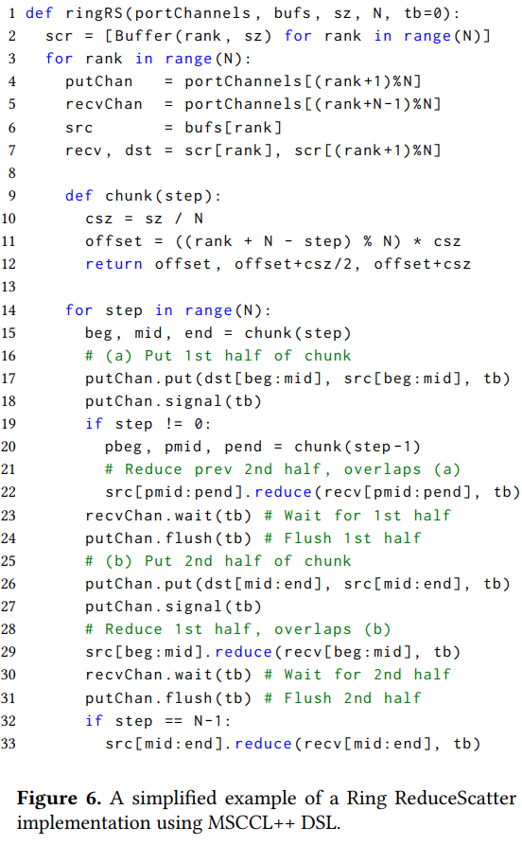
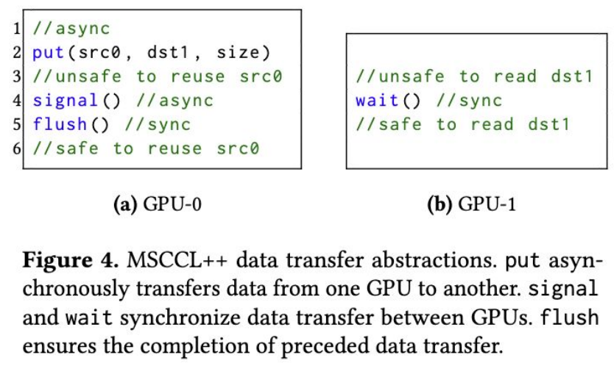
MSCCL++ (5/6)
Code Example

Slide 19
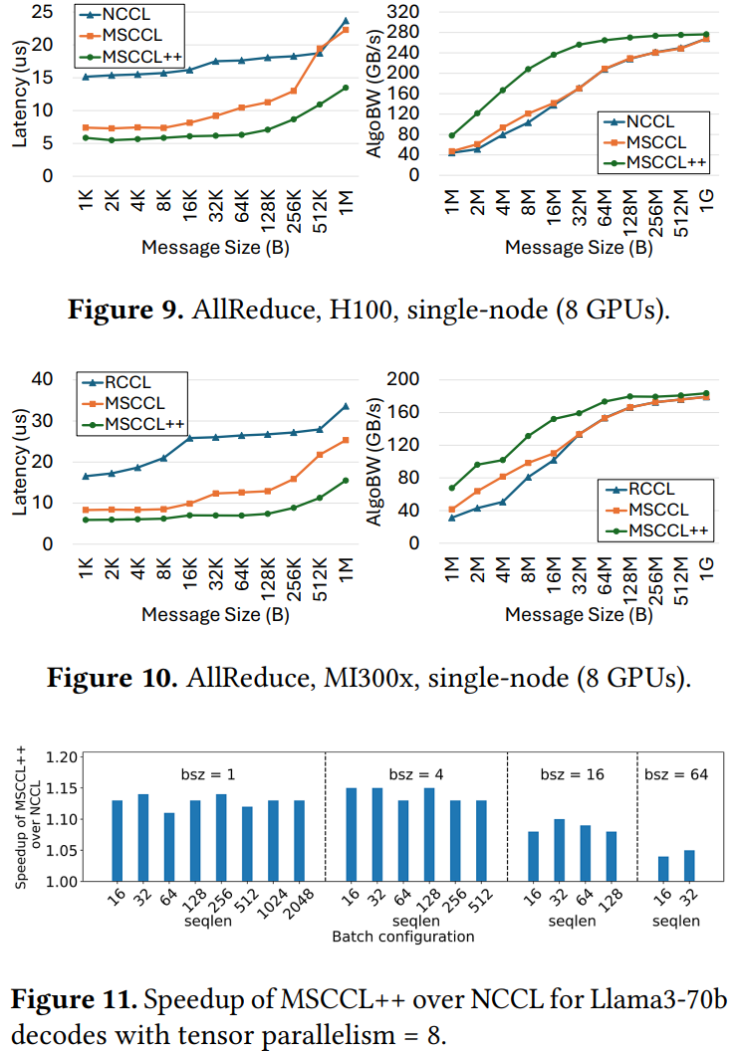
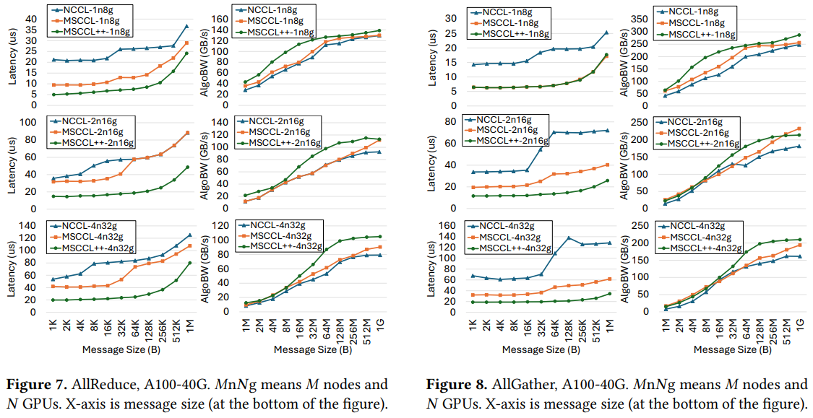
MSCCL++ (6/6)
Evaluation

Slide 20
Outline
Introduction (3 min)
Background & Motivation (11 min)
Proposed Methods & Performance Evaluation (24 min)
MSCCL++ (8 min)
syCCL (8 min)
NCCLX (8 min)
Conclusions (2 min)
Q & A (5 min)

Slide 21
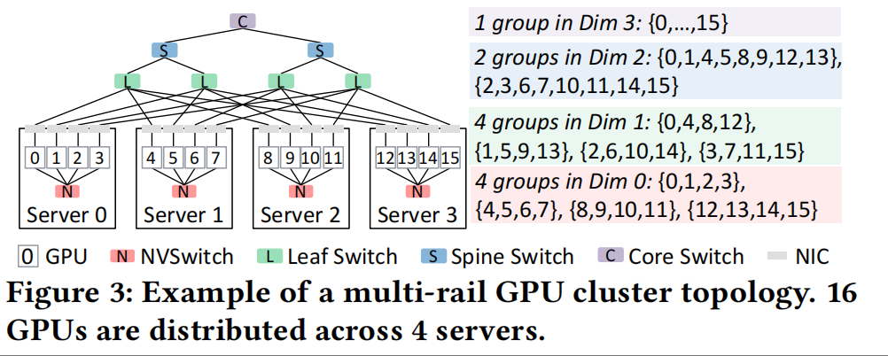
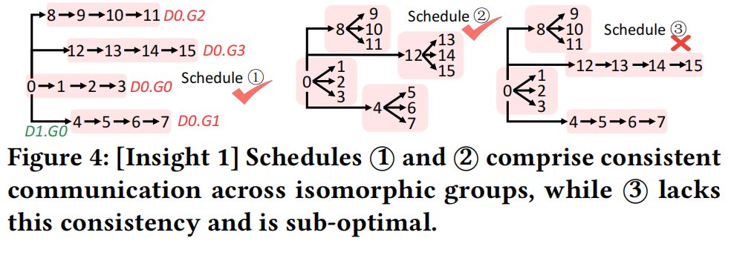
syCCL (1/7)
SyCCL reduces the exponential search space of large-scale collective scheduling by synergistically exploiting topological and collective symmetries to decompose global communication demands into tractable sub-problems.

Slide 22
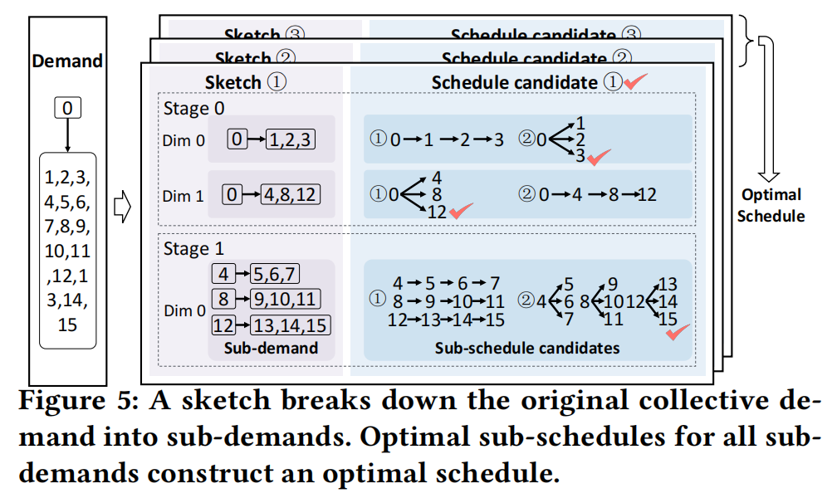
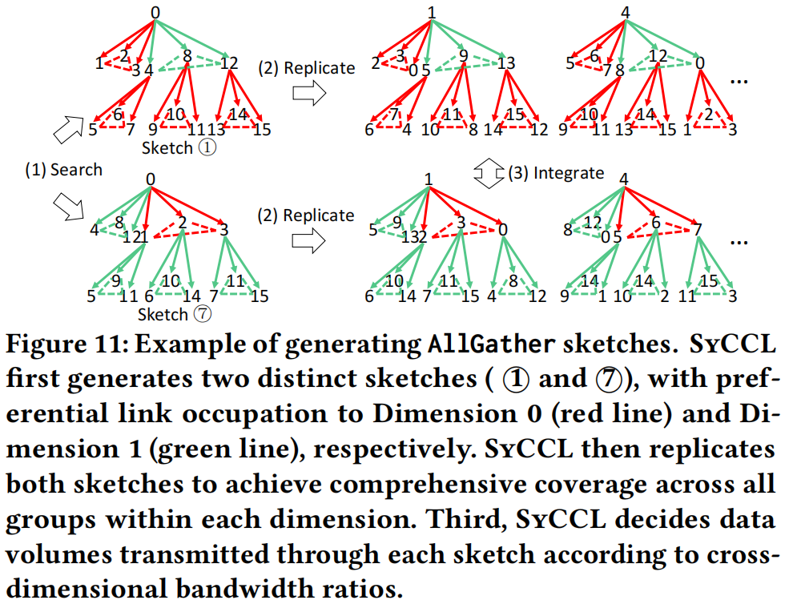
syCCL (2/7)
Three-Step Strategy Overview
Decompose: By utilizing symmetry, a large-scale communication demand (e.g., AllGather across 1024 GPUs) is broken down into multiple "sub-demands" mapped to smaller topological subsets (e.g., an 8-GPU single node).

Slide 23
syCCL (3/7)
Three-Step Strategy Overview
Search: Within the significantly reduced search space, a Mixed Integer Linear Programming (MILP) solver can find the optimal sub-schedules for the sub-topology in just a few minutes.
Integrate: These sub-schedules are assembled like building blocks. Through symmetry mapping, they are reconfigured into a complete, comprehensive scheduling plan that covers the entire large-scale cluster.

Slide 24
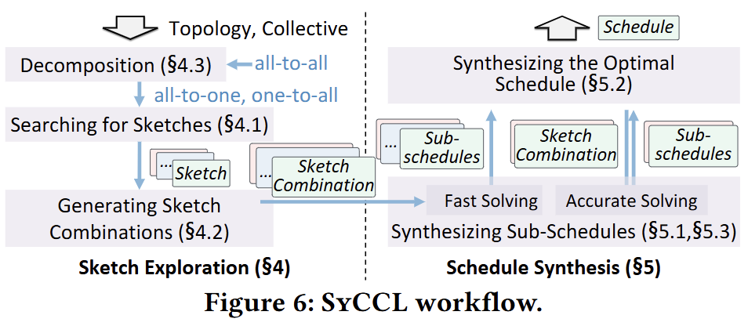
syCCL (4/7)
Architecture Overview
Sketch Exploration searches and composes candidate communication structures to generate high-quality sketches.
Schedule Synthesis generates concrete communication schedules and evaluates their performance given a sketch.

Slide 25
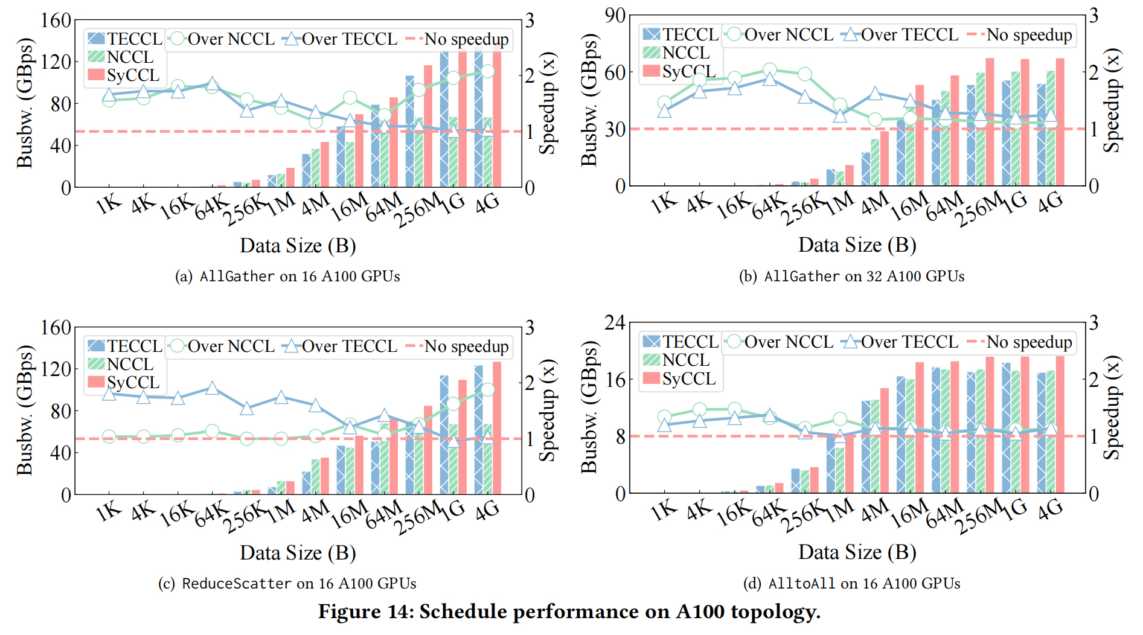
syCCL (5/7)
Evaluation

Slide 26
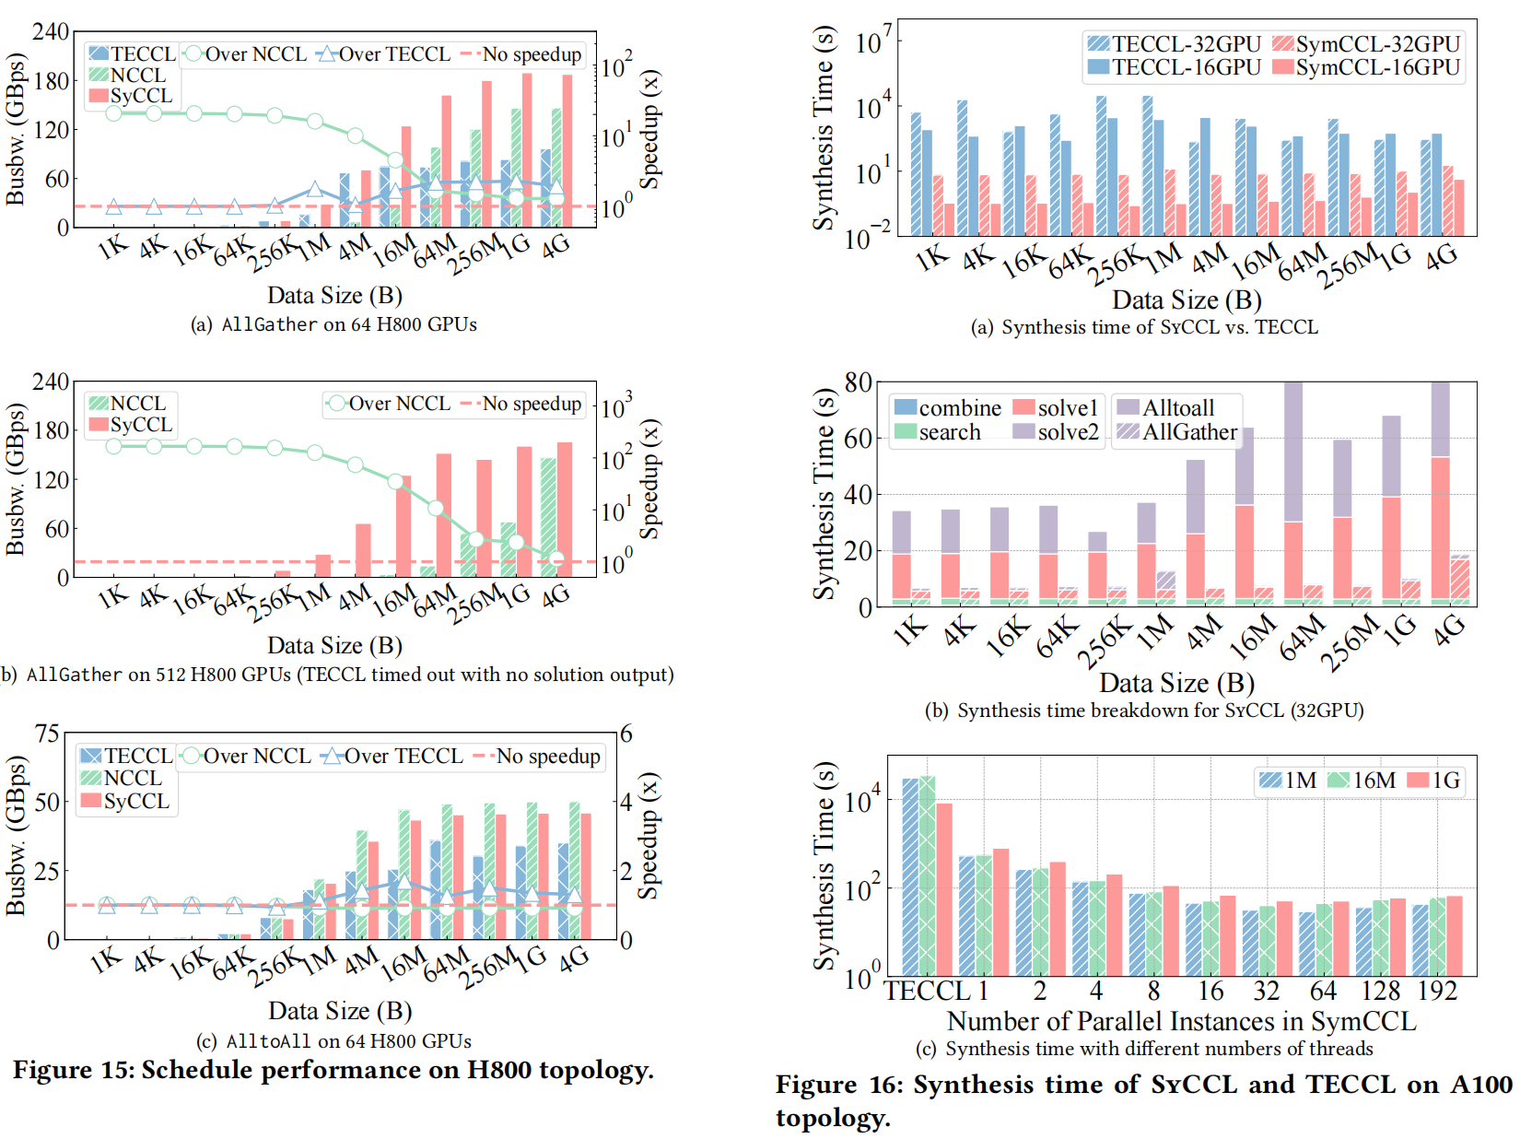
syCCL (6/7)
Evaluation

Slide 27
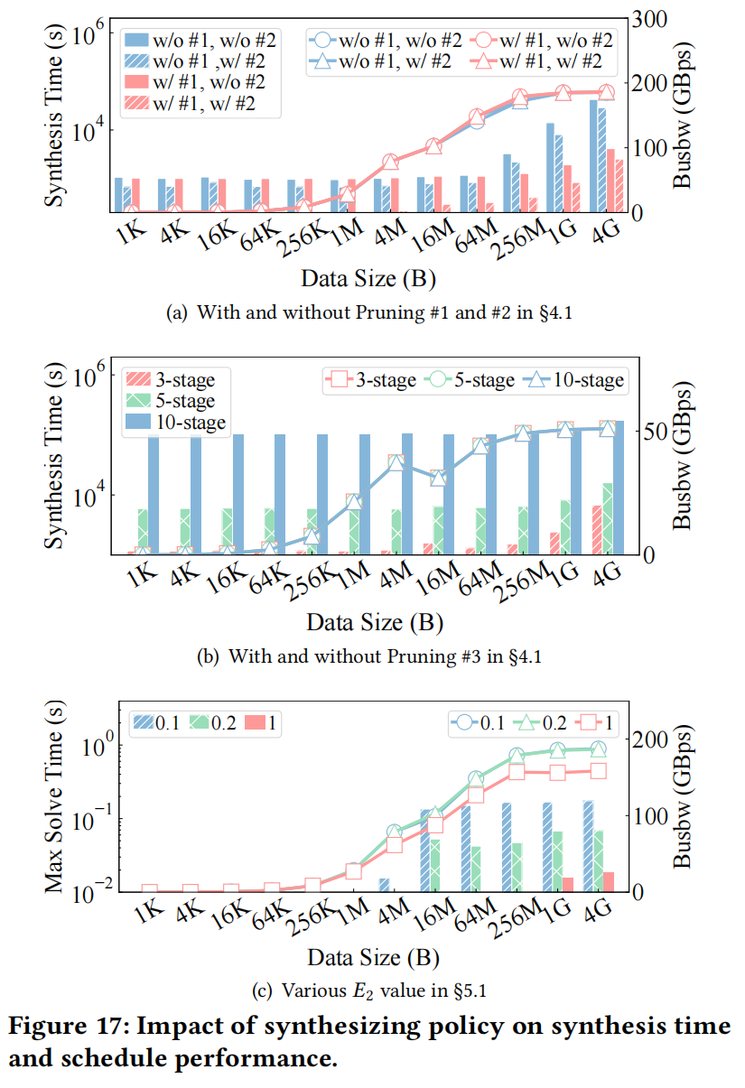
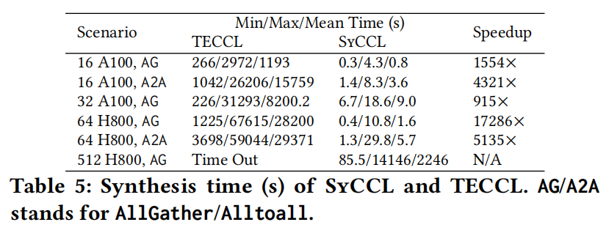
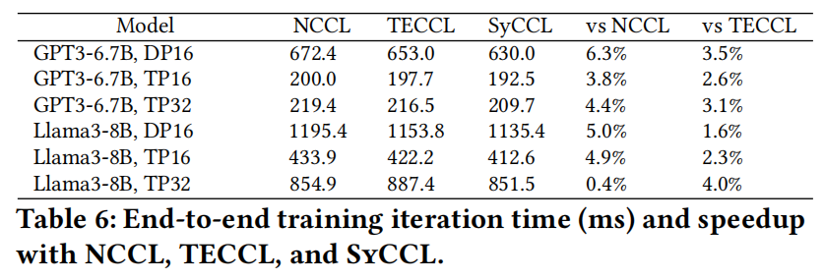
syCCL (7/7)
Evaluation

Slide 28
Outline
Introduction (3 min)
Background & Motivation (11 min)
Proposed Methods & Performance Evaluation (24 min)
MSCCL++ (8 min)
syCCL (8 min)
NCCLX (8 min)
Conclusions (2 min)
Q & A (5 min)

Slide 29
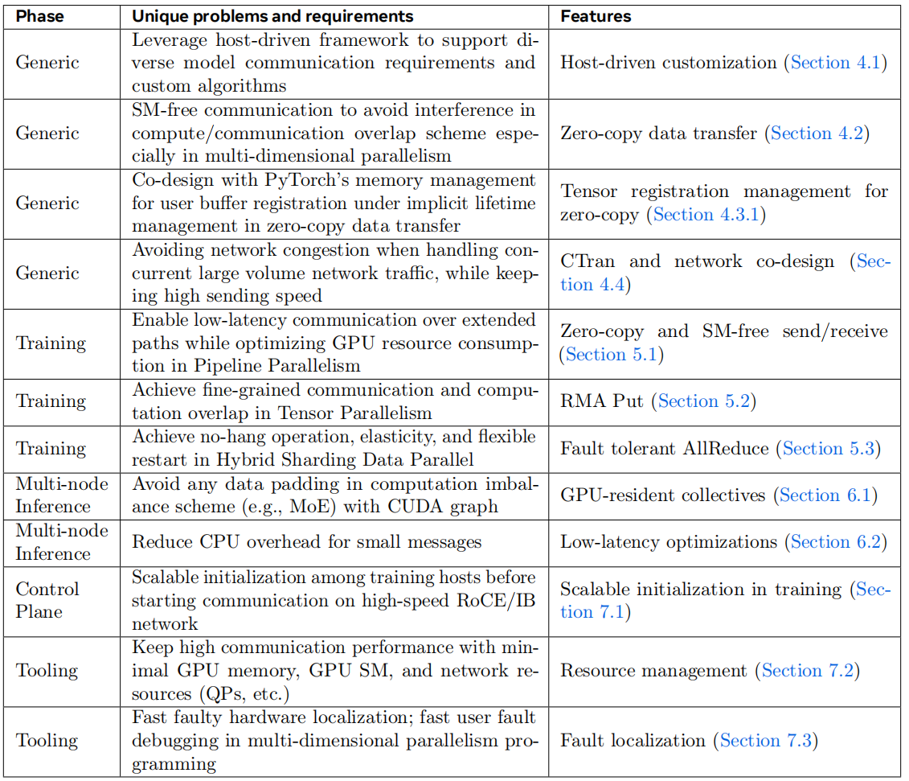
NCCLX (1/9)
Key Features
Host-driven customization framework
SM-free, zero-copy communication
Tensor registration management for zero-copy
CTran and network co-design
Pipeline Parallelism: zero-copy and SM-free send/receive
Tensor Parallelism: fine-grained overlap via RMA Put
Hybrid Sharding Data Parallelism: fault-tolerant AllReduce

Slide 30
NCCLX (2/9)
Key Features
GPU-resident collectives for imbalance-aware inference
Low-latency optimizations for small messages
Scalable initialization for large-scale training
Efficient resource management
Fast fault localization and debugging support

Slide 31
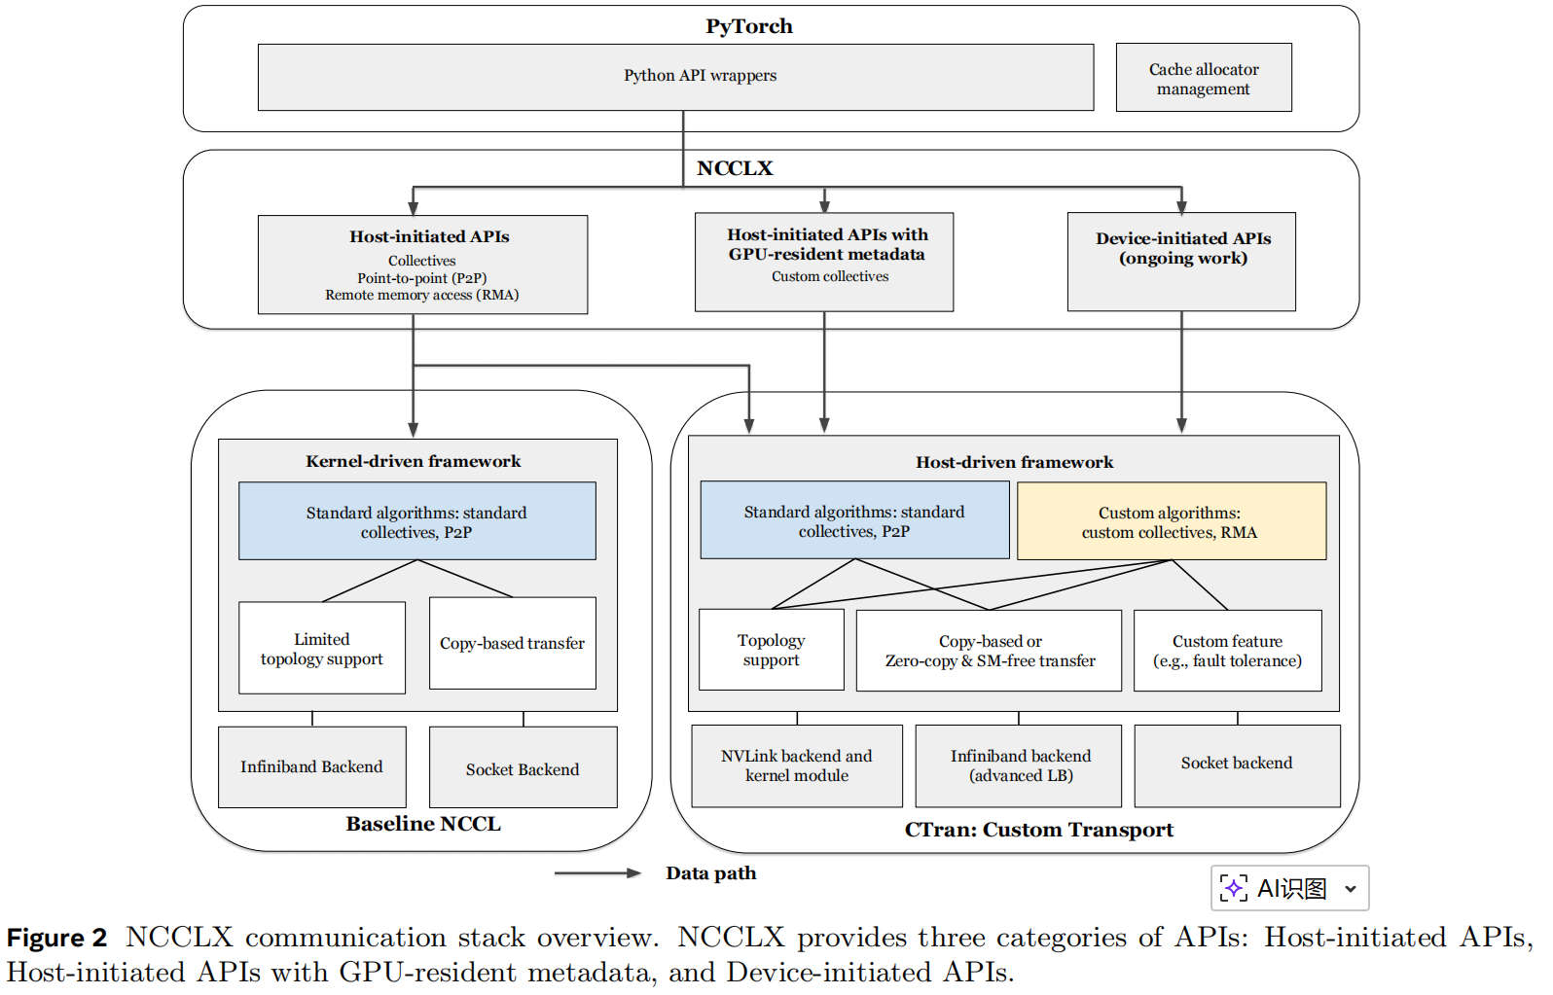
NCCLX (3/9)
Architecture Overview
Host-initiated APIs
Communication fully orchestrated by CPU
Removes unnecessary CPU–GPU synchronizations
Enables easy implementation of custom collectives
Host-initiated APIs with GPU-resident metadata
Host initiates communication
Decision-making uses metadata resident on GPUs
Designed for adaptive collectives, e.g., MoE routing-dependent communication

Slide 32
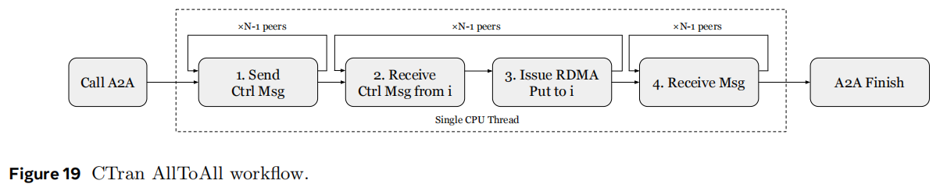
NCCLX (4/9)
Core Transport Layer: CTran, a custom-designed transport layer.
Its design is guided by two key principles: promoting zero-copy data transfer and avoiding GPU SM occupation whenever possible.
provides unified support for multiple execution models
offers richer communication semantics
supports multiple network backends, including NVLink, IB / RoCE and socket-based transports
highly optimized communication critical path

Slide 33
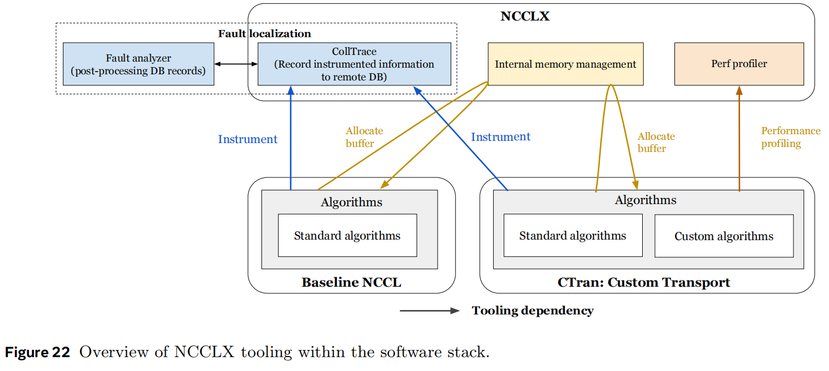
NCCLX (5/9)
Software tooling stack overview

Slide 34
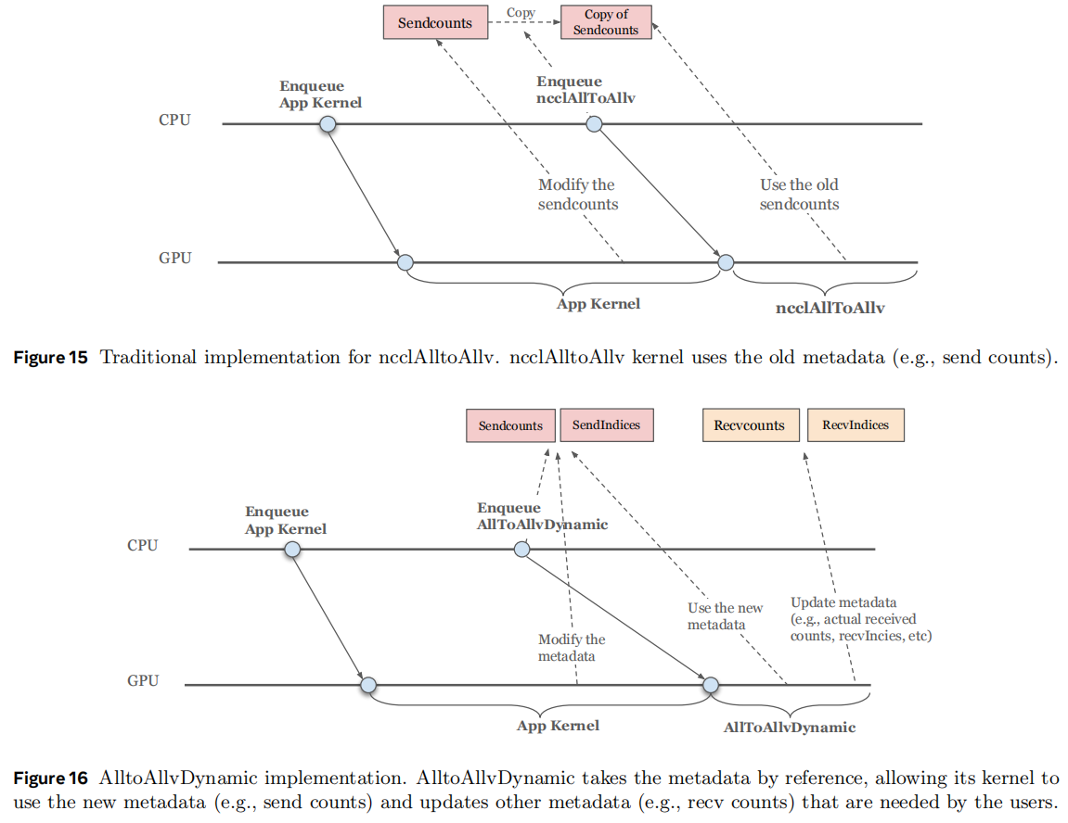
NCCLX (6/9)
ncclAllToAllv copies communication metadata (e.g., send counts) during both the initialization and enqueue phases. After the operation is enqueued on the CPU, other GPU kernels (e.g., the MoE router kernel), which may start execution before ncclAllToAllv, can modify the metadata stored in the original data structures.
In the design of GPU-resident collectives, AllToAllvDynamic takes metadata by reference rather than copying it during the enqueue phase.

Slide 35
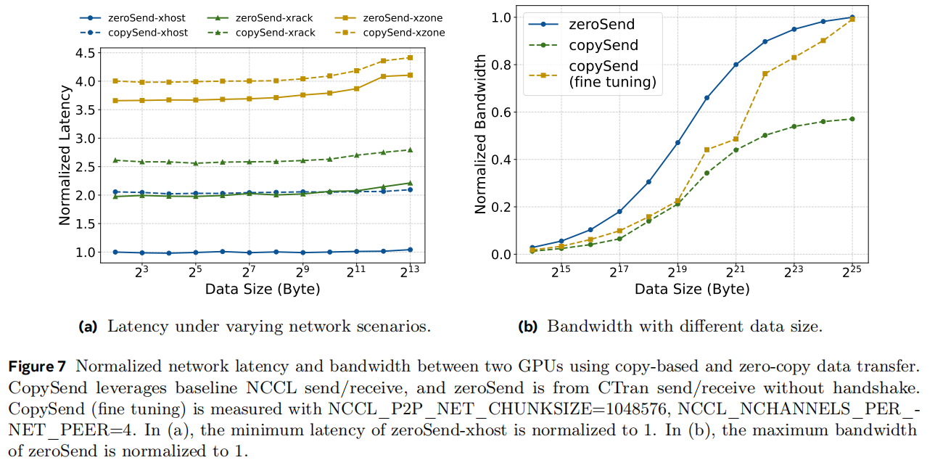
NCCLX (7/9)
Evaluation

Slide 36
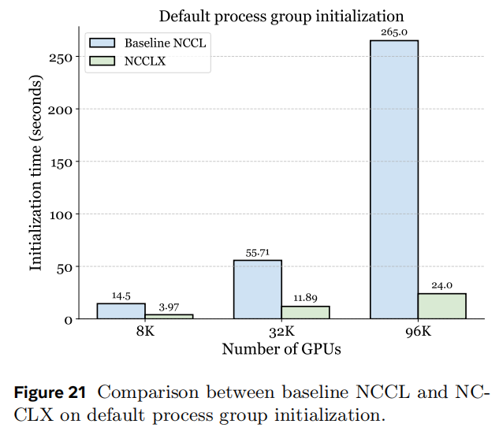
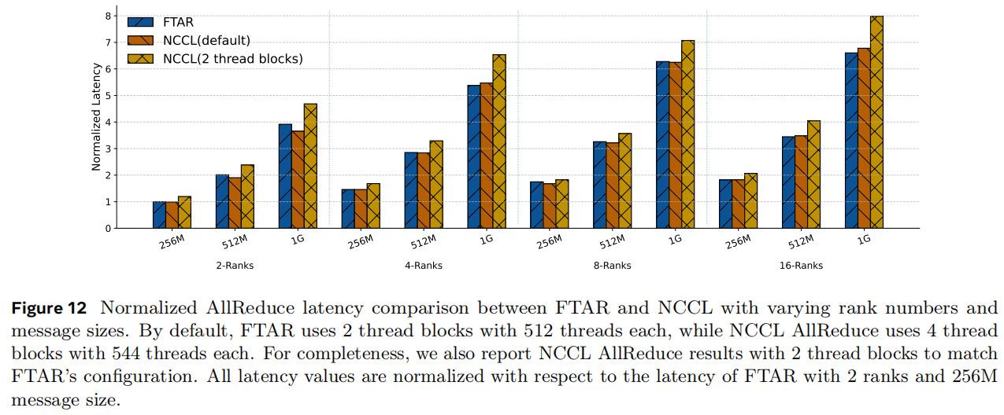
NCCLX (7/9)
Evaluation

Slide 37
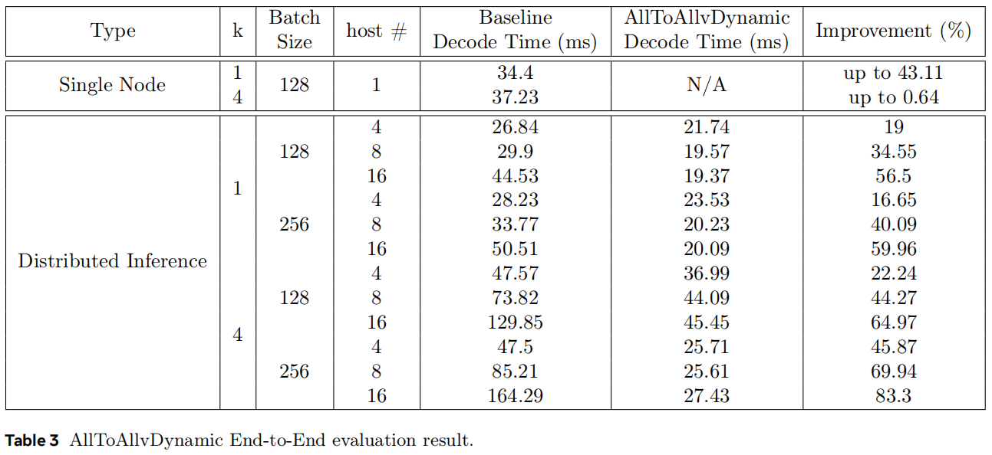
NCCLX (9/9)
Evaluation

Slide 38
Outline
Introduction (3 min)
Background & Motivation (11 min)
Proposed Methods & Performance Evaluation (24 min)
MSCCL++ (8 min)
syCCL (8 min)
NCCLX (8 min)
Conclusions (2 min)
Q & A (5 min)

Slide 39
Conclusions
Scheduling: From "Fixed Algorithms" to "Topology-Aware Synthesis".
Efficiency: From "Resource Contention" to "Hardware Offloading" .
Abstraction: From "Black-Box Libraries" to "Decoupled Primitives".
Scalability: From "Local Tuning" to "Systemic Self-Healing".
Summary:
Collective communication is evolving from a "monolithic library" into a deep hardware-software co-designed system—driven by mathematical synthesis, executed by dedicated hardware, and empowered by decoupled primitives.

Slide 40
Outline
Introduction (3 min)
Background & Motivation (11 min)
Proposed Methods & Performance Evaluation (24 min)
MSCCL++ (8 min)
syCCL (8 min)
NCCLX (8 min)
Conclusions (2 min)
Q & A (5 min)

