Slide 1
Research on Automated Code and Test Assertion Generation with LLMs 2026.1.22
Jiaming Huang
School of Data Science
Chinese University of Hong Kong, Shenzhen
Notes:
Hello everyone, I’m Jiaming Huang. The topic of my presentation is research on automated code and test assertion generation with LLMs. Both code and test assertion generation are of great significance to software development, and this is no exception for computer systems included in software development.

Slide 2
Outline
Introduction
Background & Motivation
Proposed Methods & Performance Evaluation
Summary
Q&A
Notes:
This is the outline of my presentation.

Slide 3
Introduction
Background & Motivation
Proposed Methods & Performance Evaluation
Summary
Q&A
Notes:
Let's introduce some preliminaries.

Slide 4
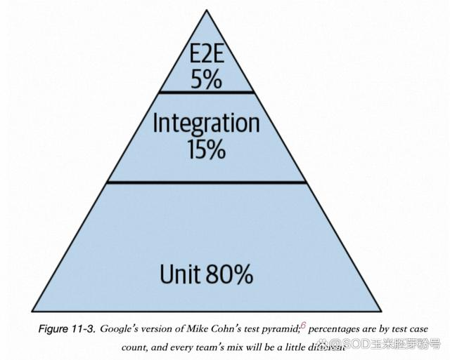
Introduction – What is Unit Test (1/3)
In different programming languages, the smallest units of the system may differ.
In procedural programming languages, the smallest unit is a function.
In object-oriented programming languages, the smallest unit is a class.
A unit test case verifies the correctness of the smallest unit of the system under testing.
[Software Engineering at Google]
Notes:
(after saying the content in the slide)Next, I would introduce the importance of automated code and test assertion generation.

Slide 5

Introduction – Importance (2/3)
The benefits of automated code generation are shown as follows:
Improve development efficiency
Improve code consistency and quality
Reduce the manual mistakes
Notes:
The first part is the importance of automated code generation

Slide 6

Introduction – Importance (3/3)
Improve testing efficiency
Reduce the knowledge requirement
and manual mistakes
Improve the quality of the system
under testing
Notes:
The second part focuses on the importance of automated unit test case generation. Unit testing can identify and fix code problems early in the software development process. However, writing unit tests requires a thorough understanding of the code under testing and extensive professional knowledge to define the test case parameters. And there are the benefits of automated unit test case generation(Reading the content of the slide). Therefore, it is urgent to improve the quality of automated unit test generation.

Slide 7
Introduction
Background & Motivation
Proposed Methods & Performance Evaluation
Summary
Q&A
Notes:
Let's introduce some preliminaries.

Slide 8
Background – Code Generation (1/6)
Natural Language and Program
Code Generation Method
Language Model
N-gram [Hindle 12]
RNN [Bhoopchand 16][Gu 16][Li 18]
Structural Model
TBCNN [Mou 16]
API Graph[Nyguyen 15]
Program Execution Model
Dynamic Embedding [Wang 16]
【Conclusion】 Traditional code generation primarily relies on the existing models. Since the models cannot fully capture the characteristics of programs based on natural language, their performance is too low to be applied in actual software development.
Notes:
Traditional code generation methods are mainly based on deep learning and can be divided into three categories: language models, structural models, and program execution models.
The main representative work of language models is xxx, the main representative work of structural models is xxx, and the main representative work of program execution models is xxx.
(xxx is in the slide, then read the conclusion)

Slide 9
Background – Code Generation (2/6)
Code Generation Methods Based on Large Language Models(LLMs)
The earliest method for generating function-level code with LLMs was based on GPT-3, trained on GitHub source code. At the same time, the HumanEval benchmark was proposed.[Chen 2021] etc.
CodeGen has trained and released a series of LLMs with up to 16.1B parameters for natural-language and programming-language data, and has opened the training library JAXFORMER.[Marcus 2022]etc.
StarCoder opens all models, data, and code. In addition, StarCoder also removes users' private information during training and excludes projects on GitHub that are not allowed by their licenses.[Li 2022]etc.
Codex
AlphaCode
CodeGen
PanGuCoder
StarCoder
WizardCoder
By leveraging a large and efficient model infrastructure and large-scale model sampling, AlphaCode improves code generation performance by exploring the search space and then filtering down to a small set of submissions based on program behavior. [Li 2021]
PanGu-Coder uses a two-stage strategy for training: the first stage involves pretraining on raw programming-language data using causal language modeling (CLM), while the second stage uses a combination of CLM and masked language modeling (MLM) training objectives.[Vinz 2022]
WizardCoder is based on StarCoder and has been trained with instruction prompt finetuning to produce a more effective model. It uses five types of prompt templates and achieves results far superior to StarCoder.[Nguyen 2023] etc.
Notes:
(final read conclusion) These works focus more on generating self-contained functions from models, without considering how to generate code more effectively for real development scenarios.

Slide 10
Background – Unit Test Generation (3/6)
Natural Language and Program
Unit Test Case Generation Method
Search-Based
Evosuite [Hindle 12]
Ad-hoc Testing
Randoop [Mou 16]
Combinatorial Testing
JBSE [Bhoopchand 16]
Symbolic Execution
KLEE [04]
【Conclusion】Traditional unit test case generation methods can produce test cases that achieve high coverage, but they cannot generate test assertions to find logical errors.
Notes:
Traditional unit test case generation methods are mainly divided into four categories: search-based, Ad-hoc testing, combinatorial testing, and symbolic execution. The main representative work of search-based methods is xxx, the main representative work of random testing is xxx, the main representative work of combinatorial testing is xxx, and the main representative work of symbolic execution is xxx.(xxx in the slide)

Slide 11
Background – Unit Test Generation (4/6)
Unit Test Case Generation Methods Based on Deep Learning and Large Language Models(LLMs)
ATLAS uses a neural machine translation (NMT)-based approach to automatically generate meaningful assertion statements for test methods..[Chen 2021] etc.
TOGA is a neural network-based approach that can infer anomalies and generate test assertions based on the context of the method under test.[Marcus 2022]etc.
ChatTester is a unit test generation method based on ChatGPT, which uses ChatGPT itself to improve the quality of the tests it generates.[Marcus 2022]etc.
ATLAS
Integration
TOGA
TestPilot
ChatTester
AGONETEST
Integration is making its first attempt to use information retrieval to generate test case assertions, including assertion-retrieval techniques based on information-retrieval and adaptive techniques for the retrieved assertions.[Li 2021]
AGONETEST is an automated system that generates test suites for Java projects. It includes a component for evaluating the generated test suites.[Nguyen 2023] etc.
TESTPILOT is an adaptive LLM-based JavaScript test generation tool that can automatically generate unit tests for methods in a given project's API.[Vinz 2022]
Notes:
(finally read the conclusion) Although these methods can generate assertions to detect logical errors, the resulting assertions have a very high false-positive rate.

Slide 12
Motivation – Code Generation (5/6)
Code Generation Benchmark for Real-world Development Scenario
Code Generation Method for Real-world Development Scenario
Challenge 1
How to select projects and code that can reflect real-world development scenarios, and set up an accurate and efficient testing environment.
How to select projects and functions, and how to prevent data leaks
How to Build an Accurate and Efficient Project-Level Testing Platform
Challenge 2
Code in real-world development scenarios often relies on functions or variables defined in other packages or files in the project.
How to select the appropriate contextual information
How to combine the selected contextual information
Notes:
This is the motivation for the research: to solve those challenges. These are the challenges in code generation.

Slide 13
Motivation – Unit Test Generation (6/6)
Unit Test Case Assertion Generation Method
Incorrect Unit Test Case Assertion Detection Method
Challenge 3
How to generate correct assertions based on the natural-language description and the program under testing
How to generate correct assertions without executing the program under test
How to generate accurate assertions using as few computing resources as possible
Challenge 4
How to detect incorrect unit test cases generated by LLMs based on natural-language descriptions
How to generate reliable postconditions
How to detect incorrect assertions through postconditions
Notes:
And these are the challenges in unit test case generation.

Slide 14
Introduction
Background & Motivation
Proposed Methods & Performance Evaluation
Summary
Q&A
Notes:
And now, we have a basic understanding of the software, hardware, and network of the cloud, along with their limitations. We introduce the methods to enhance the cloud reliability from these three aspects.

Slide 15
CoderEval (1/5)
Before July 2021, automatic code generation methods used similarity to evaluate the quality of generated code.
In July 2021, Codex used the Pass@k metric to evaluate the quality of code generated by large models.
Return a greatest common divisor of two integers a and b
def greatest_common_divisor(a: int, b: int) -> int:
greatest_common_divisor(3, 5) = 1 greatest_common_divisor(25, 15) = 5
while b: a, b = b, a % b return a
You only need to provide a standard Python environment to test whether the function under test in HumanEval is correct.
Notes:
(begin)To solve Challenge 1, CoderEval is proposed. It is a Code Generation Benchmark for Real-World Development Scenarios.
(then read “before July 2021…”, and implemented with “which is unreasonable.”)
(read comment)In July 2021, Codex proposed the HumanEval benchmark and used the Pass@k (correctness) metric to evaluate the quality of code generated by large models. It received widespread attention from both academia and industry. Subsequently, many large code models were proposed in academia and industry, such as AlphaCode, CodeGen, InCoder, and PanGu-Coder. All of the above large code models use Pass@k to assess the correctness of the code they generated.
However(then read “you only…”), a project-executable environment is required to test the correctness of this function in real-world development; more than 70% of functions require such an environment to run tests, which is not considered by HumanEval.

Slide 16
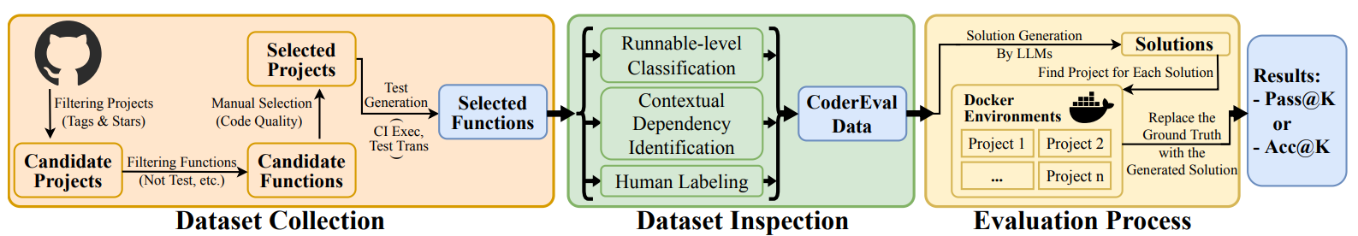
CoderEval— Construction (2/5)
Dataset Collection: Candidate item selection, function selection, final item selection, test case selection
Dataset Inspection: Context-Dependent Analysis and Identification, Function Executable-Level Classification, Manually Labeled Function Descriptions
Evaluation Process: Incremental compilation execution improves evaluation speed, and Docker ensures execution security.
Notes:
To solve the shortcomings in HumanEval, CoderEval uses a three-stage approach to construct a benchmark for real-world development scenarios.

Slide 17
CoderEval – Dataset Collection(3/5)
Notes:
Candidate project selection: Choose projects that belong to the 14 most frequently occurring tags and have high ratings.
Function selection: the candidate must not be a test function, not an interface function, not a deprecated function, use English function-level comments, can run successfully on the verification platform, and pass the project's own test cases
Final project selection: prioritize projects that include more of the selected functions
Test case: Construct a constructor call graph to obtain the test cases corresponding to the function under test

Slide 18
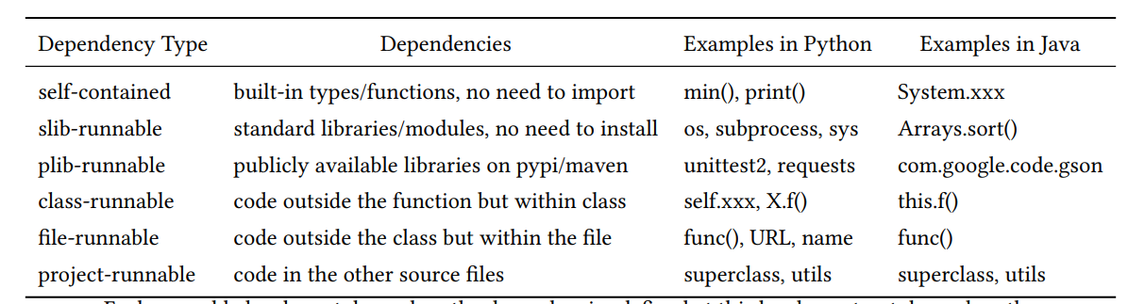
CoderEval – Dataset Inspection (4/5)
…
Notes:
As shown in the table, CoderEval divides the objective function into six operational levels.
In CoderEval, self-contained and slib-runnable level functions are considered self-contained functions, while other runnable levels are considered non-self-contained functions.
There are three main reasons for including manually annotated docstrings in CoderEval: (1) To mitigate the memory effects of LLMs (2) To study the performance of LLMs on different function descriptions (3) To provide high-quality docstrings for the functions in CoderEval

Slide 19
CoderEval – Evaluation Process (5/5)
…
Notes:
To provide a ready-to-use runtime environment for automatically executing and evaluating model-generated functions, an evaluation platform based on Linux Docker images has been built. This platform offers a virtual sandbox for safe execution.

Slide 20
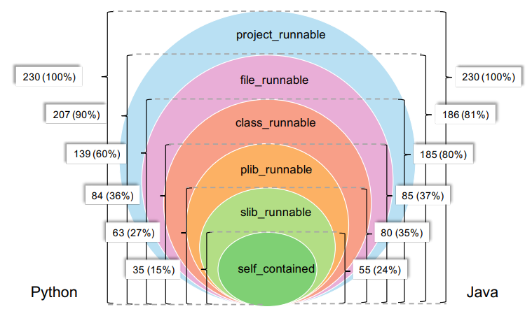
Evaluation – CoderEval (1/2)
Notes:
In CoderEval, over 70% of functions are non-self-contained functions.

Slide 21
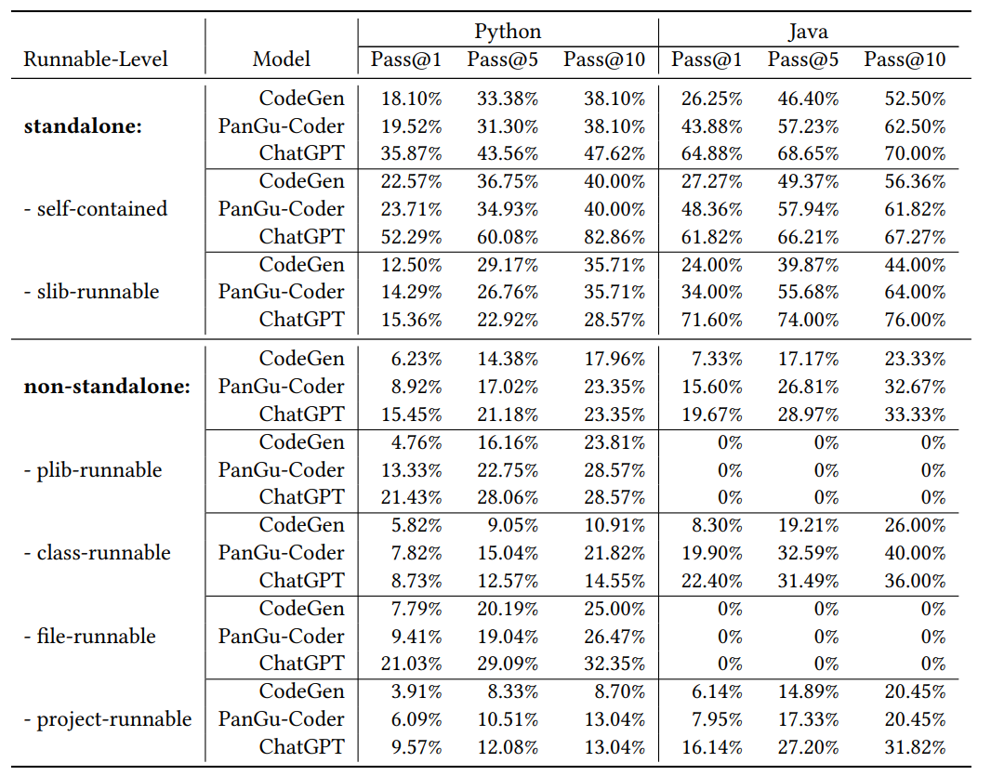
Evaluation – CoderEval (2/2)
Pass@K: The percentage of questions for which at least one of the K samples generated by the model is correct
Notes:
All models are much more effective at generating self-contained functions than at generating non-self-contained functions.

Slide 22
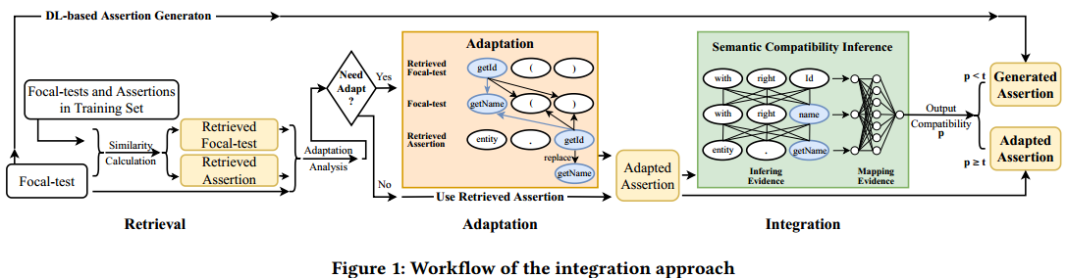
Integration – Unit Test Generation (1/1)
Unit Test Case Generation Based on the Combination of Information Retrieval and Deep Learning
Notes:
Since Challenge 2 is complex and time is limited, I would skip it and present the work on Challenge 3 directly. The work is based on the Combination of Information Retrieval and Deep Learning. The method’s baseline uses Large Language Models (ChatGPT) to Generate Unit Test Case Assertions. Then, it utilizes Information Retrieval (IR) to generate assertions. There are two IR-based approaches (which are IR-based assertion retrieval and assertion adaptation for retrieval). To further improve the effectiveness of generating unit test case assertions, a method called Integration based on information retrieval combined with deep learning is proposed. The evaluation results are shown as follows.

Slide 23
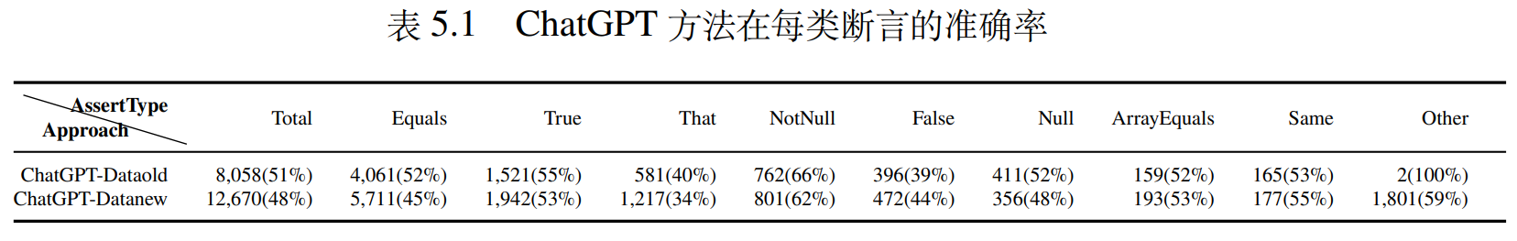
Evaluation – Integration (1/2)
Use GPT-3.5-Turbo as the core model of ChatGPT to generate a statement for each focal test. Set the temperature and top-k to 0.8 and 0.95, respectively.
Observation: On datasets from real development scenarios, ChatGPT correctly generates nearly half of the test case assertions.
Notes:
This is the result of the DL-based method, which only uses ChatGPT.(read observation)

Slide 24
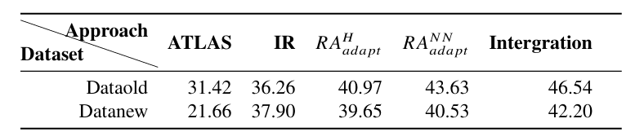
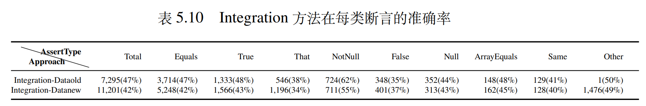
Evaluation – Integration (2/2)
Notes:
Here are the experiment results. This table shows the effectiveness of Integration across all assertions and for each assertion type. Integration consistently outperforms DL-based and IR-based methods on all assertions. The results indicate that the Integration method is effective and also suggest that combining DL-based and IR-based methods could be a promising direction for automatic assertion generation.

Slide 25
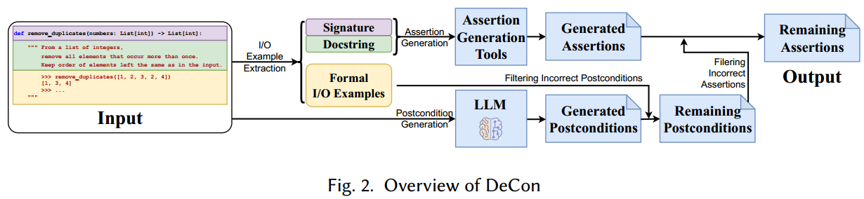
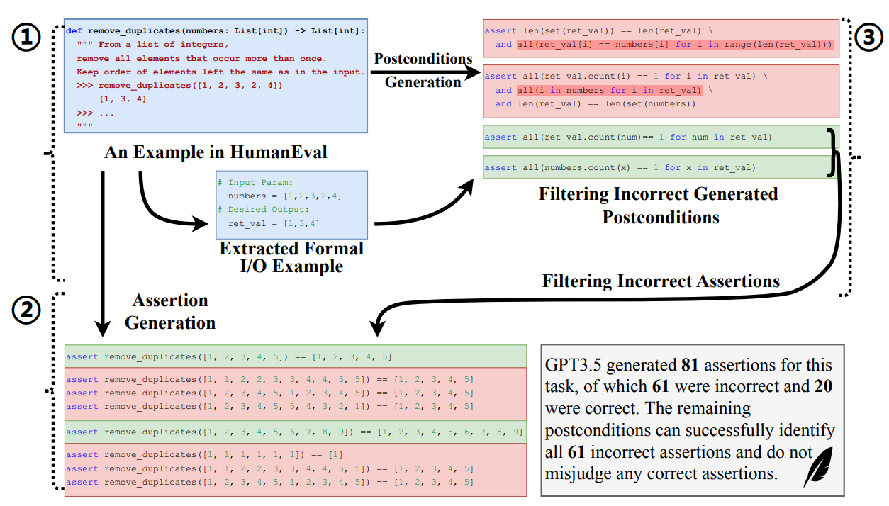
Decon – Detect Unit Test Cases (1/1)
The diagram above shows the overall flowchart of DeCon. The key idea of DeCon is to use postconditions to filter out incorrect assertions.
Notes:
Finally, we would introduce a work called Decon to solve Challenge 4: How to detect incorrect unit test cases.
Although traditional unit test case generation tools can achieve high coverage, they cannot detect logic errors in programs. Unit test case generation methods based on deep learning (including large models) can detect logic errors, but the generated test cases have a high rate of false-positive assertions. (then read the content in slide)
(final read the following) First, Decon extracts formalized inputs and expected outputs from the docstring. Then, it uses an LLM to generate postconditions for the given function signature and description. Next, it uses the formalized input and output examples to filter out any incorrect postconditions generated by the LLM. Finally, it uses the remaining postconditions to detect assertions that violate these postconditions.

Slide 26
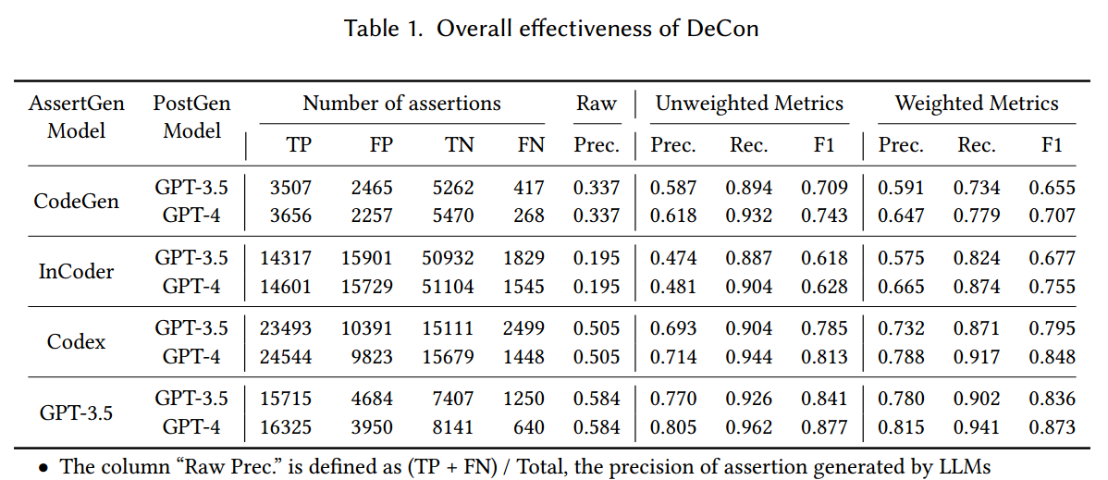
Evaluation – Decon (1/2)
The effectiveness of DeCon in detecting the validity of erroneous assertions
Accuracy Improvement: DeCon improves the accuracy of assertions by at least 31.8%, indicating that DeCon can effectively enhance the accuracy of LLM-generated assertions by detecting incorrect assertions. Trade-offs between accuracy and recall: DeCon achieves an average F1 score of 0.752.

Slide 27
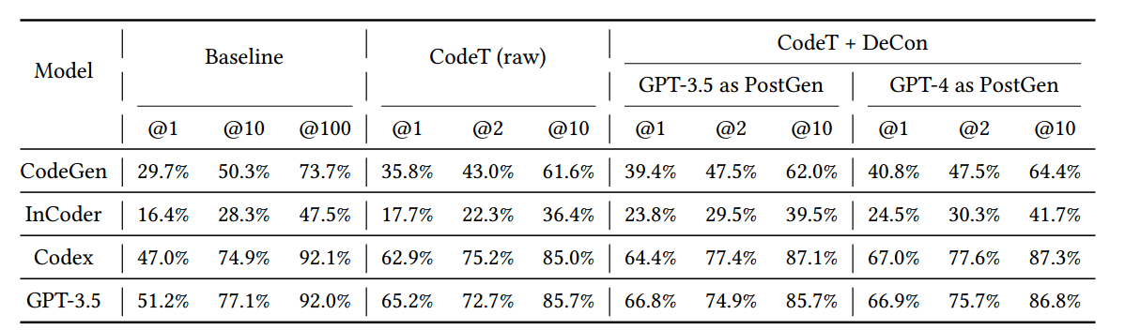
Evaluation – Decon (2/2)
The effectiveness of DeCon in improving the code generation performance of large models
Notes:
From the table, we can find that DeCon can effectively improve the performance of LLM code generation. And DeCon using GPT-4 as the PostGen model is more effective than DeCon using GPT-3.5, indicating that DeCon has greater capability for generating postconditions with a more effective model.

Slide 28
Introduction
Background & Motivation
Proposed Methods & Performance Evaluation
Summary
Q&A

Slide 29
Summary
CoderEval: A benchmark for code generation reflecting real-world development scenarios Integration: Method for Generating Unit Test Case Assertions Based on the Integration of Information Retrieval and Deep Learning DeCon: Method for detecting incorrect unit test case assertions
Notes:
In this talk, I present three works on Automated Code and Test Assertion Generation with LLMs.
CoderEval: A benchmark for code generation reflecting real-world development scenarios Select projects based on tags and star counts to obtain projects that reflect real development scenarios. Prevent data leaks by manually labeling docstrings. Improve project-level evaluation efficiency through incremental compilation.
Integration: Method for Generating Unit Test Case Assertions Based on the Integration of Information Retrieval and Deep Learning: Generate high-quality assertions through information retrieval, program analysis modifications, and methods combined with deep learning. By comparing this with assertions generated directly from large models, it highlights that methods using fewer computational resources still have advantages. DeCon: Method for detecting incorrect unit test case assertions Generate high-quality postconditions with a small number of input-output examples. Detect incorrect assertions through postconditions.

Slide 30
Thanks for listening
Q&A

