Slide 1
End-to-End AI Inference Systems for Real-Time Healthcare
Xinyuan Zhang
School of Data Science
Chinese University of Hong Kong, Shenzhen

Slide 2
Outline
Introduction
Related Work
Preliminaries
Proposed Methods
Performance Evaluation
Conclusions

Slide 3
End-to-End AI Inference Systems for Real-Time Healthcare
Introduction
Related Work
Preliminaries
Proposed Methods
Performance Evaluation
Conclusions

Slide 4
Introduction (1)
Objective
Real-time healthcare AI: surgery assistance · ICU early warning · clinical note generation · decision support
Shift: offline analysis → live intervention
Latency = safety requirement (not just performance)
Why OS matters
Mixed-criticality workloads: admin vs life-critical inference
Limited compute resources (shared CPU/GPU)
“Polite” OS fairness ≠ clinical priority
Goal
Priority-aware resource allocation
Real-time scheduling · resource management · GPU prioritization
Predictable latency · reliable clinical inference

Slide 5
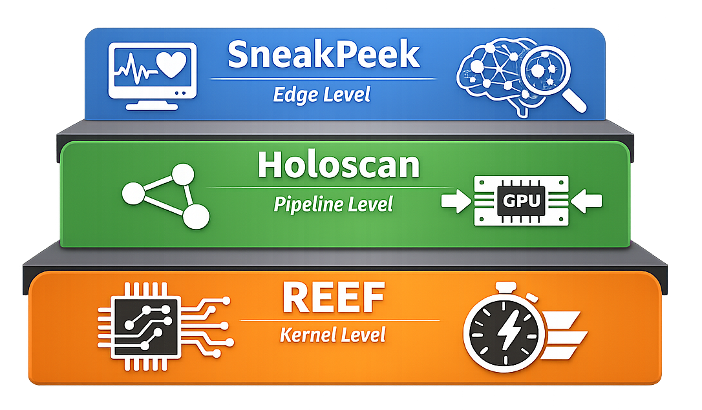
Introduction (2)
[1] Han, M., Zhang, H., Chen, R., & Chen, H. (2022). Microsecond-scale preemption for concurrent {GPU-accelerated}{DNN} inferences. In 16th USENIX Symposium on Operating Systems Design and Implementation (OSDI 22) (pp. 539-558).
[2] Sinha, S., Dwivedi, S., & Azizian, M. (2024). Towards deterministic end-to-end latency for medical AI systems in NVIDIA Holoscan. In 2024 ACM/IEEE 15th International Conference on Cyber-Physical Systems (ICCPS) (pp. 235–246).
[3] J., Frink, D., & Chandra, A. (2025, November). SneakPeek: Data-Aware Model Selection and Scheduling for Inference Serving on the Edge. In Proceedings of the 2025 ACM Symposium on Cloud Computing (pp. 748-761).

Slide 6
End-to-End AI Inference Systems for Real-Time Healthcare
Introduction
Related Work
Preliminaries
Proposed Methods
Performance Evaluation
Conclusions

Slide 7
Related Work
Inference serving systems
Clipper (NSDI ’17): low-latency prediction serving layer [1]
Clockwork (OSDI ’20): predictable DNN inference; tail-latency control [2]
INFaaS (ATC ’21): “model-less” serving; dynamic model-variant selection [3]
Tail latency & isolation
The Tail at Scale (Dean & Barroso): tail dominates SLO violations [4]
Heracles: coordinated isolation for SLOs under colocation [5]
GPU scheduling & preemption
Chimera (ASPLOS ’15): collaborative GPU preemption; controlled multitasking [6]
Tanasic et al. (ISCA ’14): HW support for preemptive GPU multiprogramming [7]
[1] Crankshaw, D., Wang, X., Zhou, G., Franklin, M. J., Gonzalez, J. E., & Stoica, I. (2017). Clipper: A {Low-Latency} online prediction serving system. In 14th USENIX Symposium on Networked Systems Design and Implementation (NSDI 17) (pp. 613-627).
[2] Gujarati, A., Karimi, R., Alzayat, S., Hao, W., Kaufmann, A., Vigfusson, Y., & Mace, J. (2020). Serving {DNNs} like clockwork: Performance predictability from the bottom up. In 14th USENIX Symposium on Operating Systems Design and Implementation (OSDI 20) (pp. 443-462).
[3] Romero, F., Li, Q., Yadwadkar, N. J., & Kozyrakis, C. (2021). {INFaaS}: Automated model-less inference serving. In 2021 USENIX Annual Technical Conference (USENIX ATC 21) (pp. 397-411).
[4] Dean, J., & Barroso, L. A. (2013). The tail at scale. Communications of the ACM, 56(2), 74-80.
[5] Lo, D., Cheng, L., Govindaraju, R., Ranganathan, P., & Kozyrakis, C. (2015, June). Heracles: Improving resource efficiency at scale. In Proceedings of the 42nd Annual International Symposium on Computer Architecture (pp. 450-462).
[6] Park, J. J. K., Park, Y., & Mahlke, S. (2015). Chimera: Collaborative preemption for multitasking on a shared GPU. ACM SIGARCH Computer Architecture News, 43(1), 593-606.
[7] Tanasic, I., Gelado, I., Cabezas, J., Ramirez, A., Navarro, N., & Valero, M. (2014). Enabling preemptive multiprogramming on GPUs. ACM SIGARCH Computer Architecture News, 42(3), 193-204.

Slide 8
End-to-End AI Inference Systems for Real-Time Healthcare
Introduction
Related Work
Preliminaries
Proposed Methods
Performance Evaluation
Conclusions

Slide 9
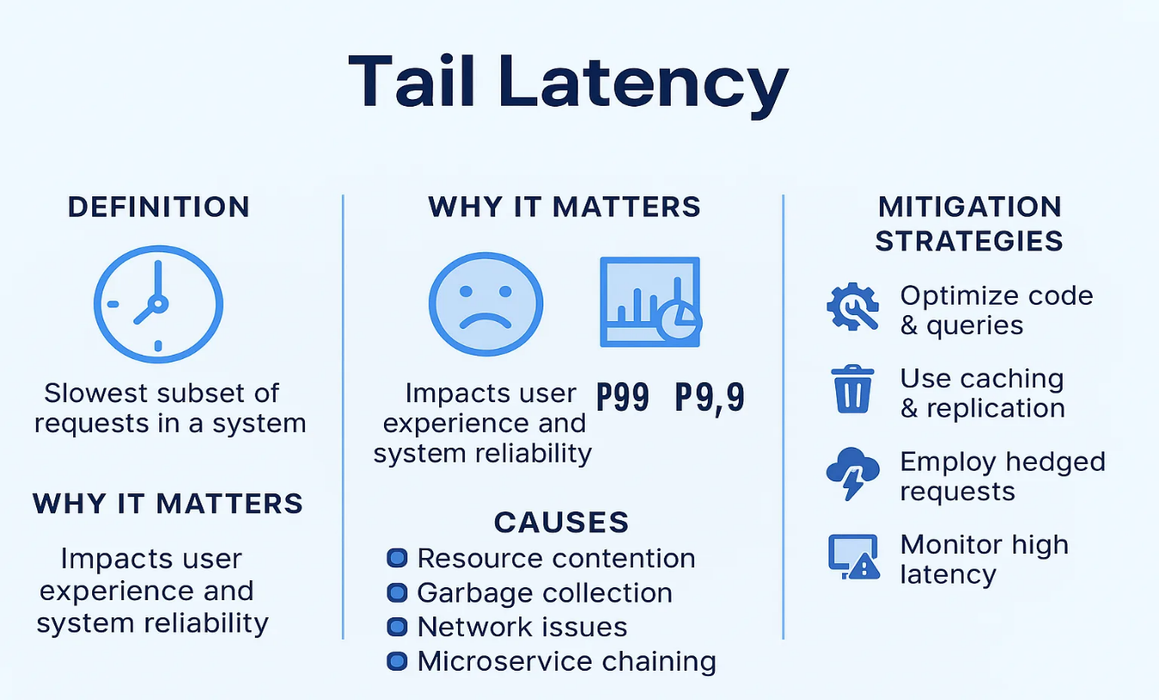
Preliminaries - SLOs & tail latency
SLO definition
“X% requests < deadline D”
Percentile target (e.g., P99)
Healthcare requirement
Few misses still harmful
Tail = safety-critical
Why tail matters
Pipeline compounding (capture → preproc → inference → render)
Interference / contention–driven (OS-controlled factors)
Key takeaway
Optimize beyond mean: max latency + jitter
Goal: predictable end-to-end timing

Slide 10
Preliminaries - GPU Non-Preemption
CPU vs GPU execution
CPU: frequent time-slicing
GPU kernels: run-to-completion (limited preemption)
Problem
Long best-effort kernel blocks urgent inference
Head-of-line blocking
Tail latency spikes
System trade-off
Reserve GPU for real-time → underutilization
Share GPU → deadline/SLO risk

Slide 11
Preliminaries - Determinism & Jitter
Why determinism in healthcare
OR setting: jitter > slow
Stable delay tolerable; unpredictable delay breaks hand–eye coordination & trust
Source of variability
Inference + real-time visualization (graphics + compute)
Shared GPU: streams / contexts / scheduling interactions
Contention without strong isolation → latency dispersion
Deterministic-latency objective
Tighten latency distribution
↓ max latency
↓ tail spread
↓ jitter
(not only ↓ average)

Slide 12
Preliminaries - Edge Constraints
Hospitals = fixed edge budget
Often 1 GPU, no elastic scaling
Local edge: ↓ WAN latency, ↓ privacy risk
Two coupled choices
Model variant: accuracy ↔ latency
Scheduling: order / batch for deadlines
Goal
Max utility = accuracy − deadline penalties

Slide 13
End-to-End AI Inference Systems for Real-Time Healthcare
Introduction
Related Work
Preliminaries
Proposed Methods
Performance Evaluation
Conclusions

Slide 14
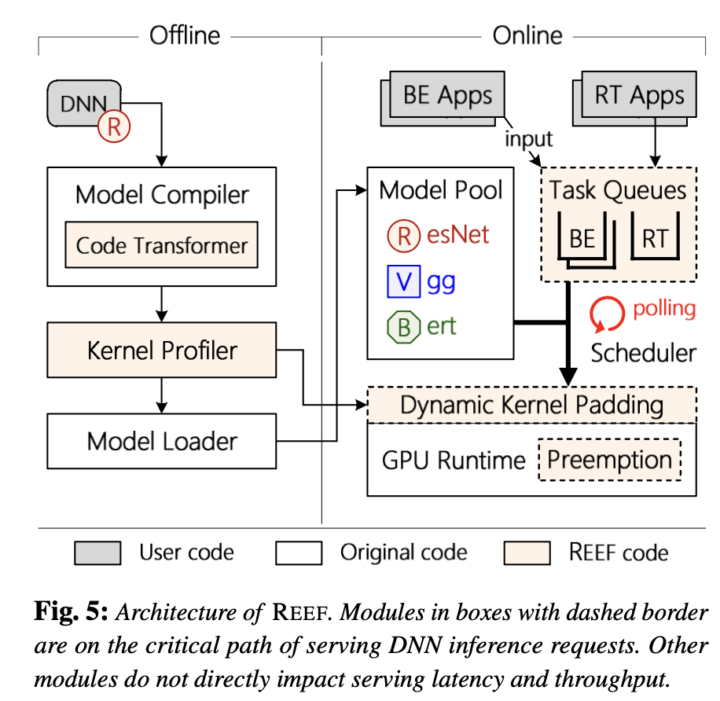
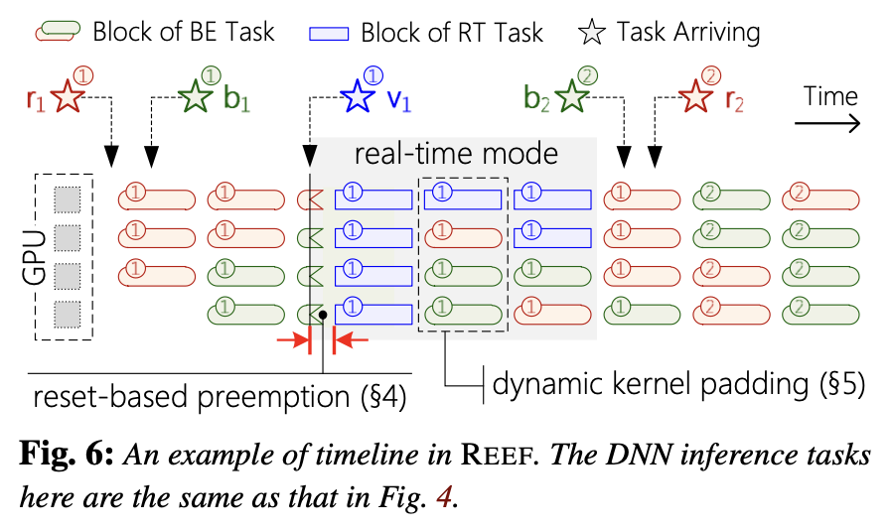
Proposed Methods - REEF
Fig.2: An example of timeline in REEF.
Fig.1: Architecture of REEF. Modules in boxes with dashed border are on the critical path of serving DNN inference requests. Other modules do not directly impact serving latency and throughput.

Slide 15
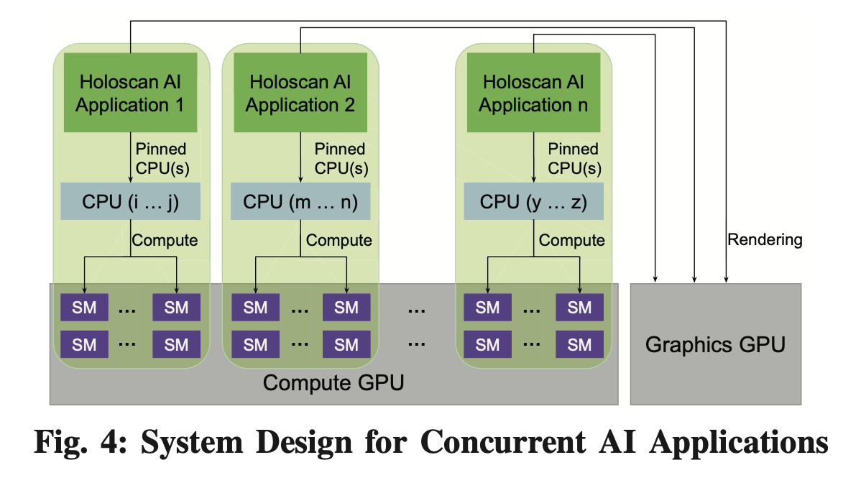
Proposed Methods - Holoscan
CUDA MPS partitioning: reserve SM + GPU memory per app
Compute–graphics isolation: split workloads across GPUs (↓ context switch)
Load balancing + admission control: prevent oversubscription
Determinism metrics: max · tail · flatness
Design principle: tighten latency distributions
Fig.3: System Design for Concurrent AI Applications

Slide 16
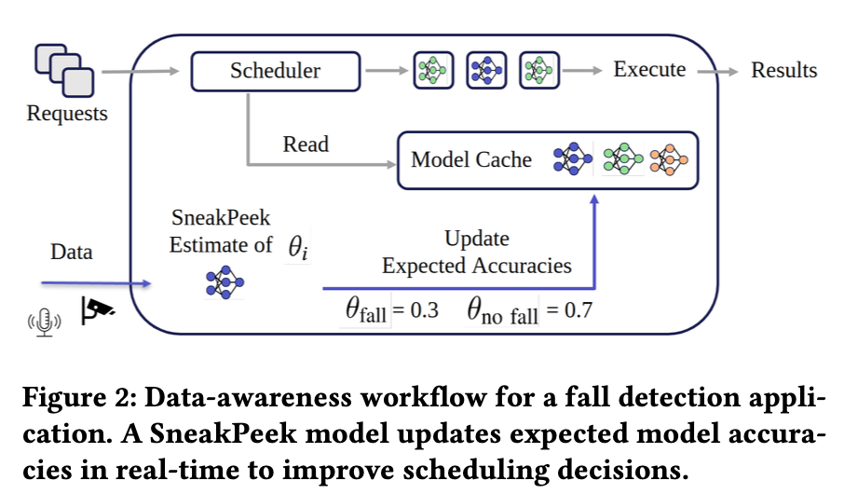
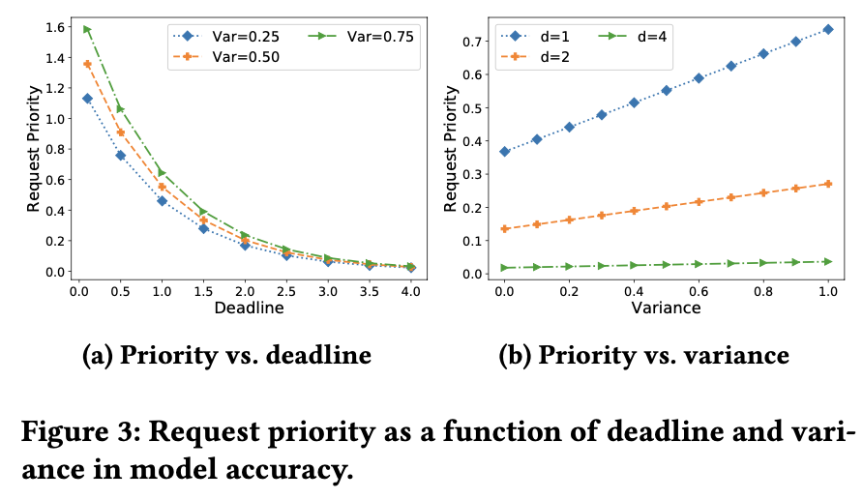
Proposed Methods - SneakPeek
New priority: urgency (deadline) × payoff (accuracy variance)
Grouped scheduling: plan batching explicitly to reduce model swap overhead
“SneakPeek” data-awareness: estimate class frequencies online → sharper accuracy estimates
Short-circuit inference to meet deadlines when needed
Fig.4: Data-awareness workflow for a fall detection appli- cation. A SneakPeek model updates expected model accura- cies in real-time to improve scheduling decisions.
Fig.5: Request priority as a function of deadline and vari- ance in model accuracy.

Slide 17
End-to-End AI Inference Systems for Real-Time Healthcare
Introduction
Related Work
Preliminaries
Proposed Methods
Performance Evaluation
Conclusions

Slide 18
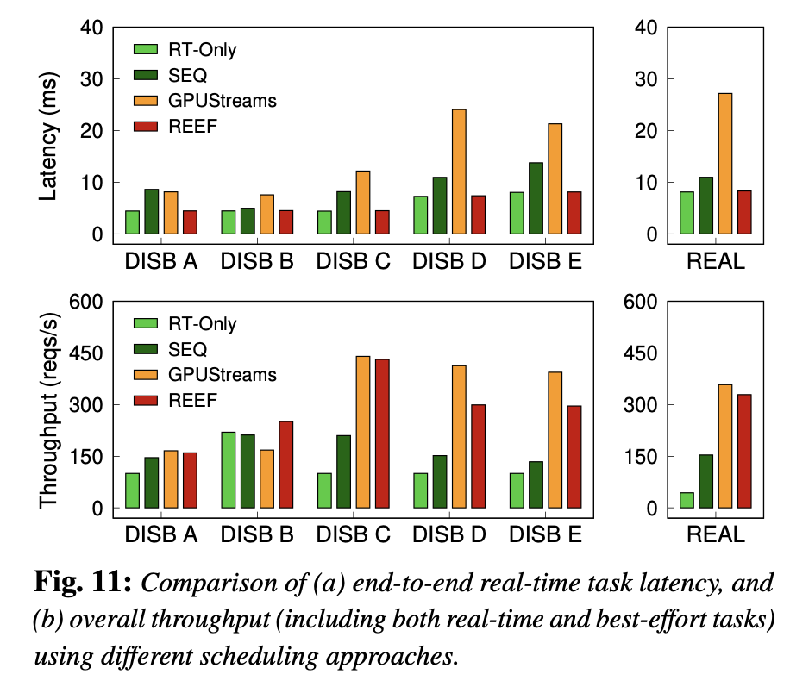
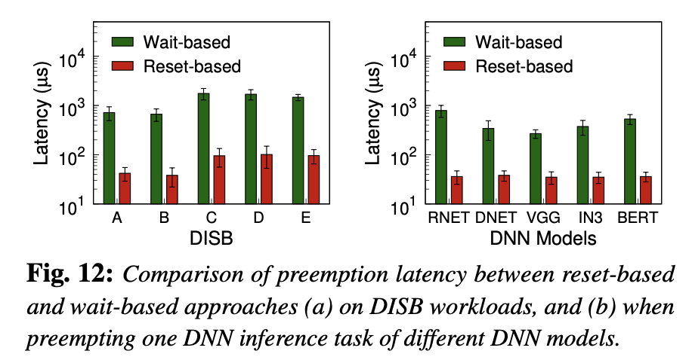
Performance Evaluation - REEF
Throughput:
Up to 7.7× improvement
Latency Overhead:
< 2% end-to-end for real-time tasks
Preemption Latency:
< 40 μs (10× reduction)
Fig.7: Comparison of (a) end-to-end real-time task latency, and (b) overall throughput (including both real-time and best-effort tasks) using different scheduling approaches.
Fig.6: Comparison of preemption latency between reset-based and wait-based approaches (a) on DISB workloads, and (b) when preempting one DNN inference task of different DNN models.

Slide 19
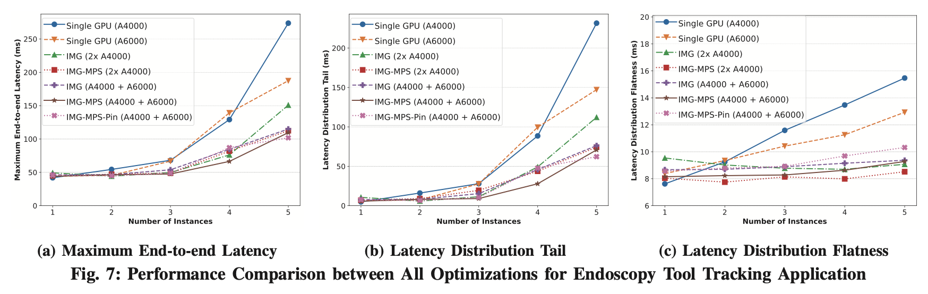
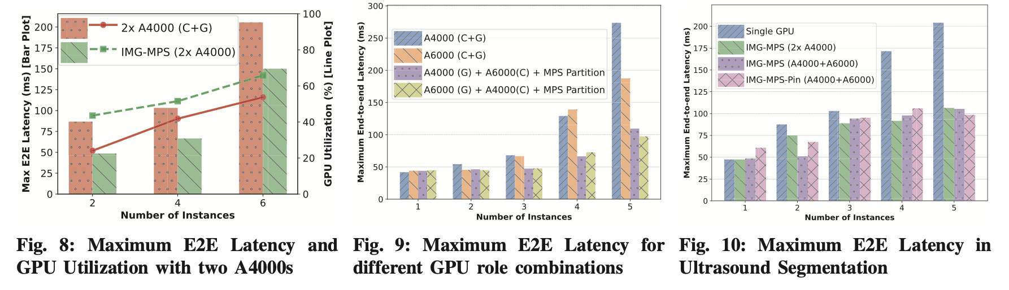
Performance Evaluation - Holoscan
Max Latency:
↓ 21–30% (vs. single-GPU baseline)
Distribution Flatness:
↓ 17–25% (tighter, more predictable tails)
vs. Default Multi-GPU:
↓ 35% max latency + 42% better GPU utilization
Fig.8: Performance Comparison between All Optimizations for Endoscopy Tool Tracking Application
Fig.9: Maximum E2E Latency and
GPU Utilization with two A4000s
Fig.10: Maximum E2E Latency for
different GPU role combinations
Fig.11: Maximum E2E Latency in
Ultrasound Segmentation

Slide 20
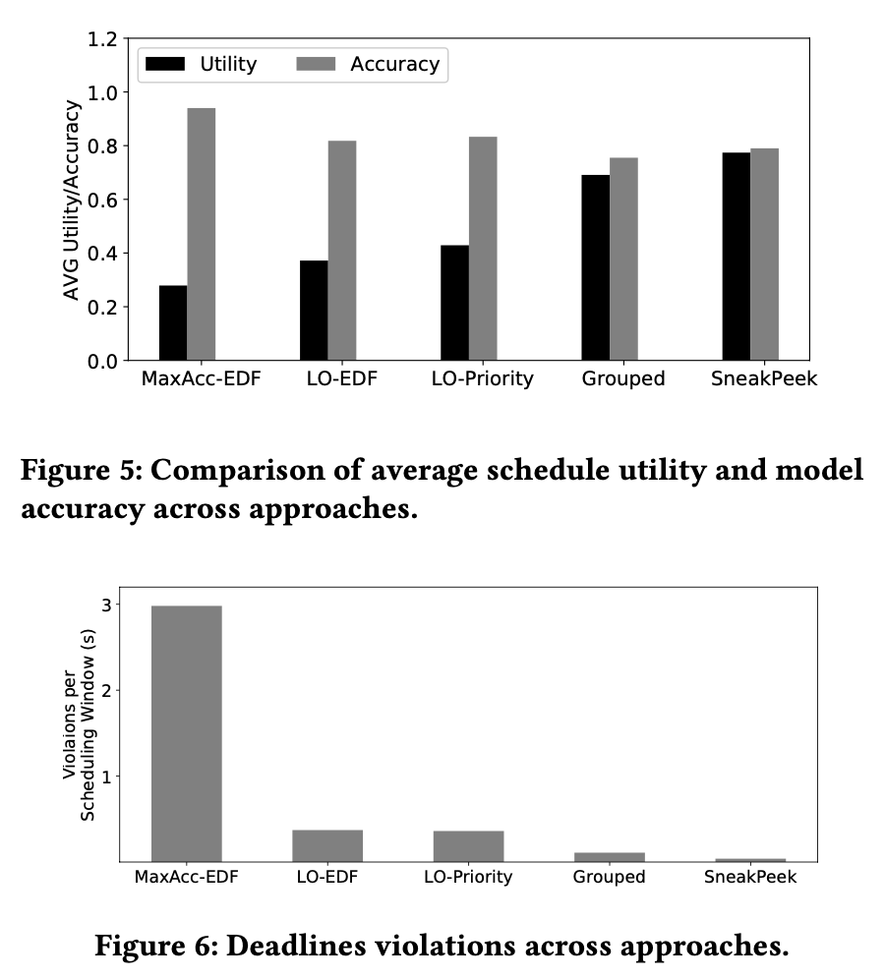
Performance Evaluation - SneakPeek
Setup:
3 healthcare apps (fall detection, voice commands, heart monitoring) on single GPU (RTX 3060) — no resource elasticity
Baselines:
EDF ordering + model selection heuristics (LO-EDF, MaxAcc-EDF)
Headline Results:
2× utility increase vs. LO-EDF (0.78 vs. 0.4)
Near-zero deadline violations with grouped scheduling + short-circuit inference
Key Insight: Data-awareness counters distribution shift (e.g., rare falls) by dynamically estimating class frequencies, reducing accuracy prediction error by 30–50%
Lesson: In fixed-resource deployments, optimize for deadline-aware utility, not just accuracy
Fig.12: Comparison of average schedule utility and model accuracy across approaches.
Fig.13: Deadlines violations across approaches.

Slide 21
End-to-End AI Inference Systems for Real-Time Healthcare
Introduction
Related Work
Preliminaries
Proposed Methods
Performance Evaluation
Conclusions

Slide 22
Conclusions and Future Work
Remarks
Healthcare AI: latency = safety
Focus: tail + jitter, not mean
Contributions
REEF: Fast GPU cut-in (preemption) + utilization
Holoscan: Deterministic latency via isolation/reservation
SneakPeek: Edge utility (model choice + scheduling)
Takeaway
Need preemption + determinism + urgency-aware scheduling
Next
Integrate into one stack; clinical validation

Slide 23
Q & A

