Slide 1
Beyond Algorithms : Hardware-Constrained Data Systems from Storage to Search 2026.01.27
Xixian QI
(120090691)
School of Data Science
Chinese University of Hong Kong, Shenzhen

Slide 2
Outline
Introduction (4 min)
Background & Overview (4 min)
Proposed Methods & Performance Evaluation (18 min)
Index: DiskANN (6 min)
Index: PipeANN (6 min)
Query: Hitcher (6 min)
Conclusions (1 min)
References
Q & A (3 min)

Slide 3
Outline
Introduction (4 min)
Background & Overview (4 min)
Proposed Methods & Performance Evaluation (18 min)
Index: DiskANN (6 min)
Index: PipeANN (6 min)
Query: Hitcher (6 min)
Conclusions (1 min)
References
Q & A (3 min)

Slide 4
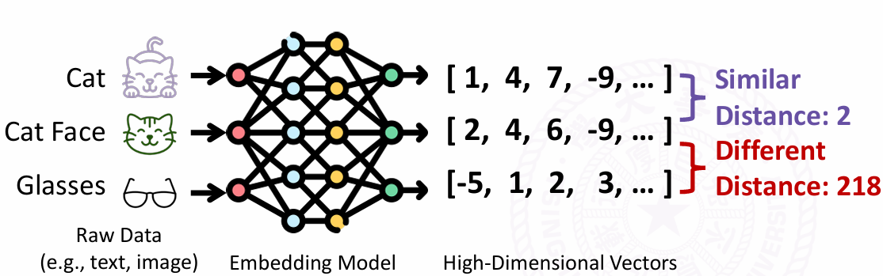
Introduction – Vector Search (1/4)
What is vector search?
A vector is a numerical representation of a label positioned in a geometric space, such that the distance between vectors encodes how similar or different those labels are.
Figure 1: Visualization of a Vector
Notes:
Figure cited from: https://www.usenix.org/conference/osdi25/presentation/guo

Slide 5
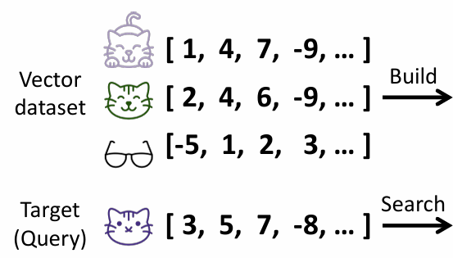
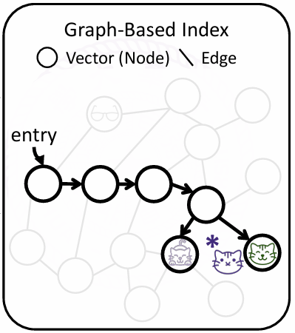
Introduction – Vector Search (2/4)
What is vector search?
A vector is a numerical representation of a label positioned in a geometric space, such that the distance between vectors encodes how similar or different those labels are.
Vector search finds the most relevant items by comparing distances in a vector space, returning the items whose vectors lie closest to the query.
Figure 2: Visualization of ANN (1/2)
Notes:
Figure cited from: https://www.usenix.org/conference/osdi25/presentation/guo (explain figure)

Slide 6
Introduction – ANN (3/4)
What and why is ANN?
Exact search always finds the true global nearest neighbors
However, it is computationally expensive because it compares the query against all vectors.
Approximate Nearest Neighbor (ANN) methods relax this:
in return for a small chance of missing the exact global minimum, ANN achieves dramatically faster search and better scalability.
🤗
Figure 3: Visualization of ANN (2/2)
Notes:
Figure cited from: https://www.usenix.org/conference/osdi25/presentation/guo (explain new path to🤗)

Slide 7

Introduction – ANN (4/4)
Why is ANN (again)?
Alibaba runs a database with 2B vectors (several TB)
Exact search takes >5min to compute on SSD!
ANN responds in ~10ms (4 orders faster)
How good is ANN?
Latency
Bandwidth
Recall
Precision (trivial)
Figure 4: Searching an Item in Taobao
Notes:
(Detailed explanation of the three metrics)

Slide 8
Outline
Introduction (4 min)
Background & Overview (4 min)
Proposed Methods & Performance Evaluation (18 min)
Index: DiskANN (6 min)
Index: PipeANN (6 min)
Query: Hitcher (6 min)
Conclusions (1 min)
References
Q & A (3 min)

Slide 9
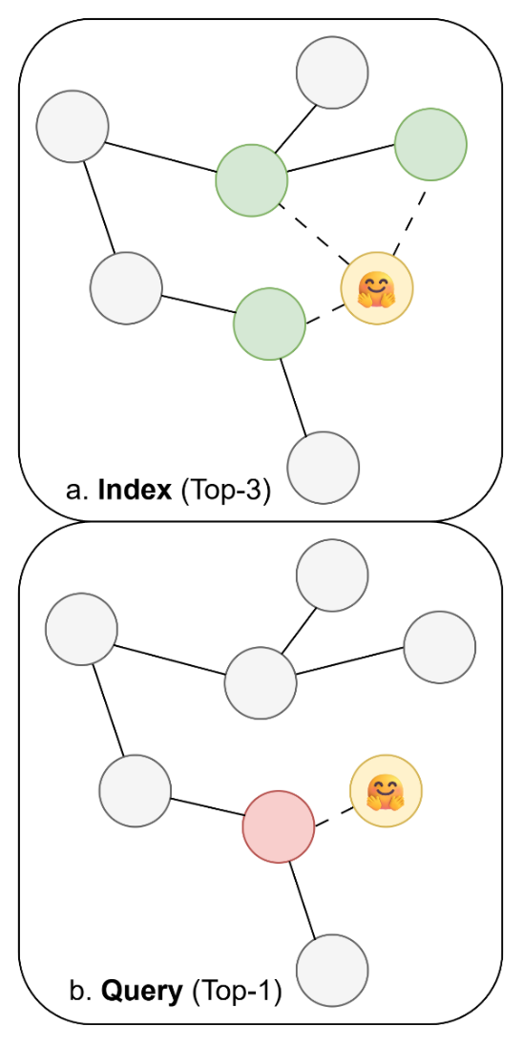
Background & Overview: Best-First Search (1/6)
ANNs can be categorized into:
Hashing-based methods
Tree-based methods
Graph-based methods (best balance between metrics ✅)
Best-first search (norm of graph-based methods) involves 2 stages:
Index: recursively run
Candidate Acquisition
Neighbor Selection
Query:
Like Index phase, except filters Top-1 neighbors except Top-K ones.
Figure 5: Index phase & Query phase
Notes:
Detailed explained difference of two stages

Slide 10
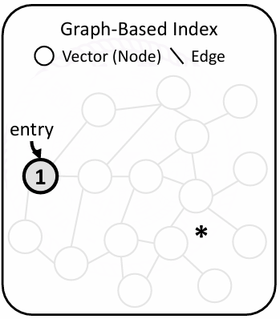
Background & Overview: Best-First Search (2/6)
How does best-first search work?
Starting from the entry point, select the nearest unvisited vector 1 in the candidate pool
Step 1: Select
Figure 6: Visualization of Best-first search (1/4)
Notes:
Figure cited from: https://www.usenix.org/conference/osdi25/presentation/guo

Slide 11
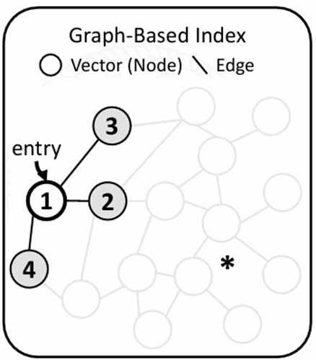
Background & Overview: Best-First Search (3/6)
How does best-first search work?
Starting from the entry point, select the nearest unvisited vector 1 in the candidate pool
Read its neighbor IDs {2, 3, 4}
Step 2: Candidate Acquisition
Figure 7: Visualization of Best-first search (2/4)
Notes:
Figure cited from: https://www.usenix.org/conference/osdi25/presentation/guo

Slide 12
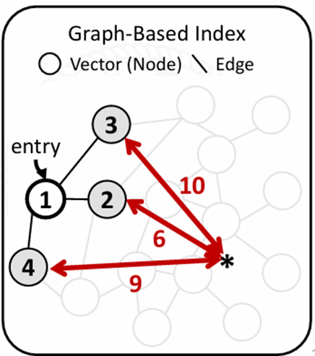
Background & Overview: Best-First Search (4/6)
How does best-first search work?
Starting from the entry point, select the nearest unvisited vector 1 in the candidate pool
Read its neighbor IDs {2, 3, 4}
Compare its neighbors’ ({2, 3, 4}) distances to the target vector *
Step 3: Neighbor Selection
Figure 8: Visualization of Best-first search (3/4)
Notes:
Figure cited from: https://www.usenix.org/conference/osdi25/presentation/guo

Slide 13
Background & Overview: Best-First Search (5/6)
How does best-first search work?
Starting from the entry point, select the nearest unvisited vector 1 in the candidate pool
Read its neighbor IDs {2, 3, 4}
Compare its neighbors’ ({2, 3, 4}) distances to the target vector *
Add its neighbors to the candidate pool, sort them, mark 1 as visited
(Candidate Pool:{(#2, 6), (#4, 9), (#3, 10)})
Repeat the process until no nearer node detected.
Step 4: Candidate Pool Update
Figure 9: Visualization of Best-first search (4/4)
Notes:
Figure cited from: https://www.usenix.org/conference/osdi25/presentation/guo

Slide 14
Background & Overview: Best-First Search (6/6)
Review: Several algorithmic improvements on ANNs has been made.
Hierarchical navigable small world (HNSW) with 2758 cites
Navigating Spreading-out Graph (NSG) with 578 cites
However, these algorithms improves algorithmic topology with the assumption that the entire graph fits in RAM.
Gap: in reality, ANNs suffer from various hardware constraints.
Cache Misses: Graph algorithms jump randomly between nodes.
OOM (Out of Memory): the graph is too huge to fit in memory.
Read Amplification: each vector (<1024bits) is far smaller than the page size (4kb)
SIMD Under-utilization: indirect bounds limit the capability of SIMD
…
Hardware flaws should be considered in algorithm design!
Notes:
Skip the details in `gap`

Slide 15
Outline
Introduction (4 min)
Background & Overview (4 min)
Proposed Methods & Performance Evaluation (18 min)
Index: DiskANN (6 min)
Index: PipeANN (6 min)
Query: Hitcher (6 min)
Conclusions (1 min)
References
Q & A (3 min)

Slide 16
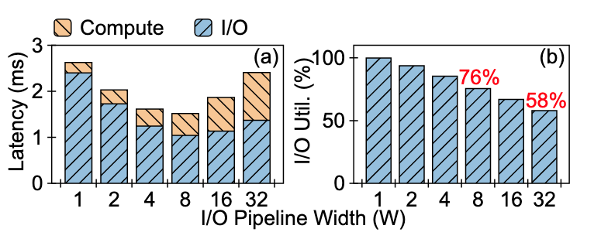
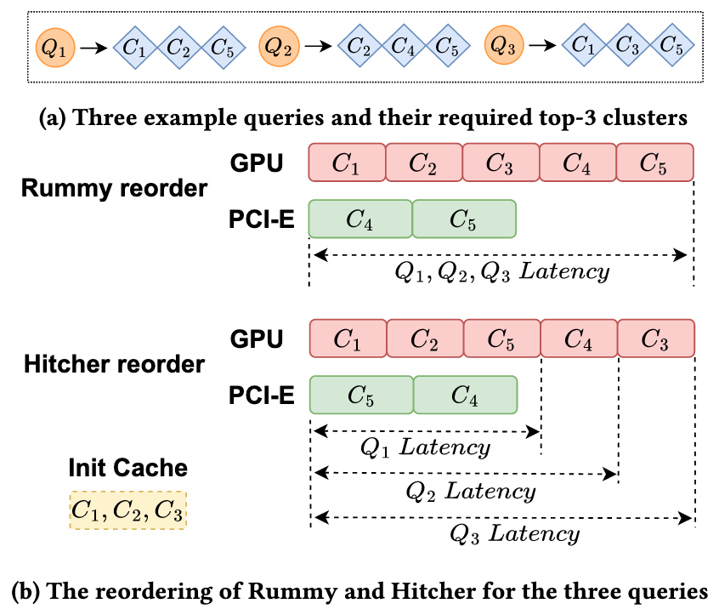
Proposed Methods & Performance Evaluation: Overview
Index (offline):
both papers are I/O-aware to speed up Candidate Acquisition
DiskANN
PipeANN
Query (online):
reorder the tasks in pipeline to fully utilize GPU parallelism
Hitcher
Figure 10(a): I/O contributes more to Latency
Figure 10(b): GPU task scheduling
Notes:
Explain Figures

Slide 17
Outline
Introduction (4 min)
Background & Overview (4 min)
Proposed Methods & Performance Evaluation (18 min)
Index: DiskANN (6 min)
Index: PipeANN (6 min)
Query: Hitcher (6 min)
Conclusions & Future Work (1 min)
References
Q & A (3 min)

Slide 18
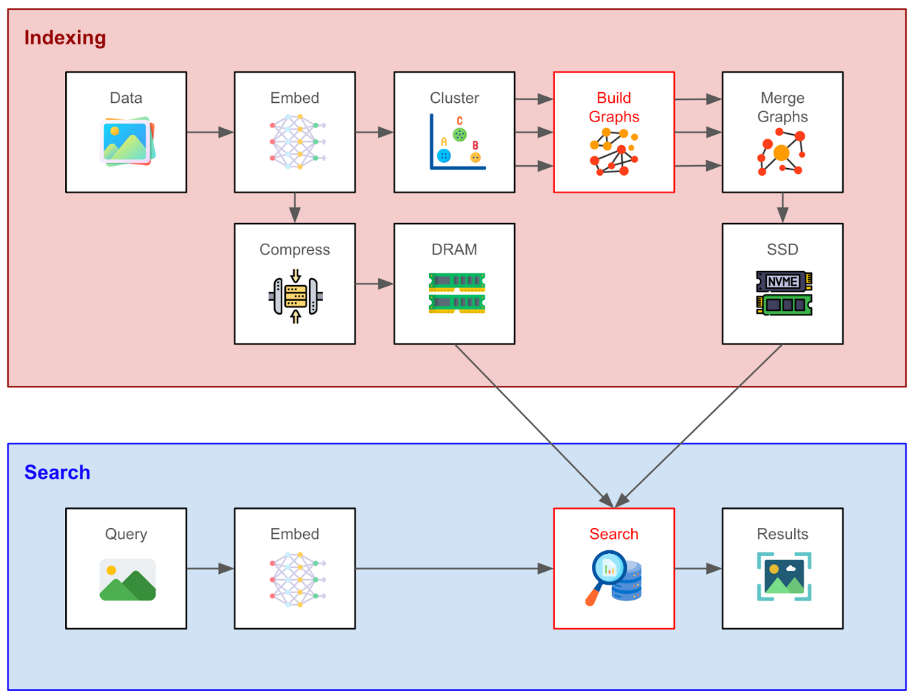
DiskANN: Architecture Overview (1/6)
To mitigate the I/O overhead in SSD, DiskANN proposed:
Vamana Algorithm: Reduce the number of round-trips when indexing.
DiskANN system: Employ a hybrid memory-disk architecture to balance high-speed query routing.
Beam Search optimization: Utilize asynchronous exploration to overlap I/O operations.
Figure 11: Workflow of DiskANN
Notes:
Point out the relationship between text and fig.

Slide 19
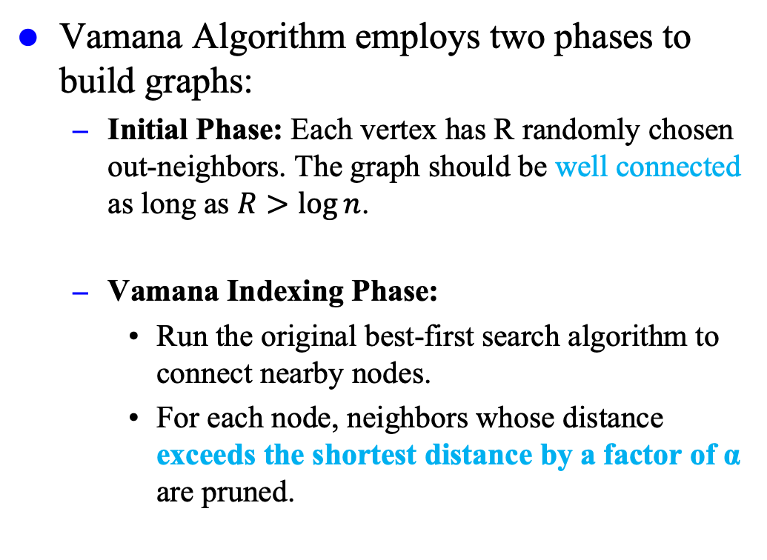
DiskANN: Vamana Algorithm (2/6)
Vamana Algorithm employs two phases to build graphs:
Initial Phase: Each vertex has R randomly chosen out-neighbors. The graph should be well connected as long as $R>\log{n}$.
Vamana Indexing Phase:
Run the original best-first search algorithm to connect nearby nodes.
For each node, neighbors whose distance exceeds the shortest distance by a factor of α are pruned.
Figure 12: Workflow of DiskANN
Notes:
Point out the relationship between text and fig.

Slide 20
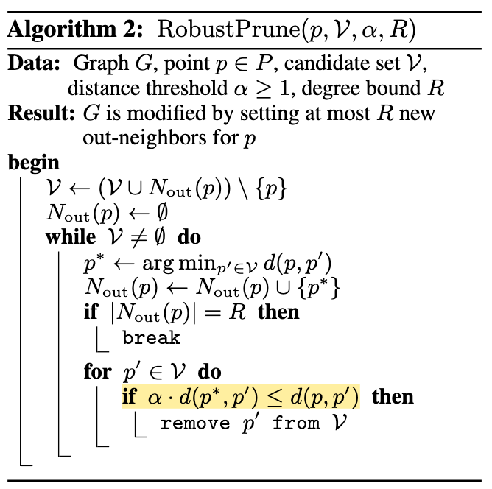
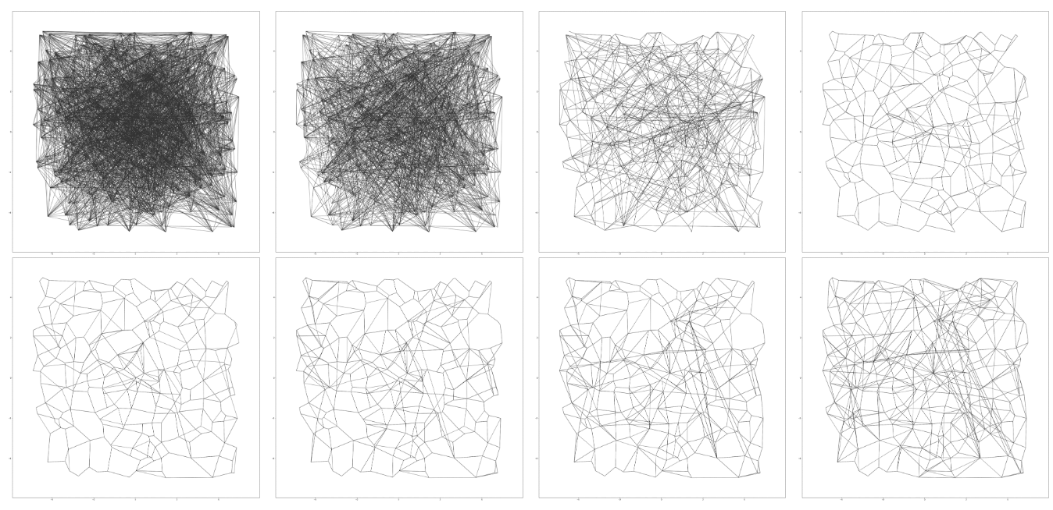
DiskANN: Vamana Algorithm (3/6)
Vamana Indexing Phase:
Run the original best-first search algorithm to connect nearby nodes.
For each node, neighbors whose distance exceeds the shortest distance by a factor of α are pruned.
Algorithm 1: Robust Prune Algorithm
Result: Some long-range edges are maintained to reduce #hops!
Figure 13: Progression of the graph
Notes:
Show highlight code -> show long-range connection in progression graph -> Present the result

Slide 21
DiskANN: DiskANN System (4/6)
DiskANN system employs two-tier storage hierarchy.
DRAM navigates the next candidate nodes.
Fast but expensive
Store Product Quantization vectors and nodes
SSD loads and computes distances in the candidate pool.
Slow but cheap
Store full vectors and nodes
Figure 14: Workflow of DiskANN
Notes:
!

Slide 22
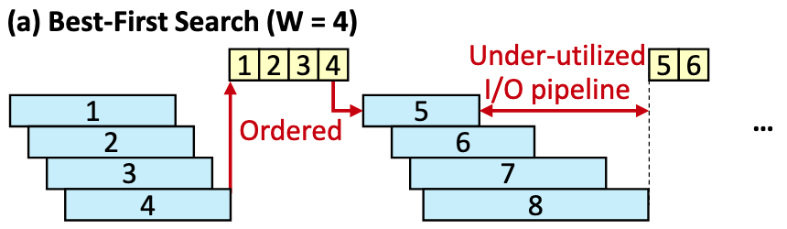

DiskANN: Beam Search Optimization (5/6)
Beam Search achieves latency hiding through fetching a batch of neighbors simultaneously.
The beam widths $W$ should be carefully selected to balance latency and throughput.
Figure 15: Pipeline of beam search with W=4
Figure 16: Workflow of DiskANN

Slide 23
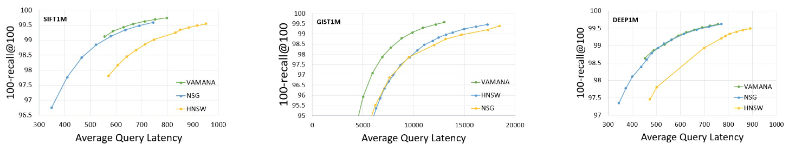
DiskANN: Evaluation (6/6)
Evaluation
Tested on three dataset: SIFT1M, GIST1M, DEEP1M
Figure 17: Latency (microseconds) vs recall plots comparing HNSW, NSG and Vamana
Notes:
100 recall@100: given Top-100, how many items match

Slide 24
Outline
Introduction (4 min)
Background & Overview (4 min)
Proposed Methods & Performance Evaluation (18 min)
Index: DiskANN (6 min)
Index: PipeANN (6 min)
Query: Hitcher (6 min)
Conclusions & Future Work (1 min)
References
Q & A (3 min)

Slide 25
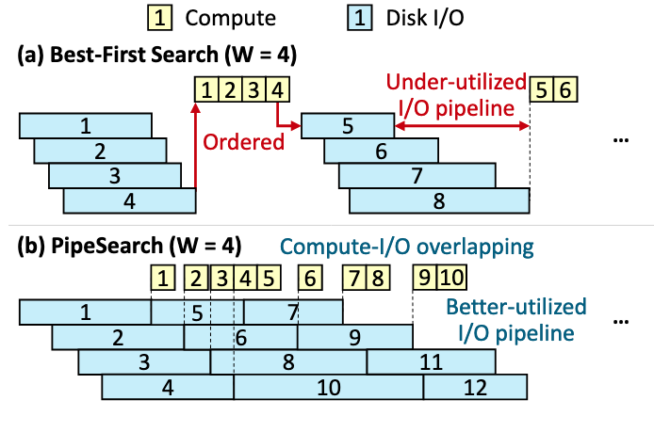
PipeANN: Architecture Overview (1/8)
DiskANN is good, but it’s not perfect:
Long I/O latency: I/O pipeline is not fully used during CPU computation and gathering between steps.
Ordered I/O: Each step still requires synchronously waiting for all the I/Os to finish.
PipeANN employs PipeSearch to break the ordering across search steps. Besides, it is optimized with:
Dynamic I/O pipeline width
Strict missing neighbor bound
Figure 18: Comparison between two algorithms
Notes:
Use example to show the points.

Slide 26
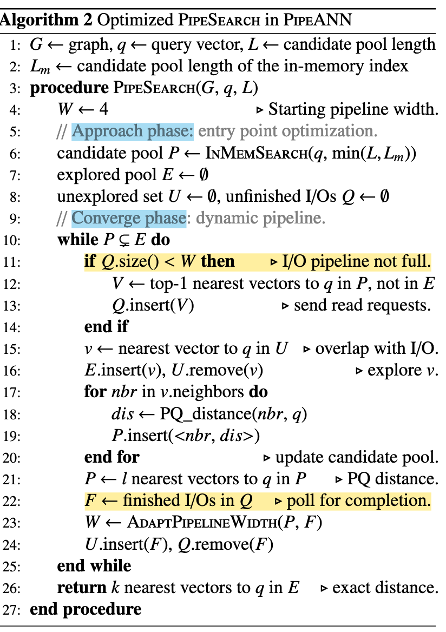
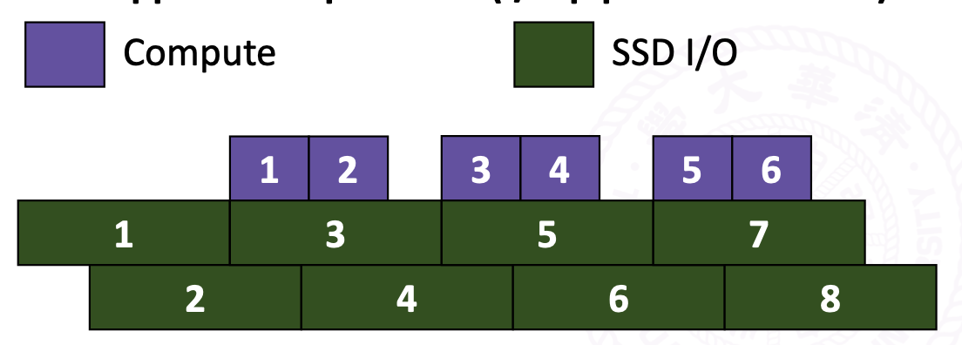
PipeANN: PipeSearch (2/8)
PipeSearch decouples load from compute.
💾 Pipeline not full, read.
🛠️ Pipeline full, compute.
Algorithm 2: PipeSearch Pipeline
Set U: Intermediate (load but unexplored)
Load the smallest candidate so far
Normal Compute
Update U with newest fetched data
Figure 19: PipeSearch Pipeline
Notes:
Explain left texts with example. Then, briefly state the differences of PipeSearch.
Figure cited from: https://www.usenix.org/conference/osdi25/presentation/guo

Slide 27
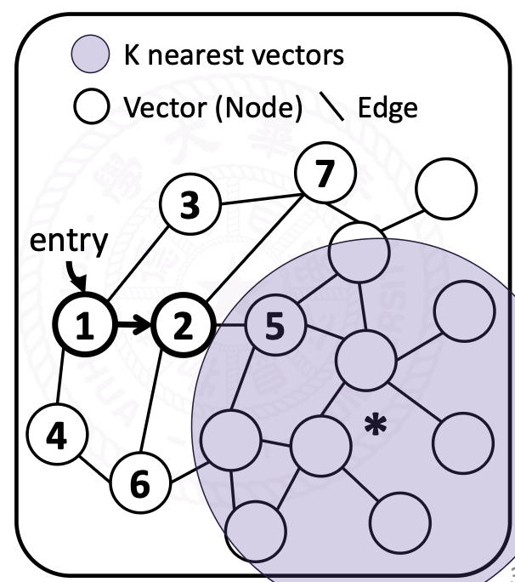
PipeANN: Optimization 1 (3/8)
What’s the optimal value for I/O width W?
Wider: parallel but speculative reads
Narrower: sequential but best-first reads
PipeANN dynamically adjusts it’s width.
Approach phase: Smaller W
Less useful but unvisited vectors
Speculative reads leads to wastes
Figure 20: Illustration of two phases
Notes:
Figure&text cited from: https://www.usenix.org/conference/osdi25/presentation/guo

Slide 28
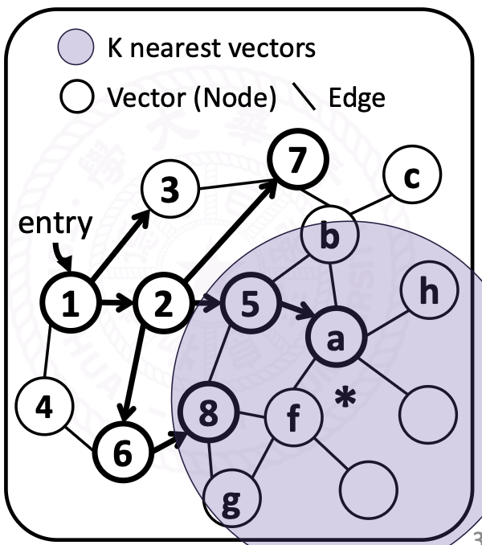
PipeANN: Optimization 1 (4/8)
What’s the optimal value for I/O width W?
Wider: parallel but speculative reads
Narrower: sequential but best-first reads
PipeANN dynamically adjusts it’s width.
Approach phase: Smaller W
Less useful for unvisited vectors
Speculative reads leads to wastes
Converge phase: Larger W
More useful for unvisited vectors
Speculative leads to acceleration
Figure 21: Illustration of two phases
Notes:
Figure&text cited from: https://www.usenix.org/conference/osdi25/presentation/guo

Slide 29
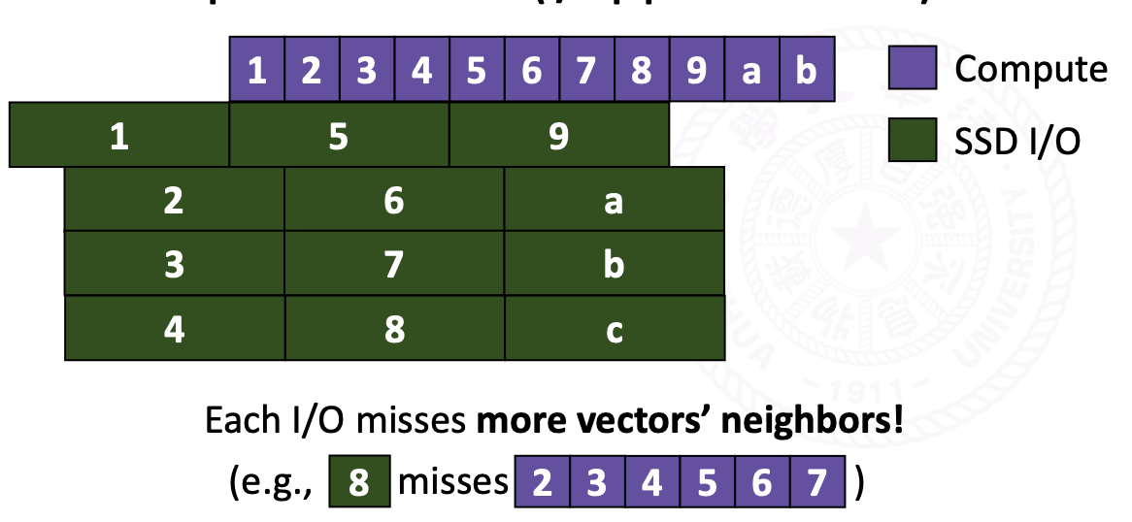
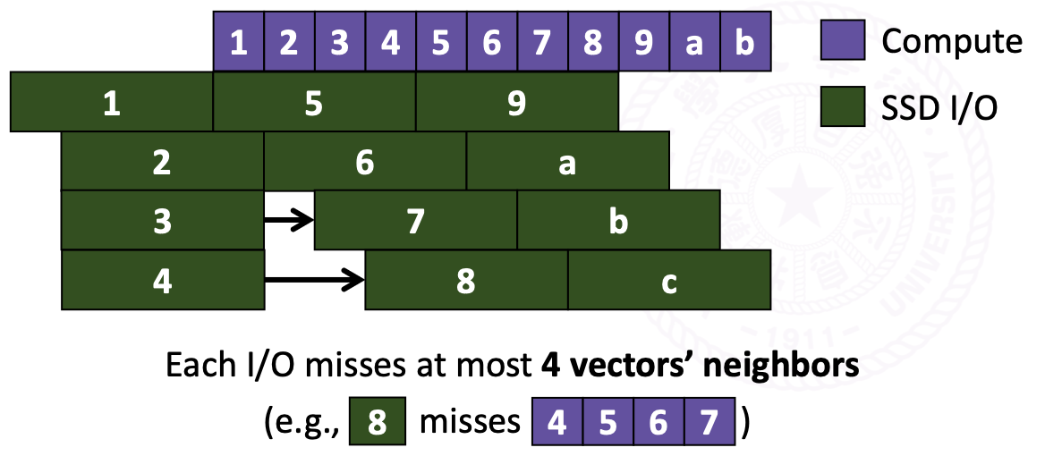
PipeANN: Optimization 2 (5/8)
When multiple I/Os finish simultaneously, filling up the pipeline may make I/O miss the neighbor information.
Handling I/O one by one solve the issue!
Figure 22: Missing information of node 8 w/o optimization 2
Notes:
Figure&text cited from: https://www.usenix.org/conference/osdi25/presentation/guo

Slide 30
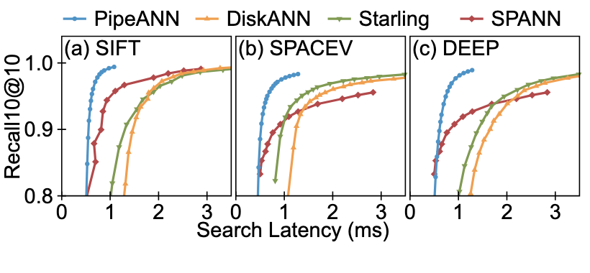
PipeANN: Evaluation (6/8)
Evaluation
Tested on three dataset: SIFT, SPACEV, DEEP
Compared with DiskANN, Starling, DPANN
Figure 23: Search latency on 100M dataset
Notes:
100 recall@100: given Top-100, how many items match

Slide 31
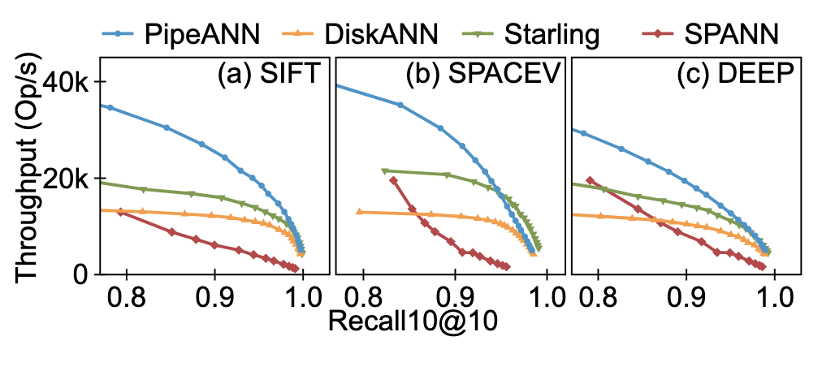
PipeANN: Evaluation (7/8)
Evaluation
Tested on three dataset: SIFT, SPACEV, DEEP
Compared with DiskANN, Starling, DPANN
Figure 24: Search throughput on 100M dataset
Notes:
100 recall@100: given Top-100, how many items match

Slide 32
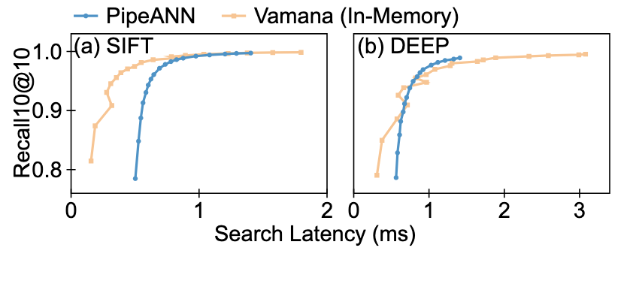
PipeANN: Evaluation (8/8)
Is it indeed better than DiskANN?
Compared with In-Memory Index!
Figure 25: Search latency of PipeANN compared with Vamana
Notes:
100 recall@100: given Top-100, how many items match

Slide 33
Outline
Introduction (4 min)
Background & Overview (4 min)
Proposed Methods & Performance Evaluation (18 min)
Index: DiskANN (6 min)
Index: PipeANN (6 min)
Query: Hitcher (6 min)
Conclusions & Future Work (1 min)
References
Q & A (3 min)

Slide 34
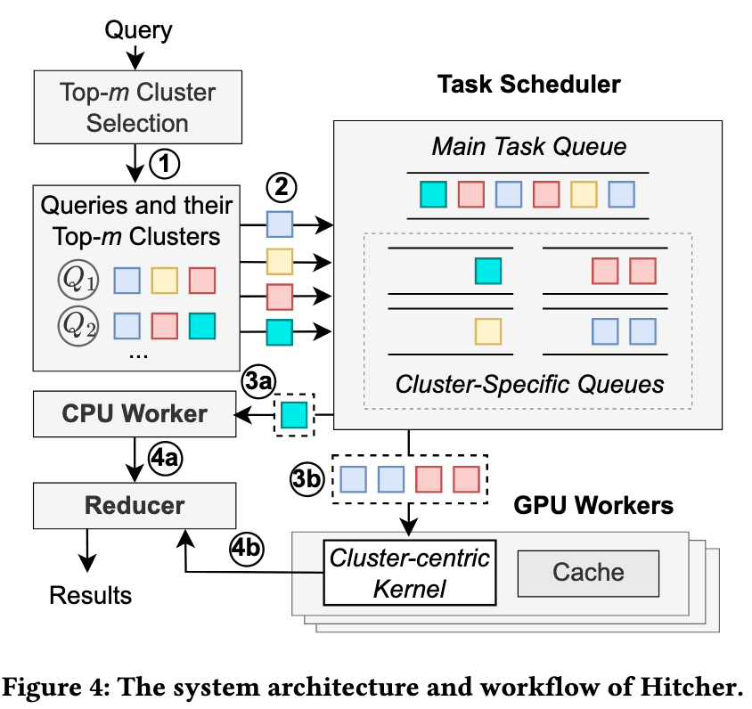
Hitcher: Architecture Overview (1/6)
Motivation:
Unlike the sequential nature of indexing, query processing involves random, scattered access across graph clusters.
Though offering massive throughput, GPU are bottlenecked by high latency when handling such irregular access patterns.
Rummy: original GPU-based method
Process each query independently → Low data reuse.
Hitcher: a better re-ordered pipeline method
Cluster-Centric Kernel
Hitch-Ride Ordering
Optimizations: CPU Offloading & Multi-GPU support
Figure 26: The system architecture and workflow of Hitcher
Notes:
Motivation: Query is somehow different from indexing: queries arrive in a random order, each query access multiple clusters of a graph

Slide 35
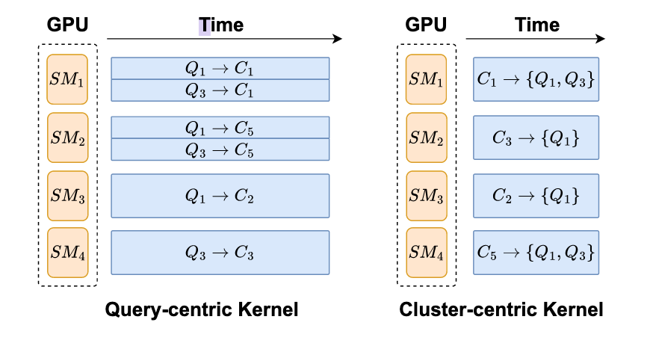
Hitcher: Cluster-Centric Kernel (2/6)
Query-centric kernel (Rummy)
Queries are decomposed as query-cluster pair.
Each pair launch one thread block with independent memory.
Redundant loads! (e.g. Cluster C1&C5)
Cluster-centric kernel (Hitcher)
Queries are grouped with the same cluster.
Each group assigns one thread block with shared memory.
Load once, multiple pass!
Figure 27: A comparison between the execution of the query-centric GPU kernel and cluster-centric GPU kernel.

Slide 36
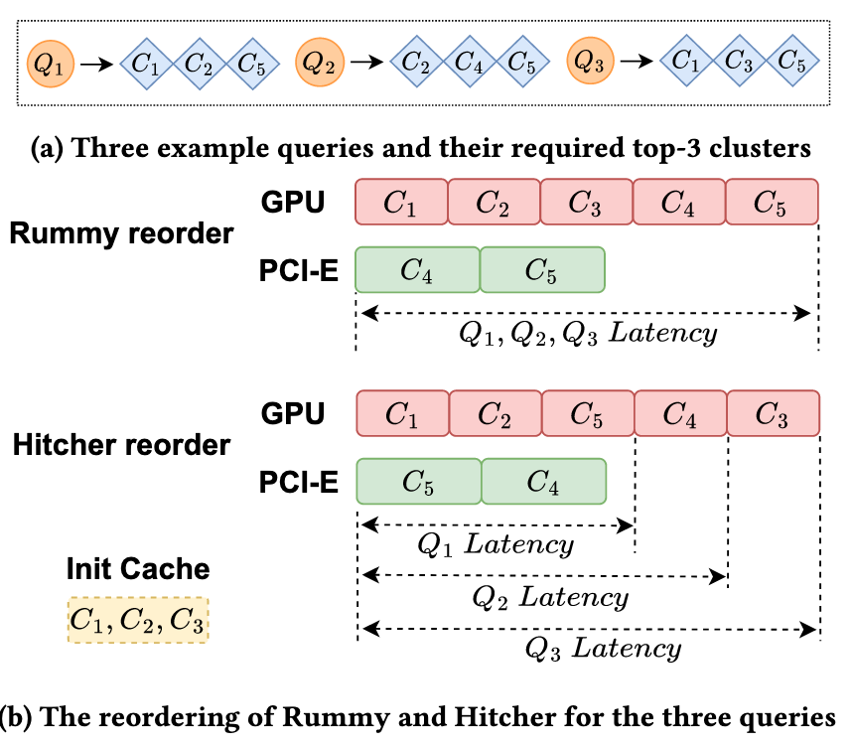
Hitcher: Hitch-Ride Ordering (3/6)
Batch-based Re-ordering (Rummy)
Queries are buffered until a large batch is full.
Re-ordering and scheduling happen only after the batch closes.
Early queries must wait for the entire batch to fill -> High Latency.
Figure 28: Comparison between Hitcher and Rummy
Notes:
No need to explain algorithm details.

Slide 37
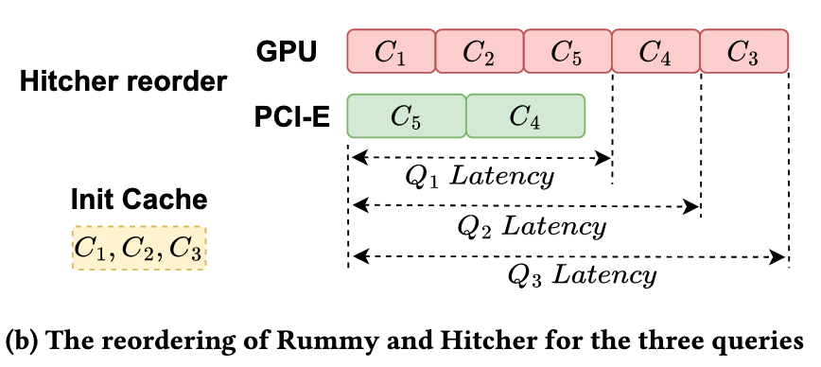
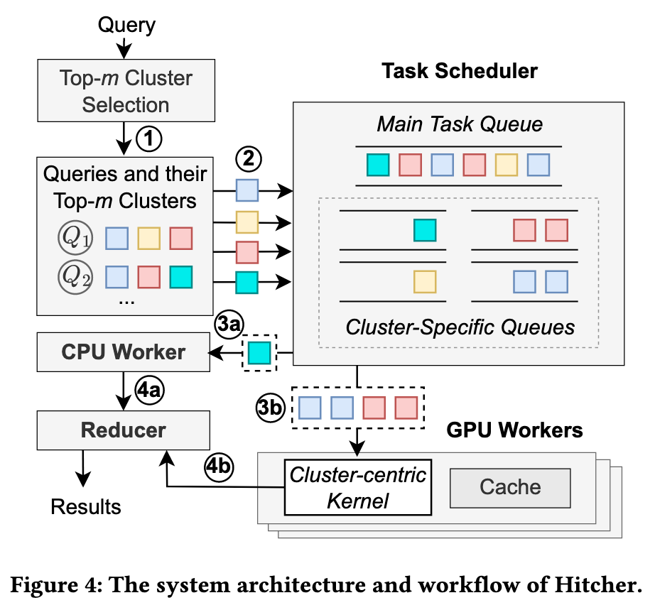
Hitcher: Hitch-Ride Ordering (4/6)
Batch-based Re-ordering (Rummy)
Queries are buffered until a large batch is full.
Re-ordering and scheduling happen only after the batch closes.
Early queries must wait for the entire batch to fill -> High Latency.
Hitch-Ride Ordering (Hitcher)
Queries are processed continuously with stream.
Incoming queries immediately join (“hitch a ride” on) the same cluster.
Instant dispatch -> Low latency.
Figure 29: Hitch-ride order workflow
Notes:
No need to explain algorithm details.

Slide 38
Hitcher: Other Optimizations (5/6)
Asynchronous Data Transfer
Dual Main Task Queues
Query ID-Based Scheduling
CPU Offloading
Strategic Offloading
Prioritization Rules
Figure 30: The system architecture and workflow of Hitcher
Notes:
Skip

Slide 39
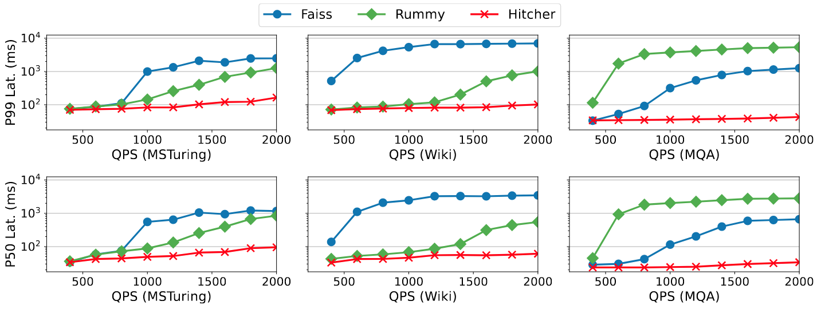
Hitcher: Evaluation (6/6)
Evaluation
Tested on three dataset: MSTuring, Wiki, MQA.
Compared other GPU approaches: Faiss, Rummy.
Figure 31: The P99 query latency (top row) and P50 query latency (bottom row) of Hitcher and the baseline systems

Slide 40
Outline
Introduction (4 min)
Background & Overview (4 min)
Proposed Methods & Performance Evaluation (18 min)
Index: DiskANN (6 min)
Index: PipeANN (6 min)
Query: Hitcher (6 min)
Conclusions & Future Work (1 min)
References
Q & A (3 min)

Slide 41
Conclusions & Future Work
Research trends of have shifted from pure algorithmic workflows to hardware-aware co-design.
Three hardware-constrained ANNs are introduced:
Index: DiskANN (SSD-optimized)
Index: PipeANN (SSD-optimized)
Query: Hitcher (GPU-optimized)
Further direction:
Hybrid search introduces filtering bottleneck, limiting parallelism.
LLM is able to learn graph patterns, yet the computational overhead of model inference remains a bottleneck.

Slide 42
References
(Algorithms)
[HNSW] Y. A. Malkov and D. A. Yashunin, "Efficient and robust approximate nearest neighbor search using hierarchical navigable small world graphs," IEEE Transactions on Pattern Analysis and Machine Intelligence, vol. 42, no. 4, pp. 824–836, 2018.
[NSG] C. Fu, C. Xiang, C. Wang, and D. Cai, "Fast approximate nearest neighbor search with the navigating spreading-out graph," Proceedings of the VLDB Endowment, vol. 12, no. 5, pp. 461–474, 2019.
(Systems & Hardware)
[DiskANN] S. J. Subramanya, F. Devvrit, H. V. Simhadri, R. Krishnawamy, and R. Kaczmarek, "DiskANN: Fast accurate billion-point nearest neighbor search on a single node," in Advances in Neural Information Processing Systems (NeurIPS), 2019.
[PipeANN] H. Guo and Y. Lu, "Achieving Low-Latency Graph-Based Vector Search via Aligning Best-First Search Algorithm with SSD," in Proceedings of the 19th USENIX Symposium on Operating Systems Design and Implementation (OSDI), 2025.
[Hitcher] Qihui Zhou, Changji LI, Guanxian Jiang, Chenhao Ma, Xiao Yan, Yu Mao, Ming-Chang Yang, James Cheng, “Hitcher: Efficient GPU-based Vector Search via Cluster-Centric Kernel and Hitch-Ride Ordering,” In SIGKDD Conference on Knowledge Discovery and Data Mining (KDD), 2026.

Slide 43
Q & A

