Slide 1
PD-Disaggregation in Large Language Models
Chengxuan PEI
School of Data Science
Chinese University of Hong Kong, Shenzhen
Notes:
Good afternoon, everyone.
Today, I'll be presenting a comprehensive analysis of Prefill-Decode disaggregation architectures for Large Language Model (LLM for short) serving systems, based on three recent research papers that are reshaping how we think about LLM inference optimization.
This is a particularly timely topic as LLM services scale to billions of tokens daily while facing increasingly tight latency requirements.

Slide 2
Outline
Introduction
Transformer Architecture, Two-Phase Inference, KV Cache.
Background
Aggregation vs. Disaggregation. Trade-offs and Real-World Workload Challenges.
Work 1: Mooncake¹
1, Qin, R., Li, Z., He, W., Cui, J., Tang, H., Ren, F., ... & Xu, X. (2024). Mooncake: A kvcache-centric disaggregated architecture for llm serving. ACM Transactions on Storage.
Work 2: NynaServe²
2, Ruan, C., Chen, Y., Tian, D., Shi, Y., Wu, Y., Li, J., & Li, C. (2025). DynaServe: Unified and Elastic Execution for Dynamic Disaggregated LLM Serving. arXiv preprint arXiv:2504.09285.
Work 3: TaiChi³
3, Wang, C., Zuo, P., Chen, Z., Liang, Y., Yu, Z., & Yang, M. C. (2025). Prefill-decode aggregation or disaggregation? unifying both for goodput-optimized llm serving. arXiv preprint arXiv:2508.01989.
Conclusion
Notes:
Over the next 30 minutes, we'll follow this structure:
First, I'll establish the fundamentals of LLM inference and the critical performance metrics.
Then, we'll examine the background of aggregation versus disaggregation, exploring the fundamental trade-offs and real-world challenges.
The core of the presentation will be a deep dive into three groundbreaking systems: Mooncake, DynaServe, and TaiChi.
Each represents a distinct philosophy in tackling the PD disaggregation problem.
Finally, we'll synthesize these insights and discuss future directions.

Slide 3
Outline
Introduction
Transformer Architecture, Two-Phase Inference, KV Cache.
Background
Aggregation vs. Disaggregation. Trade-offs and Real-World Workload Challenges.
Work 1: Mooncake¹
1, Qin, R., Li, Z., He, W., Cui, J., Tang, H., Ren, F., ... & Xu, X. (2024). Mooncake: A kvcache-centric disaggregated architecture for llm serving. ACM Transactions on Storage.
Work 2: NynaServe²
2, Ruan, C., Chen, Y., Tian, D., Shi, Y., Wu, Y., Li, J., & Li, C. (2025). DynaServe: Unified and Elastic Execution for Dynamic Disaggregated LLM Serving. arXiv preprint arXiv:2504.09285.
Work 3: TaiChi³
3, Wang, C., Zuo, P., Chen, Z., Liang, Y., Yu, Z., & Yang, M. C. (2025). Prefill-decode aggregation or disaggregation? unifying both for goodput-optimized llm serving. arXiv preprint arXiv:2508.01989.
Conclusion
Notes:
Let's begin with the fundamentals.

Slide 4
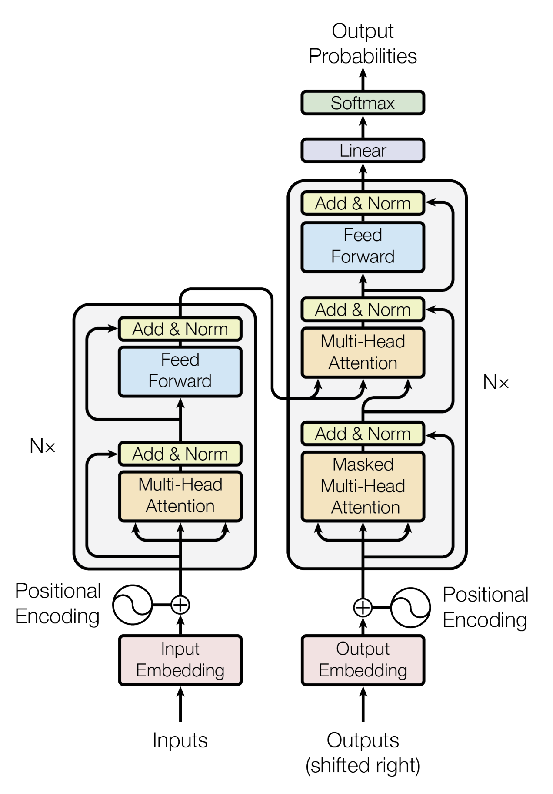
Introduction-LLM System (1/2)
Decoder–only Transformer Architecture:
Most LLMs adopt a Transformer with stacked layers, each containing self-attention and feed-forward (FFN). Each layer processes tokens through two main computational paths.
Two-Phase Inference:
Prefill Phase: Process the entire input prompt at once to compute the initial Key-Value (KV) cache.
Decode Phase: Generate tokens one by one, appending to the KV cache.
Fig 1. Transformer Architecture
Notes:
Modern LLMs are built on the Transformer architecture, which you see illustrated here.
(click) The key insight from the seminal "Attention is All You Need" paper is that we can process sequential data entirely through self-attention mechanisms.
For inference, we use a decoder-only structure where each layer contains two main components: a self-attention block and a feed-forward network.
(click)Now, critically, LLM inference happens in two distinct phases.
(click) The prefill phase processes your entire input prompt in parallel—imagine feeding a 1000-token document all at once. This is compute-intensive matrix-matrix multiplication, highly parallelizable and saturates GPU compute units.
(click)The decode phase, however, is autoregressive: it generates tokens one by one, each depending on all previous tokens. This becomes memory-bound matrix-vector operations, where performance is limited by memory bandwidth rather than computation.
This two-phase nature creates a fundamental tension in system design.

Slide 5
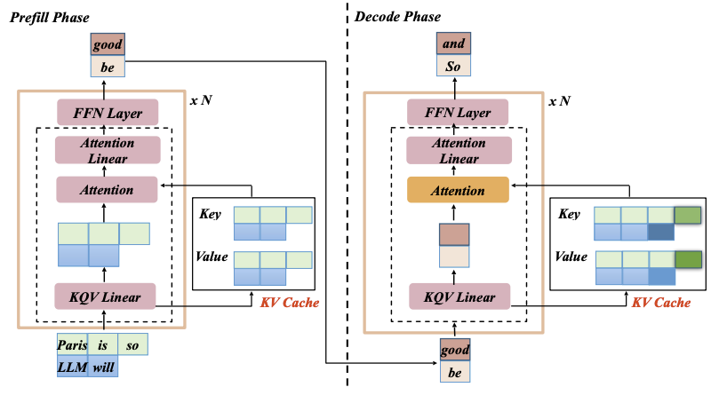
Introduction – Prefill & Decode (2/2)
Prefill Phase:
Parallelism: High.
Operations: Matrix-Matrix.
Bottleneck: Computation.
Decode Phase:
Parallelism: Low.
Operations: Matrix-Vector.
Bottleneck: Memory Bandwidth.
How do we architect serving systems
that excel at both phases simultaneously?
Fig 2. Prefill and Decode
Notes:
As this figure shows, prefill and decode have opposed characteristics.
(click)Prefill: high parallelism, compute-bound, fast for the first token but doesn't generate subsequent tokens.
(click)Decode: low parallelism, memory-bound, bottlenecked by KV cache loading, but produces the actual output stream.
The KV cache is our critical optimization. During prefill, we compute and store Key-Value tensors for every token. During decode, we reuse this cache, appending one new KV pair per generated token. Without this, we'd be recomputing everything from scratch—completely infeasible for long sequences.
(click)Understanding this dichotomy (dīˈkädəmē) leads us to the central question: How do we architect serving systems that excel at both phases simultaneously?

Slide 6
Outline
Introduction
Transformer Architecture, Two-Phase Inference, KV Cache.
Background
Aggregation vs. Disaggregation. Trade-offs and Real-World Workload Challenges.
Work 1: Mooncake¹
1, Qin, R., Li, Z., He, W., Cui, J., Tang, H., Ren, F., ... & Xu, X. (2024). Mooncake: A kvcache-centric disaggregated architecture for llm serving. ACM Transactions on Storage.
Work 2: NynaServe²
2, Ruan, C., Chen, Y., Tian, D., Shi, Y., Wu, Y., Li, J., & Li, C. (2025). DynaServe: Unified and Elastic Execution for Dynamic Disaggregated LLM Serving. arXiv preprint arXiv:2504.09285.
Work 3: TaiChi³
3, Wang, C., Zuo, P., Chen, Z., Liang, Y., Yu, Z., & Yang, M. C. (2025). Prefill-decode aggregation or disaggregation? unifying both for goodput-optimized llm serving. arXiv preprint arXiv:2508.01989.
Conclusion
Notes:
Next, I will give details on the aggregation and disaggregation system

Slide 7
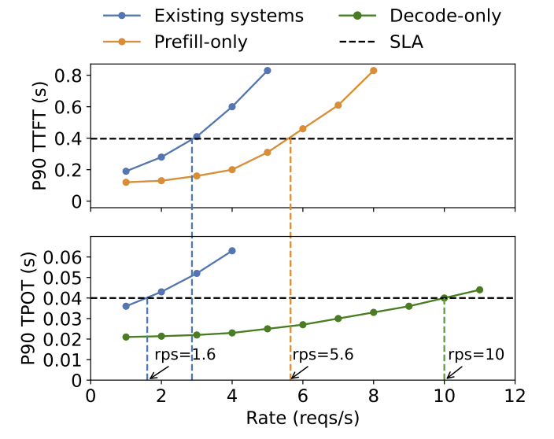
Background-PD Aggregation (1/2)
Description:
As the prefill and decoding phases share the LLM weights and working memory, existing LLM serving systems typically collocate both phases on the same GPU.
Performance Metrics:
Time to first token (TTFT)
Time per output token (TPOT)/Time between tokens (TBT)
Objective:
LLM serving system should maximize throughput under constrained TTFT and TPOT.
Fig 3. Prefill and Decode Latency
Notes:
(click)Traditionally, systems like vLLM and Orca use PD aggregation—collocating both phases on the same GPU instance. This seems natural: they share the same model weights and KV cache.
The system continuously batches requests, mixing prefill and decode operations.
(click)The performance metrics we care about are TTFT—Time To First Token, measuring prefill speed—and TPOT or TBT, Time Per Output Token or Time Between Tokens, measuring decode speed.
(click)Our goal is maximizing throughput while keeping both under SLOs, which represents the service level objective.
But there's a hidden problem here.

Slide 8
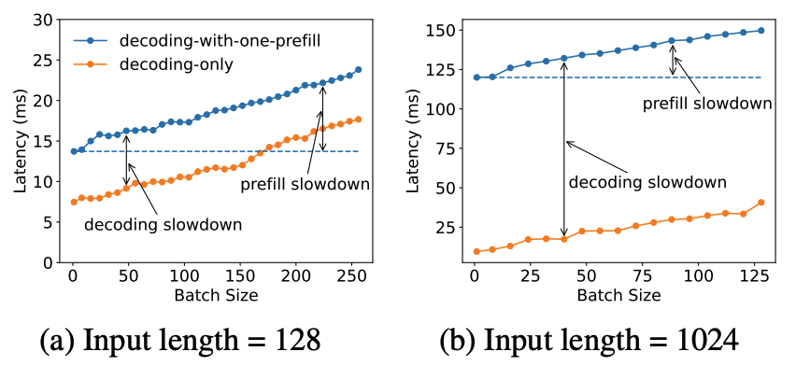
Background-Challenges (2/2)
Root cause analysis:
Colocating prefill and decoding phases on the same GPUs unavoidably share their resource and parallelism settings.
Prefill
Decode
Computation-
bound
✖️
Memory-
bound
Intra-op
Parallelism
✖️
Larger
Batch size
Fig 4. Prefill-Decode Interference
Tight SLO on
TTFT
Tight SLO on
TPOT
Notes:
Colocation creates prefill-decode interference.
Look at this characterization: prefill is compute-bound, prefers large batch sizes and high intra-op parallelism to maximize FLOPS.
Decode is memory-bound, needs small batches to maintain low latency.
When they share the same GPU, each fights for resources.
The figure shows what happens during inference.
When a large prefill batch arrives, it dominates the GPU, stalling all decodes in progress. This creates unpredictable latency spikes.
With tight SLOs—say 50ms per token—this is catastrophic.
You can see how prefill's demand for large batches conflicts with decode's need for responsiveness(rəˈspänsivnəs).
This interference is not a minor inefficiency—it's a fundamental architectural limitation that becomes more severe as context lengths grow. Modern workloads regularly see 128K token contexts, making prefill operations extremely long-running.

Slide 9
Outline
Introduction
Transformer Architecture, Two-Phase Inference, KV Cache.
Background
Aggregation vs. Disaggregation. Trade-offs and Real-World Workload Challenges.
Work 1: Mooncake¹
1, Qin, R., Li, Z., He, W., Cui, J., Tang, H., Ren, F., ... & Xu, X. (2024). Mooncake: A kvcache-centric disaggregated architecture for llm serving. ACM Transactions on Storage.
Work 2: NynaServe²
2, Ruan, C., Chen, Y., Tian, D., Shi, Y., Wu, Y., Li, J., & Li, C. (2025). DynaServe: Unified and Elastic Execution for Dynamic Disaggregated LLM Serving. arXiv preprint arXiv:2504.09285.
Work 3: TaiChi³
3, Wang, C., Zuo, P., Chen, Z., Liang, Y., Yu, Z., & Yang, M. C. (2025). Prefill-decode aggregation or disaggregation? unifying both for goodput-optimized llm serving. arXiv preprint arXiv:2508.01989.
Conclusion
Notes:
Now, let's examine how three different systems attack this problem.

Slide 10
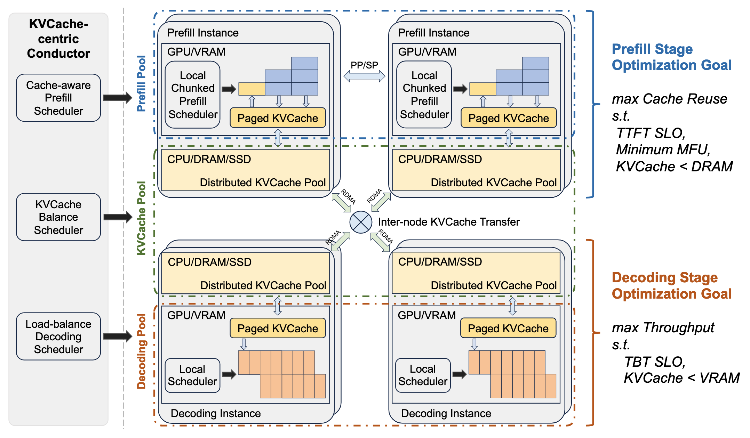
Mooncake-Architecture (1/4)
Fig 5. Mooncake Architecture
Notes:
First up is Mooncake, the serving platform for Kimi, developed by Moonshot AI. This is arguably the most mature production deployment of PD disaggregation, handling over 100 billion tokens daily across thousands of nodes.
Mooncake's architecture is KVCache-centric. It doesn't just separate prefill and decode—it creates a global, distributed KVCache pool using underutilized CPU, DRAM, SSD, and RDMA resources across the cluster.
The Conductor is the global scheduler that orchestrates everything: KVCache reuse, prefill instance selection, and decode load balancing.
Notice the disaggregation at two levels:
First, prefill and decode nodes are separate.
Second, KVCache is decoupled from GPU memory and stored in a distributed pool.
This allows fast cache sharing across sessions and requests.

Slide 11
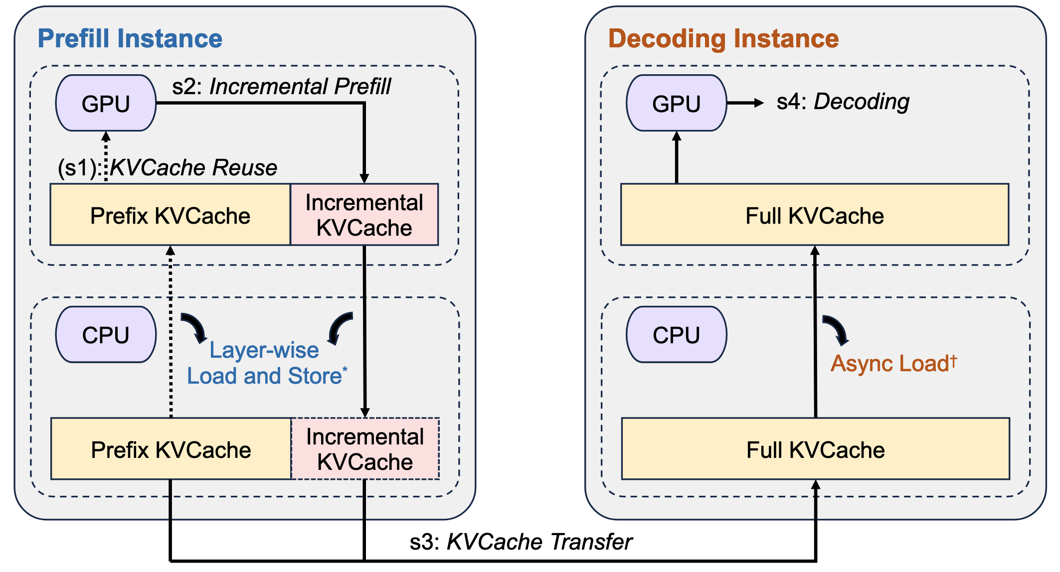
Mooncake-Workflow (2/4)
KV-Cache Reuse: It loads the prefix cache from remote CPU memory into GPU memory based on the prefix cache block keys to bootstrap the request. This step is skipped if no prefix cache exists.
Incremental Prefill: The prefill node completes the prefill stage using prefix cache and stores the newly generated incremental KVCache back into CPU memory.
KVCache Transfer: This step is asynchronously executed and overlapped with the above incremental prefill step, streaming the KVCache generated by each model layer to the destination decoding node’s CPU memory to reduce waiting time.
Decoding: After all the KVCache is received in the CPU memory of the decoding node, the request joins the next batch in a continuous batching manner.
Fig 6. Mooncake Workflow

Slide 12
Mooncake-Workflow (3/4)
Incremental
Prefill
Decoding
Time Line
KVCache
Reuse
KVCache
Transfer
Fig 6. Mooncake Workflow
Notes:
Let's walk through a request's lifecycle, shown here in four steps:
(click)KVCache Reuse: When a request arrives, the Conductor identifies reusable prefix KVCache blocks from previous conversations.
It loads these from remote CPU memory into the prefill GPU.
For multi-turn chats, this can reuse 40-60% of computation.
(click)Incremental Prefill: The prefill node processes only the new tokens not in cache, storing results back to CPU memory.
For long contexts exceeding 1000 tokens, it uses chunked pipeline parallelism—splitting across multiple nodes to reduce TTFT.
(click)KVCache Transfer: As each layer completes, its KVCache is streamed asynchronously to the target decode node's CPU memory, overlapping computation with communication.
(click)Decoding: Once all KVCache arrives, the request joins a continuous batch on the decode node for autoregressive generation.
This pipelined approach hides transfer latency.
The timeline shows how steps 2 and 3 overlap, with transfer happening layer-by-layer as prefill progresses.

Slide 13
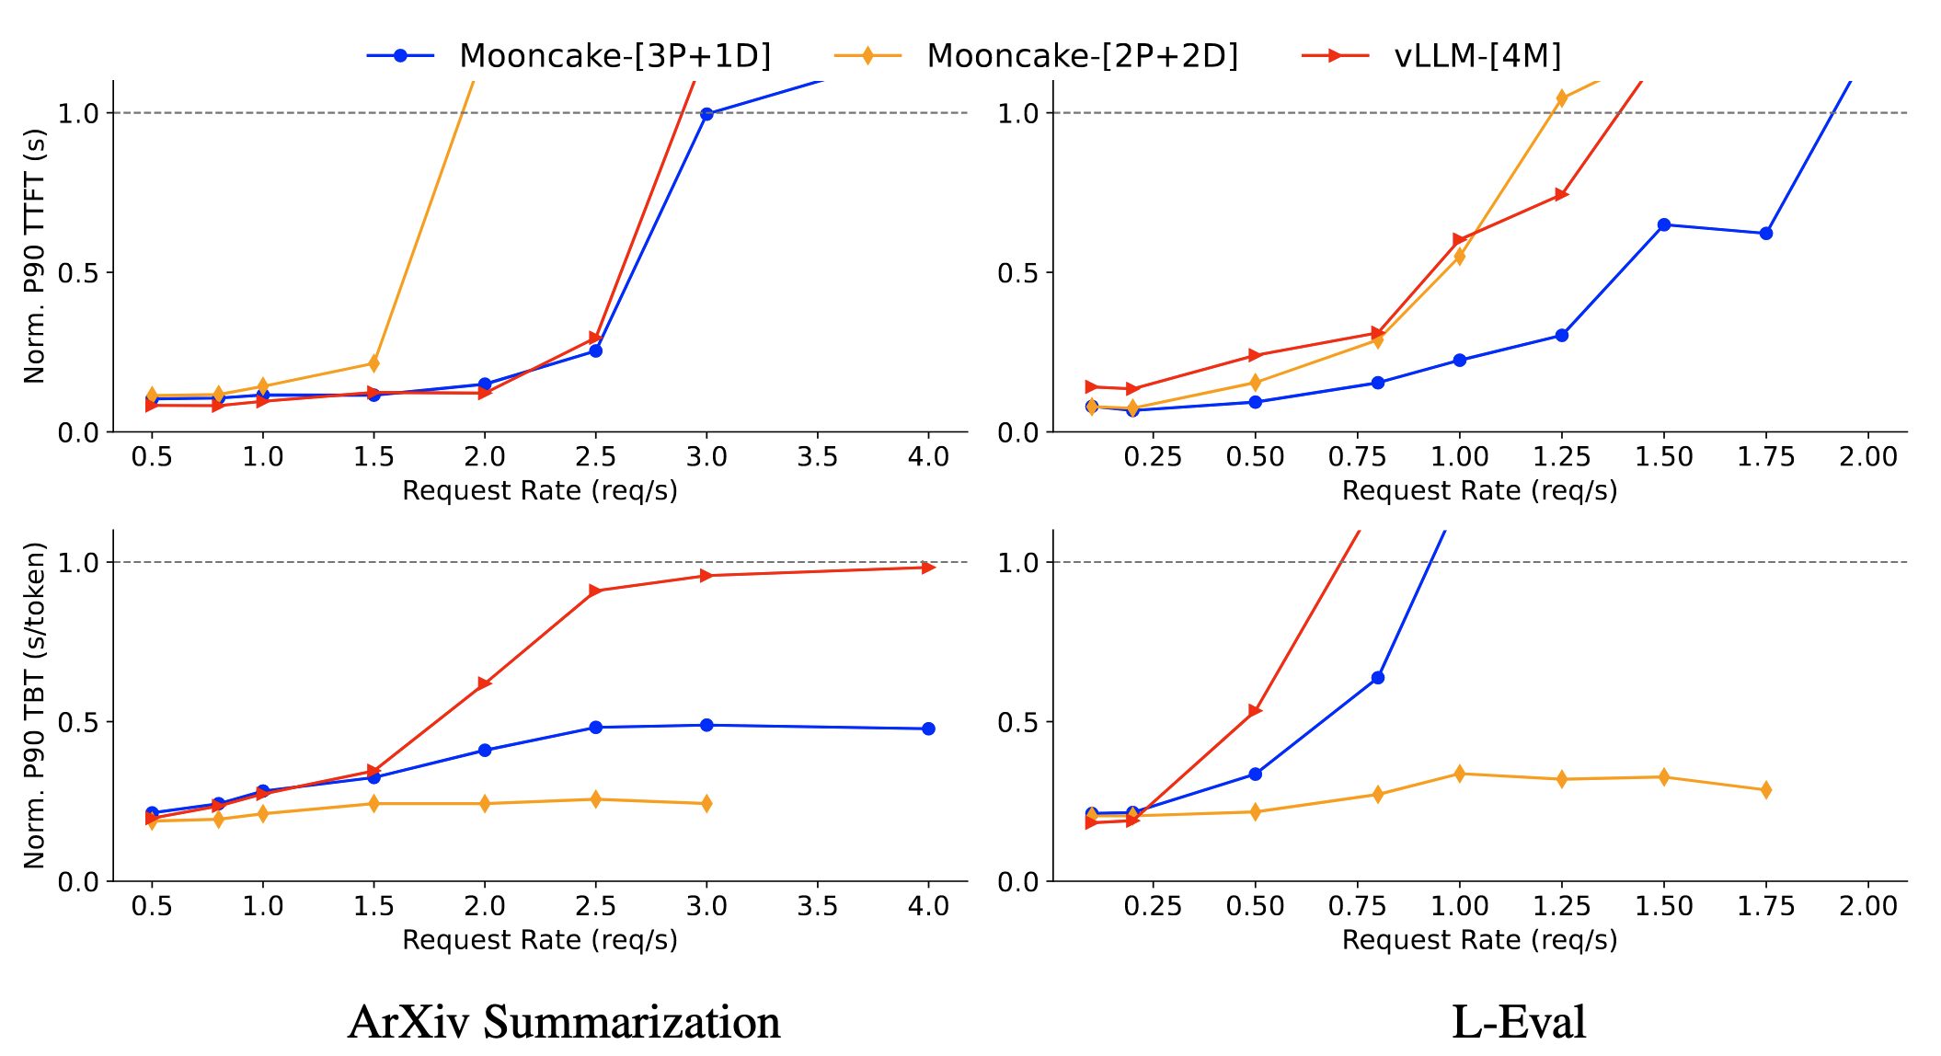
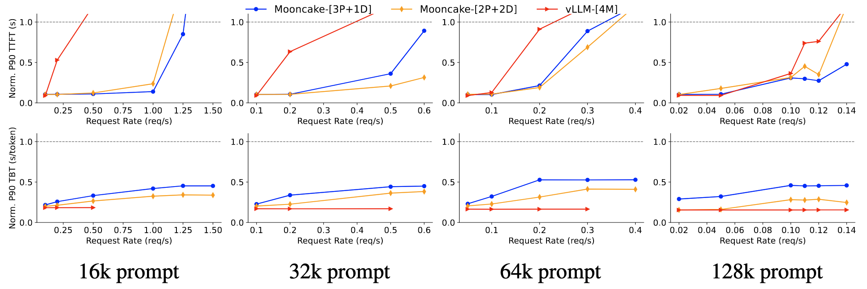
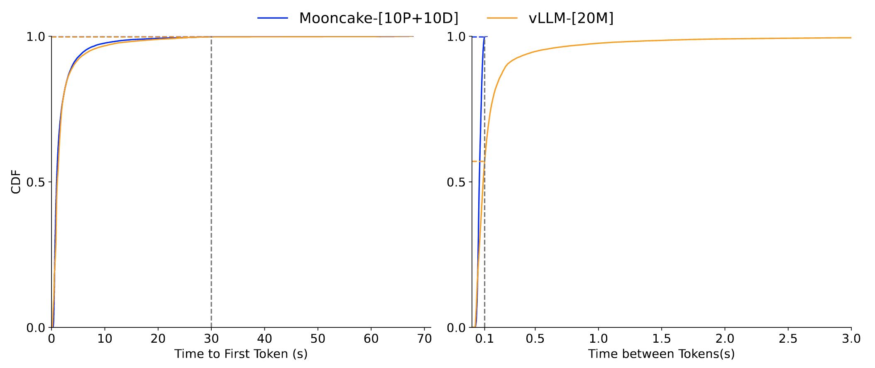
Mooncake-Evaluation (4/4)
Fig 7. End-to-End experiments on the ArXiv Summarization and L-Eval datasets
Fig 8. End-to-End experiments on simulated data
Fig 9. Request TTFT and TBT distributions of Mooncake and vLLM under real workloads
Notes:
The evaluation shows dramatic improvements. On real workloads, Mooncake achieves 59% to 498% higher effective request capacity compared to vLLM while meeting SLOs.
The key graphs show:
Considering End-to-end latency distributions:
Mooncake maintains tight TTFT and TBT clusters within SLO bounds, while vLLM shows long tails.
Considering Real trace experiments: At different TBT thresholds, Mooncake consistently supports higher request rates.
The architecture enables Kimi to handle 115% more requests on A800 clusters and 107% more on H800 clusters.
Mooncake's success comes from treating KVCache as a first-class resource, not just a byproduct.
The distributed cache pool achieves hit rates up to 2.36x higher than local caching, saving up to 48% of prefill computation time.

Slide 14
Outline
Introduction
Transformer Architecture, Two-Phase Inference, KV Cache.
Background
Aggregation vs. Disaggregation. Trade-offs and Real-World Workload Challenges.
Work 1: Mooncake¹
1, Qin, R., Li, Z., He, W., Cui, J., Tang, H., Ren, F., ... & Xu, X. (2024). Mooncake: A kvcache-centric disaggregated architecture for llm serving. ACM Transactions on Storage.
Work 2: NynaServe²
2, Ruan, C., Chen, Y., Tian, D., Shi, Y., Wu, Y., Li, J., & Li, C. (2025). DynaServe: Unified and Elastic Execution for Dynamic Disaggregated LLM Serving. arXiv preprint arXiv:2504.09285.
Work 3: TaiChi³
3, Wang, C., Zuo, P., Chen, Z., Liang, Y., Yu, Z., & Yang, M. C. (2025). Prefill-decode aggregation or disaggregation? unifying both for goodput-optimized llm serving. arXiv preprint arXiv:2508.01989.
Conclusion
Notes:
But Mooncake uses static PD separation. What if workloads are highly dynamic?
Enter DynaServe, which asks: Instead of static separation, can we adaptively partition each request?

Slide 15
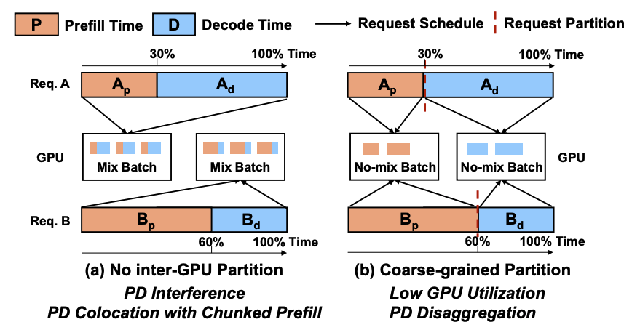
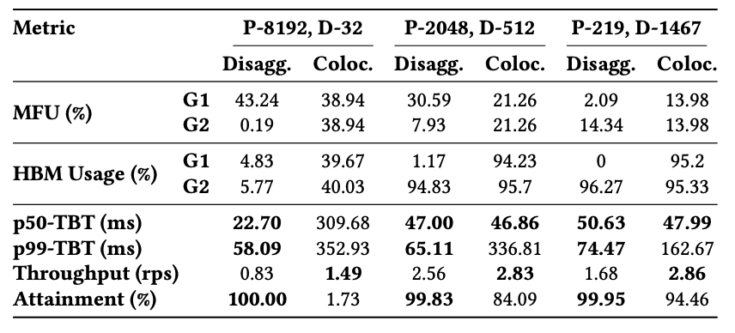
NynaServe - Insights (1/5)
Drawbacks of PD aggregation:
Heavy prefill workloads (especially for long contexts) may stall latency-sensitive decode steps, leading to long tail latencies between tokens.
The optimization with chunked-prefill only works when the decode phase dominates.
Drawbacks of PD aggregation:
The architecture achieves optimal throughput when prompt and output workloads are well-balanced.
Any imbalance in the workload, such as when prompt lengths increase or output lengths shrink, creates uneven resource utilization across the two GPU pools, resulting in resource fragmentation and degraded overall efficiency.
Fig 10. Partition and scheduling strategies in LLM serving
Table 1. GPU resource utilization under two A100 (G1&G2)

Slide 16
NynaServe – Insights (2/5)
Drawbacks of PD aggregation:
Heavy prefill workloads may stall latency-sensitive decode steps.
Chunked-prefill optimization only works when the decode phase dominates.
Fig 10. Partition and scheduling strategies in LLM serving
Drawbacks of PD disaggregation:
Works well with a balanced prompt and output length.
Imbalanced workloads create uneven resource utilization.
Table 11. GPU resource utilization under two A100 (G1&G2)
Notes:
The observation behind is that both aggregation and disaggregation have drawbacks.
(click)For aggregation, ….
(click)For disaggregation, …..
DynaServe's insight is that real-world workloads like Azure Code and BurstGPT show extreme temporal variance. Some periods are prefill-heavy—imagine users pasting long documents. Other periods are decode-heavy—like extended reasoning sessions.
Static configurations waste resources.
(click)The table quantifies GPU utilization imbalance under PD disaggregation:
With a long-prompt workload, the prefill GPU hits 43% MFU (Model Flops Utilization) but only 4.8% HBM usage, while the decode GPU is memory-saturated but compute-idle at 0.2% MFU. This leads to 44% throughput drops.

Slide 17
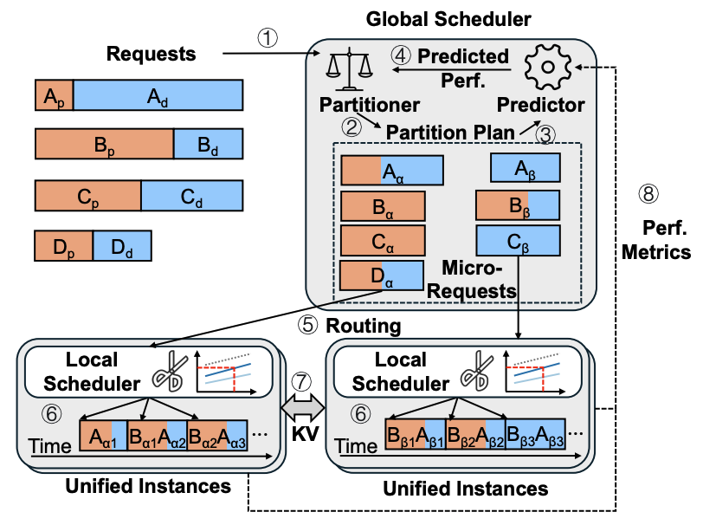




NynaServe - Design Philosophy (3/5)
Design Philosophy
Request
Prefill
Decode
Fig 11. NynaServe Architecture
Micro Request Abstraction
Unified Working load
Notes:
DynaServe introduces the micro-request abstraction.
Instead of treating prefill and decode as monolithic phases, it can split any request at any token boundary into two cooperating segments, α and β.
On the left is the detailed process.
(click)At first, the global scheduler receives a request.
(click)The request may contain the prefill task and the decode part.
(click)These two tasks are served with a micro request abstraction.
(click)Then the task is unified and dispatched to different GPUs.
This creates a unified execution model: Every GPU instance is equal and can process any micro-request.
The global scheduler decides split points and routes micro-requests based on real-time load. Local schedulers on each GPU then form SLO-aware batches dynamically.
The design philosophy is simple: Balance execution time across all GPUs, not just prefill vs decode ratios.
If GPU-1 is idle waiting for GPU-2, we're wasting capacity.

Slide 18
NynaServe – Workflow (4/5)
Design 1: Global scheduler handles all serving requests (①).
First, the scheduler determines the predicted optimal splitting point of each request (②~④).
Second, the scheduler routes the partitioned micro-requests to executors (⑤). It runs a lightweight performance predictor, which collects periodic runtime statistics (⑧).
Design 2: Unified execution instances run micro-requests dispatched by the global scheduler on its GPUs.
Given a set of buffered requests, a local scheduler builds token-level batches via an SLO-aware control mechanism (⑥).
When the micro-requests of an LLM request span two execution instances, the instances exchange the required KV cache blocks over RDMA (⑦).
Fig 11. NynaServe Architecture
Notes:
Here's how the two-level scheduler works:
(click)Global Scheduler: For each incoming request, it predicts output length (using prior work). It then searches split points using binary search—typically 6 iterations—to balance predicted execution time across GPU instances.
This uses a lightweight performance predictor that simulates virtual batches in microseconds.
(click)Unified execution instances(Local Scheduler): On each GPU, it forms batches considering three factors: batch size, prefill-to-decode token ratio, and decode context length.
It maintains a profile table recording latency for different combinations, which may contain (prefill length, context length, decode count) .
Before each batch, it looks up this table to determine the maximum prefill tokens that fit within the SLO.
It greedily adds prefill requests until hitting this budget, ensuring high utilization without latency violations.
When micro-requests span instances, KVCache is transferred in chunks as each layer completes, overlapping communication with computation. This is 94% more efficient than waiting for full request completion.

Slide 19
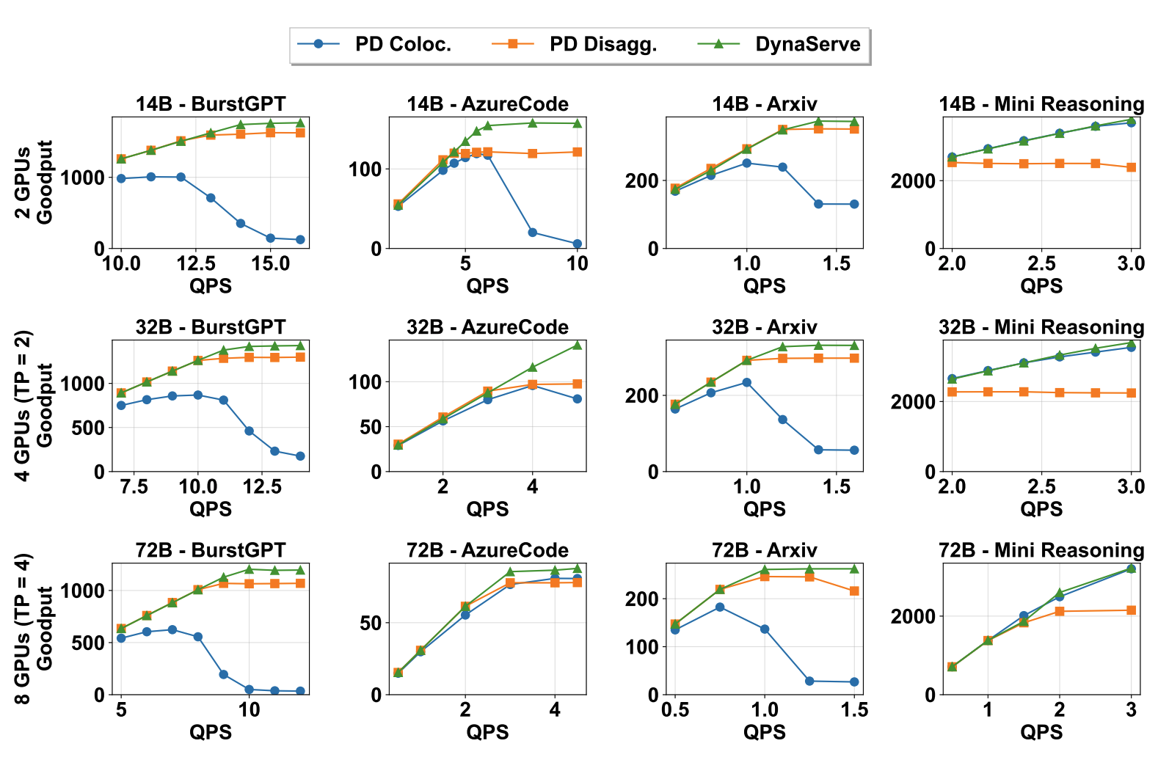
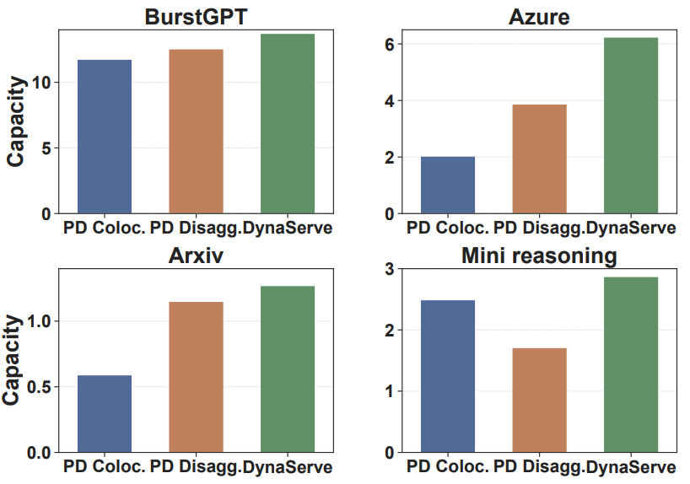
NynaServe – Evaluation (5/5)
Fig 12. Serving Capacity Comparison
Fig 12. Goodput Comparison
Notes:
DynaServe's results are compelling: 1.15× to 3.07× higher serving capacity than PD colocation, and 1.09× to 1.67× over PD disaggregation.
Goodput improvements reach 1.91× over colocation and 1.61× over disaggregation.
The key advantage is adaptability.
In decode-heavy Mini-Reasoning workloads, DynaServe dynamically reduces prefill interference.
In prefill-heavy Azure Code workloads, it shifts more resources to prefill processing. The scheduling overhead is just 14-17ms per request—negligible compared to multi-second inference times.

Slide 20
Outline
Introduction
Transformer Architecture, Two-Phase Inference, KV Cache.
Background
Aggregation vs. Disaggregation. Trade-offs and Real-World Workload Challenges.
Work 1: Mooncake¹
1, Qin, R., Li, Z., He, W., Cui, J., Tang, H., Ren, F., ... & Xu, X. (2024). Mooncake: A kvcache-centric disaggregated architecture for llm serving. ACM Transactions on Storage.
Work 2: NynaServe²
2, Ruan, C., Chen, Y., Tian, D., Shi, Y., Wu, Y., Li, J., & Li, C. (2025). DynaServe: Unified and Elastic Execution for Dynamic Disaggregated LLM Serving. arXiv preprint arXiv:2504.09285.
Work 3: TaiChi³
3, Wang, C., Zuo, P., Chen, Z., Liang, Y., Yu, Z., & Yang, M. C. (2025). Prefill-decode aggregation or disaggregation? unifying both for goodput-optimized llm serving. arXiv preprint arXiv:2508.01989.
Conclusion
Notes:
But both Mooncake and DynaServe still operate in either "aggregation mode" or "disaggregation mode." What if the optimal solution requires both simultaneously?
TaiChi—named after the philosophy of balancing opposites—identifies a critical insight: PD aggregation and disaggregation excel under different SLO regimes.

Slide 21
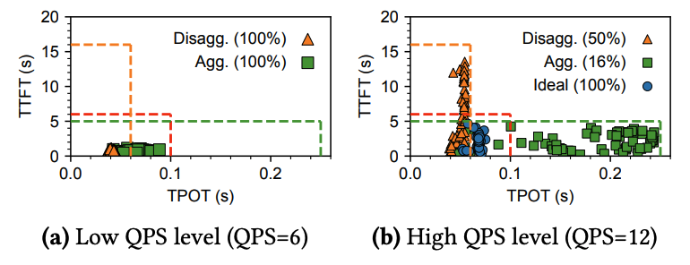
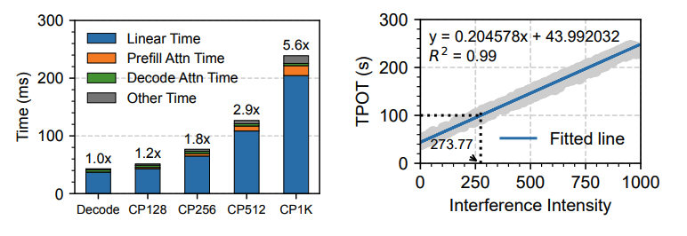
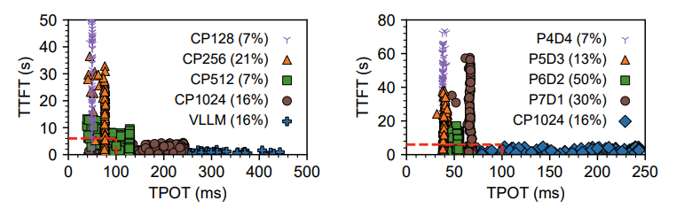
TaiChi-Insights (1/6)
Observation 1: PD aggregation performs best under tight TTFT and relaxed TPOT constraints, while PD disaggregation is more effective under tight TPOT and relaxed TTFT. However, when TTFT and TPOT constraints are balanced, both approaches struggle to meet SLOs effectively. (Fig 12)
Observation 2: The high TPOT in PD aggregation arises from prefill interference due to computation-bound linear operations, with a strong linear relationship between interference intensity and TPOT.
Observation 3: The high TTFT in PD disaggregation stems from request queuing, which occurs because PD disaggregation offers lower prefill processing capacity compared to PD aggregation.
One Key observation: Works like NynaServe
can only achieve nearly 60%~81% accuracy
on predicting output length.
Fig 12. Observation 1
Fig 13. Observation 2
Fig 14. Observation 3
Notes:
(click)Observation 1
(click)Observation 2
(click)Observation 3
(click)But one key observation

Slide 22
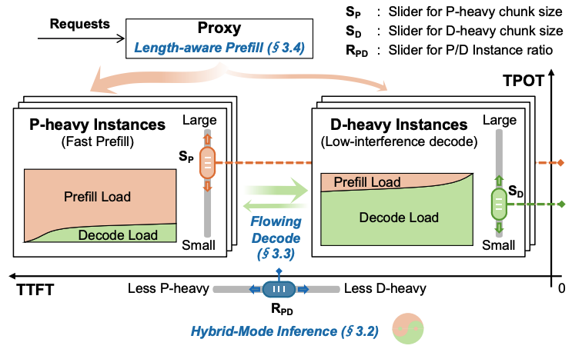
TaiChi-Architecture (2/6)
Key idea：
Shifting the latency across prefill/decode phases and across requests.
Two main components:
P-heavy instances: Optimized for prefill tasks with larger chunk sizes, minimizing TTFT, suffer from higher TPOT handling decode tasks.
D-heavy instances: Optimized for decode tasks with smaller chunk sizes, minimizing TPOT, can handle certain degradable prefill tasks.
The proxy:
Dispatching prefill and decode tasks to appropriate instances.
Fig 15. TaiChi Architecture
Notes:
(click)The key idea of Taichi is that the latency of the prefill and decode phase can be shifted.
TaiChi unifies both approaches through differentiated-capability instances:
(click)P-heavy instances: They are optimized for prefill tasks with Large chunk sizes (e.g., 1024 tokens). They perform fast prefill, but suffer from higher TPOT when handling decode tasks.
D-heavy instances: They are optimized for decode tasks with small chunk sizes (e.g., 128 tokens). They perform slow prefill, have lower TPOT, can handle prefill tasks with degraded performance.
(click)The proxy……
This creates a hybrid-mode inference where:
Batch handling is aggregated: Both instance types process mixed prefill/decode batches for high utilization.
Request handling is disaggregated: A request's prefill can be on P-heavy while its decode is on D-heavy.
This dual nature enables latency shifting—strategically degrading some requests' latency to improve others.

Slide 23
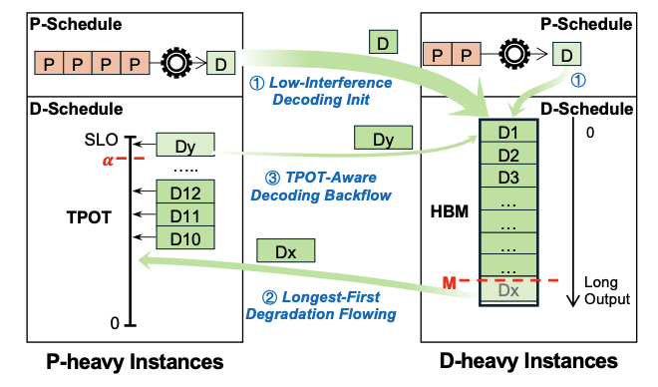
TaiChi-Flowing Decode Scheduling (3/6)
Goal: Dynamically migrating decode requests between D-heavy instances and P-heavy instances.
Low-Interference Decode Init: (Step ①) Initially schedule a decode request to a D-heavy instance.
Longest-First Degradation Flowing: (Step ②) Selectively offload a portion of decode requests, which have the current longest output, to P-heavy instances.
TPOT-Aware Decode Backflow: (Step ③) Monitor requests’ real-time TPOT and migrate those approaching the TPOT SLO back to D-heavy instances.
Fig 15. Flowing Decode Scheduling
Notes:
(click) goal of Flowing decode scheduling it to control TPOT through dynamic migrating decode requests between B-heavy instances and P-heavy instances.
It has three main steps
(click)Low-Interference Decode Init: New decode requests start on D-heavy instances to protect short-output requests from premature TPOT violations.
(click)Longest-First Degradation Flowing: When D-heavy memory hits a threshold (e.g., 95%), select the request with the longest current output and migrate it to a P-heavy instance.
This request can absorb interference because it has already enjoyed many low-interference iterations.
(click)TPOT-Aware Decode Backflow: Monitor real-time TPOT on P-heavy instances. When a request's TPOT approaches the SLO (e.g., 96% of threshold), migrate it back to D-heavy.
This prevents over-degradation.
The algorithm isolates degradations to specific requests, preventing batch-level interference spread.

Slide 24
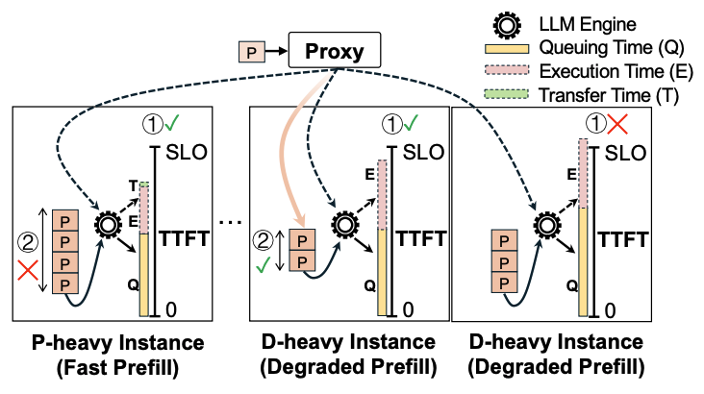
TaiChi-Len-Aware Prefill Scheduling (4/6)
Goal: Exploit the lower urgency of short prefill requests by routing them to D-heavy instances.
Estimated waiting time (TTFT):
On P-heavy instance: SUM(Q, E, T)
On D-heavy instance: SUM(Q, E)
Strategy:
Select the instance with the fewest queuing prefill tokens.
Fig 15. Length-aware Prefill Scheduling
Notes:
(click)The goal of Length-aware prefill scheduling is to control TTFT by exploiting short requests' latency tolerance:
(click)For an incoming prefill request, the proxy estimates its TTFT on each instance as: TTFT = Queuing Time + Execution Time + Transfer Time
Queuing time is the sum of remaining prefill execution times on that instance. Execution time is predicted via cost models. Transfer time is for P-heavy instances only.
(click)The scheduler selects the instance with fewest queued prefill tokens among those satisfying TTFT SLO. This typically chooses a D-heavy instance for short requests, naturally degrading them while freeing P-heavy resources for long, latency-critical prefill requests.
This is a degradation strategy, not just load balancing. It's intentionally routing short requests to slower instances because they can afford the latency.

Slide 25
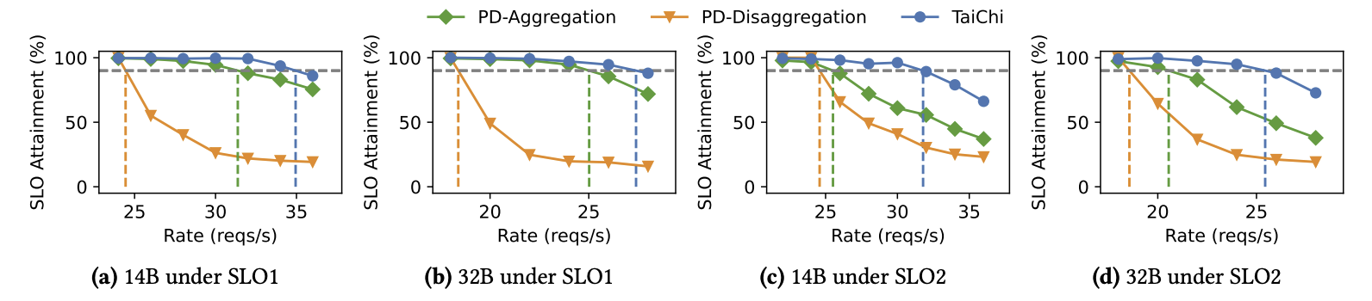
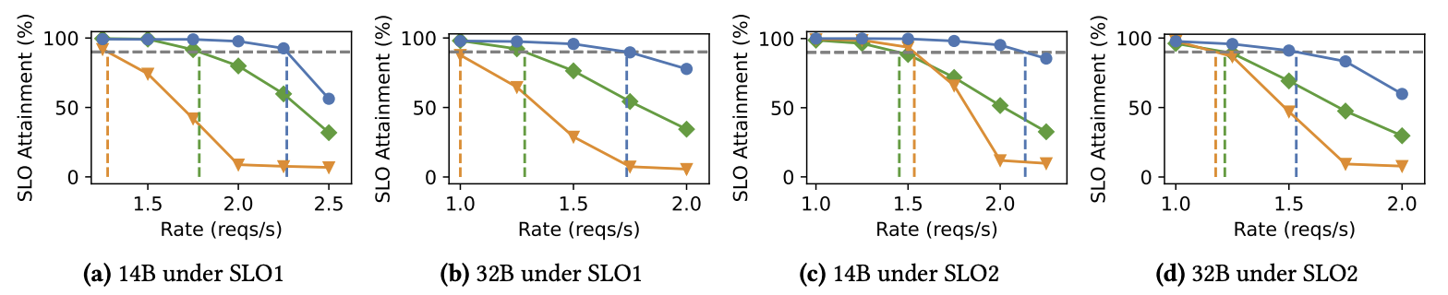
TaiChi-Evaluation1 (5/6)
Fig 16. Goodput (vertical lines) for chatbot tasks using Qwen-2.5 models under SLO1 and SLO2.
Fig 17. Goodput (vertical lines) for summarization tasks using Qwen-2.5 models under SLO1 and SLO2.
Notes:
TaiChi's results are striking: Up to 77% goodput improvement over state-of-the-art systems. Specifically:
Under balanced SLOs, TaiChi achieves 1.29-1.77× higher goodput than PD disaggregation.
TTFT is reduced by up to 13.2× compared to disaggregation.
TPOT is reduced by up to 1.69× compared to aggregation.

Slide 26
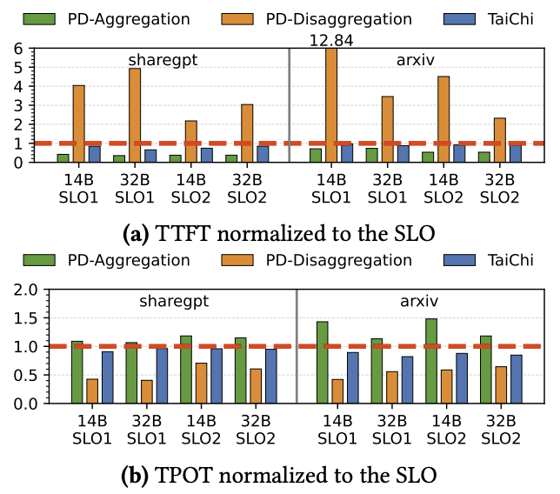
TaiChi-Evaluation2 (6/6)
Fig 18. P90 Latency normalized to the SLOs.
Notes:
The breakdown analysis shows that the hybrid architecture alone provides the foundation, flowing decode scheduling adds 12.9% SLO attainment by controlling TPOT, and length-aware prefill scheduling adds another 11.7% by managing TTFT.

Slide 27
Outline
Introduction
Transformer Architecture, Two-Phase Inference, KV Cache.
Background
Aggregation vs. Disaggregation. Trade-offs and Real-World Workload Challenges.
Work 1: Mooncake¹
1, Qin, R., Li, Z., He, W., Cui, J., Tang, H., Ren, F., ... & Xu, X. (2024). Mooncake: A kvcache-centric disaggregated architecture for llm serving. ACM Transactions on Storage.
Work 2: NynaServe²
2, Ruan, C., Chen, Y., Tian, D., Shi, Y., Wu, Y., Li, J., & Li, C. (2025). DynaServe: Unified and Elastic Execution for Dynamic Disaggregated LLM Serving. arXiv preprint arXiv:2504.09285.
Work 3: TaiChi³
3, Wang, C., Zuo, P., Chen, Z., Liang, Y., Yu, Z., & Yang, M. C. (2025). Prefill-decode aggregation or disaggregation? unifying both for goodput-optimized llm serving. arXiv preprint arXiv:2508.01989.
Conclusions
Notes:
Next is our conclusioin

Slide 28
Conclusions
Cache is king: Global KVCache reuse transforms economics.
Flexibility matters: Static partitioning cannot handle dynamic workloads.
Balance is achievable: Hybrid architectures can extract the best of both worlds.
Notes:
(click) cache is the king
(click) Flexibility matter
(click) Balance is ahievable
The future of LLM serving lies not in choosing between aggregation or disaggregation, but in intelligently orchestrating both based on workload, SLOs, and available resources.

Slide 29
Q & A
Notes:
Thank you for your attention. I'm happy to take questions on any aspect of these systems—their design trade-offs, implementation challenges, or how they might apply to your specific serving scenarios.

