Slide 1
Tracing Operation System's Microkernel Journey and Its Performance Trade-offs
Zhangtianyi Chen
School of Data Science
Chinese University of Hong Kong, Shenzhen
Notes:
OK， Today I gona introduce something that I am interested in but it is not my research topic

Slide 2
Outline
Introduction
Related Work
Preliminaries
Proposed Methods
Performance Evaluation
Conclusions

Slide 3
Kernel and Microkernel
Introduction
Related Work
Preliminaries
Proposed Methods
Performance Evaluation
Conclusions
Notes:
开局要加一点内容

Slide 4
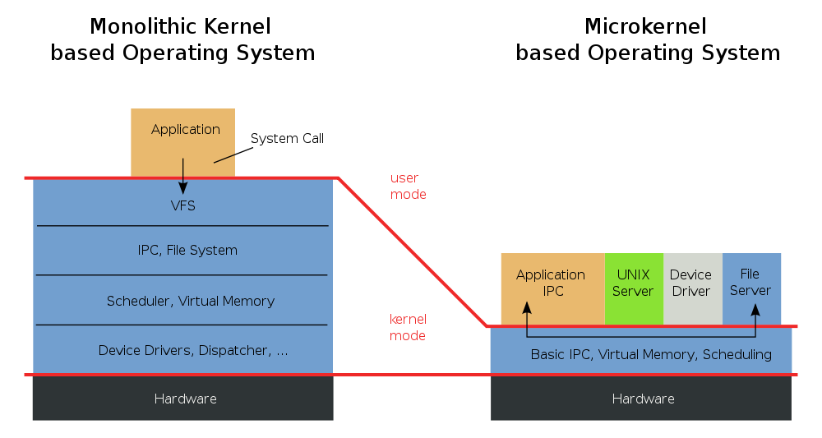
Introduction - Kernel and MicroKernel
What is MicroKernel
Kernel (Monolithic): A monolithic kernel (like Linux) is an "all-in-one" architecture.
Microkernel: A microkernel minimizes the privileged code base by keeping only the absolute essentials (IPC, scheduling, low-level address space management) in Kernel Mode, while moving most services (drivers, file systems) to unprivileged User Mode.
Notes:
首先，我们来看最经典的单体内核（Monolithic Kernel）架构。尽管它是传统设计的代表，但至今仍是主流，比如我们熟知的 Linux。它的核心逻辑是‘大一统’：将文件系统、驱动程序、调度器等所有服务模块，全部塞进高权限的内核态统一管理。
你可以把它想象成一个**‘全能型大开间办公室’**。在这个房间里，所有的职员（服务）混坐在一起，每个人都握着整栋大楼的所有钥匙。
相比之下，微内核（Microkernel）则推崇‘极致简约’。它对内核态进行了‘大瘦身’，只保留进程间通信（IPC）和基础调度等绝对核心的功能，而将文件系统、驱动等大部分服务‘下放’到了低权限的用户态。这就像是把那个大办公室拆分成了多个独立隔间，只有行政主管留在中心负责协调。
Let's start with the Monolithic Kernel, a classic architecture that remains the backbone of most modern operating systems, such as Linux. The defining characteristic here is 'centralization'—all service modules, from file systems to device drivers, reside within the Kernel Mode under unified management.
You can think of it as an 'All-in-one Open-plan Office.' In this setup, every service works in the same room, and every 'employee' holds a master key to the entire building.
In contrast, the Microkernel follows a 'Minimalist' philosophy. It strips the kernel down to its absolute essentials—keeping only core functions like IPC and basic scheduling in Kernel Mode. Most other services are 'outsourced' to the unprivileged User Mode. This effectively transforms the open-plan office into a series of private cubicles, where the kernel acts as a management team ensuring everyone can still communicate.

Slide 5
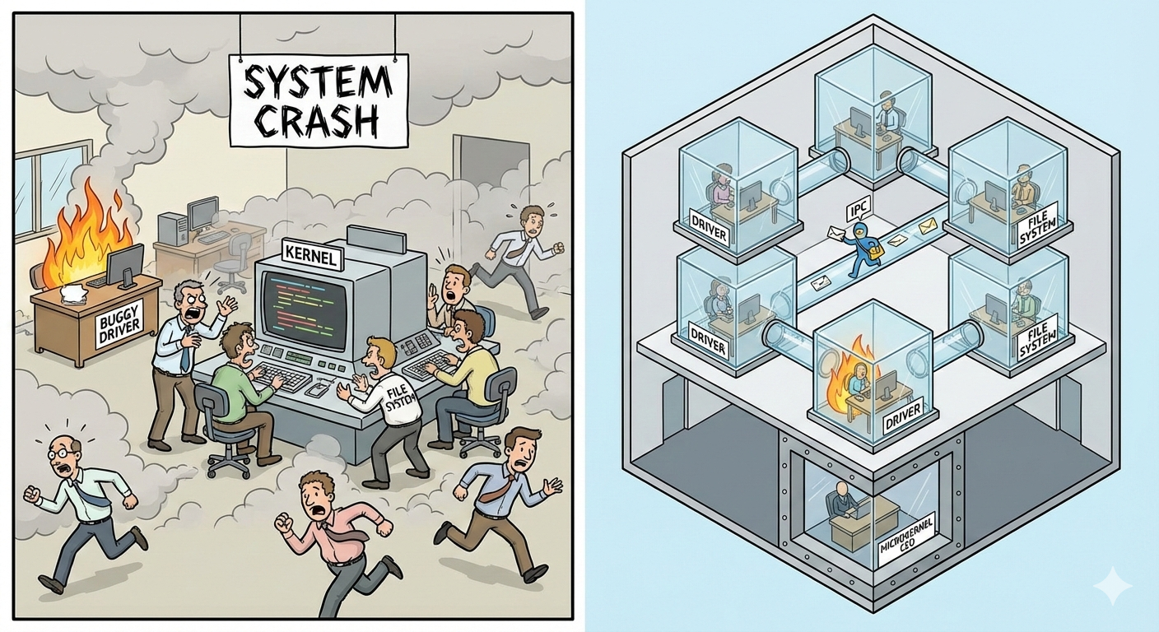
Introduction – Pros & Cons
Monolithic Kernel——Philosophy: "Performance First" 🏎️
High Efficiency: Direct function calls between components.
Mature Ecosystem: Decades of optimization. (e.g. Linux)
Fragile: Bug in one driver = System Crash (BSOD) 💥.
Hard to Maintain: Huge codebase, difficult to debug or verify.
Microkernel——Philosophy: "Reliability & Security First" 🛡️
Isolation: Driver crash ≠ System crash.
Security: Small TCB (Trusted Computing Base), easier to secure.
IPC Overhead: Switching between User/Kernel modes is costly🐢
Complexity: Asynchronous communication is harder.
Notes:
单体内核（Monolithic Kernel）的座右铭是‘性能至上’。
优点： 由于所有部门都在一个大办公室里，大家沟通只需‘吼一嗓子’（直接函数调用），办事效率极高。经过几十年的优化，它已经拥有了像 Linux 这样极其成熟的生态。
缺点： 但它的致命伤在于脆弱。因为没有墙，一旦某个驱动职员不小心点燃了纸篓，大火会迅速蔓延，导致整个系统蓝屏崩溃（BSOD）。而且代码量巨大，后期维护和排查错误就像在乱麻中找线头。
微内核（Microkernel）则坚持‘安全与可靠第一’。
优点： 它的隔离性极佳。就算文件服务的办公室起火了，也不会波及他人，系统依然稳如泰山。因为核心代码量（TCB）非常小，也更容易进行安全加固。
缺点： 它的代价是**‘沟通成本’**。因为大家都在独立隔间，每次办事都要通过管理员送信（IPC 通讯），在用户态和内核态之间反复切换非常耗时。此外，异步沟通的逻辑也让系统开发变得更加复杂。
Now, let's look at the trade-offs between these two architectures.
The Monolithic Kernel operates on a 'Performance First' philosophy.
Pros: Since everyone is in the same 'room,' communication is handled via direct function calls, leading to high efficiency. It also benefits from a mature ecosystem with decades of optimization.
Cons: However, it is fragile. A single bug in one driver can trigger a full system crash (BSOD). Moreover, the massive codebase makes it incredibly hard to debug or maintain.
In contrast, the Microkernel emphasizes 'Reliability and Security'.
Pros: Its biggest strength is isolation. A driver crash does not equal a system crash. With a smaller TCB (Trusted Computing Base), the core is much easier to secure and verify.
Cons: The downside is the IPC overhead. Constantly switching between User and Kernel modes for communication is costly and can slow things down. The system's overall complexity also increases due to the challenges of managing asynchronous communication.

Slide 6
A Brief History of Micorkernels
Introduction
Related Work
Preliminaries
Proposed Methods
Performance Evaluation
Conclusions

Slide 7
Related Work - A Brief History of Micorkernels (1/2)
milestone 1: The First Generation (1980s - early 90s)
Key System: Accetta et al., "Mach: A New Kernel Foundation for UNIX Development," USENIX 1986.
Focus: Flexibility & Portability. (Trying to move Unix services out of the kernel).
The Outcome (Why it failed): "Performance Disaster" 🐢.
IPC was 🔥too slow (often 50%+ overhead). They blamed the architecture.
milestone 2: The Second Generation (Mid-90s)
Key System: J. Liedtke, "Improving IPC by Kernel Design," SOSP 1993.
Focus: Extreme Performance Optimization.
Introduced Fast IPC (register passing, zero-copy). Performance became comparable to monolithic kernels.
Notes:
The development of the microkernel has not been without challenges. Milestone 1 (The First Generation): Represented by the Mach system, the focus was on flexibility. However, it turned out to be a "Performance Disaster" with IPC overhead often exceeding 50%. Many blamed the architecture itself for this failure.
Milestone 2 (The Second Generation): In the mid-90s, J. Liedtke(liki) revolutionized the field. By introducing Fast IPC techniques like register passing and single-copy, he achieved performance levels comparable to monolithic kernels.

Slide 8
Related Work - A Brief History of Micorkernels (2/2)
milestone 3: The New Paradigm - Modern Practicality (2000s - Present)
Key Systems & Papers:
seL4: G. Klein et al., "seL4: Formal Verification of an OS Kernel," SOSP 2009.
Asterinas: Y. Peng et al., "Asterinas: A Linux ABI-Compatible, Rust-Based Framekernel OS with a Small and Sound TCB," USENIX ATC 2025.
Focus: The Shift from "Verification" to "Construction"
The Problem with Absolute Security (seL4): While seL4 achieved a "bug-free" state through formal verification, the cost was extreme—high development complexity and poor ecosystem compatibility.
Notes:
Milestone 3: The New Paradigm, spanning from the 2000s to the present.
The focus has shifted from mere 'Verification' to 'Intelligent Construction'. We've learned that absolute security comes at an extreme cost. For instance, while seL4 achieved a 'bug-free' state through formal verification, it suffered from immense development complexity and poor ecosystem compatibility.
Today’s trend is about finding a practical middle ground. A prime example is Asterinas, a Rust-based OS that maintains a small and sound TCB while remaining Linux ABI-compatible.

Slide 9
1. Improving IPC by Kernel Design 2. seL4: Formal Verification of an OS Kernel 3. Asterinas: A Linux ABI-Compatible, Rust-Based Framekernel OS with a Small and Sound TCB
Introduction
Related Work
Preliminaries
Proposed Methods
Performance Evaluation
Conclusions

Slide 10
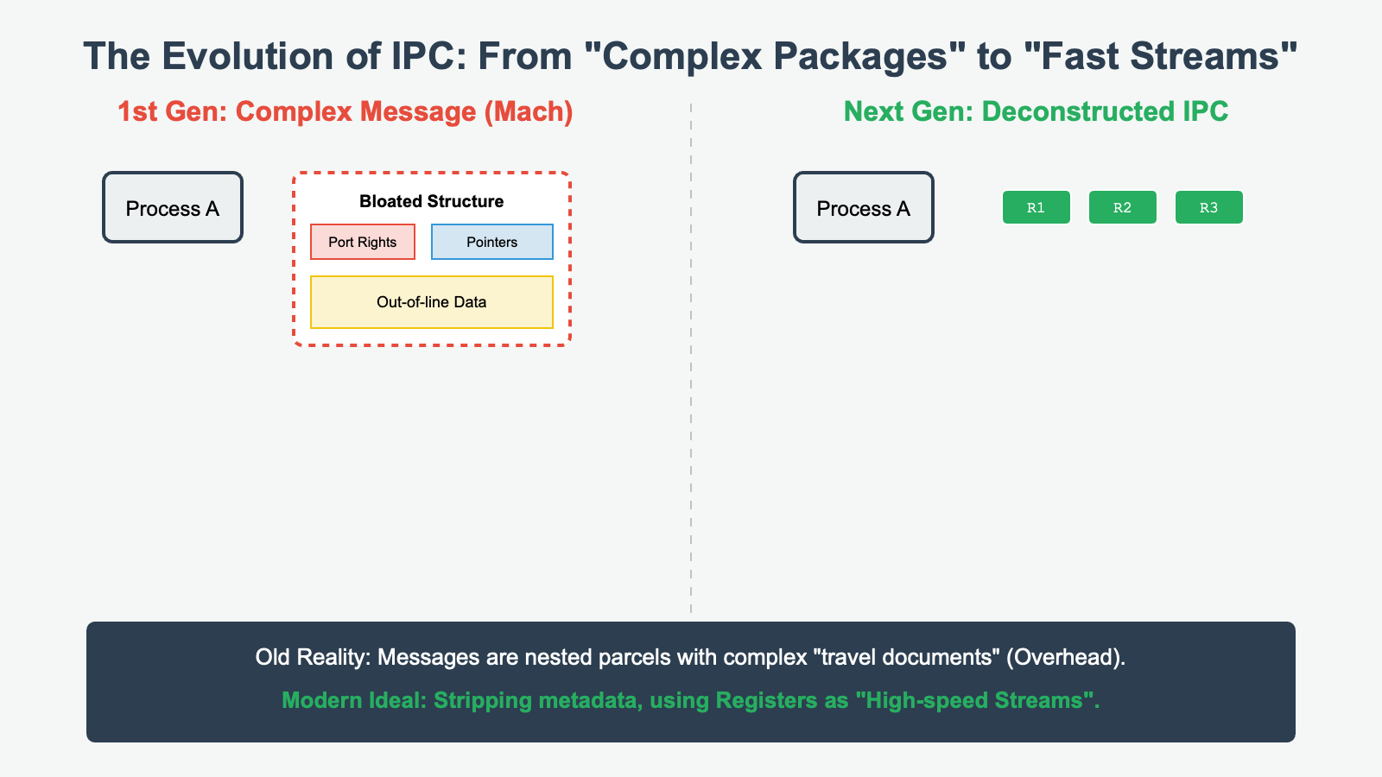
Preliminaries - Design in Mach
The Ideal: Pursuing Absolute Universality
Design Vision: First-generation microkernels (such as Mach) aimed to create a "super-universal" message format capable of seamless, transparent transmission across a network.
The Reality: Deconstructing the "Complex Message" (Figure 1)
Bloated Structure: Messages were not merely raw data; they were embedded with extensive metadata, Port Rights, and pointers to other data blocks.
Analogy: This is like a package filled with countless nested smaller parcels, each requiring its own set of complex "travel documents".
The Bottleneck: Prohibitive Communication Overhead (Figure 2)
Translation Costs: When Process A sends a message to B, the kernel does more than copy bytes; it must translate, transfer, and reassemble complex data structures
Performance Hit: This design, optimized for network transparency, became a massive burden that crippled local Inter-Process Communication (IPC) performance.
Fig.1: The bottleneck of the first generation of microkernel
Notes:
Before diving into the technical details, let's look at the vision behind first-generation microkernels like Mach.
The Ideal: Designers aimed for a "super-universal" message format that treated local and network transmissions identically.
The Reality: This pursuit led to a bloated message structure. As shown in the top-left diagram, messages were packed with metadata, port rights, and complex pointers.
Why was Mach’s IPC so slow? Because the kernel was doing too much. When Process A sent a message to B, the kernel spent more time translating and reassembling complex data structures than actually moving the data. These "translation costs" resulted in the 50%+ performance disaster we discussed earlier.
To break this bottleneck, the concept of L3 kernel is introduced

Slide 11
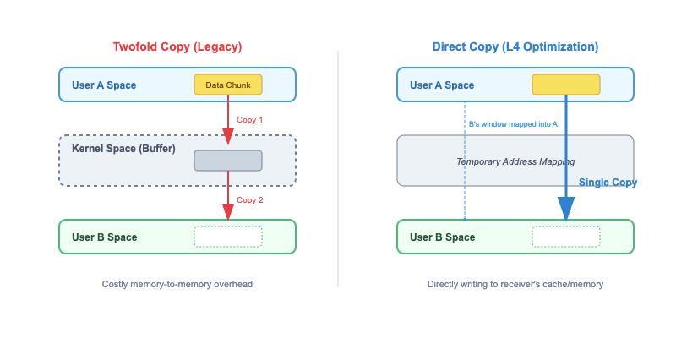
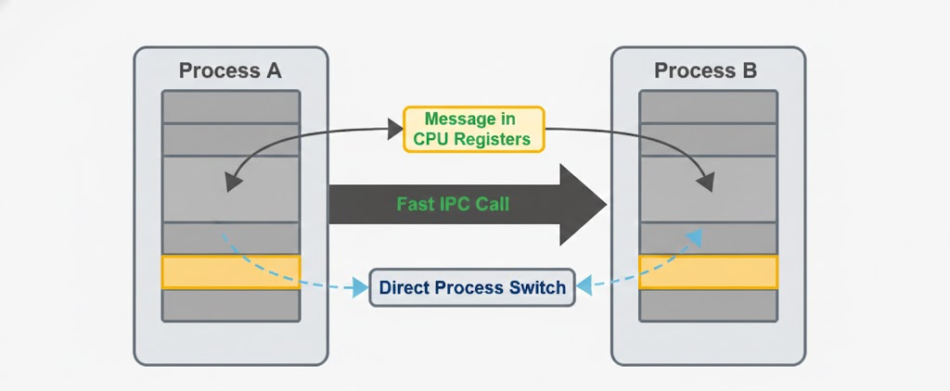
Proposed Methods - Improving IPC by Kernel Design
Fig. 2: Comparison of IPC Copy Mechanisms: Twofold Copy (Legacy) vs. Direct Copy (L3 Optimization)
Fig.3: Register Passing & Direct Switch
Single-copy / Zero-copy: Liedtke introduced the "direct copy" mechanism, which allows data to bypass the kernel buffer and be directly written from the sender's space to the receiver's space.
Temporary Mapping: By modifying the page table entry (PTE) through the kernel, a "window" of B is temporarily mapped within the address space of A, achieving physical penetration of the address space.
One more subtraction: For short messages, L3 further employs CPU registers (Register Passing) to transfer data, completely eliminating memory access latency.
Notes:
In legacy microkernels, when Process A sends data to Process B, the data must be copied twice: first from A’s user space to a kernel buffer, and then from the buffer to B’s user space.
This creates significant memory-to-memory overhead. It’s like a courier forced to unload a package at a central warehouse before reloading it for the final destination—the kernel buffer becomes a major bottleneck.
L3 eliminates this redundancy with the Direct Copy mechanism shown on the right. The kernel modifies the Page Table Entry (PTE) to create a temporary "window" of Process B's memory within Process A's address space.
This allows Process A to write data directly into B’s space, bypassing the kernel buffer entirely and achieving Single-copy
One more subtraction: For short messages, L3 bypasses memory altogether by using CPU registers to transfer data.

Slide 12
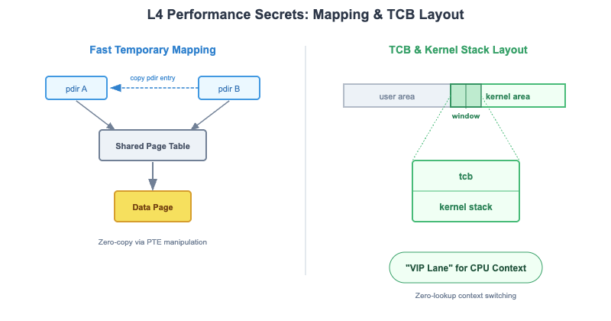
Proposed Methods - TCB & Kernel Stack Layout
Beyond Copying: L3 moves past the concept of "transporting" data; instead, it directly manipulates Page Table Entries (PTE) to align address spaces physically.
Instant Synchronization: By rapidly copying the sender’s page directory entry to the receiver’s directory, both virtual addresses point to the exact same physical data page.
Structural Mastery: L3 meticulously places the Thread Control Block (TCB) and the Kernel Stack within a fixed, predictable Memory Window.
Zero-Lookup Switching: When performing a Fast IPC context switch, the kernel avoids searching through complex global tables or linked lists to find the next thread's information.
Fig.4: L3 Performance Secrets: Mapping & TCB Layout
Notes:
2. 结构大师：TCB 与内核栈的固定布局 (TCB & Kernel Stack Layout)
中文： “除了数据传输，上下文切换也是性能杀手。L4 在内存布局上展现了‘结构化大师’的水准。
固定窗口： 它将线程控制块（TCB）和内核栈（Kernel Stack）精准地放置在内存中一个固定且可预测的窗口内。
零查表切换： 这样做的好处是，当执行快速 IPC 切换时，内核不再需要去扫描复杂的全局链表或哈希表来寻找下一个线程的信息。
VIP 通道： 这种预设布局为 CPU 提供了一条‘VIP 通道’，内核可以瞬间定位目标线程的上下文。”
English: "Beyond data transfer, context switching is a major performance killer. Fixed Window: It places the Thread Control Block (TCB) and the Kernel Stack within a fixed, predictable memory window.
Zero-Lookup Switching: This ensures that during a Fast IPC context switch, the kernel avoids searching through complex global tables or linked lists to find the next thread's info.

Slide 13
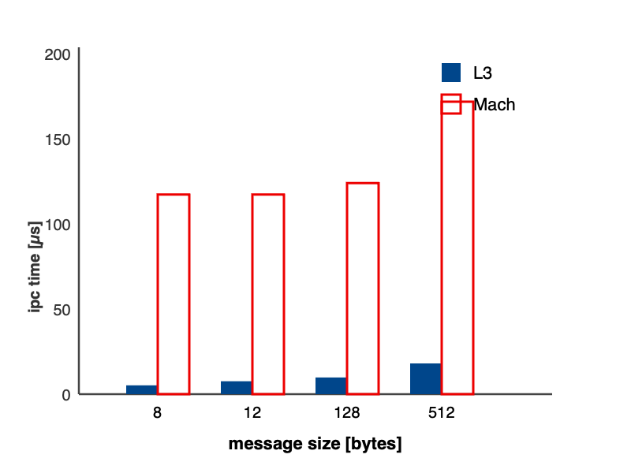
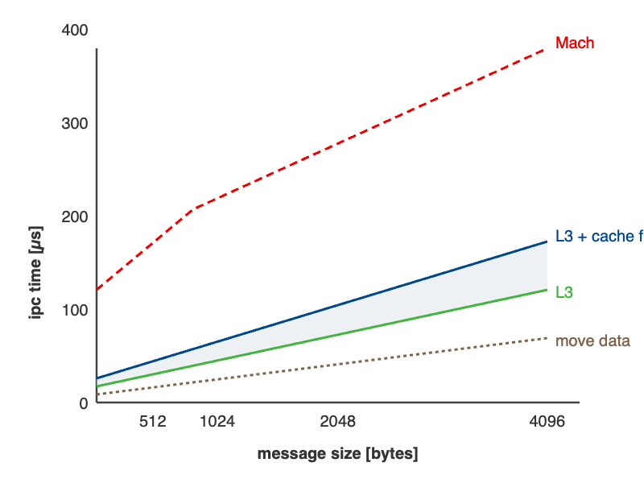
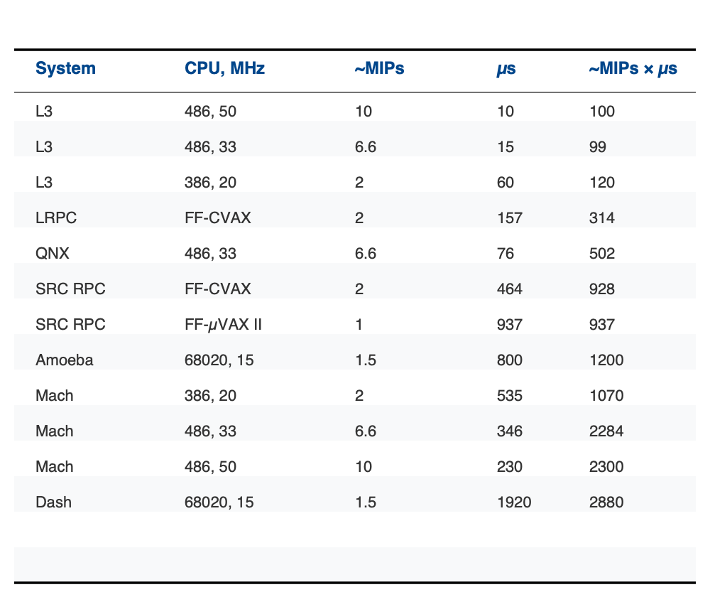
Performance Evaluation- L3 Kernel
Fig. 5: Comparison of IPC Memory Transfer Mechanics
Fig. 6: L3 IPC Performance Breakthroughs
Table 1:Null-RPC performance
Core Discovery: L3 achieves IPC (Inter-Process Communication) latencies an order of magnitude faster than Mach, with overhead approaching the theoretical hardware limit.
Key Data Comparison (Null-RPC):
L3 (486/50MHz): Requires only 10µs (approximately 100 instruction cycles).
Mach (486/50MHz): Reaches 230µs, a latency 23 times higher than L3.
Performance Gap: Even L3 running on a 386/20MHz (60µs) significantly outperforms Mach running on a much faster 486/50MHz
Notes:
中文： “为了验证 Fast IPC 的实际效果，我们来看这张对比图。左侧的柱状图清晰地展示了 L3（蓝柱） 与 Mach（红框） 在不同消息大小下的时间开销。
巨大的代差： 我们可以看到，无论消息大小如何变化，L3 的耗时都远远低于 Mach，甚至在很多场景下实现了**数量级（10倍以上）**的提速。
结论： 这张图有力地反驳了‘微内核架构天生低效’的论点——如果设计得当，微内核完全可以跑得飞快。”
English: "To validate the effectiveness of Fast IPC, let's look at the experimental results. The bar chart on the left clearly compares the time overhead of L3 (blue bars) and Mach (red outlines) across various message sizes.
As you can see, L3’s latency remains consistently and significantly lower than Mach’s, achieving a tenfold improvement in many scenarios.
2. 增长曲线：效率的稳定性
中文： “再看中间的折线图，它展示了随着消息字节数（Message Size）增加，IPC 耗时的增长趋势。
Mach 的陡峭曲线： Mach 的红虚线斜率非常高，这意味着消息越大，它的转换和拷贝负担就越沉重。
L3 的平缓曲线： 相比之下，L3（绿线）的增长非常平缓。即便加上缓存失效（Cache fill）的影响，它依然维持在极低的水平。
这意味着： L3 的设计对大规模数据传输有着极佳的可扩展性，它不仅在短消息上快，在长消息上同样稳健。”
English: ”Then, let's examine the line graph in the middle, which shows how IPC time scales with message size.
Mach’s Steep Curve: The red dashed line for Mach climbs sharply, indicating that as messages grow larger, the burden of translation and copying becomes unbearable.
L3’s Flat Curve: In contrast, L3 (the green line) remains remarkably flat. Even when accounting for cache fills, it stays at a very low level.
The Insight: This proves that L3’s design offers excellent scalability for large data transfers—it’s not just fast for short bursts, but robust for long-form communication as well."
3. 数据表：硬件极限的挑战
中文： “右侧表格提供了更详尽的原始数据，对比了不同 CPU 频率下的性能表现。
硬件级同步： 观察 L3 在不同芯片（486, 386）上的表现，其耗时几乎紧贴着硬件处理能力的极限。
核心价值： 这种性能表现标志着微内核进入了实用化时代。它告诉开发者：你再也不需要为了系统的可靠性和安全性而牺牲 50% 的性能。”
English: "The table on the right provides detailed raw data across different CPU frequencies. Looking at L3’s performance on various chips like the 486 and 386, its latency closely tracks the theoretical limits of the hardware.

Slide 14
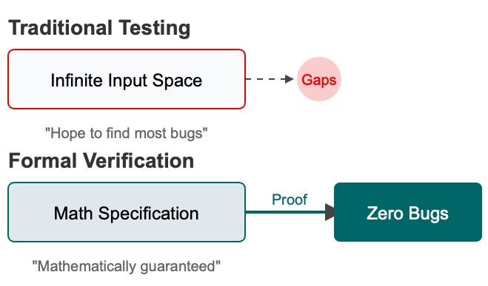



Preliminaries - Why we need Mathematical proof
Examples of crashes
1. Heartbleed Vulnerability: Eliminating the "Hidden Bug"
Context: A catastrophic bug in the OpenSSL library that exposed server memory to attackers.
Challenge: Traditional testing failed to detect this for years because the software functioned "correctly" under normal inputs.
2. DARPA HACMS Project: Military-Grade Isolation
Context: A Red Team of hackers was tasked with hijacking a "Little Bird" autonomous helicopter.
Challenge: Hackers easily breached unverified components (e.g., camera drivers) to take over flight controls on a standard OS.
3. Therac-25 & Concurrency: Preventing Race Conditions
Context: A historical medical radiation disaster caused by subtle race conditions in the software.
Challenge: These "Heisenbugs" are non-deterministic and nearly impossible to capture through random stress testing.
Fig.7: Why we need Mathematical proof
Notes:
As we just discussed, Liedtke proved through Fast IPC that microkernels can be incredibly fast. By utilizing registers for data transfer and streamlining context-switching paths, he successfully rescued the microkernel from its 'performance disaster'. By the 1990s, the L4 kernel had become the benchmark for high-performance microkernels. However, a critical question emerged: Just because code is written fast and runs fast, does that mean it is secure?
传统测试的局限性：无穷的黑盒 (The Limits of Traditional Testing)
中文： “在正式介绍 seL4 之前，我们先思考一个问题：为什么经过无数次测试的系统依然会崩溃？
无限输入空间： 正如左图所示，传统测试本质上是在‘无限的输入空间’里撞运气。无论你测试一万次还是十万次，总会有未覆盖到的**‘缝隙（Gaps）’**。
典型案例： 比如著名的**‘心脏出血’（Heartbleed）漏洞**。它潜伏在 OpenSSL 中多年未被发现，因为它在正常输入下表现得完全正确。传统测试只能‘希望’发现 Bug，但无法保证消除它们。”
English: "Before we dive into seL4, let’s consider a fundamental question: Why do systems still crash after endless testing?
Infinite Input Space: As shown on the left, traditional testing is essentially gambling within an 'infinite input space'. No matter how many times you test, there will always be uncovered 'Gaps'.
Real-world Example: Take the infamous 'Heartbleed' vulnerability. It remained hidden in OpenSSL for years because the software functioned 'correctly' under normal inputs. Traditional testing can only 'hope' to find most bugs; it cannot guarantee their absence."
2. 形式化验证：数学级的安保 (Formal Verification: Mathematically Guaranteed)
中文： “为了解决这个问题，seL4 引入了形式化验证（Formal Verification）。
数学逻辑： 它不再依赖随机测试，而是将内核逻辑转化为数学规范（Math Specification）。
零 Bug 证明： 通过数学逻辑推导出的‘证明’，我们可以从理论上排除崩溃的可能性，实现真正的**‘零 Bug’**状态。这种‘数学保证’是防御顶级黑客攻击的最后一道防线。”
English: "To solve this, seL4 embraces Formal Verification.
Mathematical Logic: Instead of relying on random tests, it converts kernel logic into a Math Specification.
Proof of Zero Bugs: By using mathematical proofs, we can theoretically eliminate the possibility of crashes, achieving a true 'Zero Bugs' state. This 'mathematical guarantee' is the ultimate defense against high-level cyberattacks."

Slide 15
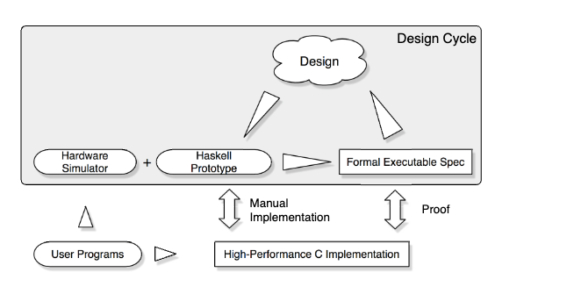
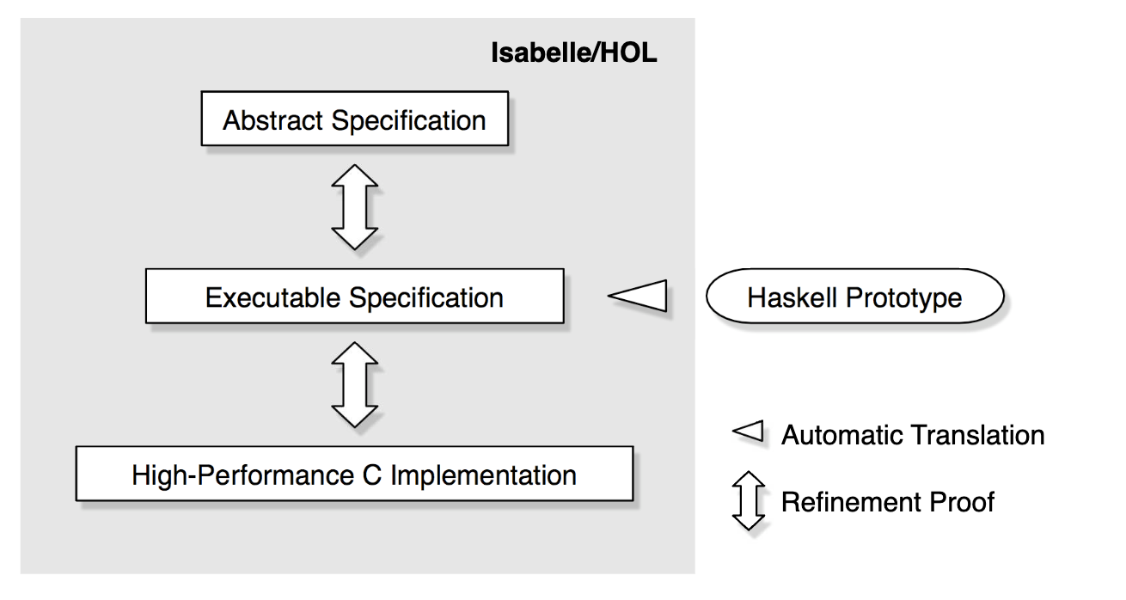
Proposed Method – The seL4 design process
Fig. 8 a): The seL4 design process
Fig. 8 b): The Refinement Layers in the verification of seL4
Executable Specification: Acts as the first functional implementation to validate kernel design before C coding.
The Bridge of Refinement: Serves as the crucial middle layer connecting Abstract Logic to High-Performance C.
Trustworthy Source: Automatically translated into Isabelle/HOL to ensure mathematical consistency and eliminate human error.
Common Ground: A unified language for OS developers to express algorithms and for verification experts to prove properties.
Notes:
1. 核心挑战：如何让数学“跑起来”？
中文： “现在我们进入最核心的部分：seL4 的设计流程。形式化验证最大的难题在于：数学规范虽然安全但不可执行，而 C 语言虽然快但难以证明。seL4 团队设计了一个精妙的‘三级跳’流程（见图 1）来解决这个矛盾。”
English: "Now we move to The seL4 design process. The biggest challenge in formal verification is that mathematical specifications are secure but not executable, while C code is fast but nearly impossible to prove. The seL4 team solved this with a sophisticated 'three-stage' process, as shown in Figure 8."
2. 第一步：Haskell 原型——可执行的蓝图 (The Executable Specification)
中文： “流程的起点是 Haskell 原型。
功能验证： 它是系统的第一个功能实现。通过连接硬件仿真器运行真实用户程序，我们可以在写一行 C 代码之前，就验证内核设计的可行性。
通用语言： 它是开发者表达算法的‘通用语’，也是验证专家证明属性的‘共同根据地’。这就像在盖大楼前，先用高精度模型进行抗震模拟。”
English: "The process begins with the Haskell Prototype.
Functional Validation: It acts as the first functional implementation, allowing us to validate the kernel design by running real user programs on hardware simulators before a single line of C code is written.
3. 第二步：精炼之桥——连接抽象与性能 (The Bridge of Refinement)
中文： “中间层是形式化可执行规范（Formal Executable Spec），它是连接‘抽象逻辑’与‘高性能实现’的关键桥梁。
自动翻译： Haskell 代码会被自动翻译成 Isabelle/HOL 数学定理证明器能理解的形式。
消除人为错误： 这种自动化转换确保了数学上的严丝合缝，彻底消除了人工理解偏差带来的隐患。”
English: "The middle layer is the Formal Executable Specification, serving as the crucial bridge connecting 'Abstract Logic' to 'High-Performance C'.
Automatic Translation: The Haskell prototype is automatically translated into Isabelle/HOL, a mathematical theorem prover.
4. 第三步：高性能 C 实现与最终证明 (High-Performance C & The Proof)
中文： “流程的终点是底部的 高性能 C 实现。
双向校验： 它是通过手动实现后，再与上层的 Haskell 原型进行‘精炼证明（Proof）’校验的。
闭环保证： 只有当数学证明确认 C 代码的行为与抽象设计完全一致时，验证才算完成。如果在底层发现了 Bug，我们会溯源至 Haskell 设计层进行修正，从而维持整个生命周期的安全性。”
English: "The process ends at the bottom with the High-Performance C Implementation. It is a manual implementation that is then checked against the Haskell prototype through a 'Refinement Proof'.
Closed-Loop Security: Verification is complete only when the proof confirms the C code behaves exactly as the abstract design intended. If a bug is found at the bottom, we trace it back to the Haskell design for correction, maintaining security throughout the lifecycle."

Slide 16
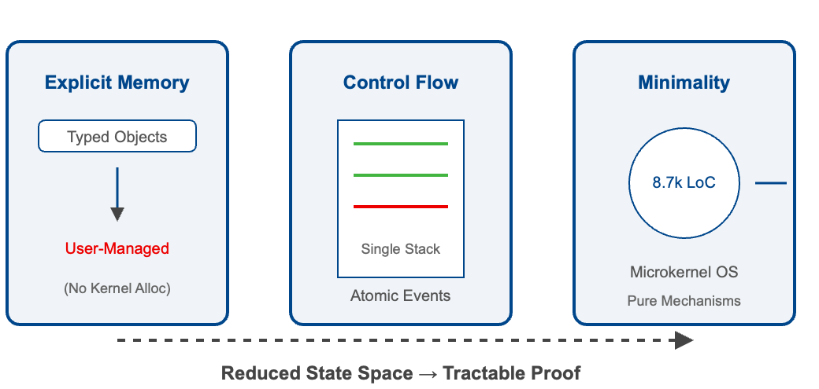
Proposed Method – Kernel Design for Verification
Strategic Design for Tractable Proof
Explicit Memory Management: The kernel abandons dynamic allocation, delegating object lifecycle management to user space via Capabilities.
Controlled Control Flow: A Single Stack and Event-based execution model eliminate complex concurrency, ensuring atomic kernel operations.
Radical Minimality: A compact codebase of only 8,700 lines of C minimizes the logical state space for formal analysis.
Verification-Driven Trade-offs: Specific architectural constraints were chosen not just for efficiency, but to ensure the mathematical proofs remain computationally feasible.
Fig. 9: Key Design Principles for Verifiability
Notes:
刚才我们看到了 seL4 严苛的验证流程（图一），但要让这个流程真正跑通，有一个致命的前提：代码必须‘好证’。如果内核设计得随心所欲，数学证明就会陷入死循环。因此，seL4 在动工之前，就确立了三大‘为了验证而生’的设计准则（图二），其核心目的只有一个——缩减状态空间，实现可行的证明（Tractable Proof）。 We have seen the rigorous verification process of seL4 (Figure 1), but for this process to truly work, there is a crucial prerequisite: the code must be 'provably correct'. If the kernel is designed arbitrarily, mathematical proofs will get stuck in an endless loop. Therefore, before starting the seL4 project, it established three major 'designed for verification' design principles (Figure 2), with the sole purpose being to reduce the state space and achieve a feasible proof (Tractable Proof).
汇报腹稿：为了验证而设计——seL4 的核心准则
1. 核心矛盾：复杂性是验证的天敌
中文： “如果我们直接验证一个像 Linux 这样拥有数百万行代码的内核，在数学上是不可能的。因为状态空间（State Space）会呈爆炸式增长。因此，seL4 的设计核心就是：通过限制架构，使数学证明变得可行（Tractable Proof）。这就像是为了让交警能看清每辆车，我们必须把繁忙的多层立交桥拆成几条笔直的单行道。”
English: "Formally verifying a kernel as massive as Linux is mathematically impossible due to the exponential explosion of the state space. Therefore, the core philosophy of seL4 is Strategic Design for Tractable Proof. To make mathematical analysis feasible, the architecture must be intentionally constrained—much like replacing a complex multi-level cloverleaf interchange with straight, predictable one-way lanes to ensure complete oversight."
2. 三大设计支柱 (Three Strategic Pillars)
中文： “请看图中的三个关键原则：
显式内存管理 (Explicit Memory Management)： 内核彻底放弃了‘动态内存分配’（No Kernel Alloc）。它将所有对象的生命周期管理通过 Capabilities（权能） 机制交给了用户态。这意味着内核本身不产生‘意外’的内存变动，让数学推导拥有确定的输入。
受控的控制流 (Controlled Control Flow)： 为了消除复杂的并发冲突，seL4 采用了‘单栈’（Single Stack）和‘基于事件’的执行模型。所有内核操作都是原子性的（Atomic），这从根本上消除了难以捉摸的海森堡 Bug。
极致简约 (Radical Minimality)： 整个内核仅有 8,700 行 C 代码。这种‘极致的小’不是为了节省空间，而是为了最小化逻辑状态空间，确保数学证明能跑得完。”
English: "Let's look at the three pillars shown in the diagram:
Explicit Memory Management: The kernel abandons dynamic allocation entirely. By delegating object lifecycle management to the user space via Capabilities, it ensures the kernel's state remains predictable and free from unexpected memory changes.
Controlled Control Flow: To eliminate complex concurrency issues, seL4 uses a 'Single Stack' and an event-based model. This ensures all kernel operations are atomic, fundamentally preventing elusive race conditions.
Radical Minimality: The codebase is limited to just 8,700 lines of C. This extreme compactness isn't about saving disk space; it's about minimizing the logical state space so the mathematical proof remains computationally feasible."

Slide 17
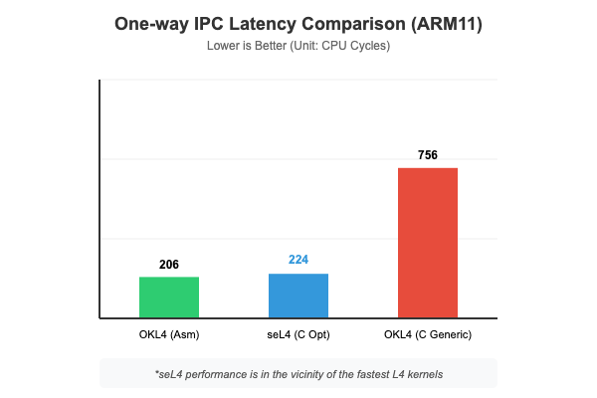
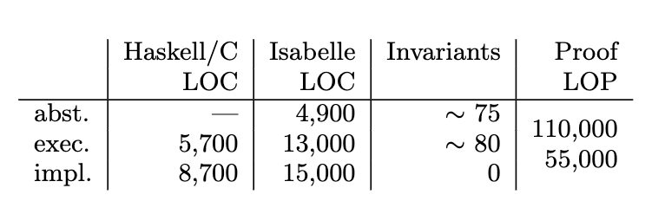
Performance Results - seL4
Performance: Only 9% overhead compared to hand-tuned assembly.
Quality: 300+ bugs found and fixed during the verification process.
Feasibility: Proved that end-to-end verification of a real-world OS is industrially viable.
Fig. 10: One-way IPC Latency Comparison
Table 2: Code and proof statistics
Notes:
打破僵局：L3 对传统微内核的超越
中文： “首先，我们用数据回应最初的质疑：微内核一定慢吗？ 请看图 1，在 90 年代初的测试中，L4（蓝柱） 相比当时主流的 Mach（红框） 实现了质的飞跃。在 8 字节到 512 字节的不同消息量下，L3 的 IPC 延迟都极其平稳且极低。 这证明了通过 Fast IPC 技术，微内核完全有能力挑战单体内核的效率。它告诉我们：性能瓶颈不在于‘微内核’这个概念，而在于平庸的实现。”
English: "First, let's address the fundamental question with data: Are microkernels inherently slow? Looking at the 90s benchmarks, L3 (blue bars) demonstrated a quantum leap over Mach (red outlines). Whether for 8-byte or 512-byte messages, L3's IPC latency remained consistently minimal. This proved that with Fast IPC techniques, a microkernel could finally challenge the efficiency of monolithic systems. It sent a clear message: the bottleneck wasn't the microkernel concept itself, but rather a mediocre implementation."
2. seL4 的奇迹：安全与性能的兼得
中文： “接下来看 seL4。很多人认为，为了实现‘形式化验证’这种极致安全，必须牺牲大量性能。但图 2 给了我们惊喜：
接近极限： 经过验证的 seL4 C 实现，其性能仅比‘手工调优的汇编代码（OKL4）’慢了 9%。
巨大的领先： 相比于未经过这种深度优化的标准 C 版本，seL4 展现出了压倒性的优势（224 vs 756 CPU cycles）。 这说明，通过精良的设计，我们可以在获得‘零 Bug’数学保证的同时，依然维持工业级的运行效率。”
English: "Now, let's look at seL4. A common misconception is that achieving 'Formal Verification' requires a massive performance sacrifice. Figure 2 proves otherwise:
Near-Limit Performance: The verified seL4 C implementation is only 9% slower than hand-tuned assembly (OKL4).
A Massive Lead: Compared to standard C implementations without such optimization, seL4 shows overwhelming superiority, clocking in at 224 vs 756 CPU cycles. This demonstrates that through superior design, we can achieve 'bug-free' mathematical guarantees while maintaining industrial-grade efficiency."

Slide 18
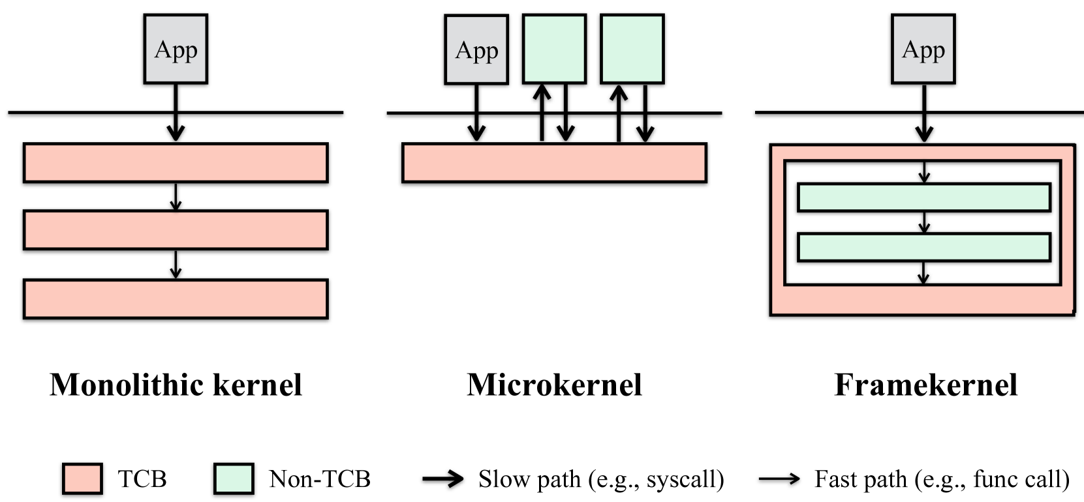
Preliminaries - The "seL4 Dilemma"
The limitation of seL4
Proof Explosion: ~10k lines of C code require 500k+ lines of proof.
Proof Fragility: Adding a simple feature (e.g., multicore scheduling) can break the entire proof chain, leading to development cycles measured in years.
Over-Simplified: Strips complex features to remain "provable," lacking native file systems, driver frameworks, or Linux compatibility.
Fragmentation: Developers must "build from scratch," leading to inconsistent tools and high entry barriers.
What Asterinas did?
Instant Verification: Leverages Rust's Static Analysis. Every compilation acts as a comprehensive security audit in seconds, eliminating the need for manual proof code.
Native Compatibility: Designed with a Linux-ABI compliant shim, enabling standard applications (Redis, Nginx) to run out-of-the-box.
Unified Framework: Provides a cohesive environment for modern cloud-native and industrial workloads.
Notes:
eL4 的局限：难以逾越的安全成本 (The seL4 Dilemma)
中文： “在领略了 seL4 数学级的安全性后，我们必须面对一个残酷的工程现实，也就是所谓的**‘seL4 困境’**。
证明爆炸与脆弱性： 正如 PPT 所示，seL4 仅 1 万行代码就对应了 50 万行证明脚本。更糟糕的是，证明链极其脆弱，增加一个简单的功能（如多核调度）就可能导致整个证明链崩溃，让开发周期以‘年’为单位。
过于简化与生态割裂： 为了保持‘可证明性’，seL4 剔除了大量现代 OS 必备的功能（如文件系统、驱动框架），且不兼容 Linux 生态。开发者往往需要‘从零构建’，这在瞬息万变的现代工业中，准入门槛实在太高了。”
English: "After witnessing the mathematical security of seL4, we must confront a harsh engineering reality known as the 'seL4 Dilemma.'
Proof Explosion & Fragility: As shown in the slide, seL4’s 10k lines of code require a staggering 500k+ lines of proof. Even worse, the proof chain is incredibly fragile; adding a simple feature like multicore scheduling can break the entire chain, leading to development cycles measured in years.
Over-simplification & Fragmentation: To remain 'provable,' seL4 strips away essential modern OS features and lacks Linux compatibility. This forces developers to 'build from scratch,' creating a high entry barrier that is often impractical for fast-paced industrial needs."
2. Asterinas 的突破：从“手动证明”到“原生验证” (What Asterinas Did)
中文： “为了破解这一困境，Asterinas 应运而生。它不仅是一个内核，更是一种全新的‘框架内核（Framekernel）’范式。
即时验证： 核心突破在于它放弃了沉重的手动证明，转而利用 Rust 语言的静态分析。每一次代码编译都相当于进行了一次秒级的深度安全审计，极大地缩短了验证周期。
原生兼容性： 不同于 seL4 的孤立，Asterinas 设计了一个兼容 Linux-ABI 的垫片层。这意味着 Redis、Nginx 等标准应用可以‘开箱即用’，无缝衔接现有成熟生态。”
English: "To overcome these hurdles, Asterinas was developed, introducing the 'Framekernel' paradigm.
Instant Verification: Its core breakthrough is replacing heavy manual proofs with Rust's Static Analysis. Every compilation acts as a comprehensive security audit in seconds, drastically shortening the verification cycle.
Native Compatibility: Unlike the isolation of seL4, Asterinas is built with a Linux-ABI compliant shim. This allows standard applications like Redis and Nginx to run out-of-the-box, bridging the gap between high security and the existing ecosystem."

Slide 19
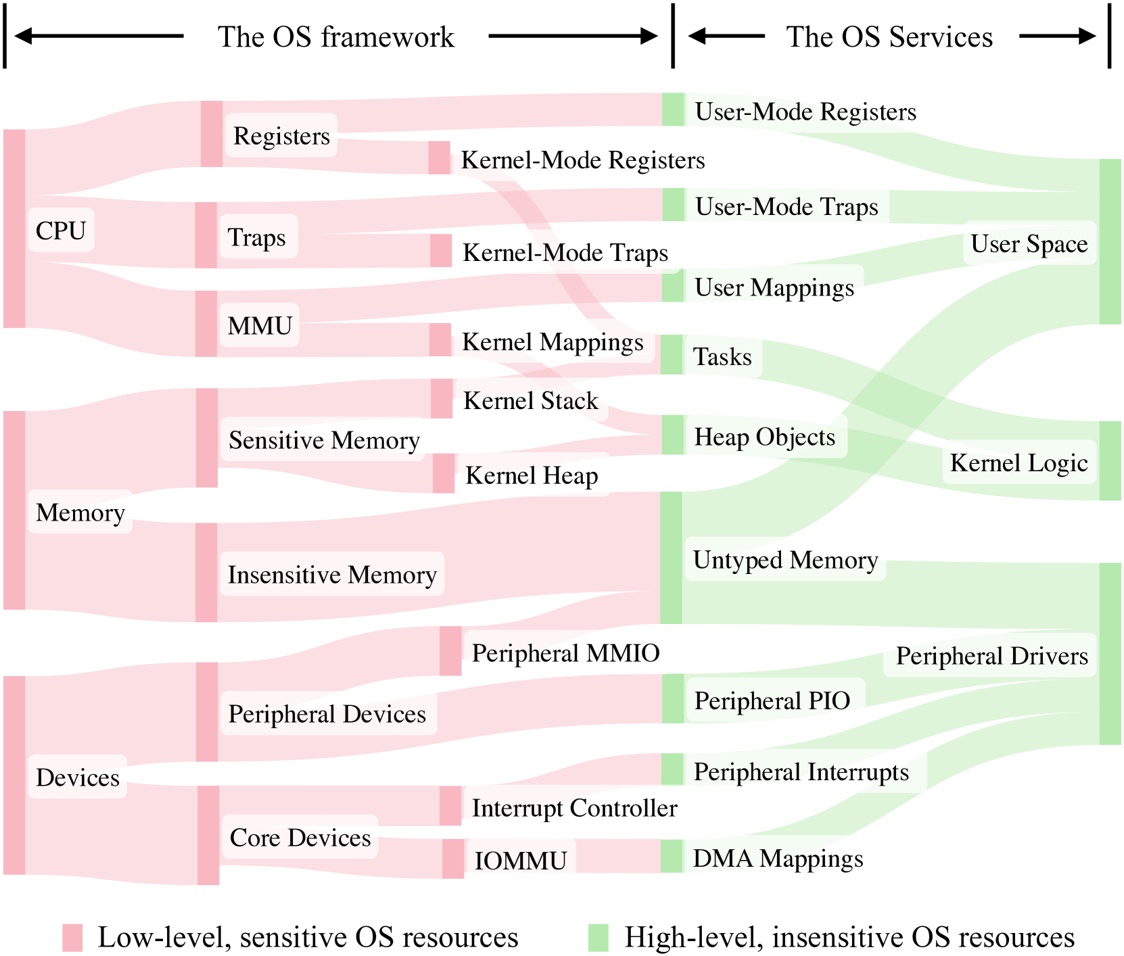
Proposed Methods - Frame kernel
Resource Encapsulation: Low-level sensitive resources (CPU, Memory, Devices) are managed by a minimal OS Framework.
Safe Service Containers: High-level OS services are wrapped in restricted Rust containers.
Zero-Cost Abstraction: Inter-service communication happens via direct function calls (Safe Rust pointers), not heavy IPC.
Fig. 11:A blueprint for framekernel construction in a resource-centric view.
Notes:
1. 核心理念：超越传统的“二元论” (Beyond Binary Isolation)
中文： “在讨论完微内核的演进后，我们来看看 Asterinas 提出的创新架构——Framekernel（框架内核）。 传统的单体内核和微内核往往只在‘用户态’和‘内核态’之间划一条粗略的红线。而 Framekernel 的核心理念是：不仅仅依靠运行时的隔离，更要依靠编译时的‘所有权管理’。 它将复杂的系统资源进行了精细化的拆解和流转。”
English: "Having discussed the evolution of microkernels, let's examine the innovative architecture proposed by Asterinas: the Framekernel. Traditional kernels typically draw a single, coarse line between 'User Mode' and 'Kernel Mode.' The core philosophy of a Framekernel is to move beyond simple runtime isolation and instead rely on compile-time 'Ownership Management.' it deconstructs and manages complex system resources with surgical precision."
2. 资源流转图：从低级敏感到底级不敏感 (The Resource Flow)
中文： “请看左侧这张非常直观的资源流转图。它展示了底层硬件资源如何被安全地抽象并转化为上层服务。
低级敏感资源 (Pink Area)： 位于最左侧，包含 CPU 寄存器、MMU、内核堆栈以及核心外设。这些是系统的命脉，必须被严格保护在‘框架（The OS framework）’内部。
资源流转： 随着流向右侧（绿色区域），这些原始资源被转化为更高级的抽象。例如，内存被转化为‘堆对象（Heap Objects）’，外设被转化为‘驱动程序’。
安全过滤： 这种流转不是简单的搬运，而是通过 Rust 的安全类型系统进行的过滤。Framekernel 确保只有经过安全封装的资源接口才能暴露给上层 OS 服务。”
English: "Look at the intuitive resource flow diagram on the left. It illustrates how raw hardware resources are securely abstracted into high-level services.
Low-level, Sensitive Resources (Pink Area): On the left, we have CPU registers, MMU, the kernel stack, and core devices. These are the system's vital organs, strictly contained within 'The OS Framework.'
Resource Transformation: As the flow moves toward the green area on the right, these raw resources are transformed into high-level abstractions—memory becomes 'Heap Objects' and peripherals become 'Drivers.'
Security Filtering: This transition isn't just a transfer; it's a filtration through Rust’s safe type system. The Framekernel ensures that only safely encapsulated interfaces are exposed to the higher-level OS services."
3. 三大关键设计点 (Key Design Insights)
中文： “结合这张图，我们可以总结出 Framekernel 的三个关键优势：
最小权限原则： 每个 OS 服务（绿色部分）只能看到它运行所必需的资源流，无法越权访问粉色区域的敏感内核逻辑。
Rust 原生隔离： 通过 Rust 的生命周期和所有权检查，我们可以在单一地址空间内实现逻辑上的‘硬隔离’，从而消除了微内核高昂的 IPC 切换成本。
可扩展的框架： 这种设计允许我们在不修改核心框架的情况下，快速增加新的外设驱动（Peripheral Drivers）或中断处理程序，同时保证系统不会因为某个驱动的崩溃而全局瓦解。”
English: "Based on this architecture, we can summarize three key advantages:
Principle of Least Privilege: Each OS service (in green) only sees the resource streams essential for its operation, preventing unauthorized access to the sensitive kernel logic in the pink area.
Rust-Native Isolation: By leveraging Rust’s lifetime and ownership checks, we achieve logical 'hard isolation' within a single address space, eliminating the high IPC context-switch costs typical of microkernels.
Extensible Framework: This design allows for the rapid addition of new peripheral drivers or interrupt handlers without modifying the core framework, ensuring that a single driver crash won't bring down the entire system."
总结过渡 (Summary)
中文： “如果说微内核是通过‘物理隔间’来保护安全，那么 Framekernel 就是通过‘代码级的权限审查’来实现更灵活、更高效的安全保障。它是现代安全系统从实验室走向大规模工业应用的关键一步。”
English: "If microkernels protect security through 'physical cubicles,' the Framekernel achieves it through 'code-level permission audits'—offering a more flexible and efficient safeguard. This represents a critical step in bringing modern secure systems from the lab to large-scale industrial use."

Slide 20
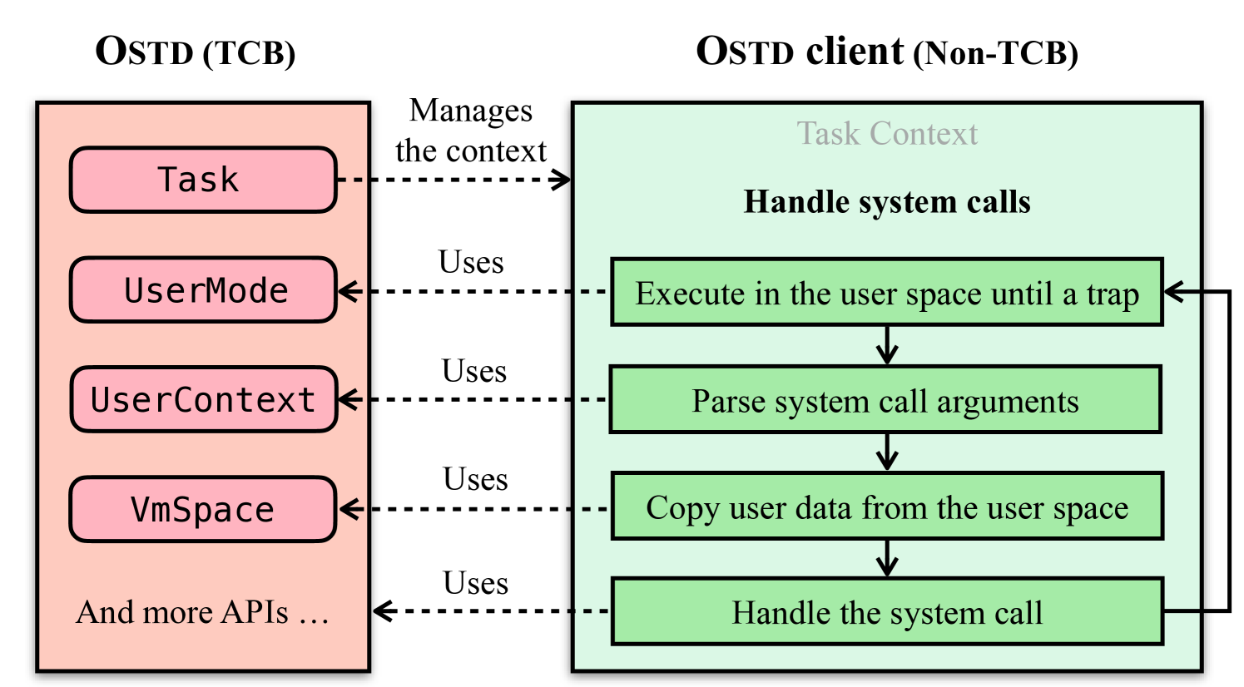
Proposed Methods - OSTD (OS Trust Domain)
TCB Minimization: The OSTD
The "5% Rule": Only ~5% of code (TCB) handles hardware-direct operations (MMU, Traps, Registers).
Safe Encapsulation: Restricts all unsafe Rust to the core OS Trust Domain (OSTD).
Safe-by-Construction: OSTD Clients
95% Safe Rust: Bulk of OS services are written in Safe Rust, eliminating memory corruption at compile time.
Compiler-Enforced: Rust’s ownership and borrowing rules act as a 24/7 automated security auditor.
Logical Memory Firewall
Privilege Stripping: Services (Clients) lack unsafe authority; they cannot overwrite other kernel modules.
API-Bound Workflow: Mandatory interaction with OSTD for sensitive tasks (e.g., data copying) creates a functional firewall.
Fig. 11: An example of OSTD APIs: system call handling
Notes:
1. 核心突破：5% 与 95% 的“黄金比例” (The 5% Rule)
中文： “为了彻底解决内核安全问题，Asterinas 引入了 OSTD（OS Trust Domain，操作系统信任域） 的概念。
TCB 极小化： 我们遵循‘5% 原则’。在整个系统中，只有约 5% 的代码（即 OSTD）被允许处理硬件直接操作，如 MMU 配置、寄存器读写等高危任务。
安全封装： 我们将所有‘Unsafe Rust’（不安全代码）严格限制在 OSTD 内部。这意味着剩下的 95% 的系统服务，都是由 100% 的 Safe Rust 编写的。这种‘安全分层’从架构上杜绝了绝大部分内存损坏漏洞。”
English: "To fundamentally address kernel security, Asterinas introduces the OSTD (OS Trust Domain).
TCB Minimization: We follow the '5% Rule.' Only approximately 5% of the codebase—the OSTD—is permitted to handle hardware-direct operations like MMU configuration or register manipulation.
Safe Encapsulation: All 'Unsafe Rust' is strictly confined within the OSTD. Consequently, the remaining 95% of OS services are written in 100% Safe Rust, architecturally eliminating the vast majority of memory corruption vulnerabilities."
2. 交互机制：OSTD 客户端与逻辑隔离 (Safe-by-Construction)
中文： “请看图中的交互流程。右侧的 OSTD client（非 TCB 部分）就像是内核中的‘普通公民’。
受限权力： 当它需要处理系统调用（如拷贝用户数据）时，它没有权限直接操作底层内存，必须通过 API 绑定工作流 向 OSTD 发起请求。
编译时审计： Rust 的编译器充当了‘24小时自动安全审计员’。通过所有权和借用检查，它在编译阶段就确保了 Client 永远无法非法重写其他内核模块的内存。”
English: "Let's look at the interaction workflow. The OSTD client on the right (non-TCB) acts like an 'ordinary citizen' within the kernel.
Restricted Authority: When handling system calls, it lacks the privilege to manipulate raw memory directly. It must instead interact with the OSTD through an API-bound workflow.
Compiler-Enforced Security: Rust's compiler acts as a '24/7 automated security auditor.' Through ownership and borrowing rules, it ensures at compile-time that clients can never illegally overwrite memory belonging to other kernel modules."
3. 逻辑内存防火墙 (Logical Memory Firewall)
中文： “这种设计的最终结果是建立了一道 ‘逻辑内存防火墙’。
特权剥离： 服务（Clients）不再拥有‘上帝视角’。它们失去了修改敏感数据结构的权力，只能在 OSTD 划定的安全圈内活动。
功能隔离： 即使某个复杂的 OS 服务（如文件系统）被攻破，由于它被锁死在 OSTD 的 API 限制之下，攻击者也无法越权控制整个硬件系统。这实现了真正意义上的‘隔离而不分割’。”
English: "The ultimate result of this design is a 'Logical Memory Firewall.'
Privilege Stripping: Services (Clients) no longer have a 'god-eye view.' They lose the authority to modify sensitive data structures and must operate within the safety boundaries defined by the OSTD.
Functional Containment: Even if a complex OS service is compromised, it remains locked under OSTD’s API restrictions, preventing an attacker from gaining full control of the hardware. This achieves true isolation without the heavy fragmentation of traditional microkernels."
这就好比我们把原本分散在不同大楼的部门集中到了一间大办公室，但给每个人都设计了透明的‘逻辑工位’。大家沟通（函数调用）不再需要出门过安检，但你依然动不了别人的电脑。这就是为什么 Asterinas 能在获得微内核防御力的同时，跑出接近 Linux 的极致性能。”

Slide 21
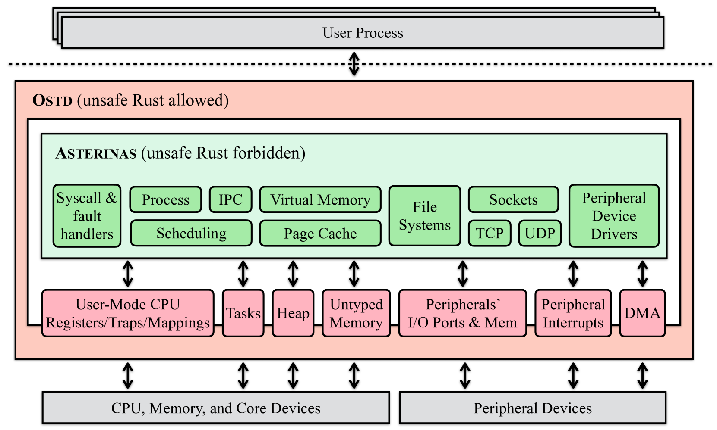
Proposed Methods - Asterinas
Dual-layer Security Boundary
Hardware Resource Encapsulation
Memory Safety Guarantee
Fig. 12: An overview of Asterinas.
Notes:
1. 架构总览：三层防护体系
中文： “请看这张架构全景图，它清晰地展示了 Asterinas 的层次结构。我们可以将其看作一个三层金字塔：
顶层：用户进程（User Process）。它们运行在完全隔离的用户空间，通过系统调用与内核交互。
中层：Asterinas 核心服务（绿色区域）。这是 OS 的主体，涵盖了进程调度、虚拟内存、文件系统等几乎所有高级功能。关键点在于：这部分代码被严禁使用 Unsafe Rust。
底层：OSTD 信任域（橙色区域）。它像一个‘安全底座’，包裹并保护着整个系统，它是唯一允许使用 Unsafe Rust 来直接操作硬件的区域。”
English: "Looking at this architectural overview, it clearly illustrates the hierarchical structure of Asterinas. We can envision it as a three-layer pyramid:
Top Layer: User Processes. These run in completely isolated user spaces, interacting with the kernel via system calls.
Middle Layer: Asterinas Core Services (Green Area). This is the main body of the OS, encompassing nearly all high-level functions like process scheduling, virtual memory, and file systems. Critically, Unsafe Rust is strictly forbidden in this section.
Bottom Layer: OSTD (Orange Area). Acting as a 'Security Foundation,' it encapsulates and protects the entire system. This is the only region permitted to use Unsafe Rust for direct hardware manipulation."
2. 核心机制：OSTD 的“守门人”角色 (The Gatekeeper)
中文： “这张图最精妙的地方在于 OSTD 如何为上层服务提供支持。
硬件抽象： 到底层的 CPU、内存和核心设备（底部灰色框）的访问，必须经过 OSTD 的转换。
资源切分： OSTD 将原始硬件资源切分为一个个受控的‘逻辑块’（如中间的小方块：Heap, Untyped Memory, Tasks 等），并以安全接口的形式暴露给绿色区域的服务。
单向依赖： 上层服务可以‘使用’这些资源，但绝对无法‘绕过’ OSTD 去直接修改硬件寄存器。这就像银行柜台（OSTD）隔离了客户（OS Services）与金库（Hardware）。”
English: "The most ingenious aspect of this diagram is how the OSTD supports upper-layer services.
Hardware Abstraction: Access to the underlying CPU, memory, and core devices must be mediated by the OSTD.
Resource Partitioning: The OSTD carves raw hardware resources into controlled 'logical blocks' (such as Heap, Untyped Memory, and Tasks), exposing them as safe interfaces to the green core services.
Unidirectional Dependency: Upper-layer services can 'use' these resources but can never 'bypass' the OSTD to modify hardware registers directly. It’s akin to a bank counter (OSTD) isolating the customer (OS Services) from the vault (Hardware)."

Slide 22
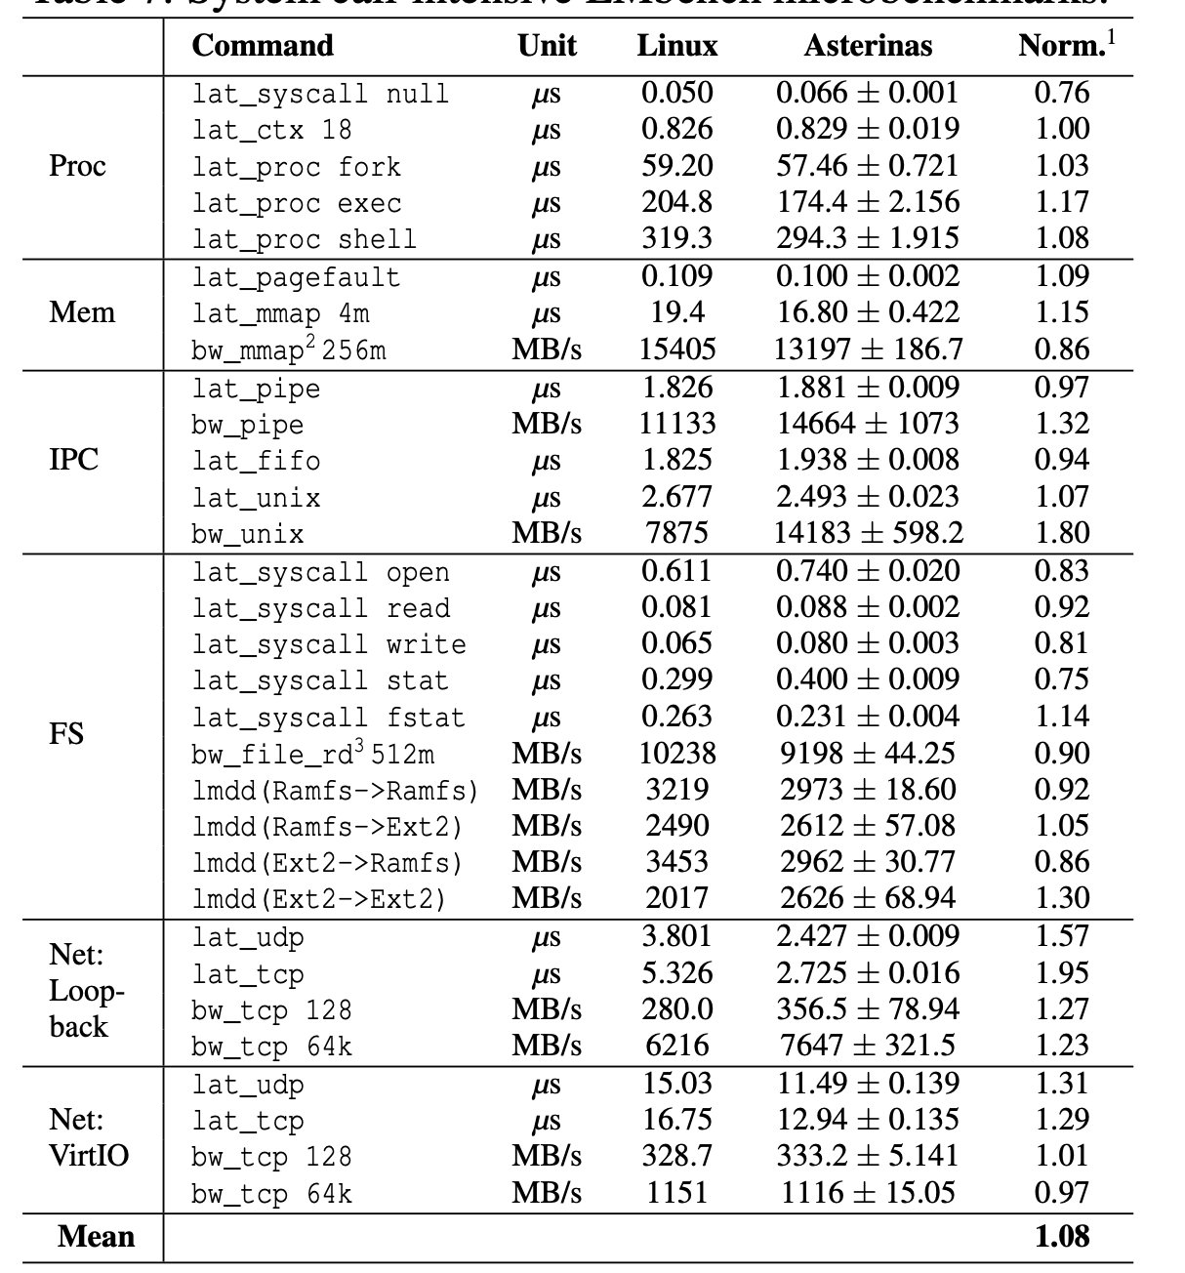
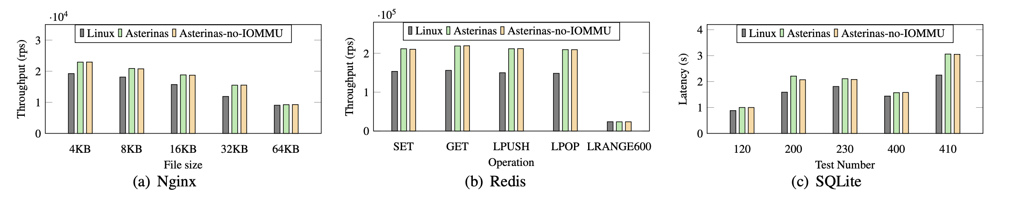
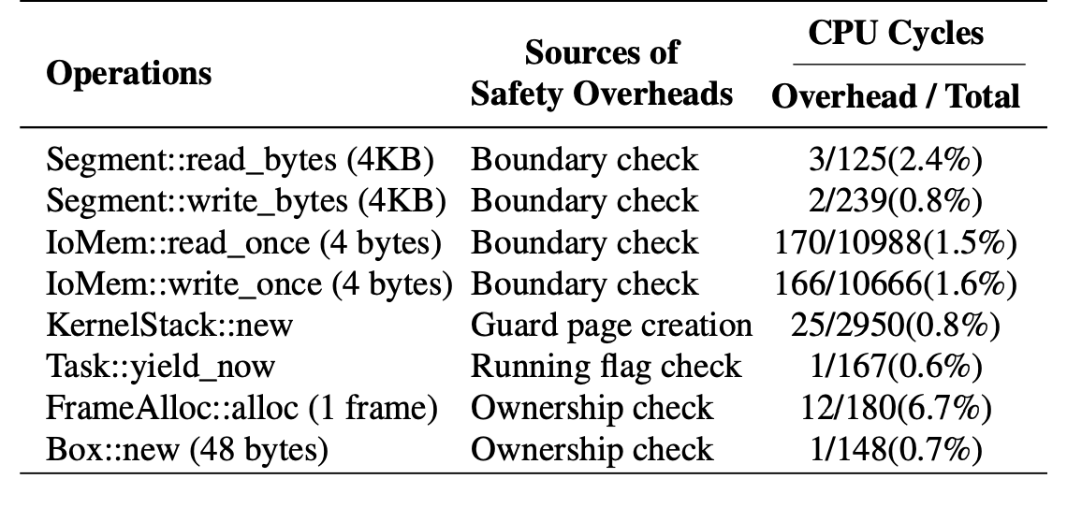
Performance Evaluation - Asterinas
Fig. 13: I/O-intensive application benchmarks with Ngnix, Redis, and SQLite.
Table 4: Overhead due to OSTD’s safety mechanism.
Table 3: System call-intensive LMbench microbenchmarks.
Notes:
1. 宏观性能：超越 Linux 的工业级表现
Macro-Performance: Outperforming Linux in Industrial Benchmarks
综合评估 (Overall)：在涵盖进程、内存、网络等数十项微基准测试中，Asterinas 的平均性能达到 Linux 的 1.08 倍。
Average performance of Asterinas improved that of Linux across dozens of microbenchmarks including process, memory, and networking.
架构优势 (Architectural Edge)：其 IPC 带宽（bw_unix）达到 Linux 的 1.8 倍，证明了 Framekernel 在处理高频系统调用时比单体内核更轻量。
IPC bandwidth (bw_unix) hit 1.8x of Linux, proving the Framekernel architecture is more lightweight than monolithic kernels for high-frequency system calls.
真实负载 (Real-world Workloads)：在 Nginx 与 Redis 测试中，Asterinas 的吞吐量与 Linux 持平，部分场景下表现更优。
In Nginx and Redis tests, Asterinas maintained throughput parity with Linux, even slightly outperforming it in specific scenarios.
2. 安全开销：极低的“安全溢价”
Safety Overheads: Minimal "Security Premium"
运行时开销 (Runtime Overhead)：Asterinas 的运行时安全检查仅带来 1% - 2% 的额外性能开销。
Runtime safety checks in Asterinas introduce a mere 1% - 2% performance overhead.
精准拆解 (Data Breakdown)：核心的边界检查（Boundary check）仅消耗 0.8% - 2.4% 的 CPU 周期。
Critical boundary checks consume only 0.8% - 2.4% of CPU cycles.
核心权衡 (The Trade-off)：该架构以极小的性能代价，换取了内核 95% 代码的绝对内存安全。
A conclusion: The architecture trades a negligible performance cost for absolute memory safety across 95% of the kernel codebase.

Slide 23
Virtualization Techniques
Introduction
Related Work
Preliminaries
Proposed Methods
Performance Evaluation
Conclusions

Slide 24
Conclusion
Improving IPC by Kernel Design (Liedtke '93)
Key Achievement: Proved that microkernel performance issues were not an inherent architectural flaw but an implementation failure. Significantly boosted IPC speed through register-based parameter passing and direct process switching.
Limitations: While it solved the "speed" problem, kernels written in C remained vulnerable to memory safety exploits and lacked rigorous formal security guarantees.
Transition: To achieve ultimate security alongside high performance, research shifted toward mathematical formal verification.
seL4: Formal Verification of an OS Kernel (seL4 '09)
Key Achievement: Utilized the Isabelle/HOL theorem prover to achieve the world's first formal verification of an OS kernel, mathematically ensuring the absence of memory vulnerabilities.
Limitations: Faced a "Proof Explosion" where verification costs were astronomical; any code change required re-proving, and the kernel remained too minimalist for broad industrial ecosystems.
Transition: The challenge became: How to achieve seL4-level security without the prohibitive "Verification Tax" while maintaining compatibility with mainstream ecosystems like Linux?.
Asterinas: A Linux ABI-Compatible, Rust-Based Framekernel OS (Asterinas '25)
Key Achievement: Introduced the Framekernel architecture, leveraging Rust's language features to replace costly formal proofs. Achieved production-level development efficiency for 95% of the codebase while maintaining a sound TCB.
Current Limits & Future Work: While Linux ABI-compatible, scaling to massive distributed systems and supporting advanced heterogeneous hardware features remains the next frontier.
Final Conclusion: Microkernels have evolved from "Optimizing Speed" and "Seeking Mathematical Perfection" to a new stage of "Balancing Security, Performance, and Ecosystem Compatibility" for industrial applications.
Notes:
1. 历史演进：从“效率灾难”到“数学巅峰”
中文： “回顾整个发展历程，微内核经历了一场深刻的范式转换：
L3/L4 时代： Liedtke 在 1993 年证明了性能瓶颈并非微内核的基因缺陷，而是实现问题。通过寄存器传参和直接进程切换，他打破了‘微内核慢’的迷信。
seL4 时代： 2009 年，seL4 通过 Isabelle/HOL 定理证明器实现了全球首个全验证内核，将系统安全提升到了数学证明的高度。它证明了‘零 Bug’在操作系统内核上是可行的。”
English: "Reflecting on the entire journey, microkernels have undergone a profound paradigm shift:
L3/L4 Era: In 1993, Liedtke proved that performance bottlenecks were not inherent to microkernels but resulted from poor implementation. By introducing register-based parameter passing and direct process switching, he shattered the myth that 'microkernels are slow'.
seL4 Era: In 2009, seL4 achieved the world's first fully verified kernel using the Isabelle/HOL theorem prover, elevating system security to the level of mathematical certainty. It proved that a 'zero-bug' state is achievable for OS kernels."
2. 现实挑战：沉重的“验证税”
中文： “然而，seL4 的成功也带来了新的困境：
验证税（Verification Tax）： 极高的证明成本（1 万行 C 代码对应 50 万行证明）和证明的脆弱性限制了它的工业扩展。
生态孤岛： 由于极度简化以维持可证明性，它难以兼容 Linux 等主流生态，导致开发周期长、门槛高。”
English: "However, seL4's success introduced new dilemmas:
Verification Tax: Astronomical proof costs (500k+ lines of proof for 10k lines of C) and proof fragility hindered industrial scaling.
Ecological Isolation: To maintain provability, seL4 remained overly minimalist, lacking Linux compatibility and leading to high entry barriers and long development cycles."
3. 未来范式：Asterinas 的“第三条路”
中文： “Asterinas (2025) 则代表了微内核的最新形态——框架内核（Framekernel）：
原生安全： 利用 Rust 的静态分析替代昂贵的手动证明，实现了 95% 代码的原生内存安全。
兼容共生： 凭借 Linux-ABI 兼容层，它直接拥抱了成熟的工业生态，实现了‘安全即插即用’。
高效落地： 实验证明，它在保持高防御等级的同时，性能表现与 Linux 旗鼓相当。”
English: "Asterinas (2025) represents the latest evolution—the Framekernel paradigm:
Native Security: Leveraging Rust's static analysis to replace costly manual proofs, it achieves native memory safety for 95% of the codebase.
Ecosystem Symbiosis: With its Linux-ABI compliant shim, it embraces existing industrial ecosystems, enabling 'plug-and-play' security.
Efficient Deployment: Experiments show that while maintaining high defense levels, its performance stands toe-to-toe with Linux."

