Slide 1
DDA2001 – Guest Lecture Computer System
Prof. Yeh-Ching Chung
School of Data Science
Chinese University of Hong Kong, Shenzhen

Slide 2
Outline
Introduction
Computer Hardware
ISA
Computer Software
System Software
Application Software
How Software and Hardware Co-Work
Conclusions

Slide 3
Introduction

Slide 4
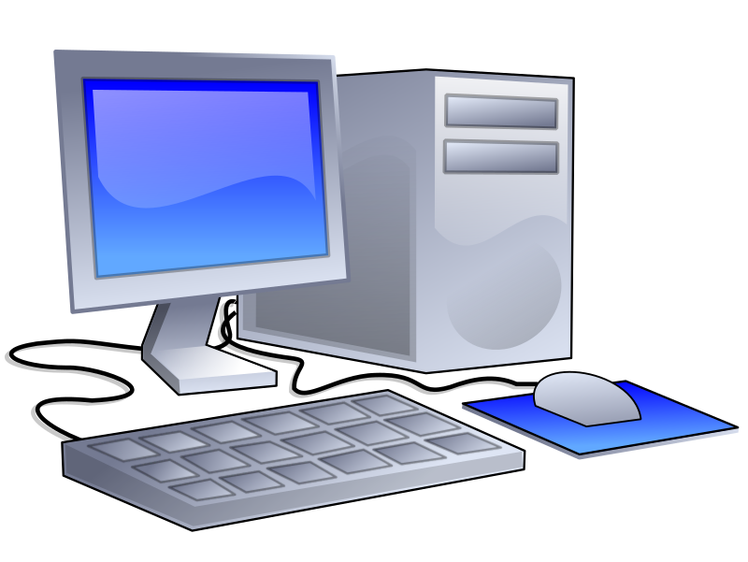
Computers (1)
Desktop computers
Designed to deliver good performance to a single user at a low cost.
Usually executing third-party software.
Usually incorporating a graphics display, a keyboard and a mouse.

Slide 5
Computers (2)
Servers
Used to run larger program for multiple users simultaneously, typically accessed only via a network, with a greater emphasis on dependability and (often) security.
Supercomputers
A high performance, high-cost class of servers with a large number of processors, huge memory and storage that are used for high-end scientific and engineering applications.
Embedded computers (microprocessors)
A computer within another system with a dedicated function or application.

Slide 6
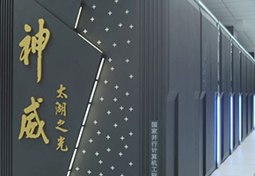
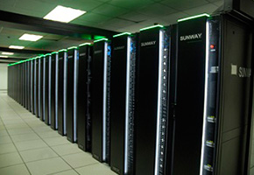
Supercomputers
Sunway TaihuLight
Fastest supercomputer in the world (as of June 2017)
Over 10 million CPU cores
Power: 15 MW
Speed: 93 PFLOPS
http://www.nsccwx.cn/wxcyw/

Slide 7
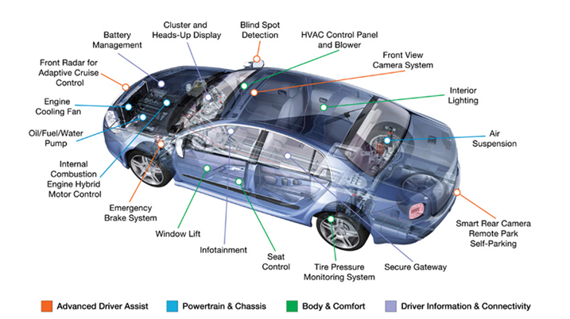
Automotive Embedded Systems
https://dcvizcayno.wordpress.com/2015/08/28/the-future-of-technology-privacy-security-and-risks-part-3-of-5/

Slide 8
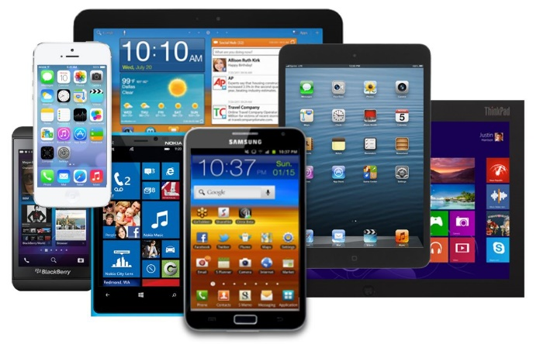

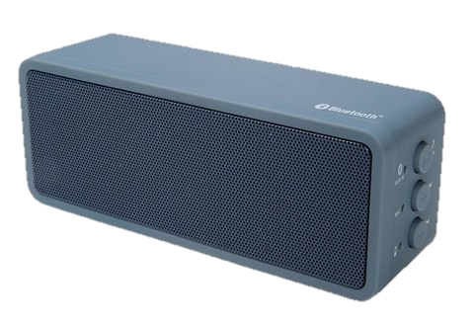
Post-PC Era
Personal Mobile Devices
Battery-operated devices with wireless connectivity.
Warehouse-Scale Computers
Datacenter containing hundreds of thousands of servers providing software as a service (SaaS).

Slide 9
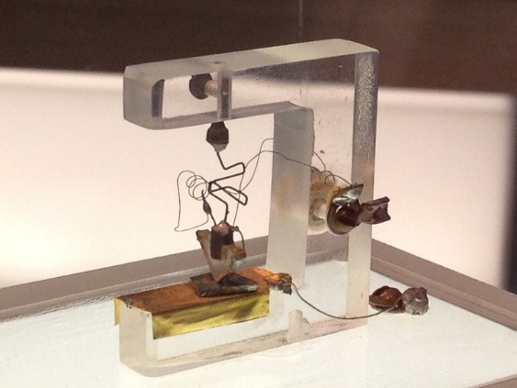
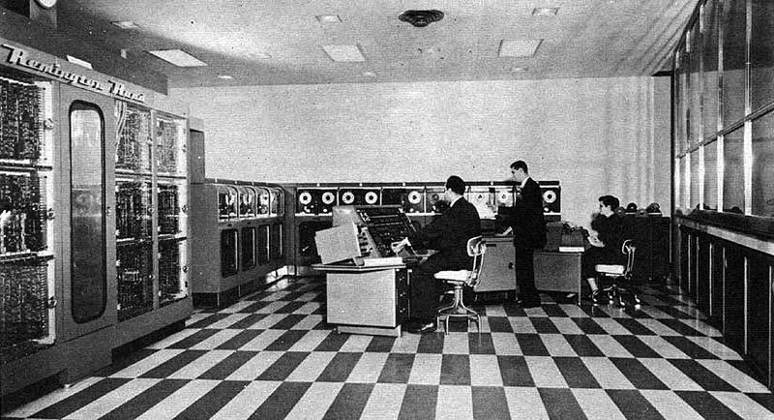
Evolution of Computer Hardware (1)
1st transistor invented by John Bardeen, Walter Brattain, and William Shockley at Bell Labs in 1947.
UNIVAC I (UNIVersal Automatic Computer I): 1st commercial computer sold in US in 1951.

Slide 10
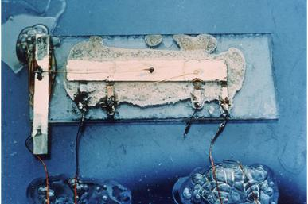
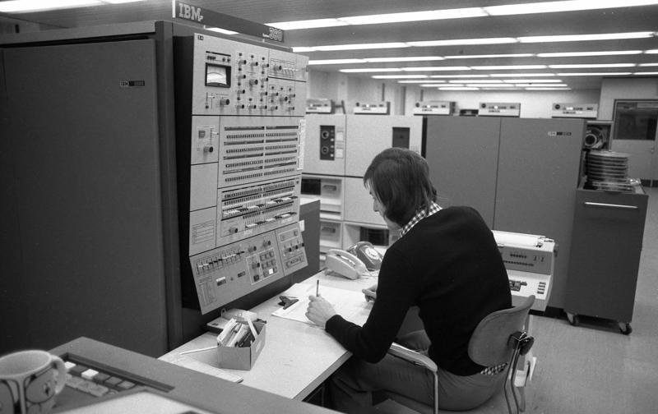
Evolution of Computer Hardware (2)
1st integrated circuit invented by Jack Kilby of Texas Instruments in 1958.
IBM System/360: 1st family of computers in 1964 with a range of performance but with the same instruction set.

Slide 11
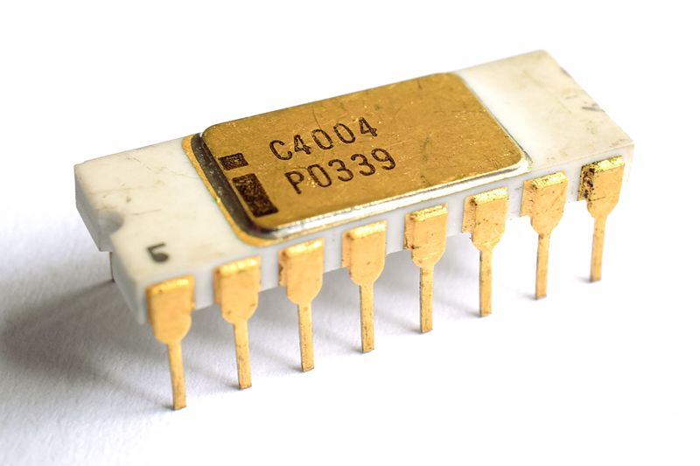
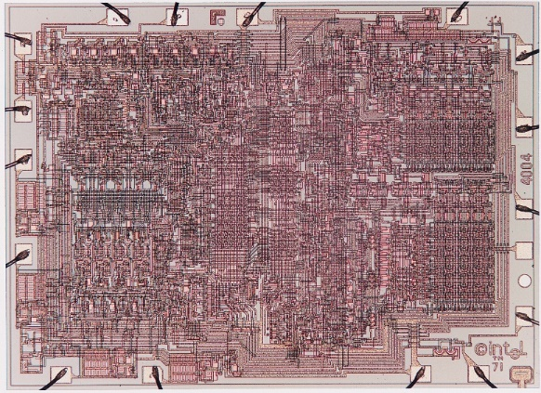
Evolution of Computer Hardware (3)
Intel 4004: 1st commercially available microprocessor by Intel in 1971.
https://en.wikipedia.org/wiki/Intel_4004

Slide 12
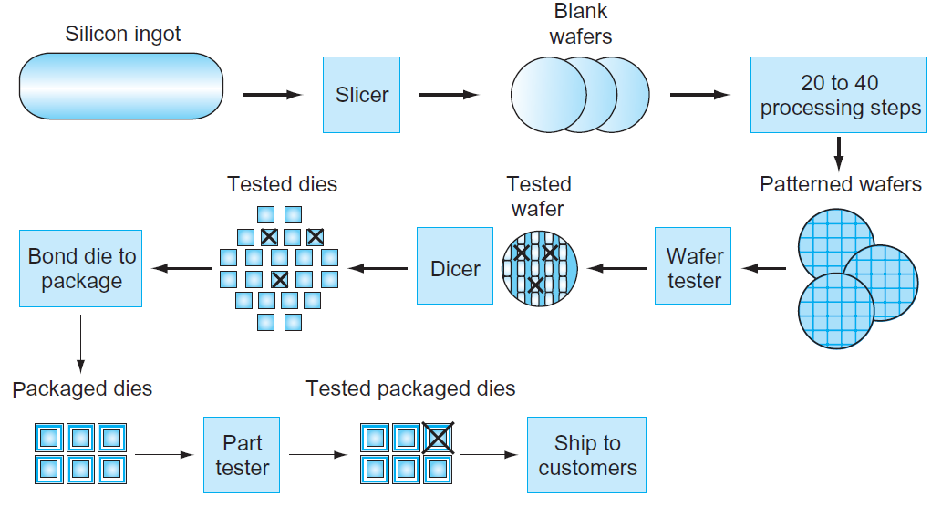
IC Manufacturing Process
Yield: proportion of working dies per wafer.

Slide 13
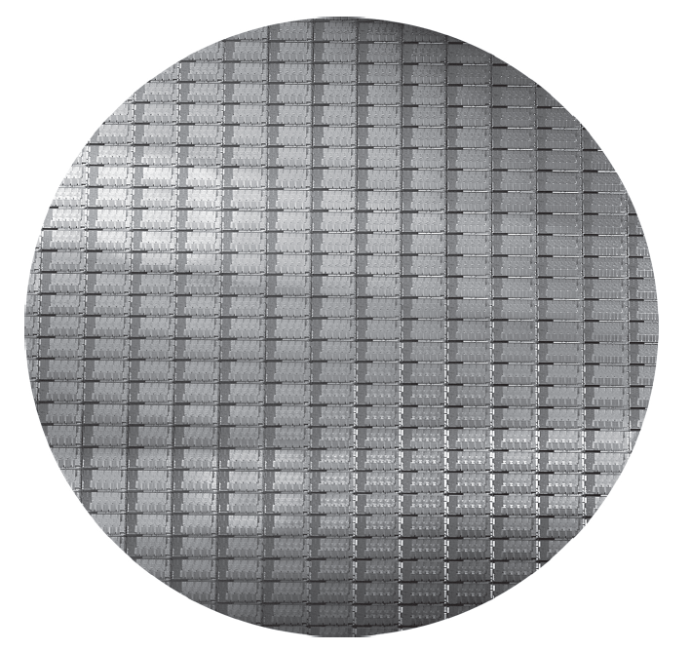
Intel Core i7 Wafer
300-mm wafer, 280 dies at 100% yield (32-nm technology).

Slide 14
Moore’s Law（1）
Processor
Logic capacity: increases about 30% per year
Performance: 2× every 1.5 years
Memory
DRAM capacity: 4× every 3 years, about 60% per year
Memory speed: 1.5× every 10 years
Cost per bit: decreases about 25% per year
Storage
Capacity: increases about 60% per year

Slide 15
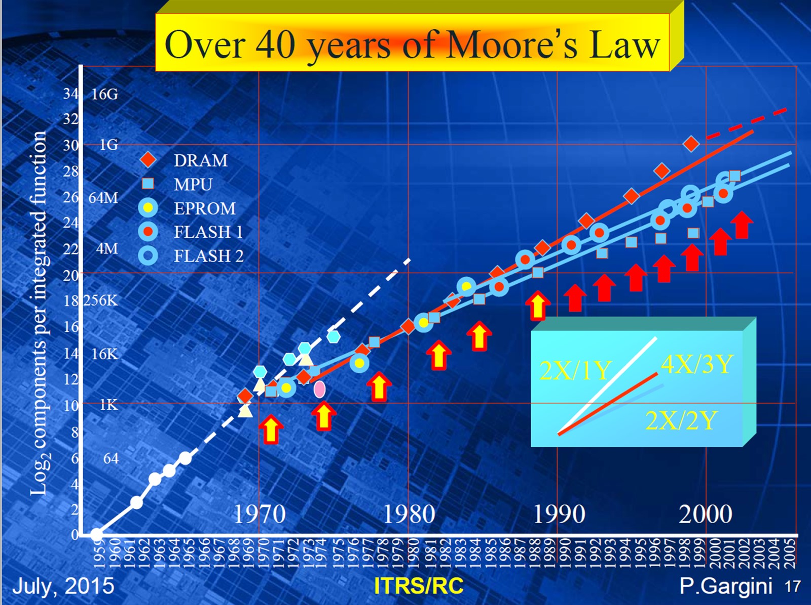
Moore’s Law（2）
http://www.itrs2.net/

Slide 16
hardware

Slide 17
Major Components of a Computer
(keyboard, mouse)
(display, printer)
(cache, SRAM, disk drive, etc.)

Slide 18
Machine Organization
Capabilities and performance characteristics of the principal functional units (e.g., registers, ALU, shifters, logic units)
Ways in which these components are interconnected
Logic and means by which such information flow is controlled
Instruction Set Architecture (ISA)
Register Transfer Level (RTL) description

Slide 19
Instruction Set Architecture (ISA)
ISA, or simply architecture – the abstract interface between the hardware and the lowest level software that includes all the information necessary to write a machine language program, including instructions, registers, memory access, I/O, etc.
Enables implementations of varying cost and performance to run identical software.
The combination of the basic instruction set (the ISA) and the operating system interface is called the Application Binary Interface (ABI).
The user portion of the instruction set plus the operating system interfaces used by application programmers.
Define a standard for binary portability across computers.

Slide 20
Related Courses
Digital Logic (switching circuit)
AND-gate, Or-gate, etc.
Computer architecture
CPU, memory, etc.
VLSI
VLSI compiler (from High-level synthesis to RTL code)
EDA tools

Slide 21
Software

Slide 22
Software
System software
Operating systems
Compiler/Assembler
Linker
Loader
Application software
Redis
QEMU
Programming languages (C, C++, etc.)
Database management systems (MySQL, etc.)
Application Software
System Software
Hardware

Slide 23


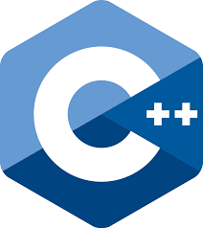
System Software
Operating System
Supervise program that interfaces the user’s program with the hardware (e.g., Linux, iOS, Windows)
Handles basic input and output operations
Allocates storage and memory
Provides for protected sharing among multiple applications
Compiler
Translate high-level language programs (e.g., C, Java) into instructions that the hardware can execute

Slide 24



Application Software
Application software
Redis
Docker
QEMU
Programming languages (C, C++, etc.)
Database management systems (MySQL, etc.)
…..

Slide 25
Software and Hardware Co-Work

Slide 26
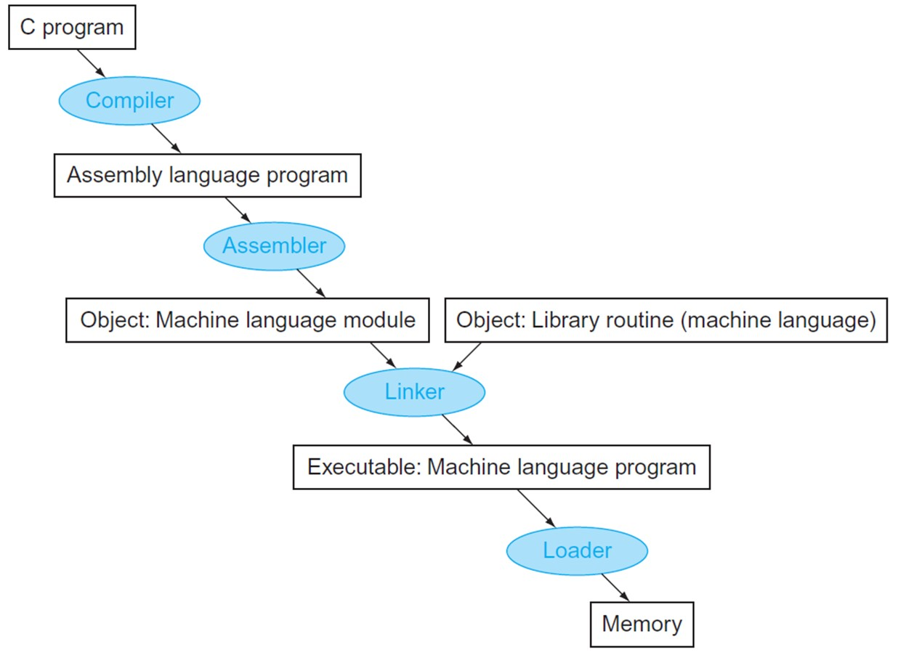
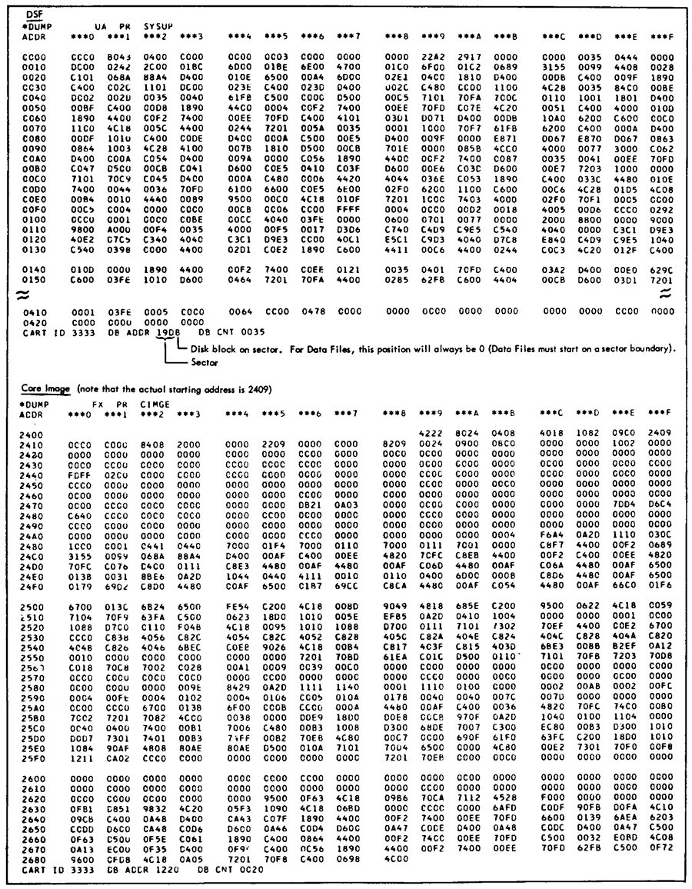
Program Compilation

Slide 27
Code Input to Device
Object Code
000000 00000 00101 0001000010000000
000000 00100 00010 0001000000100000
100011 00010 01111 0000000000000000
100011 00010 10000 0000000000000100
101011 00010 10000 0000000000000000
101011 00010 01111 0000000000000100
000000 11111 00000 0000000000001000
Processor
Memory
Devices
Network
Control
Input
Datapath
Output

Slide 28
Code Stored in Memory
Processor
Memory
Devices
Network
000000 00000 00101 0001000010000000
000000 00100 00010 0001000000100000
100011 00010 01111 0000000000000000
100011 00010 10000 0000000000000100
101011 00010 10000 0000000000000000
101011 00010 01111 0000000000000100
000000 11111 00000 0000000000001000
Control
Input
Datapath
Output

Slide 29
Code Fetch from Memory
Processor
Memory
Devices
Network
Control
000000 00000 00101 0001000010000000
000000 00100 00010 0001000000100000
100011 00010 01111 0000000000000000
100011 00010 10000 0000000000000100
101011 00010 10000 0000000000000000
101011 00010 01111 0000000000000100
000000 11111 00000 0000000000001000
Input
Datapath
Output

Slide 30
Decoding Code
Processor
Memory
Devices
Network
Control
000000 00100 00010 0001000000100000
Input
Datapath
Output

Slide 31
Executing Code
Control unit decodes the instruction to determine what to execute
Datapath unit executes the instruction as directed by control
Processor
Memory
Devices
Network
Control
000000 00100 00010 0001000000100000
Input
Datapath
Add Reg #4 and Reg #2, put result in Reg #2
Output

Slide 32
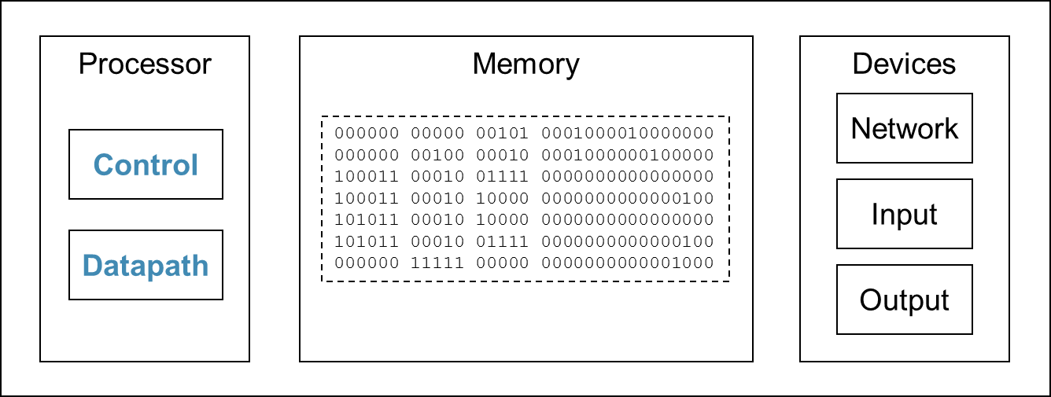
The Cycle
Processor fetches the next instruction from memory
How does it know which location in memory to fetch from next?
Fetch
Execute
Decode

Slide 33
Data Output to Device
Processor
Memory
Devices
Network
Control
Input
Datapath
Output
00000100010100000000000000000000
00000000010011110000000000000100
00000011111000000000000000001000

Slide 34
Conclusions
A computer consists of two components - hardware and software
Computer architecture course discuss the main components of hardware
OS, compiler, linker, and loader form the main components of system software

Slide 35
Q & A

