Slide 1
Optimizing MicroVM Performance for Serverless Computing
Xin Tong
School of Data Science
Chinese University of Hong Kong, Shenzhen

Slide 2
Outline
Introduction
Paper 1: Firecracker (AWS, NSDI’ 2020)
  Lightweight microVMs with strong isolation and low overhead
Paper 2: REAP (University of Edinburgh & Microsoft Research & EPFL, ASPLOS’ 2021)
  Accelerate snapshot restoration through working-set prefetching
Paper 3: FaaSnap (UCSD, EuroSys’ 2022)
  Further optimize restoration with concurrent paging and region-specific mappings
Conclusions
Notes:
Here is the outline.
本次汇报围绕 Serverless 中的微虚拟机性能优化展开。
This presentation focuses on microVM performance optimization for serverless computing.
第一篇 Firecracker 介绍如何通过精简虚拟机设计，在提供强隔离的同时降低启动和运行开销。第二篇 REAP 进一步关注快照恢复，通过记录和预取工作集，减少执行过程中的页面加载等待。
Firecracker reduces startup and runtime overhead through a minimal VM design while providing strong isolation. REAP focuses on snapshot restoration, recording and prefetching working sets to reduce page-loading delays during execution.
第三篇 FaaSnap 在此基础上，针对预取等待、工作集变化和不必要的读取，改进页面加载与内存映射。
FaaSnap addresses prefetch delays, changing working sets, and unnecessary reads through improved paging and memory mappings.

Slide 3
Introduction – Serverless Cold Starts
Serverless Execution
  Functions run on demand in isolated environments
  MicroVMs provide strong isolation with low overhead
Cold-Start Challenge
  Booting from scratch requires VM boot and runtime initialization
  Warm instances reduce latency but occupy memory while idle
Cold Start: Boot from Scratch
Create VM and
boot guest OS
Initialize runtime
and function
Execute
Guest boot and initialization add latency
Warm Start
Reuse an existing warm VM
Execute
VM already initialized; still occupies memory
Cold Start: Snapshot Restore
Create VM
Restore initialized
VM state
Execute
Memory pages still need to be loaded
Figure 1. Preparing a function instance for execution.
Notes:
Serverless 平台按请求运行函数，并负责管理底层资源。为了隔离不同用户的代码，平台可以使用微虚拟机。微虚拟机降低了传统虚拟机的开销，但在没有可用实例时，仍然需要准备执行环境。
Serverless platforms run functions on demand and manage the underlying resources. MicroVMs can isolate code from different users while reducing traditional VM overhead. However, when no instance is available, the platform still needs to prepare an execution environment.
右图展示三种方式。从头启动需要启动虚拟机并初始化运行时和函数；复用热实例可以直接执行，但空闲实例仍占内存；快照恢复则复用初始化后的状态，避免重复启动和初始化，不过内存页面仍然需要加载。
The figure shows three methods. A cold start boots the VM and initializes the runtime and function. A warm start reuses a ready instance, but idle instances occupy memory. Snapshot restoration reuses initialized state, avoiding repeated booting and initialization, although memory pages still need to be loaded.

Slide 4
Introduction - Roadmap
1. Firecracker
2. REAP
3. FaaSnap
NSDI 2020
ASPLOS 2021
EuroSys 2022
Lightweight Virtualization
Record and Prefetch
Concurrent Snapshot Loading
Function + Guest Linux
Record page accesses
Set up VM mappings
Compact WS file
Minimal Firecracker VMM
Overlap
Loader prefetches
VM executes
Prefetch all WS pages
Linux KVM
Run VM
Reduce virtualization overhead
Load first, then execute
Load while executing
Instance setup
Boot a minimal microVM
Restore initialized VM state
Restore initialized VM state
Page loading
Initialize runtime and function
Prefetch the WS, then execute
Prefetch while the VM executes
Memory handling
Minimize VMM and device overhead
Handle page faults in userspace
Use region-specific memory mappings
Figure 2. Comparison of Firecracker, REAP, and FaaSnap
Notes:
Firecracker 解决的是虚拟化环境本身的开销。它通过精简 VMM 和设备模型，提供适合 Serverless 的轻量级微虚拟机。
We begin with Firecracker. Firecracker reduces the overhead of the virtualization environment itself. Its minimal VMM and device model provide lightweight microVMs for serverless workloads.

Slide 5
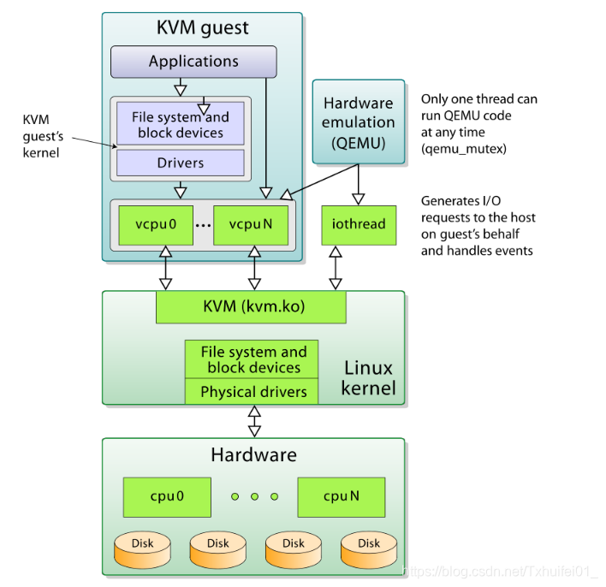
Paper 1: Firecracker
Motivation
  Efficient multi-tenant execution of serverless functions
  Strong isolation with fast startup and low overhead
Problems
  Containers: security–compatibility trade-off
  Language VMs: limited compatibility with arbitrary Linux binaries
  General-purpose VMs: high overhead and implementation complexity
Key ideas
  Keep KVM and Linux guests for isolation and compatibility
  Replace QEMU with a minimal VMM written in Rust
  Remove unnecessary devices and features
Figure 3. QEMU/KVM Virtualization Architecture
Notes:
【Motivation】
Serverless 需要在共享服务器上高密度运行不同客户的函数，因此需要兼顾强隔离、快速启动和低开销。
Serverless platforms host many customers’ functions on shared servers, requiring strong isolation, fast startup, and low overhead.
【Problems】
容器共享宿主机内核，存在安全与兼容性的取舍；语言级隔离依赖特定运行时；传统虚拟机则有较高的启动和资源开销。
Containers face security and compatibility trade-offs because they share the host kernel. Language-based isolation requires specific runtimes, while traditional VMs have higher startup and resource costs.
【Key Ideas】
图中，KVM 提供硬件辅助的客户机执行能力，QEMU 提供用户态设备模型。Firecracker 保留 KVM 和 Linux 客户机，用精简的 Rust VMM 替代 QEMU，去掉不必要的功能，降低开销和攻击面。
In the figure, KVM provides hardware-assisted guest execution, while QEMU provides the user-space device model. Firecracker retains KVM and Linux guests but replaces QEMU with a minimal Rust VMM, removing unnecessary features to reduce overhead and the attack surface.

Slide 6
Firecracker - System Architecture (1/3)
Core Architecture
  One Firecracker process per MicroVM
  KVM provides hardware-assisted virtualization
  Linux handles scheduling, memory and host I/O
Device Model
  Essential network, block and serial devices
  virtio for network and block I/O
  Omit USB, GPU and unnecessary devices
MicroVM (guest)
Firecracker
Host userspace process
Application
REST API
Guest Linux kernel
I/O
Minimal device model
virtio drivers
virtio-net
vCPU 0
•••
vCPU n
virtio-blk
Serial console
Host Linux kernel
KVM
Host I/O
Hardware virtualization
Block I/O · TUN/TAP
CPU scheduling · Memory management
Physical hardware
CPU
Memory
Disk / Network
Figure 4. Firecracker System Architecture
Notes:
每个 MicroVM 由一个宿主机用户态的 Firecracker 进程管理，通过 KVM 运行客户机代码。宿主机 Linux 负责 CPU 调度、内存管理和底层 I/O。
Each MicroVM is managed by a Firecracker process in host userspace, using KVM to execute guest code. The host Linux kernel handles CPU scheduling, memory management, and underlying I/O.
Firecracker 只保留必要设备，包括网络、块设备和串口，其中网络和块设备使用 virtio。省去 USB、GPU 等不必要的设备，有助于降低启动和资源开销。
Firecracker keeps essential devices, including network, block, and serial devices, with virtio for network and block I/O. Omitting unnecessary devices such as USB and GPUs helps reduce startup and resource overhead.

Slide 7
Firecracker - System Architecture (2/3)
API
  REST API over a Unix socket
  Host manager controls each MicroVM
Benefit
  Prepare the process and configuration early
  Start the guest only when needed
MicroVM (guest)
Firecracker
Preparation 1
Host userspace process
Manager starts
Application
REST API
Firecracker process
Guest Linux kernel
I/O
Minimal device model
virtio drivers
virtio-net
Preparation 2
vCPU 0
•••
vCPU n
virtio-blk
Manager sends
Serial console
known configuration
Host Linux kernel
KVM
Host I/O
Guest boot
Hardware virtualization
Block I/O · TUN/TAP
Manager requests boot
via REST API
CPU scheduling · Memory management
After boot
Physical hardware
Runtime and app
CPU
Memory
Disk / Network
initialization
Figure 4. Firecracker System Architecture
Figure 5. Firecracker Instance Startup Process
Notes:
Firecracker 提供基于 Unix socket 的 REST API，让宿主机管理程序配置和控制 MicroVM。
Firecracker provides a REST API over a Unix socket for the host manager to configure and control MicroVMs.
管理程序可以提前创建 Firecracker 进程并发送已知配置，等需要客户机时再请求启动，从而减少请求到来后的准备时间。
The manager can create the Firecracker process and send the available configuration in advance, then trigger guest boot when needed. This reduces preparation time after a request arrives.

Slide 8
Firecracker - System Architecture (3/3)
Performance Isolation
  Limit disk IOPS, packet rates and bandwidth
  Token buckets enforce rates and allow bursts
  One-time burst allowance accelerates boot
Security
  Jailer restricts the host-side VMM process
  Host-level mitigations address side channels
Notes:
Firecracker 使用令牌桶控制 I/O 速率，并允许启动时的一次性突发额度。
Firecracker uses token buckets to control I/O rates, with a one-time burst allowance during boot.
Jailer 限制进程权限和资源访问，部署中还通过关闭超线程等措施缓解侧信道风险。
Jailer restricts process privileges and resource access. Deployment measures such as disabling hyper-threading mitigate side channels.

Slide 9
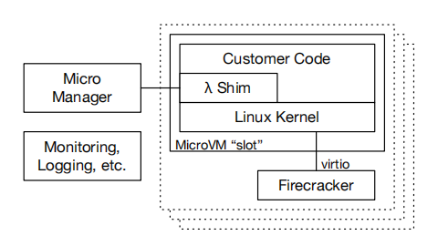
Firecracker - in AWS Lambda
Worker Architecture
  Multiple MicroVM slots on each worker
  One function execution environment per slot
  MicroManager manages Firecracker processes
Startup and Reuse
  Reuse slots for sequential invocations
  Maintain a small pool of pre-booted MicroVMs
  Faster boot allows a smaller spare pool
Figure 6. Firecracker Integration in AWS Lambda
Notes:
在 Lambda 中，每个 MicroVM 一次处理一个请求，并可供同一函数复用。MicroManager 管理 Firecracker 进程并维护预启动池；启动越快，所需备用池就越小。
In Lambda, each MicroVM handles one invocation at a time and can be reused for the same function. The MicroManager manages Firecracker processes and maintains a pre-booted pool. Faster boot times allow a smaller spare pool.

Slide 10
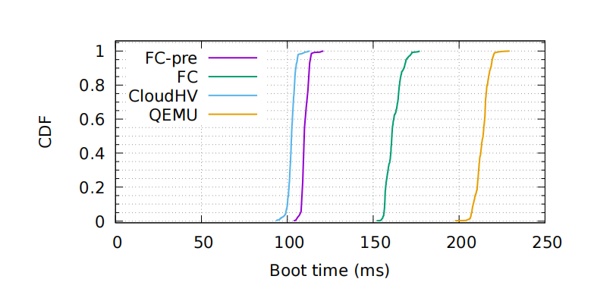
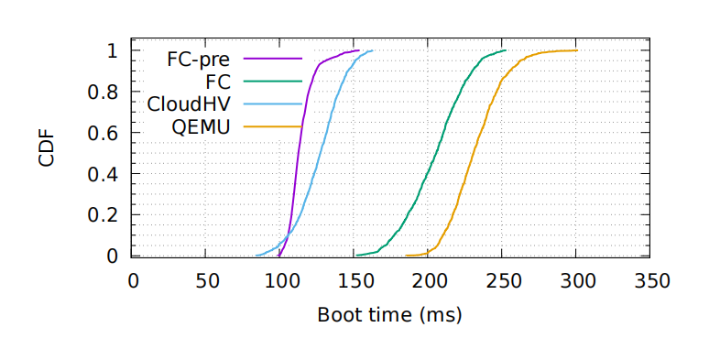
Firecracker – Evaluation (1/3)
Boot Times
Test Setup
  1 vCPU, 256 MB RAM, minimal Linux guest
  Measure until the guest init process starts
Two Measurement Modes
  FC: process creation + configuration + guest boot
  FC-pre: boot after configuration is completed
Main Findings
  FC-pre boots faster than QEMU
  The advantage remains with 50 parallel launches
Figure 7. MicroVM Boot-Time Distributions under Serial and Concurrent Startup
Notes:
首先比较不同 VMM 在串行和并发情况下的启动时间。
First, we compare VMM boot times under serial and concurrent startup.
上图是串行启动，下图是 50 个 MicroVM 并发启动。每个虚拟机配置 1 个 vCPU 和 256 MB 内存，计时到客户机 init 进程启动。
The upper graph shows serial startup, and the lower graph shows 50 concurrent starts. Each VM has one vCPU and 256 MB of memory. Timing ends when the guest init process starts.
FC 包含进程创建、API 配置和客户机启动；FC-pre 提前完成前两项，只测客户机启动时间。
FC includes process creation, API configuration, and guest boot. FC-pre completes the first two stages beforehand and measures only guest boot.
曲线越靠左，启动越快。两种测试中，FC-pre 和 Cloud Hypervisor 都比 QEMU 更快。
Curves further left indicate faster startup. FC-pre and Cloud Hypervisor boot faster than QEMU in both tests.

Slide 11
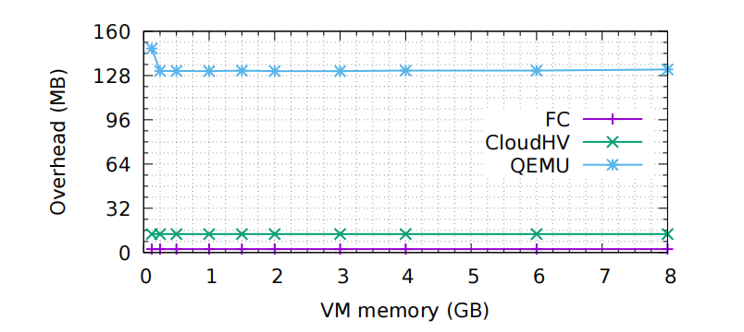
Firecracker – Evaluation (2/3)
Memory overhead
Measurement
  Extra memory beyond configured guest RAM
  VMM binary excluded
Main Findings
  Firecracker: approximately 3 MB
  Cloud Hypervisor: approximately 13 MB
  QEMU: approximately 131 MB
Deployment Benefit
  Lower overhead supports higher MicroVM density
Figure 8. VMM Memory Overhead across Different VM Memory Sizes
Notes:
接着比较各 VMM 超出客户机配置内存的额外开销。
Next, we compare each VMM’s memory overhead beyond the configured guest memory.
Firecracker 的额外内存开销约为 3 MB，低于 Cloud Hypervisor 的 13 MB 和 QEMU 的 131 MB。三者的开销总体不随客户机内存大小明显变化。
Firecracker’s memory overhead is about 3 MB, compared with 13 MB for Cloud Hypervisor and 131 MB for QEMU. These overheads remain relatively constant as guest memory increases.
因此，Firecracker 较低的单实例开销有助于在相同物理内存下部署更多 MicroVM。
Firecracker’s lower per-instance overhead helps a server host more MicroVMs within the same physical memory capacity.

Slide 12
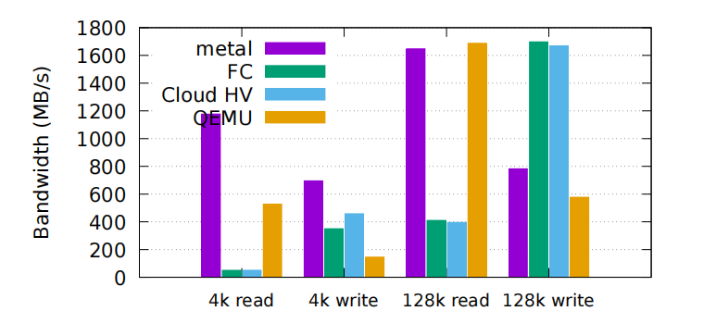
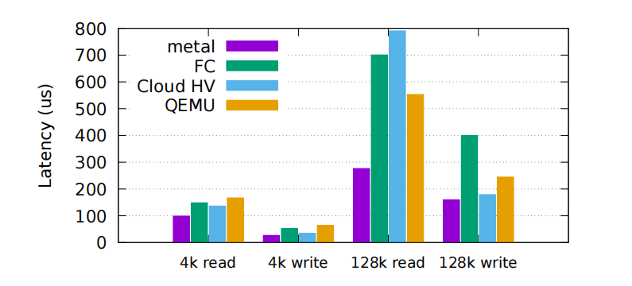
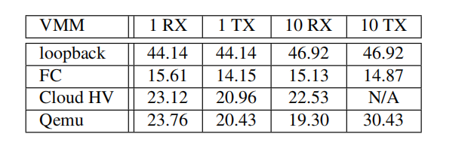
Firecracker – Evaluation (3/3)
IO Performance
Test Setup
  2 vCPUs, 512 MB RAM
  Disk rate limiting disabled
Disk Performance
  Serial I/O processing limits read throughput
  High write throughput
  Large-block I/O shows higher latency than native execution
Network Performance
  Around 15 Gb/s
Table 1. Network Throughput Comparison across VMMs
Figure 9. Block I/O Bandwidth and Latency Comparison
Notes:
最后比较磁盘吞吐量、磁盘 P99 延迟和网络吞吐量。
Finally, we compare disk throughput, disk P99 latency, and network throughput.
上图比较 4 KB 和 128 KB 数据块的随机读写吞吐量。Firecracker 的读取吞吐量低于裸机和 QEMU，尤其是 4 KB 读取。作者指出，这与测试版本串行处理磁盘 I/O 有关。
The upper graph compares random read and write throughput using 4 KB and 128 KB blocks. Firecracker’s read throughput is lower than bare metal and QEMU, especially for 4 KB reads. The authors attribute this limitation to serial disk I/O processing in the tested version.
下图比较 P99 延迟。Firecracker 在 4 KB 读取时与其他 VMM 比较接近，但在 128 KB 大块读写时，相对裸机的额外延迟更明显。
The lower graph compares P99 latency. Firecracker performs similarly to the other VMMs for 4 KB reads, but shows greater overhead relative to bare metal for 128 KB reads and writes.
网络测试中，Firecracker 的吞吐量约为 15 Gbps，低于 Cloud Hypervisor 和 QEMU。不过，作者表示，这并未成为其生产环境的性能限制。
In the network tests, Firecracker achieves around 15 Gbps, below Cloud Hypervisor and QEMU. However, the authors report that this was not a limitation in their production environment.

Slide 13
Paper 2: REAP (1/2)
Benchmarking, Analysis, and Optimization of Serverless
Function Snapshots
Dmitrii Ustiugov, Plamen Petrov, Marios Kogias, et al.
University of Edinburgh, Microsoft Research, EPFL
1. Firecracker
2. REAP
3. FaaSnap
NSDI 2020
ASPLOS 2021
EuroSys 2022
Lightweight Virtualization
Record and Prefetch
Concurrent Snapshot Loading
Function + Guest Linux
Record page accesses
Set up VM mappings
Compact WS file
Minimal Firecracker VMM
Overlap
Loader prefetches
VM executes
Prefetch all WS pages
Linux KVM
Run VM
Notes:
Firecracker 降低了虚拟机启动开销，但运行时和依赖仍需初始化。
Firecracker reduces VM boot overhead, but runtimes and dependencies still require initialization.
保存初始化后的快照，可在后续创建新实例时跳过重复初始化，但按需读页仍会造成等待。
Snapshots of initialized environments let subsequent instances skip repeated initialization, but on-demand paging still causes delays.
REAP 记录一次调用访问的页面，在后续快照恢复时提前加载它们，减少缺页等待。
REAP records pages accessed during one invocation and prefetches them during subsequent snapshot restores to reduce page-fault delays.

Slide 14
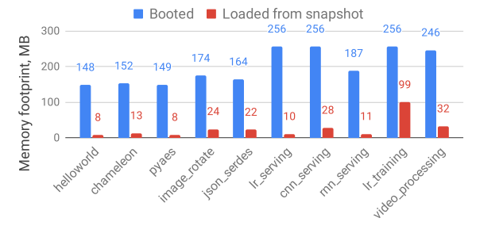
Paper 2: REAP (2/2)
Problems
  Cold boots are slow; warm instances consume memory
  Snapshot restores suffer from page faults
Key observations
  Small working sets: 24 MB on average
  Similar pages accessed across different inputs
Key ideas
  Record the pages needed by a function
  Prefetch them during future snapshot restores
Figure 10. Memory Footprint after Booting and Snapshot Restoration
Notes:
【Problems】
从头启动函数实例较慢，而保留热实例又会持续占用内存。快照可以缓解这个矛盾，让新实例跳过初始化。但基线方案按需恢复内存，访问缺失页面时才从 SSD 读取，因此缺页等待和分散读取仍会拖慢调用。
Cold boots are slow, while keeping instances warm consumes memory. Snapshots help address this trade-off by allowing new instances to skip initialization. However, the baseline loads memory on demand, so page faults and scattered SSD reads still delay execution.
【Key Observations】
为了减少这些等待，作者进一步分析调用实际需要哪些页面。结果发现，工作集平均只有约 24 MB，而且同一函数处理不同输入时，会重复访问大量相同页面。因此，可以根据之前的访问记录，提前准备后续调用可能需要的页面。
To reduce these delays, the authors examine which pages an invocation actually needs. They find that working sets average only about 24 MB, and many pages recur across different inputs. Previous access records can therefore help identify pages to load in advance.
【Key Ideas】
基于这两个观察，REAP 先在 Record 阶段记录访问的页面，并把对应的原始快照内容整理成连续的工作集文件。后续恢复时，Prefetch 阶段在执行前批量加载这些页面，用集中读取减少分散读取和缺页等待。未覆盖的页面仍按需加载。
Based on these observations, REAP first records accessed pages and packs their original snapshot contents into a contiguous working-set file. During subsequent restores, it prefetches these pages in bulk before execution, reducing scattered reads and page-fault delays. Pages outside the recorded working set are still loaded on demand.

Slide 15
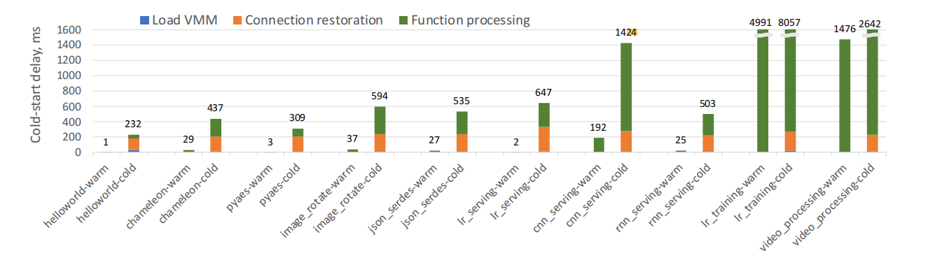
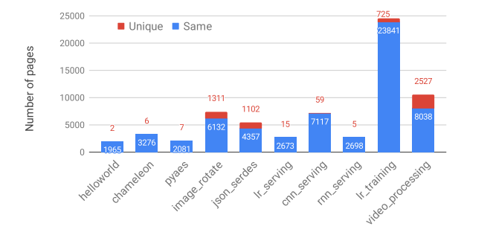
REAP - Performance Analysis
Experimental Setup
  Firecracker-based vHive; snapshots on local SSD
  Clear host page cache before each cold invocation
Cold-Start Overhead
  Snapshot-based cold invocations remain much slower than warm invocations
  On-demand page loading adds execution delays
Page Reuse
  Different inputs access many of the same pages
  Recorded page accesses can guide future prefetching
Figure 11. Latency Breakdown of Warm and Snapshot-Based Cold Invocations
Figure 12. Memory Page Reuse across Invocations with Different Inputs
Notes:
这一页用两张图说明 REAP 的设计依据。实验使用基于 Firecracker 的 vHive，快照存于本地 SSD，并在每次冷调用前清空宿主机页面缓存，避免缓存影响结果。
This slide presents the evidence behind REAP’s design. The experiments use vHive with Firecracker and local SSD snapshots. The host page cache is cleared before each cold invocation to avoid cache effects.
Figure 2：快照恢复仍有开销
冷调用包括 VMM 加载、连接恢复和函数处理，整体仍明显慢于热调用。其中，执行期间的缺页会带来磁盘读取等待，这是 REAP 要减少的开销。
Cold invocations include VMM loading, connection restoration, and function processing, and remain much slower than warm invocations. Page faults during execution introduce disk-read delays, which REAP aims to reduce.
Figure 5：重复访问使预取成为可能
同一函数即使处理不同输入，仍会访问大量相同页面。因此，可以利用一次调用的记录指导后续预取，这也是 Record 和 Prefetch 的设计依据。
Invocations of the same function access many of the same pages even with different inputs. One invocation’s access record can therefore guide future prefetching, motivating REAP’s Record and Prefetch phases.

Slide 16
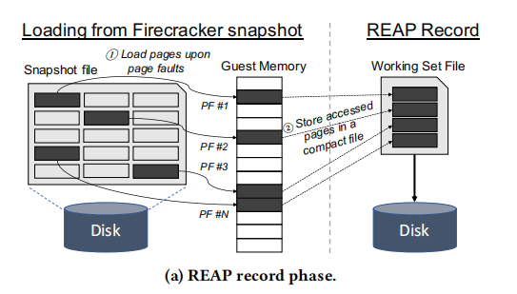
REAP - System Architecture (1/2)
Record Page Accesses
  Load pages on demand during the first invocation from a snapshot
  Record the offsets of accessed pages
Build Two Files
  WS file: compact copies of accessed pages from the original snapshot
  Trace file: original page offsets
Implementation
  A per-instance monitor in vHive-CRI handles page faults using userfaultfd
Figure 13. REAP Record Phase
Notes:
【Record】
第一次从快照恢复调用时，页面仍按需加载。vHive-CRI 的监控协程通过 userfaultfd 处理缺页，加载页面并记录它在快照文件中的位置。
During the first restored invocation, pages are loaded on demand. A monitor in vHive-CRI uses userfaultfd to handle page faults, load pages, and record their offsets in the snapshot file.
调用结束后，WS 文件紧凑保存这些页面的原始快照内容，trace 文件保存对应位置。记录会增加首次调用的开销，但能帮助后续实例更快恢复。
After the invocation, the WS file packs the pages’ original snapshot contents together, while the trace file stores their offsets. Recording adds overhead to the first invocation to accelerate later restores.

Slide 17
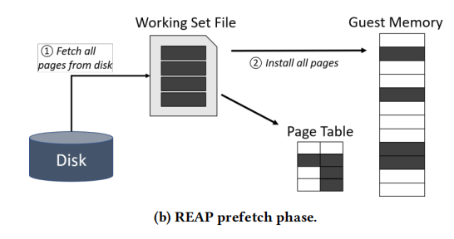
REAP - System Architecture (2/2)
Prefetch the Working Set
  Read the WS file into a host buffer in one large read
  Install pages at their recorded locations and populate page tables
Resume Execution
  Resume the instance after installing the working-set pages
  Load additional pages on demand
Efficient Disk Reads
  Compact WS files enable bulk reads
  Direct I/O bypasses the host page cache
Figure 14. REAP Prefetch Phase
Notes:
【Prefetch】
后续恢复时，REAP 先把 WS 文件批量读入宿主机缓冲区，再根据 trace 将页面安装到客户机内存，完成页表映射后恢复执行。未覆盖的页面仍按需加载。
During subsequent restores, REAP reads the WS file into a host buffer in bulk, then uses the trace to install pages into guest memory. After populating the page tables, it resumes execution. Missing pages are still loaded on demand.
这里仍需读取 SSD，但大部分页面改为执行前集中读取，减少执行期间的缺页等待。实现还使用 Direct I/O 绕过宿主机页面缓存，以减少相关开销。
SSD reads are still required, but most needed pages are read together before execution, reducing page-fault delays. The implementation also uses Direct I/O to bypass the host page cache and reduce associated overhead.

Slide 18
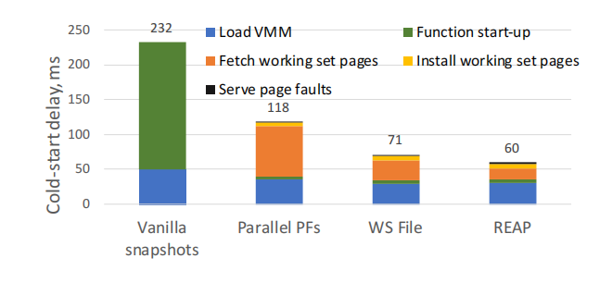
REAP – Evaluation (1/3)
Understanding the Optimizations
Experimental Setup
  Hello World on Firecracker-based vHive
  Local SATA SSD
  1 vCPU and 256 MB memory per VM
Optimization Steps
  Parallel PFs: overlap reads from the original snapshot
  WS File: fetch packed pages in one large read
  REAP: bypass the host page cache with Direct I/O
Figure 15. Cold-Start Latency across REAP Optimization Steps
Notes:
这一页用 Hello World 比较四种页面加载方案，分析快照恢复的系统开销。
This slide uses Hello World to compare four page-loading configurations and examine snapshot-restoration overhead.
基线快照需要 232 毫秒。根据 trace 从原快照并行读取页面后，延迟降到 118 毫秒；将页面整理成紧凑的 WS 文件并批量读取后，进一步降到 71 毫秒。
The baseline takes 232 milliseconds. Reading pages from the original snapshot in parallel reduces latency to 118 milliseconds. Packing them into a compact WS file for bulk reads further reduces it to 71 milliseconds.
完整 REAP 再使用 Direct I/O 绕过宿主机页面缓存，将延迟降到 60 毫秒。这说明，改善页面读取方式并减少宿主机 I/O 开销，可以明显加快恢复。
Full REAP additionally uses Direct I/O to bypass the host page cache, reducing latency to 60 milliseconds. These results show that improving page loading and reducing host I/O overhead can substantially accelerate restoration.

Slide 19
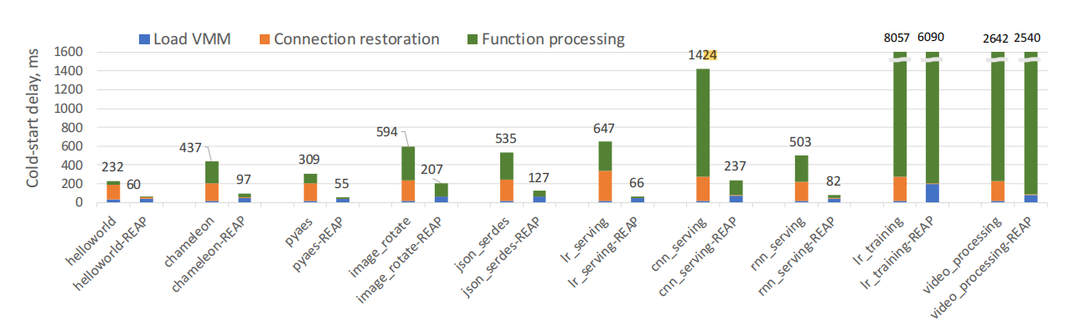
REAP – Evaluation (2/3)
Performance Across Functions
Overall Performance
  1.04–9.7× speedup, averaging 3.7×
  Compared with baseline Firecracker snapshots
Faster Connection Restoration
  45× faster on average, reduced to 4–7 ms
Workload-Dependent Benefits
  Pages missing from the recorded working set still require demand loading
Figure 16. Cold-Start Latency Comparison between Baseline Snapshots and REAP
Notes:
这一页比较不同函数的冷调用延迟。Figure 每组左侧是基线快照，右侧是 REAP。在测试函数中，REAP 平均加速 3.7 倍，范围为 1.04 到 9.7 倍。
The Figure compares cold-invocation latency across functions, with baseline snapshots on the left and REAP on the right. Across the tested functions, REAP achieves an average speedup of 3.7 times, ranging from 1.04 to 9.7 times.
预取也覆盖了连接恢复所需的页面，使这一阶段平均加速 45 倍，耗时降至 4 至 7 毫秒。
Prefetching also covers the pages needed for connection restoration, accelerating this stage by 45 times on average and reducing it to 4–7 milliseconds.
不过，视频处理的收益较小。作者推测，输入变化改变了工作集，使部分页面仍需按需加载，限制了加速效果。
Video processing benefits less. The authors suggest that input changes alter the working set, leaving some pages to be loaded on demand and limiting the speedup.

Slide 20
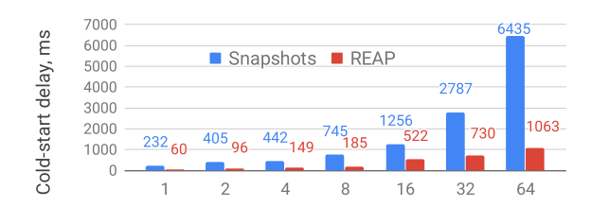
REAP – Evaluation (3/3)
Overhead and Scalability
Recording Overhead
  28% higher latency for the first invocation
  WS and trace files reused in later cold invocations
Scalability
  Lower latency than baseline under concurrency
  Disk-bandwidth bottleneck at 16+ concurrent instances
Figure 17. Cold-Start Latency under Concurrent Instance Loading
Notes:
REAP 需要先记录页面访问并生成 WS 和 trace 文件，使首次调用延迟平均增加 28%。这些文件可以复用于后续冷调用。
REAP records page accesses and creates the WS and trace files, increasing first-invocation latency by 28% on average. Subsequent cold invocations can reuse these files.
Figure 9 比较多个 Hello World 实例并发冷启动的效果。在各个测试并发规模下，REAP 的每实例平均延迟都低于基线，说明并发恢复时仍能保持收益。
This figure evaluates concurrent cold starts of Hello World. REAP has lower average latency per instance at every tested concurrency level, retaining its benefits during concurrent restoration.

Slide 21
Paper 3: FaaSnap (1/3)
FaaSnap: FaaS Made Fast Using Snapshot-based VMs
Lixiang Ao, George Porter, Geoffrey M. Voelker
University of California San Diego
1. Firecracker
2. REAP
3. FaaSnap
NSDI 2020
ASPLOS 2021
EuroSys 2022
Lightweight Virtualization
Record and Prefetch
Concurrent Snapshot Loading
Function + Guest Linux
Record page accesses
Set up VM mappings
Compact WS file
Minimal Firecracker VMM
Overlap
Loader prefetches
VM executes
Prefetch all WS pages
Linux KVM
Run VM
Notes:
REAP 通过预取工作集减少了缺页等待，但新输入可能改变工作集，而且实例仍需要等待预取完成。下一篇 FaaSnap 进一步研究如何应对工作集变化，并让页面加载与执行重叠，从而降低冷调用延迟。
REAP reduces page-fault delays by prefetching the working set. However, new inputs may change the working set, and the instance still waits for prefetching to finish. The next paper, FaaSnap, addresses working-set variation and overlaps page loading with execution to further reduce cold-invocation latency.

Slide 22
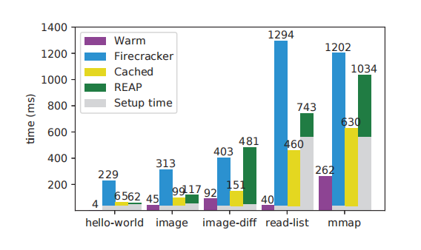
Paper 3: FaaSnap (2/3)
Motivation
  Further reduce snapshot-based cold-invocation latency
Problems
  Changing inputs reduce working-set coverage
  Large working sets delay execution during prefetching
  Anonymous-memory allocation can trigger unnecessary disk readsn
Figure 18. Function Invocation Latency across Baseline Configurations
Notes:
这一页分析 REAP 预取之后仍然存在的开销，重点是输入变化、大工作集和新内存分配。
This slide examines the overheads that remain after REAP’s prefetching, focusing on input changes, large working sets, and new memory allocation.
右图中，Warm 复用热实例，Firecracker 按需恢复，Cached 提前缓存快照页面，REAP 则预取工作集。灰色表示准备时间，彩色表示调用时间，两部分相加才是总延迟。
Warm reuses an existing instance, Firecracker restores pages on demand, Cached keeps snapshot pages in the host cache, and REAP prefetches the working set. Gray shows setup time, while colors show invocation time. Together, they give the total latency.
先比较 image 和 image-diff 的绿色部分：换输入后，REAP 未覆盖部分所需页面，调用时间明显增加。再看 read-list 和 mmap 的灰色部分：工作集较大，使执行前加载和安装页面的准备时间增加。
Comparing the green portions of image and image-diff, changed inputs leave some required pages outside REAP’s recorded working set, increasing invocation time. For read-list and mmap, the large gray portions show the cost of loading and installing large working sets before execution.
mmap 还暴露了另一个问题：客户机申请新的匿名内存，也可能触发宿主机读取快照中的旧内容。因此，后续优化还需要减少预取等待、适应工作集变化，并避免不必要的读取。
The mmap test reveals another problem: allocating new anonymous memory in the guest can still trigger reads of old snapshot contents on the host. Further optimization therefore needs to reduce prefetch delays, accommodate working-set changes, and avoid unnecessary reads.

Slide 23
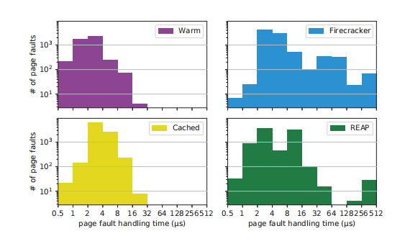
Paper 3: FaaSnap (3/3)
Key Observations
  Cached pages are cheaper to access than disk-resident pages
  Working sets can change across invocations
  Memory regions require different handling
Key Ideas
  Overlap page loading with execution
  Record host pages to broaden prefetch coverage
  Use region-specific memory mappings
Figure 19. Page Fault Handling Time Distributions across Configurations
Notes:
这张图分析 image-diff 的缺页处理时间，横轴是耗时，纵轴是次数。右上蓝色 Firecracker 的慢速尾部更明显，而左下黄色 Cached 主要集中在较短时间，说明缓存页面可以减少磁盘读取带来的等待。
This figure shows page-fault handling times for image-diff. The horizontal axis shows time, and the vertical axis counts faults. Blue Firecracker has a longer slow tail than yellow Cached, showing how cached pages reduce disk-read delays.
右下绿色 REAP 中，提前安装的页面处理较快，但工作集之外的页面仍需用户态处理，并可能等待磁盘读取。因此，恢复方案还需要高效处理未记录的页面。
In green REAP, preinstalled pages are handled quickly, but pages outside the working set require userspace handling and may wait for disk reads. Restoration must therefore also handle unrecorded pages efficiently.
结合上一页的问题，FaaSnap 提出三个方向：让预取与执行重叠，减少执行前的等待；记录宿主机预读到缓存中的页面，扩大预取覆盖；按内存区域采用不同映射，让零区域使用匿名内存，避免不必要的读取。
Together with the previous findings, this motivates three directions: overlap prefetching with execution to reduce initial waiting, record host readahead pages to broaden coverage, and use region-specific mappings so zero regions can use anonymous memory without disk reads.

Slide 24
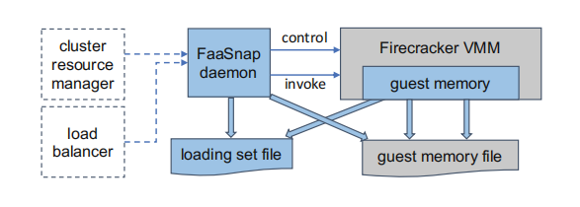
FaaSnap - System Architecture (1/4)
FaaSnap Daemon
  Manages VMs and snapshot resources
  Forwards function invocation requests
Firecracker VMM
  Runs the guest VM
  Configures guest-memory mappings
Snapshot Files:
  Guest memory file: saved VM memory contents
  Loading set file: compact pages selected for prefetching
Figure 20. FaaSnap System Architecture
Notes:
这一页介绍 FaaSnap 的整体架构，展示管理进程、Firecracker VMM 和两类文件如何配合完成快照恢复。
This slide presents FaaSnap’s overall architecture, showing how the daemon, Firecracker VMM, and two files work together to restore a VM from a snapshot.
中间蓝色的 FaaSnap daemon 是宿主机上的核心管理进程，负责管理虚拟机和快照资源，并转发函数调用请求。
The blue FaaSnap daemon manages VMs and snapshot resources on the host and forwards function invocation requests.
右侧的 Firecracker VMM 经过修改，以支持分区域内存映射。蓝色表示 FaaSnap 新增或修改的部分，灰色表示已有的 Firecracker 组件。
The Firecracker VMM on the right is modified to support region-specific memory mappings. Blue marks FaaSnap additions or changes, while gray shows existing Firecracker components.
下方的 guest memory file 保存内存快照，loading set file 则紧凑保存选出的预取页面。接下来看这个加载集文件如何生成。
The guest memory file stores the memory snapshot, while the loading set file packs the pages selected for prefetching. Next, we look at how this loading set file is created.

Slide 25
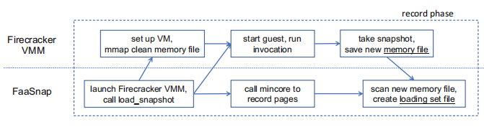
FaaSnap - System Architecture (2/4)
Host Page Recording
  Use mincore to track pages in the host page cache
  Include pages brought in by readahead
Working Set Groups
  Group pages by observed loading order
  Read groups in order, and pages sequentially within each group
Build the Loading Set File
  Capture a warm snapshot and select non-zero working-set pages
  Merge nearby regions and pack them by group and address
Figure 21. FaaSnap Record Phase and Loading Set Construction
Notes:
这一页介绍 FaaSnap 的记录阶段，说明它如何记录页面并生成加载集文件。
This slide presents FaaSnap’s record phase and explains how it records pages and creates the loading set file.
首先，daemon 启动 Firecracker 并请求加载快照（左下框），随后 VMM 设置虚拟机，映射初始快照的内存文件（左上框）。
First, the daemon launches Firecracker and requests snapshot loading. The VMM then sets up the VM and maps the initial snapshot’s memory file.
虚拟机执行函数调用时（中上框），daemon 反复调用 mincore，记录宿主机缓存中的页面，包括实际访问和预读带入的页面，并按观察顺序分组（中下框）。这样既扩大预取覆盖，也保留大致的使用顺序。
While the VM executes the function, the daemon repeatedly calls mincore to record pages in the host cache, including accessed and readahead pages. It groups them by observation order, broadening prefetch coverage while preserving access order.
调用完成后，VMM 保存暖状态快照（右上框）。daemon 再扫描新的内存文件，选出工作集中的非零页面，合并相近区域以减少映射数量，最后按组号和地址生成紧凑的加载集文件（右下框）。合并时可能包含少量中间页面。
After the invocation, the VMM saves a warm-state snapshot. The daemon scans the new memory file, selects non-zero working-set pages, and merges nearby regions to reduce mappings. It then packs them into a compact loading set file ordered by group and address. Merging may include a few intervening pages.

Slide 26
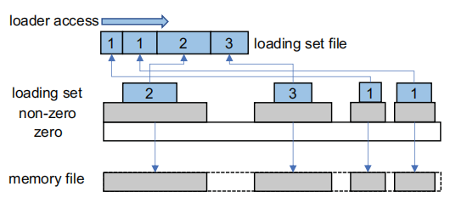
FaaSnap - System Architecture (3/4)
Zero Regions
  Map to anonymous host memory
  Provide zeros without snapshot reads
Non-zero Regions
  Map to the guest memory file
  Preserve access to pages outside the loading set
Loading Set Regions
  Map to the compact loading set file
  Overlay mappings to reduce mapping operations
Figure 22. FaaSnap Loading Set Layout and Memory Region Mapping
Notes:
上一页生成了加载集文件，这一页介绍恢复时如何根据内存区域选择不同的内容来源。
The previous slide created the loading set file. This slide explains how different memory regions use different backing sources during restoration.
首先，为整个客户机内存范围建立匿名映射，提供零值内存，对应白色 zero 层。随后，将非零区域映射到 guest memory file，对应灰色 non-zero 层。
First, an anonymous mapping provides zero-filled memory across the guest-memory range, shown in white. Non-zero regions are then mapped to the guest memory file, shown in gray.
最后，将蓝色加载集区域映射到紧凑的 loading set file。新映射覆盖相同地址处的旧映射，因此加载集页面来自紧凑文件，其余非零页面来自内存快照，未覆盖的零区域使用匿名内存。
Finally, blue loading set regions are mapped to the compact loading set file. New mappings override earlier mappings at the same addresses. Loading set pages come from the compact file, remaining non-zero pages from the memory snapshot, and uncovered zero regions use anonymous memory.

Slide 27
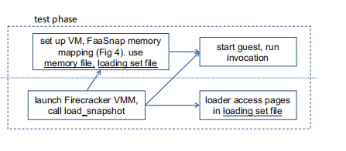
FaaSnap - System Architecture (4/4)
Concurrent Paging
  Prefetch pages in a daemon loader thread
  Start VM execution without waiting for all pages
Page Access
  Prefetched pages are served from the host page cache
  Pages not yet cached require demand loading
Benefit
  Avoid blocking execution on full working-set loading
Figure 23. FaaSnap Test Phase with Concurrent Page Loading and VM Execution
Notes:
这一页展示后续调用的恢复流程。daemon 启动 Firecracker 并请求加载快照（左下框），VMM 使用内存快照和加载集文件建立映射（左上框）。
This slide shows restoration for subsequent invocations. The daemon launches Firecracker and requests snapshot loading. The VMM establishes mappings using the memory snapshot and loading set files.
准备完成后，虚拟机开始执行函数（右上框），loader 同时预取页面（右下框）。因此，FaaSnap 将预取与执行重叠，不必像 REAP 一样等待整个工作集加载完成。
After setup, the VM runs the function while the loader prefetches pages. FaaSnap overlaps prefetching with execution, avoiding REAP’s initial wait for the entire working set to load.
如果 loader 先读入页面，虚拟机就能从宿主机缓存获取，无须等待磁盘；如果虚拟机先访问未缓存的页面，仍需等待按需读取。
If the loader reads a page first, the VM can access it from the host cache without waiting for disk. If the VM reaches an uncached page first, it still waits for demand loading.

Slide 28
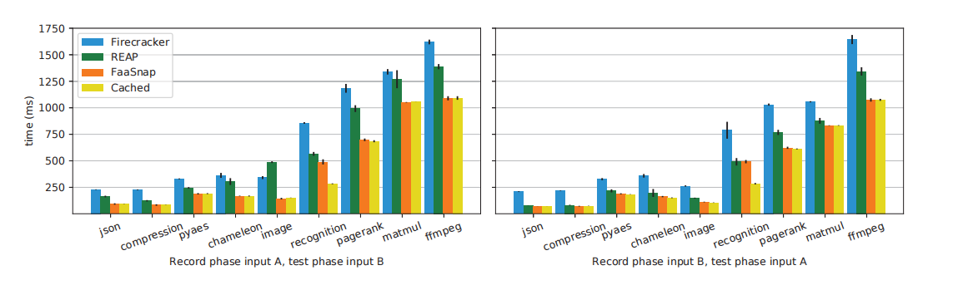
FaaSnap – Evaluation (1/4)
Application Performance
Experimental Setup
  Different inputs for recording and testing
  Compare Firecracker, REAP, FaaSnap and Cachede
Larger Test Inputs — A → B
  1.55× average speedup over REAP
Smaller Test Inputs — B → A
  1.16× average speedup over REAP
Figure 24. Function Invocation Latency under Input Changes
Notes:
这一页比较输入变化时的应用性能。A 是较小输入，B 是较大输入；上图用 A 记录、B 测试，下图反过来。纵轴包含虚拟机准备和函数调用的总时间。
This slide compares application performance under input changes. A is the smaller input and B is the larger one. The upper chart records with A and tests with B; the lower chart reverses them. The measured time includes VM setup and function invocation.
比较橙色 FaaSnap 和绿色 REAP：测试输入变大时，FaaSnap 的平均加速比为 1.55；输入变小时为 1.16。
Comparing orange FaaSnap with green REAP, FaaSnap achieves an average speedup of 1.55 times when the test input grows, and 1.16 times when it shrinks.
这是因为较大输入会访问更多记录之外的页面。REAP 需要在用户态处理这些缺页，而 FaaSnap 能更高效地处理。**它还会记录宿主机预读到缓存中的页面，在后续调用时预取更多可能需要的页面。**因此，在输入增长时，FaaSnap 的优势更明显。
Larger inputs access more pages outside the recorded working set. REAP handles these faults in userspace, while FaaSnap handles them more efficiently. It also records pages brought into the host cache by readahead, allowing subsequent invocations to prefetch more potentially needed pages. This gives FaaSnap a greater advantage when inputs grow.

Slide 29
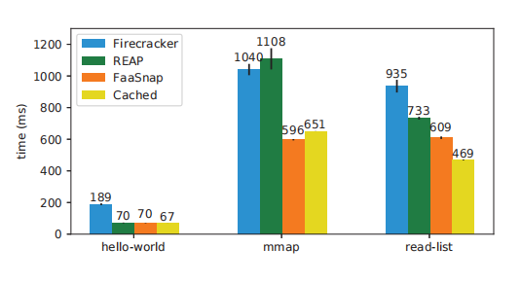
FaaSnap – Evaluation (2/4)
Synthetic Workloads
Workloads
  hello-world: basic invocation overhead
  mmap: allocate and write anonymous memory
  read-list: access a large existing list
Results
  Similar to REAP for hello-world
  Lower latency for mmap and read-list
Figure 25. Function Invocation Latency on Microbenchmarks
Notes:
上一页关注输入变化，这一页用三个合成测试观察不同开销，比较包含虚拟机准备和函数调用的总时间。
The previous slide examined input changes. This slide uses three synthetic workloads to compare total VM setup and function invocation time.
hello-world 中，绿色 REAP 和橙色 FaaSnap 都约为 70 毫秒。mmap 则申请并写入大量匿名内存，FaaSnap 通过零区域的匿名映射减少不必要的快照读取，将耗时从 REAP 的 1108 毫秒降到 596 毫秒。
For hello-world, green REAP and orange FaaSnap both take about 70 milliseconds. The mmap workload allocates and writes substantial anonymous memory. FaaSnap’s anonymous mappings for zero regions avoid unnecessary snapshot reads, reducing the time from REAP’s 1108 milliseconds to 596 milliseconds.
read-list 需要读取已有的 512 MB 列表，后台预取可能跟不上访问速度。因此，FaaSnap 的 609 毫秒虽然低于 REAP 的 733 毫秒，但仍高于页面已缓存的黄色 Cached 的 469 毫秒。
Read-list accesses an existing 512 MB list, and its reads can outpace background prefetching. FaaSnap therefore takes 609 milliseconds, below REAP’s 733 milliseconds but above yellow Cached’s 469 milliseconds, where the pages are already cached.

Slide 30
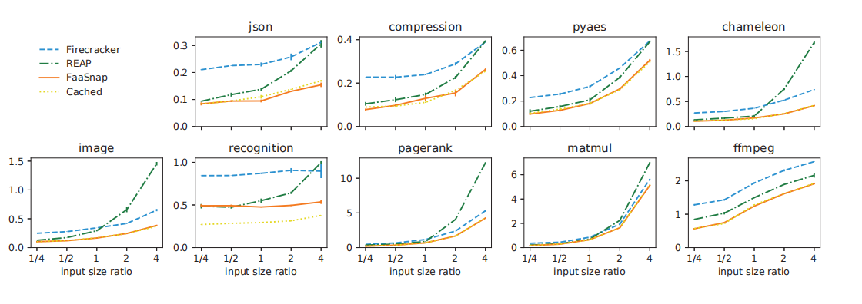
FaaSnap – Evaluation (3/4)
Input Size Sensitivity
Experimental Setup
  Test input size: ¼×–4× the recording input
  Input contents also change
Results
  REAP degrades on several workloads as inputs grow
  FaaSnap remains close to Cached for most functions
Figure 26. Function Invocation Latency across Different Input Sizes
Notes:
这一页测试输入大小变化对性能的影响。作者先记录一次页面，再复用同一份记录，用不同大小的新输入测试。横轴是测试输入与记录输入的大小比：1 表示大小相同，4 表示是原来的 4 倍；纵轴是执行时间。
This slide examines sensitivity to input size. The authors record pages once, then reuse that record while varying the test inputs. The horizontal axis shows the test-to-record input-size ratio: 1 means equal sizes, and 4 means four times as large. The vertical axis shows execution time.
重点看 image 和 chameleon。比例超过 1 后，绿色 REAP 曲线明显变陡，甚至慢于蓝色 Firecracker。这是因为更多访问落在记录之外，需要额外的用户态缺页处理。
For image and chameleon, green REAP rises sharply beyond a ratio of 1 and can become slower than blue Firecracker. More accesses fall outside the recorded working set, requiring additional userspace fault handling.
相比之下，橙色 FaaSnap 在多数测试中接近黄色 Cached，说明它更能适应输入变化带来的工作集变化。
In contrast, orange FaaSnap stays close to yellow Cached in most tests, showing greater resilience to input-driven changes in the working set.

Slide 31
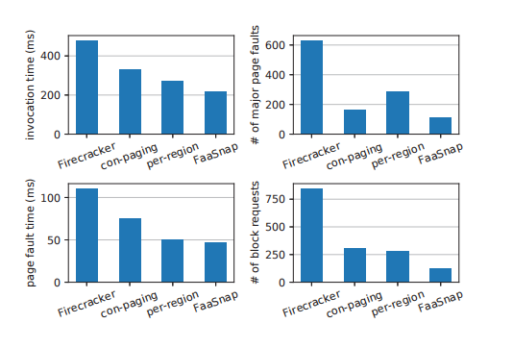
FaaSnap – Evaluation (4/4)
Optimization Breakdown
Configurations
  Firecracker: baseline
  con-paging: concurrent paging
  per-region: combined optimizations through
  FaaSnap: all optimizations
Results
  Full FaaSnap achieves the lowest invocation time
  Fault-handling time and VM-triggered disk reads decrease
Figure 27. Performance Comparison across FaaSnap Optimization Configurations
Notes:
这一页用 image 函数比较四种配置，分析各项优化的作用。第一种 Firecracker 主要按需加载页面；第二种 con-paging 增加后台预取，让页面加载与虚拟机执行重叠，但仍按地址顺序预取。
This slide uses the image function to examine four optimization configurations. Baseline Firecracker mainly loads pages on demand. Con-paging adds background prefetching to overlap loading with VM execution, but still prefetches in address order.
第三种 per-region 在此基础上，加入工作集分组、宿主机页面记录和分区域映射，分别改善预取顺序、扩大覆盖范围，并让零区域使用匿名内存，避免不必要的快照读取。
Per-region adds working-set groups, host page recording, and region-specific mappings. These improve prefetch order, broaden coverage, and serve zero regions with anonymous memory to avoid unnecessary snapshot reads.
第四种是完整 FaaSnap，进一步将需要预取的区域整理成紧凑的加载集文件，使后台 loader 能够顺序读取，减少分散访问带来的开销。
Full FaaSnap additionally packs the regions selected for prefetching into a compact loading set file. This allows the background loader to read sequentially and reduces the overhead of scattered accesses.
从结果看，左上角的调用时间逐步下降。左下角的缺页处理总时间和右下角的磁盘读取请求也减少。完整 FaaSnap 通过更高效的预取，让更多页面在虚拟机访问前准备好，从而减少执行中的等待。
The top-left chart shows progressively lower invocation time. The bottom charts also show less total page-fault handling time and fewer disk reads triggered by VM faults. Full FaaSnap’s more efficient prefetching prepares more pages before the VM accesses them, reducing execution delays.

Slide 32
Summary of Contributions
FireCracker (AWS)
  Lightweight microVMs provide strong isolation with low virtualization overhead
REAP (University of Edinburgh & Microsoft Research & EPFL)
  Record the working set and prefetch its pages before VM execution
FaaSnap (UCSD)
  Overlap page loading with VM execution and use region-specific mappings to reduce unnecessary reads
Progression:
Lightweight virtualization → Working-set prefetching → Concurrent snapshot loading
Notes:
To summarize
Firecracker 通过精简 VMM 和设备模型，在保持强隔离的同时降低虚拟化开销，为 Serverless 提供轻量级的 MicroVM。
Firecracker uses a minimal VMM and device model to reduce virtualization overhead while maintaining strong isolation for serverless workloads.
REAP 关注快照恢复中的缺页等待。它记录函数访问的工作集，并在后续恢复时批量预取这些页面，减少执行过程中的磁盘读取等待。
REAP addresses page-fault delays during snapshot restoration. It records the function’s working set and prefetches these pages in bulk during subsequent restores, reducing disk-read delays during execution.
FaaSnap 进一步让页面加载与虚拟机执行重叠，并根据内存区域的内容采用不同映射方式，减少执行关键路径中的等待和不必要的读取。
FaaSnap overlaps page loading with VM execution and uses different mappings for different memory regions, reducing delays on the execution critical path and avoiding unnecessary reads.
三篇文章的主线是：降低虚拟化开销，加快快照页面加载，再减少页面加载对函数执行的阻塞。
The three papers show a progression from reducing virtualization overhead, to accelerating snapshot page loading, to overlapping loading with execution.

Slide 33
Q & A
Thank you for listening!
Notes:
To summarize, these three papers represent a clear progression in autonomous agent systems for discovery. AlphaEvolve established the foundation: a general-purpose evolutionary coding agent that combines LLMs with automated evaluation, achieving landmark results like improving Strassen's algorithm and optimizing Google's infrastructure. EvoX introduced meta-evolution, recognizing that the search strategy itself should adapt, and achieved strong results across nearly 200 tasks with superior cost efficiency. CORAL pushed furthest toward full autonomy, giving agents control over the entire search process and introducing multi-agent co-evolution through shared persistent memory. Together, these works trace a progression from fixed search to adaptive search to fully autonomous multi-agent co-evolution, pointing toward a future of self-evolving discovery systems.

