Slide 1
CSC5031 – Operating Systems
Prof. Yeh-Ching Chung
School of Data Science
Chinese University of Hong Kong, Shenzhen

Slide 2
Class Information
Instructor
Dr. Yeh-Ching Chung (ychung@cuhk.edu.hk)
Course TA
马浩天 : haotianma@link.cuhk.edu.cn
汪梁森 : liangsenwang@link.cuhk.edu.cn
Lectures
Tuesday 10:30am – 11:50am TxC 101
Thursday 10:30am – 11:50am TxC 101
Online Platform
Blackboard (https://bb.cuhk.edu.cn)
Website
http://www.cs.nthu.edu.tw/~ychung/Syllabus/CSC5031-2026-Spring.htm

Slide 3
Textbooks & Reference
Textbooks
William Stallings - Operating Systems Internals and Design Principles, Pearson, 9th Edition, 2018
References
Maarten Van Steen and Andrew S. Tanenbaum, Distributed Systems, 3rd Edition, Pearson Education, Inc., 2020
Abraham, Peter Baer Galvin, and Greg Gagne, Operating System Concepts,10th Edition, Wiley, 2018
Papers

Slide 4
Course Syllabus
– Course Outline
– Computer System Overview
– Operating System Overview
– Process Creation and Control
– Threads
– Concurrency: Mutual Exclusion and Synchronization
– Concurrency: Deadlock and Starvation
– Memory Management
– Virtual Memory
– Uniprocess Scheduling
– I/O Management and Disk Scheduling
– File Management
– Virtual Machine

Slide 5
Course Assessment
Class participation (25%)
Term Projects (50%)
Report (25%)
If you need to apply for a leave for final exam, send email to me with supporting document beforehand.
If you are ill, obtain a medical note and email it to me as soon as possible and no later than a week after your absence.
Students are responsible to keep track on their marks.

Slide 6
Learning Outcome
Upon completing this course, students will be able to
Understand the theory of Operating Systems
Understand the practical part of Process Management
Understand the practical part of Memory Management
Understand the practical part of File Management
Understand the practical part of I/O Management

Slide 7
Academic Honesty
Zero Tolerance
Plagiarism, cheating, misconduct in test/exam will be reported to the School for handing.
Consequences
Zero marks for the concerned assignments/test/exam/whole course, reviewable demerits, non-reviewable demerits, suspension of study, dismissal from University.
University Policy to Academic Honesty
https://registry.cuhk.edu.cn/en/page/30

Slide 8
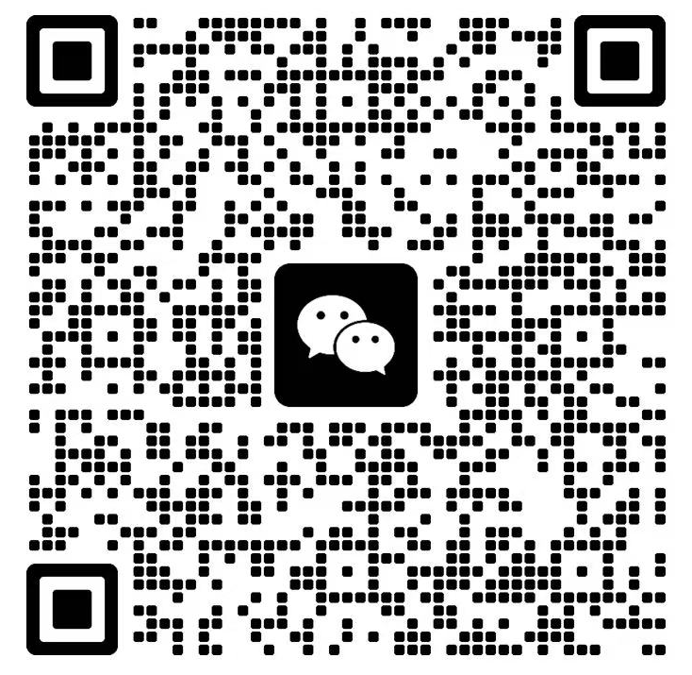
CSC5031 WeChat Group QR Code

