Slide 1
Optimizing MicroVM Performance for Serverless Computing
Xin Tong
School of Data Science
Chinese University of Hong Kong, Shenzhen

Slide 2
Outline
Introduction
Paper 1: Firecracker (AWS, NSDI’ 2020)
  Lightweight microVMs with strong isolation and low overhead
Paper 2: REAP (University of Edinburgh & Microsoft Research & EPFL, ASPLOS’ 2021)
  Accelerate snapshot restoration through working-set prefetching
Paper 3: FaaSnap (UCSD, EuroSys’ 2022)
  Further optimize restoration with concurrent paging and region-specific mappings
Conclusions
Notes:
Here is the outline.
This presentation focuses on microVM performance optimization for serverless computing.
Firecracker reduces startup and runtime overhead through a minimal VM design while providing strong isolation. REAP focuses on snapshot restoration, recording and prefetching working sets to reduce page-loading delays during execution.
FaaSnap addresses prefetch delays, changing working sets, and unnecessary reads through improved paging and memory mappings.

Slide 3
Introduction – Serverless Cold Starts
Serverless Execution
  Functions run on demand in isolated environments
  MicroVMs provide strong isolation with low overhead
Cold-Start Challenge
  Booting from scratch requires VM boot and runtime initialization
  Warm instances reduce latency but occupy memory while idle
Cold Start: Boot from Scratch
Create VM and
boot guest OS
Initialize runtime
and function
Execute
Guest boot and initialization add latency
Warm Start
Reuse an existing warm VM
Execute
VM already initialized; still occupies memory
Cold Start: Snapshot Restore
Create VM
Restore initialized
VM state
Execute
Memory pages still need to be loaded
Figure 1. Preparing a function instance for execution.
Notes:
Serverless platforms run functions on demand and manage the underlying resources. MicroVMs can isolate code from different users while reducing traditional VM overhead. However, when no instance is available, the platform still needs to prepare an execution environment.
The figure shows three methods. A cold start boots the VM and initializes the runtime and function. A warm start reuses a ready instance, but idle instances occupy memory. Snapshot restoration reuses initialized state, avoiding repeated booting and initialization, although memory pages still need to be loaded.

Slide 4
Introduction - Roadmap
1. Firecracker
2. REAP
3. FaaSnap
NSDI 2020
ASPLOS 2021
EuroSys 2022
Lightweight Virtualization
Record and Prefetch
Concurrent Snapshot Loading
Function + Guest Linux
Record page accesses
Set up VM mappings
Compact WS file
Minimal Firecracker VMM
Overlap
Loader prefetches
VM executes
Prefetch all WS pages
Linux KVM
Run VM
Reduce virtualization overhead
Load first, then execute
Load while executing
Instance setup
Boot a minimal microVM
Restore initialized VM state
Restore initialized VM state
Page loading
Initialize runtime and function
Prefetch the WS, then execute
Prefetch while the VM executes
Memory handling
Minimize VMM and device overhead
Handle page faults in userspace
Use region-specific memory mappings
Figure 2. Comparison of Firecracker, REAP, and FaaSnap
Notes:
We begin with Firecracker. Firecracker reduces the overhead of the virtualization environment itself. Its minimal VMM and device model provide lightweight microVMs for serverless workloads.

Slide 5
Paper 1: Firecracker (1/2)
Firecracker: Lightweight Virtualization for Serverless Applications
Alexandru Agache, Marc Brooker, Andreea Florescu, et al.
  AWS
1. Firecracker
2. REAP
3. FaaSnap
NSDI 2020
ASPLOS 2021
EuroSys 2022
Lightweight Virtualization
Record and Prefetch
Concurrent Snapshot Loading
Function + Guest Linux
Record page accesses
Set up VM mappings
Compact WS file
Minimal Firecracker VMM
Overlap
Loader prefetches
VM executes
Prefetch all WS pages
Linux KVM
Run VM

Slide 6
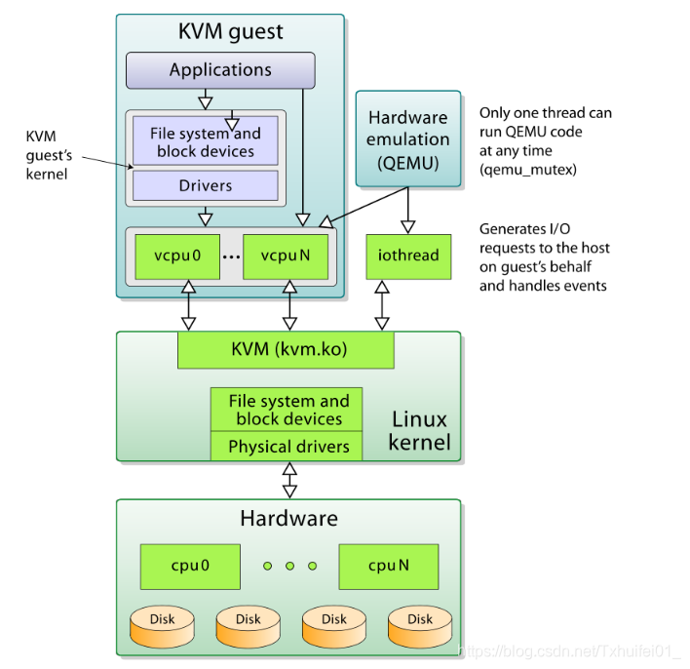
Paper 1: Firecracker (2/2)
Motivation
  Efficient multi-tenant execution of serverless functions
  Strong isolation with fast startup and low overhead
Problems
  Containers: security–compatibility trade-off
  Language VMs: limited compatibility with arbitrary Linux binaries
  General-purpose VMs: high overhead and implementation complexity
Key Ideas
  Keep KVM and Linux guests for isolation and compatibility
  Replace QEMU with a minimal VMM written in Rust
  Remove unnecessary devices and features
Figure 3. QEMU/KVM Virtualization Architecture
Notes:
【Motivation】
Serverless platforms run many customers’ functions on shared servers. They need strong isolation, along with fast startup and low overhead to support high-density deployment.
【Problems】
Existing approaches have different limitations. Containers are lightweight but share the host kernel, and restricting system calls can hurt compatibility. Language-based isolation depends on specific runtimes. Traditional VMs provide the required isolation and compatibility, but general-purpose VMMs add startup and resource overhead.
【Key Ideas】
Firecracker therefore retains VM-based isolation while simplifying the VMM to reduce overhead. In the QEMU/KVM architecture shown here, KVM provides hardware-assisted execution, while QEMU provides the user-space device model. Firecracker retains KVM and Linux guests but replaces QEMU with a minimal Rust VMM, keeping only the features needed for serverless workloads to reduce overhead and the attack surface.

Slide 7
Firecracker - System Architecture (1/3)
Core Architecture
  One Firecracker process per MicroVM
  KVM provides hardware-assisted virtualization
  Linux handles scheduling, memory and host I/O
Device Model
  Essential network, block and serial devices
  virtio for network and block I/O
  Omit USB, GPU and unnecessary devices
MicroVM (guest)
Firecracker
Host userspace process
Application
REST API
Guest Linux kernel
I/O
Minimal device model
virtio drivers
virtio-net
vCPU 0
•••
vCPU n
virtio-blk
Serial console
Host Linux kernel
KVM
Host I/O
Hardware virtualization
Block I/O · TUN/TAP
CPU scheduling · Memory management
Physical hardware
CPU
Memory
Disk / Network
Figure 4. Firecracker System Architecture
Notes:
This slide presents Firecracker’s core architecture. Each MicroVM corresponds to a Firecracker process in host userspace, which uses KVM to execute guest code. The host Linux kernel handles CPU scheduling, memory management, and underlying I/O.
To reduce VMM overhead, Firecracker simplifies the device model to essential devices, including network, block, and serial devices. Network and block devices use virtio. Omitting devices such as USB and GPUs reduces initialization work and helps lower startup and resource overhead.

Slide 8
Firecracker - System Architecture (2/3)
API
  REST API over a Unix socket
  Host manager controls each MicroVM
Benefit
  Prepare the process and configuration early
  Start the guest only when needed
MicroVM (guest)
Firecracker
Preparation 1
Host userspace process
Manager starts
Application
REST API
Firecracker process
Guest Linux kernel
I/O
Minimal device model
virtio drivers
virtio-net
Preparation 2
vCPU 0
•••
vCPU n
virtio-blk
Manager sends
Serial console
known configuration
Host Linux kernel
KVM
Host I/O
Guest boot
Hardware virtualization
Block I/O · TUN/TAP
Manager requests boot
via REST API
CPU scheduling · Memory management
After boot
Physical hardware
Runtime and app
CPU
Memory
Disk / Network
initialization
Figure 4. Firecracker System Architecture
Figure 5. Firecracker Instance Startup Process
Notes:
This slide shows how a MicroVM is configured and started. Firecracker provides a REST API over a Unix socket, allowing the host manager to configure and control the MicroVM.
The manager can create the Firecracker process and send the known configuration in advance, without booting the guest. When a request arrives, it triggers guest boot through the API. Completing process creation and configuration beforehand reduces the request’s waiting time.

Slide 9
Firecracker - System Architecture (3/3)
Performance Isolation
  Limit disk IOPS, packet rates and bandwidth
  Token buckets enforce rates and allow bursts
  One-time burst allowance accelerates boot
Security
  Jailer restricts the host-side VMM process
  Host-level mitigations address side channels
Notes:
Firecracker uses token buckets to control I/O rates, with a one-time burst allowance during boot.
Jailer restricts process privileges and resource access. Deployment measures such as disabling hyper-threading mitigate side channels.

Slide 10
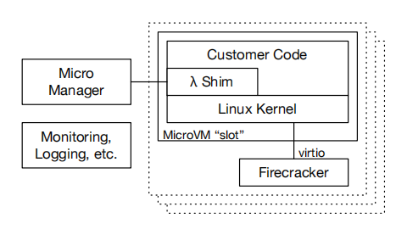
Firecracker - in AWS Lambda
Worker Architecture
  Multiple MicroVM slots on each worker
  One function execution environment per slot
  MicroManager manages Firecracker processes
Startup and Reuse
  Reuse slots for sequential invocations
  Maintain a small pool of pre-booted MicroVMs
  Faster boot allows a smaller spare pool
Figure 6. Firecracker Integration in AWS Lambda
Notes:
This slide shows how Lambda uses Firecracker. As shown in the figure, a Lambda worker runs multiple MicroVMs. Each MicroVM provides an execution slot with an environment for running a function.
Each slot handles one invocation at a time. Once it finishes, the platform can reuse the slot for subsequent invocations of the same function, avoiding the need to create a new instance each time.
The MicroManager on the worker manages the Firecracker processes, which create and control the corresponding MicroVMs.
The MicroManager also maintains a small pool of pre-booted MicroVMs to provide instances quickly when new slots are needed. Faster boot times allow the platform to keep fewer spare instances, reducing idle resource overhead.

Slide 11
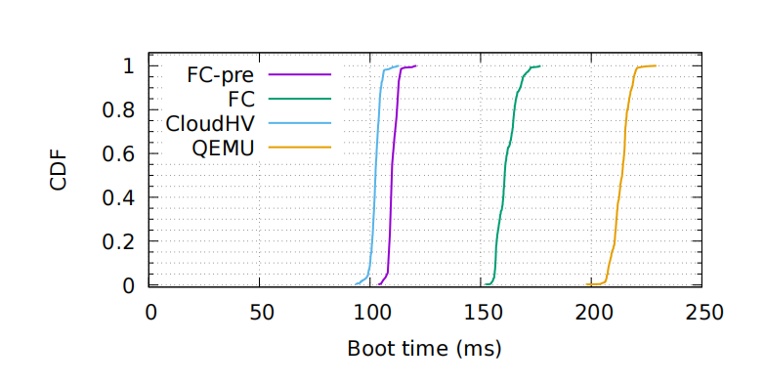
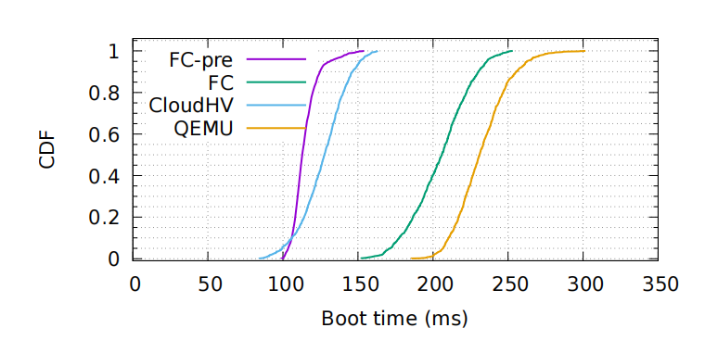
Firecracker – Evaluation (1/3)
Boot Times
Test Setup
  1 vCPU, 256 MB RAM, minimal Linux guest
  Measure until the guest init process starts
Two Measurement Modes
  FC: process creation + configuration + guest boot
  FC-pre: boot after configuration is completed
Main Findings
  FC-pre boots faster than QEMU
  The advantage remains with 50 parallel launches
Figure 7. MicroVM Boot-Time Distributions under Serial and Concurrent Startup
Notes:
First, we compare VMM boot times under serial and concurrent startup.
The upper graph shows serial startup, and the lower graph shows 50 concurrent starts. Each VM has one vCPU and 256 MB of memory. Timing ends when the guest init process starts.
FC includes process creation, API configuration, and guest boot. FC-pre completes the first two stages beforehand and measures only guest boot.
Curves further left indicate faster startup. FC-pre and Cloud Hypervisor boot faster than QEMU in both tests.

Slide 12
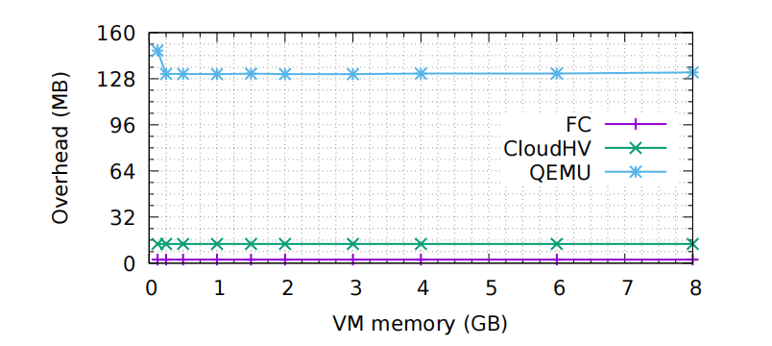
Firecracker – Evaluation (2/3)
Memory Overhead
Measurement
  Extra memory beyond configured guest RAM
  VMM binary excluded
Main Findings
  Firecracker: approximately 3 MB
  Cloud Hypervisor: approximately 13 MB
  QEMU: approximately 131 MB
Deployment Benefit
  Lower overhead supports higher MicroVM density
Figure 8. VMM Memory Overhead across Different VM Memory Sizes
Notes:
Next, we compare each VMM’s memory overhead beyond the configured guest memory.
Firecracker’s memory overhead is about 3 MB, compared with 13 MB for Cloud Hypervisor and 131 MB for QEMU. These overheads remain relatively constant as guest memory increases.
Firecracker’s lower per-instance overhead helps a server host more MicroVMs within the same physical memory capacity.

Slide 13
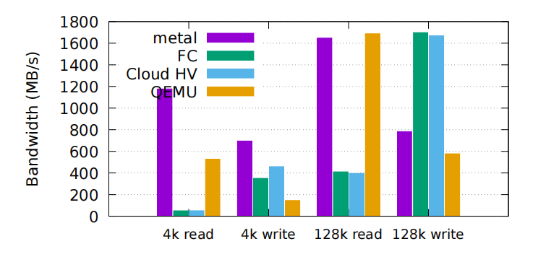
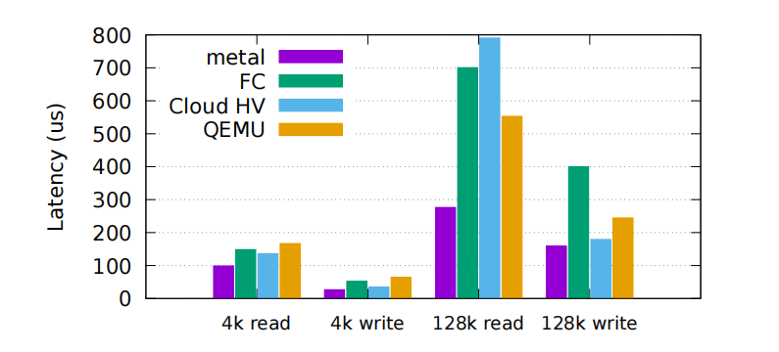
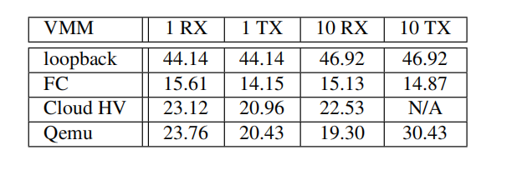
Firecracker – Evaluation (3/3)
I/O Performance
Test Setup
  2 vCPUs, 512 MB RAM
  Disk rate limiting disabled
Disk Performance
  Serial I/O processing limits read throughput
  High write throughput
  Large-block I/O shows higher latency than native execution
Network Performance
  Around 15 Gb/s
Table 1. Network Throughput Comparison across VMMs
Figure 9. Block I/O Bandwidth and Latency Comparison
Notes:
Finally, we compare disk throughput, disk P99 latency, and network throughput.
The upper graph compares random read and write throughput using 4 KB and 128 KB blocks. Firecracker’s read throughput is lower than bare metal and QEMU, especially for 4 KB reads. The authors attribute this limitation to serial disk I/O processing in the tested version.
The lower graph compares P99 latency. Firecracker performs similarly to the other VMMs for 4 KB reads, but shows greater overhead relative to bare metal for 128 KB reads and writes.
In the network tests, Firecracker achieves around 15 Gbps, below Cloud Hypervisor and QEMU. However, the authors report that this was not a limitation in their production environment.

Slide 14
Paper 2: REAP (1/2)
Benchmarking, Analysis, and Optimization of Serverless Function Snapshots
Dmitrii Ustiugov, Plamen Petrov, Marios Kogias, et al.
University of Edinburgh, Microsoft Research, EPFL
1. Firecracker
2. REAP
3. FaaSnap
NSDI 2020
ASPLOS 2021
EuroSys 2022
Lightweight Virtualization
Record and Prefetch
Concurrent Snapshot Loading
Function + Guest Linux
Record page accesses
Set up VM mappings
Compact WS file
Minimal Firecracker VMM
Overlap
Loader prefetches
VM executes
Prefetch all WS pages
Linux KVM
Run VM
Notes:
Firecracker reduces VM boot overhead, but runtimes and dependencies still require initialization.
Snapshots of initialized environments let subsequent instances skip repeated initialization, but on-demand paging still causes delays.
REAP records pages accessed during one invocation and prefetches them during subsequent snapshot restores to reduce page-fault delays.

Slide 15
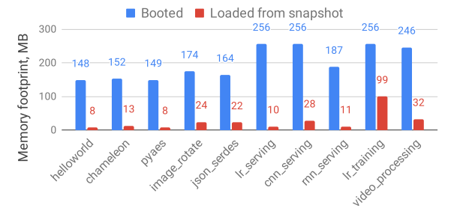
Paper 2: REAP (2/2)
Problems
  Cold boots are slow; warm instances consume memory
  Snapshot restores suffer from page faults
Key Observations
  Small working sets: 24 MB on average
  Similar pages accessed across different inputs
Key Ideas
  Record the pages needed by a function
  Prefetch them during future snapshot restores
Figure 10. Memory Footprint after Booting and Snapshot Restoration
Notes:
【Problems】
Cold boots are slow, while keeping instances warm consumes memory. Snapshots help address this trade-off by allowing new instances to skip initialization. However, the baseline loads memory on demand, so page faults and scattered SSD reads still delay execution.
【Key Observations】
To reduce these delays, the authors examine which pages an invocation actually needs. They find that working sets average only about 24 MB, and many pages recur across different inputs. Previous access records can therefore help identify pages to load in advance.
【Key Ideas】
Based on these observations, REAP first records accessed pages and packs their original snapshot contents into a contiguous working-set file. During subsequent restores, it prefetches these pages in bulk before execution, reducing scattered reads and page-fault delays. Pages outside the recorded working set are still loaded on demand.

Slide 16
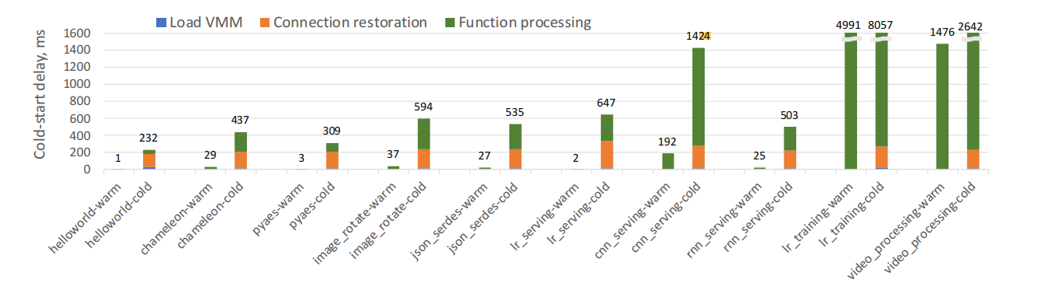
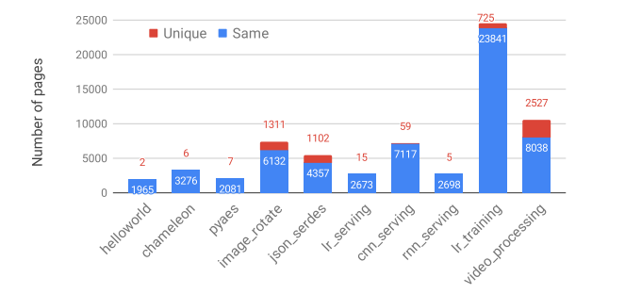
REAP - Performance Analysis
Experimental Setup
  Firecracker-based vHive; snapshots on local SSD
  Clear host page cache before each cold invocation
Cold-Start Overhead
  Snapshot-based cold invocations remain much slower than warm invocations
  On-demand page loading adds execution delays
Page Reuse
  Different inputs access many of the same pages
  Recorded page accesses can guide future prefetching
Figure 11. Latency Breakdown of Warm and Snapshot-Based Cold Invocations
Figure 12. Memory Page Reuse across Invocations with Different Inputs
Notes:
This slide presents the evidence behind REAP’s design. The experiments use vHive with Firecracker and local SSD snapshots. The host page cache is cleared before each cold invocation to avoid cache effects.
Cold invocations include VMM loading, connection restoration, and function processing, and remain much slower than warm invocations. Page faults during execution introduce disk-read delays, which REAP aims to reduce.
Invocations of the same function access many of the same pages even with different inputs. One invocation’s access record can therefore guide future prefetching, motivating REAP’s Record and Prefetch phases.

Slide 17
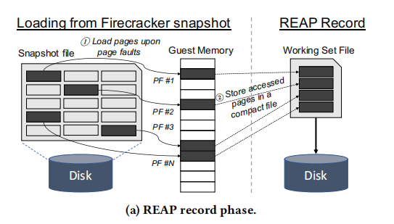
REAP - System Architecture (1/2)
Record Page Accesses
  Load pages on demand during the first invocation from a snapshot
  Record the offsets of accessed pages
Build Two Files
  WS file: compact copies of accessed pages from the original snapshot
  Trace file: original page offsets
Implementation
  A per-instance monitor in vHive-CRI handles page faults using userfaultfd
Figure 13. REAP Record Phase
Notes:
During the first restored invocation, pages are loaded on demand. A monitor in vHive-CRI uses userfaultfd to handle page faults, load pages, and record their offsets in the snapshot file.
After the invocation, the WS file packs the pages’ original snapshot contents together, while the trace file stores their offsets. Recording adds overhead to the first invocation to accelerate later restores.

Slide 18
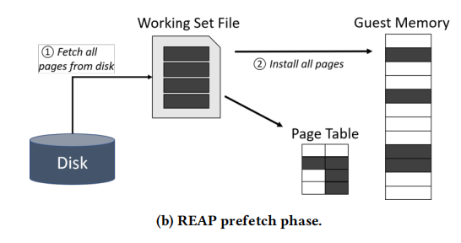
REAP - System Architecture (2/2)
Prefetch the Working Set
  Read the WS file into a host buffer in one large read
  Install pages at their recorded locations and populate page tables
Resume Execution
  Resume the instance after installing the working-set pages
  Load additional pages on demand
Efficient Disk Reads
  Compact WS files enable bulk reads
  Direct I/O bypasses the host page cache
Figure 14. REAP Prefetch Phase
Notes:
During subsequent restores, REAP reads the WS file into a host buffer in bulk, then uses the trace to install pages into guest memory. After populating the page tables, it resumes execution. Missing pages are still loaded on demand.
SSD reads are still required, but most needed pages are read together before execution, reducing page-fault delays. The implementation also uses Direct I/O to bypass the host page cache and reduce associated overhead.

Slide 19
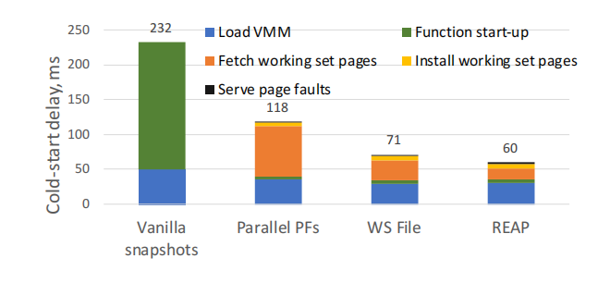
REAP – Evaluation (1/3)
Understanding the Optimizations
Experimental Setup
  Hello World on Firecracker-based vHive
  Local SATA SSD
  1 vCPU and 256 MB memory per VM
Optimization Steps
  Parallel PFs: overlap reads from the original snapshot
  WS File: fetch packed pages in one large read
  REAP: bypass the host page cache with Direct I/O
Figure 15. Cold-Start Latency across REAP Optimization Steps
Notes:
This slide uses Hello World to compare four page-loading configurations and examine snapshot-restoration overhead.
The baseline takes 232 milliseconds. Reading pages from the original snapshot in parallel reduces latency to 118 milliseconds. Packing them into a compact WS file for bulk reads further reduces it to 71 milliseconds.
Full REAP additionally uses Direct I/O to bypass the host page cache, reducing latency to 60 milliseconds. These results show that improving page loading and reducing host I/O overhead can substantially accelerate restoration.

Slide 20
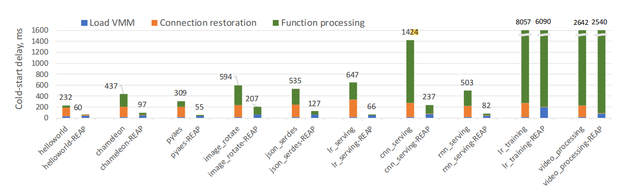
REAP – Evaluation (2/3)
Performance Across Functions
Overall Performance
  1.04–9.7× speedup, averaging 3.7×
  Compared with baseline Firecracker snapshots
Faster Connection Restoration
  45× faster on average, reduced to 4–7 ms
Workload-Dependent Benefits
  Pages missing from the recorded working set still require demand loading
Figure 16. Cold-Start Latency Comparison between Baseline Snapshots and REAP
Notes:
The Figure compares cold-invocation latency across functions, with baseline snapshots on the left and REAP on the right. Across the tested functions, REAP achieves an average speedup of 3.7 times, ranging from 1.04 to 9.7 times.
Prefetching also covers the pages needed for connection restoration, accelerating this stage by 45 times on average and reducing it to 4–7 milliseconds.
Video processing benefits less. The authors suggest that input changes alter the working set, leaving some pages to be loaded on demand and limiting the speedup.

Slide 21
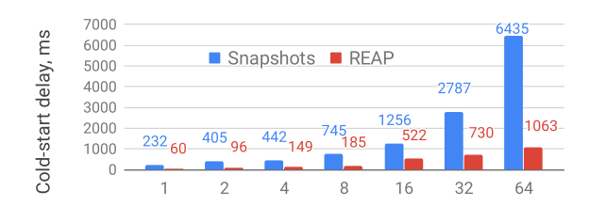
REAP – Evaluation (3/3)
Overhead and Scalability
Recording Overhead
  28% higher latency for the first invocation
  WS and trace files reused in later cold invocations
Scalability
  Lower latency than baseline under concurrency
  Disk-bandwidth bottleneck at 16+ concurrent instances
Figure 17. Cold-Start Latency under Concurrent Instance Loading
Notes:
REAP records page accesses and creates the WS and trace files, increasing first-invocation latency by 28% on average. Subsequent cold invocations can reuse these files.
This figure evaluates concurrent cold starts of Hello World. REAP has lower average latency per instance at every tested concurrency level, retaining its benefits during concurrent restoration.

Slide 22
Paper 3: FaaSnap (1/3)
FaaSnap: FaaS Made Fast Using Snapshot-based VMs
Lixiang Ao, George Porter, Geoffrey M. Voelker
UCSD
1. Firecracker
2. REAP
3. FaaSnap
NSDI 2020
ASPLOS 2021
EuroSys 2022
Lightweight Virtualization
Record and Prefetch
Concurrent Snapshot Loading
Function + Guest Linux
Record page accesses
Set up VM mappings
Compact WS file
Minimal Firecracker VMM
Overlap
Loader prefetches
VM executes
Prefetch all WS pages
Linux KVM
Run VM
Notes:
REAP reduces page-fault delays by prefetching the working set. However, new inputs may change the working set, and the instance still waits for prefetching to finish. The next paper, FaaSnap, addresses working-set variation and overlaps page loading with execution to further reduce cold-invocation latency.

Slide 23
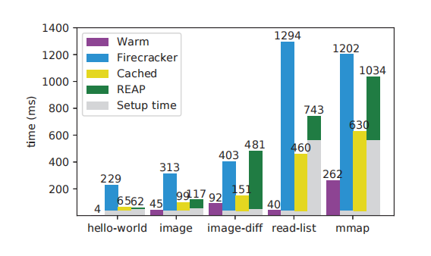
Paper 3: FaaSnap (2/3)
Motivation
  Further reduce snapshot-based cold-invocation latency
Problems
  Changing inputs reduce working-set coverage
  Large working sets delay execution during prefetching
  Anonymous-memory allocation can trigger unnecessary disk readsn
Figure 18. Function Invocation Latency across Baseline Configurations
Notes:
This slide examines the overheads that remain after REAP’s prefetching, focusing on input changes, large working sets, and new memory allocation.
Warm reuses an existing instance, Firecracker restores pages on demand, Cached keeps snapshot pages in the host cache, and REAP prefetches the working set. Gray shows setup time, while colors show invocation time. Together, they give the total latency.
Comparing the green portions of image and image-diff, changed inputs leave some required pages outside REAP’s recorded working set, increasing invocation time. For read-list and mmap, the large gray portions show the cost of loading and installing large working sets before execution.
The mmap test reveals another problem: allocating new anonymous memory in the guest can still trigger reads of old snapshot contents on the host. Further optimization therefore needs to reduce prefetch delays, accommodate working-set changes, and avoid unnecessary reads.

Slide 24
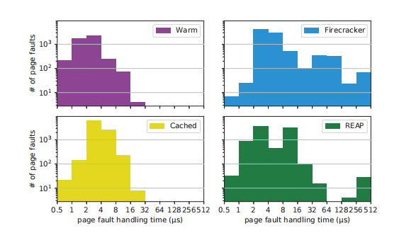
Paper 3: FaaSnap (3/3)
Key Observations
  Cached pages are cheaper to access than disk-resident pages
  Working sets can change across invocations
  Memory regions require different handling
Key Ideas
  Overlap page loading with execution
  Record host pages to broaden prefetch coverage
  Use region-specific memory mappings
Figure 19. Page Fault Handling Time Distributions across Configurations
Notes:
This figure shows page-fault handling times for image-diff. The horizontal axis shows time, and the vertical axis counts faults. Blue Firecracker has a longer slow tail than yellow Cached, showing how cached pages reduce disk-read delays.
In green REAP, preinstalled pages are handled quickly, but pages outside the working set require userspace handling and may wait for disk reads. Restoration must therefore also handle unrecorded pages efficiently.
Together with the previous findings, this motivates three directions: overlap prefetching with execution to reduce initial waiting, record host readahead pages to broaden coverage, and use region-specific mappings so zero regions can use anonymous memory without disk reads.

Slide 25
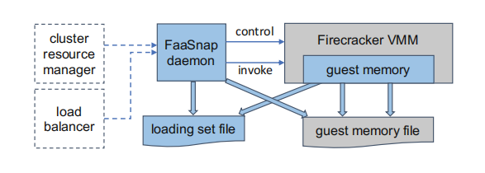
FaaSnap - System Architecture (1/4)
FaaSnap Daemon
  Manages VMs and snapshot resources
  Forwards function invocation requests
Firecracker VMM
  Runs the guest VM
  Configures guest-memory mappings
Snapshot Files:
  Guest memory file: saved VM memory contents
  Loading set file: compact pages selected for prefetching
Figure 20. FaaSnap System Architecture
Notes:
This slide presents FaaSnap’s overall architecture, showing how the daemon, Firecracker VMM, and two files work together to restore a VM from a snapshot.
The blue FaaSnap daemon manages VMs and snapshot resources on the host and forwards function invocation requests.
The Firecracker VMM on the right is modified to support region-specific memory mappings. Blue marks FaaSnap additions or changes, while gray shows existing Firecracker components.
The guest memory file stores the memory snapshot, while the loading set file packs the pages selected for prefetching. Next, we look at how this loading set file is created.

Slide 26
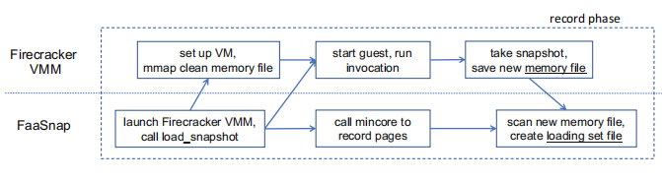
FaaSnap - System Architecture (2/4)
Host Page Recording
  Use mincore to track pages in the host page cache
  Include pages brought in by readahead
Working Set Groups
  Group pages by observed loading order
  Read groups in order, and pages sequentially within each group
Build the Loading Set File
  Capture a warm snapshot and select non-zero working-set pages
  Merge nearby regions and pack them by group and address
Figure 21. FaaSnap Record Phase and Loading Set Construction
Notes:
This slide presents FaaSnap’s record phase and explains how it records pages and creates the loading set file.
First, the daemon launches Firecracker and requests snapshot loading. The VMM then sets up the VM and maps the initial snapshot’s memory file.
While the VM executes the function, the daemon repeatedly calls mincore to record pages in the host cache, including accessed and readahead pages. It groups them by observation order, broadening prefetch coverage while preserving access order.
After the invocation, the VMM saves a warm-state snapshot. The daemon scans the new memory file, selects non-zero working-set pages, and merges nearby regions to reduce mappings. It then packs them into a compact loading set file ordered by group and address. Merging may include a few intervening pages.

Slide 27
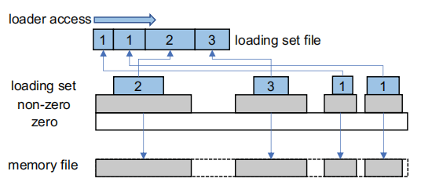
FaaSnap - System Architecture (3/4)
Zero Regions
  Map to anonymous host memory
  Provide zeros without snapshot reads
Non-zero Regions
  Map to the guest memory file
  Preserve access to pages outside the loading set
Loading Set Regions
  Map to the compact loading set file
  Overlay mappings to reduce mapping operations
Figure 22. FaaSnap Loading Set Layout and Memory Region Mapping
Notes:
The previous slide created the loading set file. This slide explains how different memory regions use different backing sources during restoration.
First, an anonymous mapping provides zero-filled memory across the guest-memory range, shown in white. Non-zero regions are then mapped to the guest memory file, shown in gray.
Finally, blue loading set regions are mapped to the compact loading set file. New mappings override earlier mappings at the same addresses. Loading set pages come from the compact file, remaining non-zero pages from the memory snapshot, and uncovered zero regions use anonymous memory.

Slide 28
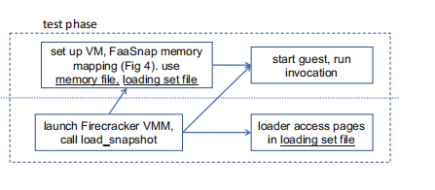
FaaSnap - System Architecture (4/4)
Concurrent Paging
  Prefetch pages in a daemon loader thread
  Start VM execution without waiting for all pages
Page Access
  Prefetched pages are served from the host page cache
  Pages not yet cached require demand loading
Benefit
  Avoid blocking execution on full working-set loading
Figure 23. FaaSnap Test Phase with Concurrent Page Loading and VM Execution
Notes:
This slide shows restoration for subsequent invocations. The daemon launches Firecracker and requests snapshot loading. The VMM establishes mappings using the memory snapshot and loading set files.
After setup, the VM runs the function while the loader prefetches pages. FaaSnap overlaps prefetching with execution, avoiding REAP’s initial wait for the entire working set to load.
If the loader reads a page first, the VM can access it from the host cache without waiting for disk. If the VM reaches an uncached page first, it still waits for demand loading.

Slide 29
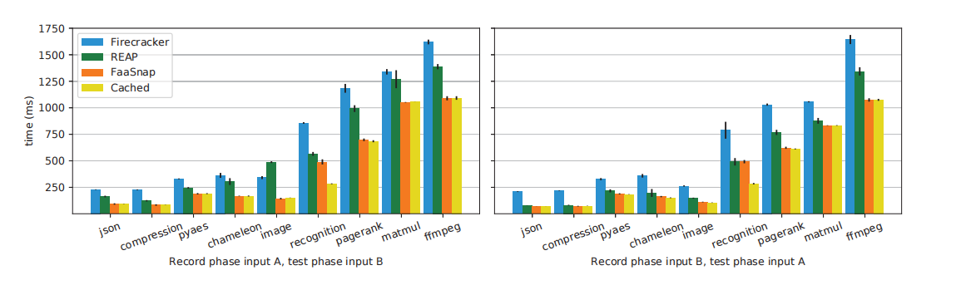
FaaSnap – Evaluation (1/4)
Application Performance
Experimental Setup
  Different inputs for recording and testing
  Compare Firecracker, REAP, FaaSnap and Cachede
Larger Test Inputs — A → B
  1.55× average speedup over REAP
Smaller Test Inputs — B → A
  1.16× average speedup over REAP
Figure 24. Function Invocation Latency under Input Changes
Notes:
This slide compares application performance under input changes. A is the smaller input and B is the larger one. The upper chart records with A and tests with B; the lower chart reverses them. The measured time includes VM setup and function invocation.
Comparing orange FaaSnap with green REAP, FaaSnap achieves an average speedup of 1.55 times when the test input grows, and 1.16 times when it shrinks.
Larger inputs access more pages outside the recorded working set. REAP handles these faults in userspace, while FaaSnap handles them more efficiently. It also records pages brought into the host cache by readahead, allowing subsequent invocations to prefetch more potentially needed pages. This gives FaaSnap a greater advantage when inputs grow.

Slide 30
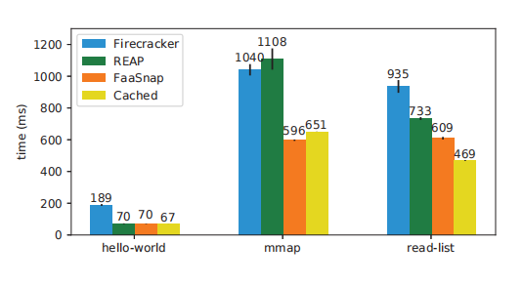
FaaSnap – Evaluation (2/4)
Synthetic Workloads
Workloads
  hello-world: basic invocation overhead
  mmap: allocate and write anonymous memory
  read-list: access a large existing list
Results
  Similar to REAP for hello-world
  Lower latency for mmap and read-list
Figure 25. Function Invocation Latency on Microbenchmarks
Notes:
The previous slide examined input changes. This slide uses three synthetic workloads to compare total VM setup and function invocation time.
For hello-world, green REAP and orange FaaSnap both take about 70 milliseconds. The mmap workload allocates and writes substantial anonymous memory. FaaSnap’s anonymous mappings for zero regions avoid unnecessary snapshot reads, reducing the time from REAP’s 1108 milliseconds to 596 milliseconds.
Read-list accesses an existing 512 MB list, and its reads can outpace background prefetching. FaaSnap therefore takes 609 milliseconds, below REAP’s 733 milliseconds but above yellow Cached’s 469 milliseconds, where the pages are already cached.

Slide 31
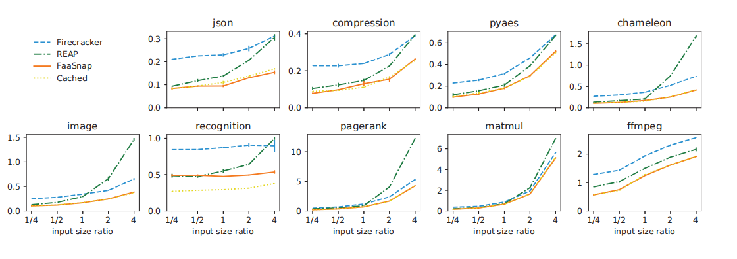
FaaSnap – Evaluation (3/4)
Input Size Sensitivity
Experimental Setup
  Test input size: ¼×–4× the recording input
  Input contents also change
Results
  REAP degrades on several workloads as inputs grow
  FaaSnap remains close to Cached for most functions
Figure 26. Function Invocation Latency across Different Input Sizes
Notes:
This slide examines sensitivity to input size. The authors record pages once, then reuse that record while varying the test inputs. The horizontal axis shows the test-to-record input-size ratio: 1 means equal sizes, and 4 means four times as large. The vertical axis shows execution time.
For image and chameleon, green REAP rises sharply beyond a ratio of 1 and can become slower than blue Firecracker. More accesses fall outside the recorded working set, requiring additional userspace fault handling.
In contrast, orange FaaSnap stays close to yellow Cached in most tests, showing greater resilience to input-driven changes in the working set.

Slide 32
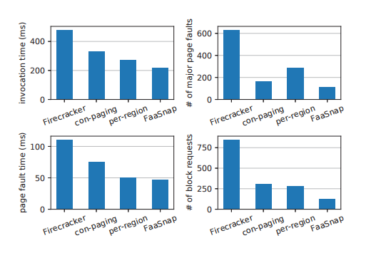
FaaSnap – Evaluation (4/4)
Optimization Breakdown
Configurations
  Firecracker: baseline
  con-paging: concurrent paging
  per-region: combined optimizations through
  FaaSnap: all optimizations
Results
  Full FaaSnap achieves the lowest invocation time
  Fault-handling time and VM-triggered disk reads decrease
Figure 27. Performance Comparison across FaaSnap Optimization Configurations
Notes:
This slide uses the image function to examine four optimization configurations. Baseline Firecracker mainly loads pages on demand. Con-paging adds background prefetching to overlap loading with VM execution, but still prefetches in address order.
Per-region adds working-set groups, host page recording, and region-specific mappings. These improve prefetch order, broaden coverage, and serve zero regions with anonymous memory to avoid unnecessary snapshot reads.
Full FaaSnap additionally packs the regions selected for prefetching into a compact loading set file. This allows the background loader to read sequentially and reduces the overhead of scattered accesses.
The top-left chart shows progressively lower invocation time. The bottom charts also show less total page-fault handling time and fewer disk reads triggered by VM faults. Full FaaSnap’s more efficient prefetching prepares more pages before the VM accesses them, reducing execution delays.

Slide 33
Summary of Contributions
FireCracker (AWS)
  Lightweight microVMs provide strong isolation with low virtualization overhead
REAP (University of Edinburgh & Microsoft Research & EPFL)
  Record the working set and prefetch its pages before VM execution
FaaSnap (UCSD)
  Overlap page loading with VM execution and use region-specific mappings to reduce unnecessary reads
Progression:
Lightweight virtualization → Working-set prefetching → Concurrent snapshot loading
Notes:
To summarize
Firecracker uses a minimal VMM and device model to reduce virtualization overhead while maintaining strong isolation for serverless workloads.
REAP addresses page-fault delays during snapshot restoration. It records the function’s working set and prefetches these pages in bulk during subsequent restores, reducing disk-read delays during execution.
FaaSnap overlaps page loading with VM execution and uses different mappings for different memory regions, reducing delays on the execution critical path and avoiding unnecessary reads.
The three papers show a progression from reducing virtualization overhead, to accelerating snapshot page loading, to overlapping loading with execution.

Slide 34
Q & A
Thank you for listening!

