Slide 1
Paper presentation · Virtualization
Virtualization, Reinvented for LLMs
Three papers, one idea: give everyone the illusion of a big private resource
vLLM · SOSP 2023
MemGPT · arXiv preprint 2023
AIOS · COLM 2025
GPU memory
Context window
The LLM itself
paged like
virtual memory
extended like
RAM + disk
time-shared
among agents
Kwon et al. SOSP '23 · Packer et al. arXiv '23 · Mei et al. COLM '25
Notes:
(≈25 s)
Today I'm presenting three papers that all reuse one old operating-system idea, virtualization, to solve new problems in large language models. vLLM applies it to GPU memory, MemGPT to the model's context window, and AIOS to the LLM itself, when many agents share one model.

Slide 2
Section 1 of 5
Basics
One trick: fake a big resource, share a small one
Notes:
(≈10 s)
And first, a little background: what virtualization is, and where memory goes inside an LLM.

Slide 3
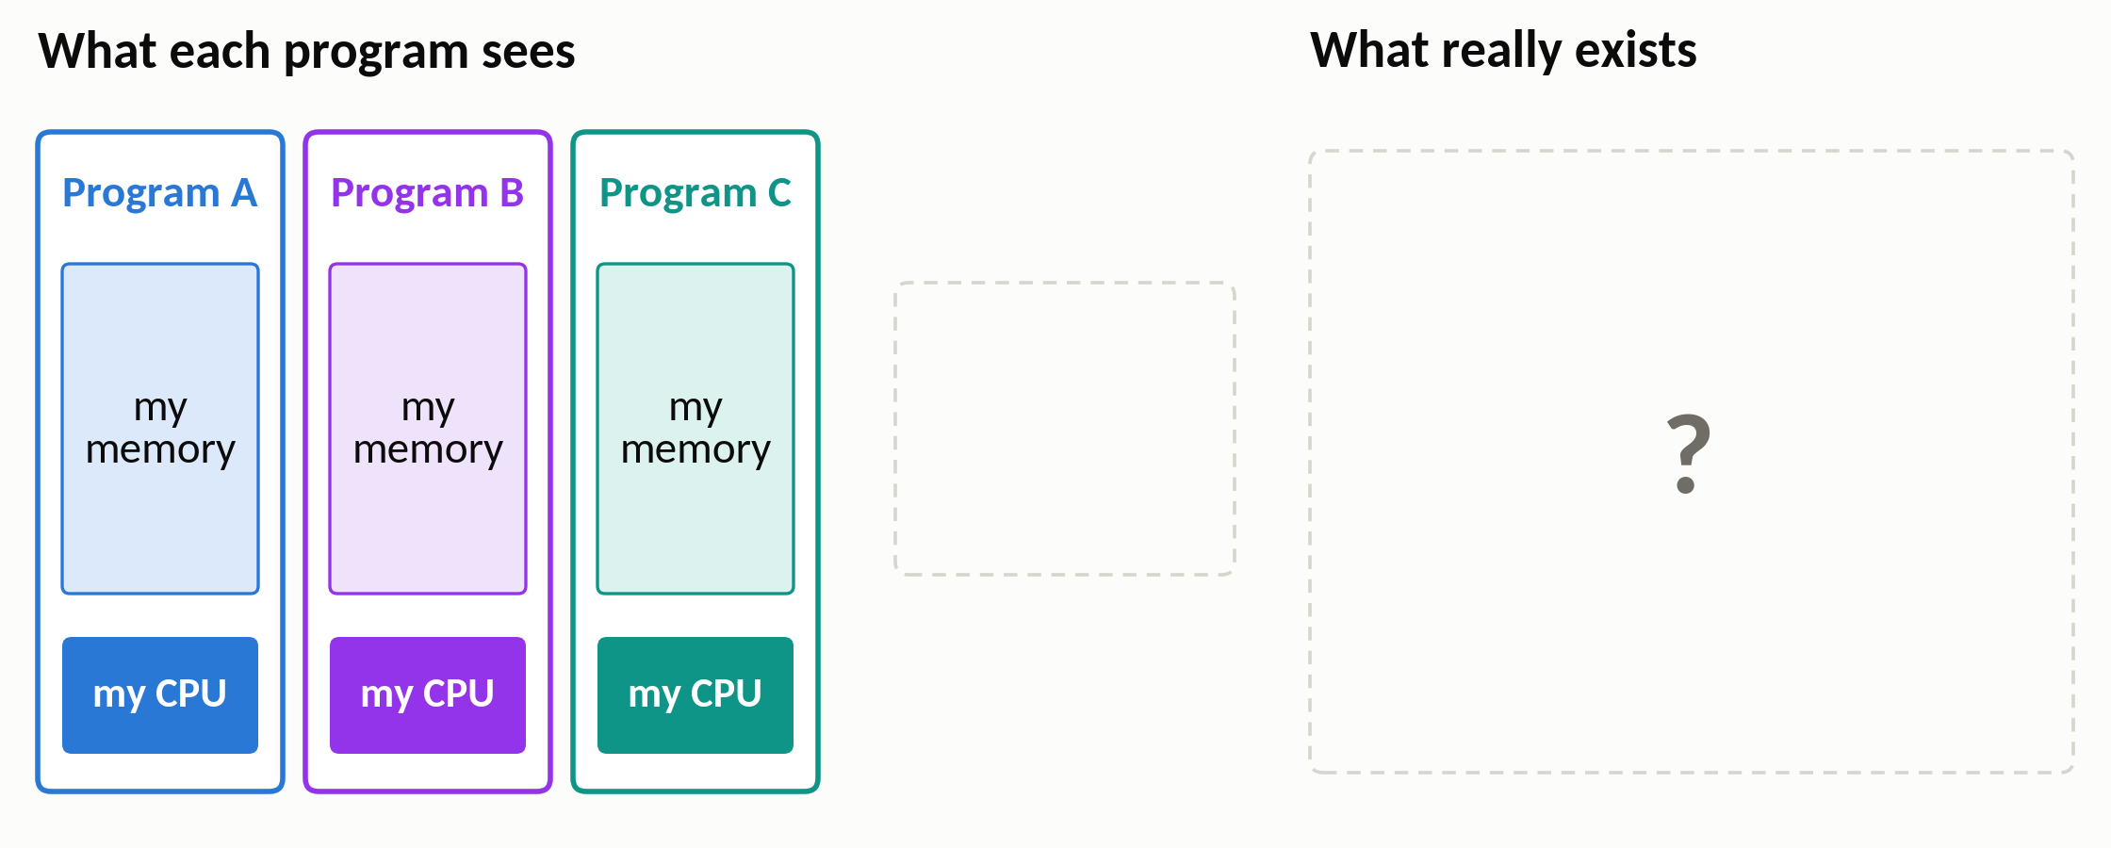
Basics
Virtualization is an illusion
Each program believes it has a big memory and a CPU to itself
3 / 28
Notes:
(≈20 s · step 1 of 2)
Let's start with what virtualization means. It means creating an illusion. Every program on your laptop believes that it has a big memory and a processor all to itself: that's the left side of this picture. But what is really underneath?
▶ Click next: In reality, the OS shares one small RAM and one CPU among them

Slide 4
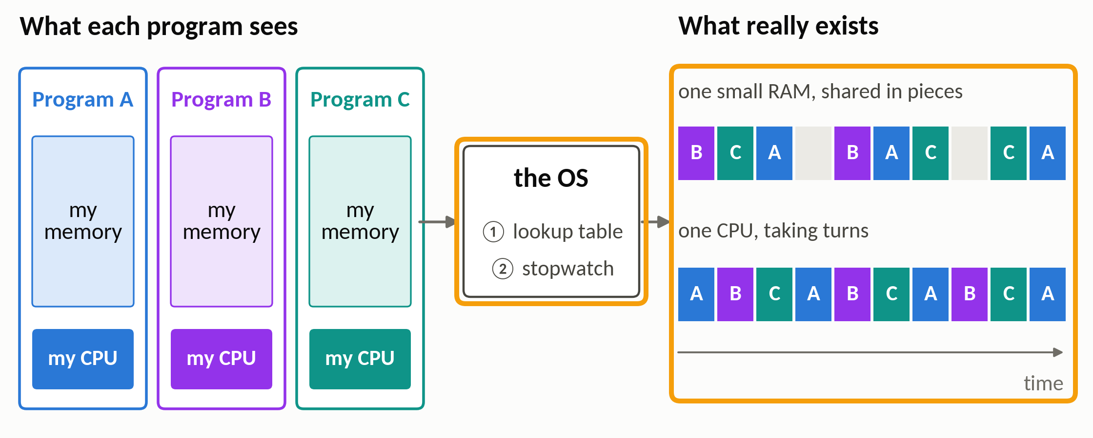
Basics
Virtualization is an illusion
In reality, the OS shares one small RAM and one CPU among them
Two tools keep the illusion alive: a lookup table and a stopwatch
3 / 28
Notes:
(≈35 s · step 2 of 2)
In reality, there is one small RAM, cut into pieces that belong to different programs, and one CPU that takes turns between them. The operating system, in the middle, keeps the illusion alive with two tools: a lookup table, which says where each program's memory really is, and a stopwatch, which switches programs every few milliseconds. Every paper today reuses one of these two tools.

Slide 5
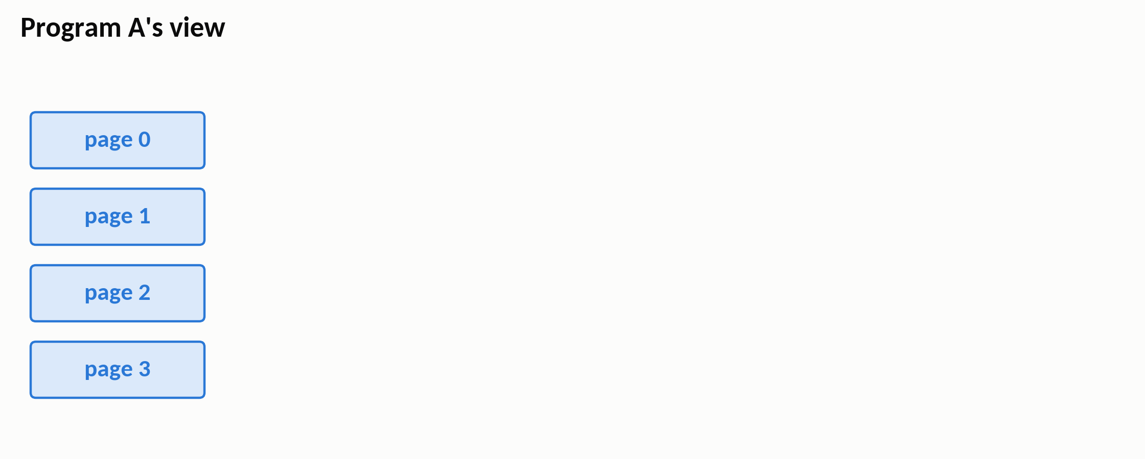
Basics
The memory tool: paging
Program A's view: four pages in a row
4 / 28
Notes:
(≈20 s · step 1 of 6)
Let's look at the memory tool first: paging. On the left is what program A sees: four pages, one after another. A page is just a fixed-size chunk of memory, a few kilobytes.
▶ Click next: Real RAM: page-sized frames, shared by programs A, B and C

Slide 6
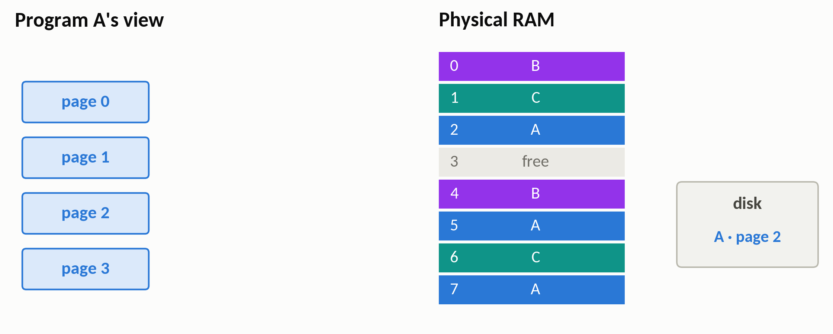
Basics
The memory tool: paging
Real RAM: page-sized frames, shared by programs A, B and C
4 / 28
Notes:
(≈20 s · step 2 of 6)
On the right is the real RAM, cut into page-sized frames. Each frame belongs to some program, A, B or C. Frame 3 is free, and A's page 2 isn't in RAM at all: it's on the disk.
▶ Click next: The page table: where each page really lives

Slide 7
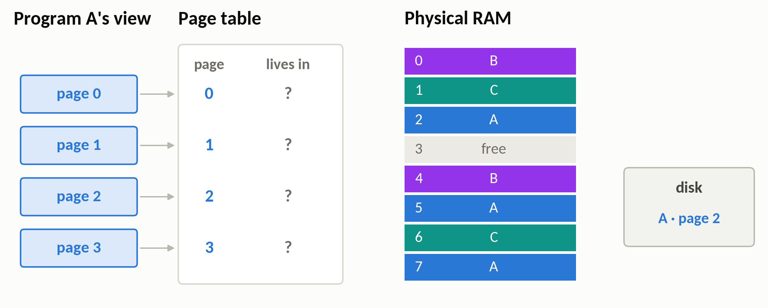
Basics
The memory tool: paging
The page table: where each page really lives
4 / 28
Notes:
(≈15 s · step 3 of 6)
In the middle is the page table, kept by the operating system. For each of A's pages, it records which frame holds it. Right now it's all question marks.
▶ Click next: Page 0 lives in frame 5

Slide 8
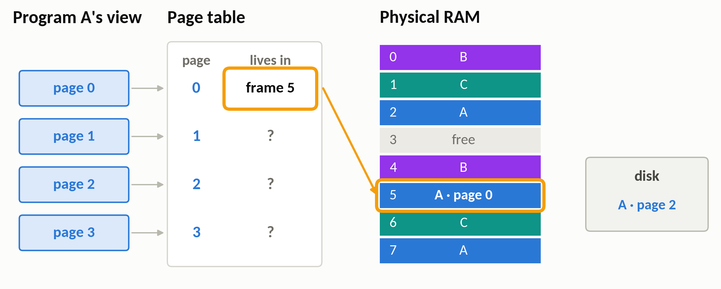
Basics
The memory tool: paging
Page 0 lives in frame 5
1
4 / 28
Notes:
(≈5 s · step 4 of 6)
Start with page 0. The table says frame 5.
▶ Click next: Pages 1 and 3 live in frames 2 and 7: scattered

Slide 9
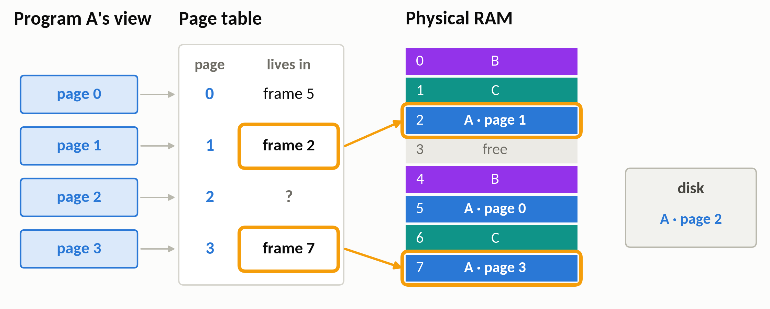
Basics
The memory tool: paging
Pages 1 and 3 live in frames 2 and 7: scattered
2
4 / 28
Notes:
(≈20 s · step 5 of 6)
Pages 1 and 3 are in frames 2 and 7. They're far apart, with other programs' frames in between, but program A never notices. It still sees four pages in a row.
▶ Click next: Page 2 is on disk: a page fault loads it into frame 3

Slide 10
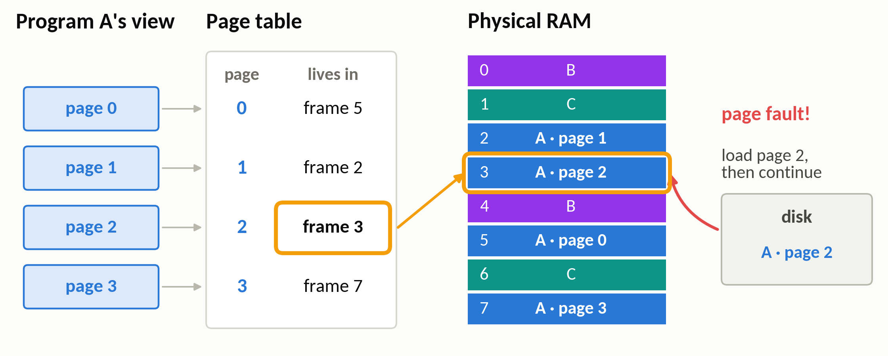
Basics
The memory tool: paging
Page 2 is on disk: a page fault loads it into frame 3
3
Fixed-size pages, handed out only when needed, found through a table
4 / 28
Notes:
(≈30 s · step 6 of 6)
And page 2 is on the disk. When A touches it, that's a page fault: the OS pauses A, copies the page into the free frame 3, updates the table, and lets A continue. So we have three things: fixed-size pieces, handed out only when needed, and found through a table. vLLM will do exactly this.

Slide 11
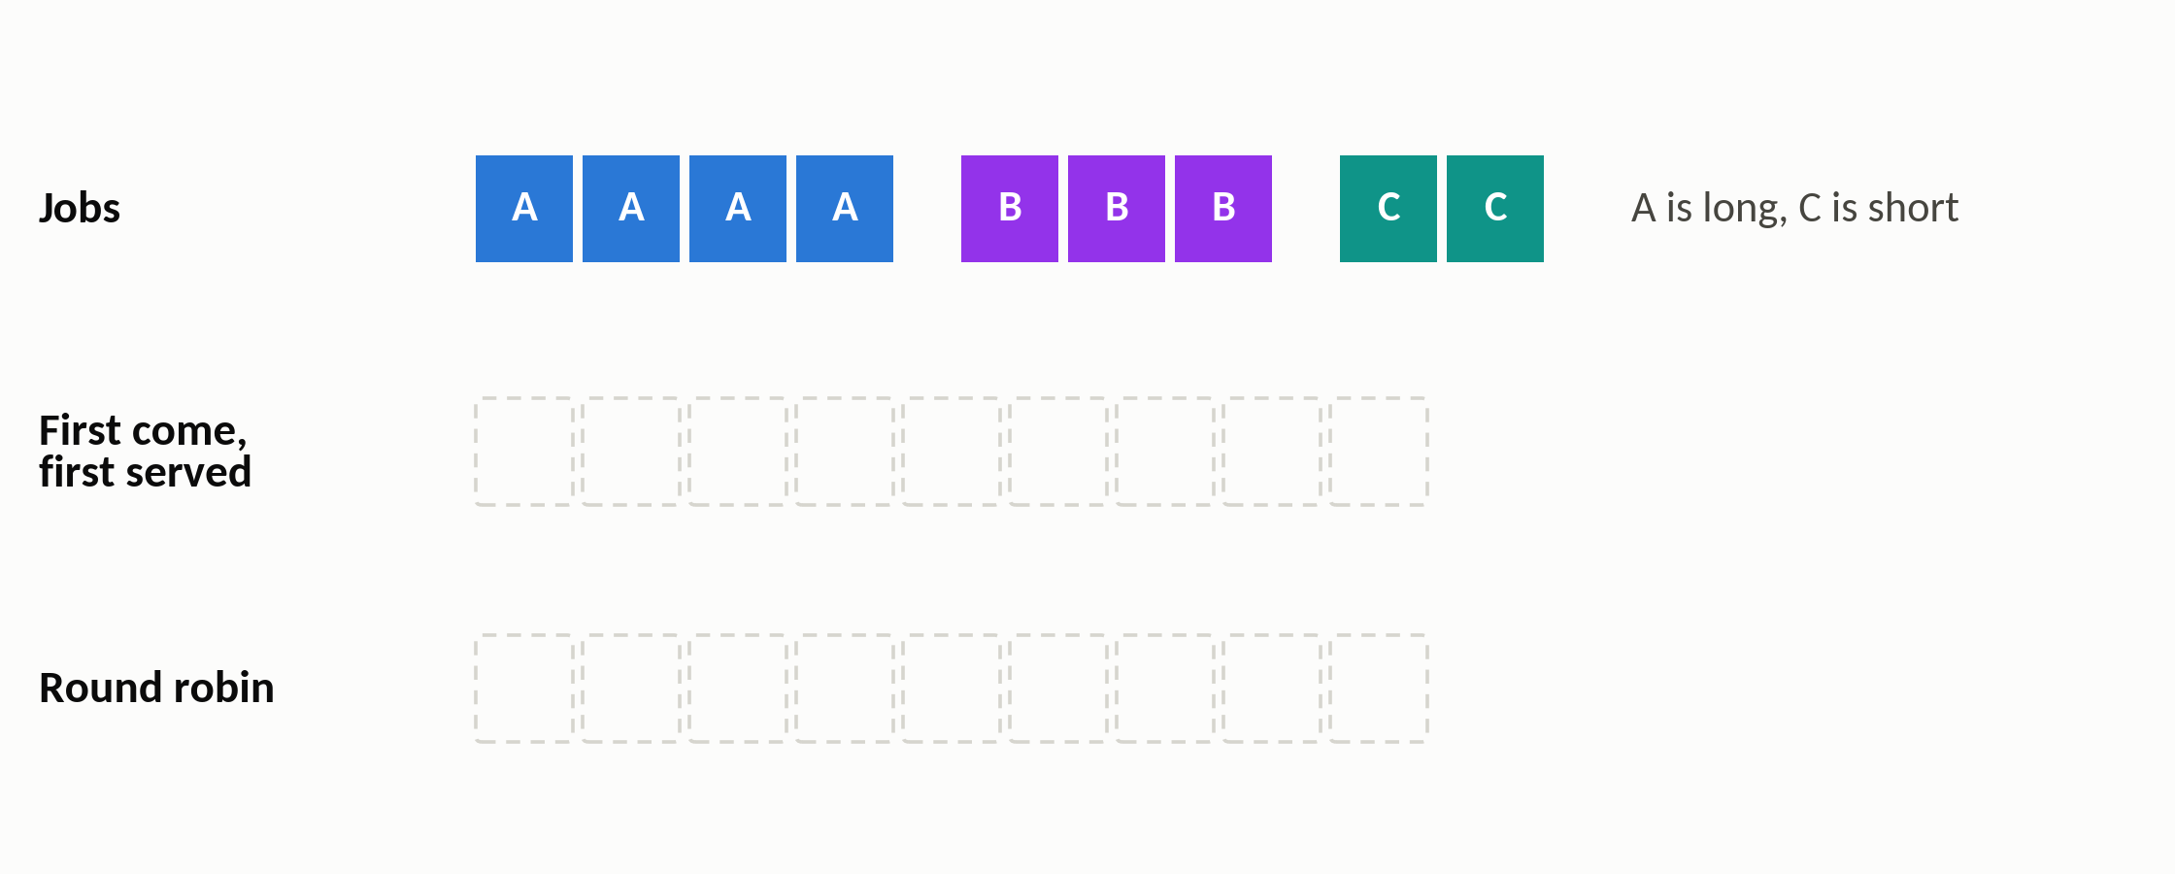
Basics
The CPU tool: time-sharing
One CPU, three jobs: A needs 4 slices, B 3, C 2
5 / 28
Notes:
(≈20 s · step 1 of 3)
Now the CPU tool: time-sharing. There is one processor, and three jobs are waiting at the same time. Each box is one slice of CPU time: A, needs four slices, B needs three, and C only two.
▶ Click next: First come, first served: C waits 7 slices

Slide 12
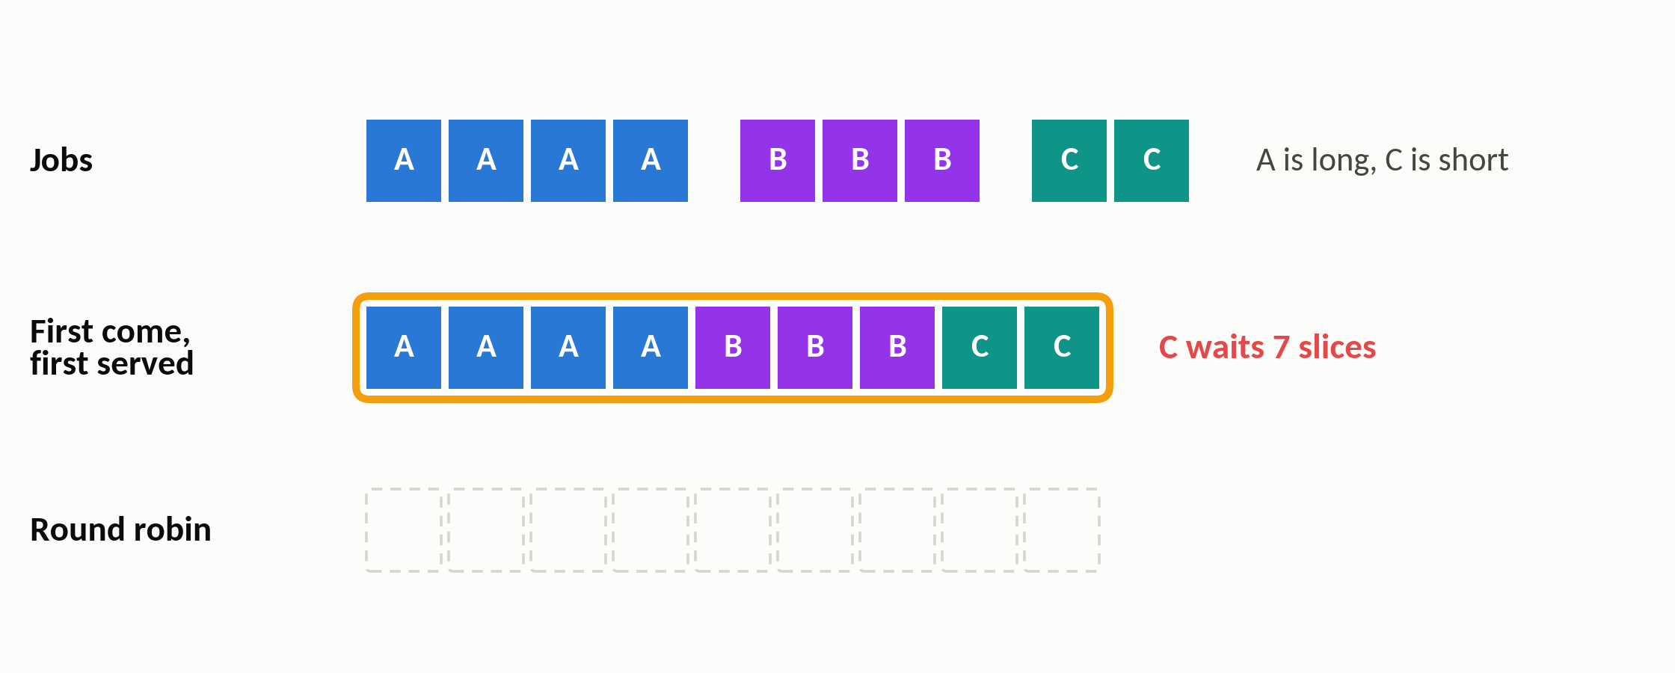
Basics
The CPU tool: time-sharing
First come, first served: C waits 7 slices
1
5 / 28
Notes:
(≈20 s · step 2 of 3)
The simplest schedule is first come, first served: A, runs to the end, then B, then C. That's only two switches, but the short job, C, waits seven slices before it even starts.
▶ Click next: Round robin: C starts after 2 slices, at the cost of 8 switches

Slide 13
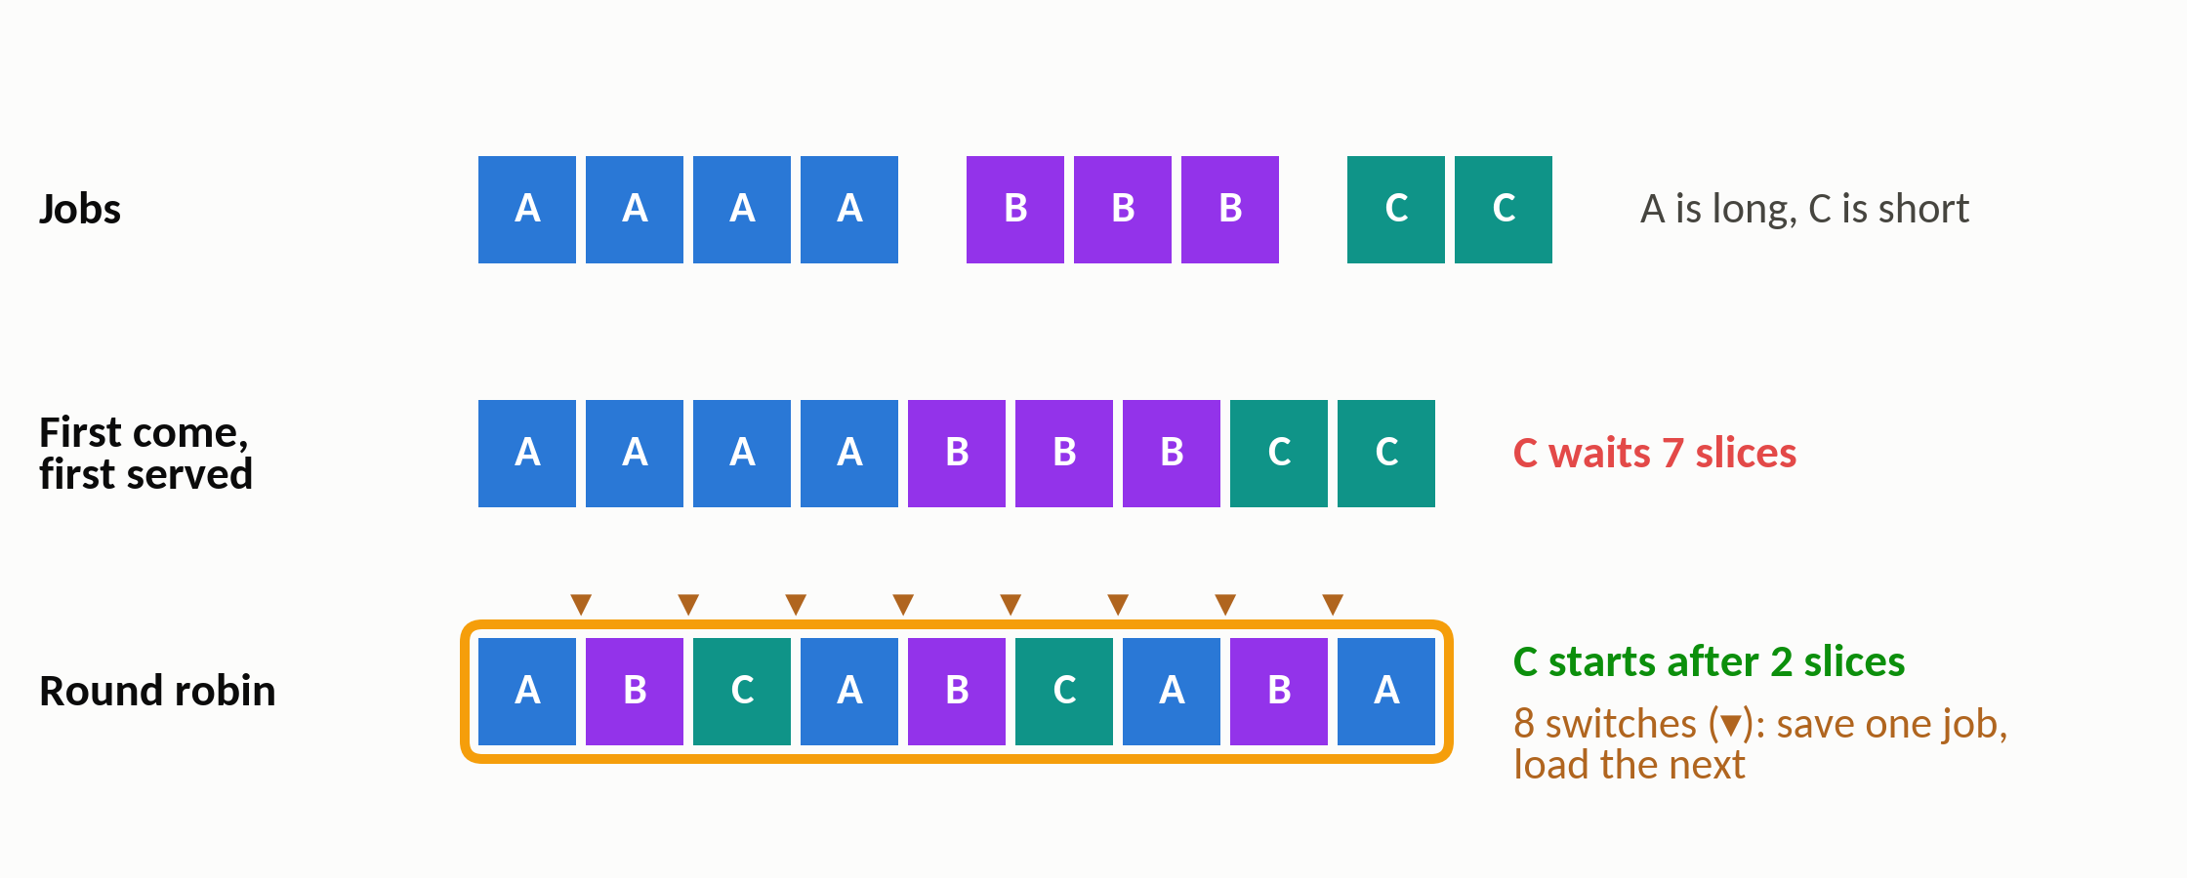
Basics
The CPU tool: time-sharing
Round robin: C starts after 2 slices, at the cost of 8 switches
2
The trade-off: fewer switches finish sooner, more switches are fairer
5 / 28
Notes:
(≈35 s · step 3 of 3)
Round robin instead gives every job one slice in turn, so now C starts after just two slices.
The price is the small triangles.
Each one is a context switch: the CPU saves where one job stopped, and loads where the next one stopped. That's eight switches instead of two. Keep this trade-off in mind; AIOS measures exactly this for LLM agents.

Slide 14
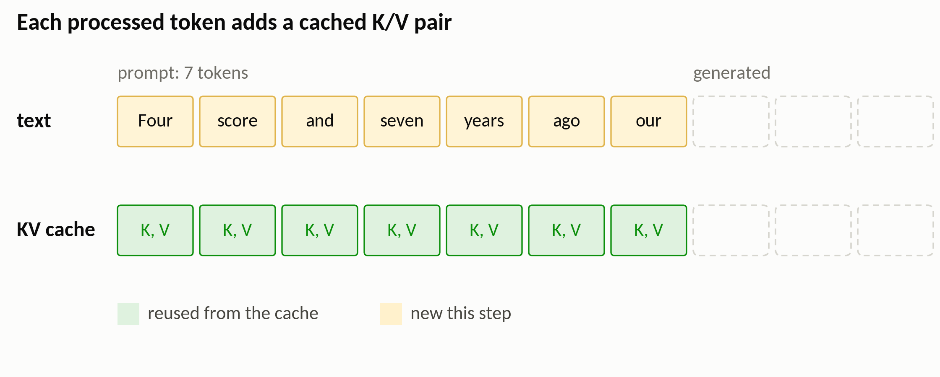
Basics
Where an LLM's memory goes: the KV cache
A 7-token prompt, with one cached key/value pair per token
6 / 28
Notes:
(≈40 s · step 1 of 4)
Now the LLM side: where does an LLM's memory go? To write each new token, attention needs a key and a value vector for every earlier token. Recomputing them at every step would be wasteful, so they are saved in GPU memory. That's the KV cache. Here the prompt that has 7 tokens, and under each one is its corresponding key and value pair, in green. These are saved vectors, not copies of the words.
▶ Click next: “fathers”: reuse the 7 pairs, add one new pair

Slide 15
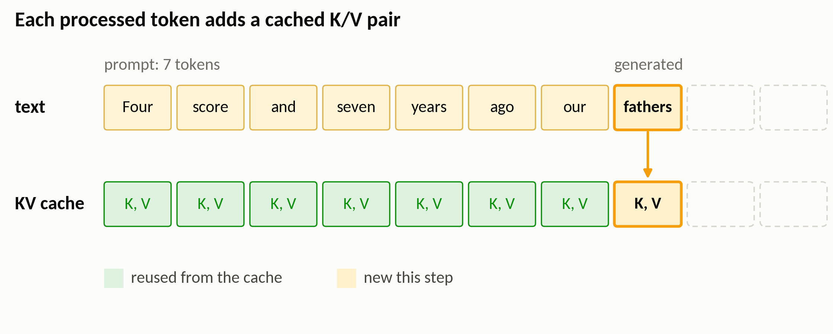
Basics
Where an LLM's memory goes: the KV cache
“fathers”: reuse the 7 pairs, add one new pair
1
6 / 28
Notes:
(≈20 s · step 2 of 4)
The next token is 'fathers'. The model reuses the seven green pairs exactly as they are, and adds just one new pair for 'fathers', in yellow, at the end of the cache.
▶ Click next: “brought”: one more pair

Slide 16
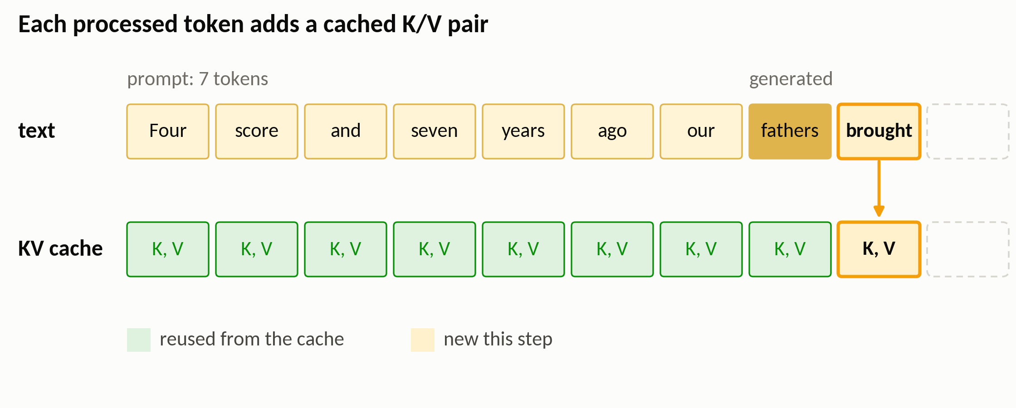
Basics
Where an LLM's memory goes: the KV cache
“brought”: one more pair
2
6 / 28
Notes:
(≈10 s · step 3 of 4)
Then comes 'brought'. Again, one new pair at the end, and everything before it, is reused.
▶ Click next: “forth”: one more, for every request being served

Slide 17
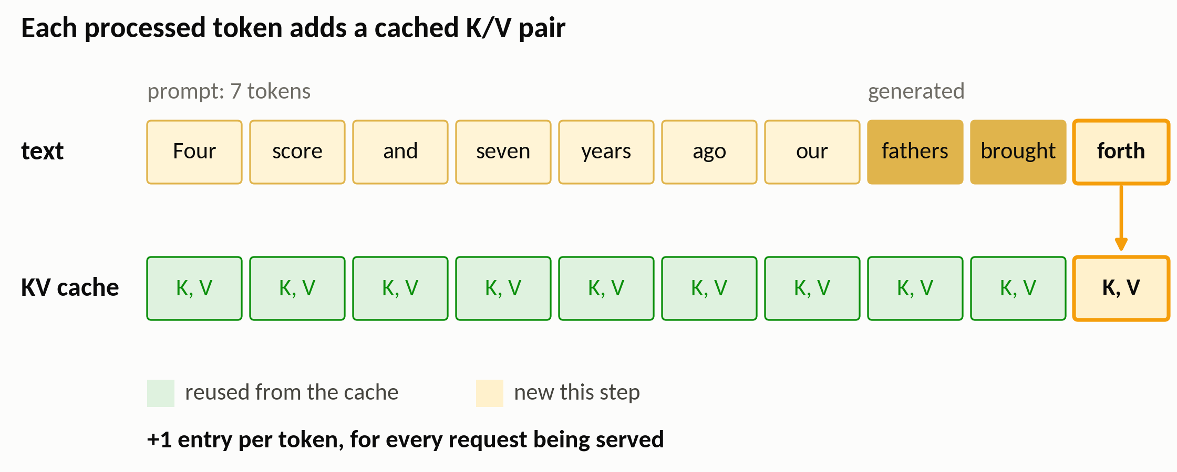
Basics
Where an LLM's memory goes: the KV cache
“forth”: one more, for every request being served
3
The KV cache grows with every token, for every request
6 / 28
Notes:
(≈25 s · step 4 of 4)
And so on, one pair per token. The key point is the line at the bottom:
this happens for every request the server is handling at the same time. All of those caches keep growing, and they all have to fit in GPU memory.

Slide 18
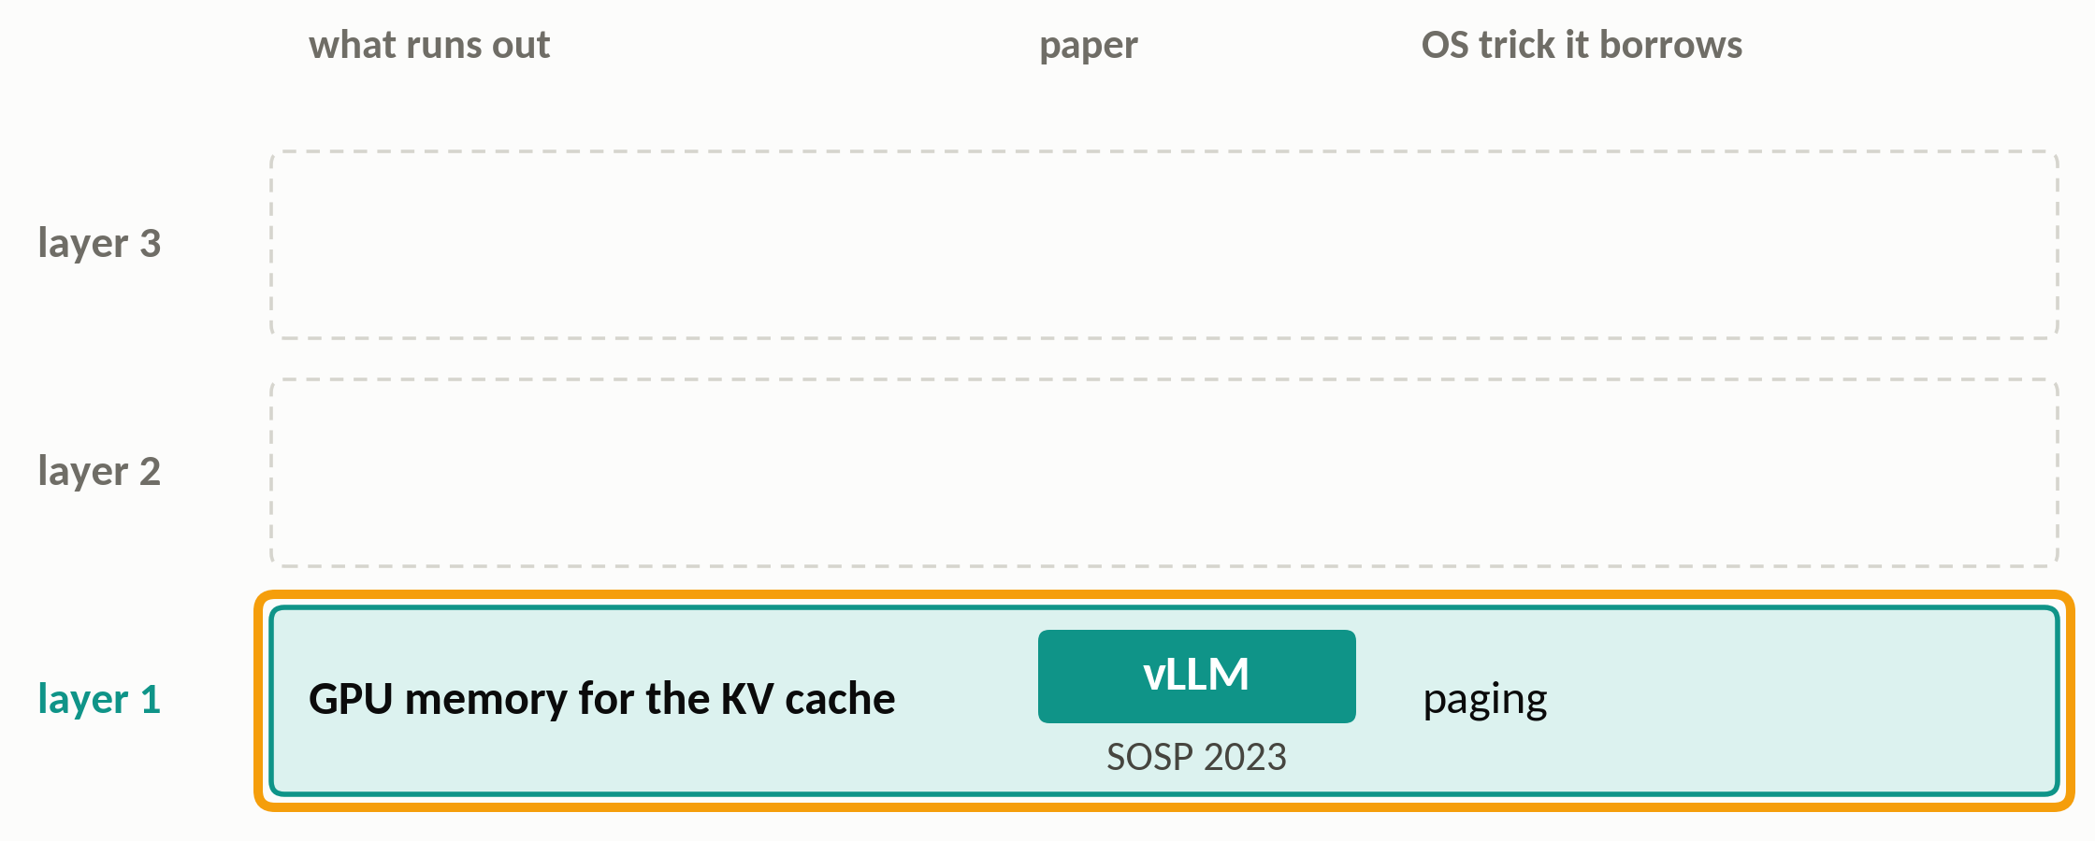
Basics
The story: one trick, three layers
Layer 1, GPU memory for the KV cache: vLLM borrows paging
7 / 28
Notes:
(≈15 s · step 1 of 3)
So here's the story of this talk: three layers, each with something that runs out. At the bottom is GPU memory for the KV cache, and vLLM fixes it by borrowing paging.
▶ Click next: Layer 2, the context window: MemGPT borrows RAM + disk

Slide 19
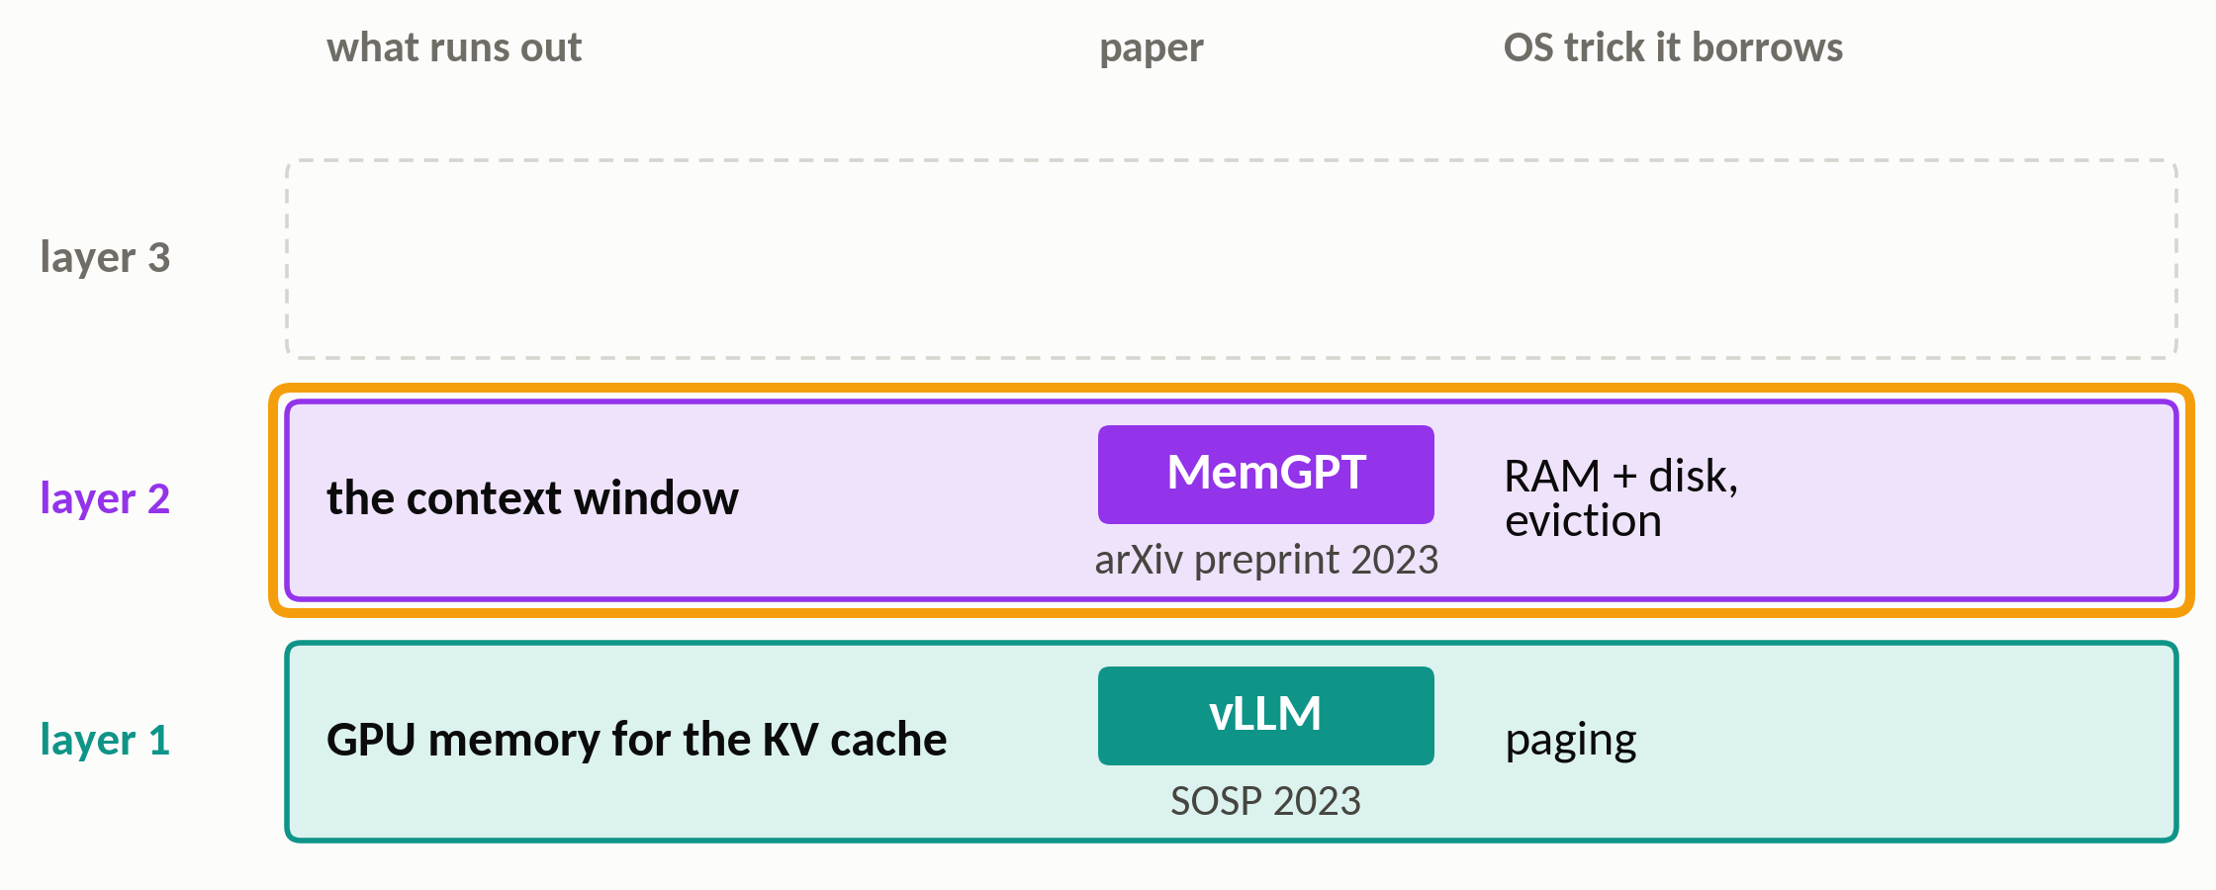
Basics
The story: one trick, three layers
Layer 2, the context window: MemGPT borrows RAM + disk
7 / 28
Notes:
(≈15 s · step 2 of 3)
One layer up is the context window: everything the model can see at once. It has a fixed size, and MemGPT stretches it by borrowing the RAM-plus-disk idea.
▶ Click next: Layer 3, one LLM shared by many agents: AIOS borrows time-sharing

Slide 20
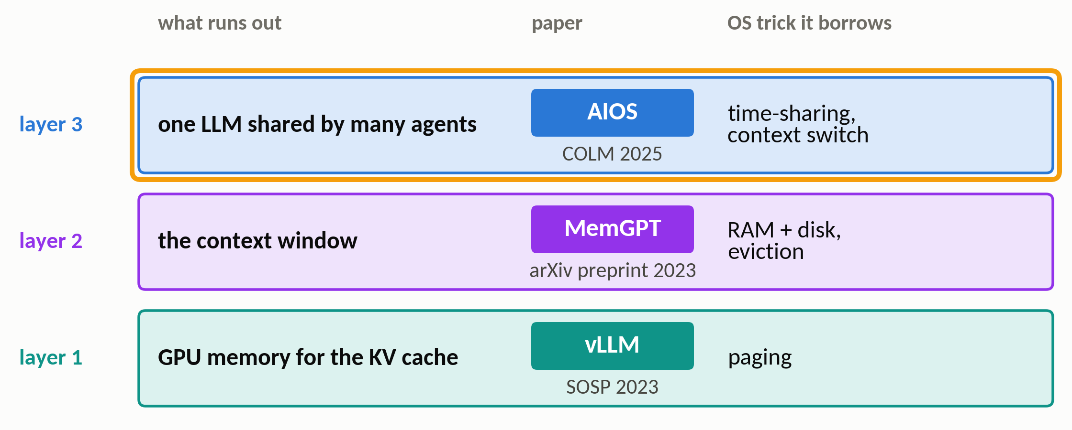
Basics
The story: one trick, three layers
Layer 3, one LLM shared by many agents: AIOS borrows time-sharing
The layers really stack: AIOS can run on vLLM, and it cites MemGPT
7 / 28
Notes:
(≈20 s · step 3 of 3)
At the top is one LLM shared by many agents, which have to take turns, and AIOS borrows time-sharing. These are not three separate analogies: AIOS can run on top of vLLM, and it cites MemGPT. So let's go bottom-up.

Slide 21
Section 2 of 5
vLLM
Page the KV cache like an OS pages memory
Kwon et al. · SOSP 2023 · UC Berkeley, Stanford, UC San Diego
Notes:
(≈15 s)
Paper one: vLLM, from UC Berkeley, at SOSP 2023. It starts from a simple question: why can one GPU serve so few requests at once?

Slide 22
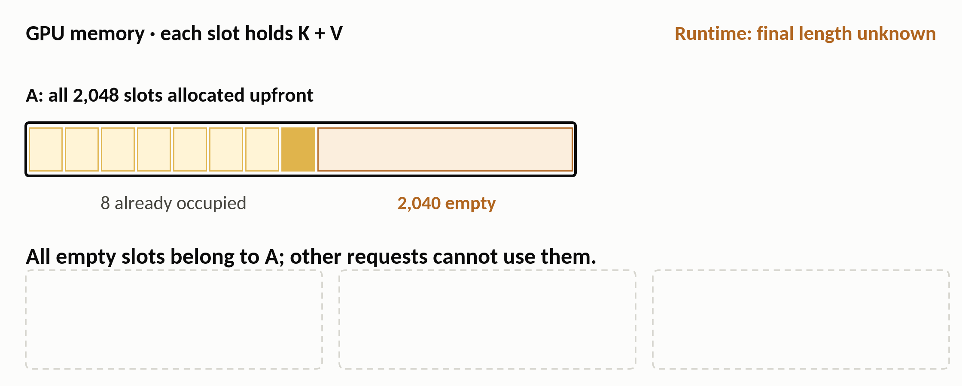
vLLM
The problem: allocate for the maximum length
Old systems reserve each request's maximum length upfront
9 / 28
Notes:
(≈25 s · step 1 of 3)
Here's how serving systems worked before vLLM. This bar is GPU memory, and each slot holds one token's keys and values. Request A gets all 2,048 slots upfront, because nobody knows how long its answer will be, and only 8 are used so far.
▶ Click next: In hindsight: 2 more slots get used, 2,038 never do

Slide 23
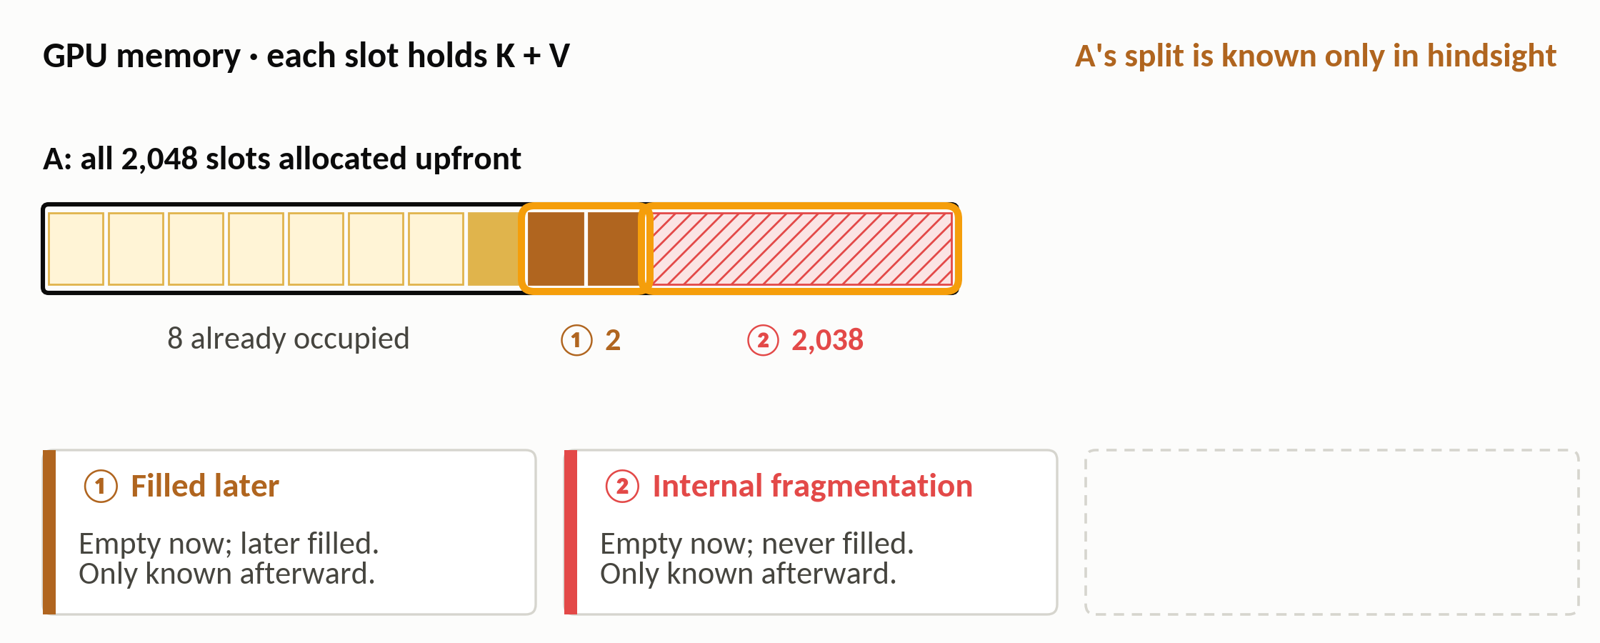
vLLM
The problem: allocate for the maximum length
In hindsight: 2 more slots get used, 2,038 never do
1
9 / 28
Notes:
(≈20 s · step 2 of 3)
Now let A finish, and look back. In hindsight, it fills just 2 more slots. The other 2,038, hatched in red, were never used at all. That's called internal fragmentation: memory given to a request that it never uses.
▶ Click next: Request B must start outside A's allocation

Slide 24
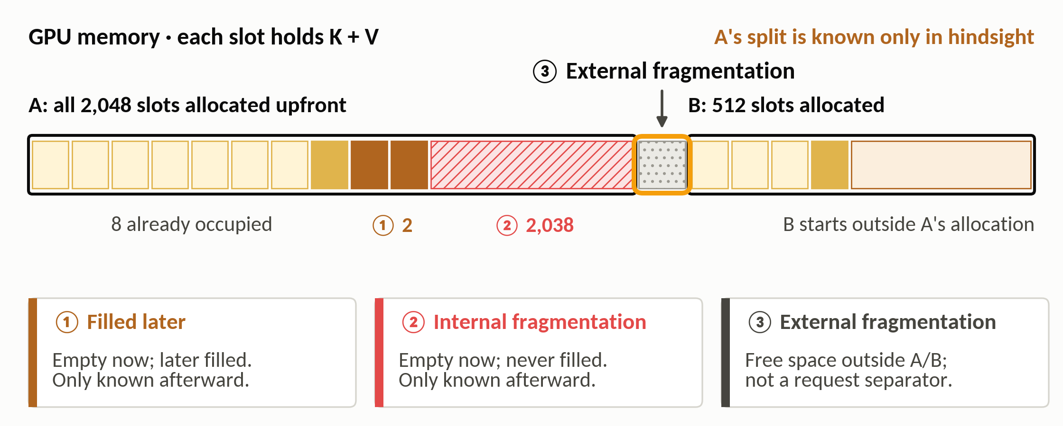
vLLM
The problem: allocate for the maximum length
Request B must start outside A's allocation
2
B cannot use A's empty slots: the whole region is already allocated
9 / 28
Notes:
(≈25 s · step 3 of 3)
And request B has to start after A's whole allocation. The little gap between them is too small for anyone, which is called external fragmentation. When the authors measured real systems, only about 20 to 38 percent of this memory held actual tokens.

Slide 25
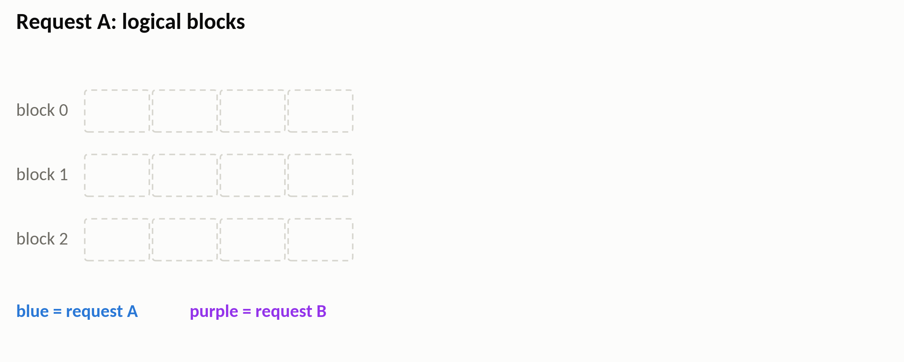
vLLM
PagedAttention: a page table for the KV cache
Request A's logical blocks: its tokens in order, 4 per block
10 / 28
Notes:
(≈25 s · step 1 of 6)
vLLM's fix is called PagedAttention, and it's the paging idea we just saw. Cut each request's KV cache into small fixed-size blocks: 4 tokens per block in this picture, 16 in the real system. On the left are request A's blocks, in the order that A sees them.
▶ Click next: Physical blocks: the GPU's real memory, shared by all requests

Slide 26
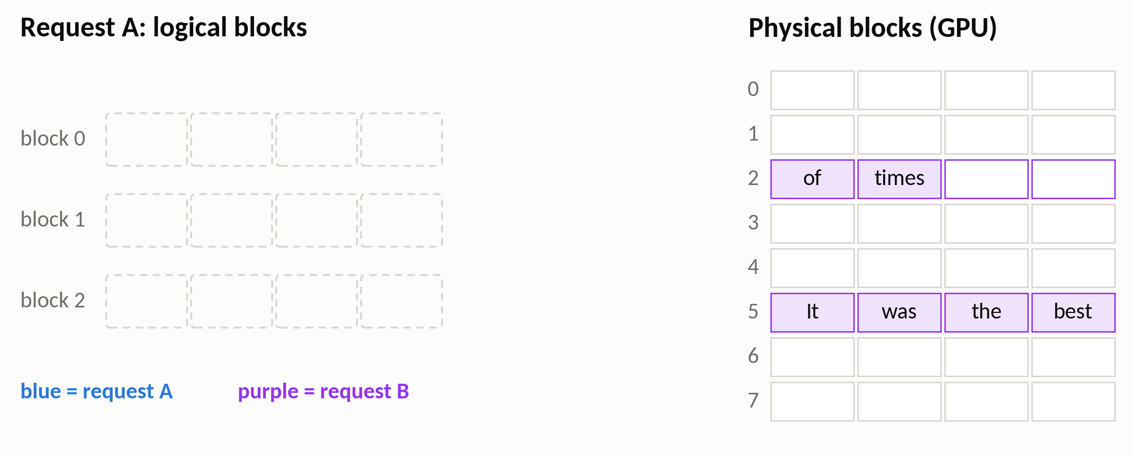
vLLM
PagedAttention: a page table for the KV cache
Physical blocks: the GPU's real memory, shared by all requests
10 / 28
Notes:
(≈25 s · step 2 of 6)
On the right is the GPU's real memory, as physical blocks. Each slot holds one token's keys and values; the word just tells you which token it is. Two blocks, in purple, already belong to another request, B. The white ones are free.
▶ Click next: The block table links the two, like a page table

Slide 27
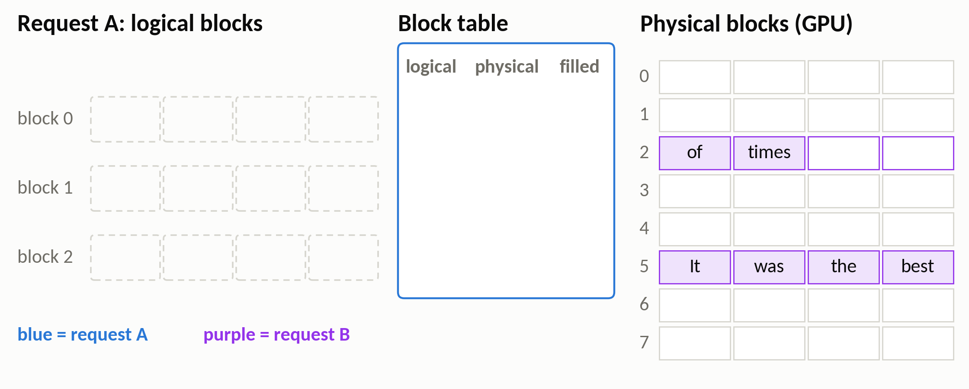
vLLM
PagedAttention: a page table for the KV cache
The block table links the two, like a page table
10 / 28
Notes:
(≈20 s · step 3 of 6)
In the middle is the block table. For each of A's blocks, it says where that block really lives on the GPU, and how many of its slots are filled. It does exactly the job of the page table.
▶ Click next: The 7-token prompt fills 2 blocks, anywhere free: 7 and 1

Slide 28
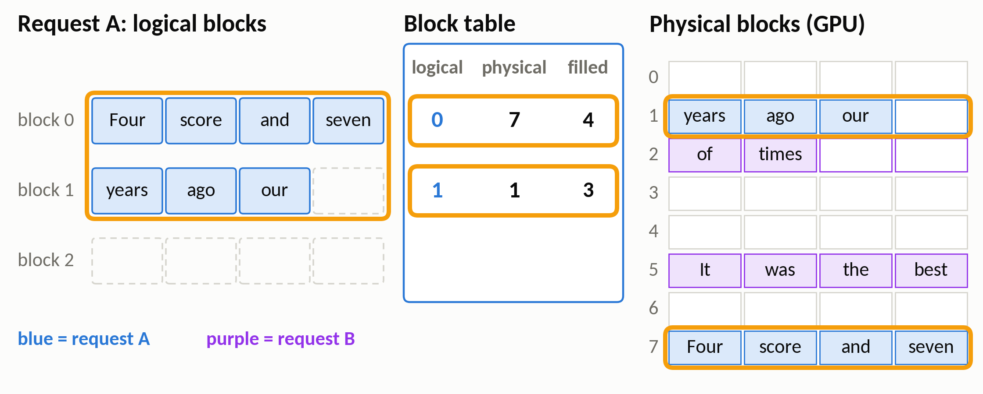
vLLM
PagedAttention: a page table for the KV cache
The 7-token prompt fills 2 blocks, anywhere free: 7 and 1
1
10 / 28
Notes:
(≈30 s · step 4 of 6)
Now A's 7-token prompt arrives. It needs two blocks, and vLLM simply takes any two free ones, blocks 7 and 1. They don't have to be next to each other. The table now says: logical block 0 lives in physical block 7, with four slots filled, and logical block 1 lives in physical block 1, with three of them filled.
▶ Click next: “fathers” fits into block 1: no new memory

Slide 29
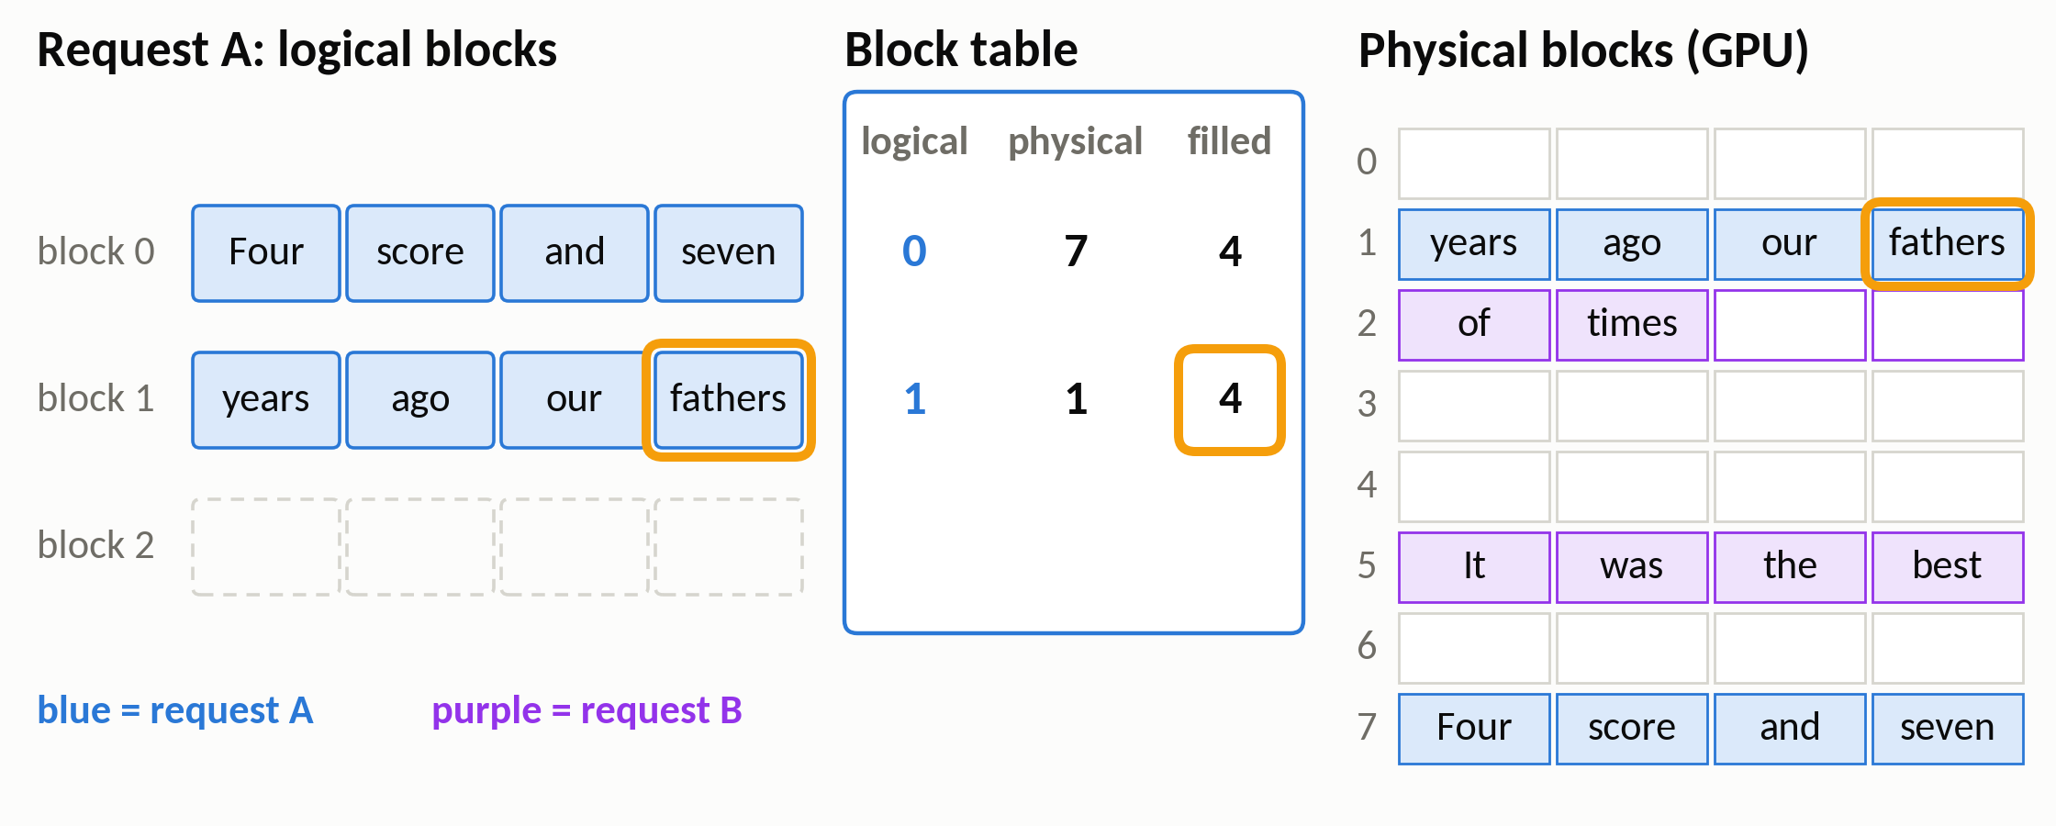
vLLM
PagedAttention: a page table for the KV cache
“fathers” fits into block 1: no new memory
2
10 / 28
Notes:
(≈15 s · step 5 of 6)
The next token, 'fathers', fits into the last empty slot of block 1. No new memory is needed; only the 'filled' count in the table changes.
▶ Click next: “brought” needs a block: only now does vLLM take block 3

Slide 30
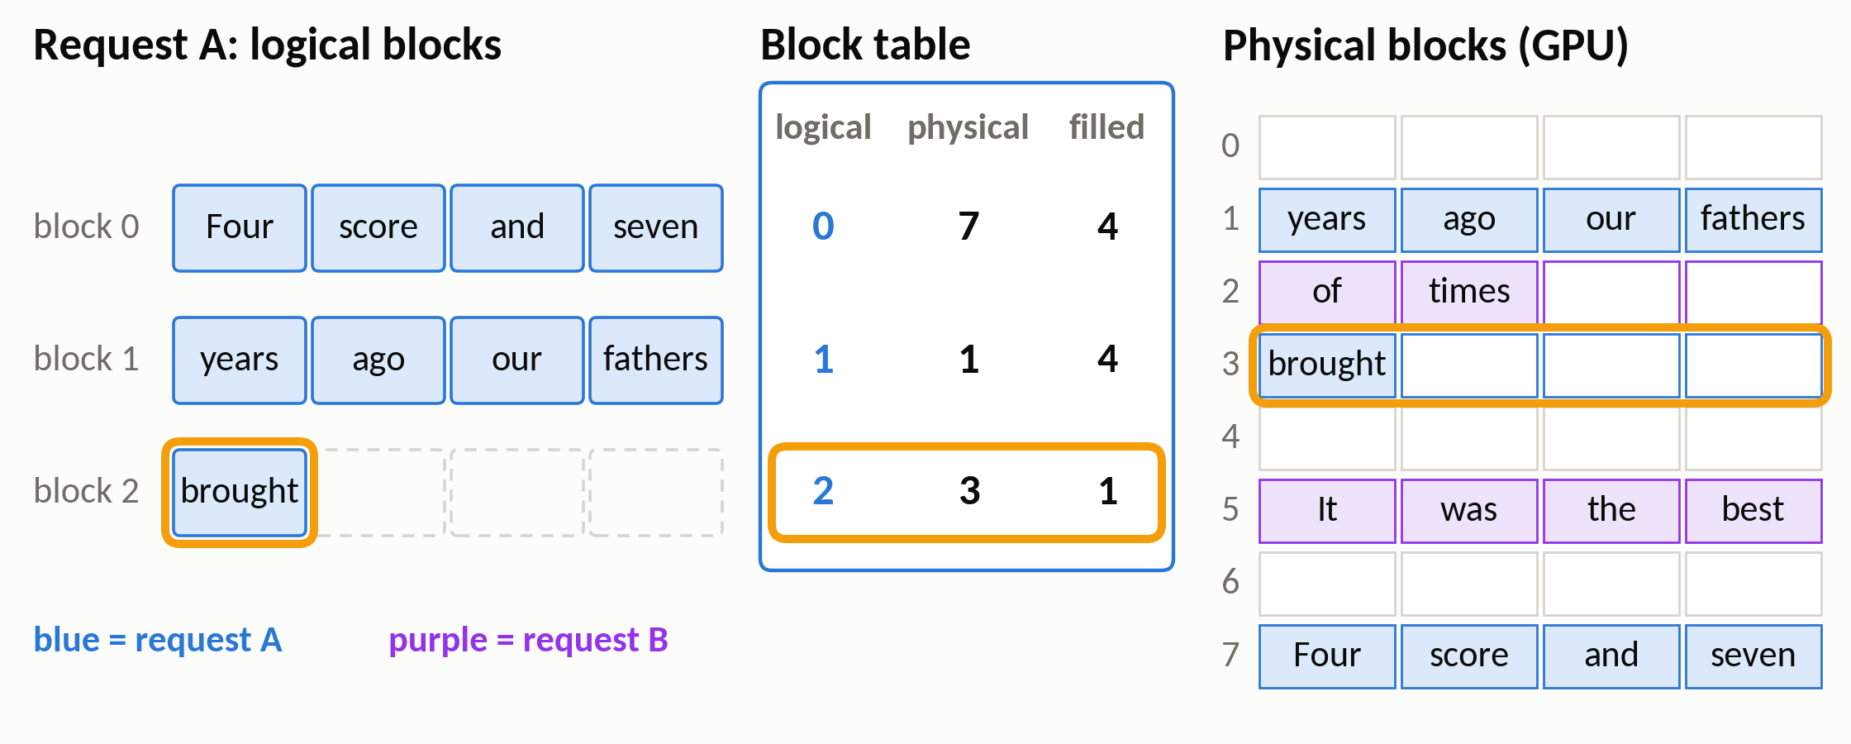
vLLM
PagedAttention: a page table for the KV cache
“brought” needs a block: only now does vLLM take block 3
3
Waste is now at most one partly filled block per request
10 / 28
Notes:
(≈40 s · step 6 of 6)
Then 'brought' needs a new block, and only now does vLLM hand out block 3. Now look at the blocks in use on the right: A's new block has three empty slots, B's last block has two, and every other block is full. So a request never wastes more than one partly filled block. And because attention simply follows the table to find each block, the model's output doesn't change at all.

Slide 31
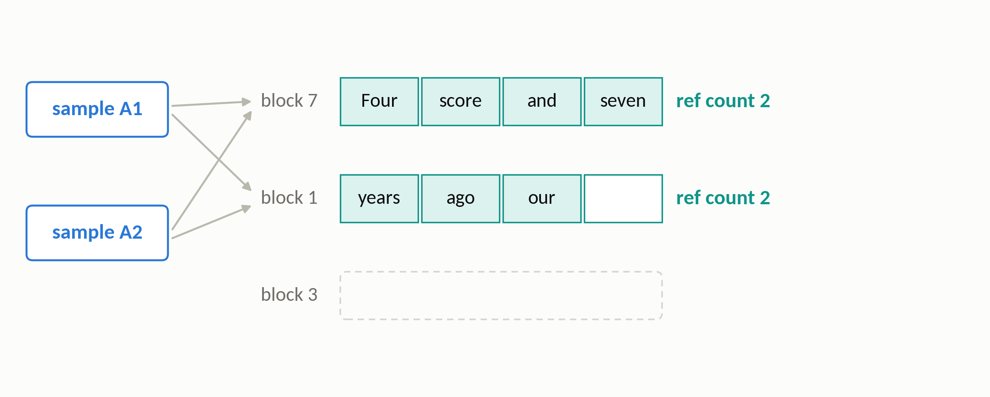
vLLM
Copy-on-write: share blocks until someone writes
Two answers to one prompt share the prompt's blocks
11 / 28
Notes:
(≈25 s · step 1 of 3)
Blocks also make sharing easy. Suppose we ask for two different answers to the same prompt. Both samples, on the left, point to the same prompt blocks, so the prompt is stored only once. The reference count on the right says how many samples use each block: two.
▶ Click next: A1 writes: copy block 1 to block 3 first, then write

Slide 32
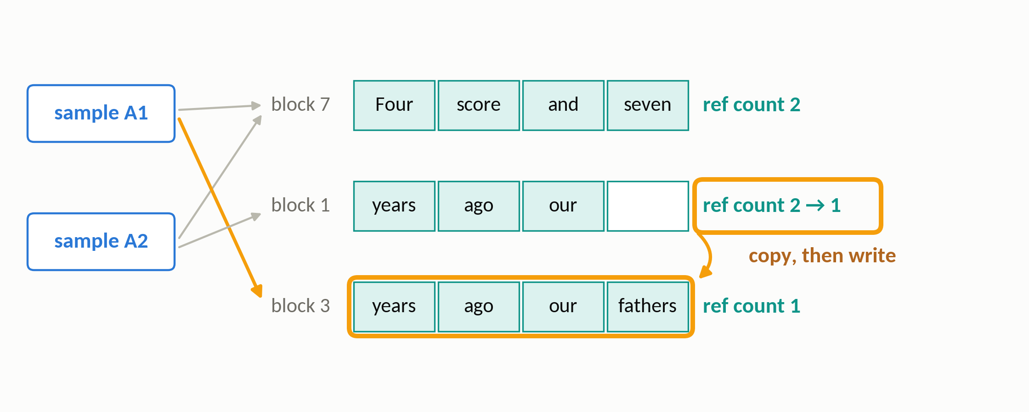
vLLM
Copy-on-write: share blocks until someone writes
A1 writes: copy block 1 to block 3 first, then write
1
11 / 28
Notes:
(≈30 s · step 2 of 3)
Now sample A1 writes 'fathers' into block 1. But block 1 is shared, and writing in place would change A2's answer too. So vLLM first copies it into a free block, block 3, and writes there. Block 1's count drops to one. That's copy-on-write, exactly what an operating system does after a process forks.
▶ Click next: A2 writes in place: block 1 now has one owner

Slide 33
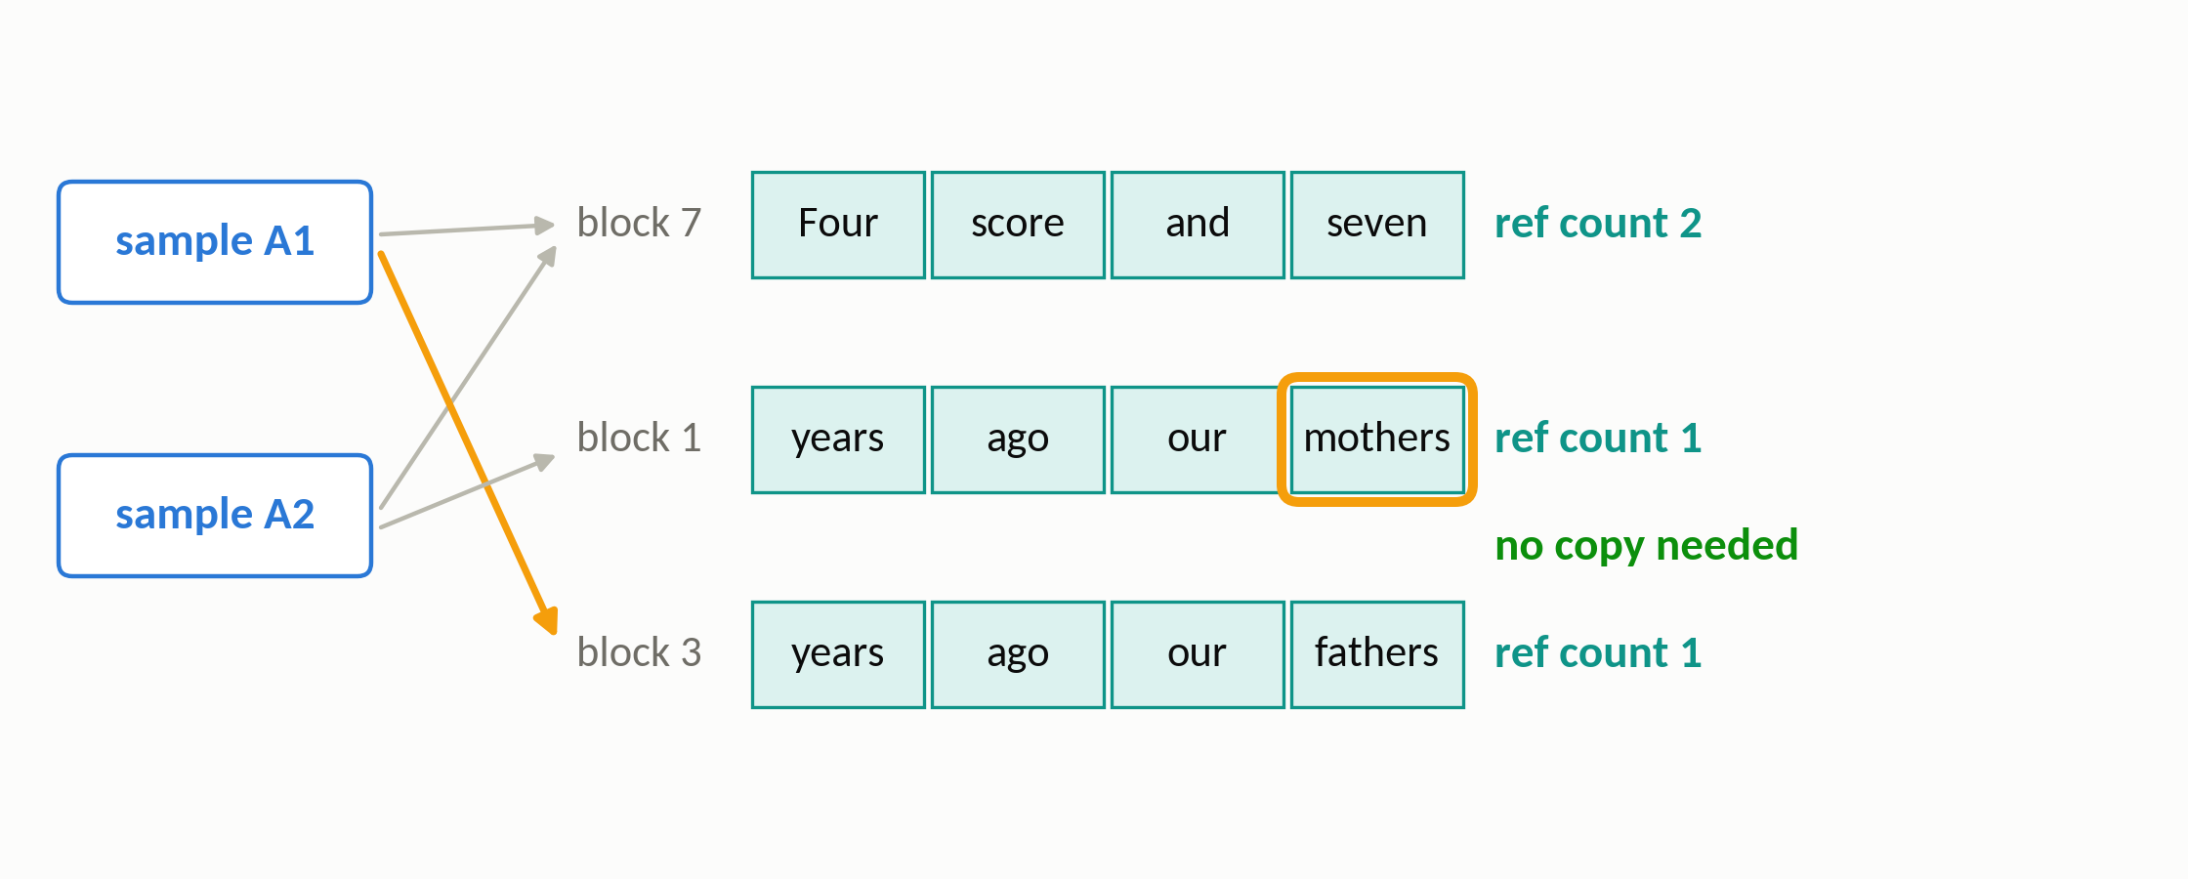
vLLM
Copy-on-write: share blocks until someone writes
A2 writes in place: block 1 now has one owner
2
Only the block where the answers differ gets copied
11 / 28
Notes:
(≈15 s · step 3 of 3)
When A2 then writes 'mothers', block 1 has a single owner, so it writes in place, with no copy. Only the block where the two answers differ was ever copied.

Slide 34
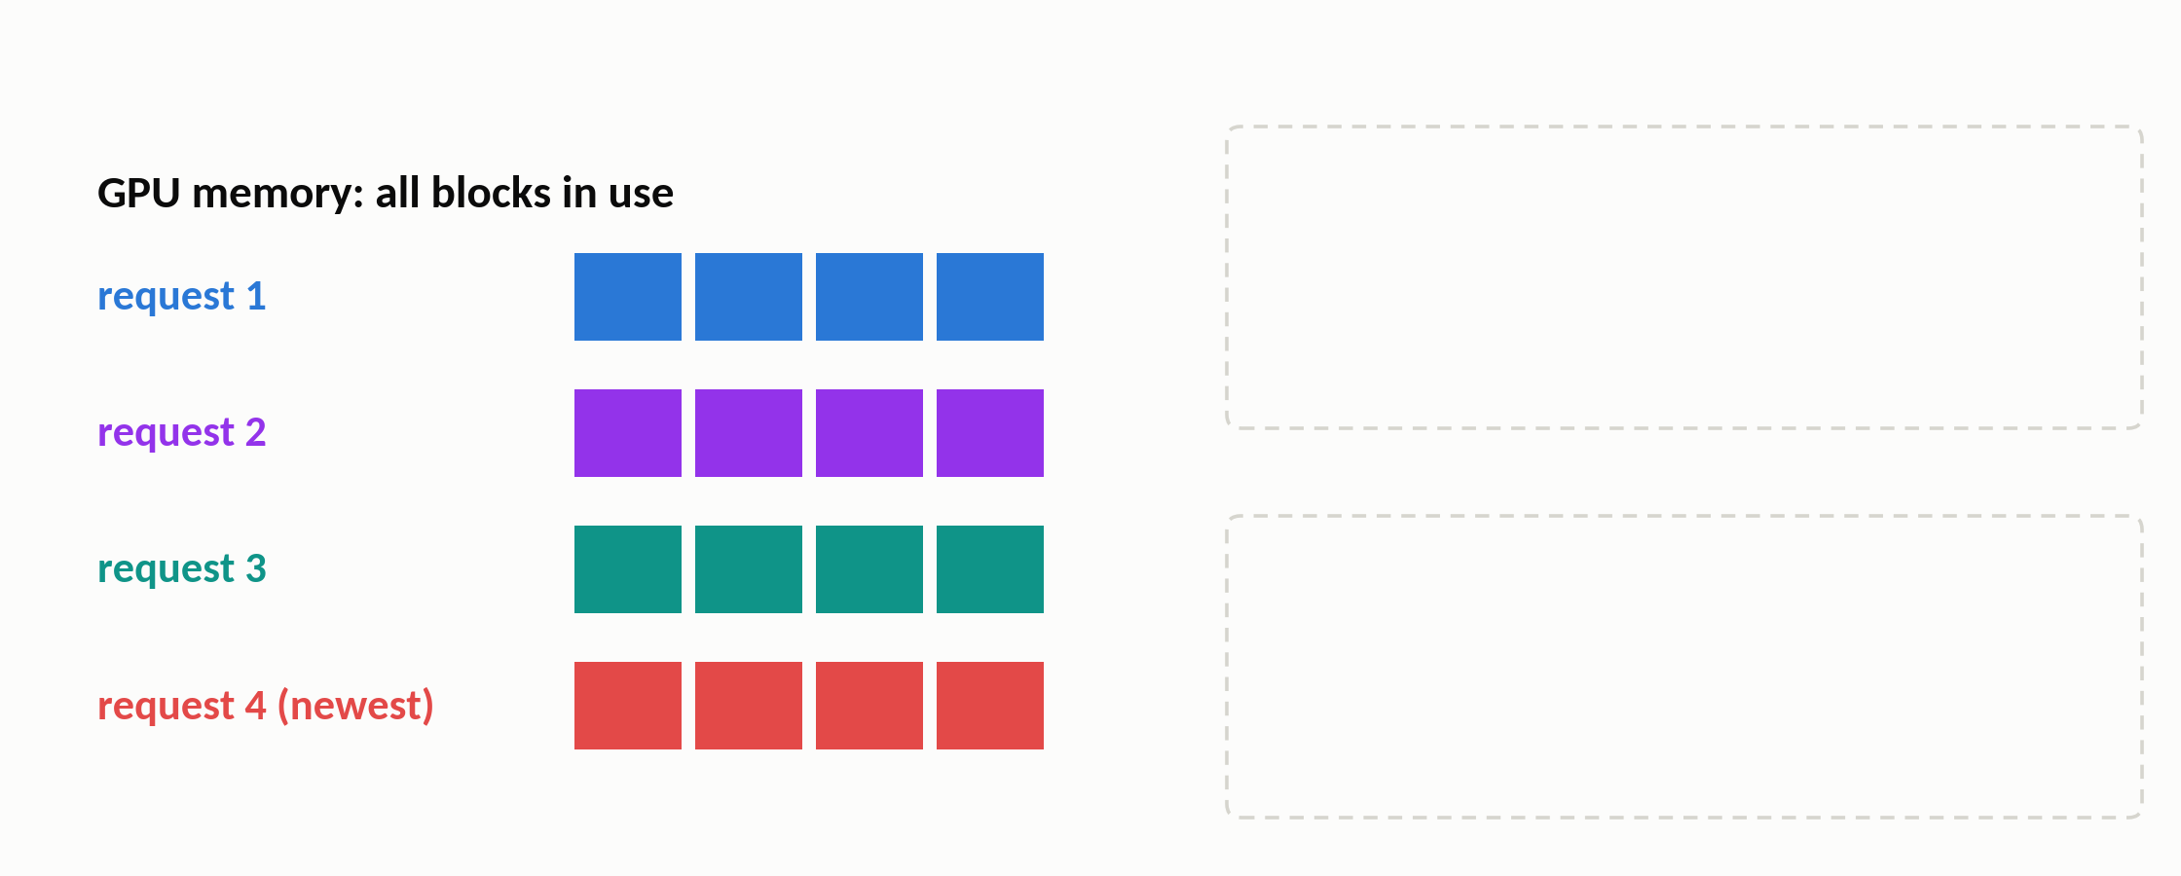
vLLM
When GPU memory runs out
GPU memory is full
12 / 28
Notes:
(≈10 s · step 1 of 4)
One last OS trick. What happens when GPU memory runs out? Here, every block is in use.
▶ Click next: Pause the newest request and free all of its blocks

Slide 35
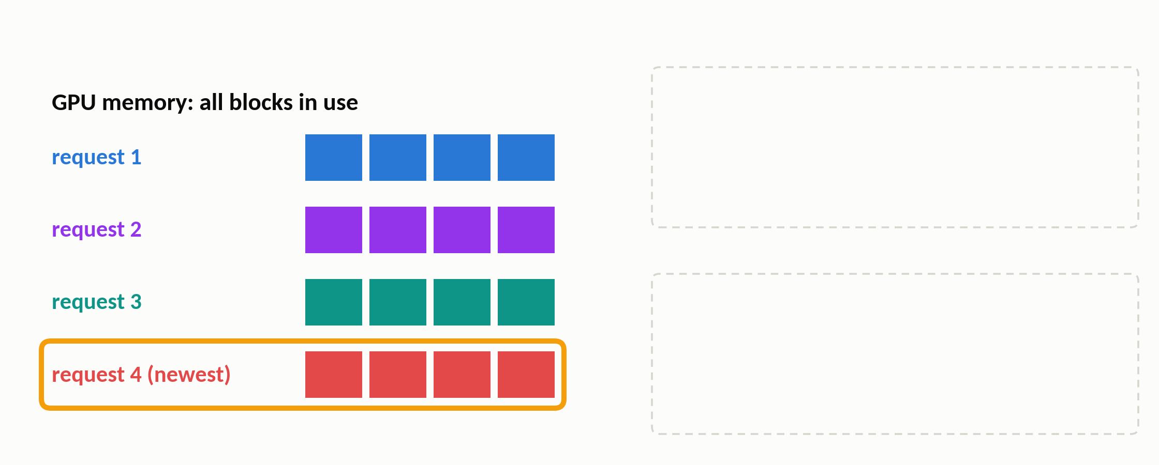
vLLM
When GPU memory runs out
Pause the newest request and free all of its blocks
1
12 / 28
Notes:
(≈15 s · step 2 of 4)
vLLM pauses the newest request, request 4, and frees all of its blocks together, cuz a request needs all of them to run.
▶ Click next: Option 1: swap its blocks out to CPU RAM

Slide 36
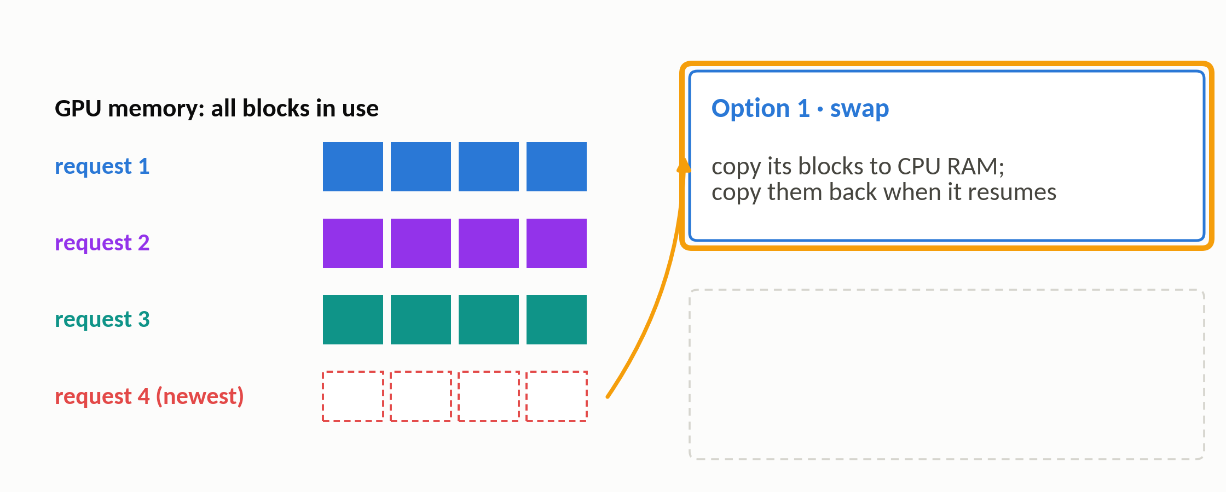
vLLM
When GPU memory runs out
Option 1: swap its blocks out to CPU RAM
2
12 / 28
Notes:
(≈10 s · step 3 of 4)
Option one is classic swapping: copy those blocks out, to CPU memory, and copy them back, when the request resumes.
▶ Click next: Option 2: drop them, and recompute from the text later

Slide 37
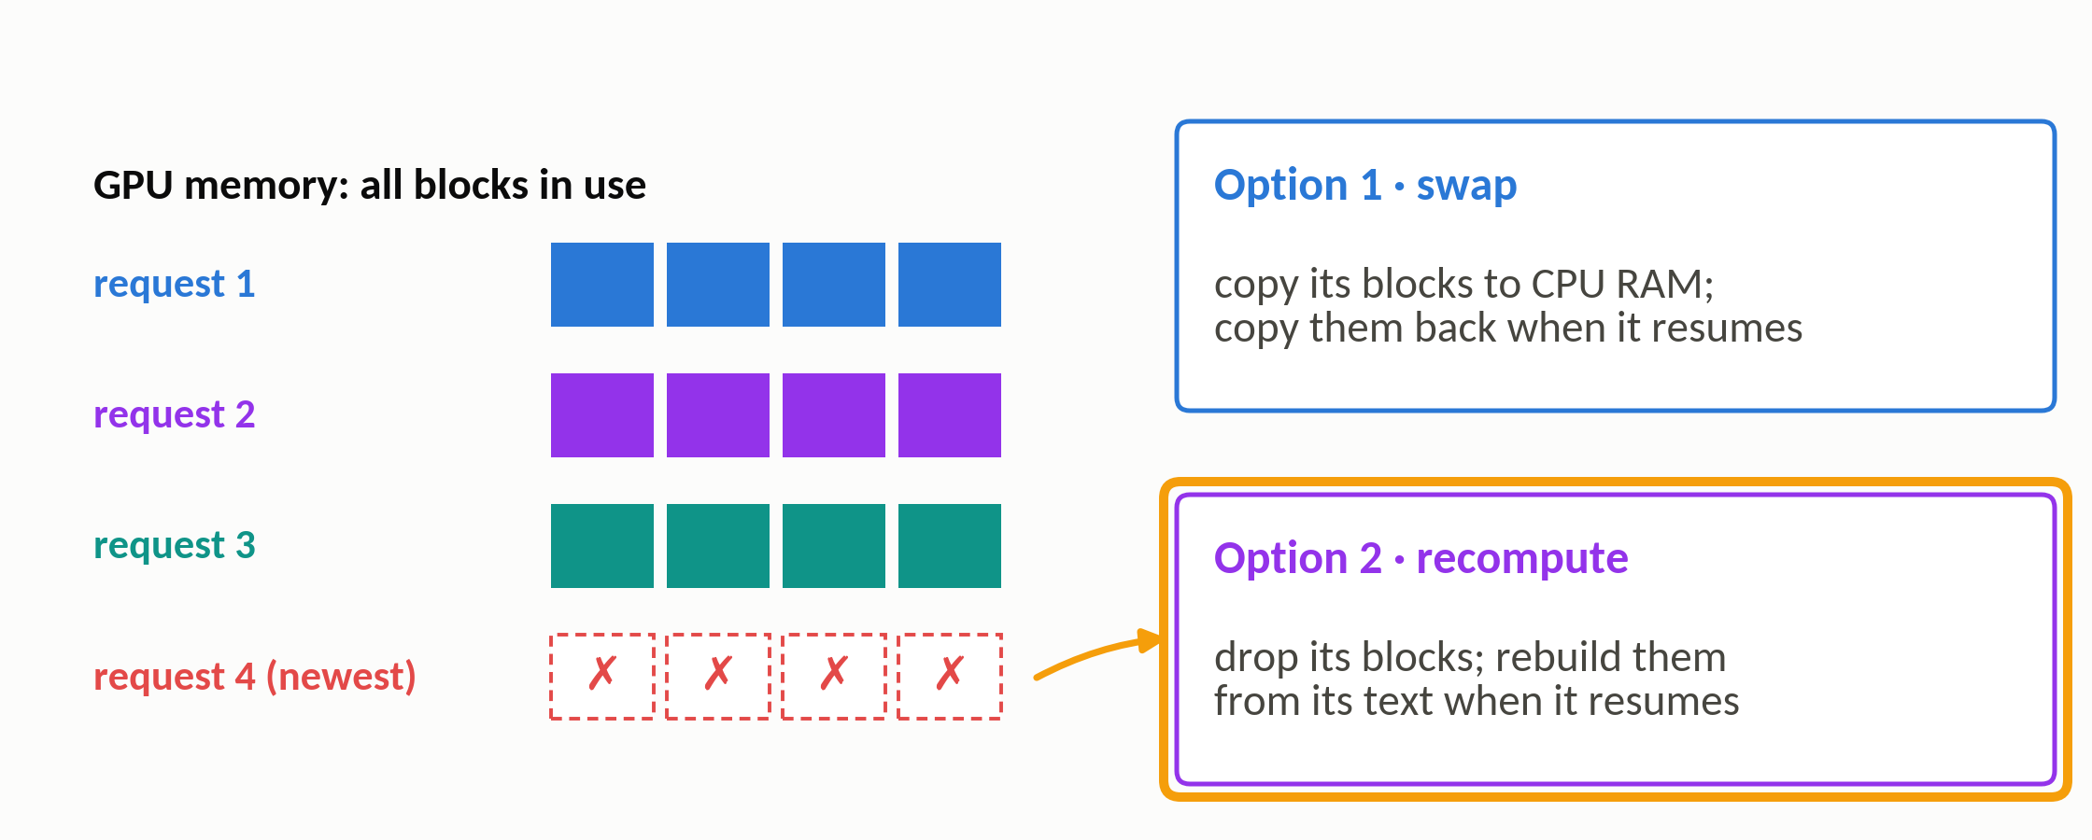
vLLM
When GPU memory runs out
Option 2: drop them, and recompute from the text later
3
Recompute has no OS equivalent: an LLM can rebuild its cache from the text
12 / 28
Notes:
(≈20 s · step 4 of 4)
Option two has no OS equivalent: just drop the blocks, and when the request resumes, recompute its cache from the text. A program's lost memory can't be regenerated, but an LLM's cache can.

Slide 38
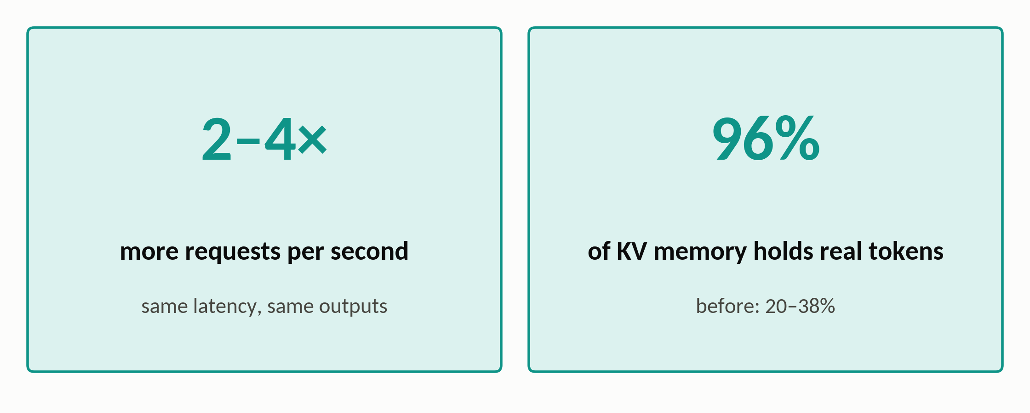
vLLM · results
vLLM: the results
Same model, same outputs: only the memory management changed
13 / 28
Notes:
(≈30 s)
So, does it pay off? At the same latency, vLLM serves 2 to 4 times more requests per second than earlier systems, with exactly the same outputs. The reason is the number on the right: about 96 percent of its KV memory now holds real tokens, compared with only 20 to 38 percent before.

Slide 39
Section 3 of 5
MemGPT
Page the context window like an OS swaps to disk
Packer et al. · arXiv preprint 2023 · UC Berkeley
Notes:
(≈10 s)
Paper two: MemGPT, also from Berkeley, published a month after vLLM. Now the memory that runs out is the context window.

Slide 40
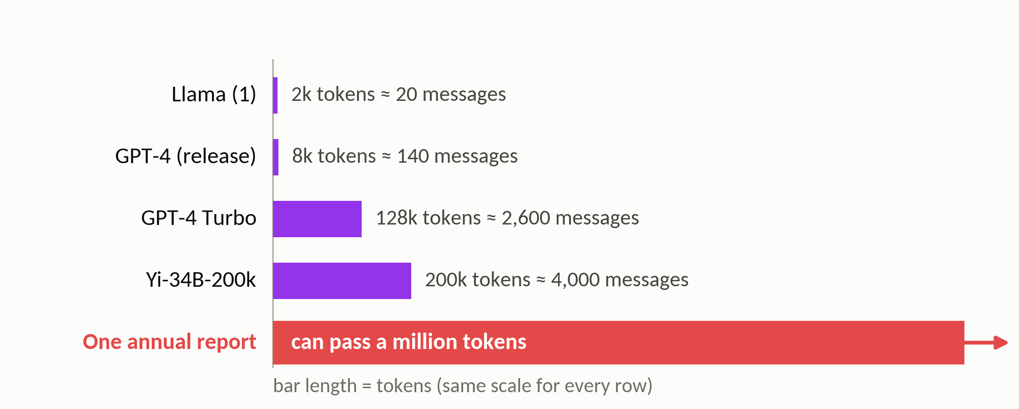
MemGPT
The problem: a fixed context window
Context windows in early 2024, on the same scale as one long document
Any fixed window overflows eventually; a bigger window only delays it
15 / 28
Notes:
(≈35 s)
The context window is everything the model can see at once, and its size is fixed. In early 2024, windows ranged from a few thousand to two hundred thousand tokens. That sounds like a lot, but a single annual report is longer than all of them, and an assistant you chat with for months keeps collecting history without limit. Any fixed window eventually overflows.

Slide 41
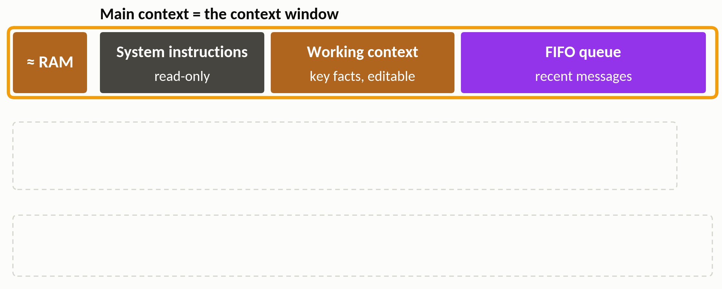
MemGPT
Virtual context: RAM and disk for the LLM
Main context = what's in the window: the “RAM”
16 / 28
Notes:
(≈20 s · step 1 of 3)
MemGPT's answer is called virtual context: treat the window like RAM. The paper calls it the main context, and it has three parts: read-only system instructions, a working context of key facts that the model can edit, and a queue of recent messages.
▶ Click next: External context = two databases outside the window: the “disk”

Slide 42
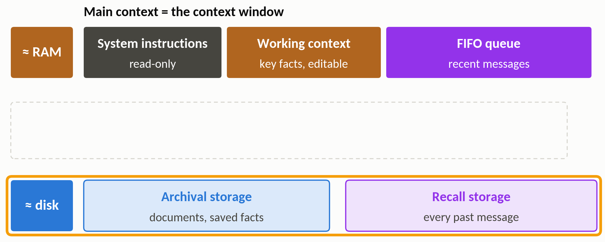
MemGPT
Virtual context: RAM and disk for the LLM
External context = two databases outside the window: the “disk”
16 / 28
Notes:
(≈15 s · step 2 of 3)
Outside the window is the disk: two databases with no size limit. Archival storage holds documents and saved facts, and recall storage keeps every past message, word for word.
▶ Click next: The LLM moves the data itself, by writing function calls

Slide 43
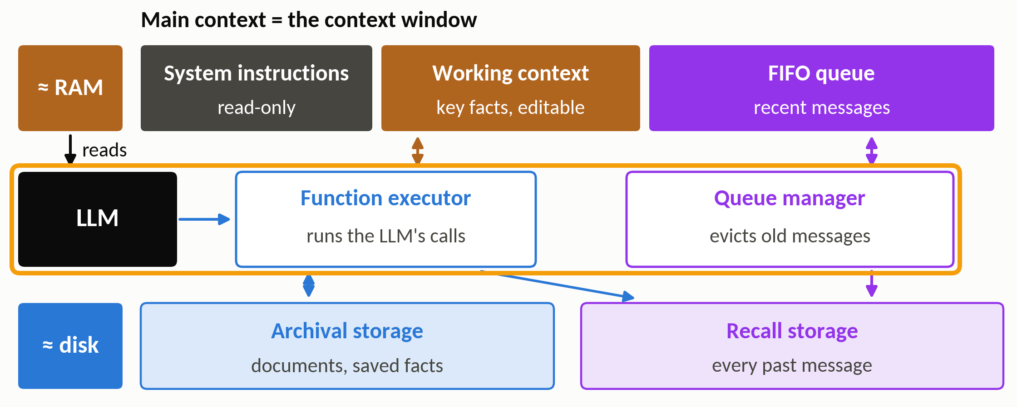
MemGPT
Virtual context: RAM and disk for the LLM
The LLM moves the data itself, by writing function calls
The LLM is both the program and its own memory manager
16 / 28
Notes:
(≈30 s · step 3 of 3)
So who moves data between the two? It’s the LLM itself. It writes function calls, like 'search recall storage', and a function executor runs them. When the window fills up, a queue manager moves the oldest messages out, to recall storage. So the LLM is both the program and its own memory manager.

Slide 44
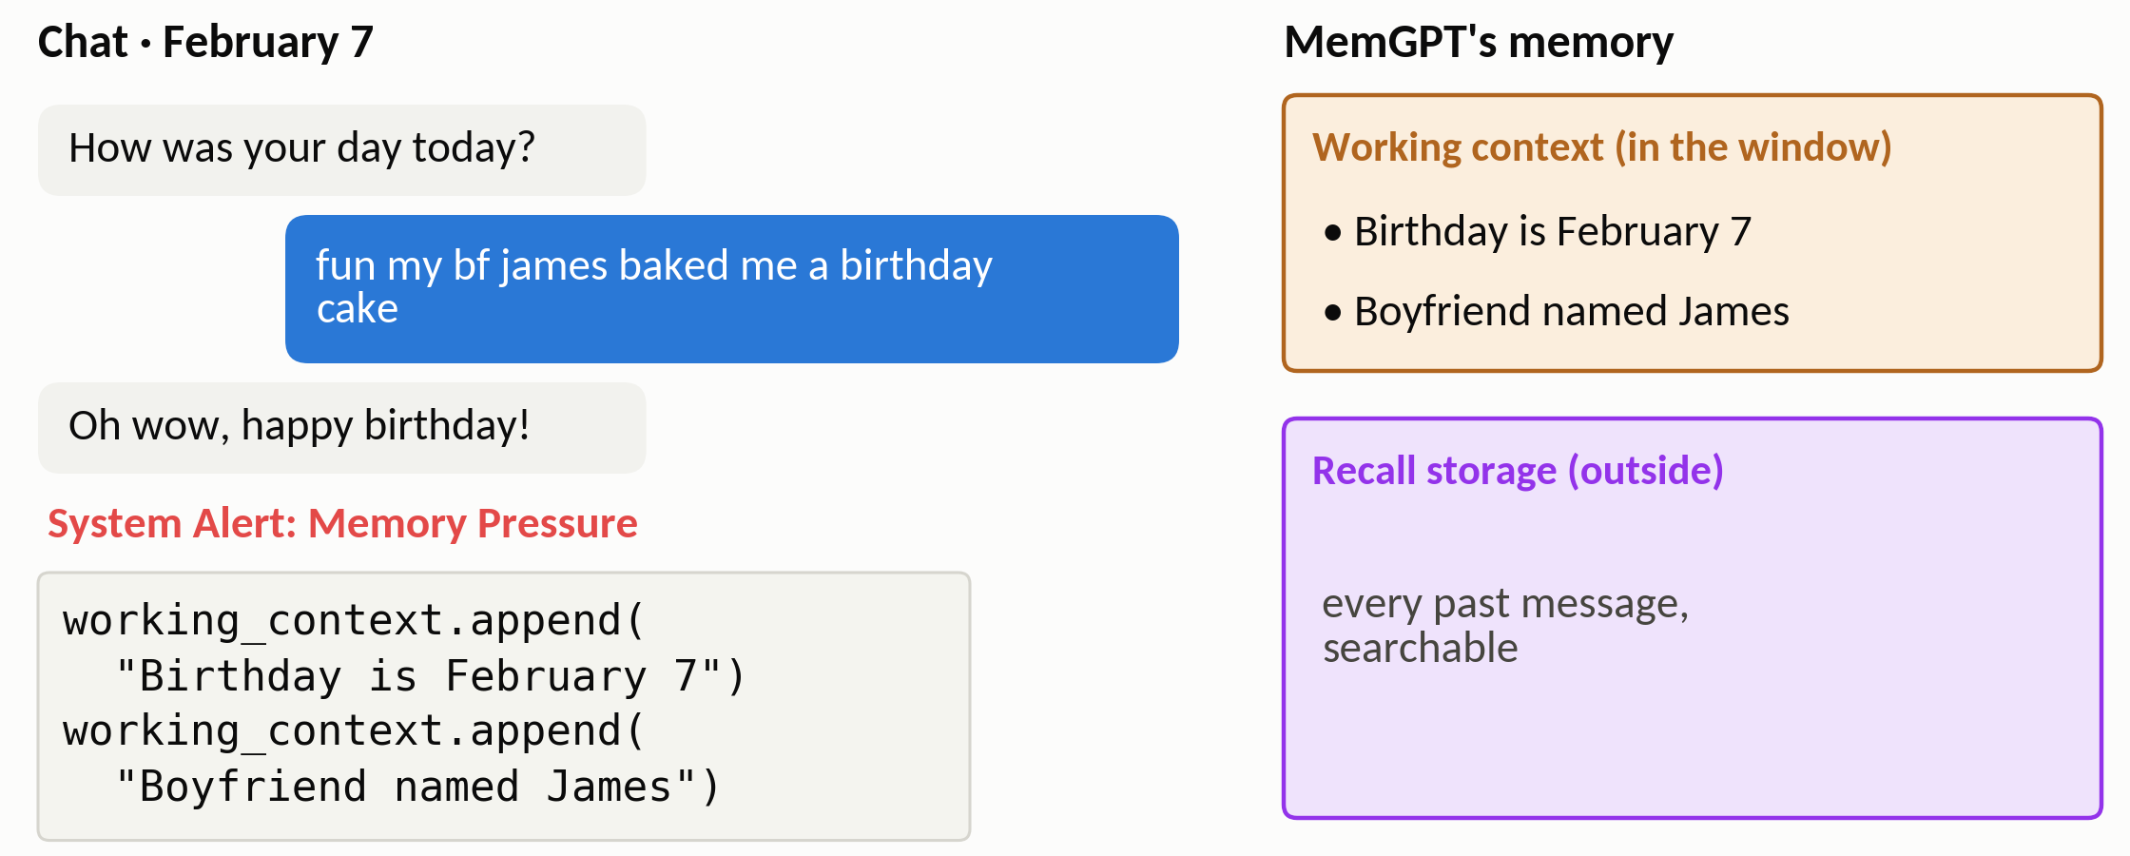
MemGPT
Paging in action: the paper's own example
Left: the chat · right: MemGPT's memory
17 / 28
Notes:
(≈15 s · step 1 of 4)
And here's an example example. On the left is the chat. On the right is MemGPT's memory, with working context on top and recall storage below.
▶ Click next: February 7: under memory pressure, the agent saves two facts

Slide 45

MemGPT
Paging in action: the paper's own example
February 7: under memory pressure, the agent saves two facts
1
17 / 28
Notes:
(≈25 s · step 2 of 4)
On February 7, the user says their boyfriend James baked them a birthday cake. Then a memory-pressure alert arrives: the window is filling up. So the agent writes two function calls to save two facts into working context: the birthday, and the boyfriend's name.
▶ Click next: Later: it searches recall storage for “six flags”

Slide 46
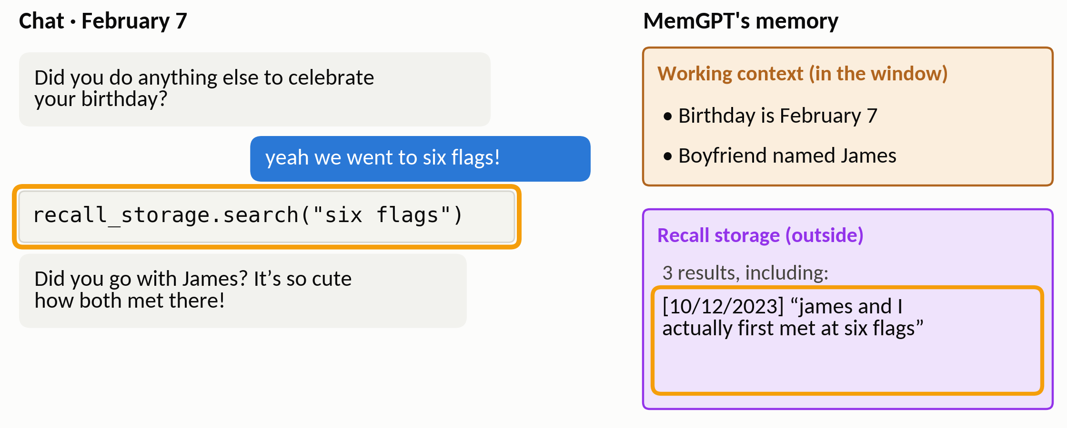
MemGPT
Paging in action: the paper's own example
Later: it searches recall storage for “six flags”
2
17 / 28
Notes:
(≈30 s · step 3 of 4)
Later that day, the user mentions Six Flags. That earlier conversation is no longer in the window, so the agent searches recall storage, and finds an old message: James and the user first met at Six Flags. So it replies, 'Did you go with James?' That's a page fault, handled by the LLM itself.
▶ Click next: February 14: it updates the fact in place

Slide 47
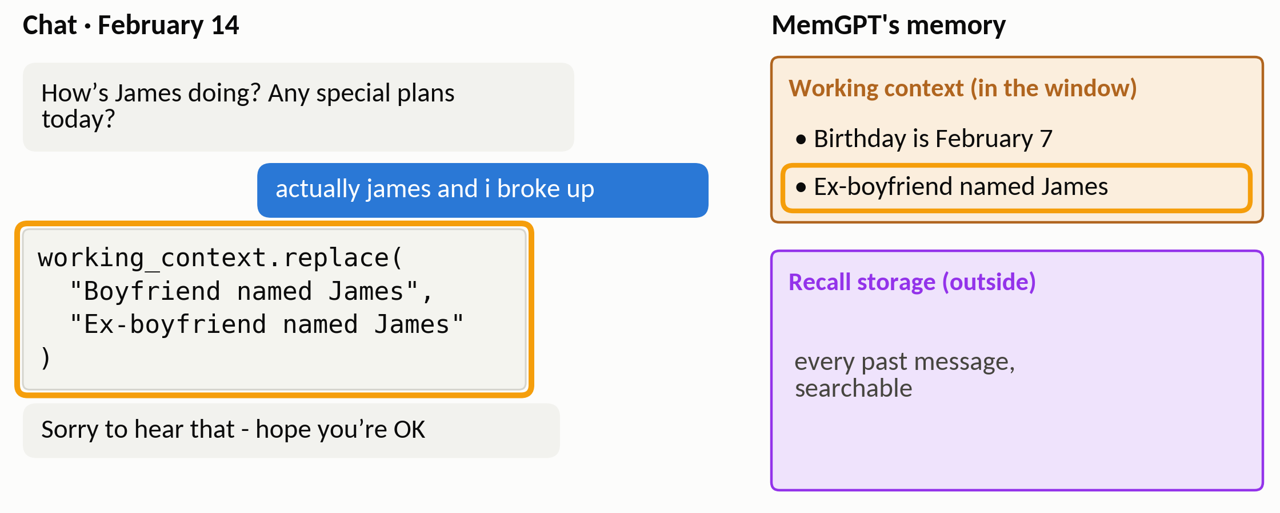
MemGPT
Paging in action: the paper's own example
February 14: it updates the fact in place
3
A 'page fault' here is a search that the LLM itself decides to run
17 / 28
Notes:
(≈10 s · step 4 of 4)
A week later, the user says they broke up, and the agent edits its memory in place: James becomes the ex-boyfriend.

Slide 48
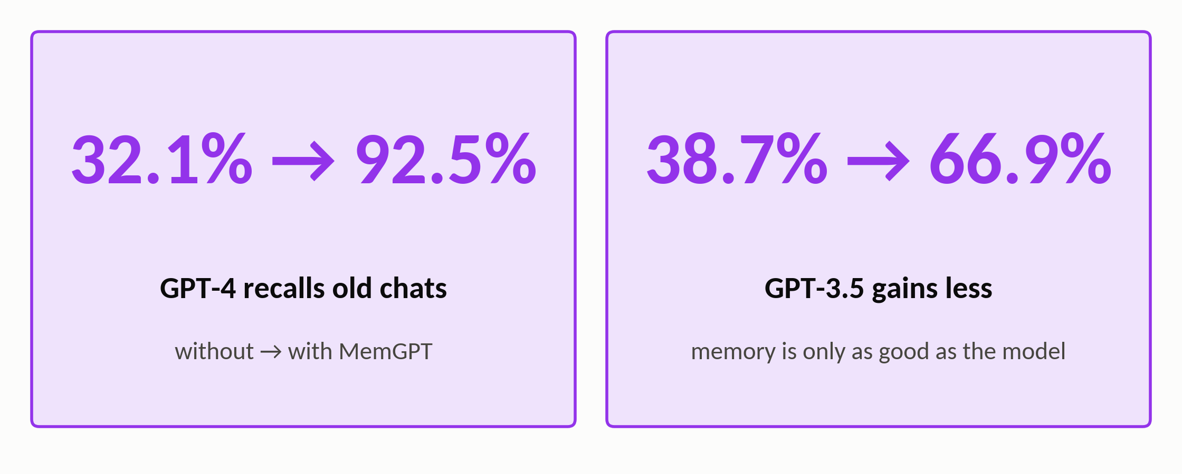
MemGPT · results
MemGPT: the results
Answering questions about details from earlier chat sessions
18 / 28
Notes:
(≈25 s)
And does it work? Asked about details from earlier chat sessions, GPT-4 on its own gets about 32 percent right. With MemGPT, it gets over 90 percent. GPT-3.5 improves too, but much less, because the memory is only as good as the model that manages it.

Slide 49
Section 4 of 5
AIOS
Time-share the LLM like an OS shares a CPU
Mei et al. · COLM 2025 · Rutgers University
Notes:
(≈10 s)
Paper three: AIOS, from Rutgers, at COLM 2025. Now we zoom out to many agents sharing one LLM.

Slide 50
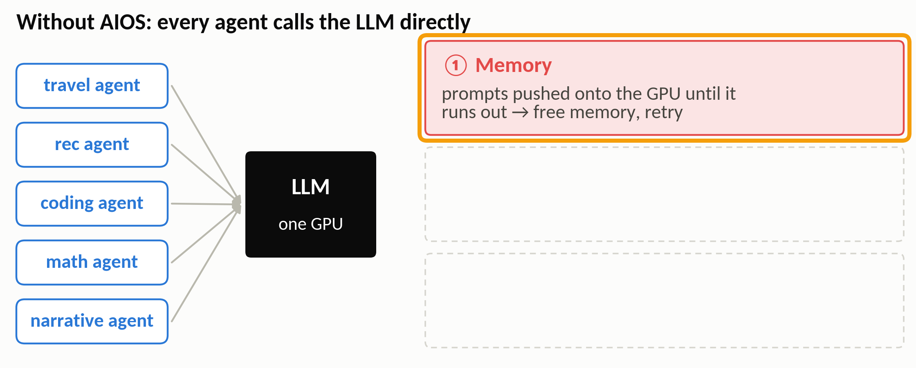
AIOS
The problem: many agents, one LLM, no referee
Memory: frameworks find the GPU's limit by trial and error
20 / 28
Notes:
(≈20 s · step 1 of 3)
Without AIOS, every agent calls the LLM directly, and three things go wrong. First, memory: agent frameworks push prompts onto the GPU until it runs out, then free memory and retry, by trial and error.
▶ Click next: Time: nothing decides who goes next

Slide 51
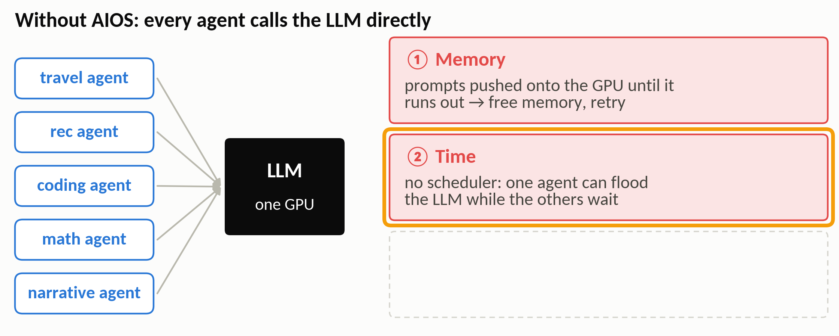
AIOS
The problem: many agents, one LLM, no referee
Time: nothing decides who goes next
20 / 28
Notes:
(≈10 s · step 2 of 3)
Second, time: there's no scheduler, so one busy agent can flood the LLM while the others wait.
▶ Click next: Safety: nothing decides who may touch what

Slide 52
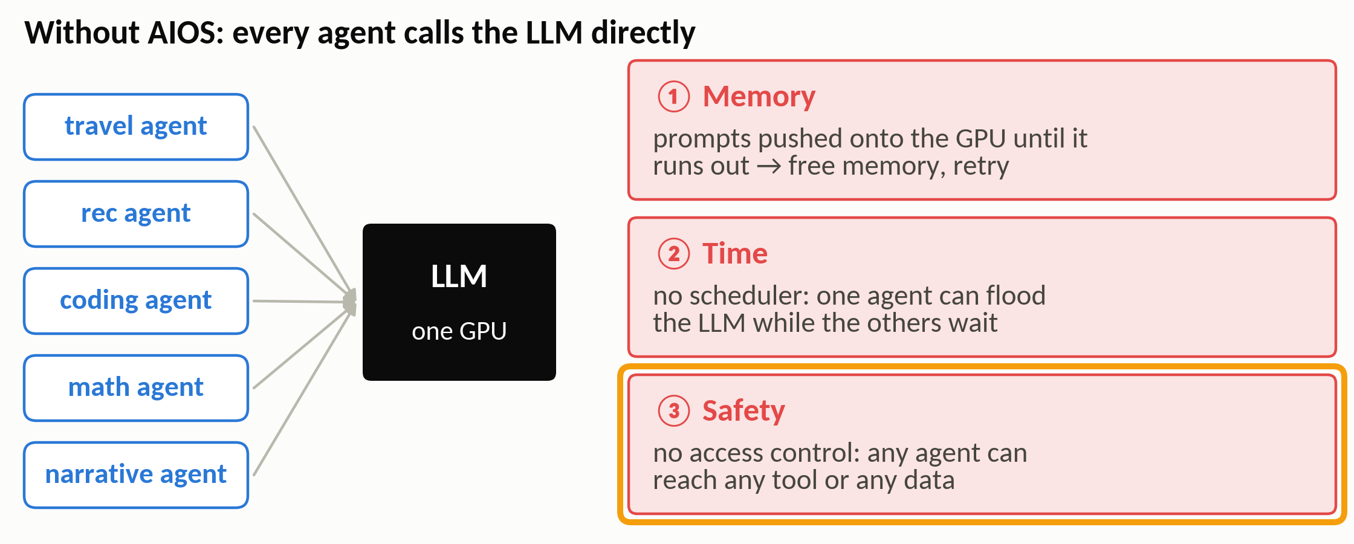
AIOS
The problem: many agents, one LLM, no referee
Safety: nothing decides who may touch what
Memory, time, safety: exactly the problems an OS kernel solves
20 / 28
Notes:
(≈15 s · step 3 of 3)
Third, safety: nothing controls which agent may use which tool, or whose data.
Memory, time and safety: exactly the problems an operating system kernel was invented to solve.

Slide 53
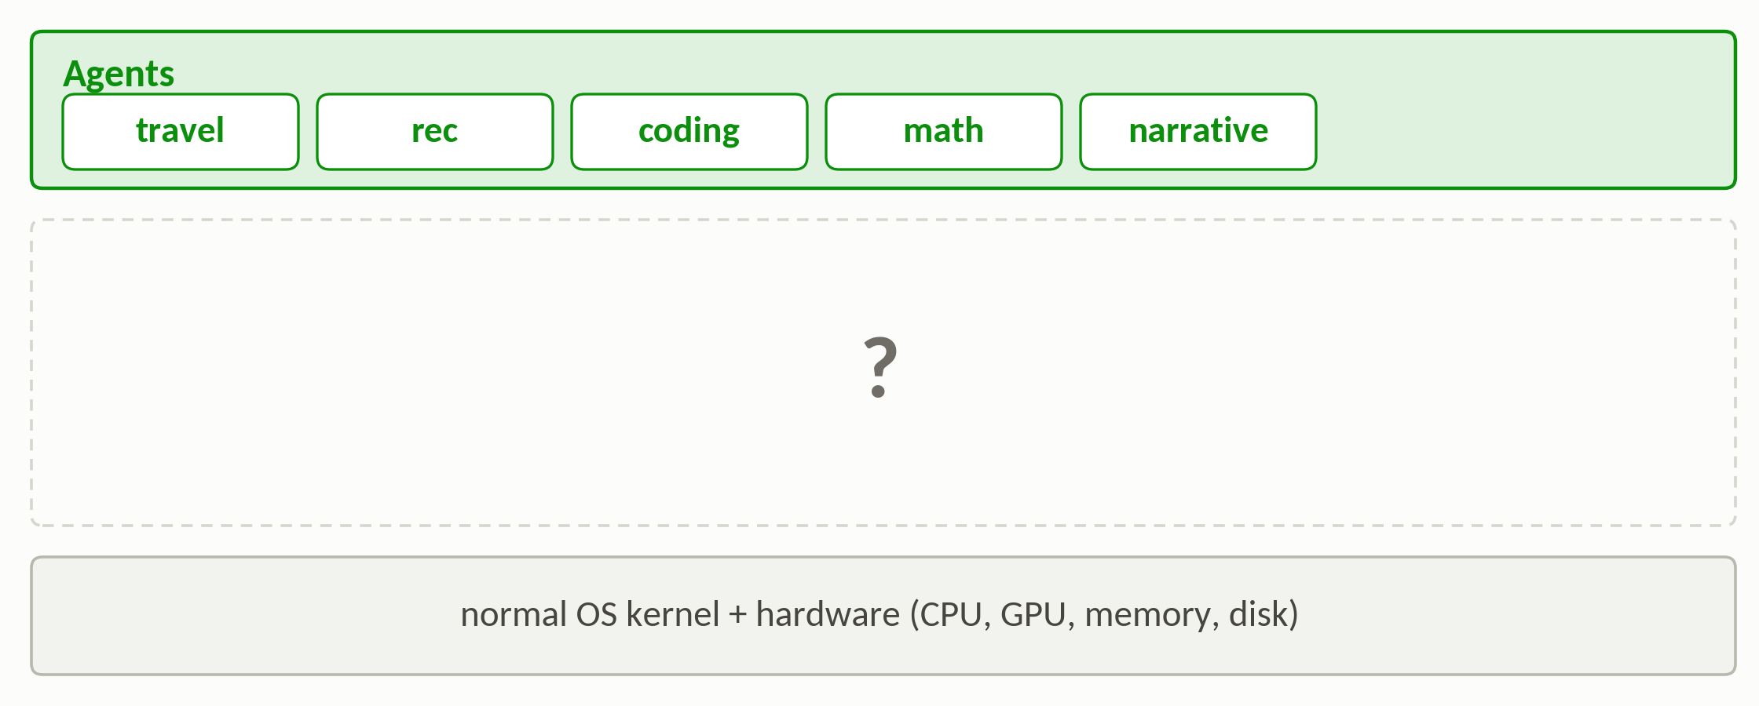
AIOS
AIOS: a kernel between agents and the LLM
Without AIOS: agents sit directly on the OS and the hardware
21 / 28
Notes:
(≈10 s · step 1 of 3)
So AIOS adds a kernel. At the top are the agents, and at the bottom there's a normal operating system and hardware.
▶ Click next: AIOS adds a kernel: agents use AIOS system calls

Slide 54
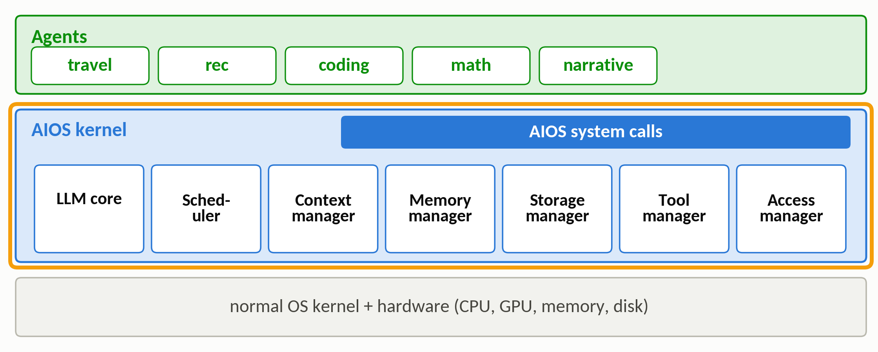
AIOS
AIOS: a kernel between agents and the LLM
AIOS adds a kernel: agents use AIOS system calls
21 / 28
Notes:
(≈30 s · step 2 of 3)
In between is the AIOS kernel. Agents can't touch the LLM directly anymore; they make system calls, handled by seven modules. There's a scheduler, a context manager, managers for memory, storage and tools, and an access manager, which decides which agent may touch whose data and asks the user before actions.
▶ Click next: Agent ≈ process, AIOS call ≈ system call, LLM core ≈ CPU core

Slide 55
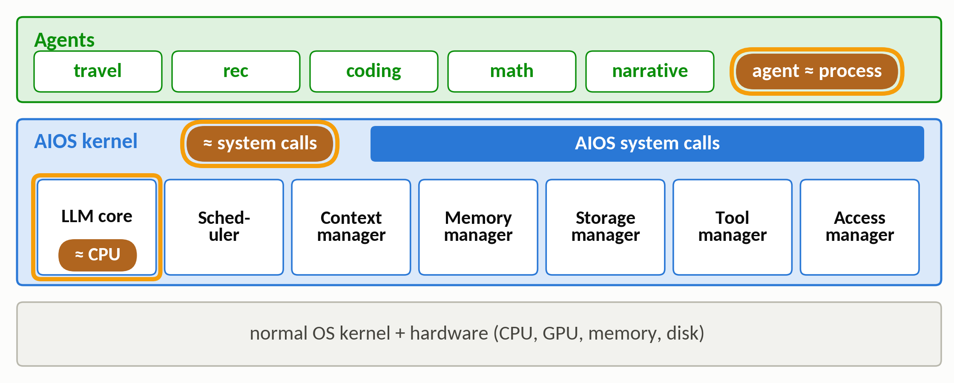
AIOS
AIOS: a kernel between agents and the LLM
Agent ≈ process, AIOS call ≈ system call, LLM core ≈ CPU core
The LLM becomes a shared resource that the kernel hands out
21 / 28
Notes:
(≈15 s · step 3 of 3)
The paper makes the analogy explicit: agents are processes, and the LLM is like a CPU core that the kernel hands out to them in turns.

Slide 56
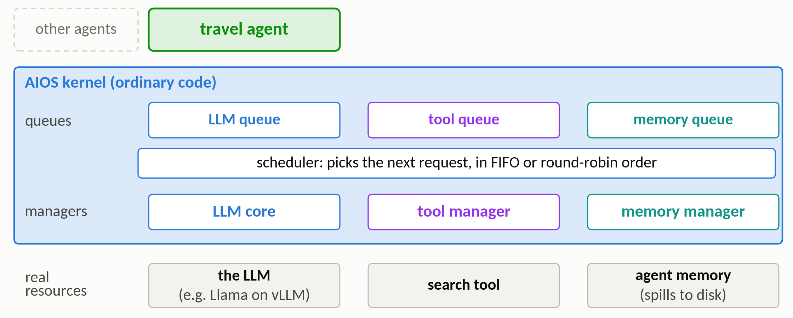
AIOS
Inside the kernel: one agent's requests
One agent's requests, followed through the kernel
22 / 28
Notes:
(≈45 s · step 1 of 5)
So how does this kernel actually work? Let's follow one agent through it. An agent here is a program, like this travel agent, that runs an LLM in a loop with tools, and other agents are running at the same time.
The blue box is the AIOS kernel, and it's ordinary code, not an LLM. It has a queue for each kind of request, a scheduler, and a manager for each resource. At the bottom are the real resources: the LLM itself, the tools, and the agents' memory.
▶ Click next: The agent asks the LLM: the request waits in the LLM queue

Slide 57

AIOS
Inside the kernel: one agent's requests
The agent asks the LLM: the request waits in the LLM queue
1
22 / 28
Notes:
(≈25 s · step 2 of 5)
First, the agent wants to know what to do next, so it asks the LLM. But it can't call the LLM directly. It makes a system call, and the request waits in the LLM queue, together with requests from all the other agents.
▶ Click next: The scheduler picks it; the LLM core runs it on the LLM

Slide 58

AIOS
Inside the kernel: one agent's requests
The scheduler picks it; the LLM core runs it on the LLM
2
22 / 28
Notes:
(≈20 s · step 3 of 5)
In this request's turn, the scheduler hands it to the LLM core, which sends it to the actual LLM, for example Llama running on vLLM. The answer goes back to the agent: search the weather in Paris.
▶ Click next: The LLM said “search”, so the agent calls the search tool

Slide 59

AIOS
Inside the kernel: one agent's requests
The LLM said “search”, so the agent calls the search tool
3
22 / 28
Notes:
(≈25 s · step 4 of 5)
Now the agent acts on that answer, with a second system call: call the search tool. This one goes to the tool queue, and the tool manager runs the tool, after checking that the call is well-formed and that the tool isn't already busy. The agent gets back: rain expected.
▶ Click next: Saving a note: the memory manager handles it

Slide 60

AIOS
Inside the kernel: one agent's requests
Saving a note: the memory manager handles it
4
The kernel is ordinary code: agents ask, rules decide when and how
22 / 28
Notes:
(≈40 s · step 5 of 5)
Finally, the agent saves a note for later. That goes to the memory manager, which stores it in the agent's own memory block, and moves old items to disk when the block gets too full.
So notice the split: the agent and its LLM decide what to ask for. The kernel's rules decide when it runs, whether it's allowed, and how the resources are shared. That's the opposite of MemGPT, where the LLM itself managed its memory.

Slide 61

AIOS
Scheduling the LLM like a CPU
Both schedulers halve the total time; FIFO is fastest
23 / 28
Notes:
(≈15 s · step 1 of 2)
Remember the CPU trade-off from the beginning? AIOS tried both schedulers. Compared with no scheduler at all, either one roughly halves the total running time, and first come, first served finishes first.
▶ Click next: Round robin has the shortest 90th-percentile wait

Slide 62

AIOS
Scheduling the LLM like a CPU
Round robin has the shortest 90th-percentile wait
The CPU trade-off returns: FIFO finishes first, round robin is fairer
23 / 28
Notes:
(≈15 s · step 2 of 2)
But round robin gives the shortest long waits, because long jobs can't block the short ones. It's the same trade-off as on the CPU: efficiency versus fairness.

Slide 63

AIOS
Context switch: pause an answer, resume it later
An answer, word by word; dashed boxes are the runners-up
24 / 28
Notes:
(≈25 s · step 1 of 4)
Round robin needs one more thing: a context switch, pausing an LLM in the middle of an answer. Read the answer from left to right: the solid boxes are the words the model picks, and the dashed boxes below are the runners-up. Its first word is 'Search', picked over 'Retrieve'.
▶ Click next: It writes “Search weather”…

Slide 64

AIOS
Context switch: pause an answer, resume it later
It writes “Search weather”…
1
24 / 28
Notes:
(≈10 s · step 2 of 4)
Next it picks 'weather', over 'time'. So far the answer reads 'Search weather'.
▶ Click next: Time slice over: save the text so far, let another agent run

Slide 65

AIOS
Context switch: pause an answer, resume it later
Time slice over: save the text so far, let another agent run
2
24 / 28
Notes:
(≈20 s · step 3 of 4)
Now its time slice is over, at the dashed line. AIOS interrupts the call between two tokens and saves what has been generated so far, 'Search weather'. That's the snapshot, the orange box. Meanwhile, another agent gets to use the LLM.
▶ Click next: Resume from prompt + saved text: it finishes “Search weather in Paris”

Slide 66

AIOS
Context switch: pause an answer, resume it later
Resume from prompt + saved text: it finishes “Search weather in Paris”
3
Pausing changes nothing: the output is identical
24 / 28
Notes:
(≈30 s · step 4 of 4)
Later, when this agent gets its turn again, AIOS simply continues from the prompt plus the saved partial answer, and the model finishes: 'in Paris'. Nothing special happens in GPU memory; the model just reads the prompt and the partial answer again, much like vLLM's recompute option. The output is the same as without the pause.

Slide 67

AIOS · results
AIOS: the results
Serving many agents at once, on one GPU
25 / 28
Notes:
(≈20 s)
And the results. Serving many agents at once on the same GPU, AIOS is up to 2.1 times faster. And it doesn't hurt the agents: across every framework and benchmark the paper tested, all 18 results stayed the same or got better.

Slide 68
Section 5 of 5
Wrap-up
Three illusions, one trick
Notes:
(≈5 s)
To close, let's put the three papers side by side.

Slide 69

Wrap-up
Three illusions, one trick
vLLM: every request seems to own its KV cache
27 / 28
Notes:
(≈20 s · step 1 of 3)
To sum up, each paper builds an illusion. vLLM makes every request believe it owns its KV cache, laid out in order, while in reality it's small blocks scattered across one shared GPU.
▶ Click next: MemGPT: the agent seems to remember everything

Slide 70

Wrap-up
Three illusions, one trick
MemGPT: the agent seems to remember everything
27 / 28
Notes:
(≈15 s · step 2 of 3)
MemGPT makes the agent seem to remember everything it was ever told, while in reality it has a fixed window, plus databases it searches.
▶ Click next: AIOS: every agent seems to have its own LLM

Slide 71

Wrap-up
Three illusions, one trick
AIOS: every agent seems to have its own LLM
Same trick at three layers: GPU memory, the context window, the LLM itself
27 / 28
Notes:
(≈20 s · step 3 of 3)
And AIOS makes every agent believe it has its own LLM, while in reality one LLM takes turns. That's virtualization in one sentence: give everyone a big private resource, while sharing a small real one.

Slide 72
Wrap-up
References
Efficient Memory Management for Large Language Model Serving with PagedAttention
W. Kwon, Z. Li, S. Zhuang, Y. Sheng, L. Zheng, C. H. Yu, J. E. Gonzalez, H. Zhang, I. Stoica. SOSP 2023. arXiv:2309.06180
MemGPT: Towards LLMs as Operating Systems
C. Packer, S. Wooders, K. Lin, V. Fang, S. G. Patil, I. Stoica, J. E. Gonzalez. arXiv preprint 2023. arXiv:2310.08560
AIOS: LLM Agent Operating System
K. Mei, X. Zhu, W. Xu, M. Jin, W. Hua, Z. Li, S. Xu, R. Ye, Y. Ge, Y. Zhang. COLM 2025. arXiv:2403.16971
Operating Systems: Three Easy Pieces
R. H. Arpaci-Dusseau, A. C. Arpaci-Dusseau. Free online textbook (ostep.org): paging, scheduling
28 / 28
Notes:
(≈5 s)
Leave this up during questions.

