Slide 1
CSC6032 – Advanced Operating Systems
Prof. Yeh-Ching Chung
School of Data Science
Chinese University of Hong Kong, Shenzhen

Slide 2
Class Information
Instructor
Dr. Yeh-Ching Chung (ychung@cuhk.edu.hk)
Course TA
刘宇轩 : yuxuanliu1@link.cuhk.edu.cn
Lectures
Tuesday 13:30am – 14:50am ZX111
Thursday 13:30am – 14:50am ZX111
Online Platform
Blackboard (https://bb.cuhk.edu.cn)
Website
http://www.cs.nthu.edu.tw/~ychung/syllabus/CSC6032-2026-Spring.htm

Slide 3
Textbooks & Reference
Textbooks
Distribute OS by Tanenbaum
Virtualization-From Desktop to Enterprise by Chris Wolf and Erick M. Halter
References
Papers

Slide 4
Course Syllabus
Distributed OS
Distributed Systems
Process and Thread
Distributed Shared Memory
Distributed File Systems
Virtualization
System Virtualization
Storage Virtualization
Network Virtualization
GPU Virtualization
Software Virtualization
Hardware Support Virtualization

Slide 5
Course Assessment
Class participation (25%)
Term Projects (50%)
Report (25%)
If you need to apply for a leave, send email/WeChat note to me in advance.
If you are ill, obtain a medical note and email it to me as soon as possible and no later than a week after your absence.
Students are responsible to keep track on their marks.

Slide 6
Learning Outcome
Upon completing this course, students will be able to
Understand the content of Distributed Systems
Understand the content of Distributed Shared-Memory Systems
Understand the content of Distributed File Systems
Understand the content of System Virtualization
Understand the content of CPU Virtualization
Understand the content of Memory Virtualization
Understand the content of IO Virtualization
Understand the content of Storage Virtualization

Slide 7
Academic Honesty
Zero Tolerance
Plagiarism, cheating, misconduct in test/exam will be reported to the School for handing.
Consequences
Zero marks for the concerned assignments/test/exam/whole course, reviewable demerits, non-reviewable demerits, suspension of study, dismissal from University.
University Policy to Academic Honesty
https://registry.cuhk.edu.cn/en/page/30

Slide 8
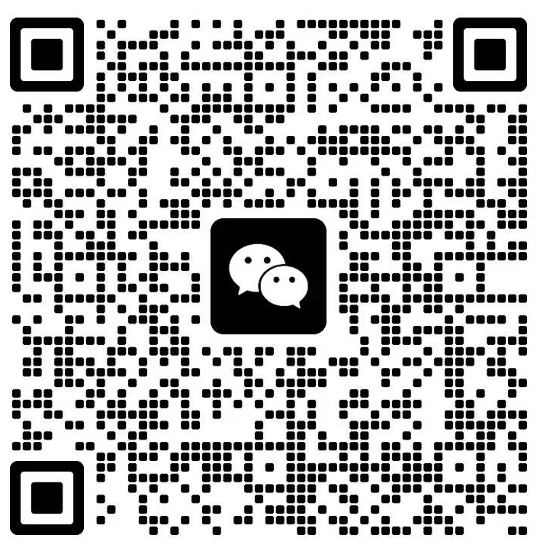
CSC6032 WeChat Group QR Code

