Slide 1
Memory Management for LLM-Based Agents An OS-Inspired Perspective on Agent Memory 2026.3.31
Yuan Xie
School of Data Science
Chinese University of Hong Kong, Shenzhen

Slide 2
Outline
Introduction (5 min)
Background & Motivation (3 min)
Proposed Methods & Performance Evaluation (24 min)
A-Mem (9 min)
Memory-OS (9 min)
APC (6 min)
Conclusions (2 min)
Q & A (2 min)

Slide 3
Outline
Introduction (5 min)
Background & Motivation (3 min)
Proposed Methods & Performance Evaluation (24 min)
A-Mem (9 min)
Memory-OS (9 min)
APC (6 min)
Conclusions (2 min)
Q & A (2 min)

Slide 4
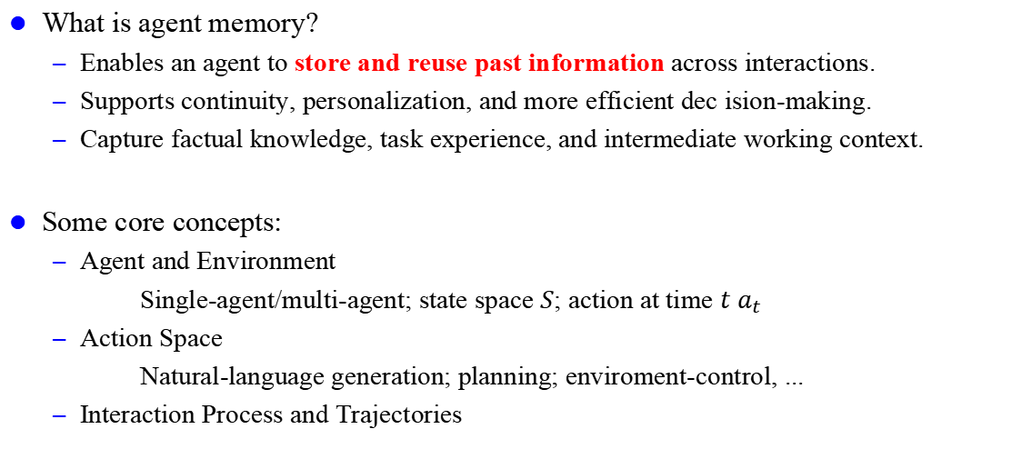
Introduction – Agents Memory (1/2)
What is agent memory?
Enables an agent to store and reuse past information across interactions.
Supports continuity, personalization, and more efficient dec ision-making.
Capture factual knowledge, task experience, and intermediate working context.
Some core concepts:
Agent and Environment
Single-agent/multi-agent; state space $S$; action at time $t$ $a_{t}$
Action Space
Natural-language generation; planning; enviroment-control, ...
Interaction Process and Trajectories

Slide 5
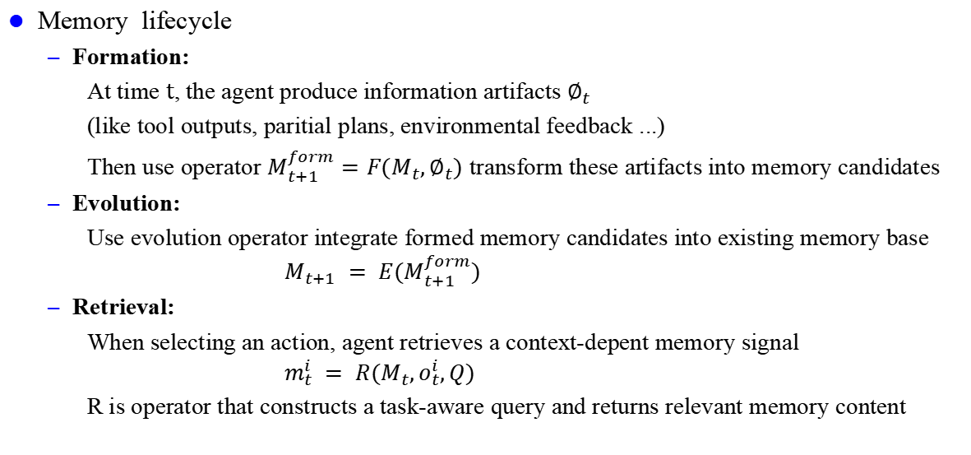
Introduction – Agents Memory (2/2)
Memory lifecycle
Formation:
At time $t$, the agent produce information artifacts $∅_{t}$
(like tool outputs, paritial plans, environmental feedback ...)
Then use operator $M_{t+1}^{form}=F(M_{t},∅_{t})$ transform these artifacts into memory candidates
Evolution:
Use evolution operator integrate formed memory candidates into existing memory base
$$M_{t+1} = E(M_{t+1}^{form})$$
Retrieval:
When selecting an action, agent retrieves a context-depent memory signal
$$m_{t}^{i} = R(M_{t},o_{t}^{i},Q)$$
R is operator that constructs a task-aware query and returns relevant memory content
persistent and
self-evolving！

Slide 6
Outline
Introduction (5 min)
Background & Motivation (3 min)
Proposed Methods & Performance Evaluation (24 min)
A-Mem (9 min)
Memory-OS (9 min)
APC (6 min)
Conclusions (2 min)
Q & A (2 min)

Slide 7
Background & Motivation (1/2)
From which aspect can we improve agent memory?
Forms:
What architectural or representational forms can agent memory take?
Functions:
Why need agent memory, and what roles or purposes does it serve?
Dynamics:
How does agent memory operate, adapt and evolve over time?

Slide 8
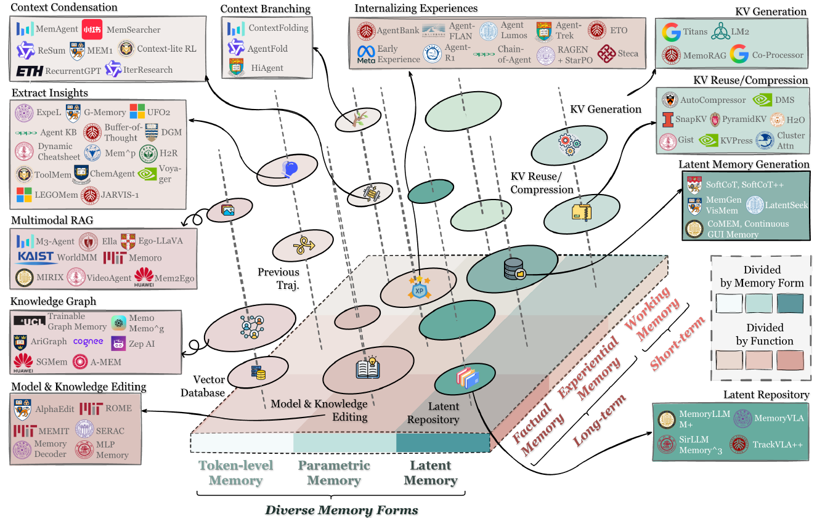
Background & Motivation (2/2)
Devided by Form
Token-level memory
Parametric memory
Latent Memory
Devided by Function
Factual memory
Experimential memory
Working memory
Fig 1. Overview of agent memory

Slide 9
Outline
Introduction (5 min)
Background & Motivation (3 min)
Proposed Methods & Performance Evaluation (24 min)
A-Mem (9 min)
Memory-OS (9 min)
APC (6 min)
Conclusions (2 min)
Q & A (2 min)

Slide 10
Outline
Introduction (5 min)
Background & Motivation (3 min)
Proposed Methods & Performance Evaluation (24 min)
A-Mem (9 min)
Memory-OS (9 min)
APC (6 min)
Conclusions (2 min)
Q & A (2 min)

Slide 11
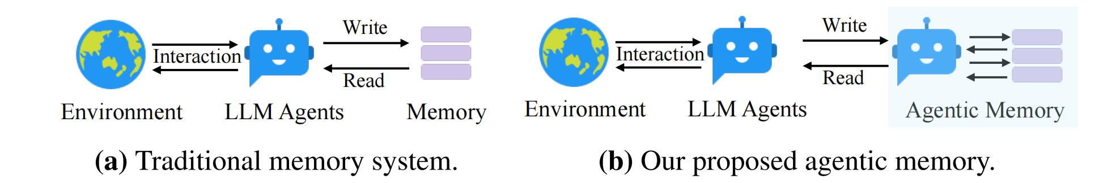
A-Mem (1/8)
Motivation
Current memory system is too negative
Enable basic storage and retrieval but lack sophisticated memory organization
Fixed operations and structures limits their adaptability across diverse tasks
Fig 2. Comparison between traditional memory and A-Mem
Notes:
(from form aspect)

Slide 12
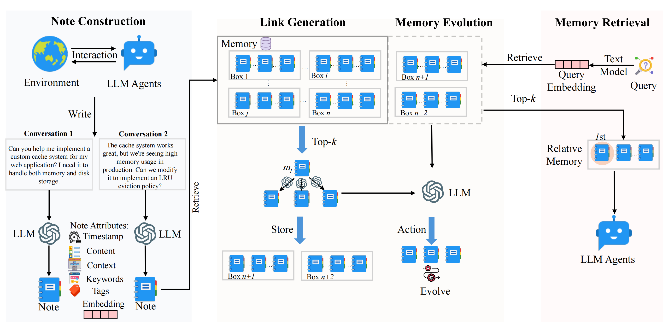
A-Mem (2/8)
Architecture Overview
Note construction:
1) interaction
2) write conversation
3) generate attributes
4) constract new note
5) text encoder generate
embedding
Fig 3. A-Mem architecture comprises three integral parts in memory storage

Slide 13
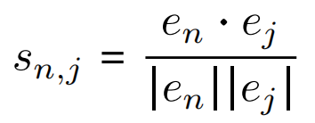

A-Mem (3/8)
Architecture Overview
Link generation:
1) analysis historical memories
2) indentify top-k relevant connections
3) establish links to meaningful similarites
Step 3 is auto-link driven by semantics (by LLM), rather than handcraft rules.
Fig 3. A-Mem architecture comprises three integral parts in memory storage

Slide 14
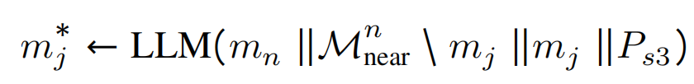

A-Mem (4/8)
Architecture Overview
Memory evolution:
1) using textual information and relationship with new memory
2) find nearest neighbor set, check update or not (context,keyword, ...)
Memory retrieval:
1) compute dense vector representation for query
2) compute similarity score between query and memories
3) find top k historical memories
4) construct contextually appropriate prompt
5) using retrieved memories help agent better understand and response

Slide 15
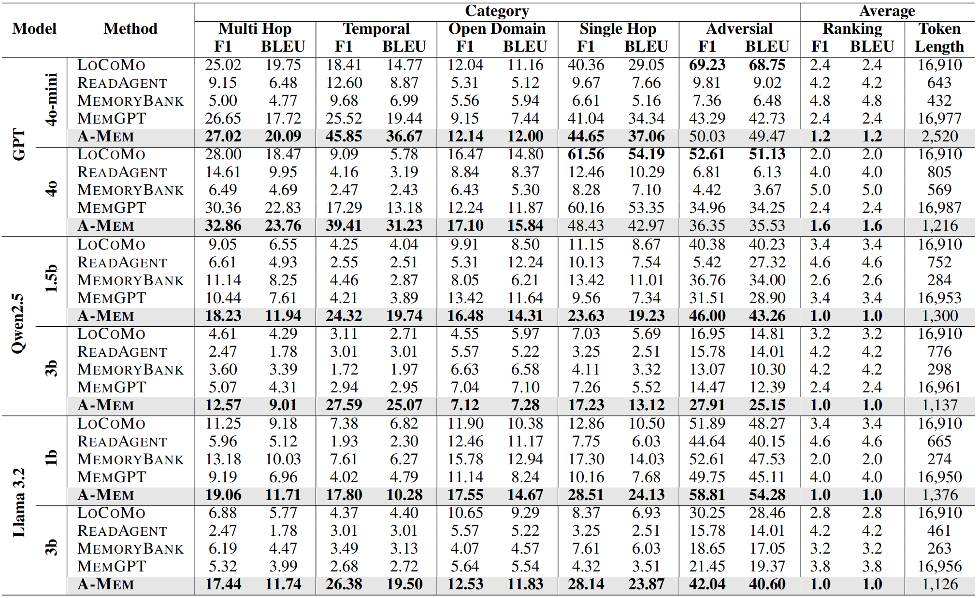
A-Mem (5/8)
Evaluation
A-Mem has
best accurancy &
lower token length
Table 1. Experimental results on LoCoMo dataset

Slide 16
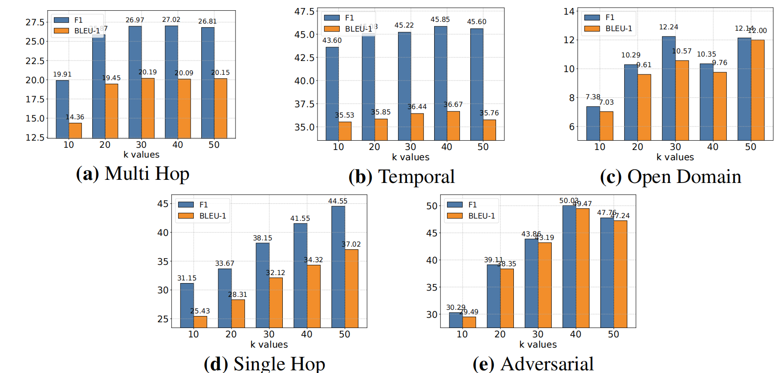
A-Mem (6/8)
Hyperparameter anslysis - retrieval parameter k
Fig 4. Impact of memory retrieval parameter k across different task categories

Slide 17
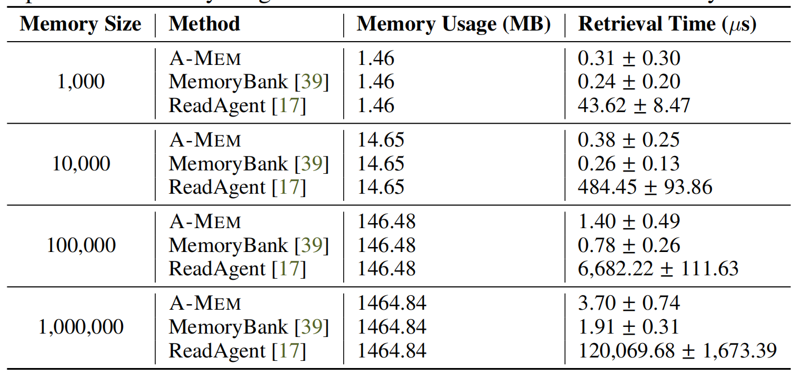
A-Mem (7/8)
Hyperparameter anslysis - memory size
Table 2. Experimental results on LoCoMo dataset

Slide 18
A-Mem (8/8)
Conclusion
A-Mem shows a new way to form the memory:
1) use structured notes + dynamic links instead of predifined structures to adapt
diverse real-word tasks.
2) auto generate contextual descriptions for memory and use LLM to determine
whether update the historical memory or not.

Slide 19
Outline
Introduction (5 min)
Background & Motivation (3 min)
Proposed Methods & Performance Evaluation (24 min)
A-Mem (9 min)
Memory-OS (9 min)
APC (6 min)
Conclusions (2 min)
Q & A (2 min)

Slide 20
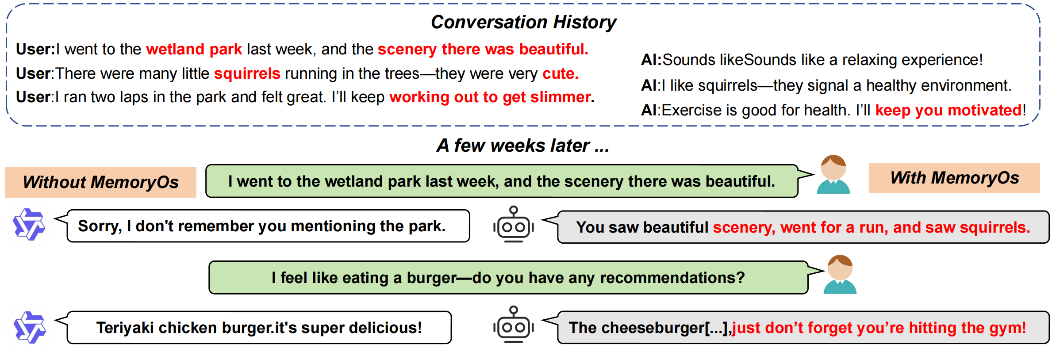
Memory-OS (1/8)
Motivation
LLM agents suffer from fixed context window and inadequate memory management
Lead to weak long-term coherence, poor personalization, factual inconsistency, ...
Existing methods mainly optimize one single aspect (storage, retrieval, update)
MemoryOS treats memory as a complete management system, rather than only a retrieval database!
Notes:
(from function aspect)

Slide 21
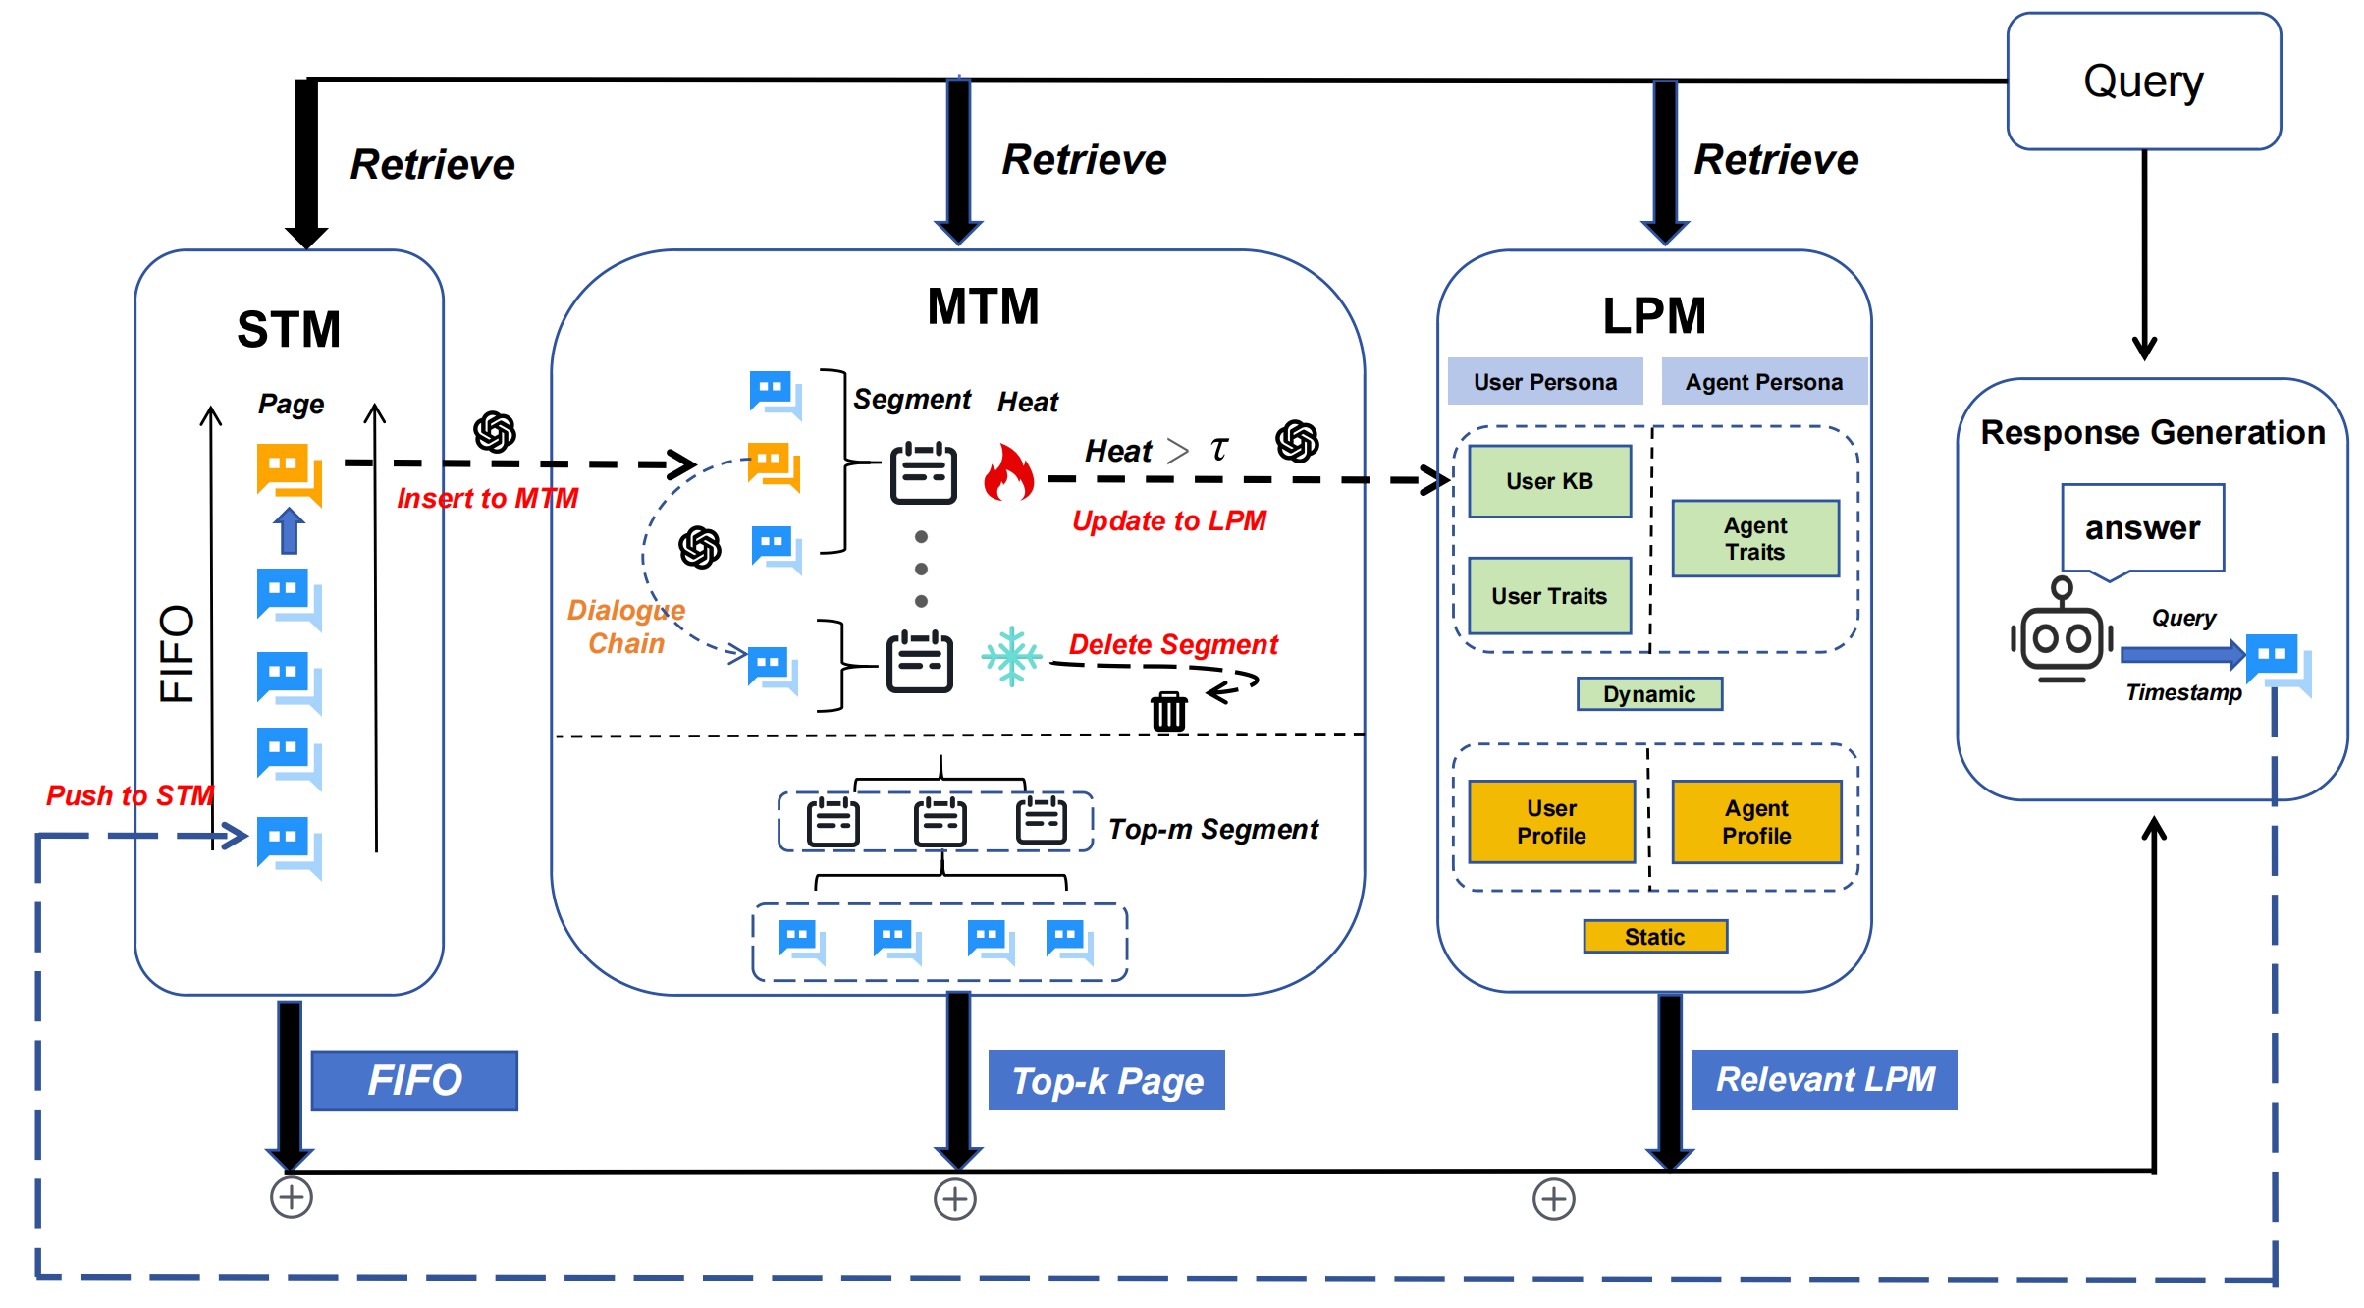
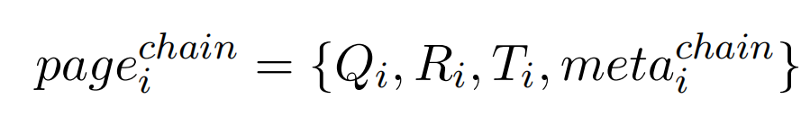
Memory-OS (2/8)
Architecture Overview
Short-term memory:
1) store recent interaction
(query, response, time)
2) build dialogue chain
to maintain contextual
information
3) generate meta-info
(update & summary
chain linkage)
Fig 5. Impact of memory retrieval parameter k across different task categories

Slide 22
Memory-OS (3/8)
Architecture Overview
Mid-term memory:
1) adopts segmented paging architecture
2) group same-topic dialogue pages
into segments
3) summary segment content by LLM
4) compute similarity between dialogue
page and segments
5) merge highly-similar pages into
the same segment
6) update/delete segment by heat

Slide 23
Memory-OS (4/8)
Architecture Overview
Long-term personal memory:
For user persona
1) static user profile (gender, name, …)
2) write user knowledge base (KB) that stores factual information
3) generate user traits that contains interests, habits and preference
For agent persona
1) static agent profile (settings, roles, characters, …)
2) update agent traits through interactions
Notes:
This
module ensures that both the user and the assistant
maintain a persistent memory of important
personal details and characteristics, ensuring consistency
and personalization over long-term interactions.

Slide 24
Memory-OS (5/8)
Memory Updating
STM → MTM:
STM is maintained as a fixed-length queue.
Old dialogue pages are transferred by first-in-first-out
MTM internal management:
dynamically maintain segments according to Heat score.
mainly concern: retrieval frequency, interaction length and recency
MTM → LPM:
high heat segment promote into LPM
low heat segment delete to control capacity

Slide 25
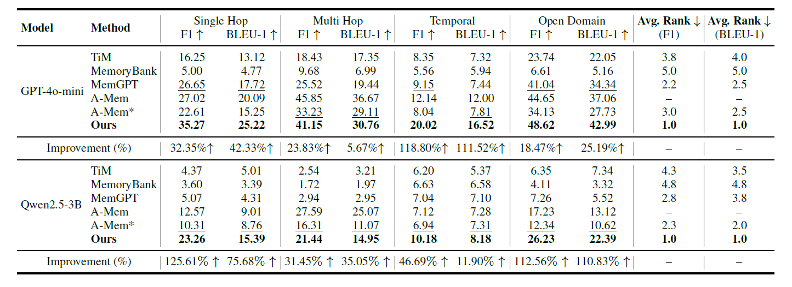
Momory-OS (6/8)
Evaluation
Table 3. LoCoMo dataset comparison with per-category scores and average ranks

Slide 26
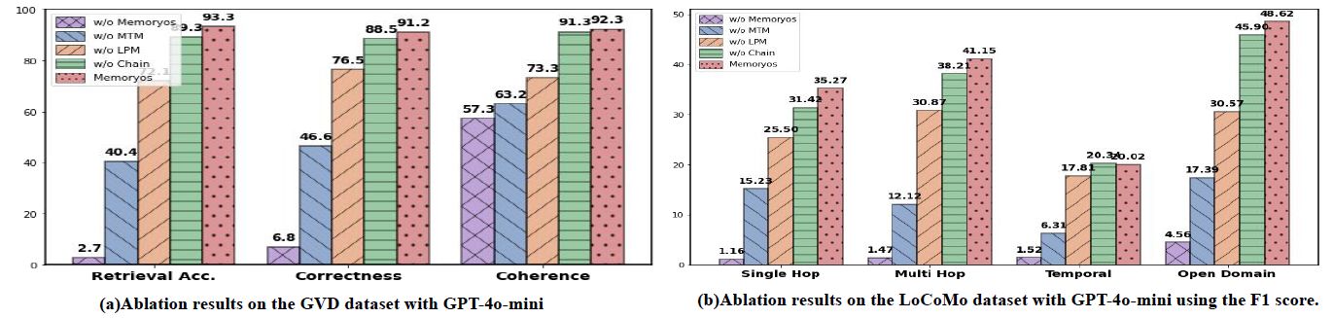
Momory-OS (7/8)
Ablation
Fig 6. The ablation study on the GVD and LoCoMo benchmark datasets

Slide 27
Memory-OS (8/8)
Conclusion
This work shows a novel memory management system:
1) sperate short/mid/long term memory.
2) using heat-driven eviction to manage memory tiers
3) achieving coherent, personalized conversation on long history

Slide 28
Outline
Introduction (5 min)
Background & Motivation (3 min)
Proposed Methods & Performance Evaluation (24 min)
A-Mem (9 min)
Memory-OS (9 min)
APC (6 min)
Conclusions (2 min)
Q & A (2 min)

Slide 29
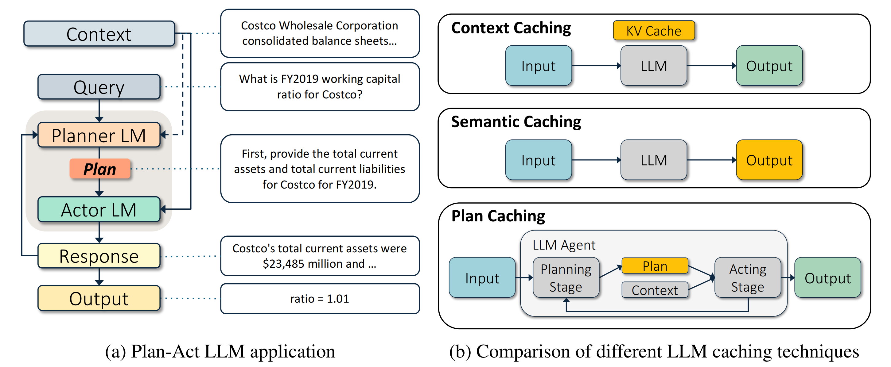
Agentic Plan Caching (1/6)
Motivation
Reasoning or multimodel LLM cost most in planing
Once generate strategy, action stage is easier
Fig 7. Plan-Act LLM applications and caching techniques

Slide 30
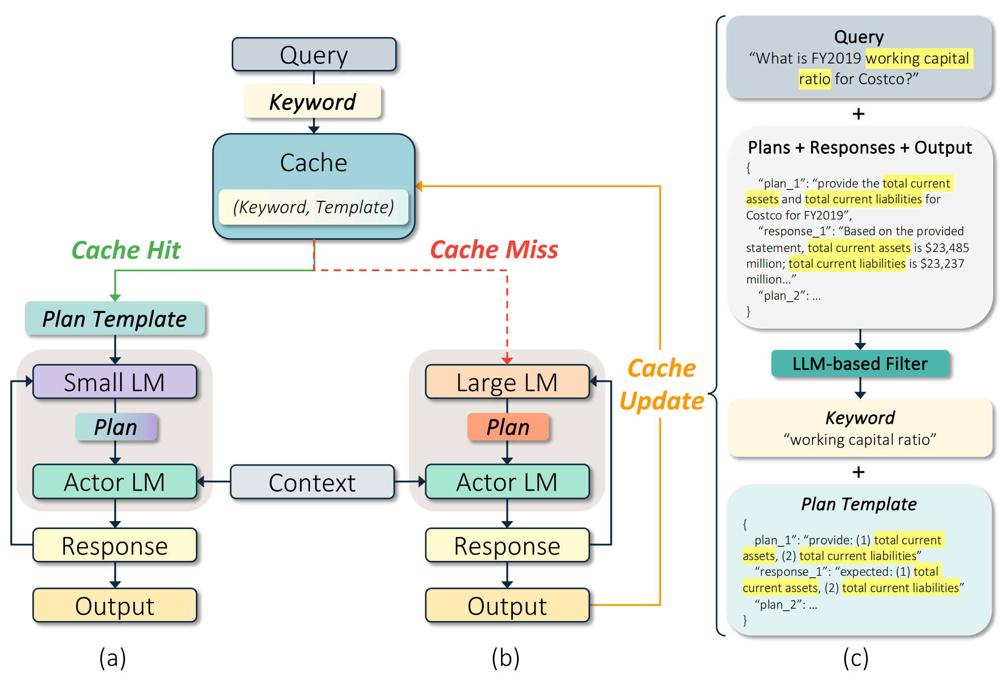
Agentic Plan Caching (2/6)
Architecture Overview
Cache hit:
keywords match
use small LM do plan
then actor LM give response
Cache miss:
keywords not match
use large LM fo plan
then actor LM give response
update cache (plan template, kw)
Fig 8. Agentic plan caching framework

Slide 31
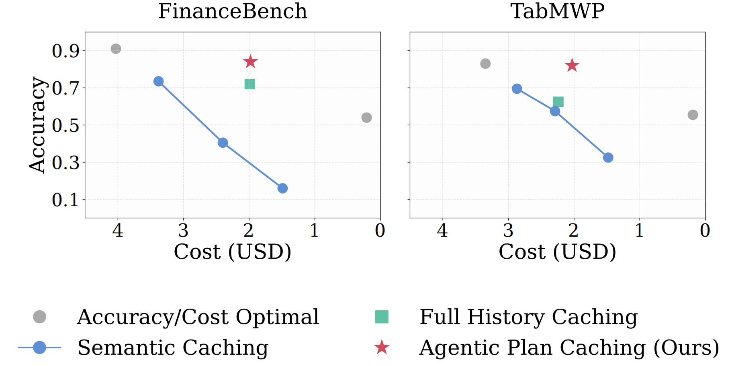
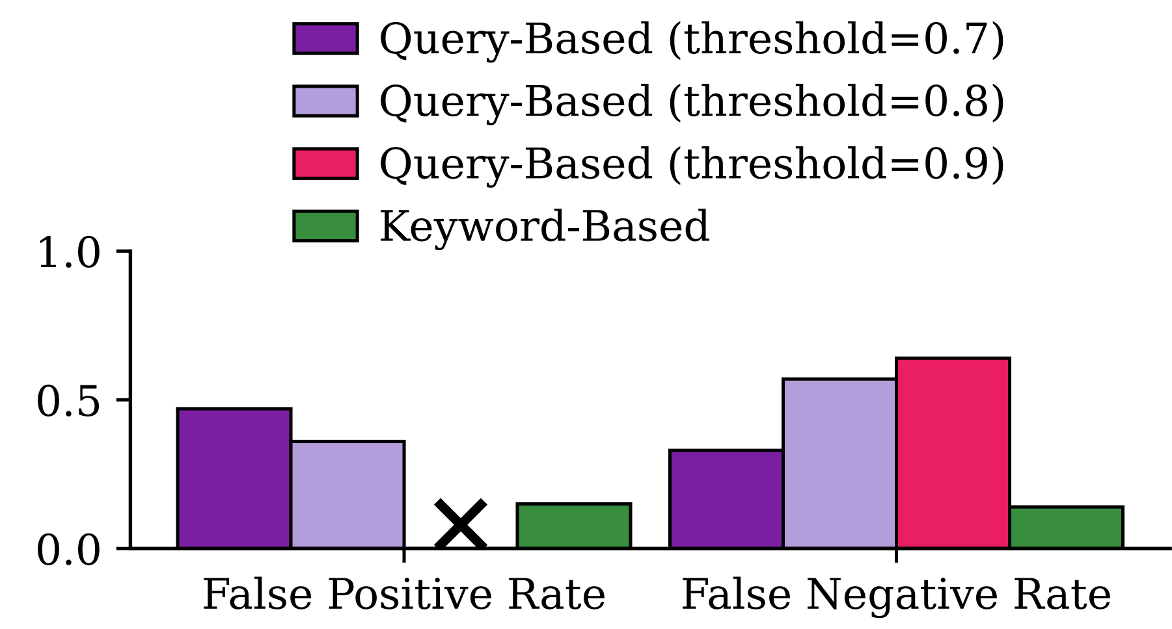
Agentic Plan Caching (3/6)
Evaluation
Query-based vs Keyword-based:
Caching compare:
Fig 9. Query-Based v. Keyword-Based Cache Search
Fig 10. Results across four baselines and agentic plan caching

Slide 32
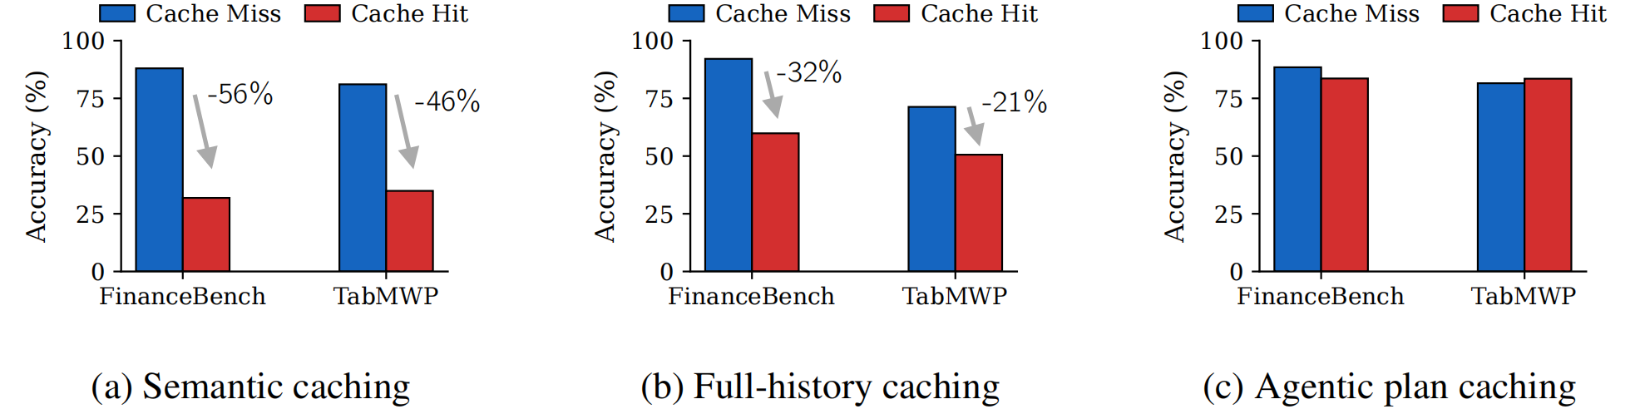
Agentic Plan Caching (4/6)
Evaluation
Cache miss vs Cache hit under different setting:
usual methods have performance trade-off despite potential cost saving, saving plan is better under some scene like finance
Fig 11. Accuracy comparison across caching methods

Slide 33
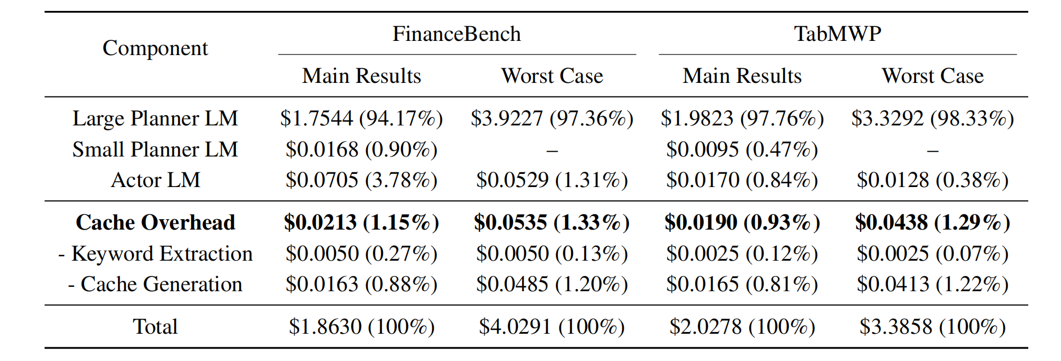
Agentic Plan Caching (5/6)
Evaluation
Cost analysis:
Table 4. Cost analysis on different dataset

Slide 34
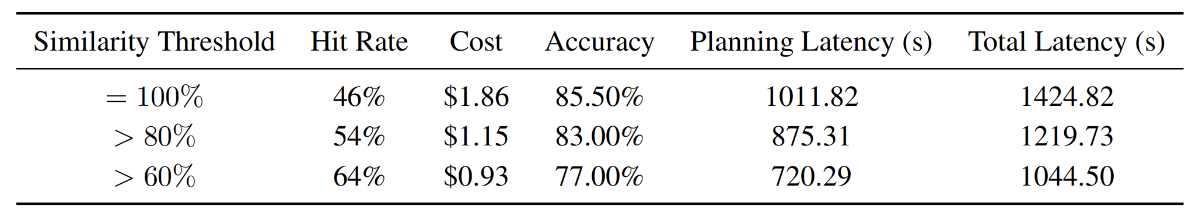
Agentic Plan Caching (6/6)
Evaluation
Fuzzy keyword matching:
Conclusion
APC proposed plan-level caching method and significantly reduce the cost while maintain accurancy
Plan caching can recude error when query hit compared with other caching stategies
Table 5. Fuzzy Keyword Matching Results

Slide 35
Outline
Introduction (5 min)
Background & Motivation (3 min)
Proposed Methods & Performance Evaluation (24 min)
A-Mem (9 min)
Memory-OS (9 min)
APC (6 min)
Conclusions (2 min)
Q & A (2 min)

Slide 36
Conclusions
Agent memory is moving beyond simple context accumulation toward structured and adaptive memory systems
Memory should be organized, not just stored
Memory should evolve, not remain static
Memory should improve both capability and efficiency

Slide 37
Outline
Introduction (5 min)
Background & Motivation (3 min)
Proposed Methods & Performance Evaluation (24 min)
A-Mem (9 min)
Memory-OS (9 min)
APC (6 min)
Conclusions (2 min)
Q & A (2 min)

