Slide 1
From Benchmark to Agents: How SWE-bench Advanced LLM4Code?
Manyi Wang
School of Data Science
Chinese University of Hong Kong, Shenzhen

Slide 2
Outline
Introduction (3 min)
SWE-bench: Real-world Issues Resolution (6 min)
SWE-bench overview (3 min)
Evaluation results (2 min)
SWE-bench family (1 min)
Two Paradigms: Pipeline-based vs. Agent-based (10 min)
Two paradigms (2 min)
SWE-agent: The agent-based approach (3 min)
Agentless: The pipeline-based approach (3 min)
Comparison (2 min)
Conclusions (2 min)
Notes:
Here's the outline. We'll start with a brief introduction to LLM4Code. Then we’ll go into detail of our first paper SWE-bench, The I’ll talk about the two paradigms for solving SWE-bench — pipeline-based and agent-based. I’ll introduce the second paper xxx and the third paper xxx, We'll close with the conclusions.

Slide 3
Outline
Introduction (3 min)
SWE-bench: Real-world Issues Resolution (6 min)
SWE-bench overview (3 min)
Evaluation results (2 min)
SWE-bench family (1 min)
Two Paradigms: Pipeline-based vs. Agent-based (10 min)
Two paradigms (2 min)
SWE-agent: The agent-based approach (3 min)
Agentless: The pipeline-based approach (3 min)
Comparison (2 min)
Conclusions (2 min)
Notes:
First, I’ll give the introduction of llm4code.

Slide 4
Introduction - LLM4Code (1/1)
What’s LLM4Code?
Applying LLM to software engineering tasks, such as code generation, code understanding, program repair.
However, as LLM capabilities rapidly advanced, code generation gradually emerged as the dominant and most impactful task in LLM4Code research.
Function-level Code Generation
Class-level Code Generation
Repo-level Code Generation
Real-world Github Issues Resolution
2021
2022
2023
2024
HumanEval
MBPP
APPS
RepoBench
CrossCodeEval BigCodeBench
ClassEval
SWE-bench
Figure 1. Timeline of Code Generation Benchmark Evolution
Notes:
So what is LLM4Code?
At first, llm4code has a wider defintion that applying large language models to many software engineering tasks, such as code generation, code understanding, program repair, test generation, and more.
However, as today’s LLMs grew more powerful, code generation gradually became the dominant focus. Why? Because code generation is inherently a composite task.
To generate correct code — especially at the repository level — you need code understanding, fault localization, program repair reasoning, and test awareness, all at once. It serves as the ultimate stress test for model capabilities in software engineering.
You can see the timeline of code generation in figure 1. In 2021, before emergence of lm, we had function-level benchmarks where you write a single Python function from a docstring. Then in 2022, ClassEval pushed to class-level generation. In 2023, RepoBench, CrossCodeEval and bigcodebench, started testing cross-file dependencies. But these were still completion tasks — the model is told roughly where to write code.

Slide 5
Introduction - LLM4Code (1/1)
What’s LLM4Code?
Applying LLM to software engineering tasks, such as code generation, code understanding, program repair.
However, as LLM capabilities rapidly advanced, code generation gradually emerged as the dominant and most impactful task in LLM4Code research.
Today’s Focus!
Function-level Code Generation
Class-level Code Generation
Repo-level Code Generation
Real-world Github Issues Resolution
2021
2022
2023
2024
HumanEval
MBPP
APPS
RepoBench
CrossCodeEval BigCodeBench
ClassEval
SWE-bench
Figure 1. Timeline of Code Generation Benchmark Evolution
Notes:
And then came SWE-bench in 2024 — that's today's focus. Where the benchmark actually evaluates the large codebase editing capability, which is as same as real world development.

Slide 6
Outline
Introduction (3 min)
SWE-bench: Real-world Issues Resolution (6 min)
SWE-bench overview (3 min)
Evaluation results (2 min)
SWE-bench family (1 min)
Two Paradigms: Pipeline-based vs. Agent-based (10 min)
Two paradigms (2 min)
SWE-agent: The agent-based approach (3 min)
Agentless: The pipeline-based approach (3 min)
Comparison (2 min)
Conclusions (2 min)
Notes:
Then I’ll introduce the swe-bench.

Slide 7
SWE-bench Overview (1/4)
What’s SWE-bench?
An evaluation framework consisting of 2,294 software engineering problems drawn from real GitHub issues and corresponding pull requests across 12 popular Python repositories.
Why do we need SWE-bench?
Existing benchmarks are saturated and test only isolated functions, whereas SWE‑bench requires repository‑scale, multi‑file reasoning—capturing real‑world software engineering practice.
Notes:
I’ll introduce the swe-bench in four questions.
The first question is, what is SWE-bench? SWE-bench is xxxx…..
The second question is: Why do we need it? SWE-bench made a qualitative leap: instead of completing code snippets, models must resolve real GitHub issues in real repositories. This requires navigating codebases with thousands of files, localizing faults with no guidance, producing multi-file patches, and passing real test suites. the complexity of real-world software development processes extends far beyond just code completion.

Slide 8
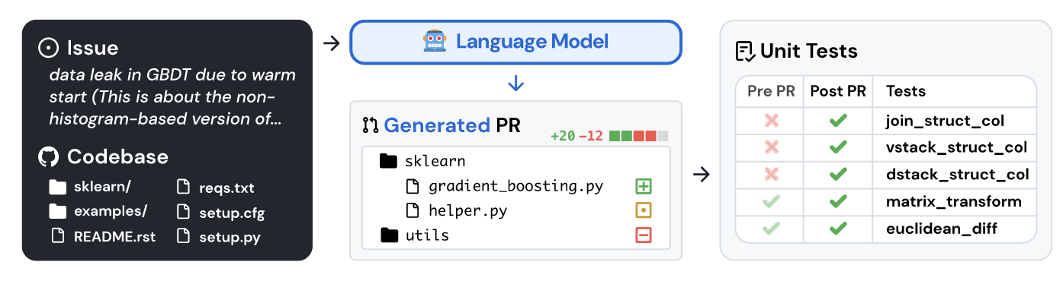
SWE-bench Overview (2/4)
Three-stage automated construction pipeline
Scrape 90,000 PRs from 12 popular Python repos.
Attribute filter — keep only merged PRs that resolve a GitHub issue and contribute test changes.
Execution filter — keep only instances with ≥1 test changing from fail to pass "fail-to-pass" tests.
Input:
Issue description.
Codebase at pre-PR commit.
Output:
A patch file (diff format).
Figure 2. Construction Pipeline of SWE-bench
Notes:
The third question is : how is SWE-bench constructed?
The pipeline is illustrated in figure 2, it’s through a three-stage automated pipeline.
The first stage is to scrape prs from popular repositories.
Stage two is the attribute filter — they keep only merged PRs that are linked to a GitHub issue AND contribute test changes. This indicates the developer wrote tests to verify their fix.
Stage three is the execution filter — they actually run the tests before and after the PR, and keep only instances where at least one test flips from fail to pass. These "fail-to-pass" tests become the ground truth for evaluation. Through this filtering, 90,000 PRs are reduced to 2,294 high-quality instances.
The last question is: How do you use it? The input is an issue text description plus the complete codebase at the pre-PR commit. The output is a patch file in diff format — the model must figure out which files to modify and exactly what code to change. Evaluation is fully automated: apply the patch, run the tests. If the fail-to-pass tests now pass and existing tests don't break, the issue is considered resolved. the metric is the percentage of resolved instances. So actually it’s a framework for execution-based evaluation, and don’t need any human feedback.

Slide 9
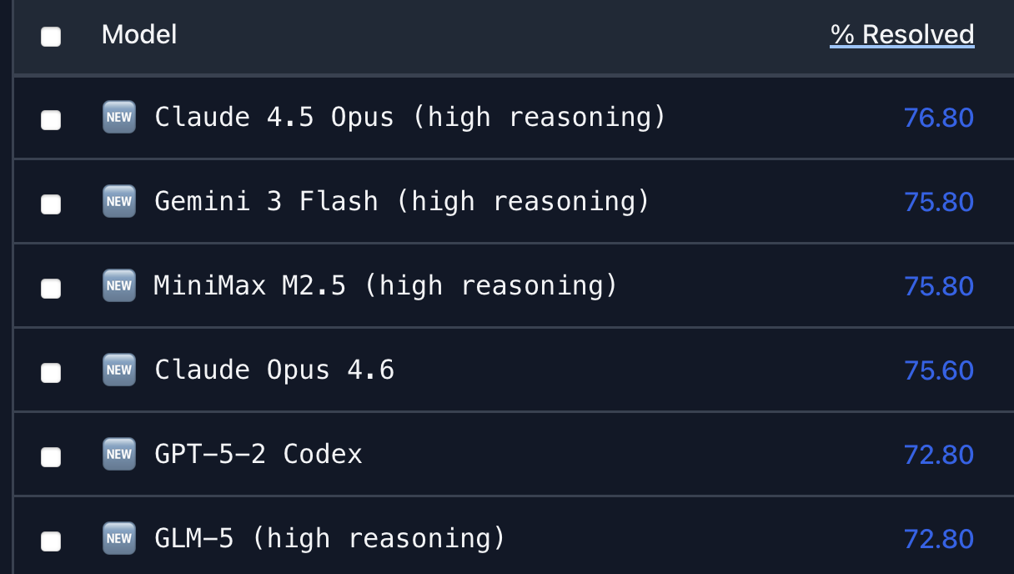
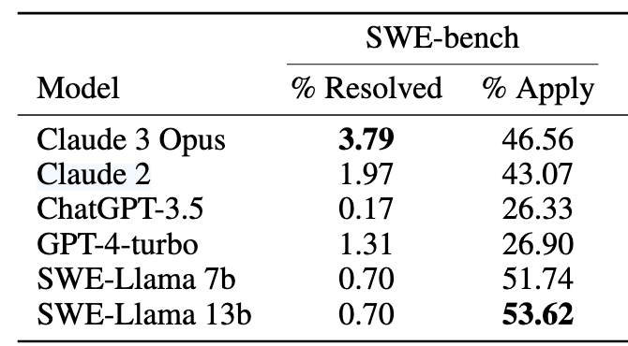
Evaluation Results on SWE-bench (3/4)
Initial evaluation result
Claude 3 Opus reaches the highest resolve rate 3.79%.
Today’s evaluation result
Claude Opus 4.5 reaches the highest resolve rate 76.8%.
Table 1. Initial Results on SWE-bench
Figure 3. Today’s resolution rate of SWE-bench
Notes:
This slide shows two versions of evaluation results of SWE-bench.
The left table shows the initial result. From the table, you can see that the best-performing model — Claude 3 Opus achieved only 3.79% resolve rate.
Now look at the right side — it’s today's leaderboard. Claude 4.5 Opus leads at 76.8%. The comparision highlights the remarkable progress in just a short period.

Slide 10
SWE-bench Family (4/4)
SWE-bench family
SWE-bench Lite: 300 curated subset.
SWE-bench Verified: 500 instances, validated by 93 annotators.
SWE-bench Multilingual.
SWE-bench Multimodal.
Notes:
Since then, SWE-bench has spawned an entire family of variants. SWE-bench Lite is a 300-instance curated subset for faster experiments. SWE-bench Verified is a 500-instance subset validated by 93 human software engineers — addressing issues like ambiguous descriptions and unreliable tests. There are also multilingual and multimodal extensions. This ecosystem shows how influential SWE-bench has become the standard adopted by OpenAI, Anthropic, Google, and Meta for evaluating their models' coding capabilities.

Slide 11
Outline
Introduction (3 min)
SWE-bench: Real-world Issues Resolution (6 min)
SWE-bench overview (3 min)
Evaluation results (2 min)
SWE-bench family (1 min)
Two Paradigms: Pipeline-based vs. Agent-based (10 min)
Two paradigms (2 min)
SWE-agent: The agent-based approach (3 min)
Agentless: The pipeline-based approach (3 min)
Comparison (2 min)
Conclusions (2 min)

Slide 12
Two Paradigms (1/4)
Agent-based
Agent-based scaffolds equip one or more agents with tools for planning, repository access, and code editing, enabling them to make decisions and update the codebase autonomously.
Iterative: Observe → Think → Act → feedback loop (ReAct-style)
Representative: SWE-agent.
Pipeline-based
Pipeline-based scaffolds rely on human prior knowledge to decompose the issue resolution task into predefined phases, which are then executed sequentially.
Fixed sequence: Repo Preprocessing → Localization → Repair → Validation
Representative: Agentless.
Notes:
The first one is the agent-based paradigm. Agent-based scaffolds equip one or more agents with tools for planning, repository access, and code editing, enabling them to make decisions and update the codebase autonomously. The workflow is iterative — observe, think, act, get feedback, repeat — following a ReAct-style loop. The representative system is SWE-agent. This approach offers high flexibility, but agent behavior may deviate from the intended pipeline, potentially leading to task failure.
Pipeline-based scaffolds rely on human prior knowledge to decompose the task into predefined phases executed sequentially — repo preprocessing, localization, repair, and validation. The representative system is Agentless. This approach offers more control and predictability, but has lower autonomy — if one phase fails, there's no way to recover.
Both paradigms share the same high-level goal — generate a correct patch. But they differ fundamentally in who controls the workflow: the LLM deciding autonomously, or a human-designed fixed pipeline.

Slide 13
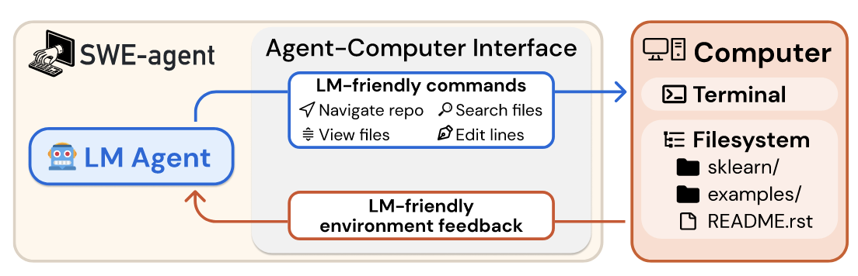
SWE-agent: The Agent-based Approach (2/4)
Core motivation
LLM agents represent a new category of end users with their own needs and abilities, and would benefit from specially-built interfaces to the software they use.
Agent-Computer Interface (ACI)
Current LMs are vulnerable to a number of pitfalls when searching for relevant content in a Linux shell environment. Some exploration patterns (e.g., chains of cd, ls, cat) are extremely inefficient.
Design interfaces FOR LM agents, not just reuse human interfaces.
Figure 4. Overview of SWE-agent
Notes:
Their core motivation is : "LM agents represent a new category of end users with their own needs and abilities, and would benefit from specially-built interfaces to the software they use." Just as humans benefit from IDEs like VSCode, LLM agents need interfaces tailored to their specific capabilities and limitations.
they designed interfaces specifically FOR LM agents. The ACI provides a small set of simple commands — open, scroll, edit with built-in linting, search_file, find_file. The edit command integrates with a file viewer, shows line numbers, and includes a syntax checker that blocks broken edits immediately. Environment feedback is concise and informative.

Slide 14
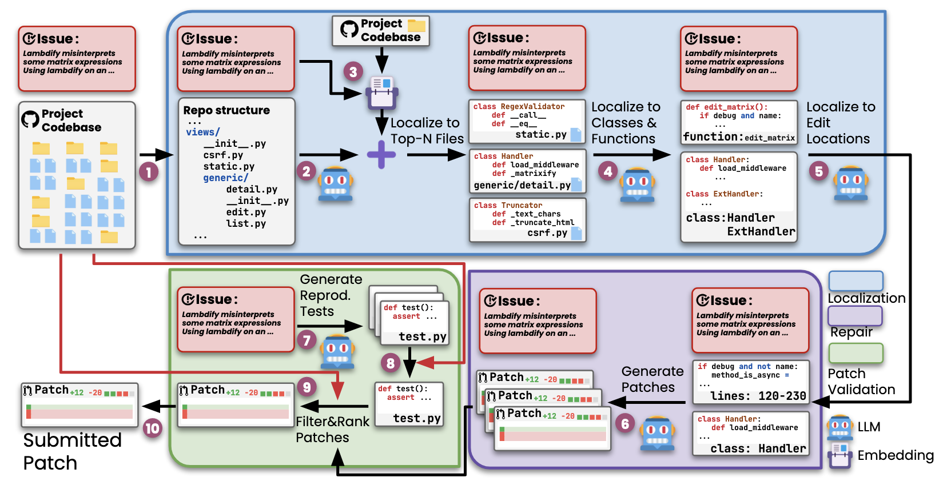
Agentless: The Pipeline-based Approach (3/4)
Core motivation
Do we really have to employ complex autonomous software agents?
Three-phase pipeline
Localization: File-level -> Class-level -> Function-level
Repair: candidate patches in Search/Replace diff format.
Validation: syntax check → regression test → reproduction test generation → majority voting
Figure 5. Overview of Agentless
Notes:
Their core motivation is : "Do we really have to employ complex autonomous software agents?" They identified three limitations of agent-based approaches — complex tool usage leading to errors, lack of control making agents easily confused, and limited self-reflection causing error amplification. Their answer was: maybe we don't need agents at all.
Agentless follows a simple three-phase pipeline, shown in Figure 4.
Phase one is hierarchical localization. They convert the repository structure into a tree format, ask the LLM to identify the top 3 suspicious files, then extract class and function signatures, and narrow down to relevant elements, and finally pinpoint exact edit locations.
Phase two is repair. For each of edit location sets, they generate patches using a Search/Replace diff format. This diff format is key — it avoids generating complete code blocks and instead focuses on small, targeted edits, reducing hallucination.
Phase three is validation — syntax check, regression testing, optional reproduction test generation, and majority voting to select the final patch.

Slide 15
Comparison (4/4)
 | Strengths | Weaknesses
Pipeline-based Approach: Agentless | Cost-efficient: $0.70 vs. $1.62 per issue Reproducible: deterministic pipeline, no stochastic trajectories | Upper-bounded by localization quality Lower autonomy
Agent-based Approach: SWE-agent | Adaptive: can change strategy based on observations Richer exploration: can run tests, examine outputs, iterate | Higher cost, more LLM calls Cascading failures
Notes:
Let's compare the two approaches side by side.
Agentless — the pipeline-based approach — has clear strengths in cost-efficiency: $0.70 versus $1.62 or more per issue for SWE-agent. It's reproducible — a deterministic pipeline with no stochastic trajectories. Easy to understand and debug. But it's upper-bounded by localization quality. If the hierarchical localization misses the right file, there's no recovery mechanism. And it has lower autonomy — it can't adapt if something unexpected happens.
SWE-agent — the agent-based approach — shines in adaptability. It can change strategy based on what it observes. If the first hypothesis about the bug is wrong, it can pivot. It can run tests, examine outputs, and iterate. But this comes at a cost — literally. More LLM calls mean higher expenses. And there's the risk of cascading failures: the SWE-agent paper found that 51.7% of trajectories have at least one failed edit, and "cascading failed edits make up 23.4% of failures." There's also a fascinating finding: "agents succeed quickly and fail slowly" — successful runs average 12 steps, while unsuccessful ones drag on for 21 steps.
Neither approach dominates the other. They represent genuine trade-offs between control and flexibility, cost and capability. And in practice, the field is converging — many modern systems combine elements of both.

Slide 16
Outline
Introduction (3 min)
SWE-bench: Real-world Issues Resolution (6 min)
SWE-bench overview (3 min)
Evaluation results (2 min)
SWE-bench family (1 min)
Two Paradigms: Pipeline-based vs. Agent-based (10 min)
Two paradigms (2 min)
SWE-agent: The agent-based approach (3 min)
Agentless: The pipeline-based approach (3 min)
Comparison (2 min)
Conclusions (2 min)
Notes:
Here's the outline. We'll start with a brief introduction to LLM4Code. Then we’ll go into detail of our first paper SWE-bench, The I’ll talk about the two paradigms for solving SWE-bench — pipeline-based and agent-based. I’ll introduce the second paper agentless and the third paper swe-agent, We'll close with a comparison and conclusions.

Slide 17
Conclusions (1/1)
SWE-bench transformed LLM4Code evaluation
From "contrived problems" to real-world software engineering.
Enabled the community to measure and drive progress: 1.96% → ~80% in 2.5 years.
Two paradigms, each with lasting influence
Agent-based (SWE-agent): introduced the ACI concept; established that "interface design affects the performance of language model agents”.
Pipeline-based (Agentless): proved simplicity can be competitive; set the template for most subsequent methods.
Notes:
Two key takeaways.
First, SWE-bench transformed LLM4Code evaluation. It moved us from contrived, function-level problems to real-world software engineering. And it enabled the community to measure and drive extraordinary progress — from 1.96% to roughly 80% on SWE-bench Verified in just 2.5 years. That's a 40x improvement, driven almost entirely by better system design and more capable models.
Second, two paradigms emerged, each with lasting influence. The pipeline-based approach, represented by Agentless, proved that simplicity can be surprisingly competitive. It set the template for most subsequent methods — the survey by Jiang et al. confirms that Agentless's hierarchical localization has been "followed by most subsequent methods." The agent-based approach, represented by SWE-agent, introduced the influential ACI concept and established that "interface design affects the performance of language model agents." The key insight is that how you present information to LLMs and how you let them interact with their environment matters just as much as the underlying model.
Looking ahead, the field is shifting toward hybrid approaches combining pipeline control with agent flexibility, and toward RL-trained domain-specific models. The benchmark itself keeps evolving — SWE-bench Pro now addresses contamination concerns. The story of SWE-bench is really the story of how a well-designed benchmark can catalyze an entire field.
This is my pre, thank you.

