Slide 1
System Design for Large-Scale Reinforcement Learning Workloads
Chujiao Wang
School of Data Science
Chinese University of Hong Kong, Shenzhen

Slide 2
Outline
Introduction (2 min)
Background & Motivation (3 min)
Proposed Methods & Performance Evaluation (18 min)
IMPALA (6 min)
SEED RL (6 min)
Sample Factory (6 min)
Conclusions (2 min)
Q & A (5 min)

Slide 3
Outline
Introduction (2 min)
Background & Motivation (3 min)
Proposed Methods & Performance Evaluation (18 min)
IMPALA (6 min)
SEED RL (6 min)
Sample Factory (6 min)
Conclusions (2 min)
Q & A (5 min)

Slide 4
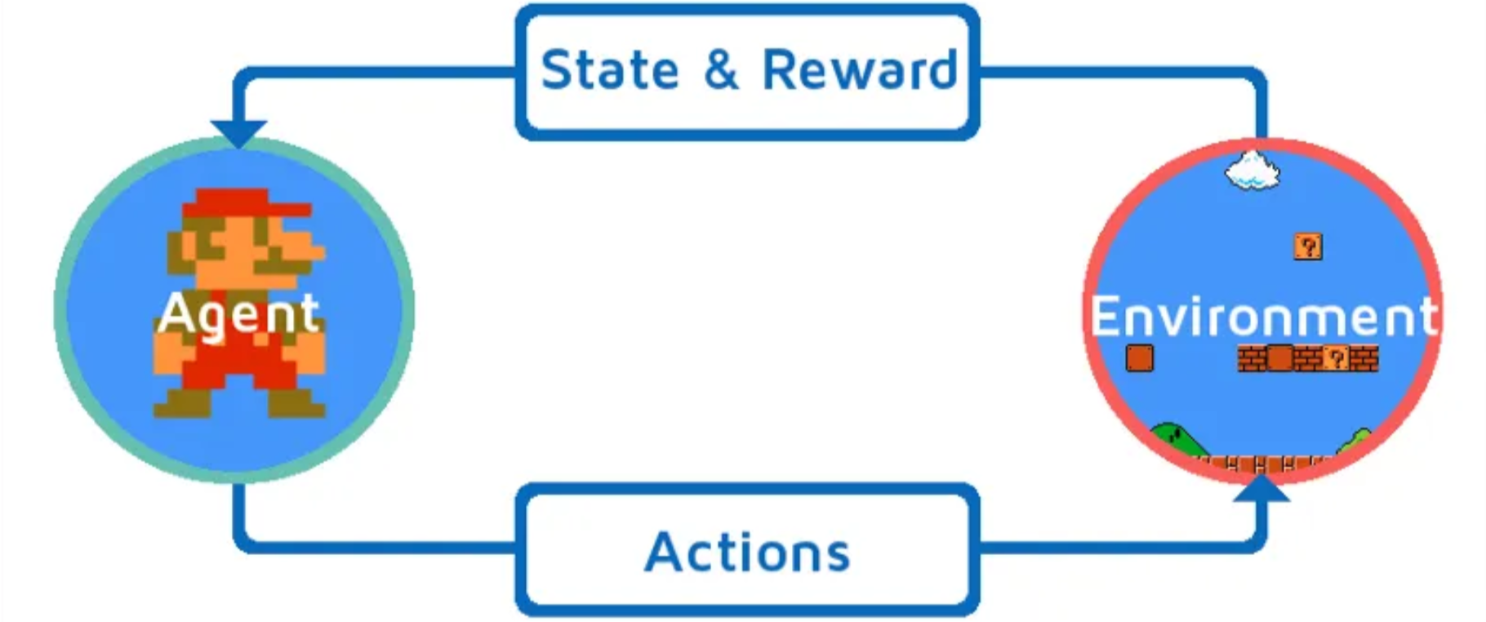
Introduction (1/2)
What is Reinforcement Learning?
Agent interacts with an environment
Takes actions and receives rewards
Learns to maximize long-term reward

Slide 5
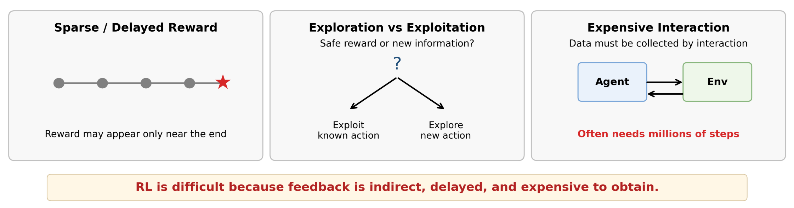
Introduction (2/2)
Why is Reinforcement Learning Difficult?
Rewards can be sparse or delayed
Agents must balance exploration and exploitation
Training often requires massive interaction with the environment

Slide 6
Outline
Introduction (2 min)
Background & Motivation (3 min)
Proposed Methods & Performance Evaluation (18 min)
IMPALA (6 min)
SEED RL (6 min)
Sample Factory (6 min)
Conclusions (2 min)
Q & A (5 min)

Slide 7
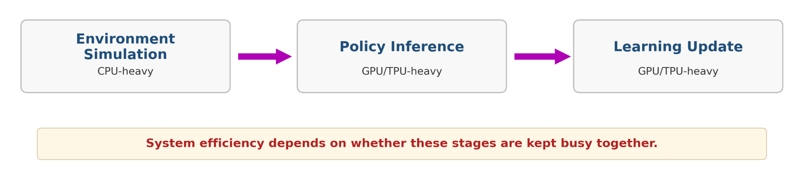
Background & Motivation (1/2)
Modern RL is increasingly a system problem
RL training combines simulation, inference, and learning
These stages run at very different speeds
Poor coordination leads to idle CPUs / GPUs

Slide 8
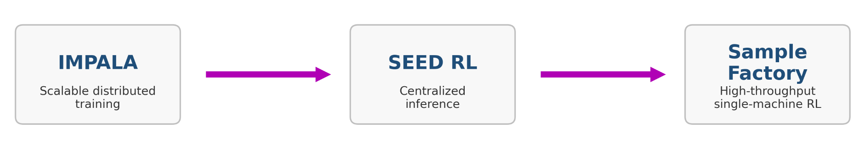
Background & Motivation (2/2)
Why system design matters in RL
Large-scale RL is a systems workload
Efficiency depends on how computation is organized
This motivates comparing different system designs

Slide 9
Outline
Introduction (2 min)
Background & Motivation (3 min)
Proposed Methods & Performance Evaluation (18 min)
IMPALA (6 min)
SEED RL (6 min)
Sample Factory (6 min)
Conclusions (2 min)
Q & A (5 min)

Slide 10
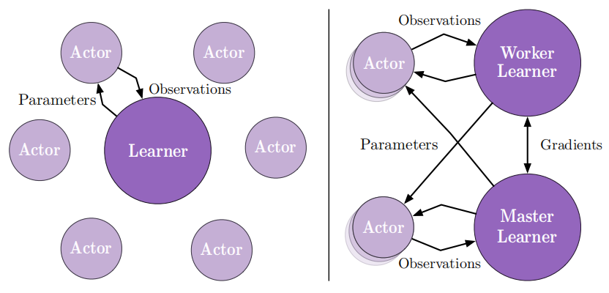
IMPALA (1/4)
Goal: scale RL training to many actors and many tasks.
Actors generate experience and send trajectories to the learner.
The learner updates one shared policy from batched data.
Decoupling acting and learning improves throughput and scalability.
decouple acting and learning

Slide 11
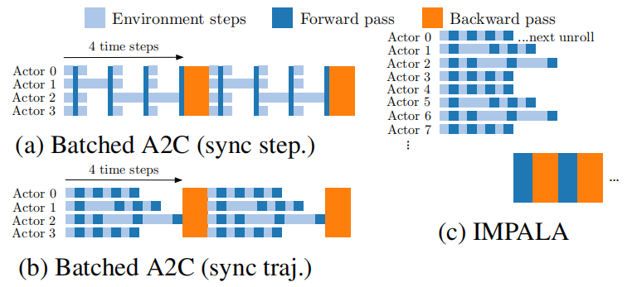
IMPALA (2/4)
Why Decoupling Improves Throughput
Synchronous A2C-style training stalls at synchronization points
Slow environment workers delay the whole batch
IMPALA removes this bottleneck with asynchronous actors
Less synchronization means higher throughput.

Slide 12
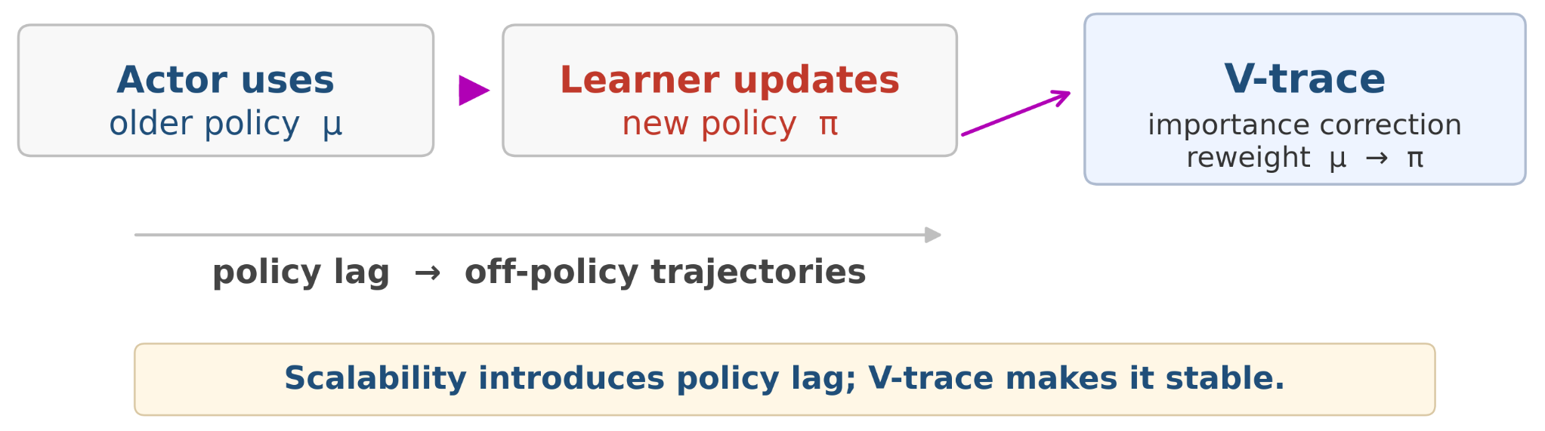
IMPALA (3/4)
Policy Lag and V-trace
Decoupling actors and learners introduces policy lag
Trajectories are generated by an older behavior policy μ
V-trace reweights these trajectories to safely update the target policy π

Slide 13
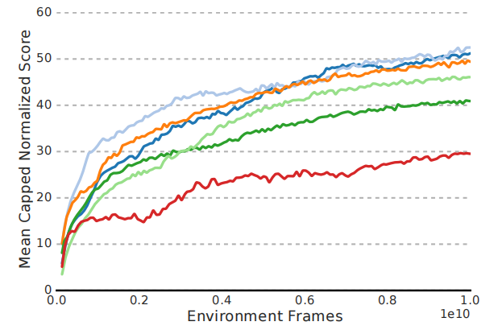
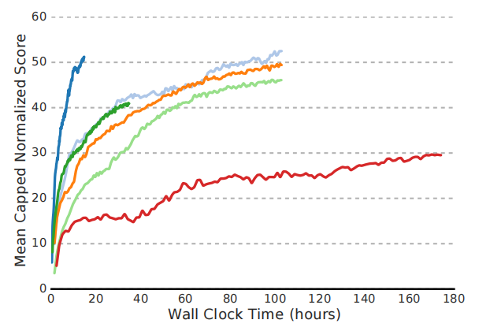


IMPALA (4/4)
High Throughput Translates into Better Learning
IMPALA reaches both high final performance and fast convergence
The wall-clock plot is the key result: higher throughput leads to much faster learning in practice
This shows that better RL system design can directly improve algorithmic efficiency

Slide 14
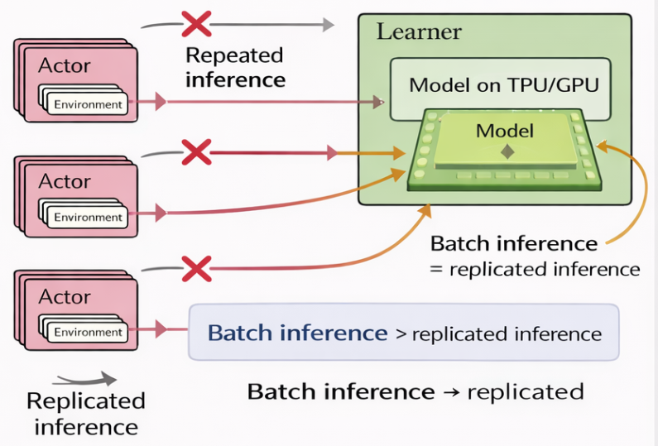
SEED RL (1/5)
Can we move inference to where accelerators already are?
In IMPALA, each actor still runs policy inference locally.
This scales well, but becomes inefficient as models grow larger and more expensive.
SEED RL rethinks the system design by reorganizing where inference happens.

Slide 15
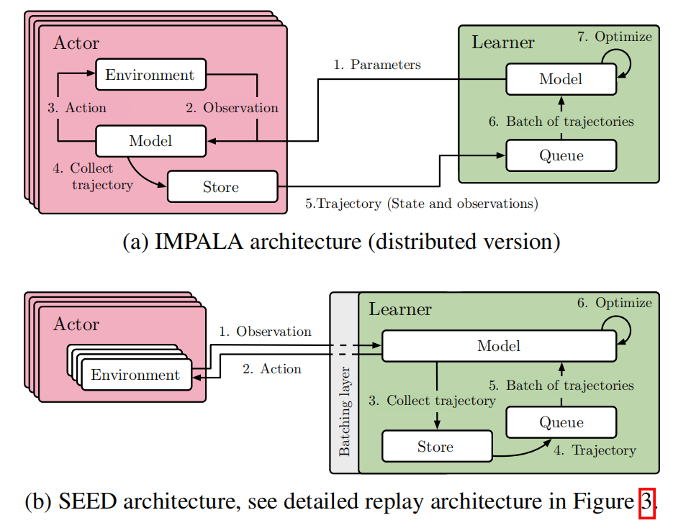
SEED RL (2/5)
SEED’s Core Design: Centralized Inference
Actors only run environments and send observations to the learner.
The learner performs inference and training, then sends actions back.
This enables large batched inference and better accelerator utilization.

Slide 16
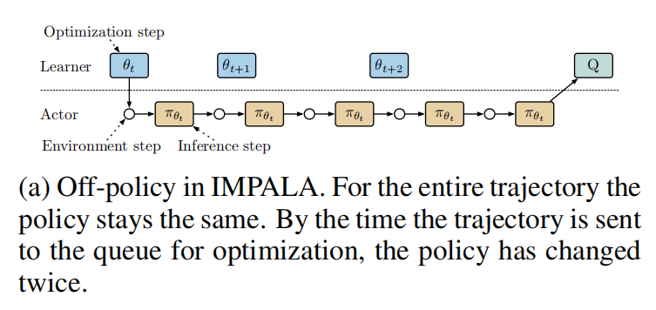
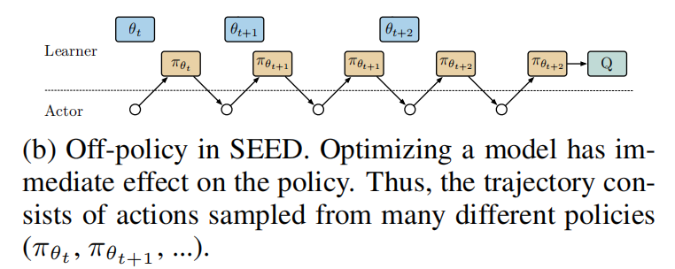
SEED RL (3/5)
Centralized Inference Comes with a Trade-off
Centralizing inference improves efficiency, but changes how policy lag appears.
In SEED, one trajectory may contain actions from multiple nearby policy versions.
The paper shows this remains near on-policy in practice while delivering large systems gains.

Slide 17
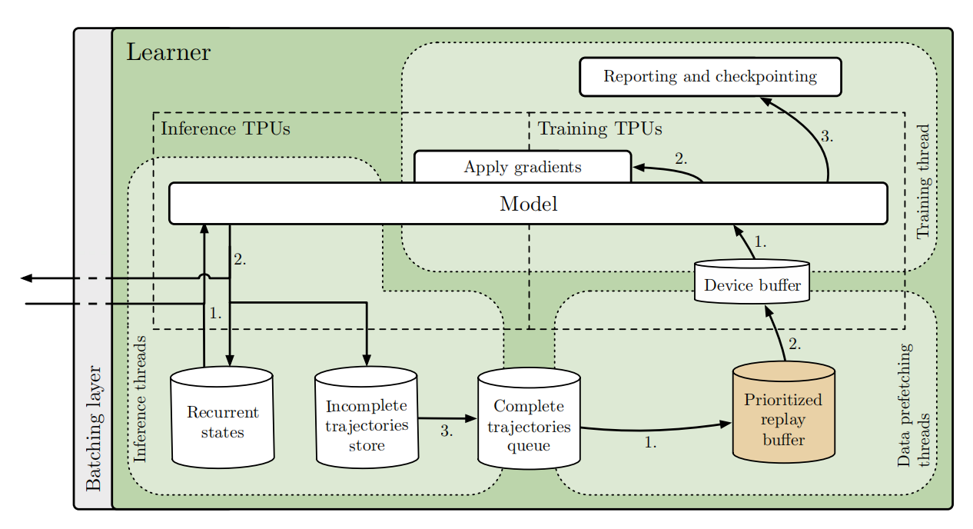
SEED RL (4/5)
Training pipeline
Making Centralized Inference Practical
Inference is batched on accelerator hardware.
Trajectories are stored and queued efficiently.
Training continuously updates the same learner-side model.
Inference pipeline
Trajectory pipeline

Slide 18
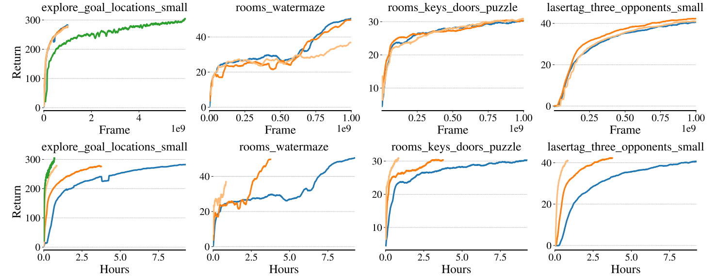


SEED RL (5/5)
Results: Faster and More Efficient RL
SEED maintains similar sample efficiency to IMPALA.
In wall-clock time, it learns much faster through centralized batched inference.
The speedup becomes larger with more accelerator resources.

Slide 19
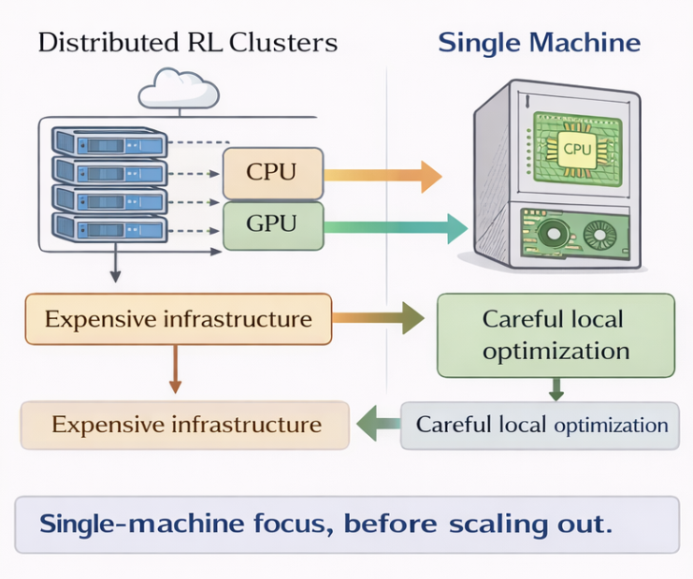
Sample Factory (1/5)
High-Throughput RL on a Single Machine
Many large-scale Rl systems focus on distributed infrastructure.
Sample factory ask how far single-node optimization can go.
The goal is to maxmize CPU/GPU utilization and reduce idle time.

Slide 20
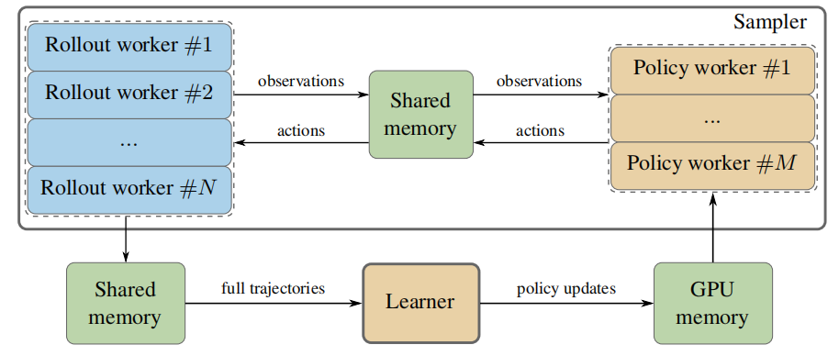


Sample Factory (2/5)
System Overview: Rollout, Inference, Learning
Rollout workers step environments and collect observations.
Policy workers run batched GPU inference and return actions.
The learner updates the model using completed trajectories.

Slide 21
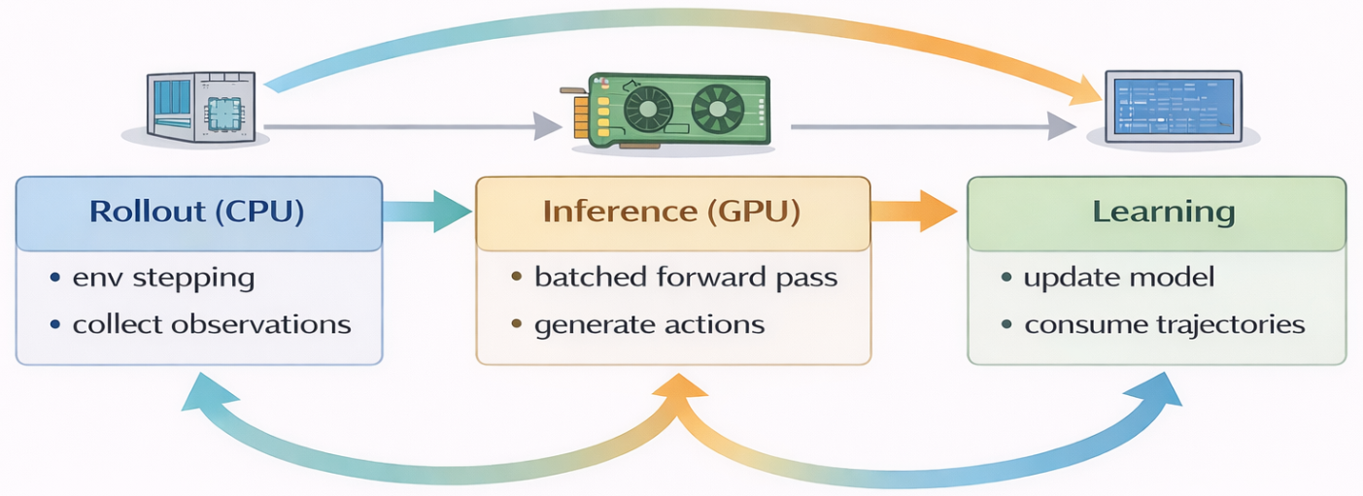
Sample Factory (3/5)
Three-Stage Asynchronous Pipeline
The pipeline is split into rollout, inference, and learning stages.
These stages run asynchronously instead of sequentially.
CPU environment stepping and GPU inference can overlap in time.

Slide 22
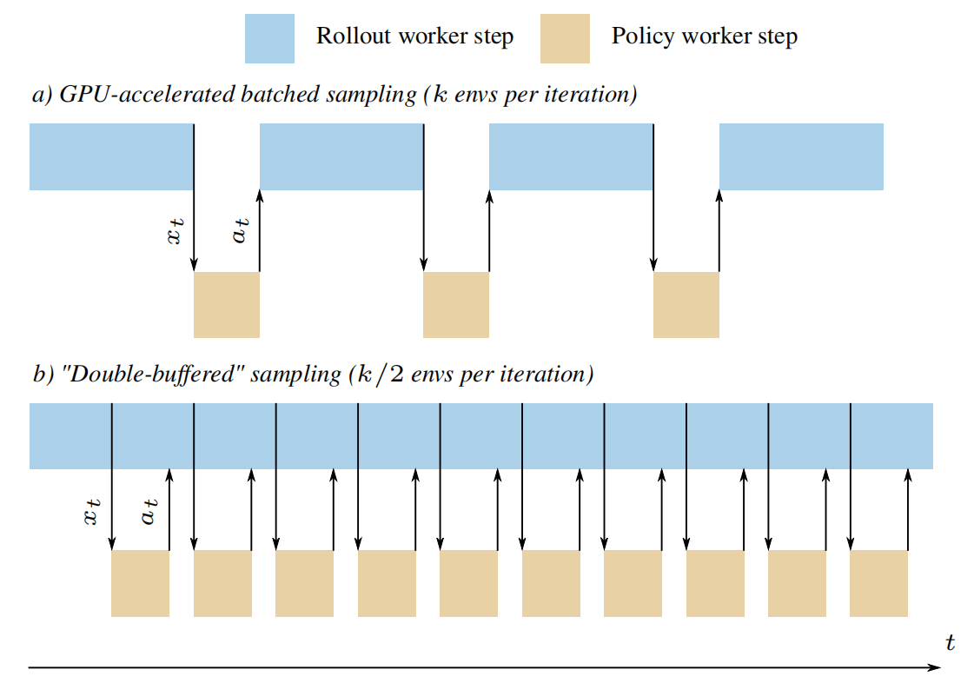
Sample Factory (4/5)
Double-Buffered Sampling
Each rollout worker manages multiple environments.
These environments are split into two alternating groups.
While one group waits for actions, the other continues environment stepping.

Slide 23
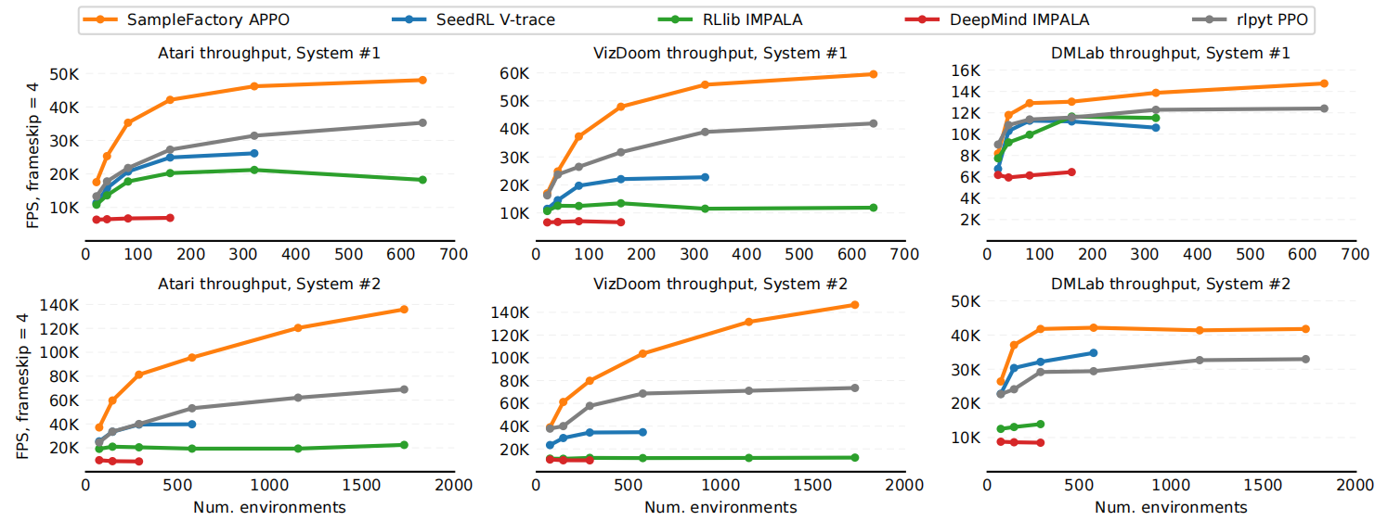
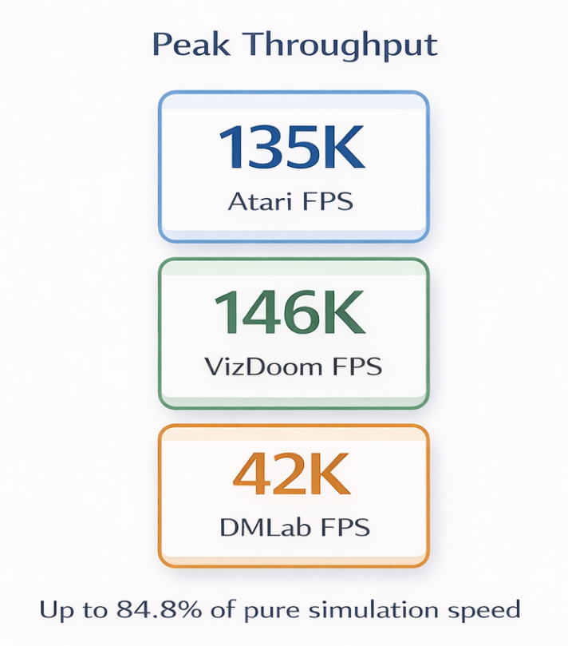
Sample Factory (5/5)
Result: High Throughput without Scaling Out
Higher FPS than prior RL systems across major RL benchmarks.
Gains come from better overlap, batching, and utilization.

Slide 24
Outline
Introduction (2 min)
Background & Motivation (3 min)
Proposed Methods & Performance Evaluation (18 min)
IMPALA (6 min)
SEED RL (6 min)
Sample Factory (6 min)
Conclusions (2 min)
Q & A (5 min)

Slide 25
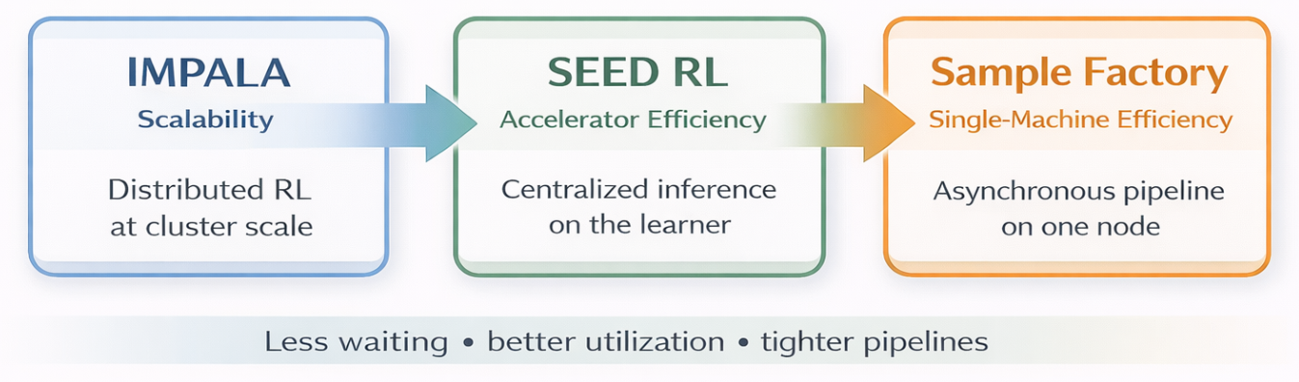
Conclusion
System Design as the Driver of RL Efficiency
System design increasingly determines RL throughput and wall-clock performance.
Progress comes from reducing waiting, communication, and hardware under-utilization.
The broader trend is algorithm–system co-design, not just more compute.

Slide 26
Outline
Introduction (2 min)
Background & Motivation (3 min)
Proposed Methods & Performance Evaluation (18 min)
IMPALA (6 min)
SEED RL (6 min)
Sample Factory (6 min)
Conclusions (2 min)
Q & A (5 min)

Slide 27
Q&A
Thanks For Your Listening!

