Slide 1
Operating System Support for Large-Scale Graph Learning 2026.04.07
Shicheng Dai
School of Data Science
Chinese University of Hong Kong, Shenzhen

Slide 2
OUTLINE
Introduction (5 min)
Background & Motivation (3 min)
Proposed Methods & Performance Evaluation (24 min)
BGL (8 min)
MGG (8 min)
AdaQP (8 min)
Conclusions (2 min)
Q & A (2 min)

Slide 3
OUTLINE
Introduction (5 min)
Background & Motivation (3 min)
Proposed Methods & Performance Evaluation (24 min)
BGL (8 min)
MGG (8 min)
AdaQP (8 min)
Conclusions (2 min)
Q & A (2 min)

Slide 4
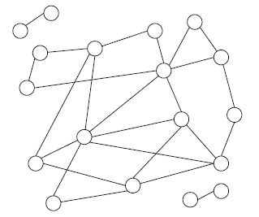
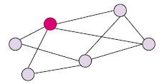
Introduction - graph learning stresses
Message passing on a graph
The core systems issue is not the GNN formula itself, but how to align data, communication, and compute at scale.
•
Large graphs create huge memory footprints and irregular access patterns.
•
Each layer needs neighbor features or embeddings before local computation can finish.
•
As the system scales, the bottleneck shifts from pure math to data movement.
Subgraph
Aggregate
neighbors
Update node
embeddings
Next layer /
next epoch

Slide 5
Introduction - Two training regimes
Sampling-based
training
Full-graph distributed
training
Graph
store
Sampling
Feature
I/O
GPU
train
Partition
graph
Exchange
messages
Aggregate
+ update
•
Only a sampled subgraph enters the GPU each iteration.
•
The whole graph remains logically active during training.
•
Key bottlenecks: subgraph sampling and feature retrieval.
•
Key bottlenecks: remote messages, imbalance, and waiting.
•
Representative paper: BGL.
•
Representative papers: MGG and AdaQP.
The three papers optimize three different bottleneck locations - before the GPU, inside the GPU kernel, and across devices.

Slide 6
OUTLINE
Introduction (5 min)
Background & Motivation (3 min)
Proposed Methods & Performance Evaluation (24 min)
BGL (8 min)
MGG (8 min)
AdaQP (8 min)
Conclusions (2 min)
Q & A (2 min)

Slide 7
Background - bottlenecks
A training iteration can be viewed as a pipeline with three system-critical stages
(A) Data preparation
(B) Intra-node execution
(C) Inter-device communication
sampling, partitioning, feature retrieval
local/remote overlap inside multi-GPU kernels
message volume, imbalance, waiting
BGL
MGG
AdaQP
Why is this angle useful:
•
It avoids presenting the three papers as unrelated tricks.
•
It also explains why their design choices differ: BGL is pipeline-fed and data-centric; MGG is kernel-centric; AdaQP is communication-centric.
•
This framing is new compared with a paper-by-paper summary and makes the talk more coherent.

Slide 8
motivation
Storyline for the talk
BGL
MGG
AdaQP
Sampling-based
Single multi-GPU
full-graph
Distributed
full-graph
Feed GPUs more efficiently
Overlap remote access
with local compute
Reduce communication
and hide wait time
The optimization target gradually moves outward:
•
BGL optimizes how the system prepares training data for the GPU.
•
MGG optimizes how a multi-GPU node executes irregular GNN kernels.
•
AdaQP optimizes what is exchanged across devices and when computation waits.
This progression makes the comparison sharper: each paper attacks a different layer of the system stack.

Slide 9
OUTLINE
Introduction (5 min)
Background & Motivation (3 min)
Proposed Methods & Performance Evaluation (24 min)
BGL (8 min)
MGG (8 min)
AdaQP (8 min)
Conclusions (2 min)
Q & A (2 min)

Slide 10
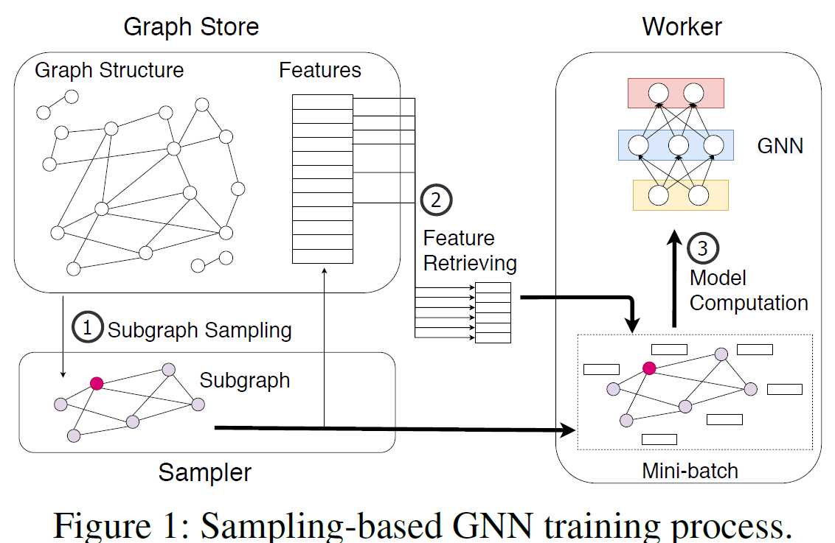
bgl (1/3) - bottleneck
BGL focuses on sampling-based GNN training, where the GPU is often under-utilized because the front-end data pipeline is too slow.
BGL decomposes one iteration into three stages: subgraph sampling, feature retrieving, and model computation.
•
The paper treats the first two stages as data I/O and preprocessing, and argues that they dominate end-to-end training on large graphs.
•
So the architecture should be introduced as a data-supply pipeline feeding the GPU, rather than as a new GNN computation engine.
•

Slide 11
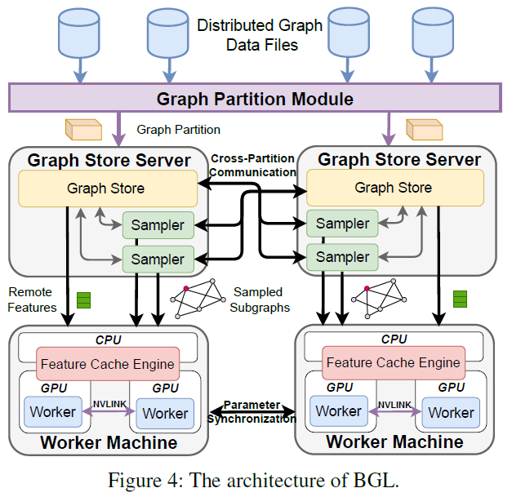
bgl (1/3) - Workflow
Figure 4 expands the architecture into concrete system roles: graph partition module, graph store servers, samplers, feature cache engines, and GPU workers.
•
The figure shows why BGL is a distributed pipeline: partition once, sample on servers, retrieve features, and then synchronize parameters across workers.
•
This is the right place to introduce the three mechanisms in context: dynamic cache, GNN-oriented partitioning, and profiling-based resource isolation.
•

Slide 12
bgl (2/3) - Mechanism chain
1. Dynamic feature
cache
2. Better graph
partitioning
3. Resource isolation
•
Use FIFO rather than expensive LRU/LFU.
•
Partition for multi-hop locality, not just one-hop structure.
•
Different preprocessing stages compete for CPU, memory, PCIe, and network.
•
Raise hit ratio with proximity-aware ordering.
•
Also balance training nodes, not only total nodes.
•
Assign isolated resources to reduce contention.
•
Exploit temporal locality across nearby mini-batches.
•
Goal: reduce cross-partition sampling traffic.
•
This helps BGL outperform simpler asynchronous pipelines.
BGL is a data-supply system. It wins by making the GPU wait less, not by changing the GNN mathematics.

Slide 13
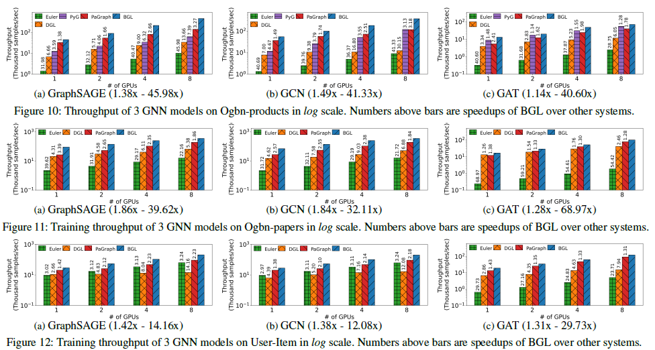
bgl (3/3) – e2e sppedup
•
Across the reported settings, BGL achieves 1.14x-69x speedups over the four baselines; the geometric-mean speedup over PaGraph is 1.91x.
•
The paper attributes the gains to dynamic caching, better locality-aware partitioning, and resource isolation.
•
It also claims strong scalability and reports GPU utilization gains up to 99% for GAT and from 10% to 65% for GraphSAGE on the reported setup.
Takeaway: BGL represents the “feed the GPU better” line of OS support for graph learning.

Slide 14
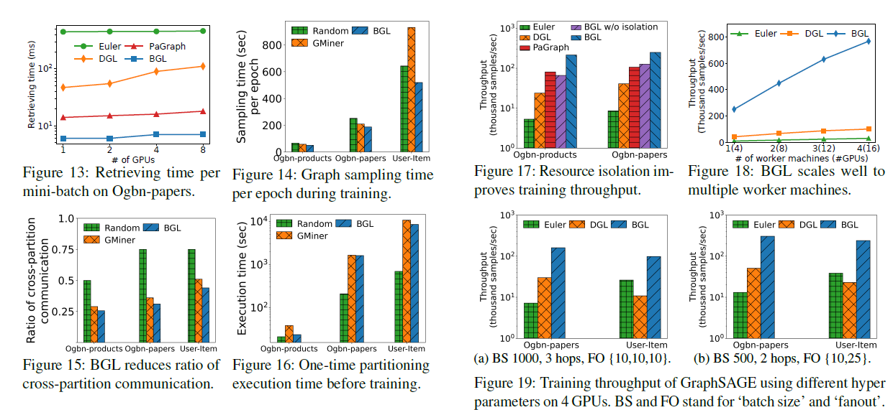
bgl (3/3) – mechanism evidence
•
Mechanism evidence: the paper shows that cache and partitioning reduce retrieving time, sampling time, and cross-partition communication together.
•
Resource isolation and scaling results show that the front-end pipeline must remain balanced, otherwise bottlenecks simply move between stages.

Slide 15
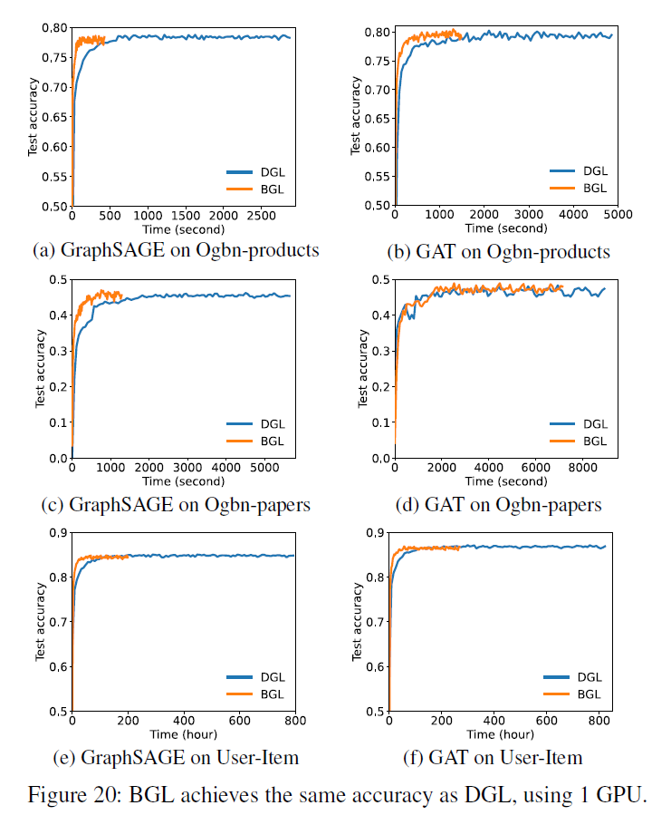
bgl (3/3) – Model quality
•
BGL converges to almost the same accuracy as DGL.
•
The key difference is that convergence is reached much faster in wall-clock time.
•
So BGL’s improvements are system-level, not accuracy tradeoffs.

Slide 16
OUTLINE
Introduction (5 min)
Background & Motivation (3 min)
Proposed Methods & Performance Evaluation (24 min)
BGL (8 min)
MGG (8 min)
AdaQP (8 min)
Conclusions (2 min)
Q & A (2 min)

Slide 17
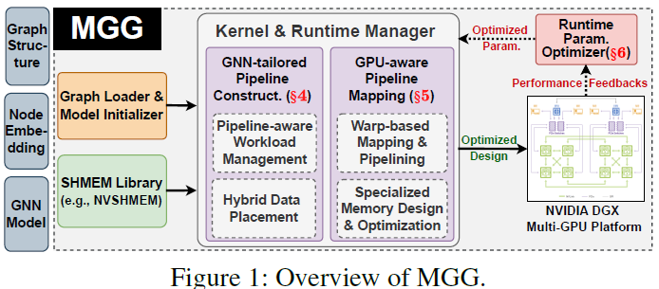
MGG (1/3) - architecture
If BGL optimizes the front-end pipeline before data reaches the GPU, MGG moves one step deeper and asks how irregular GNN execution should be organized inside a multi-GPU node.
•
Existing systems treat communication and computation almost separately, which works better for dense DNNs than irregular GNNs.
•
MGG instead models GNN execution as a dynamic software pipeline inside GPU kernels.
•
The architecture has two main halves: kernel construction/mapping and runtime parameter optimization.
Figure 1: pipeline construction creates overlap opportunities, mapping assigns them to GPU execution units, and runtime optimization retunes the next iteration using performance feedback.

Slide 18
MGG (2/3) – Design logic
1. Pipeline construction
2. GPU-aware mapping
3. Runtime adaptation
•
Break irregular GNN aggregation into finer operations.
•
Map pipeline stages to warp-level GPU execution more carefully.
•
Monitor latency and performance feedback from actual execution.
•
Manage workload at pipeline level instead of only per layer.
•
Exploit direct GPU-GPU communication rather than going through CPU host memory.
•
Update configuration for the next iteration instead of using one static policy.
•
Use hybrid data placement so local and remote access can be interleaved.
•
Use specialized memory design for irregular accesses.
•
The paper explicitly argues that input and hardware properties both matter.
MGG is about turning irregular GNN execution into a schedulable pipeline problem at the GPU-kernel level.

Slide 19
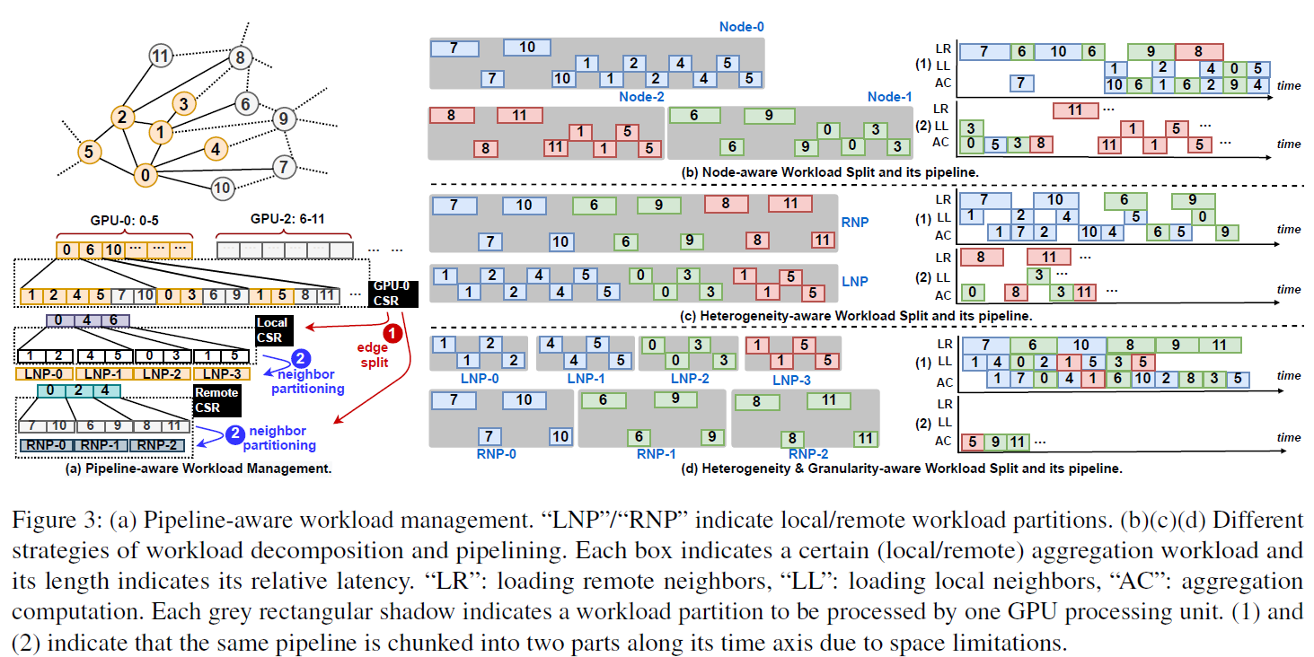
MGG (2/3) – Design logic
•
Figure 3 shows that MGG does not use one fixed workload split. It first balances work across GPUs, then reduces pipeline bubbles, and finally refines granularity.
•
The paper distinguishes local and remote neighbor partitions explicitly, which turns overlap opportunity into something schedulable rather than accidental.
•
This is why MGG is stronger than a generic overlap claim: the pipeline is deliberately constructed around irregular local/remote access patterns.

Slide 20
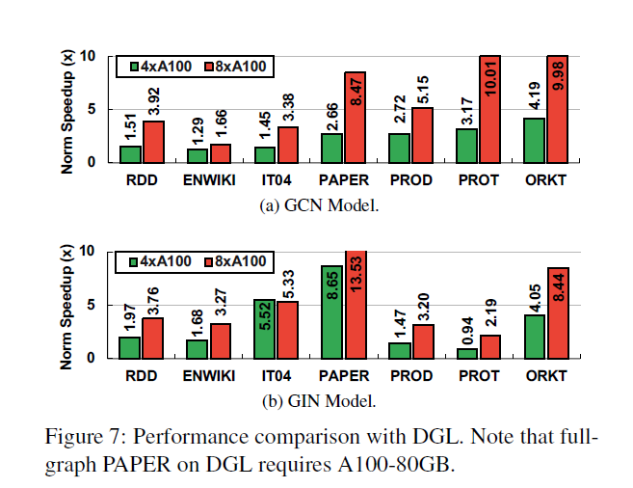
MGG (3/3) – main results
•
Q1. Does MGG consistently outperform the mainstream full-graph baseline DGL?
•
Yes. The paper reports average speedups of 4.25× on GCN and 4.57× on GIN.
•
The gain becomes larger with more GPUs, suggesting that MGG is strongest when remote-access pressure grows.

Slide 21
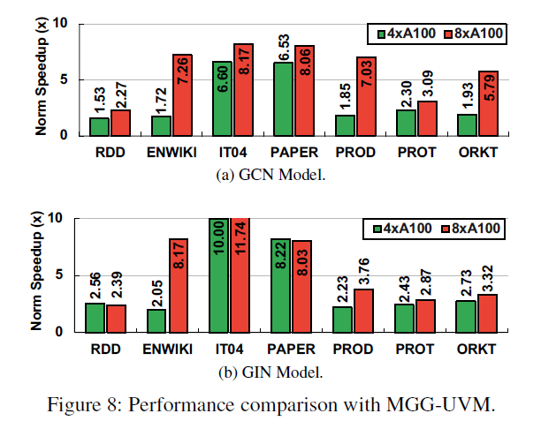
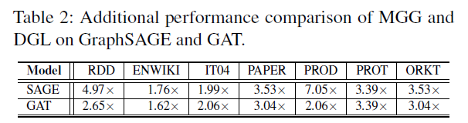
MGG (3/3) – other results
•
Q2. Why is fine-grained GPU-GPU communication better than UVM-based remote access? The paper reports 4.58× / 5.04× average speedups over MGG-UVM on GCN / GIN.
•
Q3. Why does the pipeline stay balanced? Neighbor partitioning and workload interleaving reduce imbalance and pipeline bubbles.
•
Q4. Is the gain from one trick?
No. Primitive choice and runtime parameter search also matter, so the improvement is coordinated rather than isolated.

Slide 22
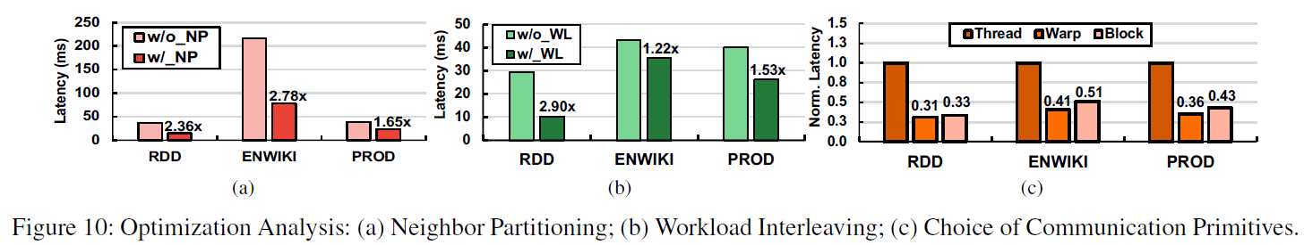
MGG (3/3) - Mechanism evidence
•
Neighbor partitioning: without it, latency is much higher because workload imbalance becomes severe across warps.
•
Workload interleaving: local and remote work should be mixed instead of mapped separately; otherwise pipeline bubbles remain.

Slide 23
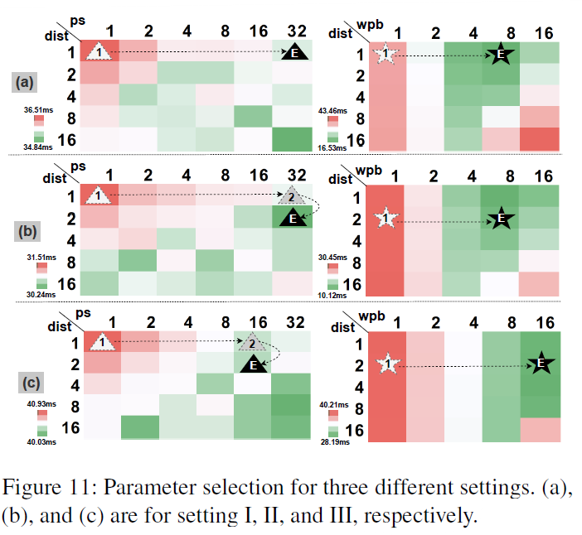
MGG (3/3) - Mechanism evidencess
•
Primitive choice and parameter search matter too, so MGG’s gain is a coordinated effect rather than one isolated trick.
MGG wins through several interacting optimizations: pipeline structure, workload interleaving, primitive choice, and runtime parameter tuning.

Slide 24
OUTLINE
Introduction (5 min)
Background & Motivation (3 min)
Proposed Methods & Performance Evaluation (24 min)
BGL (9 min)
MGG (9 min)
AdaQP (6 min)
Conclusions (2 min)
Q & A (2 min)

Slide 25
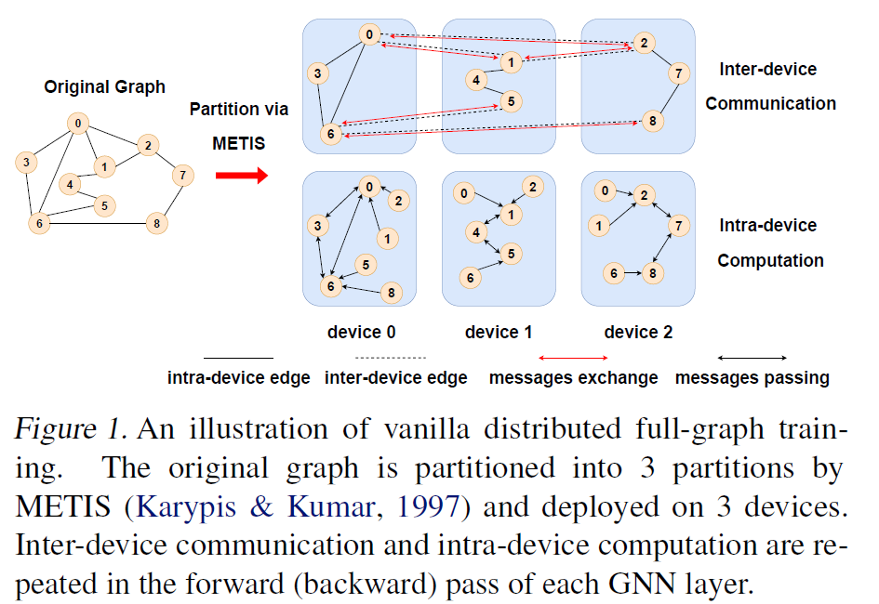
Adaqp (1/3) - motivation
After discussing intra-node irregular execution in MGG, AdaQP moves one step further outward and focuses on inter-device communication in distributed full-graph training.
•
Vanilla full-graph training repeatedly exchanges features, embeddings, and embedding gradients for remote neighbors.
•
Those exchanges are imbalanced across devices, so some devices wait longer in each communication round.
•
The paper argues that central nodes can compute while marginal-node communication is happening if resources are controlled carefully.

Slide 26
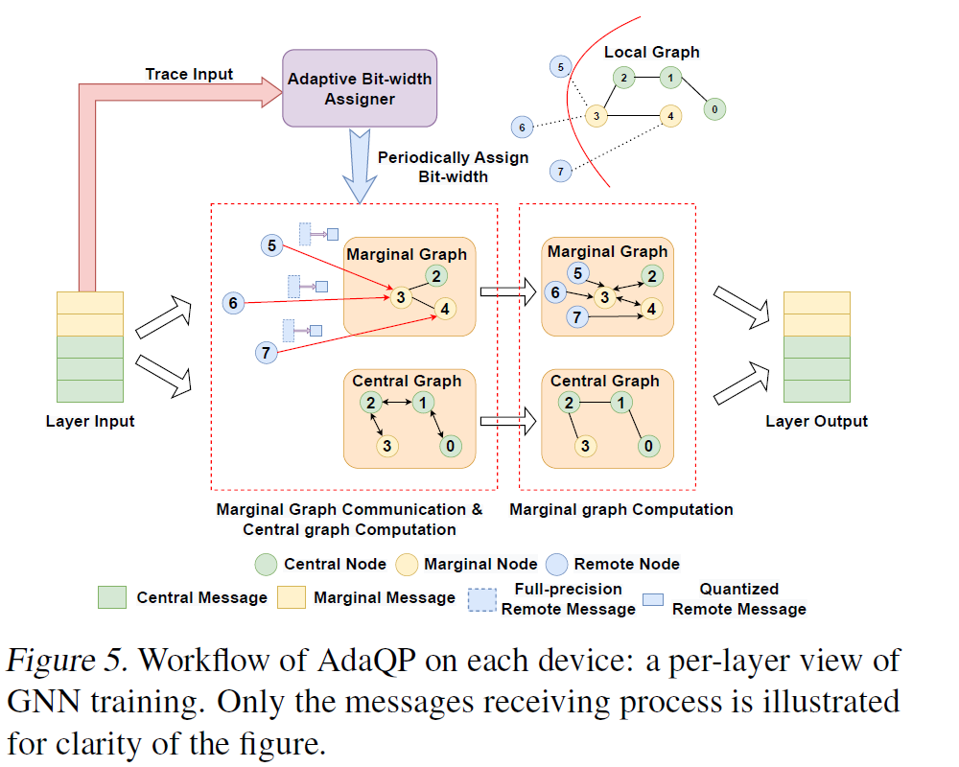
Adaqp (2/3) - Two core ideas
Adaptive message quantization
Central/marginal graph parallelization
•
Quantize remote messages to lower-precision integers during communication.
•
Split each partition into central nodes and marginal nodes.
Assign bit-width adaptively instead of using one uniform setting for all messages.
Hide central-node computation under marginal-node communication time.
•
•
•
The paper proves an O(T^-1) convergence rate under its assumptions and frames bit-width selection as a variance-time tradeoff.
•
Use GPU resource isolation so quantization, de-quantization, and central computation do not fight for compute at the same moment.
AdaQP = quantization + parallelization. But to make this workflow practical, extra control logic is still needed.

Slide 27
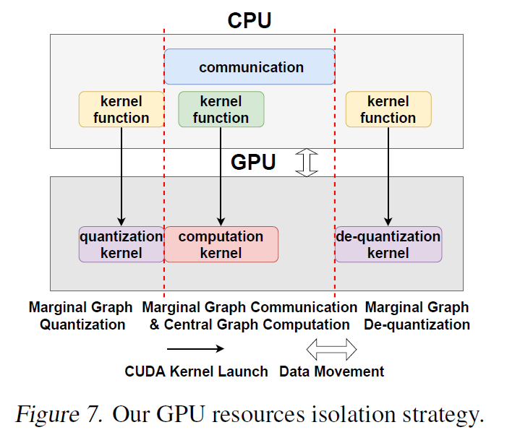
Adaqp (2/3) – extra control logic
•
Adaptive bit-width assignment is a periodic control loop: trace, estimate, optimize, and broadcast new assignments.
•
Figure 7 shows why overlap cannot be left to free GPU scheduling: quantization, central computation, and de-quantization compete for resources.
•
So AdaQP adds explicit resource isolation to control execution order and preserve the benefit of overlap.
So the contribution of AdaQP is not only lower-bit communication, but a controlled workflow that turns saved communication time into useful computation.

Slide 28
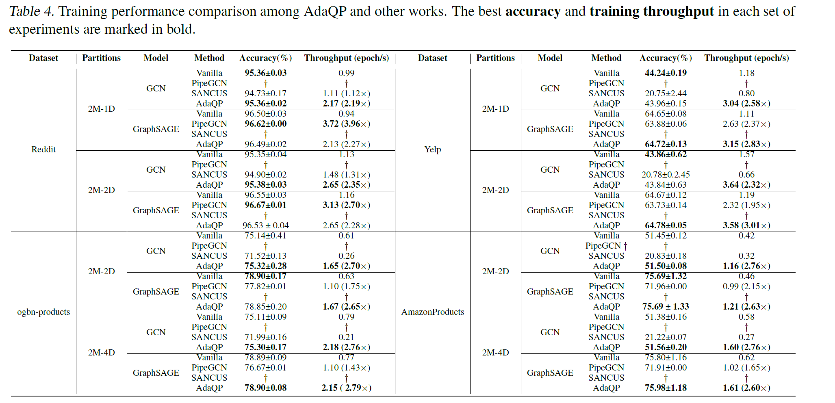
adaqp (3/3) - Performance
•
The paper reports throughput improvements of 2.19x-3.01x with small accuracy fluctuations, often within about +/-0.3 percentage points.
•
It also reports communication-time reduction up to 80.94% and average reduction of 79.98% in the experiments discussed in the paper.
•
Compared with PipeGCN and SANCUS, the claim is that AdaQP reaches target accuracy faster because it cuts communication without relying on stale embeddings.
Takeaway: AdaQP represents the “communicate less and wait less” line of OS support.

Slide 29
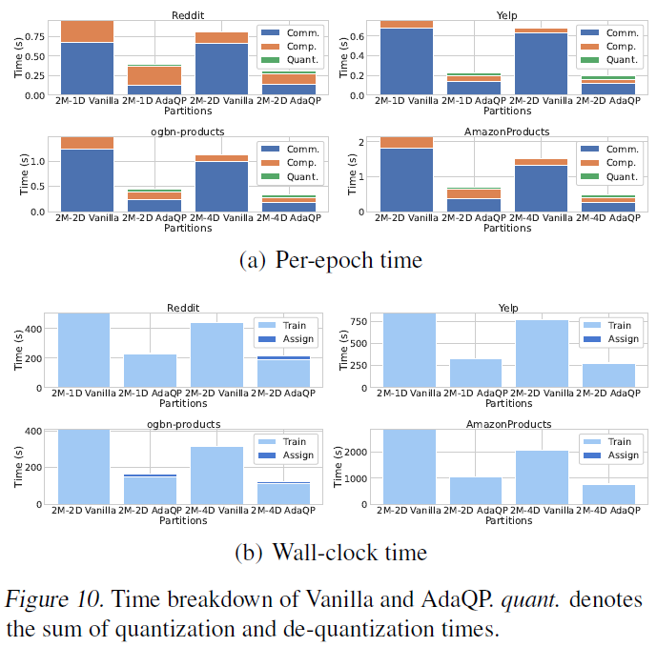
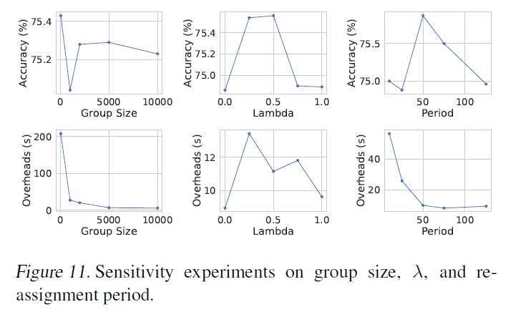
adaqp (3/3) - Performance
•
Figure 10 counts optimization overhead directly: quantization adds cost, but the saved communication and waiting time are still much larger overall.
•
Figure 11 adds sensitivity analysis, showing that adaptive assignment needs tuning but remains robust across settings.

Slide 30
OUTLINE
Introduction (5 min)
Background & Motivation (3 min)
Proposed Methods & Performance Evaluation (24 min)
BGL (9 min)
MGG (9 min)
AdaQP (6 min)
Conclusions (2 min)
Q & A (2 min)

Slide 31
conclusions
Paper
Training regime
Main bottleneck
Main system idea
What it contributes
BGL
sampling-based distributed
data I/O + preprocessing
dynamic cache + partition + isolation
keeps GPUs busy by fixing the data supply chain
MGG
single-node multi-GPU full-graph
remote access on the critical path
fine-grained kernel pipeline + runtime feedback
treats irregular GNN execution as a schedulable pipeline
AdaQP
distributed full-graph
all-to-all communication volume and stragglers
adaptive quantization + central/marginal overlap
reduces traffic and hides waiting without relying on stale messages

Slide 32
conclusions
•
Large-scale graph learning stresses systems because its bottlenecks move between data preparation, communication, and irregular compute.
•
BGL shows how OS-style pipeline design and locality management can fix the front end of the training loop.
•
MGG shows that inside a multi-GPU node, fine-grained overlap and runtime-aware kernel mapping matter a lot.
•
AdaQP shows that in distributed full-graph training, reducing message volume and hiding wait time can improve throughput without large accuracy loss.
•
Overall takeaway: as graph learning scales up, the optimization target moves outward along the system stack — from data supply, to intra-node execution, and finally to inter-device communication.

Slide 33
OUTLINE
Introduction (5 min)
Background & Motivation (3 min)
Proposed Methods & Performance Evaluation (24 min)
BGL (8 min)
MGG (8 min)
AdaQP (8 min)
Conclusions (2 min)
Q & A (2 min)
Notes:
Thank you very much for listening. I will be happy to take any questions.

