Slide 1
The Evolution of Distributed LLM Training Systems 2026.4.7
Jun’an Chen
School of Data Science
The Chinese University of Hong Kong, Shenzhen

Slide 2
Outline
Introduction (5 min)
Background & Motivation (3 min)
Proposed Methods (18 min)
Megatron-LM (6 min)
Alpa (6 min)
MegaScale (6 min)
Conclusions (2 min)
Q & A (2 min)

Slide 3
Outline
Introduction (5 min)
Background & Motivation (3 min)
Proposed Methods (18 min)
Megatron-LM (6 min)
Alpa (6 min)
MegaScale (6 min)
Conclusions (2 min)
Q & A (2 min)

Slide 4
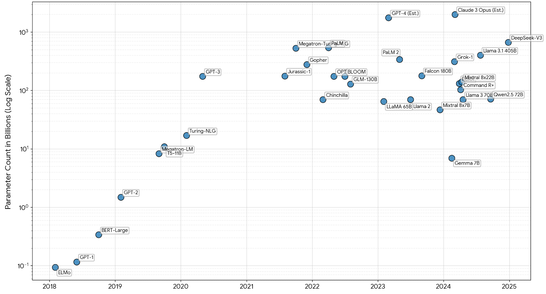
Introduction (1/2)
The training of Large Language Models (LLMs) has evolved rapidly, requiring massive computational resources.
Fig 1. Trend of LLM parameter sizes

Slide 5
Introduction (2/2)
The evolution of distributed training systems through three key stages:
Megatron-LM: Manual, hard-coded model partitioning.
Alpa: Compiler-driven, automated parallelism execution plans.
MegaScale: Massive-scale production engineering and fault tolerance.
This progression from manual partitioning to automated orchestration to fault-tolerant production systems represents the maturation of distributed LLM training.

Slide 6
Outline
Introduction (5 min)
Background & Motivation (3 min)
Proposed Methods (18 min)
Megatron-LM (6 min)
Alpa (6 min)
MegaScale (6 min)
Conclusions (2 min)
Q & A (2 min)

Slide 7
Background & Motivation (1/2)
Traditional parallelism vs. the LLM challenge
Data parallelism: Replicates the model across workers and divides the data. However, this fails when the model cannot fit entirely on one worker.
Pipeline parallelism: Distributes model layers among multiple devices. This can suffer from idle time.
The core motivation: Efficient large-scale model training requires tuning a complex combination of data, operator, and pipeline parallelization approaches.

Slide 8
Background & Motivation (2/2)
Evolution of the systems problem
Problem 1 → Solved by Megatron-LM: How do we partition a model's math when it exceeds a single GPU's memory?
Problem 2 → Solved by Alpa: Manually figuring out how to partition operators and allocate devices creates a massive combinatorial space. How do we automate this?
Problem 3 → Solved by MegaScale: At the scale of 10,000+ GPUs, software and hardware faults become virtually inevitable. How do we maintain stability and efficiency?

Slide 9
Outline
Introduction (5 min)
Background & Motivation (3 min)
Proposed Methods (18 min)
Megatron-LM (6 min)
Alpa (6 min)
MegaScale (6 min)
Conclusions (2 min)
Q & A (2 min)

Slide 10
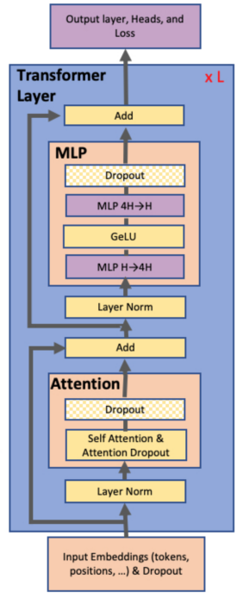
Megatron-LM (1/5)
Key observation: A transformer layer consists of a self attention block followed by a two-layer, multi-layer perceptron (MLP). Transformer architecture contains natural parallelism opportunities.
Model parallelisms: By introducing parallelism in general matrix multiplication (GEMM) operations, it can be achieved without rewriting the model or relying on special compilers.
MLP
Self attention
Fig 2. Transformer architecture

Slide 11
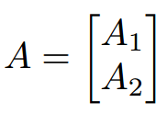
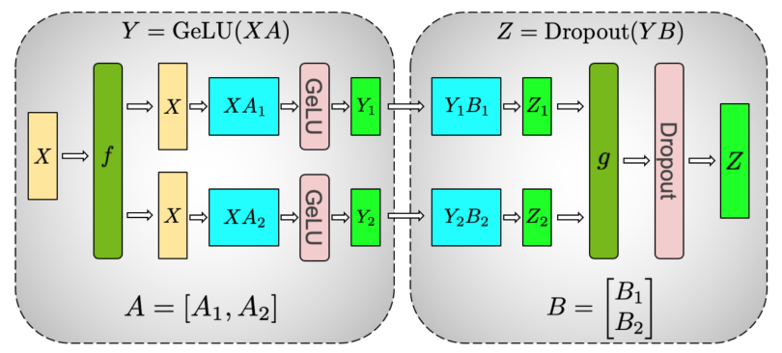




Megatron-LM (2/5)
One option is to split the weight matrix A along its rows:
Another option is to split the weight A along its columns:
Fig 3. MLP with model parallelism

Slide 12
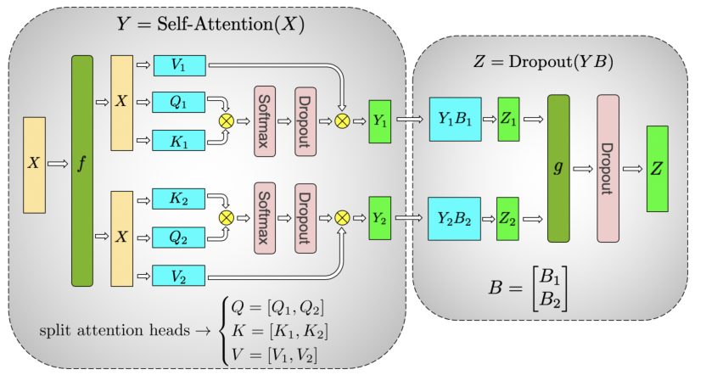
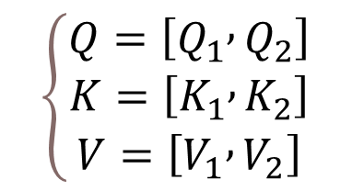
Megatron-LM (3/5)
Partition the GEMMs associated with key (K), query (Q), and value (V ) in a column parallel fashion:
$$\left\{\begin{matrix}Q=\left[Q_{1} , Q_{2}\right] \\ K=\left[K_{1} , K_{2}\right] \\ V=\left[V_{1} , V_{2}\right]\end{matrix}\right.$$
Megatron-LM leverages the mathematical structure of transformers rather than fighting against it.
Fig 4. Self-Attention with model parallelism

Slide 13
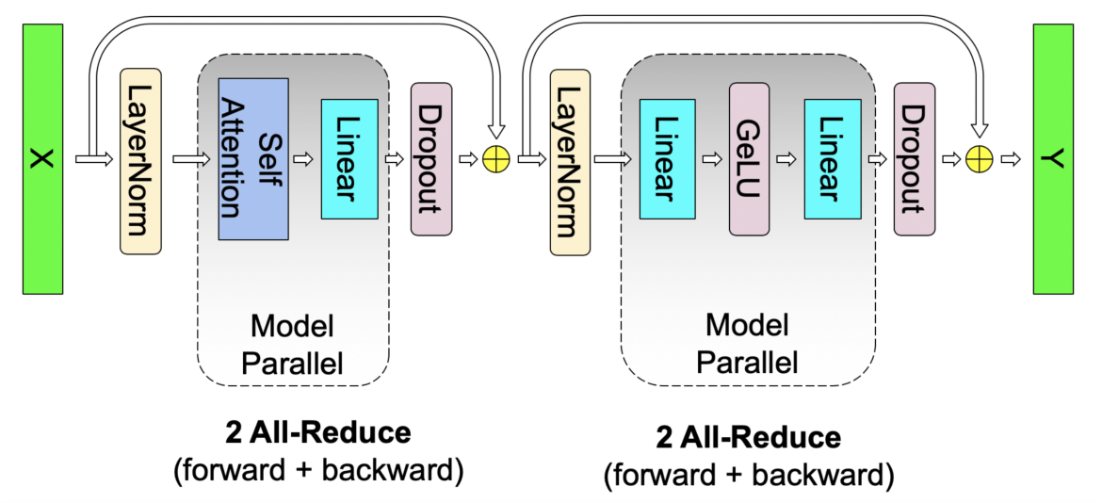
Megatron-LM (4/5)
A complete transformer layer requires only four communication operations total: two in the forward pass and two in the backward pass.
Fig 5. Communication operations in a transformer layer.

Slide 14
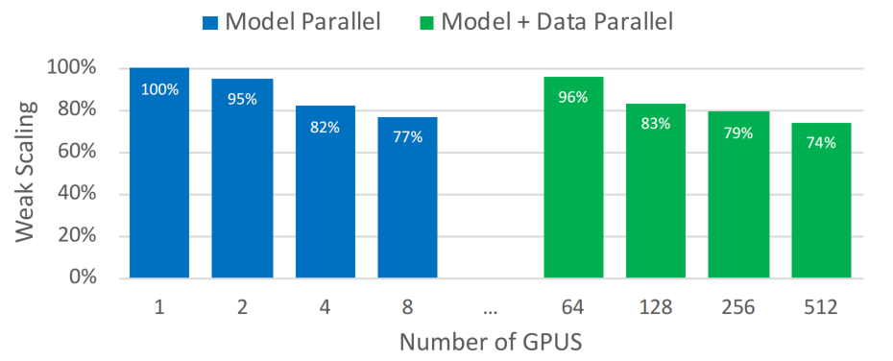
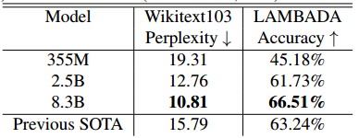
Megatron-LM (5/5)
Evaluation
Table 1. Zero-shot results
Fig 6. Model and model + data parallel weak scaling efficiency as a function of the number of GPUs.

Slide 15
Outline
Introduction (5 min)
Background & Motivation (3 min)
Proposed Methods (18 min)
Megatron-LM (6 min)
Alpa (6 min)
MegaScale (6 min)
Conclusions (2 min)
Q & A (2 min)

Slide 16
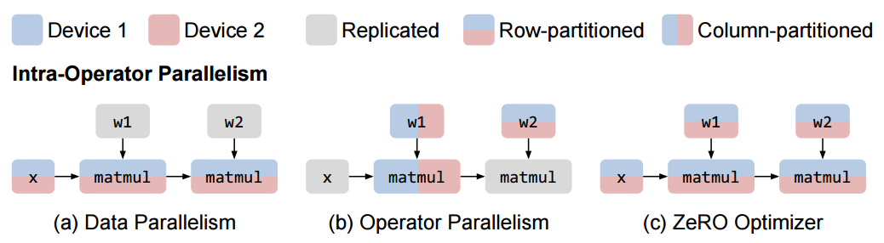
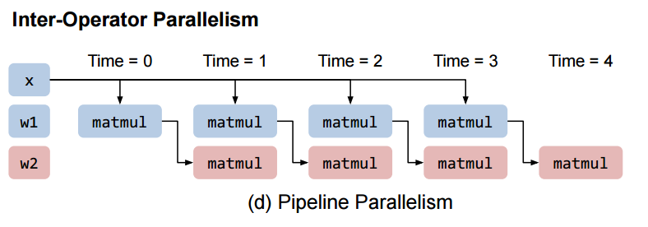
Alpa (1/5)
Recatalog existing parallelization approaches into two orthogonal categories:
Intra-operator parallelism.
Partition the tensor along some dimensions.
Assign to multiple devices.
Execute different portions at the same time.
Inter-operator parallelism.
Do not perform operator partitioning.
Assign different operators of the graph on distributed devices.
Fig 7. Common parallelization techniques for training a 2-layer Multi-layer Perceptron (MLP)

Slide 17
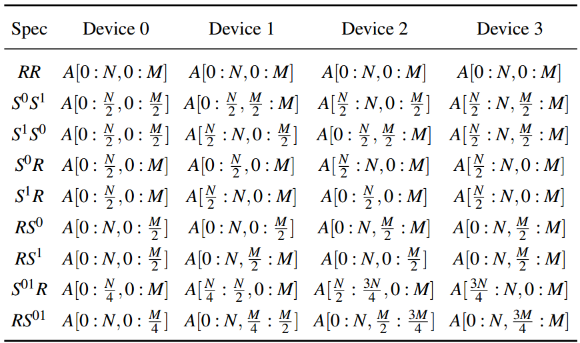
Alpa (2/5)
Table 2. Sharding specs of a 2-dimentional tensor on a 2×2 device mesh. A is a (N,M) tensor
Intra-operator parallelism
SPMD-style parallelism
Partition operators evenly across devices
Executes the same instructions on all devices

Slide 18
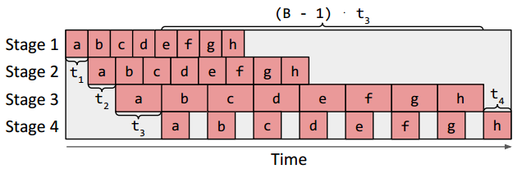
Alpa (3/5)
Inter-Operator parallelism
Goal: Minimize end-to-end pipeline latency.
Method:
Dynamic programming
Operator clustering
Fig 8. Illustration of the total latency of a pipeline

Slide 19
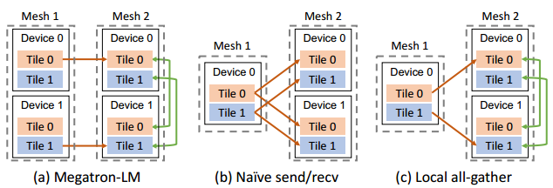
Alpa (4/5)
Parallelism orchestration
The true contribution of Alpa is how it combines Intra-operator and inter-operator parallelism types together
Fig 9. Cross-mesh resharding. (a) The scatter-gather optimization for equal mesh shapes in Megatron-LM. (b) The naive send/recv for unequal mesh shapes. (c) The generalized local all-gather optimization for unequal mesh shapes.

Slide 20
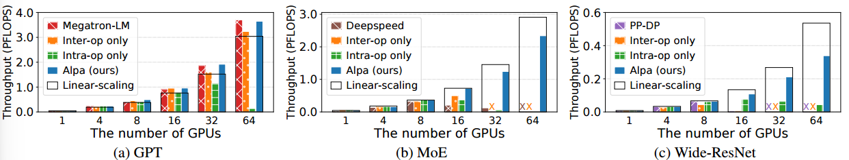
Alpa (5/5)
Evaluation：Alpa could train models that were completely out-of-memory for baseline approaches
Fig 10. End-to-end evaluation results.
“×” denotes out-of-memory. Black boxes represent linear scaling.

Slide 21
Outline
Introduction (5 min)
Background & Motivation (3 min)
Proposed Methods (18 min)
Megatron-LM (6 min)
Alpa (6 min)
MegaScale (6 min)
Conclusions (2 min)
Q & A (2 min)

Slide 22
MegaScale (1/4)
Scaling large language model training to more than 10,000 GPUs
Algorithmic optimizations
Communication strategies
Data pipeline management
Network performance tuning techniques

Slide 23
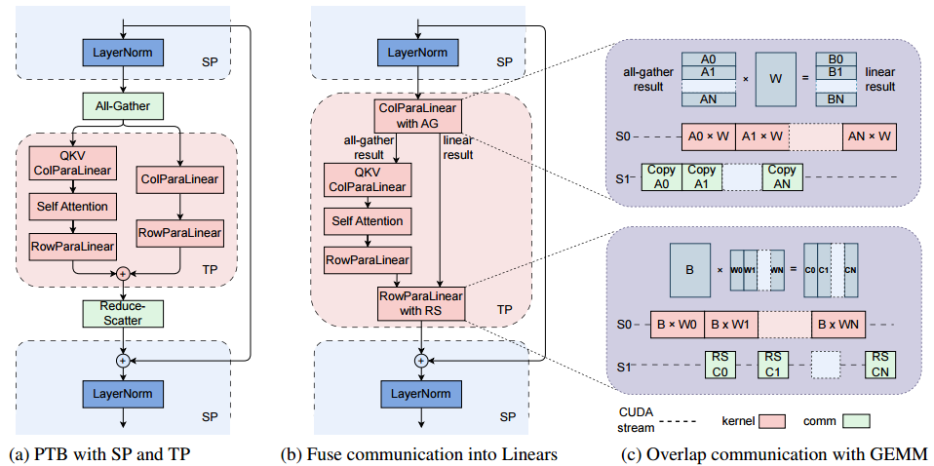
MegaScale (2/4)
Efficient training at scale
Algorithmic optimizations
Communication overlapping in 3D parallelism
Efficient operators & data pipeline
System level optimization
Collective communication group initialization
Network performance tuning
Fig 11. Overlapping communication in tensor parallelism (TP) and sequence parallelism (SP) with parallel transformer block (PTB).

Slide 24
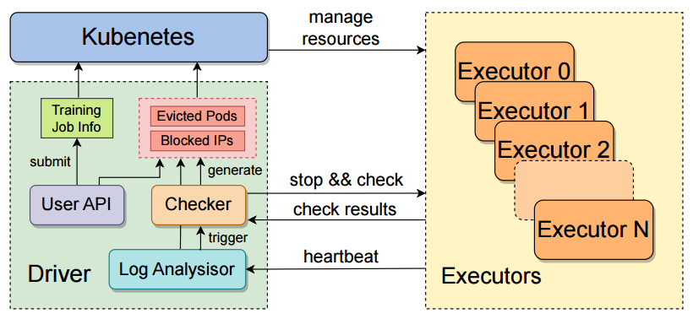
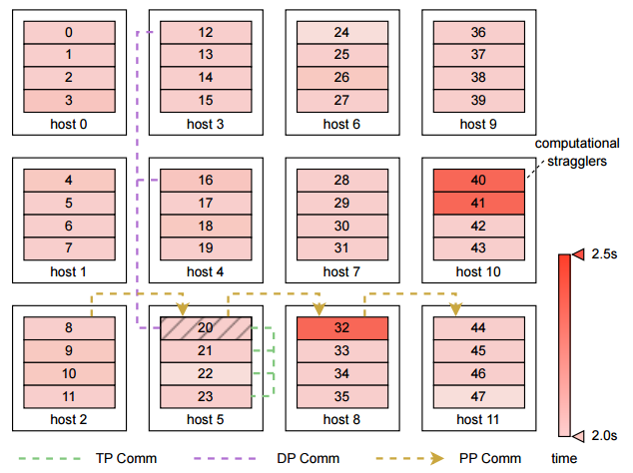
MegaScale (3/4)
Stable training at scale
Fault tolerance
Robust training workflow
Data collection and analysis
Diagnostic tests
Fast checkpointing and recovery
Training rroubleshooting
Performance diagnosis with CUDA event monitor
3D parallel training visualization
Fig 12. Robust training workflow.
The biggest contribution of MegaScale is its full approach to fault tolerance.
Fig 13. Performance heat-map.

Slide 25
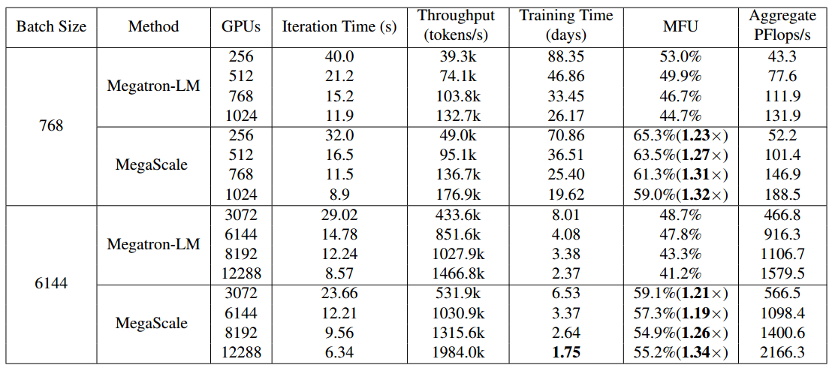
MegaScale (4/4)
Evaluation
Table 3. Strong-scaling training performance for the 175B model.

Slide 26
Outline
Introduction (5 min)
Background & Motivation (3 min)
Proposed Methods (18 min)
Megatron-LM (6 min)
Alpa (6 min)
MegaScale (6 min)
Conclusions (2 min)
Q & A (2 min)

Slide 27
Conclusion (1/2)
System | Max Scale | Key Innovation | Main Contribution
Megatron-LM | 512 GPUs | Manual model parallelism | Use the transformer structure to parallelize
Alpa | ~1,000 GPUs | Compiler-based optimization | Combines two parallelism types together
MegaScale | 10,000+ GPUs | Enterprise-scale infrastructure | Full approach to fault tolerance

Slide 28
Conclusion (2/2)
Megatron-LM: Broke the memory wall via manual parallelism.
Alpa: Automated the search space via compiler design.
MegaScale: Hardened the system for 10K+ scale production.

Slide 29
Thanks
Junan Chen
School of Data Science
The Chinese University of Hong Kong, Shenzhen
Notes:
That's all for my presentation today—thank you for your attention! I'm happy to take any questions you might have.

