Slide 1
CSC6032 – Advanced Operating Systems
Prof. Yeh-Ching Chung
School of Data Science
Chinese University of Hong Kong, Shenzhen

Slide 2
Outline
Background
Naming and Transparency
Remote File Access
Stateful versus Stateless Service
HDFS
Ceph File System

Slide 3
Objectives
To explain the naming mechanism that provides location transparency and independence
To describe the various methods for accessing distributed files
To contrast stateful and stateless distributed file servers
To show how replication of files on different machines in a distributed file system is a useful redundancy for improving availability
To introduce the HDFS and Ceph files as examples of distributed file systems

Slide 4
Background
Distributed file system (DFS) – a distributed implementation of the classical time-sharing model of a file system, where multiple users share files and storage resources
A DFS manages set of dispersed storage devices
Overall storage space managed by a DFS is composed of different, remotely located, smaller storage spaces
There is usually a correspondence between constituent storage spaces and sets of files

Slide 5
DFS Structure
Service – software entity running on one or more machines and providing a particular type of function to a priori unknown clients
Server – service software running on a single machine
Client – process that can invoke a service using a set of operations that forms its client interface
A client interface for a file service is formed by a set of primitive file operations (create, delete, read, write)
Client interface of a DFS should be transparent, i.e., not distinguish between local and remote files

Slide 6
Naming and Transparency
Naming – mapping between logical and physical objects
Multilevel mapping – abstraction of a file that hides the details of how and where on the disk the file is actually stored
A transparent DFS hides the location where in the network the file is stored
For a file being replicated in several sites, the mapping returns a set of the locations of this file’s replicas; both the existence of multiple copies and their location are hidden

Slide 7
Naming Structures
Location transparency – file name does not reveal the file’s physical storage location
Location independence – file name does not need to be changed when the file’s physical storage location changes

Slide 8
Naming Schemes — Three Main Approaches
Files named by combination of their host name and local name; guarantees a unique systemwide name
Attach remote directories to local directories, giving the appearance of a coherent directory tree; only previously mounted remote directories can be accessed transparently
Total integration of the component file systems
A single global name structure spans all the files in the system
If a server is unavailable, some arbitrary set of directories on different machines also becomes unavailable

Slide 9
Remote File Access
Remote-service mechanism is one transfer approach
Reduce network traffic by retaining recently accessed disk blocks in a cache, so that repeated accesses to the same information can be handled locally
If needed data not already cached, a copy of data is brought from the server to the user
Accesses are performed on the cached copy
Files identified with one master copy residing at the server machine, but copies of (parts of) the file are scattered in different caches
Cache-consistency problem – keeping the cached copies consistent with the master file
Could be called network virtual memory

Slide 10
Cache Location – Disk vs. Main Memory
Advantages of disk caches
More reliable
Cached data kept on disk are still there during recovery and don’t need to be fetched again
Advantages of main-memory caches
Permit workstations to be diskless
Data can be accessed more quickly
Performance speedup in bigger memories
Server caches (used to speed up disk I/O) are in main memory regardless of where user caches are located; using main-memory caches on the user machine permits a single caching mechanism for servers and users

Slide 11
Cache Update Policy
Write-through – write data through to disk as soon as they are placed on any cache
Reliable, but poor performance
Delayed-write – modifications written to the cache and then written through to the server later
Write accesses complete quickly; some data may be overwritten before they are written back, and so need never be written at all
Poor reliability; unwritten data will be lost whenever a user machine crashes
Variation – scan cache at regular intervals and flush blocks that have been modified since the last scan
Variation – write-on-close, writes data back to the server when the file is closed
Best for files that are open for long periods and frequently modified

Slide 12
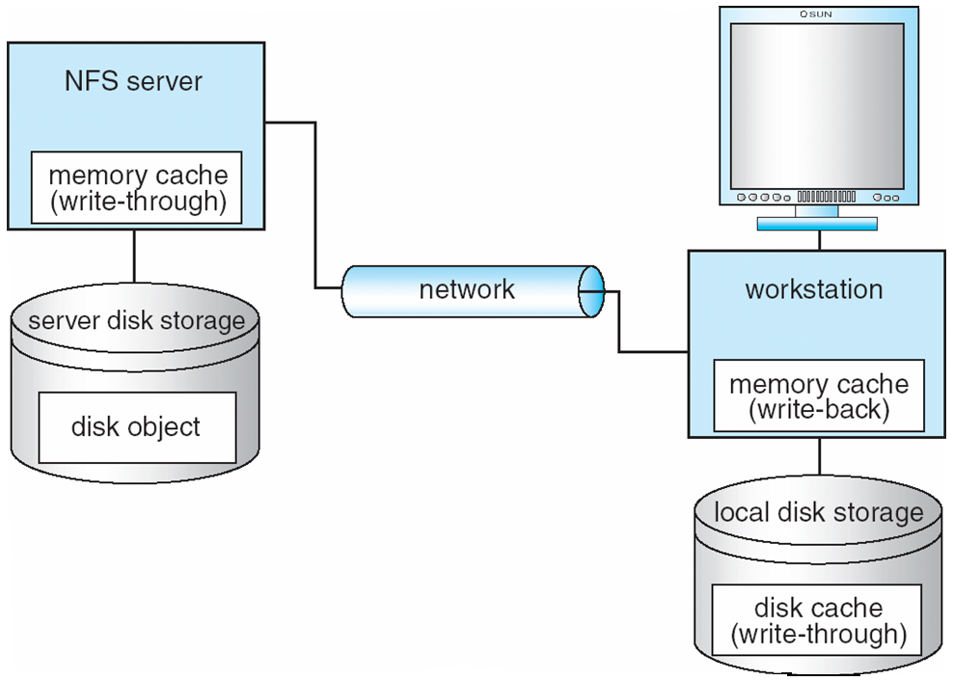
Cachefs and its Use of Caching

Slide 13
Consistency
Is locally cached copy of the data consistent with the master copy?
Client-initiated approach
Client initiates a validity check
Server checks whether the local data are consistent with the master copy
Server-initiated approach
Server records, for each client, the (parts of) files it caches
When server detects a potential inconsistency, it must react

Slide 14
Comparing Caching and Remote Service (1)
In caching, many remote accesses handled efficiently by the local cache; most remote accesses will be served as fast as local ones
Servers are contracted only occasionally in caching (rather than for each access)
Reduces server load and network traffic
Enhances potential for scalability
Remote server method handles every remote access across the network; penalty in network traffic, server load, and performance
Total network overhead in transmitting big chunks of data (caching) is lower than a series of responses to specific requests (remote-service)

Slide 15
Comparing Caching and Remote Service (2)
Caching is superior in access patterns with infrequent writes
With frequent writes, substantial overhead incurred to overcome cache-consistency problem
Benefit from caching when execution carried out on machines with either local disks or large main memories
Remote access on diskless, small-memory-capacity machines should be done through remote-service method
In caching, the lower intermachine interface is different form the upper user interface
In remote-service, the intermachine interface mirrors the local user-file-system interface

Slide 16
Stateful File Service
Mechanism
Client opens a file
Server fetches information about the file from its disk, stores it in its memory, and gives the client a connection identifier unique to the client and the open file
Identifier is used for subsequent accesses until the session ends
Server must reclaim the main-memory space used by clients who are no longer active
Increased performance
Fewer disk accesses
Stateful server knows if a file was opened for sequential access and can thus read ahead the next blocks

Slide 17
Stateless File Server
Avoids state information by making each request self-contained
Each request identifies the file and position in the file
No need to establish and terminate a connection by open and close operations

Slide 18
Distinctions Between Stateful & Stateless Service (1)
Failure Recovery
A stateful server loses all its volatile state in a crash
Restore state by recovery protocol based on a dialog with clients, or abort operations that were underway when the crash occurred
Server needs to be aware of client failures in order to reclaim space allocated to record the state of crashed client processes (orphan detection and elimination)
With stateless server, the effects of server failure sand recovery are almost unnoticeable
A newly reincarnated server can respond to a self-contained request without any difficulty

Slide 19
Distinctions Between Stateful & Stateless Service (2)
Penalties for using the robust stateless service:
longer request messages
slower request processing
additional constraints imposed on DFS design
Some environments require stateful service
A server employing server-initiated cache validation cannot provide stateless service, since it maintains a record of which files are cached by which clients
UNIX use of file descriptors and implicit offsets is inherently stateful; servers must maintain tables to map the file descriptors to inodes, and store the current offset within a file

Slide 20
File Replication
Replicas of the same file reside on failure-independent machines
Improves availability and can shorten service time
Naming scheme maps a replicated file name to a particular replica
Existence of replicas should be invisible to higher levels
Replicas must be distinguished from one another by different lower-level names
Updates – replicas of a file denote the same logical entity, and thus an update to any replica must be reflected on all other replicas
Demand replication – reading a nonlocal replica causes it to be cached locally, thereby generating a new nonprimary replica

Slide 21
Hadoop File System

Slide 22
Hadoop File System
Highly fault-tolerant
High throughput
Suitable for applications with large data sets
Streaming access to file system data
Can be built out of commodity hardware

Slide 23
Fault Tolerance
Failure is the norm rather than exception
A HDFS instance may consist of thousands of server machines, each storing part of the file system’s data.
Since we have huge number of components and that each component has non-trivial probability of failure means that there is always some component that is non-functional.
Detection of faults and quick, automatic recovery from them is a core architectural goal of HDFS.

Slide 24
Data Characteristics
Streaming data access
Applications need streaming access to data
Batch processing rather than interactive user access.
Large data sets and files: gigabytes to terabytes size
High aggregate data bandwidth
Scale to hundreds of nodes in a cluster
Tens of millions of files in a single instance
Write-once-read-many: a file once created, written and closed need not be changed – this assumption simplifies coherency
A map-reduce application or web-crawler application fits perfectly with this model.

Slide 25
MapReduce
Cat
Bat
Dog
Other
Words
(size:
TByte)
combine
reduce
map
part0
split
reduce
combine
split
map
part1
combine
reduce
split
map
part2
split
map

Slide 26
Namenode and Datanodes
Master/slave architecture
HDFS cluster consists of a single Namenode, a master server that manages the file system namespace and regulates access to files by clients.
There are a number of DataNodes usually one per node in a cluster.
The DataNodes manage storage attached to the nodes that they run on.
HDFS exposes a file system namespace and allows user data to be stored in files.
A file is split into one or more blocks and set of blocks are stored in DataNodes.
DataNodes: serves read, write requests, performs block creation, deletion, and replication upon instruction from Namenode.

Slide 27
HDFS Architecture
Namenode
Metadata(Name, replicas..)
(/home/foo/data,6. ..
Metadata ops
Client
Block ops
Read
Datanodes
Datanodes
B
replication
Blocks
Rack1
Write
Rack2
Client

Slide 28
File System Namespace
Hierarchical file system with directories and files
Create, remove, move, rename etc.
Namenode maintains the file system
Any meta information changes to the file system recorded by the Namenode.
An application can specify the number of replicas of the file needed as a replication factor of the file. This information is stored in the Namenode.

Slide 29
Data Replication
HDFS is designed to store very large files across machines in a large cluster.
Each file is a sequence of blocks.
All blocks in the file except the last are of the same size.
Blocks are replicated for fault tolerance.
Block size and replicas are configurable per file.
The Namenode receives a Heartbeat and a BlockReport from each DataNode in the cluster.
BlockReport contains all the blocks on a Datanode.

Slide 30
Replica Placement (1)
The placement of the replicas is critical to HDFS reliability and performance.
Optimizing replica placement distinguishes HDFS from other distributed file systems.
Rack-aware replica placement:
Goal: improve reliability, availability and network bandwidth utilization
Research topic
Many racks, communication between racks are through switches.
Network bandwidth between machines on the same rack is greater than those in different racks.
Namenode determines the rack id for each DataNode.

Slide 31
Replica Placement (2)
Replicas are typically placed on unique racks
Simple but non-optimal
Writes are expensive
Replication factor is 3
Another research topic?
Replicas are placed: one on a node in a local rack, one on a different node in the local rack and one on a node in a different rack.
1/3 of the replica on a node, 2/3 on a rack and 1/3 distributed evenly across remaining racks.

Slide 32
Replica Selection
Replica selection for READ operation: HDFS tries to minimize the bandwidth consumption and latency.
If there is a replica on the Reader node then that is preferred.
HDFS cluster may span multiple data centers: replica in the local data center is preferred over the remote one.

Slide 33
Safemode Startup
On startup Namenode enters Safemode.
Replication of data blocks do not occur in Safemode.
Each DataNode checks in with Heartbeat and BlockReport.
Namenode verifies that each block has acceptable number of replicas
After a configurable percentage of safely replicated blocks check in with the Namenode, Namenode exits Safemode.
It then makes the list of blocks that need to be replicated.
Namenode then proceeds to replicate these blocks to other Datanodes.

Slide 34
Filesystem Metadata
The HDFS namespace is stored by Namenode.
Namenode uses a transaction log called the EditLog to record every change that occurs to the filesystem meta data.
For example, creating a new file.
Change replication factor of a file
EditLog is stored in the Namenode’s local filesystem
Entire filesystem namespace including mapping of blocks to files and file system properties is stored in a file FsImage. Stored in Namenode’s local filesystem.

Slide 35
Namenode
Keeps image of entire file system namespace and file Blockmap in memory.
4GB of local RAM is sufficient to support the above data structures that represent the huge number of files and directories.
When the Namenode starts up it gets the FsImage and Editlog from its local file system, update FsImage with EditLog information and then stores a copy of the FsImage on the filesytstem as a checkpoint.
Periodic checkpointing is done. So that the system can recover back to the last checkpointed state in case of a crash.

Slide 36
Datanode
A Datanode stores data in files in its local file system.
Datanode has no knowledge about HDFS filesystem
It stores each block of HDFS data in a separate file.
Datanode does not create all files in the same directory.
It uses heuristics to determine optimal number of files per directory and creates directories appropriately:
Research issue?
When the filesystem starts up it generates a list of all HDFS blocks and send this report to Namenode: Blockreport.

Slide 37
The Communication Protocol
All HDFS communication protocols are layered on top of the TCP/IP protocol
A client establishes a connection to a configurable TCP port on the Namenode machine. It talks ClientProtocol with the Namenode.
The Datanodes talk to the Namenode using Datanode protocol.
RPC abstraction wraps both ClientProtocol and Datanode protocol.
Namenode is simply a server and never initiates a request; it only responds to RPC requests issued by DataNodes or clients.

Slide 38
Objectives
Primary objective of HDFS is to store data reliably in the presence of failures.
Three common failures are: Namenode failure, Datanode failure and network partition.

Slide 39
DataNode Failure and Heartbeat
A network partition can cause a subset of Datanodes to lose connectivity with the Namenode.
Namenode detects this condition by the absence of a Heartbeat message.
Namenode marks Datanodes without Hearbeat and does not send any IO requests to them.
Any data registered to the failed Datanode is not available to the HDFS.
Also the death of a Datanode may cause replication factor of some of the blocks to fall below their specified value.

Slide 40
Re-replication
The necessity for re-replication may arise due to:
A Datanode may become unavailable,
A replica may become corrupted,
A hard disk on a Datanode may fail, or
The replication factor on the block may be increased.

Slide 41
Cluster Rebalancing
HDFS architecture is compatible with data rebalancing schemes.
A scheme might move data from one Datanode to another if the free space on a Datanode falls below a certain threshold.
In the event of a sudden high demand for a particular file, a scheme might dynamically create additional replicas and rebalance other data in the cluster.
These types of data rebalancing are not yet implemented: research issue.

Slide 42
Data Integrity
Consider a situation: a block of data fetched from Datanode arrives corrupted.
This corruption may occur because of faults in a storage device, network faults, or buggy software.
A HDFS client creates the checksum of every block of its file and stores it in hidden files in the HDFS namespace.
When a clients retrieves the contents of file, it verifies that the corresponding checksums match.
If does not match, the client can retrieve the block from a replica.

Slide 43
Metadata Disk Failure
FsImage and EditLog are central data structures of HDFS.
A corruption of these files can cause a HDFS instance to be non-functional.
For this reason, a Namenode can be configured to maintain multiple copies of the FsImage and EditLog.
Multiple copies of the FsImage and EditLog files are updated synchronously.
Meta-data is not data-intensive.
The Namenode could be single point failure: automatic failover is NOT supported! Another research topic.

Slide 44
Data Blocks
HDFS support write-once-read-many with reads at streaming speeds.
A typical block size is 64MB (or even 128 MB).
A file is chopped into 64MB chunks and stored.

Slide 45
Staging (1)
A client request to create a file does not reach Namenode immediately.
HDFS client caches the data into a temporary file. When the data reached a HDFS block size the client contacts the Namenode.
Namenode inserts the filename into its hierarchy and allocates a data block for it.
The Namenode responds to the client with the identity of the Datanode and the destination of the replicas (Datanodes) for the block.
Then the client flushes it from its local memory.

Slide 46
Staging (2)
The client sends a message that the file is closed.
Namenode proceeds to commit the file for creation operation into the persistent store.
If the Namenode dies before file is closed, the file is lost.
This client side caching is required to avoid network congestion; also it has precedence is AFS (Andrew file system).

Slide 47
Replication Pipelining
When the client receives response from Namenode, it flushes its block in small pieces (4K) to the first replica, that in turn copies it to the next replica and so on.
Thus data is pipelined from Datanode to the next.

Slide 48
Application Programming Interface
HDFS provides Java API for application to use.
Python access is also used in many applications.
A C language wrapper for Java API is also available.
A HTTP browser can be used to browse the files of a HDFS instance.

Slide 49
FS Shell, Admin and Browser Interface
HDFS organizes its data in files and directories.
It provides a command line interface called the FS shell that lets the user interact with data in the HDFS.
The syntax of the commands is similar to bash and csh.
There is also DFSAdmin interface available
Browser interface is also available to view the namespace.

Slide 50
Space Reclamation
When a file is deleted by a client, HDFS renames file to a file in be the /trash directory for a configurable amount of time.
A client can request for an undelete in this allowed time.
After the specified time the file is deleted and the space is reclaimed.
When the replication factor is reduced, the Namenode selects excess replicas that can be deleted.
Next heartbeat(?) transfers this information to the Datanode that clears the blocks for use.

Slide 51
Summary
We discussed the features of the Hadoop File System, a peta-scale file system to handle big-data sets.
What discussed: Architecture, Protocol, API, etc.
Missing element: Implementation
The Hadoop file system (internals)
An implementation of an instance of the HDFS (for use by applications such as web crawlers).

Slide 52
Ceph File System

Slide 53
System Objectives
Excellent performance and reliability
Unparallel scalability thanks to
Distribution of metadata workload inside metadata cluster
Use of object storage devices (OSDs)
Designed for very large systems
Petabyte scale (10⁶ gigabytes)

Slide 54
Characteristics of Very Large Systems
Built incrementally
Node failures are the norm
Quality and character of workload changes over time

Slide 55
System Overview
System architecture
Key ideas
Decoupling data and metadata
Metadata management
Autonomic distributed object storage

Slide 56
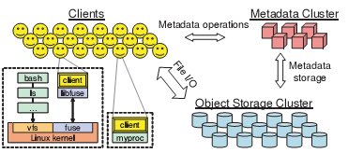
System Architecture (1)

Slide 57
System Architecture (2)
Clients
Export a near-POSIX file system interface
Cluster of OSDs
Store all data and metadata
Communicates directly with clients
Metadata server cluster
Manages the namespace (files + directories)
Security, consistency and coherence

Slide 58
Key Ideas
Separate data and metadata management tasks
- Metadata cluster does not have object lists
Dynamic partitioning of metadata data tasks inside metadata cluster
Avoids hot spots
Let OSDs handle file migration and replication tasks

Slide 59
Decoupling Data and Metadata
Metadata cluster handles metadata operations
Clients interact directly with OSD for all file I/O
Low-level bloc allocation is delegated to OSDs
Other OSD still require metadata cluster to hold object lists
Ceph uses a special pseudo-random data distribution function (CRUSH)

Slide 60
Metadata Management
Dynamic Subtree Partitioning
Lets Ceph dynamically share metadata workload among tens or hundreds of metadata servers (MDSs)
Sharing is dynamic and based on current access patterns
Results in near-linear performance scaling in the number of MDSs

Slide 61
Autonomic Distributed Object Storage
Distributed storage handles data migration and data replication tasks
Leverages the computational resources of OSDs
Achieves reliable highly-available scalable object storage
Reliable implies no data losses
Highly available implies being accessible almost all the time

Slide 62
The Client
Performing an I/O
Client synchronization
Namespace operations

Slide 63
Perform I/O
When client opens a file
Sends a request to the MDS cluster
Receives an i-node number, information about file size and striping strategy and a capability
Capability specifies authorized operations on file (not yet encrypted )
Client uses CRUSH to locate object replica
Client releases capability at close time

Slide 64
Client Synchronization (1)
POSIX requires
One-copy serializability
Atomicity of writes
When MDS detects conflicting accesses by different clients to the same file
Revokes all caching and buffering permissions
Requires synchronous I/O to that file

Slide 65
Client Synchronization (2)
Synchronization handled by OSDs
Locks can be used for writes spanning object boundaries
Synchronous I/O operations have huge latencies
Many scientific workloads do significant amount of read-write sharing
POSIX extension lets applications synchronize their concurrent accesses to a file

Slide 66
Namespace Operations
Managed by the MDSs
Read and update operations are all synchronously applied to the metadata
Optimized for common case
readdir returns contents of whole directory (as NFS readdirplus does)
Guarantees serializability of all operations
Can be relaxed by application

Slide 67
The MDS Cluster
Storing metadata
Dynamic subtree partitioning
Mapping subdirectories to MDSs

Slide 68
Store Metadata
Most requests likely to be satisfied from MDS in-memory cache
Each MDS lodges its update operations in lazily-flushed journal
Facilitates recovery
Directories
Include i-nodes
Stored on a OSD cluster

Slide 69
Dynamic Subtree Partitioning
Ceph uses primary copy approach to cached metadata management
Ceph adaptively distributes cached metadata across MDS nodes
Each MDS measures popularity of data within a directory
Ceph migrates and/or replicates hot spots

Slide 70
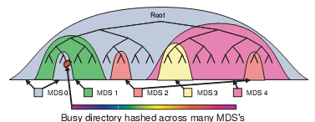
Mapping subdirectories to MDSs

Slide 71
Distributed Object Storage CRUSH
Data distribution with CRUSH
Replication
Data safety
Recovery and cluster updates
EBOFS

Slide 72
Data Distribution with CRUSH (1)
Wanted to avoid storing object addresses in MDS cluster
Ceph firsts maps objects into placement groups (PG) using a hash function
Placement groups are then assigned to OSDs using a pseudo-random function (CRUSH)
Clients know that function

Slide 73
Data Distribution with CRUSH (2)
To access an object, client needs to know
Its placement group
The OSD cluster map
The object placement rules used by CRUSH
Replication level
Placement constraints

Slide 74
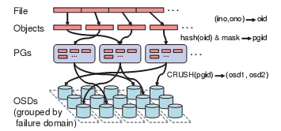
How files are striped

Slide 75
Replication
Ceph’s Reliable Autonomic Data Object Store autonomously manages object replication
First non-failed OSD in object’s replication list acts as a primary copy
Applies each update locally
Increments object’s version number
Propagates the update

Slide 76
Data Safety
Achieved by update process
Primary forwards updates to other replicas
Sends ACK to client once all replicas have received the update
Slower but safer
Replicas send final commit once they have committed update to disk

Slide 77
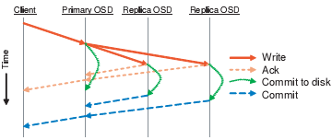
Commit writes

Slide 78
Recovery and Cluster Updates
RADOS monitors OSDs to detect failures
Recovery handled by same mechanism as deployment of new storage
Entirely driven by individual OSDs

Slide 79
EBOFS
Most DFS use an existing local file system to manage level-storage
Each Ceph OSD manages its local object storage with EBOFS (Extent and B-tree based Object File System
B-Tree service locates objects on disk
Block allocation is conducted in term of extents to keep metadata compact

Slide 80
Performance & Scalability
Want to measure
Cost of updating replicated data
Throughput and latency
Overall system performance
Scalability
Impact of MDS cluster size on latency

Slide 81
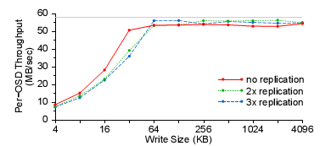
Impact of Replication (1)

Slide 82
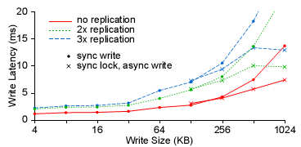
Impact of replication (2)
Transmission times dominate for large synchronized writes

Slide 83
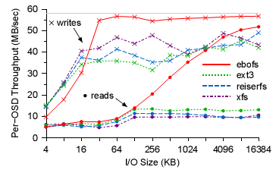
File System Performance

Slide 84
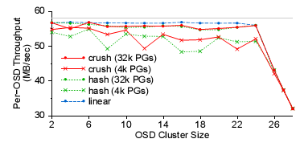
Scalability
Switch is saturated at 24 OSDs

Slide 85
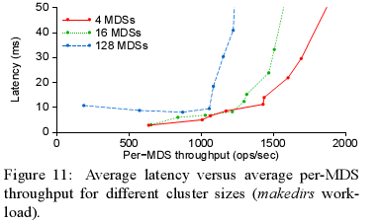
Impact of MDS Cluster Size on Latency

Slide 86
Conclusion
Ceph addresses three critical challenges of modern DFS
Scalability
Performance
Reliability
Achieved though reducing the workload of MDS
CRUSH
Autonomous repairs of OSD

