Slide 1
The Evolution of AI Agents: From Memory Architecture to Self-Improving Agents
Zhixuan Tan
School of Data Science
Chinese University of Hong Kong, Shenzhen
Notes:
"Hello everyone. Today I want to share 3 on the evolution of AI agents

Slide 2
The Evolution Path
From limited context to self-improving systems
LLM with
Memory-Managed
Context-Evolving
Self-Improving
Limited Context
Agent
Agent
Agent
Limited Context
Long-term Memory
Evolving Playbook
Learning from Interaction
Key Message: AI agents are not only becoming better at reasoning; they are also becoming better at remembering, organizing experience, and improving through use.
Notes:
When we evaluate agents, we usually focus on their reasoning capabilities, tool use, or task completion rates. But I think there is another important dimension: Memory. A truly capable agent shouldn't just be smart in a single turn. It needs to remember past interactions, structure that experience into reusable knowledge, and actually keep improving after deployment.
So, the key message I want to set up from the beginning is this: the next frontier for AI agents is not just about better reasoning; it is about moving from limited context windows to continuous, self-improving systems."

Slide 3
Outline
Introduction: The need for evolution beyond reasoning
Paper 1: MemGPT
Paper 2: Agentic Context Engineering
Paper 3: OpenClaw-RL
Conclusions
Notes:
You probably know this from using AI agents like ChatGPT, Gemini, or OpenClaw in practice: when the context is still short, they often look very smart. But once you keep input more and more information, they can start to get confused, lose focus, and behave in weird ways. They get lost in the long history, and the really important information is no longer used properly. That is why we need to manage their memory, instead of just making the context longer and longer.
Here is the three paper I going to talk today,
First, we will look at MemGPT, which focus on the immediate memory management problem.
Second, we'll move to Agentic Context Engineering (ACE), which prevents context collapse by turning log experience into a structured, evolving playbook.
Third, I will present OpenClaw-RL, which is use the 用户 trajectory，to train RL turn the daily talk to training signal
Finally, we will conclusions."

Slide 4
Why This Evolution Matters
Motivation
Roadmap
1
More Interaction
MemGPT
Agents face longer, more realistic settings
How should agents manage memory beyond a limited context window?
More Experience
2
Accumulate history over time
ACE
3
Three Core Needs
Remember
How should context evolve over time?
Organize
OpenClaw-RL
Improve
How can agents improve from ongoing interaction?
Notes:
“To motivate this talk, let us start from a simple observation.
As agents are used in longer and more realistic settings, they no longer face only one-step tasks. They interact repeatedly with users, tools, environments, and external systems. That means they accumulate more and more experience over time.
Once that happens, three questions become central.
First, how should an agent remember useful information beyond a limited context window?
Second, even if the agent can store information, how should it organize that information into something actually useful for future decisions, instead of just accumulating history?
And third, can the agent go one step further and actually improve through use, rather than remaining static after deployment?
This is why I chose these three papers. MemGPT addresses memory, ACE addresses context evolution, and OpenClaw-RL addresses learning from interaction.
So the roadmap is very simple: first memory, then context evolution, and finally self-improvement through RL.”

Slide 5
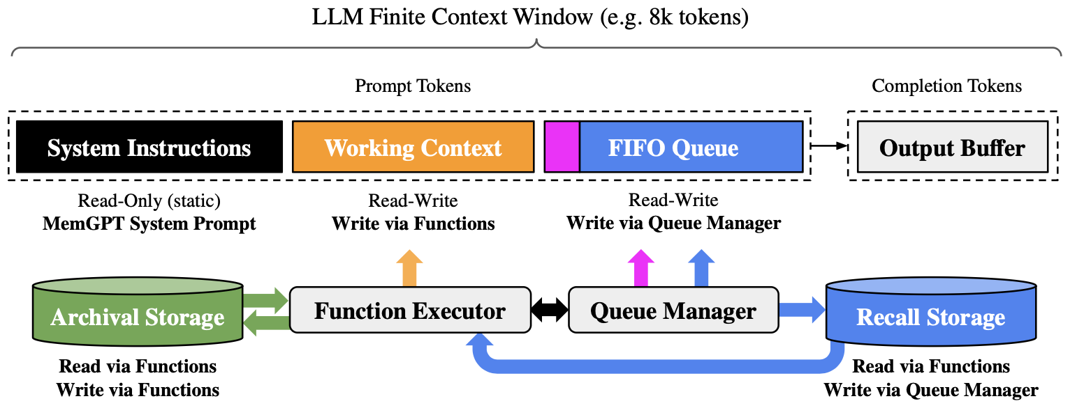
MemGPT: Memory as System Design
A fixed context window is not enough for long-horizon agents
The Problem
MemGPT's Insight
Standard LLMs have finite context windows, but interaction history keeps growing. The bottleneck is not only reasoning ability—it's memory.
Treat memory as a system design problem, like an operating system. Separate memory into different layers instead of forcing everything into one prompt.
[INSERT IMAGE]
MemGPT Architecture Diagram
System Instructions / Working Context / FIFO Queue / Archival Storage / Recall Storage
Notes:
“Now I move to the first paper, MemGPT.
The main question here is very simple: how can an LLM-based agent handle long-term information when its active context window is limited?
For long-horizon tasks, the bottleneck is often not only reasoning ability. It is also memory. A standard LLM cannot keep all relevant history visible forever, because the active context is finite.
MemGPT addresses this by treating memory as a system design problem. Instead of putting everything into one flat prompt, it separates memory into different layers.
"To understand how MemGPT handles this, let's look at how it splits the finite context window into distinct memory tiers.
Inside the active prompt, there are three main blocks. First, the System Instructions, which are static, read-only rules. Next is the Working Context, a read-write scratchpad where the model can actively store variables and current thoughts. Finally, the FIFO Queue holds the most recent messages.
However, we know that if we just let this active window experience context bloat, the model's reasoning performance will drop compared to having clean, information.
So, MemGPT provides a way out. When the queue gets full, the agent uses the Queue Manager and Function Executor to actively page data out of the prompt.
It moves this data into long-term databases: Archival Storage for general facts, and Recall Storage for older conversation history. The agent can explicitly search and retrieve from these external workspaces only when necessary.
So, the key contribution of MemGPT is not simply adding more text. It is introducing, operating-system-like memory management for LLM agents."

Slide 6
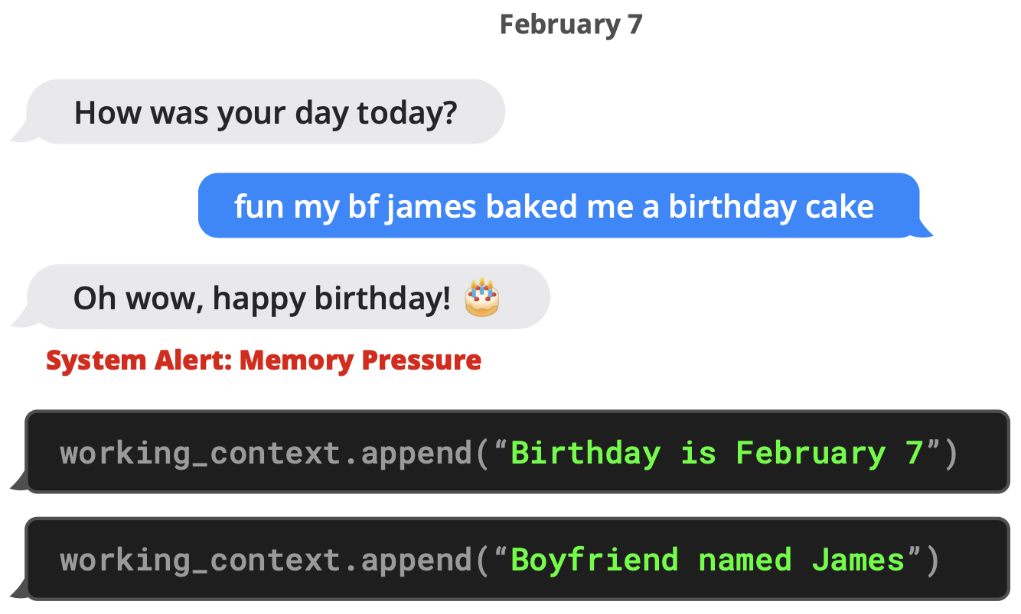
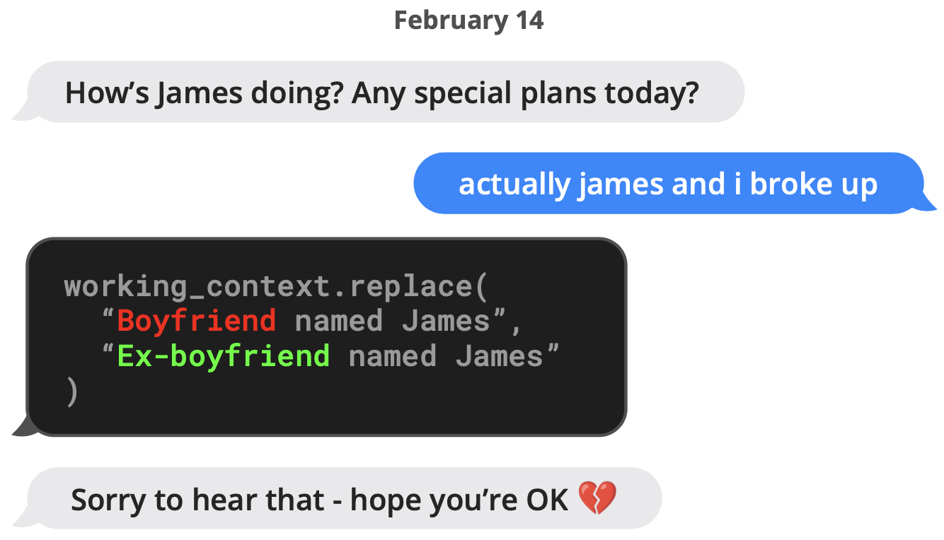
Memory in Practice: Update & Retrieval
Memory is not just storage—it also needs retrieval and revision
[INSERT IMAGE]
[INSERT IMAGE]
James Example (Part 1 & 2)
Nobel Prize Retrieval Example
Birthday → Boyfriend James → Ex-boyfriend James
Agent searches archival storage for information
Memory must be revisable and state-aware, not just append-only.
Agent can explicitly retrieve from long-term storage when needed.
MemGPT makes memory explicit, queryable, and revisable.
Notes:
"Here are two examples showing how MemGPT handles memory in practice.
Let's look at the first scenario on February 7th. The user mentions it's her birthday and her boyfriend baked her a cake. From the user's perspective, the agent simply replies, 'Oh wow, happy birthday!'
But what is happening behind the scenes? The agent actively writes down two specific facts into its working context: first, the user's birthday is February 7th, and second, her boyfriend is named James.
Now, look at what happens on February 14th. The user mentions that she and James broke up. At this point, the agent doesn't just blindly retrieve old memory or append a new. Instead, it actively updates the memory, replacing 'boyfriend' with 'ex-boyfriend'.
I think this example is crucial because it shows that a true agent memory isn't just a static log. It must be explicit, queryable, and completely revisable."

Slide 7
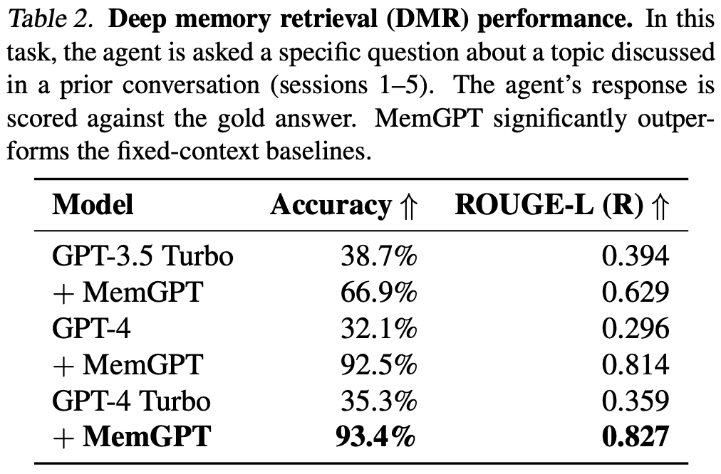
Why MemGPT Matters
Significant improvement in deep memory retrieval
Deep Memory Retrieval
Agent is asked about topics from prior sessions. Without MemGPT, baselines perform poorly. With MemGPT, dramatic improvements.
GPT-4 Turbo
35.3%
93.4%
Without MemGPT
With MemGPT
[INSERT IMAGE]
Deep Memory Retrieval Table (Table 2)
93.4% accuracy with MemGPT
GPT-4
32.1%
92.5%
Without MemGPT
With MemGPT
Notes:
"So, does this architecture work well? Let's look at the numbers.
Here we have the Deep Memory Retrieval task. In this test, the agent is asked a specific question about a topic from a past conversation.
Without MemGPT, standard models struggle because the information is no longer in their active prompt. But look at the jump when we add memory system. For GPT-4 Turbo, accuracy skyrockets from 35.3% to 93.4%. We see a similar huge jump for GPT-4, going from 32.1% to 92.5%.
The main takeaway here is very simple: If your agent needs to succeed over long interactions, you cannot just rely on the model's standard context window. You need a memory system."

Slide 8
Next Stage
But Memory Is Only the First Step
MemGPT helps agents remember
But raw memory is not yet an evolving strategy
We need to organize experience into better context
Notes:
So remembering facts is one thing, but solving tasks needs more than facts—it needs strategy. Instead of only storing the past, we want to turn experience into structured guidance. That leads us to ACE.

Slide 9
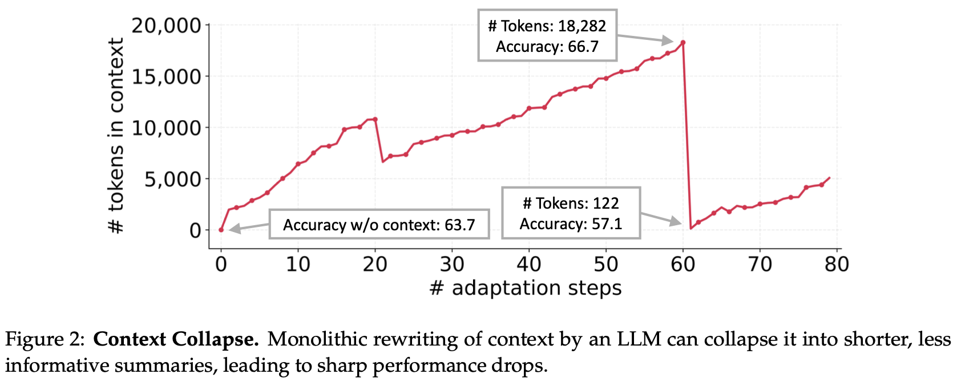
From Memory to Evolving Context
Why memory alone is not enough
The Problem: Context Collapse
ACE's Insight
Simply rewriting context into shorter summaries can be dangerous. Repeated monolithic rewriting causes context collapse.
Shorter context is not always better. Compression destroys useful knowledge. Context should become an evolving playbook.
[INSERT IMAGE]
Good context is not just shorter; it is more structured and more reusable.
Notes:
This paper starts from an important observation: even if an agent has memory, memory alone is not enough. The real question is how experience should be organized into useful context for future problem solving.
A natural idea is to keep rewriting the context into shorter and shorter summaries. But ACE argues that this can be dangerous.
The paper identifies a problem called context collapse. Repeated rewriting can make the context shorter, but also less useful, because important detail, structure, and procedural knowledge may be lost.
So the key point is that shorter context is not always better context. Good context should become an evolving playbook, not just a compressed summary.”

Slide 10
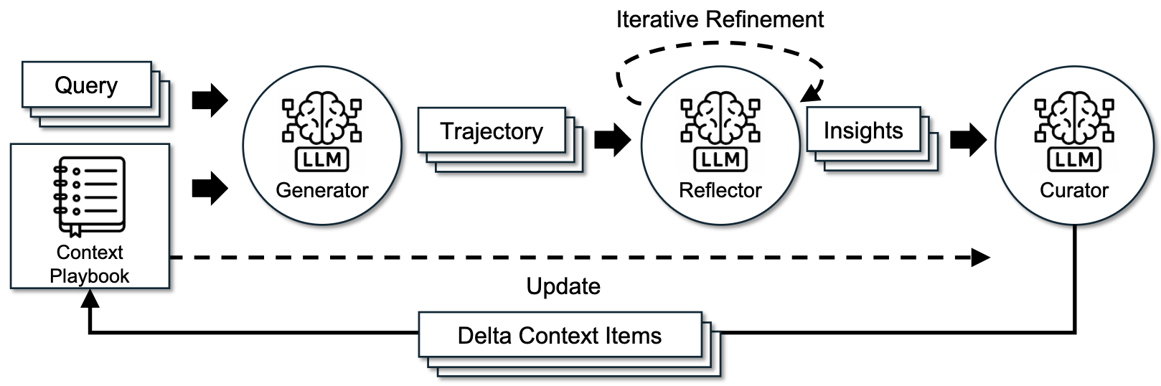
ACE Framework
Context evolves through generation, reflection, and curation
1
Generator
Uses current playbook to solve tasks and produce trajectories
2
Reflector
Analyzes trajectories and extracts insights (what worked, what failed)
3
Curator
Converts insights into structured delta context items and updates playbook
Figure: ACE p1.png - Framework architecture
ACE updates context incrementally, not monolithically.
Notes:
How does ACE avoid this collapse?
The core idea is to make context adaptation as a structured multi-stage process, instead of a single rewrite step.
First, the Generator uses the current playbook to solve tasks and produce trajectories.
Second, the Reflector analyzes those trajectories and extracts useful insights, such as what success, what failed, and what should be changed.
Third, the Curator(Q er rator) converts those insights into structured delta context items and updates the playbook.
So ACE does not overwrite the whole context. Instead, it improves the context incrementally through generation, reflection, and curation.
I think this is the most important conceptual contribution of the paper: context is no longer a static prompt or a summary. It becomes an evolving external knowledge structure.”

Slide 11
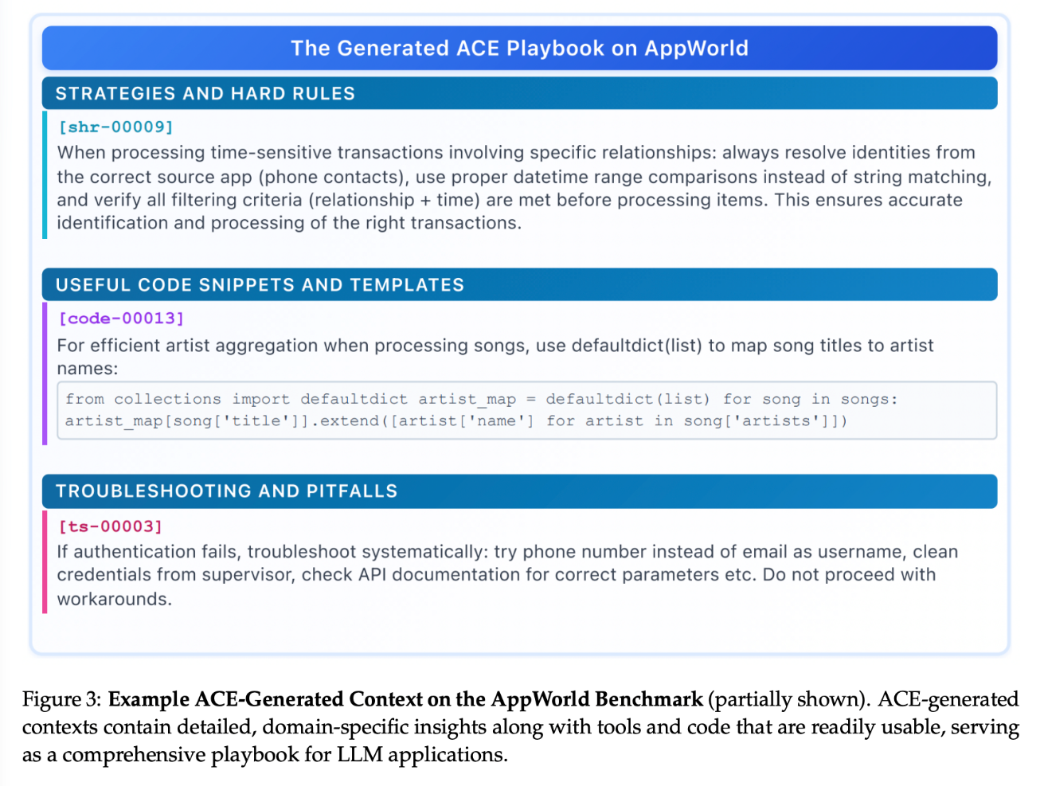
ACE Builds a Structured Playbook
Not raw history, but reusable procedural knowledge
What ACE Produces
A structured playbook containing strategies, rules, templates, and troubleshooting advice—not just raw conversation history.
Strategies & Hard Rules
Procedural guidelines for task execution
[INSERT IMAGE]
Generated ACE Playbook Example
Code Snippets & Templates
AppWorld case showing structured playbook content
Reusable components for common tasks
Troubleshooting & Pitfalls
Common errors and how to avoid them
Figure: ACE p3.jpeg - Playbook example
ACE turns experience into reusable procedural context.
Notes:
"So, what's the final output of this whole process?
As you can see, it is definitely not a messy chat log. It is a highly structured playbook.
It breaks down the agent's experience into three simple buckets:
First, Strategies and Rules—this tells the agent exactly how to do the task next time.
Second, Code Snippets—so the agent doesn't have to write the same code from scratch again.
Third, Troubleshooting—so it learns from past mistakes and knows what pitfalls to avoid.
In short, ACE doesn't just save history. It turns past experience into reusable skills."

Slide 12
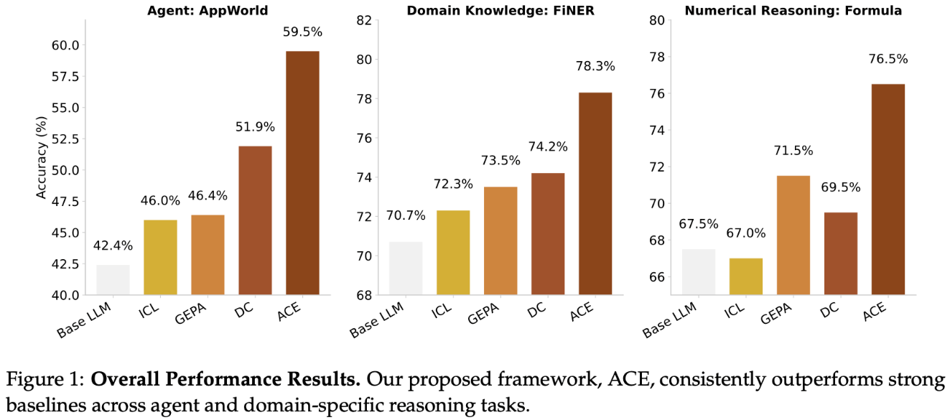
ACE Improves Context, Not Yet the Policy
Strong empirical gains across agent and reasoning tasks
Performance Improvements
ACE consistently outperforms strong baselines across both agent tasks and domain-specific reasoning tasks.
AppWorld Average Gain
Finance Average Gain
[INSERT IMAGE]
+10.6%
+8.6%
Overall Performance Bar Chart
ACE vs baselines across multiple benchmarks
Important Boundary
ACE mainly improves the external context. The underlying model policy is still mostly fixed.
MemGPT externalizes memory, while ACE externalizes strategy.
Notes:
"So, does this actually work? Yes.
As you can see, ACE consistently beats the baselines. they get 10.6% higher result on AppWorld, and 8.6% on finance tasks. It clearly drives better performance.
But here is the Important Boundary.
ACE only improves the external context. The underlying model's policy is still completely fixed.
So, to sum up: MemGPT externalizes memory, and ACE externalizes strategy.
But what if we want the agent itself to actually learn? That brings us to our final paper: OpenClaw-RL."

Slide 13
Final Stage
From Evolving Context to Evolving Policy
ACE improves the external playbook
But can the agent itself continue improving?
Can behavior improve through real interaction?
This leads us to OpenClaw-RL
Notes:
ACE is great, but relying only on an external playbook has limits. If you use OpenClaw a lot, you probably know that it already contains a huge number of built-in skills—something like 20 K tokens of instructions. When you keep adding even more skills, you often find that they do not help much, and sometimes the result is even worse than using the model.
Why does this happen? Because once the skill context becomes too large, the model cannot pay attention to every skill equally well. Some skills may overlap, some may contradict each other, and some just get buried(埋葬) in the long prompt.
So at this point, the problem is not only about adding better skills. The deeper problem is that the model itself needs to become better at understanding, selecting, and applying those skills. That is the motivation behind OpenClaw-RL.

Slide 14
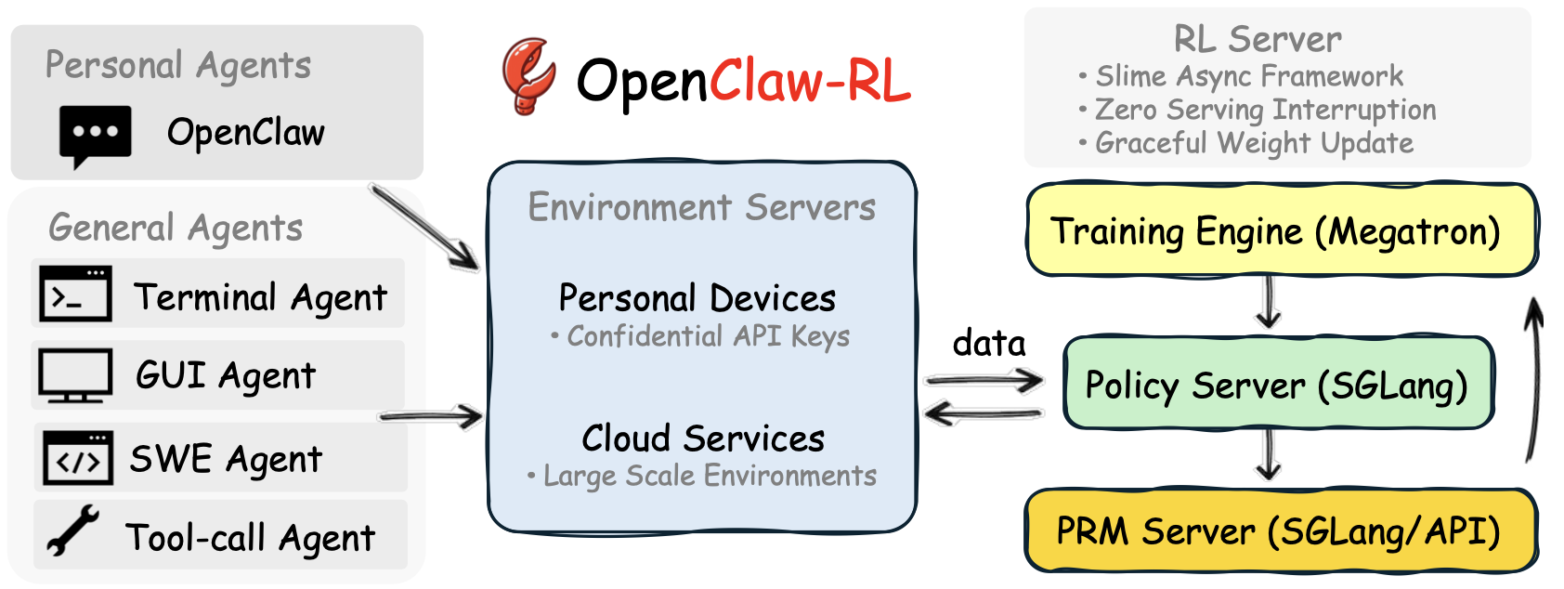
OpenClaw-RL
A unified RL framework for personal and general agents
Key Design Principle
Train while serving—the system handles requests while the policy improves asynchronously in the background.
1
Agent Environments
Personal, Terminal, GUI, SWE, Tool-call agents
[INSERT IMAGE]
2
Environment Servers
OpenClaw-RL Overall Framework
Route interactions, collect data
System architecture showing environments, servers, and training loop
3
Training Loop
Policy server + RL engine + reward modeling
OpenClaw-RL turns deployed agents into continually trainable systems.
Notes:
Let's look at how it actually works on this slide.
The magic here is the Key Design Principle: Train while serving. It means the agent improves in the background without stopping its service.
The process has three main parts:
Number One: Agent Environments. On the left, we have different deployed agents—like personal assistants, terminal agents, or coding agents. They are out there interacting and making mistakes.
Number Two: Environment Servers. These servers sit in the middle and collect all those interactions and feedback data.
Number Three: The Training Loop. This is the RL server on the right. While the Policy Server keeps answering user requests, the Training Engine takes the collected data and asynchronously updates the model's weights.
So, as the bottom line says: OpenClaw-RL turns deployed agents into continually trainable systems."

Slide 15
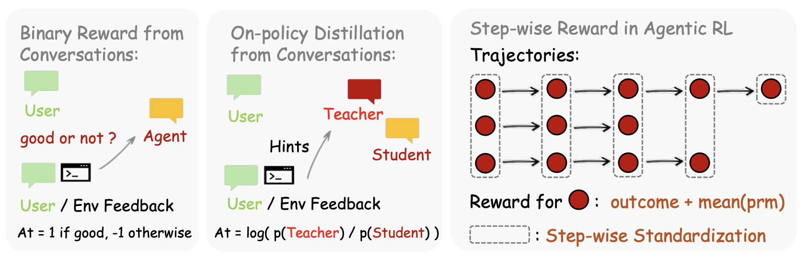
OpenClaw-RL Learns from Interaction
Multiple forms of learning signal
1. Binary Reward
User/environment gives good vs. bad evaluation. Applied at sequence level.
2. Directional Feedback
On-policy distillation—hints and corrections provide stronger signal than scalar reward.
[INSERT IMAGE]
Learning Signal Types
3. Step-wise Reward
Binary reward / OPD / Step-wise reward
For long trajectories: combine outcome reward with intermediate estimates for denser learning.
OpenClaw-RL combines evaluative, directional, and step-wise supervision.
Notes:
“The next question is: once we have interaction data, how do we actually learn from it?
OpenClaw-RL uses multiple forms of learning signal.
The first is binary reward. The system can treat user or environment feedback as a simple good-versus-bad signal and apply RL at the sequence level.
The second is directional feedback, or on-policy distillation. Here the system is not only told whether the answer is good or bad, but also given hints or corrections about how it should improve.
The third is step-wise reward for longer trajectories. Instead of assigning credit only at the end, the framework can combine final outcome signals with intermediate reward estimates, so that learning becomes denser and more stable.

Slide 16
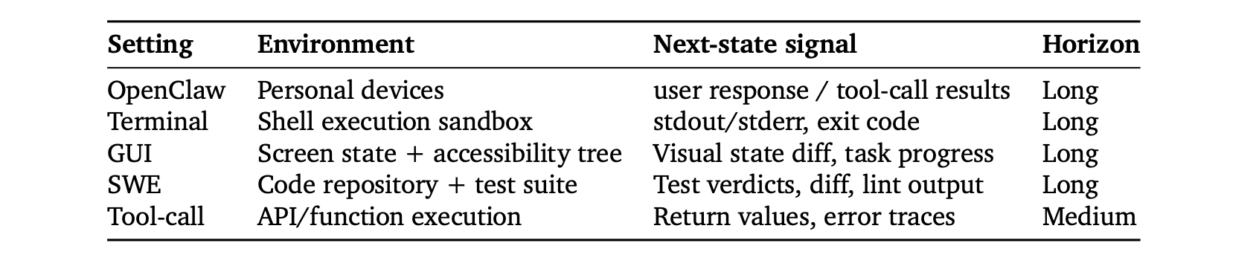
Learning Signal
Personal Assistant
GUI
User replies, tool-call results
Visual state changes, task progress
Terminal
Software Engineering
stdout, stderr, exit codes
Test verdicts, diffs, lint output
Notes:
The paper shows that scalable RL is possible across multiple agent settings, including terminal, GUI, software engineering, and tool-call environments. As we just discussed, the system learns from interaction itself. And in different settings, those signals come in different forms.

Slide 17
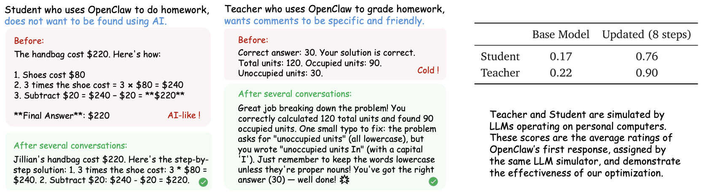
Agents Improve by Being Used
Scalable RL across multiple agent settings
Performance Curves
Across Terminal, GUI, SWE, and Tool-call environments,
performance improves as RL training proceeds.
Personalization Example
[INSERT IMAGE]
Student
Less AI-like responses
Teacher
More specific and friendly
Personalization Example
Ratings improve substantially after few updates
Student/teacher preference adaptation
Broader Significance
Agents may improve simply by being used—a new
direction for agent evolution.
Notes:
The paper also includes a more intuitive personalization example. In the student setting, the desired response should sound less AI-like. In the teacher setting, the desired response should be more specific and friendly. After only a 36 interaction, the personalization score improve alot.
So the broader significance of OpenClaw-RL is not only that it can optimize a benchmark. It suggests a new direction for agent evolution: agents may improve simply by being used.”

Slide 18
Conclusion
What changes across the three papers
Main Question | How can agents remember? | How can context evolve? | How can agents learn from interaction?
What Is Improved | Memory access & storage | External playbook / context | Policy / behavior
Knowledge Form | Hierarchical memory | Structured evolving playbook | Rewarded & distilled trajectories
Adaptation Style | Memory management | Reflection + curation | RL from ongoing interaction
Main Limitation | Remembers, but doesn't organize strategy deeply | Improves context, but policy is mostly fixed | More complex, depends on feedback quality
The evolution is from storing information, to structuring knowledge, to updating behavior.
Notes:
If we look across these three papers, the entire evolution path becomes clear.
With MemGPT, we upgraded the agent's storage—we externalized memory.
* With ACE, we upgraded the playbook—we externalized strategy.
* And with OpenClaw-RL, we upgraded the actual weight of the model—we externalized continual improvement.
So, what is the ultimate takeaway here? It's that the treating AI agents as static, 'out-of-the-box' problem solvers is ending. The real frontier is what happens over time.
But this paradigm shift leaves us with some massive open questions for the field: * First, when is it better to just update an external context versus updating the model’s weight? * Second, if an agent is constantly learning from real interaction, how do we keep that improvement stable and safe? * And third, what is the perfect architecture that balances memory, context, and RL?
Ultimately, the next generation of agents won't be defined just by how smart they are on day one. They will be defined by how well they remember, organize experience, and improve through use.
Thank you."

Slide 19
Thank you!
Zhixuan Tan
School of Data Science
Chinese University of Hong Kong, Shenzhen

