Slide 1
Chapter 5: CPU Scheduling

Slide 2
Proportional Share Scheduling
T shares are allocated among all processes in the system
An application receives N shares where N < T
This ensures each application will receive N / T of the total processor time

Slide 3
POSIX Real-Time Scheduling
The POSIX.1b standard
API provides functions for managing real-time threads
Defines two scheduling classes for real-time threads:
SCHED_FIFO - threads are scheduled using a FCFS strategy with a FIFO queue. There is no time-slicing for threads of equal priority
SCHED_RR - similar to SCHED_FIFO except time-slicing occurs for threads of equal priority
Defines two functions for getting and setting scheduling policy:
pthread_attr_getsched_policy(pthread_attr_t *attr, int *policy)
pthread_attr_setsched_policy(pthread_attr_t *attr, int policy)

Slide 4
POSIX Real-Time Scheduling API
#include <pthread.h>
#include <stdio.h>
#define NUM_THREADS 5
int main(int argc, char *argv[])
{
int i, policy; pthread_t_tid[NUM_THREADS];
pthread_attr_t attr;
/* get the default attributes */
pthread_attr_init(&attr);
/* get the current scheduling policy */ if (pthread_attr_getschedpolicy(&attr, &policy) != 0)
fprintf(stderr, "Unable to get policy.\n");
else {
if (policy == SCHED_OTHER) printf("SCHED_OTHER\n");
else if (policy == SCHED_RR) printf("SCHED_RR\n");
else if (policy == SCHED_FIFO) printf("SCHED_FIFO\n");
}

Slide 5
POSIX Real-Time Scheduling API (Cont.)
/* set the scheduling policy - FIFO, RR, or OTHER */ if (pthread_attr_setschedpolicy(&attr, SCHED_FIFO) != 0)
fprintf(stderr, "Unable to set policy.\n");
/* create the threads */ for (i = 0; i < NUM_THREADS; i++)
pthread_create(&tid[i],&attr,runner,NULL);
/* now join on each thread */ for (i = 0; i < NUM_THREADS; i++)
pthread_join(tid[i], NULL);
}
/* Each thread will begin control in this function */
void *runner(void *param) {
/* do some work ... */
pthread_exit(0);
}

Slide 6
Operating System Examples
Linux scheduling
Windows scheduling
Solaris scheduling

Slide 7
Linux Scheduling Through Version 2.5
Prior to kernel version 2.5, ran variation of standard UNIX scheduling algorithm
Version 2.5 moved to constant order O(1) scheduling time
Preemptive, priority based
Two priority ranges: time-sharing and real-time
Real-time range from 0 to 99 and nice value from 100 to 140
Map into global priority with numerically lower values indicating higher priority
Higher priority gets larger q
Task run-able as long as time left in time slice (active)
If no time left (expired), not run-able until all other tasks use their slices
All run-able tasks tracked in per-CPU runqueue data structure
Two priority arrays (active, expired)
Tasks indexed by priority
When no more active, arrays are exchanged
Worked well, but poor response times for interactive processes

Slide 8
Linux Scheduling in Version 2.6.23 +
Completely Fair Scheduler (CFS)
Scheduling classes
Each has specific priority
Scheduler picks highest priority task in highest scheduling class
Rather than quantum based on fixed time allotments, based on proportion of CPU time
Two scheduling classes included, others can be added
default
real-time

Slide 9
Linux Scheduling in Version 2.6.23 + (Cont.)
Quantum calculated based on nice value from -20 to +19
Lower value is higher priority
Calculates target latency – interval of time during which task should run at least once
Target latency can increase if say number of active tasks increases
CFS scheduler maintains per task virtual run time in variable vruntime
Associated with decay factor based on priority of task – lower priority is higher decay rate
Normal default priority yields virtual run time = actual run time
To decide next task to run, scheduler picks task with lowest virtual run time

Slide 10
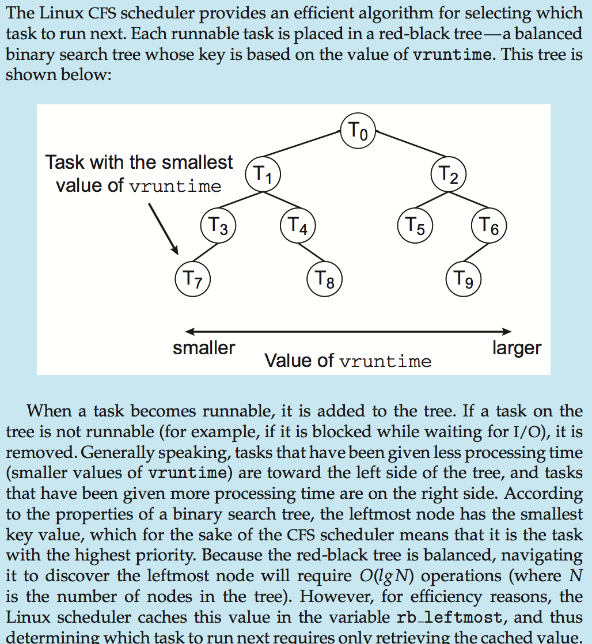
CFS Performance

Slide 11
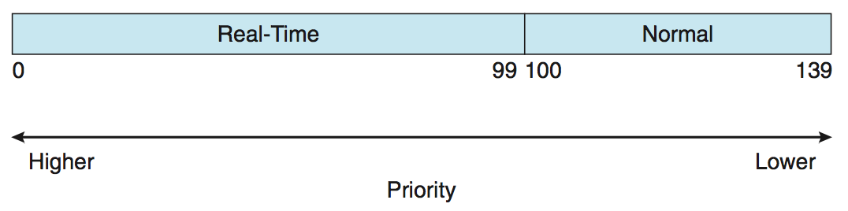
Linux Scheduling (Cont.)
Real-time scheduling according to POSIX.1b
Real-time tasks have static priorities
Real-time plus normal map into global priority scheme
Nice value of -20 maps to global priority 100
Nice value of +19 maps to priority 139

Slide 12
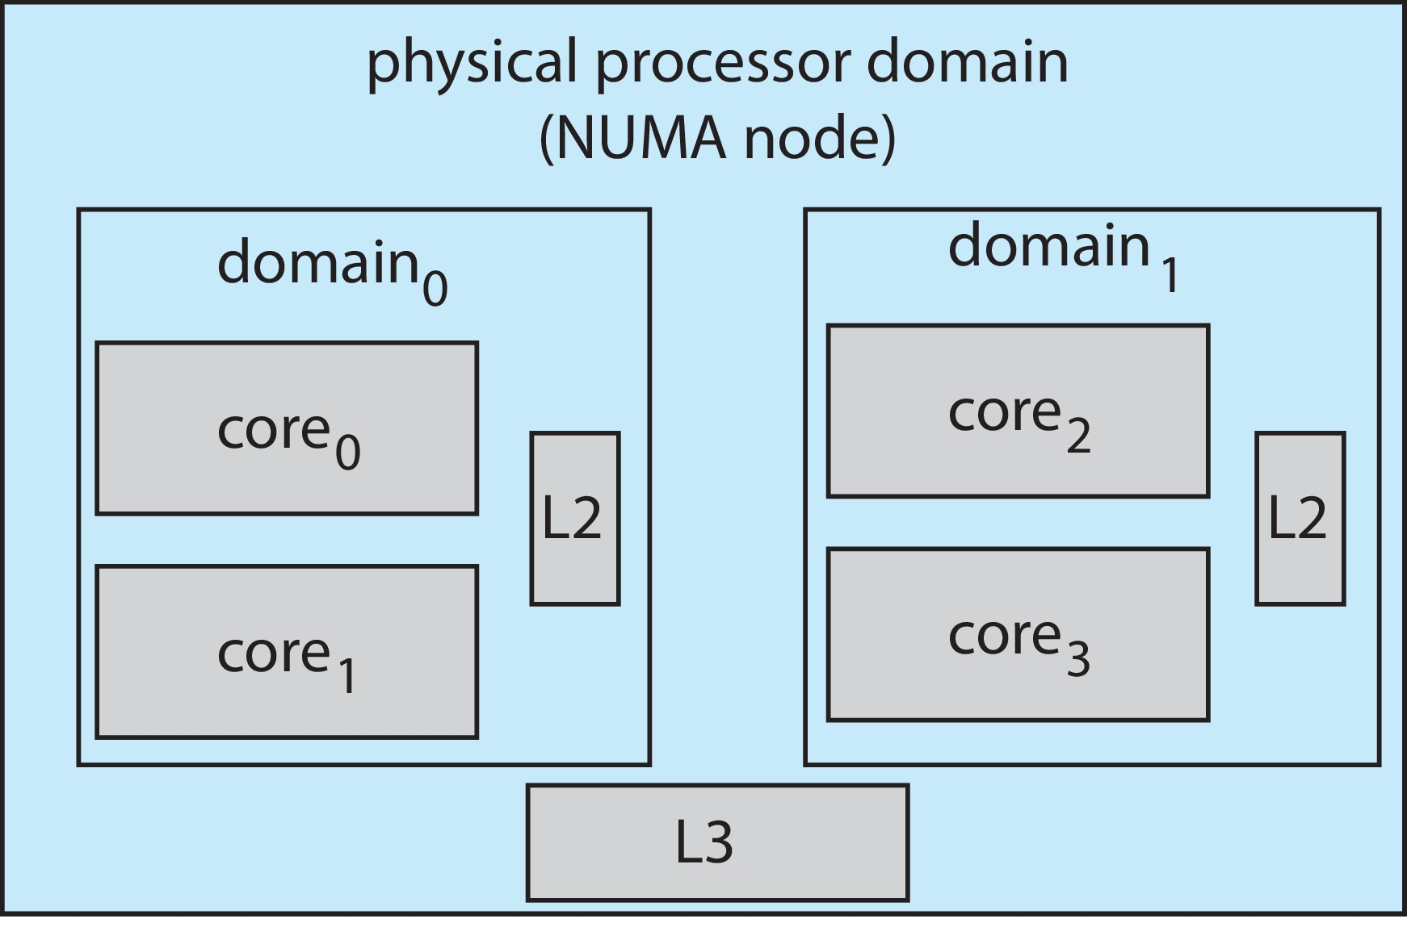
Linux Scheduling (Cont.)
Linux supports load balancing, but is also NUMA-aware.
Scheduling domain is a set of CPU cores that can be balanced against one another.
Domains are organized by what they share (i.e., cache memory.) Goal is to keep threads from migrating between domains.

Slide 13
Windows Scheduling
Windows uses priority-based preemptive scheduling
Highest-priority thread runs next
Dispatcher is scheduler
Thread runs until (1) blocks, (2) uses time slice, (3) preempted by higher-priority thread
Real-time threads can preempt non-real-time
32-level priority scheme
Variable class is 1-15, real-time class is 16-31
Priority 0 is memory-management thread
Queue for each priority
If no run-able thread, runs idle thread

Slide 14
Windows Priority Classes
Win32 API identifies several priority classes to which a process can belong
REALTIME_PRIORITY_CLASS, HIGH_PRIORITY_CLASS, ABOVE_NORMAL_PRIORITY_CLASS,NORMAL_PRIORITY_CLASS, BELOW_NORMAL_PRIORITY_CLASS, IDLE_PRIORITY_CLASS
All are variable except REALTIME
A thread within a given priority class has a relative priority
TIME_CRITICAL, HIGHEST, ABOVE_NORMAL, NORMAL, BELOW_NORMAL, LOWEST, IDLE
Priority class and relative priority combine to give numeric priority
Base priority is NORMAL within the class
If quantum expires, priority lowered, but never below base

Slide 15
Windows Priority Classes (Cont.)
If wait occurs, priority boosted depending on what was waited for
Foreground window given 3x priority boost
Windows 7 added user-mode scheduling (UMS)
Applications create and manage threads independent of kernel
For large number of threads, much more efficient
UMS schedulers come from programming language libraries like C++ Concurrent Runtime (ConcRT) framework

Slide 16
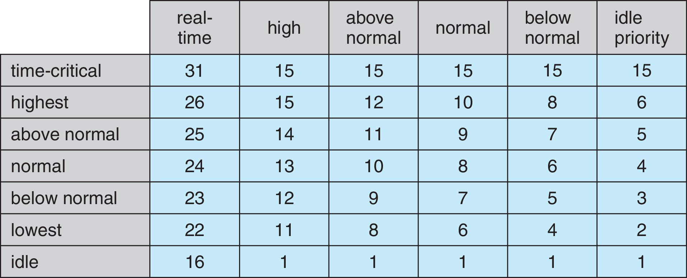
Windows Priorities

Slide 17
Solaris
Priority-based scheduling
Six classes available
Time sharing (default) (TS)
Interactive (IA)
Real time (RT)
System (SYS)
Fair Share (FSS)
Fixed priority (FP)
Given thread can be in one class at a time
Each class has its own scheduling algorithm
Time sharing is multi-level feedback queue
Loadable table configurable by sysadmin

Slide 18
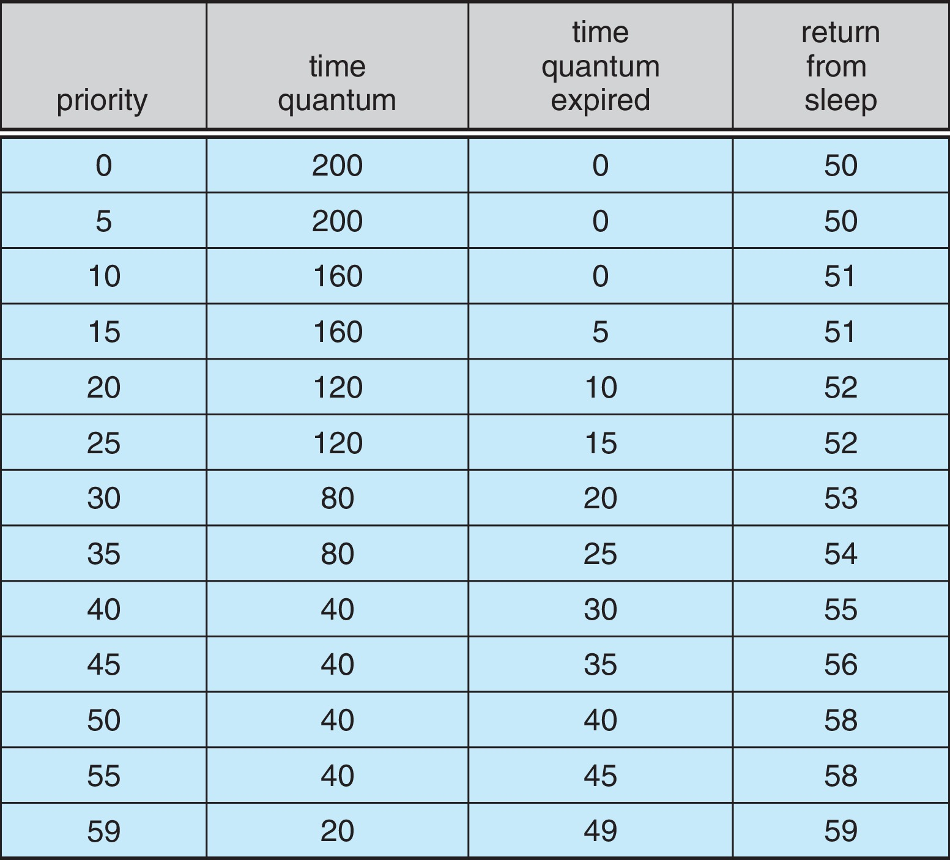
Solaris Dispatch Table

Slide 19
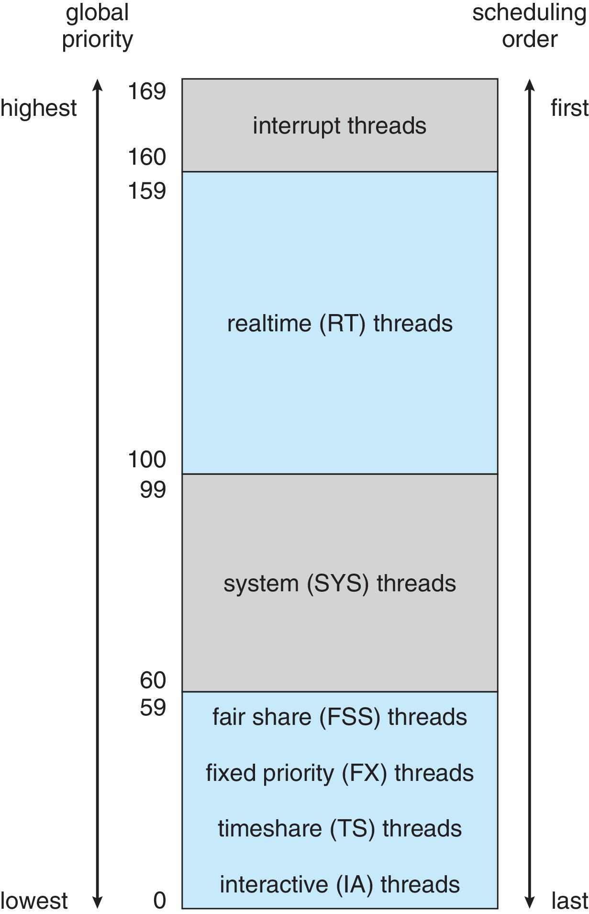
Solaris Scheduling

Slide 20
Solaris Scheduling (Cont.)
Scheduler converts class-specific priorities into a per-thread global priority
Thread with highest priority runs next
Runs until (1) blocks, (2) uses time slice, (3) preempted by higher-priority thread
Multiple threads at same priority selected via RR

Slide 21
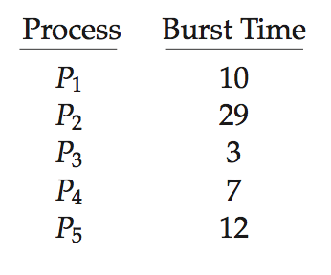
Algorithm Evaluation
How to select CPU-scheduling algorithm for an OS?
Determine criteria, then evaluate algorithms
Deterministic modeling
Type of analytic evaluation
Takes a particular predetermined workload and defines the performance of each algorithm for that workload
Consider 5 processes arriving at time 0:

Slide 22
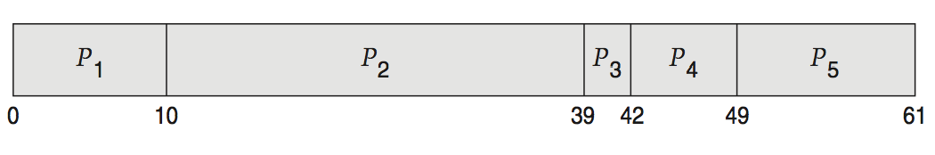
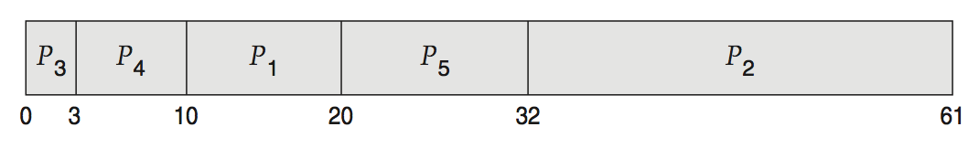
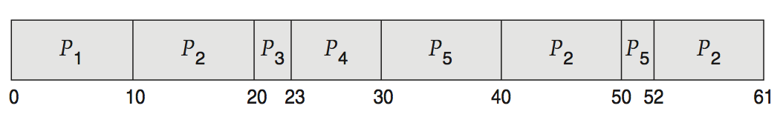
Deterministic Evaluation
For each algorithm, calculate minimum average waiting time
Simple and fast, but requires exact numbers for input, applies only to those inputs
FCS is 28ms:
Non-preemptive SFJ is 13ms:
RR is 23ms:

Slide 23
Queueing Models
Describes the arrival of processes, and CPU and I/O bursts probabilistically
Commonly exponential, and described by mean
Computes average throughput, utilization, waiting time, etc.
Computer system described as network of servers, each with queue of waiting processes
Knowing arrival rates and service rates
Computes utilization, average queue length, average wait time, etc.

Slide 24
Little’s Formula
n = average queue length
W = average waiting time in queue
λ = average arrival rate into queue
Little’s law – in steady state, processes leaving queue must equal processes arriving, thus: n = λ x W
Valid for any scheduling algorithm and arrival distribution
For example, if on average 7 processes arrive per second, and normally 14 processes in queue, then average wait time per process = 2 seconds

Slide 25
Simulations
Queueing models limited
Simulations more accurate
Programmed model of computer system
Clock is a variable
Gather statistics indicating algorithm performance
Data to drive simulation gathered via
Random number generator according to probabilities
Distributions defined mathematically or empirically
Trace tapes record sequences of real events in real systems

Slide 26
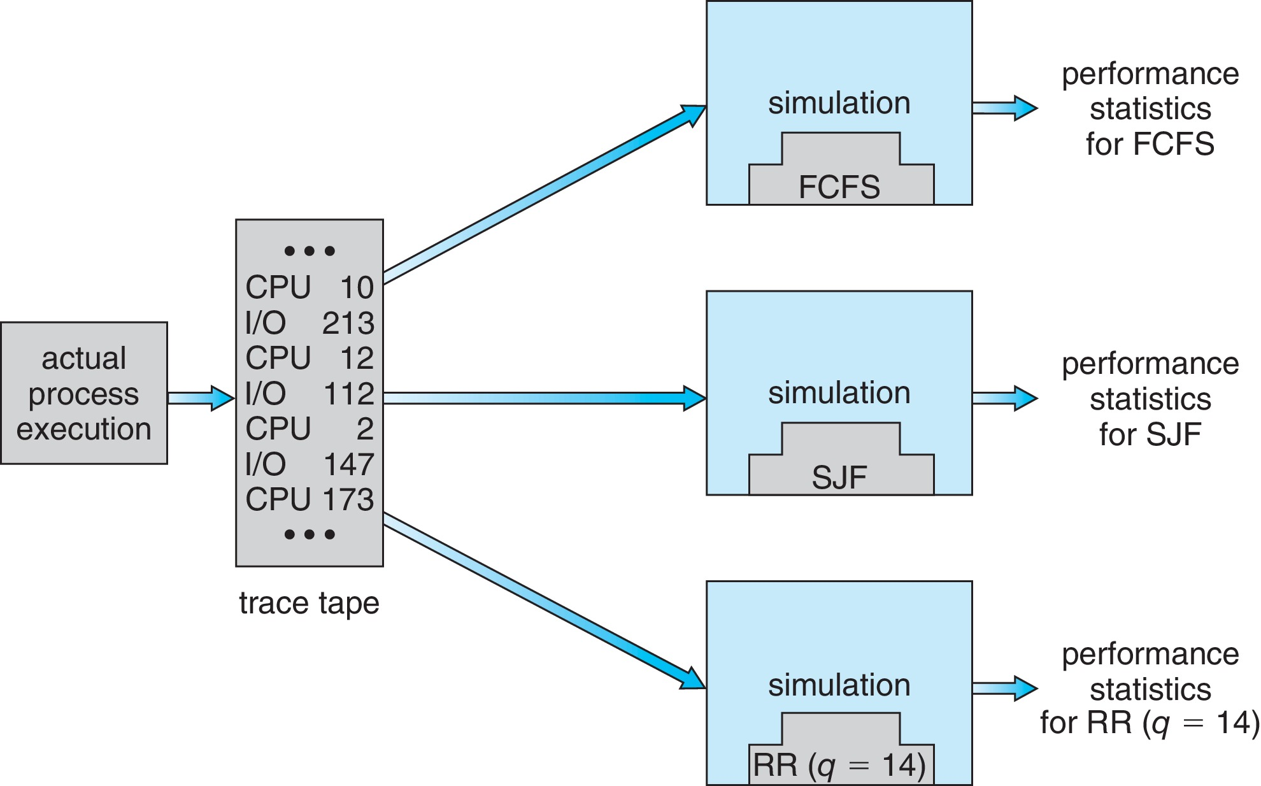
Evaluation of CPU Schedulers by Simulation

Slide 27
Implementation
Even simulations have limited accuracy
Just implement new scheduler and test in real systems
High cost, high risk
Environments vary
Most flexible schedulers can be modified per-site or per-system
Or APIs to modify priorities
But again environments vary

Slide 28
End of Chapter 5

