Slide 1
Execution-Grounded LLM Coding Agents:
From Code Generation to Autonomous Software Engineering
Tong Zhu 225040538
School of Data Science
Chinese University of Hong Kong, Shenzhen
CSC6032 Advanced Operating System, Spring 2026

Slide 2
Overview
Topic: Execution-Grounded LLM Coding Agents
Paper 1 (Foundation) — Codex: Evaluating LLMs Trained on Code arXiv 2021
Paper 2 (Systems Bridge) — CodeAct: Executable Code Actions Elicit Better LLM Agents ICML 2024
Paper 3 (Recent) — OpenHands: An Open Platform for AI Software Developers as Generalist Agents ICLR 2025
Narrative arc: Code generation capability → code execution as the right action modality for agents → an open platform for generalist agents operating in a sandboxed runtime

Slide 3
Background: Why LLMs for Code?
Bridge to systems: code is a natural domain for LLM agents because programs have explicit syntax, deterministic execution, and testable outcomes.
Software engineering is highly structured — programs have formal semantics and deterministic execution.
Pre-2021: neural code synthesis limited to small snippets.
Key insight: large-scale pre-training on public code (GitHub) transfers to unseen tasks.
Unlocks functional code generation, test writing, and eventually autonomous debugging.
Table 1. Evolution of neural code generation approaches.
Era | Approach | Capability
< 2020 | Rule-based | Templates
2020–21 | GPT-2/3 fine-tune | Snippets
2021+ | Codex-scale | Functions
2023+ | Agent loops | Full tasks

Slide 4
Paper 1 — Codex (Chen et al., arXiv 2021)
“Evaluating Large Language Models Trained on Code”
Chen et al., OpenAI. arXiv:2107.03374 (2021)
Core contribution:
GPT-based model (~12 B params) fine-tuned on 159 GB of filtered public GitHub Python code.
Introduces HumanEval: 164 handwritten Python tasks scored by running generated programs against tests.
Makes execution-based evaluation the standard lens for code generation, instead of text overlap metrics.
Why it matters:
Codex proves strong code synthesis, but its deeper legacy is making execution the oracle for programming tasks. That sets up the next question: should execution stay only as an evaluator, or become part of the agent loop itself?

Slide 5
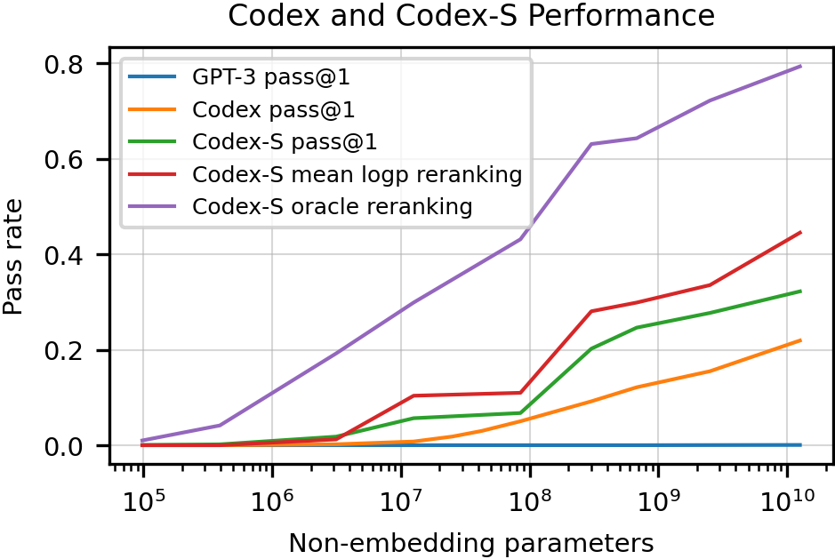
Codex — HumanEval: Execution as the Oracle
Codex made execution-based testing, not text similarity, the core way to judge code generation.
164 hand-written Python problems: docstring + signature → function body.
Hidden unit tests define functional correctness; average 7.7 tests/problem.
This figure shows pass@1 curves plus 100-sample selection results for Codex-S.
Tasks were written by hand to reduce contamination from the GitHub training corpus.
Figure lesson: the model often contains a correct solution before it can deliver one reliably at pass@1.
Figure 1. Main curves are pass@1; red/purple lines show 100-sample selection results.

Slide 6
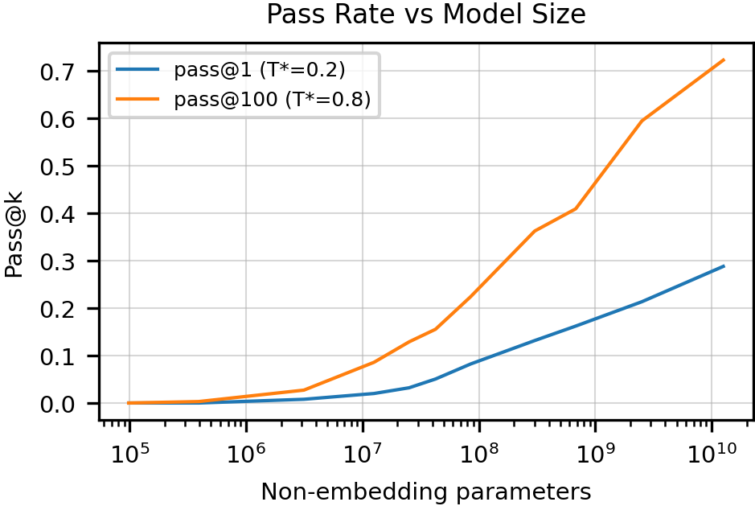
Codex — Findings, Limits, and the Next Step
Findings:
Code-tuning clearly beats the base GPT-3 model.
100-sample gains show capability exists before first-try reliability.
pass@1 and pass@100 both scale with model size.
Limitations:
No agent loop that executes, observes, and repairs.
⇒ Next: move execution from evaluator to action.
Figure 2. pass@1 and pass@100 both scale smoothly with model size (Chen et al., 2021).

Slide 7
Paper 2 — CodeAct (Wang et al., ICML 2024)
“Executable Code Actions Elicit Better LLM Agents”
Wang et al. ICML 2024
Core contribution:
Proposes CodeAct: let the agent emit executable Python code as its action.
Replaces JSON/text action formats with executable code inside a Python interpreter.
Agent observes stdout/stderr as feedback and iterates — closing the execution loop.
Also releases CodeActAgent, with 7B models fine-tuned from LLaMA-2 and Mistral.
Systems connection: Actions become executable programs that interact with tools, packages, and external environments through code.

Slide 8
CodeAct — Action Space Comparison
Code works as an action space because it is already executable, stateful, and composable.
One action can express the whole procedure.
Runtime state stays available for the next step.
Failures become actionable execution feedback.
Table 2. Comparison of action formats for LLM agents.
Property | Natural language | JSON tools | CodeAct
Executability | Needs parser | Needs router | Runs directly
Composition | Weak | One tool/call | Loops, helpers
State | Prompt only | External state | Runtime vars
Error feedback | Text only | Tool return | Traceback

Slide 9
CodeAct — A Concrete Interaction Example
Example claim: one code action can replace several tool calls while keeping runtime state alive.
Task: “Find all CSV files in the project and count total rows.”
Agent emits:
Observation (stdout):
import glob
files = glob.glob("**/*.csv", recursive=True)
total = 0
for f in files:
with open(f) as fh:
total += sum(1 for r in fh) - 1
print(files, total)
['data/a.csv', 'logs/b.csv'] 1843
Agent’s final reply:
“Found 2 CSV files, 1843 data rows total.”
One action replaces 3–4 sequential JSON tool calls.
State persists across turns; tracebacks enable self-correction.

Slide 10
CodeAct Results and Transition to OpenHands
Result: executable code actions improve both success rate and turn efficiency on realistic tasks.
M³ToolEval: 82 human-curated multi-turn tool-use tasks.
For gpt-4-1106-preview, CodeAct reaches 74.4% vs. 52.4% for JSON and 53.7% for text.
Fine-tuned 7B CodeActAgent models improve open-source agent performance, especially with the Mistral backbone.
Fewer turns: code compresses multiple actions into one.
Next question: what runtime and agent framework can support this interaction model?
OpenHands provides a sandboxed runtime, an event stream, and a hub of reusable agents.

Slide 11
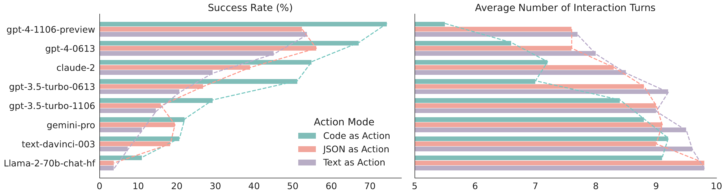
CodeAct — Zero-Shot Performance
Result: the advantage of code actions still appears in the zero-shot setting.
Figure 4. Zero-shot model performance across action formats (Wang et al., ICML 2024).

Slide 12
Paper 3 — OpenHands (Wang et al., ICLR 2025)
“An Open Platform for AI Software Developers as Generalist Agents”
Wang et al. ICLR 2025
Open-source platform for building and evaluating generalist and specialist agents.
Docker sandbox: each session gets an isolated container; no shared state.
EventStream: tracks the history of actions, observations, and user interactions.
Runtime: bash shell, IPython server, and Chromium browser inside the sandbox.
AgentHub + AgentSkills: reusable agents and tools share the same runtime abstraction.

Slide 13
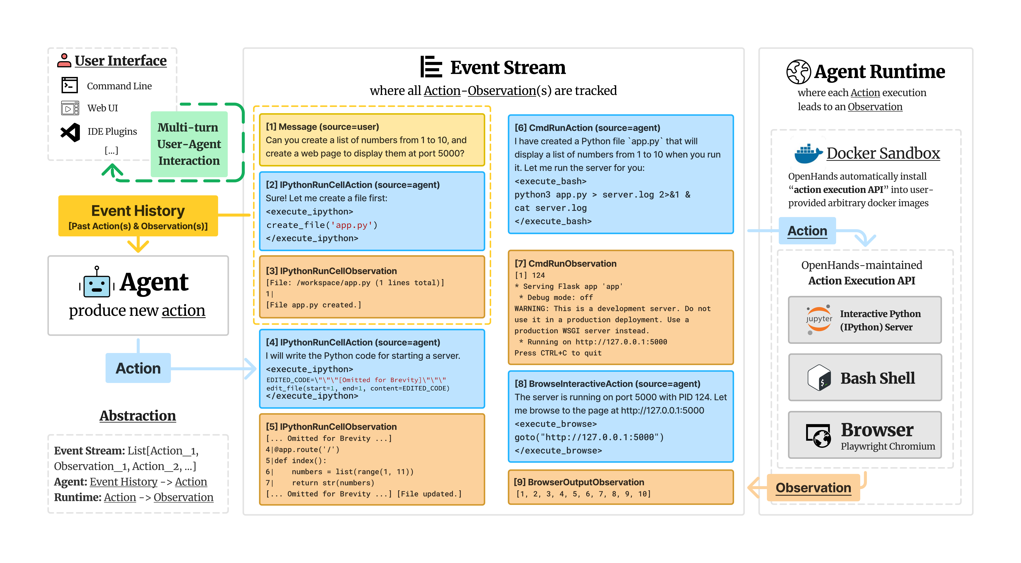
OpenHands — Architecture
OpenHands turns code-based agency into a real software system with isolation, tool access, and a unified event log.
Figure 5. OpenHands architecture (Wang et al., 2025).

Slide 14
OpenHands — AgentHub
OpenHands separates shared runtime infrastructure from agent policy, so one platform can host multiple agent styles.
CodeActAgent:
Default generalist agent in OpenHands.
Can converse with the user or act through code.
Uses bash, Python, and browser actions in one framework.
BrowsingAgent:
Generalist web agent used as a baseline for web tasks.
Similar in spirit to WebArena-style agents.
Also supports multi-agent delegation through a dedicated delegate action API.
Table 3. OpenHands agent types.
Agent | Role
CodeActAgent | Default generalist
BrowsingAgent | Web baseline
GPTSwarm Agent | Graph multi-agent
Micro Agent | Prompt specialist

Slide 15
OpenHands — Evaluation on SWE-Bench
OpenHands is valuable because it is a reusable agent platform that remains competitive on real software tasks.
SWE-Bench Lite: 300 real GitHub issues; task is to produce a passing patch.
OpenHands + Claude-3.5 Sonnet: 26.0% success rate.
Comparable to Aider (26.3%) and above SWE-Agent (18.0%) in this table.
Paper emphasizes breadth across benchmarks, not a single dominant SWE score.
Table 4. SWE-Bench Lite results (ICLR 2025).
System | Pass rate
SWE-Agent (GPT-4) | 18.0%
Aider (GPT-4o + Opus) | 26.3%
OpenHands (Claude-3.5) | 26.0%

Slide 16
Synthesis — The Narrative Arc
Conclusion: the three papers show a clear progression from code generation, to execution-grounded action, to full agent infrastructure.
Codex establishes that LLMs can generate correct code at scale.
CodeAct establishes that LLMs should act through code — not JSON or NL.
OpenHands turns the paradigm into a reusable platform: sandboxed runtime, event stream, and shared agent abstractions.
Table 5. Summary of the three papers and their OS connections.
# | Paper | Key idea | OS connection
1 | Codex | LLMs generate correct code | Execution is the evaluator
2 | CodeAct | Code is the agent action space | Executable code in a live interpreter
3 | OpenHands | Open platform for coding agents | Docker sandbox, event stream, runtime

Slide 17
Open Problems & Future Directions
Reliability: long-horizon tasks remain brittle as errors compound over many steps.
Systems tradeoff: stronger sandboxing improves safety but constrains real-world capability.
Evaluation & cost: current benchmarks are narrow, and multi-step agent runs remain expensive.

Slide 18
Conclusion
Final conclusion: the main advance in coding agents is not just better code generation, but grounding the model in an executable runtime and an agent system around it.
The trajectory is clear: generation (Codex) → execution as action (CodeAct) → agent infrastructure (OpenHands).
The main systems insight is that coding agents become substantially more useful when grounded in a real runtime.
The next stage of progress depends on improving the runtime, control loop, and reliability of these agents.
Thank you

