Slide 1
FlashAttention: From IO-Awareness to Hardware Specialization 2026.03.12
Xuanning Zhou
School of Data Science
Chinese University of Hong Kong, Shenzhen

Slide 2
Outline
Introduction (3 min)
Background (3 min)
Related works (2 min)
Methods (15 min)
﻿FlashAttention: Fast and Memory-Efficient Exact Attention with IO-Awareness
FlashAttention-2: Faster Attention with Better Parallelism and Work Partitioning
FlashAttention-3: Fast and Accurate Attention with Asynchrony and Low-precision
Conclusions (2 min)
Q & A (5 min)

Slide 3
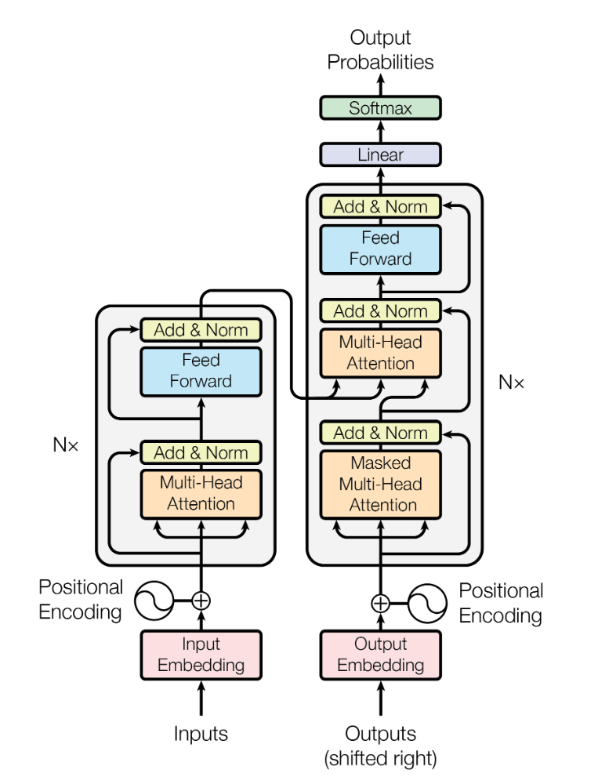
Introduction (1/3)
LLMs have become a central paradigm in AI, and their rapid scaling has made efficiency a fundamental concern.
Beyond larger models, longer context has become another major direction for improving LLM capability.
The Transformer is the dominant architecture behind modern LLMs, and self-attention is its defining mechanism.

Slide 4
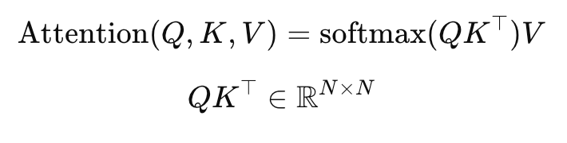
Introduction (2/3)
However, the main obstacle to long-context Transformers is the quadratic cost of self-attention.
The attention score matrix grows quadratically with sequence length.
This leads to rapidly increasing runtime and memory cost for long contexts.
As sequence length grows, self-attention becomes the dominant bottleneck in Transformer systems.

Slide 5
Introduction (3/3)
The main question is: How can we make exact attention faster and more memory-efficient by redesigning it for modern GPUs?
FA-1: Reduce memory traffic
FA-2: Improve parallelism and partitioning
FA-3: Exploit Hopper asynchrony and FP8

Slide 6
Outline
Introduction (3 min)
Background (3 min)
Related works (2 min)
Methods (15 min)
﻿FlashAttention: Fast and Memory-Efficient Exact Attention with IO-Awareness
FlashAttention-2: Faster Attention with Better Parallelism and Work Partitioning
FlashAttention-3: Fast and Accurate Attention with Asynchrony and Low-precision
Conclusions (2 min)
Q & A (5 min)

Slide 7
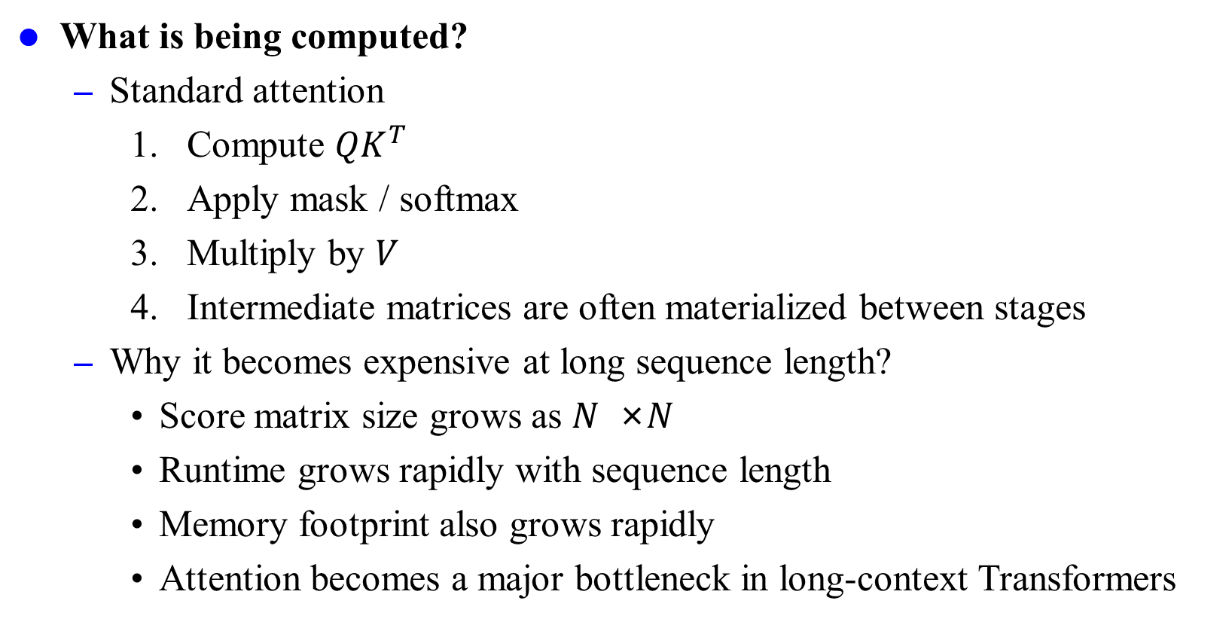
Background (1/3)
What is being computed?
Standard attention
Compute ${QK}^{T}$
Apply mask / softmax
Multiply by 𝑉
Intermediate matrices are often materialized between stages
Why it becomes expensive at long sequence length?
Score matrix size grows as 𝑁 ×𝑁
Runtime grows rapidly with sequence length
Memory footprint also grows rapidly
Attention becomes a major bottleneck in long-context Transformers

Slide 8
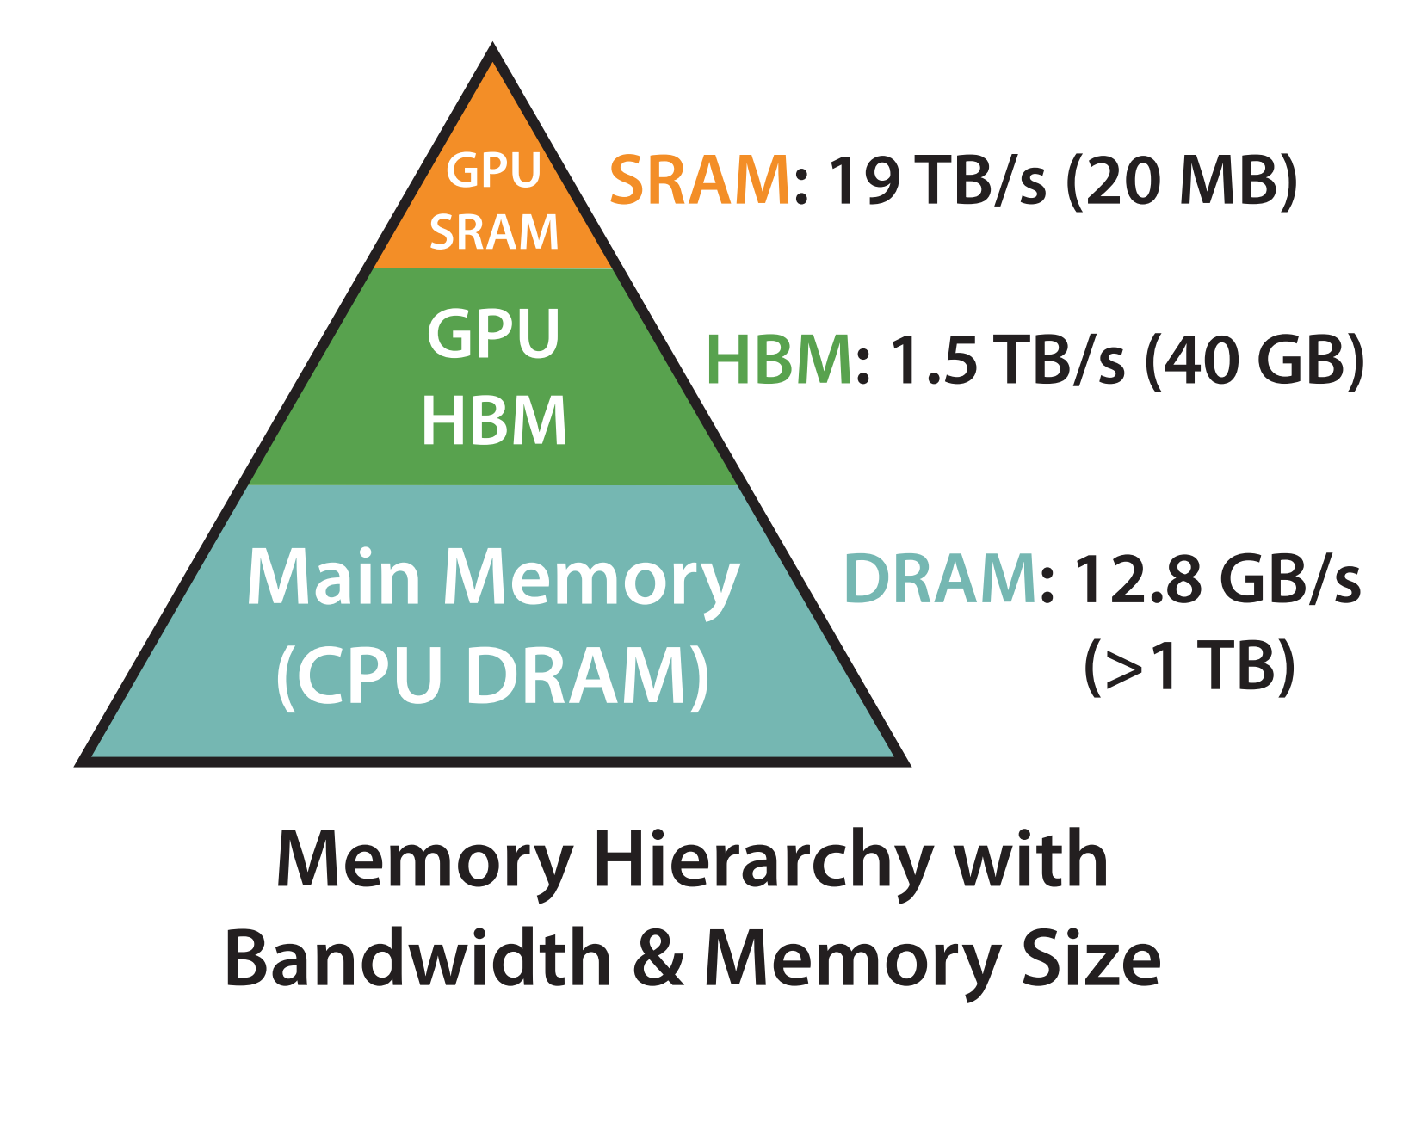
Background (2/3)
Why is it hard in practice on GPU?
From math to staged implementation
In practice, attention is executed as multiple stages
Score computation, softmax, and value aggregation are often separated
Large intermediate tensors may be materialized between stages
GPU memory hierarchy:
HBM / global memory: large, slower
SRAM / shared memory / registers: smaller, faster
Tensor Cores / compute units
Performance depends on matching computation to the memory hierarchy

Slide 9
Background (3/3)
Two ideas that make FlashAttention possible
Online Softmax
Softmax can be updated incrementally
Maintain running max and normalization
Enables exact blockwise attention
Recomputation
Recomputing some quantities can be cheaper than storing them
Reduces memory pressure
Especially useful in backward pass

Slide 10
Outline
Introduction (3 min)
Background (3 min)
Related works (2 min)
Methods (15 min)
﻿FlashAttention: Fast and Memory-Efficient Exact Attention with IO-Awareness
FlashAttention-2: Faster Attention with Better Parallelism and Work Partitioning
FlashAttention-3: Fast and Accurate Attention with Asynchrony and Low-precision
Conclusions (2 min)
Q & A (5 min)

Slide 11
Related Work
Approximate attention before FlashAttention
Sparse attention
Low-rank attention
Kernel / linear attention
Block-sparse methods
Strengths and limits of approximate attention
Lower asymptotic complexity
But may alter model behavior
Practical speedup is not always guaranteed
Hardware efficiency still matters

Slide 12
Outline
Introduction (3 min)
Background (3 min)
Related works (2 min)
Methods (15 min)
﻿FlashAttention: Fast and Memory-Efficient Exact Attention with IO-Awareness
FlashAttention-2: Faster Attention with Better Parallelism and Work Partitioning
FlashAttention-3: Fast and Accurate Attention with Asynchrony and Low-precision
Conclusions (2 min)
Q & A (5 min)

Slide 13
Methods
Positioning FlashAttention
Standard attention: exact, but not hardware-aware
Approximate methods: lower complexity, but change the computation
FlashAttention: exact attention, redesigned for hardware efficiency
Evolution of the FlashAttention series
FA-1: IO-aware exact attention
FA-2: better parallelism and work partitioning
FA-3: asynchrony and low precision on Hopper

Slide 14
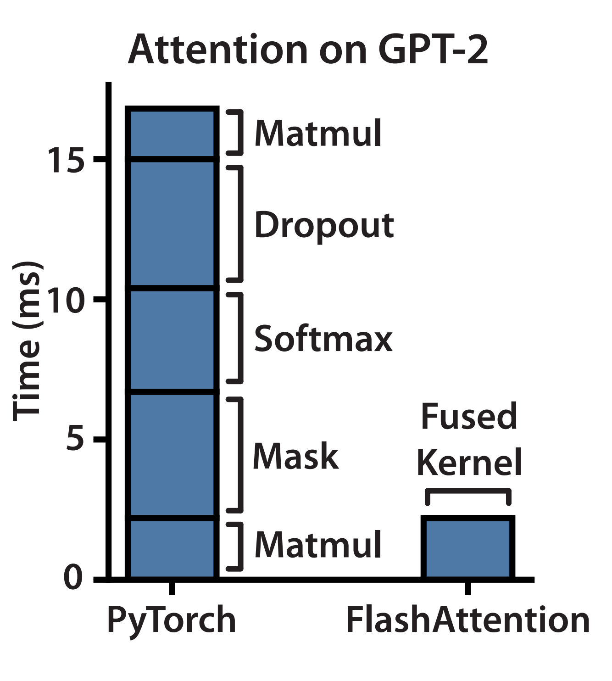
FA-1: IO-Aware Exact Attention (1/4)
Q1. In Standard Attention, Is the Real Bottleneck Computation or IO?
Standard attention is exact
Many efficient-attention methods reduce compute complexity
But lower compute complexity does not necessarily yield wall-clock speedup
FA-1 argues that the missing principle is IO-awareness
Motivation: Standard Attention Is Memory-Bound
Standard attention materializes large intermediate matrices
These tensors are repeatedly moved between HBM and SRAM
The main inefficiency is memory traffic, not only arithmetic

Slide 15
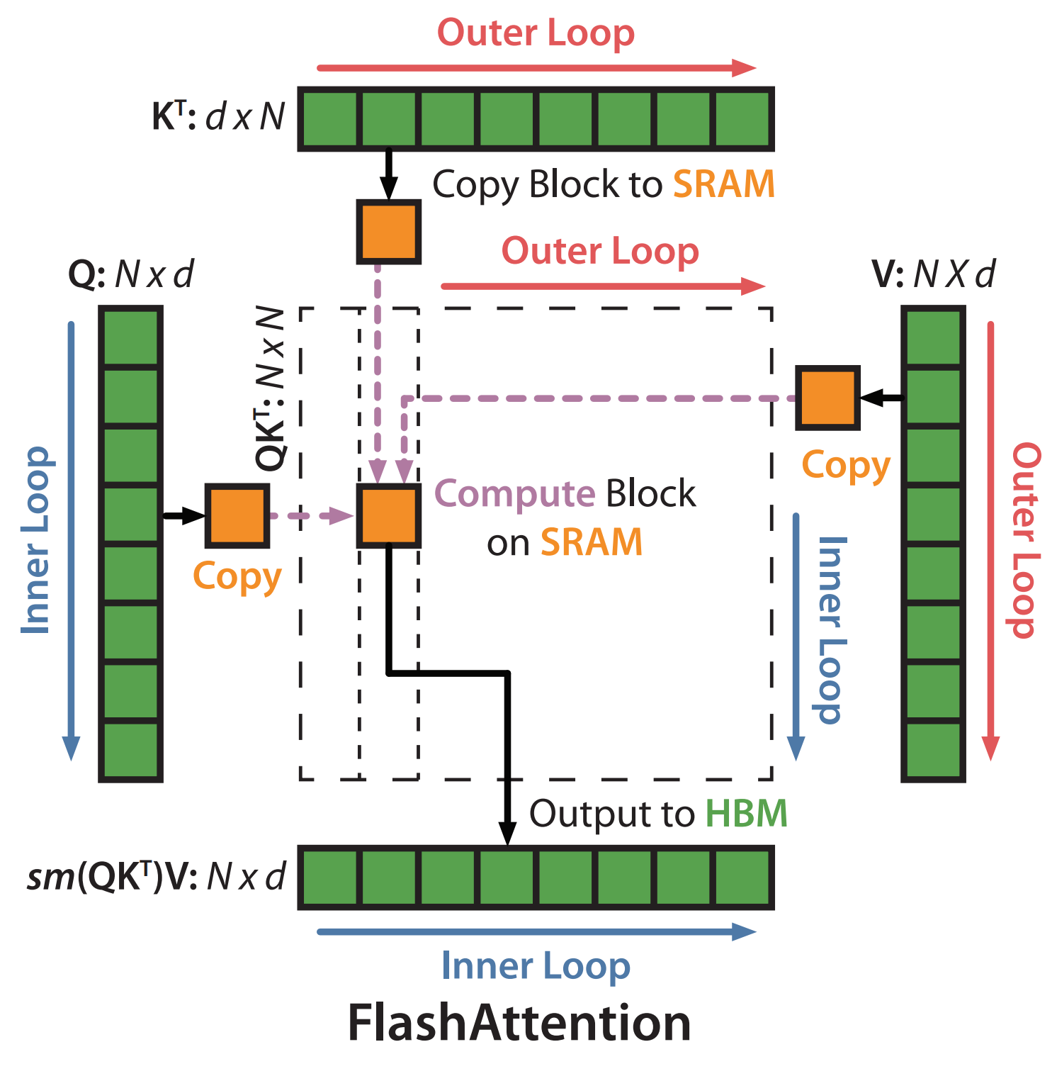
FA-1: IO-Aware Exact Attention (2/4)
Method
Make Exact Attention IO-Aware
FlashAttention is still exact attention
It does not approximate or sparsify attention
It uses tiling to reduce HBM reads/writes
The key design target is IO reduction.
Tiled Attention on SRAM
Load blocks of K and V into SRAM
Stream blocks of Q
Compute blockwise attention on-chip
Accumulate outputs without materializing the full attention matrix in HBM

Slide 16
FA-1: IO-Aware Exact Attention (3/4)
Analysis
Why the Result Is Still Exact
Every query block still interacts with all key blocks
Exact normalization is maintained through online softmax
Blockwise scheduling changes execution order, not semantics.
Backward Pass: Reduce IO Further Through Recomputation
Avoid storing large intermediates for backward
Recompute local quantities when needed
Trade extra arithmetic for lower memory traffic and memory usage.

Slide 17
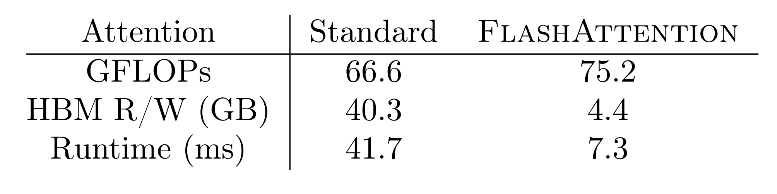
FA-1: IO-aware Exact Attention (4/4)
Experiments
FlashAttention does not mainly win by reducing arithmetic.
Its FLOPs are actually slightly higher than standard attention.
The major difference is HBM read/write, which drops from 40.3 GB to 4.4 GB.
As a result, runtime drops from 41.7 ms to 7.3 ms.
This supports the paper’s central claim that standard attention is memory-bound, and that IO-awareness is the key design principle.

Slide 18
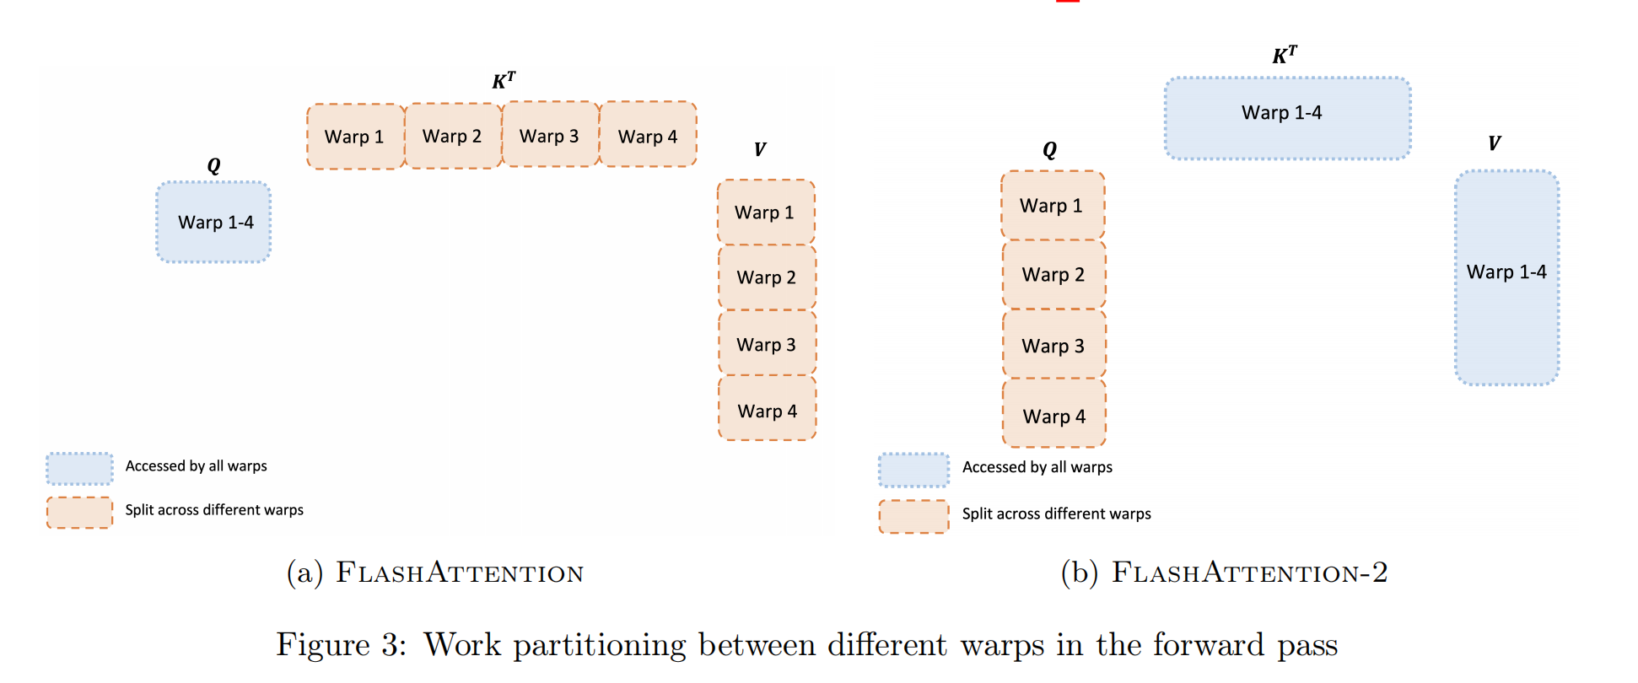
FA-2: Better Parallelism and Work Partitioning (1/6)
Q2. After Reducing IO, Why Is Attention Still Far from GEMM Efficiency?
FlashAttention-1 significantly reduces memory traffic.
However, it still reaches only 25–40% of theoretical maximum FLOPs/s.
So the next bottleneck is no longer primarily IO.
The new question is: How do we improve hardware utilization?

Slide 19
FA-2: Better Parallelism and Work Partitioning (2/6)
Motivation - The Remaining Bottleneck Is Work Partitioning
The inefficiency is due to suboptimal work partitioning between:
Thread blocks
Warps
This causes:
Low occupancy
Unnecessary shared-memory reads/writes
So the design objective shifts from IO reduction to better parallelism and scheduling.

Slide 20
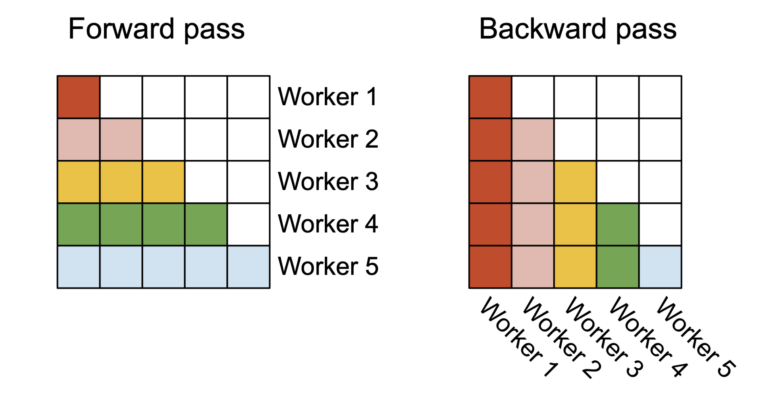
FA-2: Better Parallelism and Work Partitioning (3/6)
Method - Better Parallelism and Work Partitioning
FlashAttention-2 proposes three key changes
Reduce non-matmul FLOPs
Parallelize attention, even for a single head, across thread blocks
Distribute work among warps to reduce shared-memory communication

Slide 21
FA-2: Better Parallelism and Work Partitioning (4/6)
How FA-2 Improves GPU Utilization:
Across thread blocks: more parallelism, even for one head
Within a thread block: better work distribution among warps
Result
Higher occupancy
Less shared-memory traffic
Higher achieved FLOPs/s

Slide 22
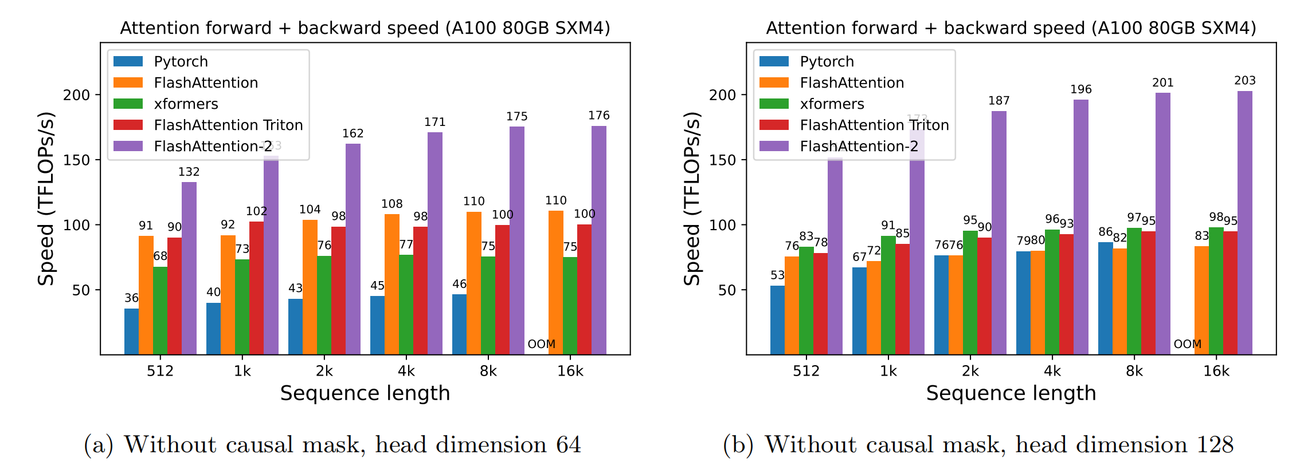
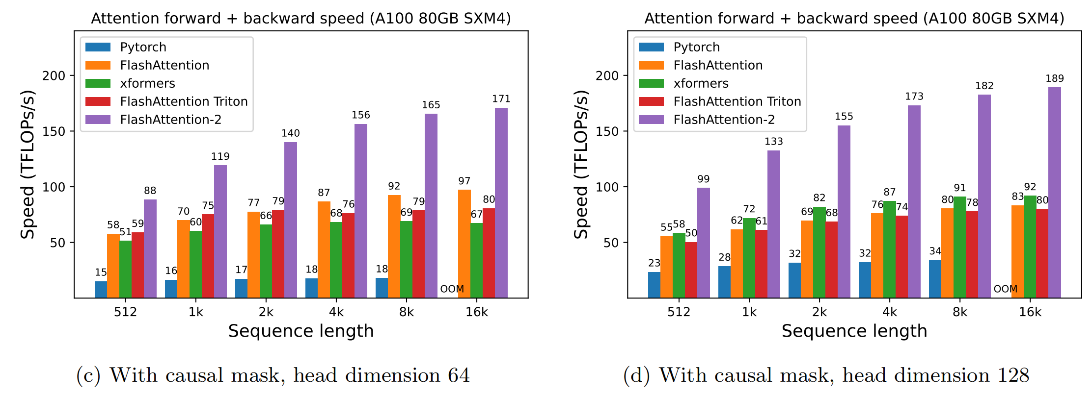
FA-2: Better Parallelism and Work Partitioning (5/6)
Experiment: FA-2 Gets Much Closer to GEMM Efficiency
Around 2× speedup compared to FlashAttention-1
Reaches 50–73% of theoretical maximum FLOPs/s on A100
End-to-end GPT-style training reaches up to 225 TFLOPs/s per A100
This corresponds to about 72% model FLOPs utilization

Slide 23
FA-2: Better Parallelism and Work Partitioning (6/6)
Takeaway: FA-2 Shifts the Focus from IO to Parallelism
FA-1 asks: How do we reduce memory traffic?
FA-2 asks: How do we better map exact attention to GPU parallelism?
Core contribution:
Better work partitioning
Better occupancy
Less shared-memory communication
FA-2 brings exact attention much closer to GEMM-style efficiency on A100.

Slide 24
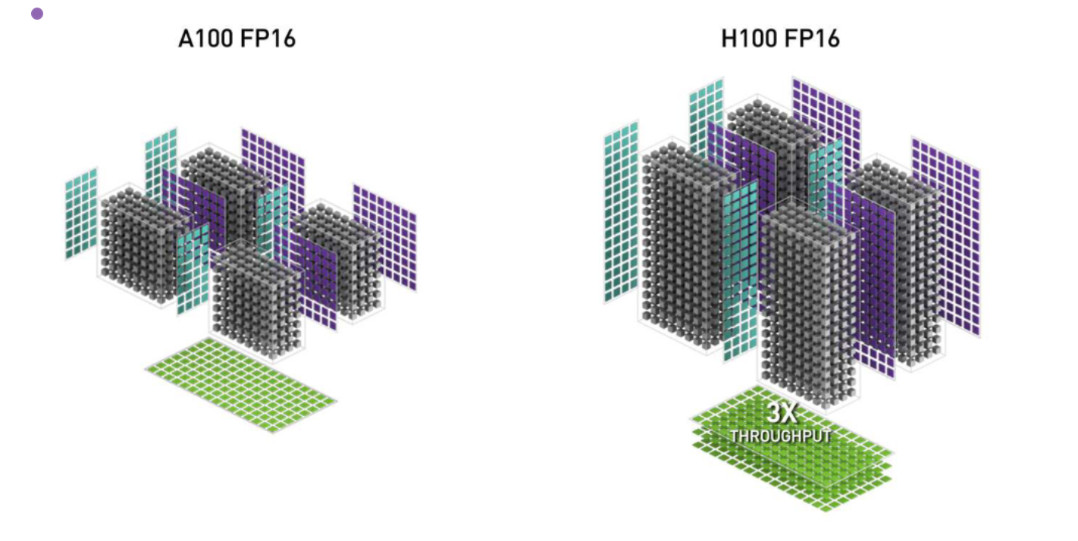
FA-3: Asynchrony and Low Precision on Hopper (1/6)
Q3. After Improving Parallelism, Why Is Attention Still Underutilizing Hopper GPUs?
FlashAttention-2 is strong on A100.
But on H100, it still achieves only about 35% utilization.
So the next question is: How do we redesign attention for Hopper?

Slide 25
FA-3: Asynchrony and Low Precision on Hopper (2/6)
Motivation: Hopper Introduces a New Optimization Target
Earlier FlashAttention versions focused on reducing memory reads/writes.
Hopper introduces new hardware capabilities:
WGMMA
TMA
FP8 support
Therefore, a new kernel design is needed to exploit:
Asynchrony
Deeper overlap
Low precision

Slide 26
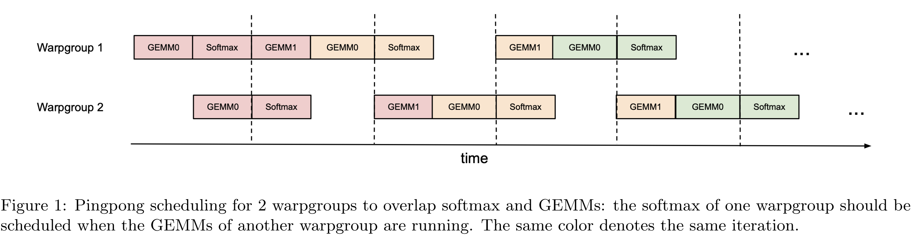
FA-3: Asynchrony and Low Precision on Hopper (3/6)
Method Overview: Three Key Ideas in FlashAttention-3
Exploit asynchrony of Tensor Cores and TMA
Overlap computation and data movement via warp specialization
Use block quantization and incoherent processing for FP8

Slide 27
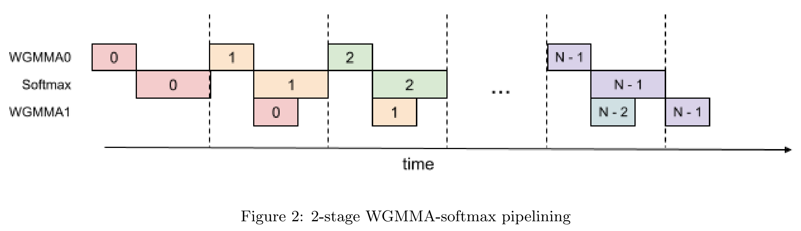
FA-3: Asynchrony and Low Precision on Hopper (4/6)
Method: Overlap, Pipelining, and Warp Specialization
Use warp specialization to separate roles across warps / warpgroups
Overlap data movement and compute
Interleave block-wise matmul and softmax
Reduce idle time and improve effective utilization on Hopper

Slide 28
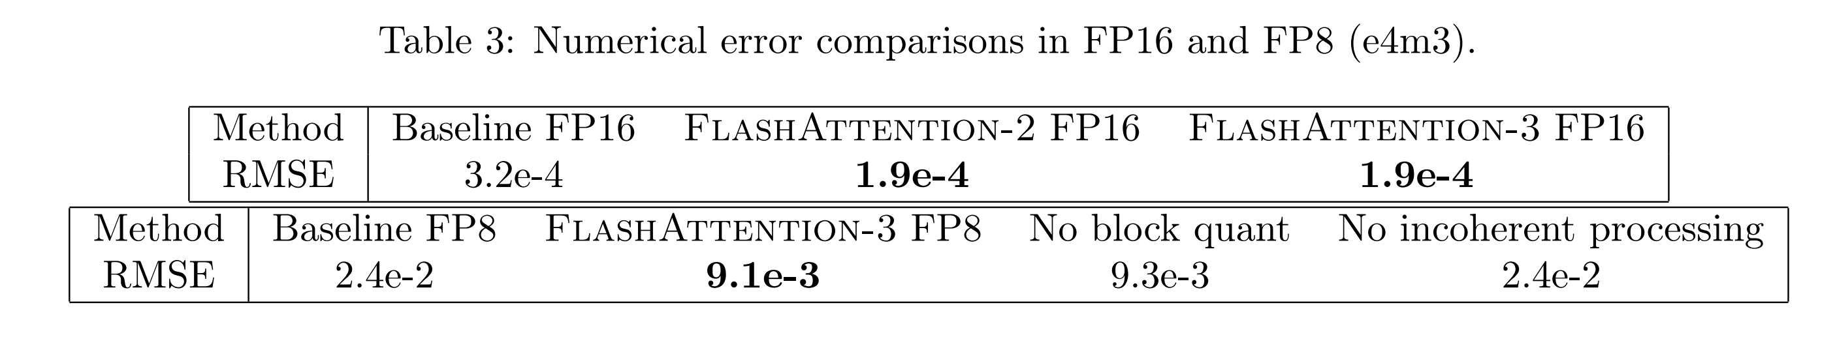
FA-3: Asynchrony and Low Precision on Hopper (5/6)
Method: FP8 with Better Accuracy
Hopper provides strong support for FP8
Naive low-precision attention can hurt numerical quality
FA-3 uses
Block quantization
Incoherent processing
Goal
Retain high throughput
Reduce quantization / numerical error

Slide 29
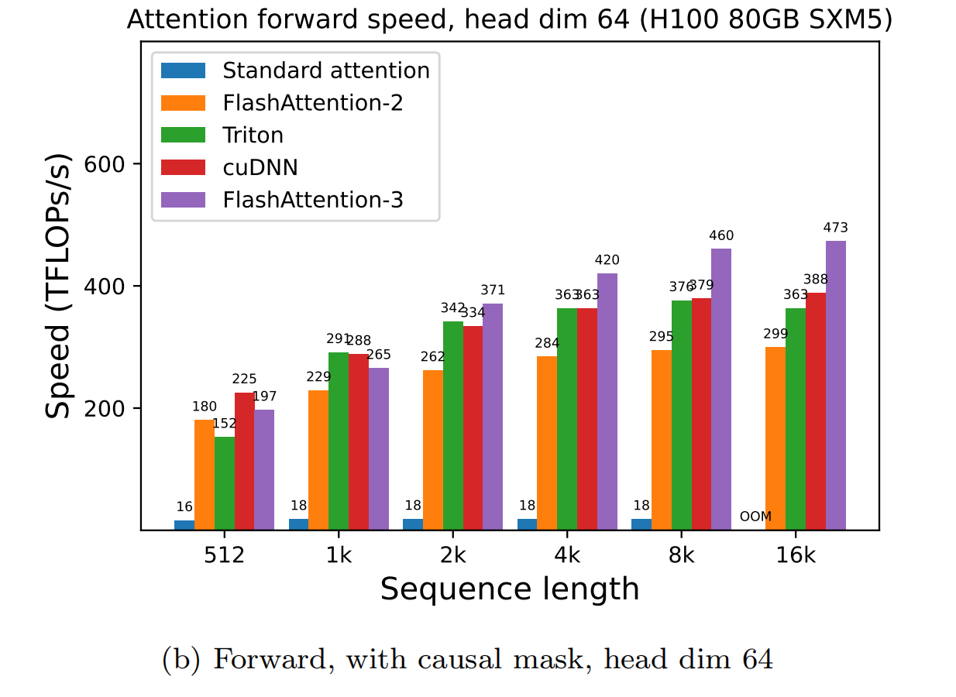
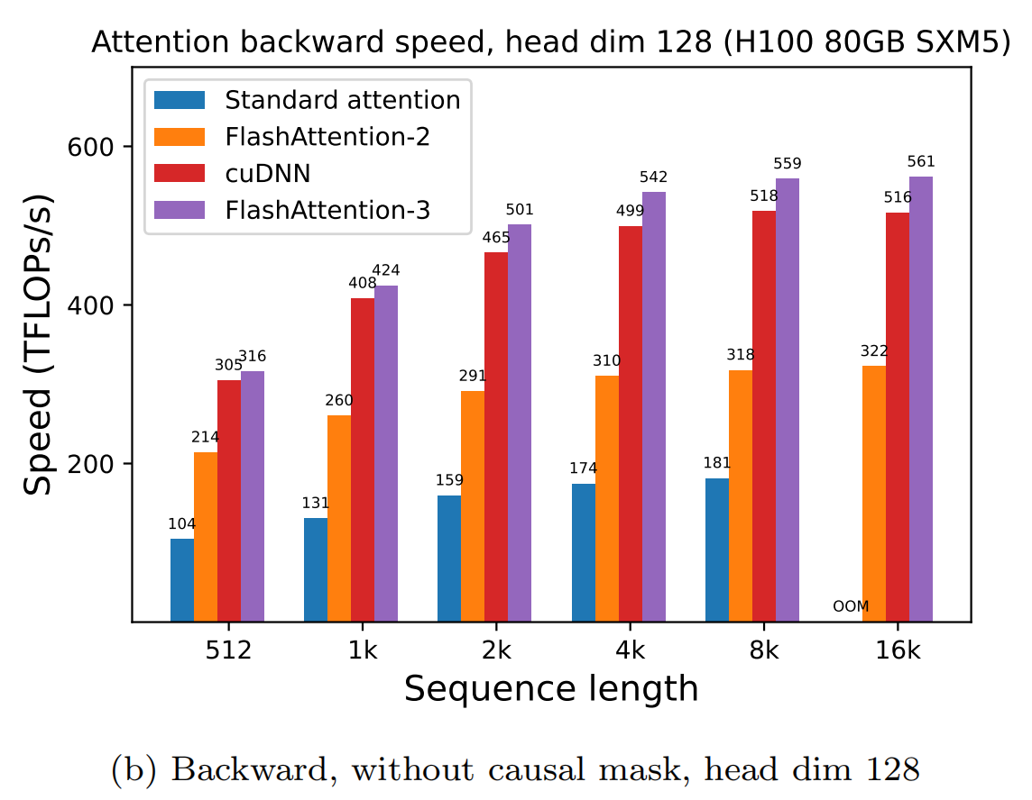
FA-3: Asynchrony and Low Precision on Hopper (6/6)
Experiment: FA-3 Exploits Hopper Much Better
1.5–2.0× speedup over FlashAttention-2 on H100
FP16 reaches up to 740 TFLOPs/s
This corresponds to about 75% utilization
FP8 reaches close to 1.2 PFLOPs/s
FP8 version achieves 2.6× lower numerical error than a baseline FP8 attention implementation

Slide 30
Outline
Introduction (3 min)
Background (3 min)
Related works (2 min)
Methods (15 min)
﻿FlashAttention: Fast and Memory-Efficient Exact Attention with IO-Awareness
FlashAttention-2: Faster Attention with Better Parallelism and Work Partitioning
FlashAttention-3: Fast and Accurate Attention with Asynchrony and Low-precision
Conclusions (2 min)
Q & A (5 min)

Slide 31
Conclusion (1/2)
Unified takeaway of FlashAttention-1/2/3
Version | Main bottleneck | Core idea | Representative gain
FA-1 | IO / HBM traffic | IO-aware exact attention via tiling | Faster exact attention by reducing memory movement
FA-2 | Work partitioning / occupancy | Better parallelism and warp/thread-block scheduling | ~2× faster than FA-1; 50–73% of peak FLOPs/s on A100
FA-3 | Hopper underutilization | Asynchrony, overlap, and FP8-aware execution | 1.5–2.0× faster than FA-2; up to 740 TFLOPs/s FP16 and ~1.2 PFLOPs/s FP8

Slide 32
Conclusion (2/2)
What Does the FlashAttention Series Teach Us?
Efficient attention is not only an algorithmic problem; it is also a systems problem.
Lower arithmetic complexity is not enough if memory traffic remains high.
Once one bottleneck is removed, the next systems bottleneck becomes visible.
The optimal attention kernel depends on the hardware generation.
Attention efficiency = algorithm × memory movement × execution mapping × hardware generation
FlashAttention is not one trick, but a sequence of exact-attention redesigns.

Slide 33
Thank You !

