Slide 1
From Hoare Logic to LLMs: Formal Verification and Generation of File Systems 2026.03.12
Xiaochuan Yan
School of Data Science
Chinese University of Hong Kong, Shenzhen

Slide 2
Outline
Introduction (2 min)
Background & Motivation (3 min)
Proposed Methods & Performance Evaluation (25 min)
FSCQ (8 min)
CRL-H and AtomFS (8 min)
SysSpec and SpecFS (9 min)
Conclusions (2 min)
Q & A (5 min)

Slide 3


Introduction - File Systems (1/2)
What are file systems?
File systems are a cornerstone of modern operating systems, providing the critical abstractions for managing persistent data.
Their design is dictated by the characteristics of underlying storage hardware and the demands of ever-changing applications.
Developers are in a perpetual cycle of adding features, optimizing performance, and resolving bugs to keep pace with innovation.
Figure 1: File system examples.
Notes:
File systems are a cornerstone of modern operating systems, providing the critical abstractions for managing persistent data. As hardware and applications continue to change, file systems also need to be upgraded. For example, dedicated systems such as EROFS have been developed for devices like mobile phones.

Slide 4
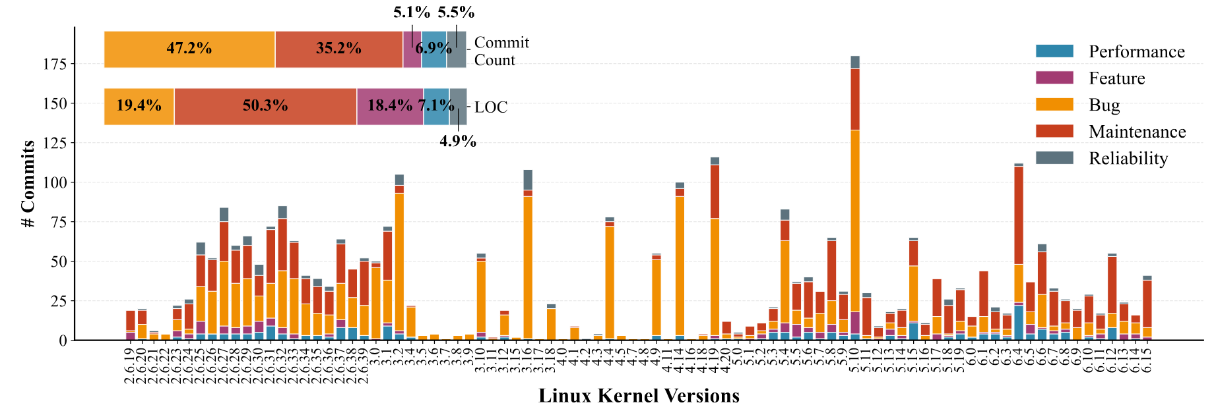
Introduction - File Systems (2/2)
Challenges in developing file system?
Analysis of Ext4 (3,157 commits from Linux 2.6.19 to 6.15) reveals: 82.4% of commits are bug fixes and maintenance. Only 5.1% introduce new functionality.
Example: fast-commit feature required 9 commits for initial implementation but triggered ~80 subsequent commits for bug fixes and maintenance.
Figure 2: File system evolution with different types of patches.
Notes:
However, this evolution comes at a steep price. An analysis of all 3,157 commits from its inception in Linux 2.6.19 to the recent 6.15 release reveals that 82.4% of all commits are dedicated to bug fixes and maintenance, which are a direct consequence of introducing new functionality (which accounts for only 5.1% of total commits). E.g., the recently merged “fast commits” feature required only 9 commits for its initial implementation, while it triggered about 80 subsequent commits to address newly introduced bugs and maintain the code. This demonstrates a common development cycle where the effort to stabilize new features far outweighs the initial implementation effort, placing a non-trivial burden on developers.

Slide 5
Outline
Introduction (2 min)
Background & Motivation (3 min)
Proposed Methods & Performance Evaluation (25 min)
FSCQ (8 min)
CRL-H and AtomFS (8 min)
SysSpec and SpecFS (9 min)
Conclusions (2 min)
Q & A (5 min)

Slide 6
Background & Motivation (1/4)
Why generative file systems?
Leveraging Large Language Models (LLMs) to generate and evolve a filesystem from prompts.
Generating a complete and useful file system from natural-language prompts is profoundly challenging, if not impossible.
Key insight: Specifications usually provide a precise and machine-understandable language to explicitly encode these invariants.
Bridging the gap between specifications and LLM-based code generation is non-trivial.
Notes:
This motivates us to explore generative file systems, which leverages the capabilities of Large Language Models to generate a complete file system and evolve it effectively. Although large models are very strong at writing code, it is still very difficult for them to directly write a complete and usable file system.
Describing requirements using natural language is not precise enough. However, using more rigorous "specifications" to describe what the system should do might help. But this also presents three problems:

Slide 7
Background & Motivation (2/4)
Challenges of Generative File Systems:
Specification Semantic Gap: Natural language prompts fail to capture multifaceted semantics including functional correctness, non-functional properties (performance), and complex concurrency control.
Complex Component Composition: LLMs' finite context window precludes generating an entire filesystem monolithically, requiring modular approach with composition challenges.
Unreliable LLM capability: Hallucination causes non-deterministic code generation.
Notes:
Challenge I: The specifications are difficult to write: the file system must not only be functionally correct, but also take into account complex situations such as concurrency and performance, which is difficult to explain in simple terms.
Challenge II: Assembling modules can easily lead to problems: the file system is too large to be generated all at once, requiring multiple modules. However, incompatible interfaces between modules, or changes to one module affecting others, all cause trouble.
Challenge III: LLMs are unstable: When writing code for large models, there is an hallucination; the same requirements may result in different outputs, which is unacceptable for system software. It is essential to ensure that the generated code is reliable every time.

Slide 8
Background & Motivation (3/4)
FSCQ (SOSP’15)
CRL-H (SOSP’19)
SysSpec (2025)
Crash Hoare Logic pioneers formal verification of file systems.
CRL-H logic was proposed for concurrent file systems to solve the linearization point problem.
Using LLM to generate evolvable file system code from specifications
Notes:
Several key research projects over the past few years have laid the foundation for this "automatic generation of file systems according to specifications." First, there was FSCQ, which used a logic called CHL to implement a machine-verifiable file system for the first time, although it initially lack support for multiprocessors and was slow to write. Then came AtomFS, which addressed the issue of concurrent verification on top of FSCQ, ensuring system correctness even in multi-core environments. Finally, SysSpec applied these verification methods to large models, freeing developers from writing line-by-line C code; instead, they wrote specifications that LLMs would follow to generate code, making updates easier. These three research projects have gradually propelled file systems from "manual coding and manual verification" to "automatic generation according to specifications and machine-guaranteed correctness."

Slide 9
Outline
Introduction (2 min)
Background & Motivation (3 min)
Proposed Methods & Performance Evaluation (25 min)
FSCQ (8 min)
CRL-H and AtomFS (8 min)
SysSpec and SpecFS (9 min)
Conclusions (2 min)
Q & A (5 min)

Slide 10
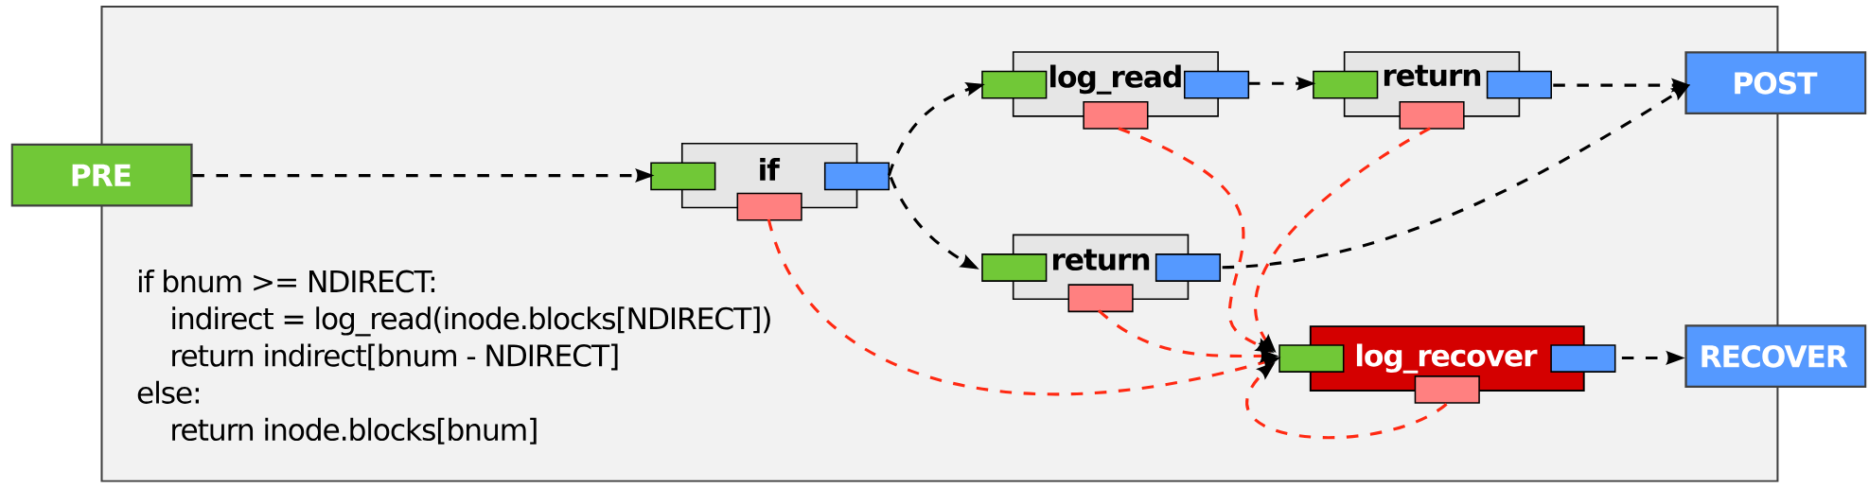
FSCQ (1/7)
Figure 3: Example control flow of a CHL procedure that looks up the address of a block in an inode, with support for indirect blocks. (The actual code in FSCQ checks for some additional error cases.) Gray boxes represent the specifications of procedures. The dark red box represents the recovery procedure. Green and pink boxes represent preconditions and crash conditions, respectively. Blue boxes represent postconditions. Dashed arrows represent logical implication.
Notes:
To address issue of verification in crashing, researchers propose Crash Hoare Logic (CHL). You can think of it as a "crash-safe" enhanced version of traditional Hoare logic. Traditional Hoare logic uses preconditions {P} and postconditions {Q} to describe the functionality of a piece of code. However, it assumes that the program either runs perfectly or doesn't run at all, failing to describe the situation where it "crashes halfway through execution."
First is crash conditions. Every procedure now comes with a crash condition that specifies the possible disk states at any point where a crash might occur. Second, CHL divides states into regular and recovery execution semantics. When a system crashes and reboots, it starts running the recovery procedure, which produces a recovered state. Third, Logical Address Space: To concisely describe high-level concepts such as files and directories, CHL extends the separation logic. You can describe "what is the Nth byte of a file" using "pointers," just like describing disk blocks, which greatly simplifies the writing of higher-level specifications.

Slide 11
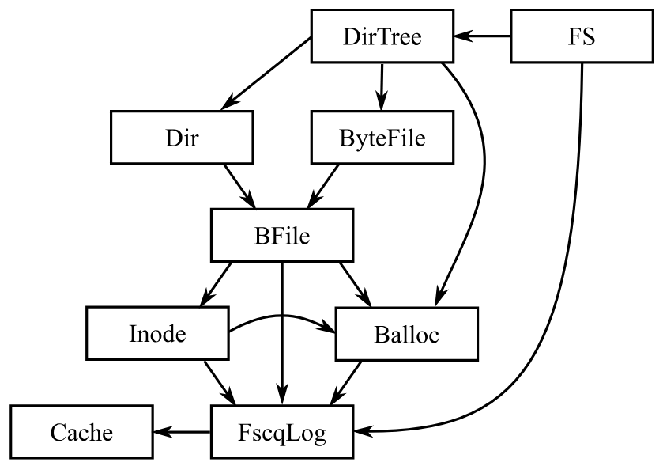
FSCQ (2/7)
FSCQ is based on the xv6 file system and uses a layered structure:
Figure 4: FSCQ components. Arrows represent procedure calls.
Notes:
Based on CHL, they developed the FSCQ file system. Its design draws inspiration from the teaching system xv6 and employs a layered architecture, with each layer utilizing CHL to ensure its correctness.

Slide 12
FSCQ (3/7)
FSCQ Architecture & Design Patterns
Layered stack: FscqLog → Buffer Cache → Bitmap Allocator (Balloc) → Inode Layer → BFile → Dir → DirTree → FS
Invariant pattern: Each layer uses representation invariants decomposing state into disjoint pieces using separation logic's star operator (⋆)
Example: File layer invariant splits disk into four disjoint regions—allocation bitmap, inode table, blocks in use by files, and free blocks.
Figure 4: FSCQ components. Arrows represent procedure calls.
Notes:
At the bottom layer is FscqLog, a pre-write logging system. It encapsulates asynchronous, potentially out-of-order physical disk operations into a synchronous logical disk that provides "atomic transactions." Regardless of when a crash occurs, FscqLog guarantees that transactions either complete entirely or are not executed at all. The upper layers include inode management, the directory tree, and ultimately, the POSIX system call interface. Because the underlying logging layer handles the complexities of crashes, the upper layers can focus on file system logic, greatly simplifying verification work.

Slide 13
FSCQ (4/7)
Implements FSCQ in the Coq proof helper. Machine-checkable mathematical proof that ensures:
No data loss: No allocated disk blocks or inodes will be lost.
Structural consistency: The directory structure is always a tree, with no cycles.
Operation atomicity: System calls like `rename` either fully take effect or roll back to their previous state after a crash, never leaving intermediate states like "the file was renamed, but the directory entry wasn't updated."
Notes:
Authors completed the implementation and verification of FSCQ in the Coq proof helper. This means we have a machine-checkable mathematical proof that ensures: No data loss: No allocated disk blocks or inodes will be lost. Structural consistency: The directory structure is always a tree, with no cycles. Operation atomicity: System calls like `rename` either fully take effect or roll back to their previous state after a crash, never leaving intermediate states like "the file was renamed, but the directory entry wasn't updated."

Slide 14
FSCQ (5/7)
Evaluation – Correctness & Crash Testing
Eliminated bug classes: Directory tree cycles, resource leaks (lost blocks/inodes), atomicity violations (partial operations).
Systematic crash testing methodology: Workloads generated 320 distinct crash states (taking every prefix of writes up to sync points combined with subsets of unsynced writes).
Result: Recovery produced only 10 distinct logical states, all consistent with POSIX semantics (either operation completed fully or rolled back completely).
Notes:
Now, turning to evaluation: How well does this approach work in practice? First, regarding correctness, FSCQ eliminates entire classes of bugs that have plagued production file systems. Theorems guarantee that FSCQ maintains the tree structure of directories—preventing cycles that could cause hangs. Resource allocation never loses blocks or inodes. The logging layer ensures that system calls are atomic with respect to crashes: either all writes in a transaction persist, or none do. This prevents the "atomicity violations" where, for example, a file is partially created or a rename leaves the file system in an inconsistent state.
Researchers validated this through systematic crash testing. They ran workloads that create files, modify directories, and move data, recording all disk writes and syncs. By taking every possible prefix of writes up to each sync point and combining them with every subset of subsequent unsynced writes, they generated 320 distinct crash states. After running FSCQ's recovery procedure on each, they found only 10 distinct logical states, all of which were consistent with POSIX semantics—either the operation completed or it rolled back completely. This gives confidence that specifications capture the intended behavior and that the unverified components, such as the FUSE driver, do not introduce inconsistencies.

Slide 15
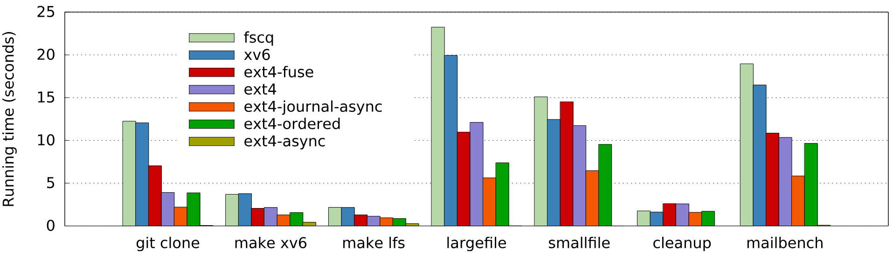
FSCQ (6/7)
Performance Evaluation
Comparable to xv6: Compiling xv6 source takes 3.7s on FSCQ vs. 3.7s on xv6 (both on SSD)
Gap with ext4: FSCQ ~2× slower due to design choices (4 disk syncs per commit vs. ext4's 2), not verification overhead; ext4 uses optimizations like async journal commits not yet implemented.
CPU overhead: ~4× compared to xv6's C implementation (artifact of Haskell extraction from Coq, not the logic itself).
Figure 5: Running time for each phase of the application benchmark suite, and for delivering 200 messages with mailbench.
Notes:
Performance-wise, FSCQ demonstrates that verified systems can achieve usable performance. Compared against xv6—a similar educational file system with write-ahead logging—FSCQ performs comparably. For example, compiling the xv6 source code takes same time on FSCQ and xv6, both running on an SSD. The gap between FSCQ and production systems like ext4 comes from design choices rather than verification overhead. FSCQ uses a simple logging protocol that requires four disk syncs per commit versus ext4's two, and ext4 employs optimizations like asynchronous journal commits and ordered data mode that have not yet implemented by FSCQ. The CPU overhead of FSCQ—implemented in Haskell extracted from Coq—is roughly 4x that of xv6's C implementation, but this is an artifact of the extraction process, not the logic itself.

Slide 16
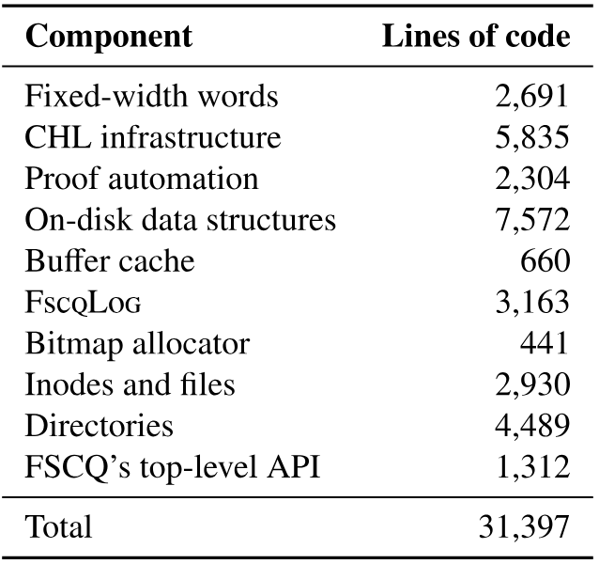
FSCQ (7/7)
Scale: ~30,000 lines of Coq code (including CHL infrastructure and proofs) vs. ~3,000 lines of C for xv6.
Case studies demonstrating incremental evolution:
Asynchronous disk writes: ~1,000 lines changed in FscqLog; layers above required no modifications.
Indirect blocks: ~1,500 lines touched in inode layer only.
Buffer cache: ~900 lines changed across entire system.
Figure 6: Combined lines of code and proof for FSCQ components.
Notes:
Finally, regarding development effort: FSCQ consists of approximately 30,000 lines of Coq code, compared to 3,000 lines of C for xv6. This includes the CHL infrastructure, proof automation, and all specifications. More importantly, the architecture supports incremental evolution. When researchers added asynchronous disk writes to FscqLog—changing about 1,000 lines—the layers above required no modifications because the logical interface remained synchronous. Adding indirect blocks touched only 1,500 lines in the inode layer. Even adding a buffer cache, which required threading mutable state through functional implementation, changed only about 900 lines across the entire system. These case studies demonstrate that once the infrastructure exists, adding features requires effort proportional to the complexity of the feature itself, not a complete re-proof of the entire system.

Slide 17
Outline
Introduction (2 min)
Background & Motivation (3 min)
Proposed Methods & Performance Evaluation (25 min)
FSCQ (8 min)
CRL-H and AtomFS (8 min)
SysSpec and SpecFS (9 min)
Conclusions (2 min)
Q & A (5 min)

Slide 18
CRL-H and AtomFS (1/8)
Why verifying concurrent file systems is so difficult?
“Linearized" interface - any concurrent operation should appear to be completed atomically at a single moment.
Find its "linearization point"—the moment its effect becomes visible.
External linearization point (path inter-dependency) makes it tough to prove the linearizability of file systems.
Notes:
First, let's look at why verifying concurrent file systems is so difficult. We want the file system to provide a "linearized" interface, equivalent to atomicity, represents that the operations appear to take effect at a single discrete point in time. Traditionally, the most intuitive way to prove an operation is linearized, is to find its "linearization point"—the moment its effect becomes visible to the outside world. This point is usually within its own code, such as before releasing a lock.
However, in concurrent file systems, things become more complex. Authors observe a phenomenon called "path inter-dependency“.
For example, imagine two operations executing simultaneously:
A `mkdir a/b/c` operation is creating directories level by level.
A `rename a /e` operation renames the entire directory `a`.
When the `rename` operation completes, it has modified the directory structure. At this point, the paths `/a/b` that the still-running `mkdir` operation depends on, have been changed. To obtain sequential, legal history, the `rename` operation must "help" the `mkdir` operation take effect before it does itself. This means that the linearization point of `mkdir` is not in its own code, but rather in the code of `rename`. We call this an "external linearization point." This "path inter-dependency" is a fundamental challenge for proving the linearizability of file systems.

Slide 19
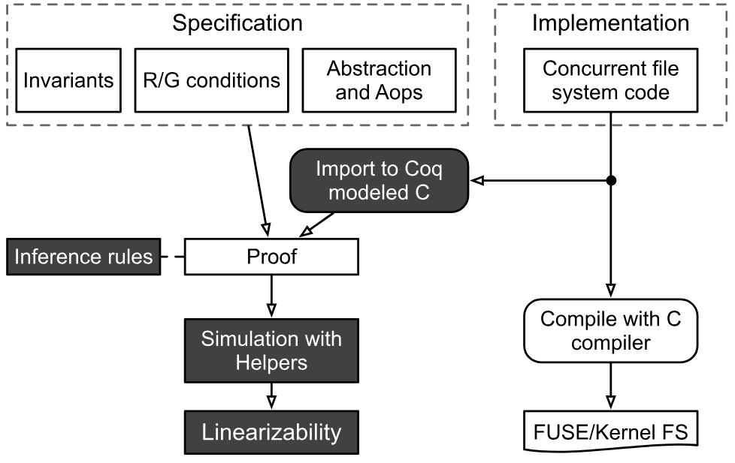
CRL-H and AtomFS (2/8)
Verifying Concurrent File Systems with CRL-H.
Helper Mechanism: Allows a thread (e.g., `rename`) to "help" other threads complete their abstract operations before executing its own LP.
Abstraction Relation with Roll-back: during consistency checks, the effects of the helper operations are "rolled back" from the abstract state.
Rely/Guarantee Reasoning: Combinatorial verification is achieved by proving that Guarantees of all threads are consistent with their Relys.
Figure 7. Development flow of applying CRL-H to verify concurrent file systems. Rectangular boxes denote source code; rounded boxes denote processes. Shaded boxes denote CRL-H framework components. The curved box denotes executable binary of the file system.

Slide 20
CRL-H and AtomFS (3/8)
How exactly does the Helper mechanism work?
Ghost states: Record necessary information.
Thread pool: Records what operation each thread is performing.
Help list: Records the execution order of the threads that received help.
‘linothers’: Based on the recorded ghost states, identifies all threads that need help, determines a correct execution order, and then executes them all at once at the abstract level.
Notes:
How exactly does the Helper mechanism work? Authors introduce some ghost states to record necessary information. Thread pool: Records what operation each thread is performing. Help list: Records the execution order of the threads that received help. Most importantly, they define a new primitive, `linothers`. At the linearization point of `rename`, we execute it. This primitive, based on the recorded ghost states (e.g., which paths each thread has locked), identifies all threads that need help, determines a correct execution order, and then executes them all at once at the abstract level. This is like `rename`, doing the work for a series of operations at a critical moment and arranging the order of execution.

Slide 21
CRL-H and AtomFS (4/8)
Reconciling State Divergence.
The roll-back mechanism addresses the state divergence that occurs during the helping process.
When a helper executes abstract operations early, the abstract state can move ahead of the concrete state where the helped operations are still physically running.
Forcing the concrete state forward to match is impractical due to file system complexity.
CRL-H maintains consistency by recording the effects of helped operations in the ghost state and rolling them back when establishing the abstraction relation.
Micro-operations, such as inode insertions and creations, are tracked in the Effect field of each thread's descriptor.
These effects are applied in reverse order to reconcile the temporal gap between logical linearization and physical execution.
Notes:
Another ingenious design is the "rollback mechanism." When helper occurs, the abstract state (our ideal file system) has already advanced several steps due to the helped operation, but the concrete physical state (the data in memory) hasn't changed. To establish the correspondence between these two, instead of forcibly pushing the physical state, they use the recorded operation effects during verification to roll back the abstract state, making it match the physical state. In this way, we can always ensure the consistency of the verification logic.

Slide 22
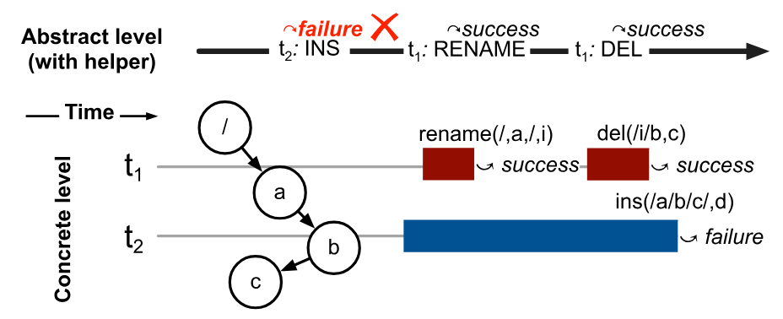
CRL-H and AtomFS (5/8)
AtomFS: A Verified Concurrent File System
The authors applied CRL-H to develop AtomFS, the first formally-verified, fine-grained concurrent file system providing linearizable POSIX-like interfaces.
AtomFS implements a concurrent in-memory file system utilizing per-inode locking.
Lock-coupling requires threads to acquire the next inode's lock before releasing the current one to maintain execution order relative to concurrent traversals.
Figure 8: Non-bypassable criterion violation. The del bypasses ins and first acquires the lock of c.
Notes:
The authors validated the self-designed concurrent file system, AtomFS, using CRL-H. AtomFS's design follows a key principle they call the "No-Bypassable Rule." What is this rule? A helped thread (such as `mkdir` whose effect is prematurely executed by `rename`) cannot be "bypassed" by other unhelped threads during physical execution. How is this achieved? They employ lock coupling technology during path traversal. That is, when a thread traverses the path, it must acquire the lock of the next node before releasing the lock of the current node. This ensures that while a helped thread is still physically executing, other threads attempting to "cut in line" cannot preemptively lock the node they are about to access, thus avoiding disruption of the logical execution order and the physical execution order.

Slide 23
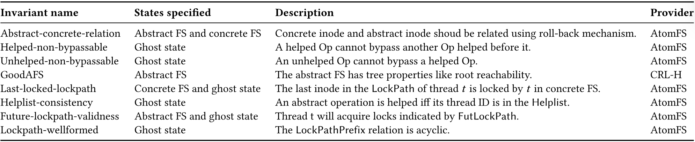
CRL-H and AtomFS (6/8)
Table 1: Invariants in AtomFS. Using CRL-H to verify AtomFS requires specifying several invariants. Each invariant (with
invariant name) specifies restrictions between states (i.e., abstract FS, concrete FS and ghost state) as explained in description.
Notes:
To complete the verification, authors defined eight core invariants to constrain the entire system. The most crucial of these is: Abstract-Concrete Relationship: Utilizing the previously mentioned "rollback mechanism," ensuring that the abstract file system tree and the concrete memory data structure remain consistent at all times. Non-bypassable Invariant: Through the “LockPath" recorded in the ghost state, we strictly guarantee the validity of the aforementioned "non-bypassable criterion."

Slide 24
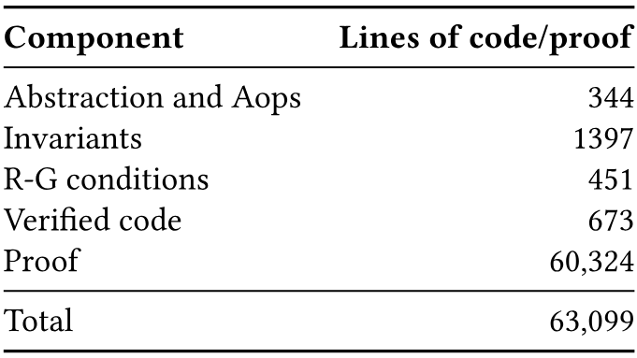
CRL-H and AtomFS (7/8)
Rigorous Mechanized Verification
All proofs for AtomFS were mechanized in the Coq proof assistant.
The verification involves roughly 63,000 lines of specification and proof code to verify 673 lines of C implementation.
The codebase breaks down into 344 lines for abstraction/operations, 1,397 lines for invariants, and 451 lines for rely-guarantee conditions.
AtomFS successfully passed 418 out of 451 test cases in the standard Linux xfstests suite.
Table 2. Lines of specifications, implementations, and proofs for AtomFS.
Notes:
The entire verification process was automated using the Coq proof assistant. They wrote approximately 63,000 lines of proof code to verify a 673-line C implementation. While the proof workload was substantial, it was manageable for such a complex concurrent system.
They performed functional testing on AtomFS using the Linux standard file system testing suite xfstests, passing 418 out of 451 test cases. All failed cases were due to missing features (such as hard links, permission checks, etc.), and none were due to concurrency bugs. This gave a great confidence that the verification method was effective.

Slide 25
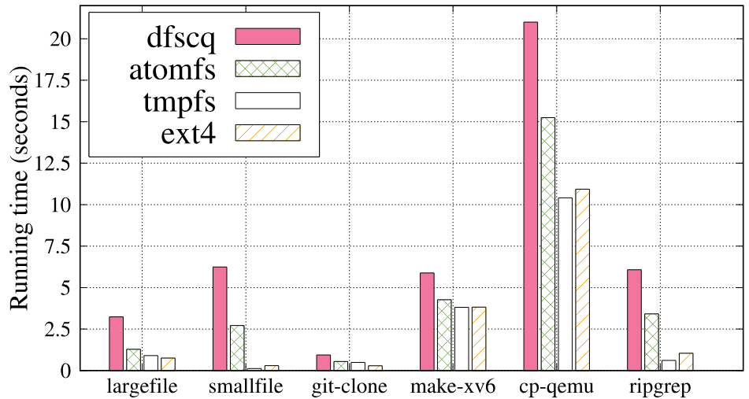
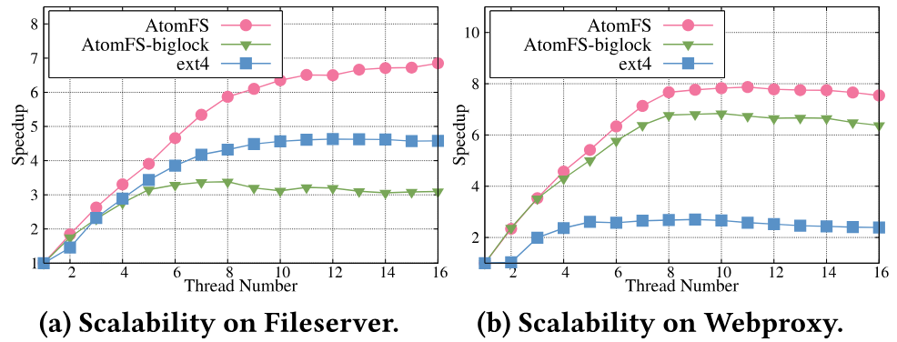
CRL-H and AtomFS (8/8)
Figure 9. Application workloads. The figure shows the running time of different application workloads (i.e., git, compile, cp, ripgrep). Largefile benchmark will operate on a big file with 10MB, and the smallfile operates on 10K files with 1KB size.
Figure 10. Scalability of AtomFS. The overall scalability
of AtomFS is better than the big-lock version of AtomFS
and ext4.
Notes:
Finally, let's look at performance. As a user-space file system (based on FUSE), AtomFS's performance, while not comparable to kernel-space ext4, fully demonstrates its multi-core scalability. Compared to the also validated sequential file system DFSCQ, AtomFS achieves a speedup of about twice in real-world application workloads (such as Git cloning and compilation). This is thanks to the C implementation, which avoids Haskell runtime overhead and truly utilizes multi-core capabilities.
In Filebench tests, compared to a coarse-grained, heavily lock-dependent version of AtomFS, AtomFS achieves a 1.46x increase in throughput under a 16-thread Fileserver load, proving that the lock coupling mechanism effectively utilizes directory-level concurrency.

Slide 26
Outline
Introduction (2 min)
Background & Motivation (3 min)
Proposed Methods & Performance Evaluation (25 min)
FSCQ (8 min)
CRL-H and AtomFS (8 min)
SysSpec and SpecFS (9 min)
Conclusions (2 min)
Q & A (5 min)

Slide 27
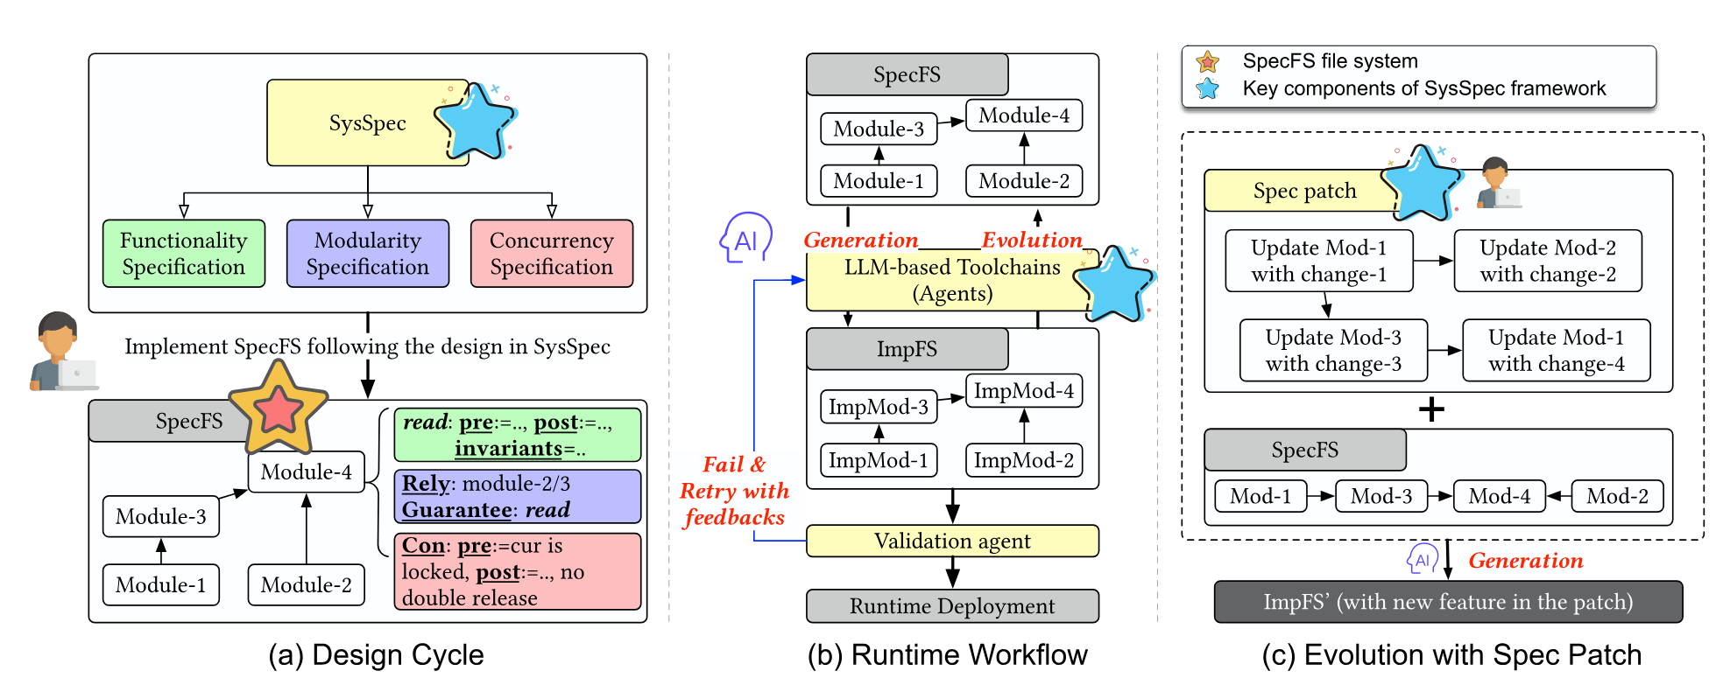
SysSpec - Design Overview (1/14)
Figure 11: SysSpec design overview.
Notes:
Researchers propose the SysSpec framework, which replaces vague hints with structured, precise specifications to guide LLM in generating correct and evolvable file systems.

Slide 28
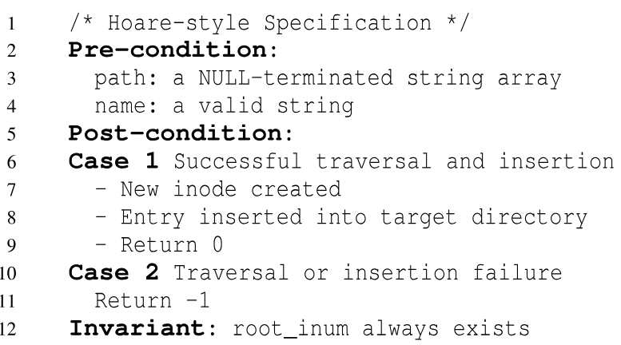
SysSpec - Functionality Specification (2/14)
Built on three components inspired by formal methods:
Pre- and post-conditions following Hoare Logic define contractual obligations for each function.
Invariants are properties that must hold true across all state transitions.
System algorithm outlines high-level logic for achieving state transitions.
Intent allows developers to inject NL high-level guidance to steer the LLM toward better implementation choices.
Figure 12: Simplified functionality specificaiton for atomfs_ins.
Notes:
Drawing inspiration from Hoare Logic, this approach defines function contracts using preconditions and postconditions, ensures global consistency using invariants, and describes the implementation strategy using system algorithm. The specification is divided into three complexity levels: simple modules require only preconditions, postconditions, and invariants; medium-complexity modules can incorporate natural language intent descriptions; and complex modules require explicit algorithms.

Slide 29
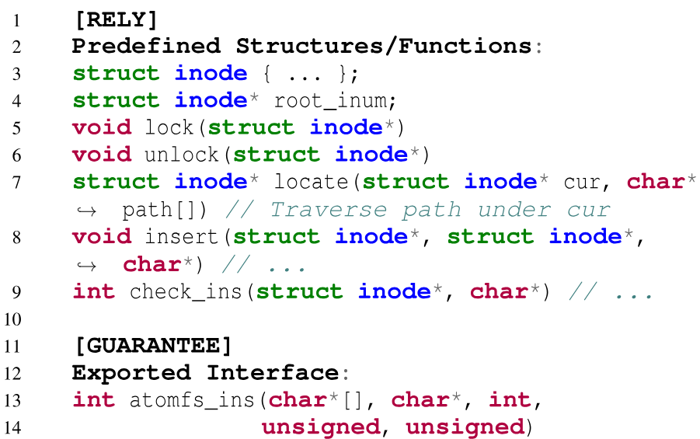
SysSpec - Modularity Specification (3/14)
Aligning module design with two intrinsic properties of LLM reasoning.
1) Strict size constraints ensure each module fits entirely within the model’s context window.
2) Rely-Guarantee conditions from concurrent program verification.
Each module’s Rely conditions must be entailed by the Guarantees of its dependencies.
Figure 13: Rely-Guarantee specifications for atomfs_ins. Both rely and guarantee conditions are simplified for clarity.
Notes:
To address the limitations of the LLM context, authors break down the system into small modules (≤500 lines of code) and adopt a Rely-Guarantee contract: each module declares the components it depends on (Rely) and the interface behavior it provides (Guarantee). Logical implicature between modules ensures correct composition and also supports integration with external libraries.

Slide 30
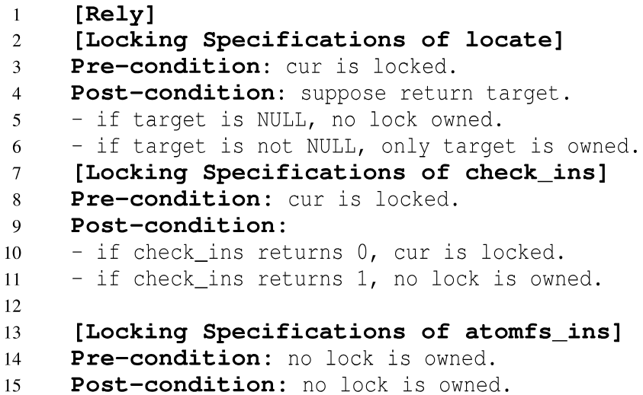
SysSpec - Concurrency Specification (4/14)
Decouple concurrent logic from the functional logic:
First directs the LLM to generate primary functional code.
Second pass, using the dedicated concurrency specification to instrument the code with the required locking and other concurrent behaviors.
Figure 14: Concurrency specifications for atomfs_ins.
Notes:
Concurrency logic is complex, and LLMs are prone to errors. Authors separate concurrency from functionality: first, LLMs generate sequential code, and then add synchronization mechanisms according to independent concurrency specifications (such as locking protocols). This two-phase generation greatly reduces the difficulty.

Slide 31
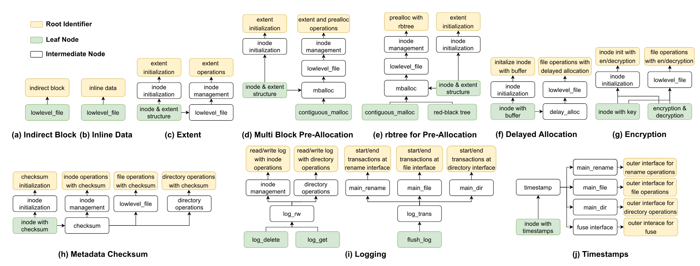
DAG-Structured Specification Patch (5/14)
Figure 15: Features implemented by SpecFS. For simplicity, a node in the figure may encompass multiple modules of specifications. “Root Identifier” indicates that this node is the root node, along with its associated logic.
Notes:
DAG (Directed Acyclic Graph) structured specification patch is to manage file system evolution.
When the file system evolves, developers only need to write high-level specification patches, rather than modifying C code. Patches use a DAG structure: Leaf nodes: Local modifications do not affect other modules. Intermediate nodes: Depend on the guarantees of child nodes to progressively build new functionality. Root node: Provides the same interface as the original implementation, allowing safe replacement of old modules. The toolchain generates code from bottom to top in dependency order, ensuring consistency.

Slide 32
The SysSpec Toolchain (6/14)
SpecCompiler: Translates SysSpec into C code that can be compiled and deployed.
Two-phase prompting. The generation difficulty is greatly reduced by writing logic first and then adding the necessary locking and concurrent behaviors.
CodeGen + SpecEval. SpecEval agent reviews the output against the specification. CodeGen agent retries.
SpecValidator: Performs the final, holistic verification of the complete C code.
SpecAssistant:
First validates and reformats to meet SysSpec’s syntax.
Enters an automated refinement loop.
On success, SpecAssistant provides with the refined specification and the C implementation.
On failure, returns the last attempted specification annotated with detailed diagnostics.
Notes:
The SysSpec Toolchain comprises three LLM-based agents.
SpecCompiler translates SysSpec into C code using two primary techniques: two-phase prompting (generating logic first, then adding concurrency) and an iterative retry-with-feedback loop involving a CodeGen agent and a SpecEval reviewer. If SpecEval identifies flaws, it generates actionable feedback for CodeGen to retry until the specification is satisfied.
SpecValidator fights LLM hallucination through dual validation: reusing SpecEval logic to check modules against specifications, and running unit and regression tests.
SpecAssistant validates and reformats developer drafts to meet SYSSPEC’s syntax, then enters an automated refinement loop. On success, it provides refined specifications and C implementations; on failure, it returns annotated diagnostics as a debug log that guides the developer in resolving the issue.

Slide 33
SpecFS: A Case for Generative FS (7/14)
Based on a prior formally verified file system, AtomFS.
Implement AtomFS’s high-level design with SysSpec’s specifications.
SpecFS is organized into 45 distinct modules.
Supports a wide range of standard POSIX calls.
Correctness equivalent to that of AtomFS, failing only 64/754 test cases, all attributable to unimplemented functionality.
Comprises approximately 4,300 lines of code.
Ranks 42nd among 82 file systems in the Linux 6.1.10 kernel.
Offering a trade-off between generation accuracy (strict SysSpec) and the use of simplified specification.
Most issues in SpecFS are diagnosed at the specification level.
Notes:
Researchers demonstrate SYSSPEC through SPECFS, a concurrent in-memory FUSE-based file system based on the formally verified AtomFS design. SPECFS comprises 45 distinct modules including file operations, inode management, and POSIX interfaces. The generated C implementation contains approximately 4,300 lines of code, ranking 42nd among 82 file systems in Linux 6.1.10.
Rather than porting AtomFS's C implementation, they reimplemented its design using SYSSPEC specifications including pre/post-conditions, invariants, rely/guarantee contracts, and concurrency specs. Validated against xfstests, SPECFS demonstrates equivalent correctness to the original AtomFS, failing only 64 of 754 test cases due to unimplemented functionality.
Empirical study reveals that while strict SYSSPEC adherence ensures accuracy, simplified specifications can occasionally still yield correct code, offering a trade-off between accuracy and efficiency. When debugging, they initially locate bugs in generated C code, then validate the high-level design against specifications—most issues are diagnosed at the specification level.

Slide 34
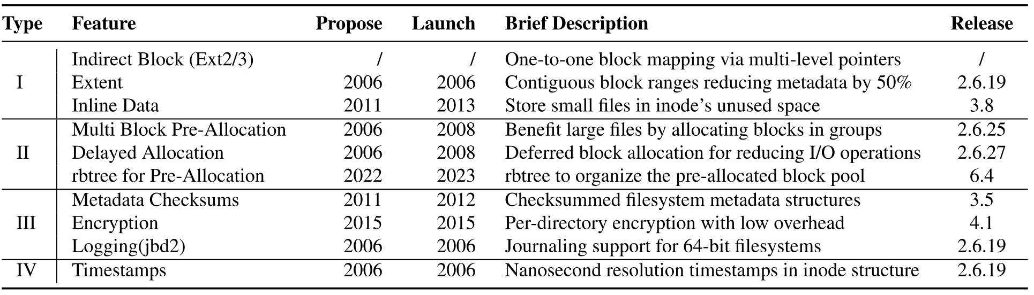
SpecFS: Case Study of Evolutions (8/14)
Evolve the design of SpecFS with 10 well-known Ext4’s features using spec patches.
File structure modification.
Design update for existing operations.
New functionalities implementation with new operations.
Hyperparameters or metadata modification.
Table 3: Case study of applying Ext4 features to AtomFS. “Propose” and “Launch“ indicate the year an feature proposed and the year it is merged. “Release“ indicates the Linux version with the feature. "Indirect Block" is an exception in the table, as it originates from ext2/3.
Notes:
SPECFS showcases evolvability through integration of 10 Ext4 features via spec patches, categorized as: (I) file structure modification (e.g., Extents), (II) design updates for existing operations, (III) new functionalities, and (IV) hyperparameter modifications.

Slide 35
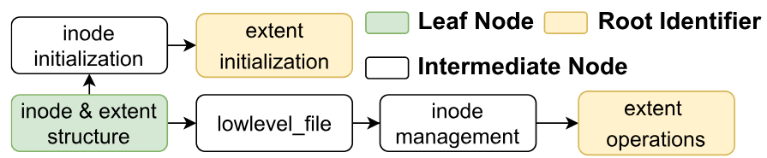
SpecFS: Case Study of Evolutions (9/14)
Extent: Transforms the file structure from individual blocks into extents.
Defining new data structure for extent and inode.
Updates the low-level file operations in lowlevel_file.
inode_management module is modified to invoke these new extent operations.
Figure 16: DAG-Structured patch for implementing “Extent”. For simplicity, a node in the figure may encompass multiple modules of specifications. “Root Identifier” indicates that this node is the root (along with its associated logic).
Notes:
For example, the Extent feature transforms file structures from individual blocks to contiguous ranges. The DAG patch begins with new data structures, updates low-level file operations, modifies inode management to invoke extent operations, and uses the updated inode management as the root node to replace the original.

Slide 36
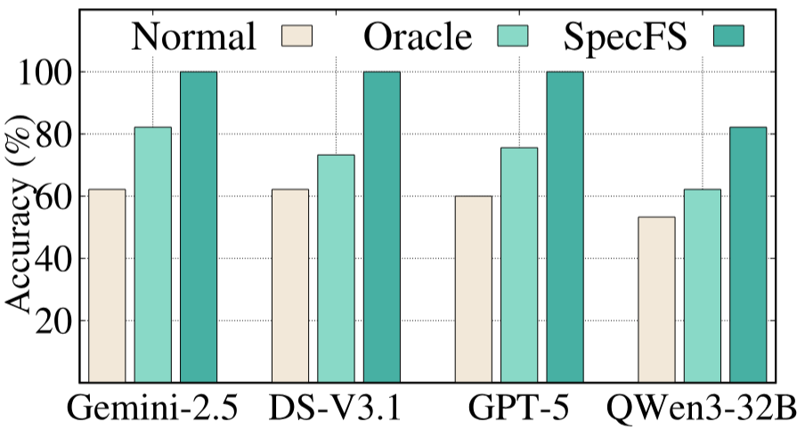
Evaluations on Accuracy (10/14)
Implements 45 AtomFS modules. Needs to pass all functional tests and manual equivalent inspection.
Normal baseline: file logic and dependency APIs.
Oracle baseline: Normal baseline + ground-truth code
Figure 17: Accuracy results for implementing AtomFS. “GPT-5” in the figure denotes GPT-5-minimal.
Notes:
Evaluations on Accuracy. SPECFS achieves 100% accuracy on powerful models (Gemini-2.5-Pro, DS-V3.1) for generating AtomFS modules, compared to 81.8% for oracle baselines with ground-truth code, demonstrating that SYSSPEC's specification design significantly enhances generation accuracy.

Slide 37
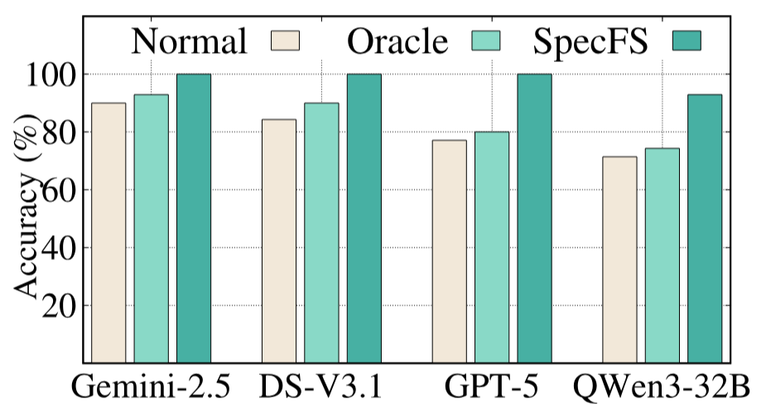
Evaluations on Generalizability (11/14)
Whether SpecFS can accurately generate the ten features in Table 1.
SpecFS consistently exhibits higher generation accuracy across all evaluated models.
Whether the concurrency specifications of SysSpec are general for various locking methods.
dentry_lookup of Linux VFS layer: lock-free RCU for the hash list and spinlocks for individual dentries
Figure 18: Accuracy results for implementing new features. “GPT-5” in the figure denotes GPT-5-minimal.
Notes:
Evaluations on Generalizability. The framework successfully generates 10 Ext4 features encompassing 64 functional modules with high accuracy. Concurrency specifications prove generalizable across various locking methods, successfully generating code using both lock-free RCU and spinlocks for dentry lookup operations.

Slide 38
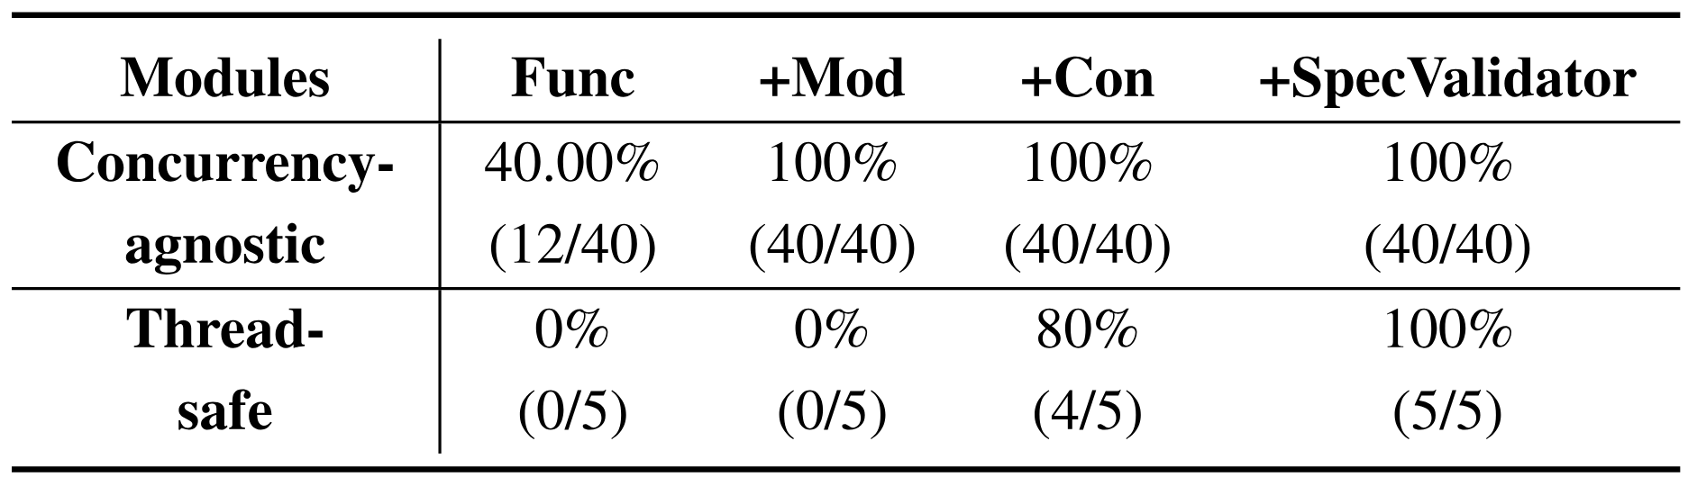
Ablation Study (12/14)
40 concurrency-agnostic modules and 5 thread-safe modules.
Functionality specification alone is insufficient (primarily due to interface mismatch).
Modularity specification effectively supports the generation of concurrency-agnostic modules.
Incorporating a concurrency specification and agent-supported self-validation to achieve correctness and robustness for thread-safe modules.
Table 4: Ablation study. The evaluation uses DeepSeek-V3.1 Reasoning. “Func”, “Mod”, “Con” means Functionality, Modularity and Concurrency Specifications respectively.
Notes:
Ablation Study. Functionality specification alone is insufficient due to interface mismatches. Combining functionality with modularity specifications supports concurrency-agnostic modules, while adding concurrency specifications and agent-supported self-validation achieves correctness for thread-safe modules.

Slide 39
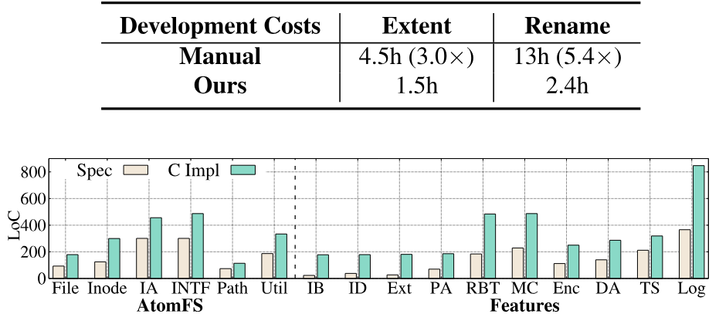
Evaluations on Productivity (13/14)
Improves the programming productivity of the two implementations by 3.0× and 5.4×.
“extent” feature for original AtomFS.
“rename” module of AtomFS.
Require fewer lines than corresponding C source code.
Table 4: Productivity improvement.
Figure 19: Lines of code comparison between specification and
source code. The results contain six basic logical layers of AtomFS
and ten new features in Table 3. The abbreviations are as follows.
IA: Interface Auxiliary; INTF: Interface; Util: Utility; IB: Indirect
Block; ID: Inline Data; Ext: Extent; PA: Pre-Allocation; RBT:
rbtree for Pre-Allocation; MC: Metadata Checksums; Enc: Encryption; DA: Delayed Allocation; TS: Timestamps; Log: Logging.
Notes:
Productivity. SPECFS improves productivity by 3.0× for multi-module features (Extent) and 5.4× for complex locking logic (Rename). Specifications consistently require fewer lines than generated C code.

Slide 40
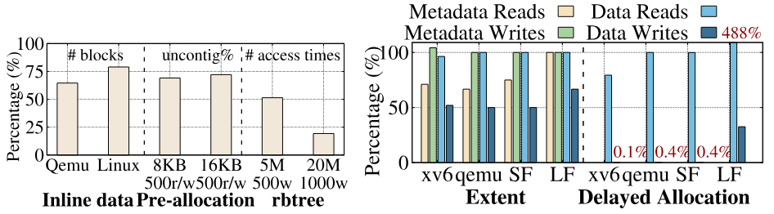
Performance Optimizations (14/14)
Figure 20: Performances improvements with new features implemented by SPECFS. The results were normalized before and after optimization, and a lower percentage indicates better performance. Test cases in the right are “xv6 compilation” (“xv6”), “copy qemu” (“qemu”),“small file” (“SF”), “large file” (“LF”). The “SF” and “LF” tests involve various read or write operations on multiple small or large files, respectively representing metadata-intensive and data-intensive workloads. The data for "Delayed Allocation" that is either too long or too short is marked in the figure.
Notes:
Performance. Optimizations yield significant improvements: Inline Data reduces file sizes by 35.4%; multi-block pre-allocation decreases uncontiguous I/O by 30%; red-black trees for block pools reduce access frequency by 80.7%; Extents reduce total I/O operations; and Delayed Allocation eliminates up to 99.9% of write operations.

Slide 41
Outline
Introduction (2 min)
Background & Motivation (3 min)
Proposed Methods & Performance Evaluation (25 min)
FSCQ (8 min)
CRL-H and AtomFS (8 min)
SysSpec and SpecFS (9 min)
Conclusions (2 min)
Q & A (5 min)

Slide 42
Conclusions
The first paper’s contributions are CHL and a case study of applying CHL to build FSCQ, the first certified crash-safe file system. The benefit of the verification approach is that FSCQ has a machine-checked proof that FSCQ avoids bugs that have a long history of causing data loss in previous file systems.
The second paper has presented CRL-H, a framework for specifying, implementing, and verifying concurrent file systems with atomic interfaces through the helper mechanism. CRL-H is applied to specify and verify AtomFS, the first formally verified, fine-grained, concurrent file system.
SysSpec is a framework and a case for generative file systems. Different from traditional paradigms, SysSpec shifts the developer’s focus from writing low-level code to designing high-level specification, and SpecFS shows the potential benefits on evolvability.

Slide 43
Outline
Introduction (2 min)
Background & Motivation (3 min)
Proposed Methods & Performance Evaluation (25 min)
FSCQ (8 min)
CRL-H and AtomFS (8 min)
SysSpec and SpecFS (9 min)
Conclusions (2 min)
Q & A (5 min)

