Slide 1
From OS Paging to PagedAttention: Memory Management in Large Multimodal Models
Yuhao Shen
School of Data Science
Chinese University of Hong Kong, Shenzhen
Notes:
Good morning, Professor and classmates. My name is Yuhao Shen. My research background is primarily in AI for Health and medical Vision-Language Models. Today, I am very excited to share my presentation titled: 'From OS Paging to PagedAttention: Memory Management in Large Multimodal Models'. We will explore how classic operating system concepts are being reinvented to solve the memory bottlenecks in modern AI.

Slide 2
Outline
Introduction
Related Work
Preliminaries
Proposed Methods
Performance Evaluation
Conclusions
Notes:
Here is the outline for today's presentation. I will start by introducing the memory bottlenecks we face in large multimodal models, particularly in medical applications. Then, we will review classic OS principles and explore three state-of-the-art works that elegantly adapt these OS concepts to solve AI inference challenges.

Slide 3
From OS Paging to PagedAttention: Memory Management in Large Multimodal Models
Introduction
Related Work
Preliminaries
Proposed Methods
Performance Evaluation
Conclusions
Notes:
Let's begin with the introduction and understand the core problem.

Slide 4
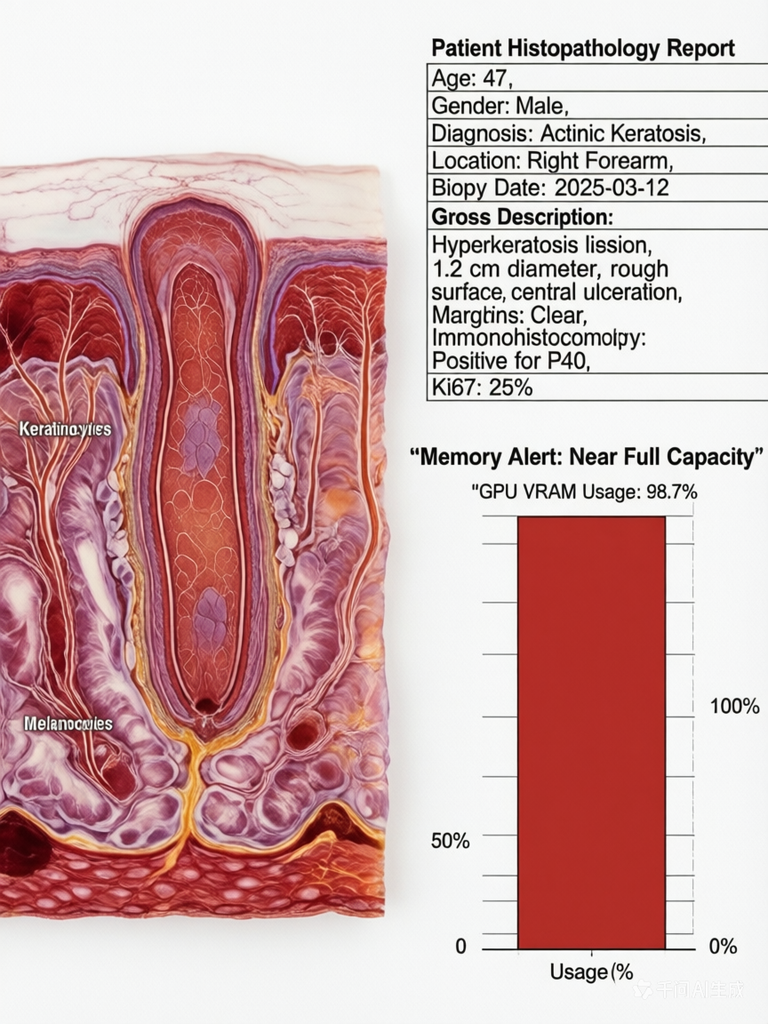
Introduction - The Memory Wall in Medical VLMs
The Challenge: High-resolution inputs lead to explosive memory consumption.
Medical VLMs process massive 1024x1024 clinical images.
Long patient clinical histories further expand the context window drastically.
The Bottleneck: GPU VRAM becomes the primary constraint, not compute.
Dynamic Key-Value (KV) cache grows linearly with every generated token.
Memory capacity fundamentally limits batch size and overall system throughput.
Notes:
"The major challenge we face in deploying medical Vision-Language Models is explosive memory consumption. As you can see on the right, medical VLMs process massive, high-resolution clinical images, alongside lengthy patient histories, which drastically expands the context window. The real bottleneck here is not the GPU's compute power, but its VRAM constraint. As shown on the left, the dynamic Key-Value, or KV cache, grows linearly with every generated token , easily pushing VRAM usage to near full capacity. This memory limit fundamentally restricts our batch size and overall system throughput."

Slide 5
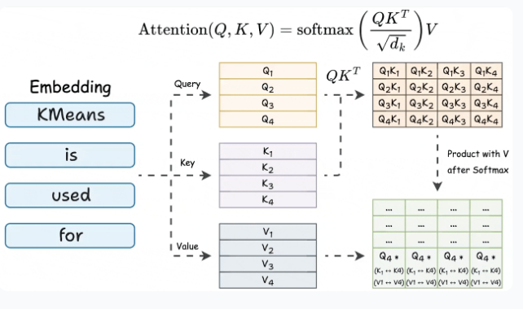
Introduction - The Anatomy of LLM Inference Memory
Static vs. Dynamic Memory: The dual nature of LLM resource allocation.
Model weights are static, predictable, and strictly read-only during inference.
The KV cache is highly dynamic, stateful, and unpredictable in total size.
The Unpredictable Nature of Autoregressive Generation:
The exact length of the model's output is completely unknown at the time of the initial request.
This unpredictability makes memory pre-allocation extremely difficult for system schedulers.
Notes:
"To understand this memory wall, we must look at the anatomy of LLM inference memory. There is a dual nature here: static versus dynamic memory. Model weights are static, predictable, and strictly read-only. However, the KV cache is highly dynamic, stateful, and its total size is extremely unpredictable. This is due to the unpredictable nature of autoregressive generation. Because the exact length of the model's output is completely unknown at the time of the initial request , memory pre-allocation becomes extremely difficult for system schedulers.

Slide 6
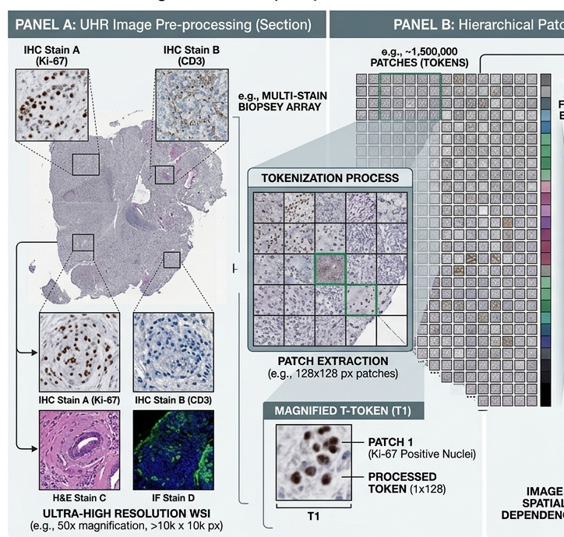
Introduction - The Unique Demands of Medical AI
Massive token generation from high-resolution visual encoders.
Medical VLMs process ultra-high-resolution diagnostic images (e.g., pathology slides), translating into millions of dense visual tokens.
This creates an exceptionally large initial KV cache footprint before the autoregressive text generation even begins.
Clinical reasoning strictly prohibits context truncation.
Diagnostic workflows heavily rely on lengthy patient clinical histories and continuous multi-turn consultations.
Unlike general AI chatbots, forcefully dropping earlier context to save memory is unacceptable as it can lead to fatal diagnostic errors.
Notes:
"This unpredictability is uniquely amplified in medical AI. Looking at the tokenization process of an ultra-high resolution Whole Slide Image on this slide, a single image can be divided into a massive amount of patches—sometimes up to 1.5 million tokens. This massive initial state, combined with the fact that we cannot predict the exact output length , makes naive memory pre-allocation an absolute nightmare for inference systems."

Slide 7
From OS Paging to PagedAttention: Memory Management in Large Multimodal Models
Introduction
Related Work
Preliminaries
Proposed Methods
Performance Evaluation
Conclusions
Notes:
"So, how do existing frameworks handle this massive memory pressure? Let's move on to the Related Work

Slide 8
Related Work - LLM Serving & Fragmentation
Standard Approach: Frameworks pre-allocate contiguous GPU memory.
Allocation is based strictly on the Maximum Sequence Length expected.
This naive design mimics early, primitive OS memory allocation schemes.
Memory Fragmentation: A significant waste of precious VRAM capacity.
Internal fragmentation occurs from over-provisioning for unknown, shorter output lengths.
External fragmentation arises from irregular memory chunk sizes over time.
Notes:
"The standard approach in traditional frameworks is to pre-allocate contiguous GPU memory based strictly on the maximum expected sequence length. Honestly, this naive design mimics the early, primitive memory allocation schemes of operating systems. And the result? Severe memory fragmentation, which is a significant waste of precious VRAM capacity. We suffer from internal fragmentation due to over-provisioning for unknown, shorter output lengths , and external fragmentation arising from irregular memory chunk sizes over time

Slide 9
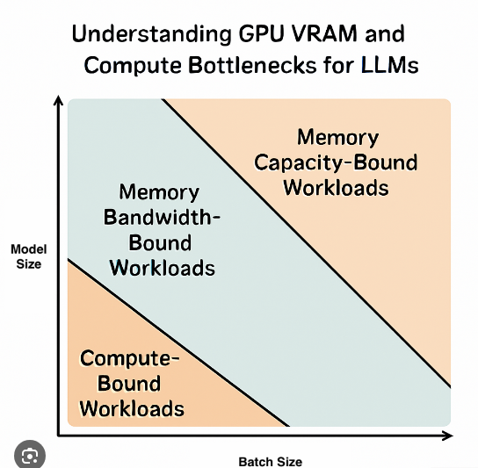
Related Work - Hardware Solutions and Limitations
Scaling Out with Multi-GPU Parallelism:
Tensor Parallelism and Pipeline Parallelism distribute memory across multiple GPUs.
These approaches alleviate single-card VRAM limits through distributed computing.
The Limitations for Clinical Deployments:
Introduces heavy communication overhead across the PCIe or NVLink interconnects.
Local hospital deployments often prefer single-GPU workstations to ensure patient data privacy and reduce costs.
Notes:
To bypass this memory wall, some researchers propose hardware-level solutions, primarily scaling out with Multi-GPU parallelism like Tensor and Pipeline parallelism. While this distributes the memory burden, it introduces heavy communication overhead across PCIe or NVLink interconnects. Furthermore, let's look at the reality of clinical deployments. In local hospital settings, or even in our own labs when working with a couple of high-end consumer GPUs like RTX 4090s, absolute VRAM capacity remains a hard ceiling. Hospitals heavily prefer single-GPU workstations to ensure patient data privacy and reduce hardware costs. Thus, hardware scaling is not a universal cure

Slide 10
From OS Paging to PagedAttention: Memory Management in Large Multimodal Models
Introduction
Related Work
Preliminaries
Proposed Methods
Performance Evaluation
Conclusions
Notes:
"Since hardware scaling has its strict limitations, we must look for software-level breakthroughs. This brings us to Section 3: Preliminaries, where we look back at classic Operating System designs for inspiration

Slide 11
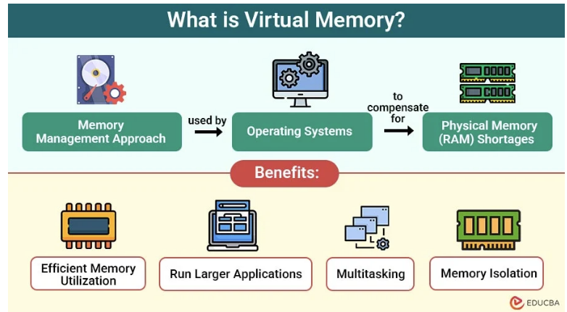
Preliminaries - Virtual Memory and Paging
Virtual Memory: Abstracting physical RAM into logical address spaces.
Isolates processes from each other to ensure system stability.
Presents a contiguous memory illusion to applications, simplifying software development.
Notes:
"Let's revisit Virtual Memory and Paging. As we know, virtual memory abstracts physical RAM into logical address spaces. It isolates processes to ensure system stability and presents an illusion of contiguous memory to the applications. This abstraction simplifies software development tremendously, freeing programmers from worrying about fragmented physical hardware

Slide 12
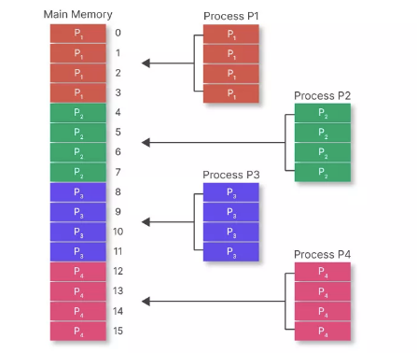
Preliminaries - Paging Mechanism
Paging Mechanism: The ultimate solution to external fragmentation.
Divides physical memory into fixed-size "frames" and logical memory into equal-sized "pages".
Utilizes a Page Table to dynamically map logical pages to scattered physical frames.
Notes:
"At the core of virtual memory is the Paging mechanism. It is the ultimate solution to external fragmentation. By dividing physical memory into fixed-size 'frames' and logical memory into equal-sized 'pages', the OS completely eliminates the need for contiguous physical allocation. It utilizes a Page Table to dynamically map continuous logical pages to scattered physical frames. , and it is also exactly what modern AI frameworks are replicating

Slide 13
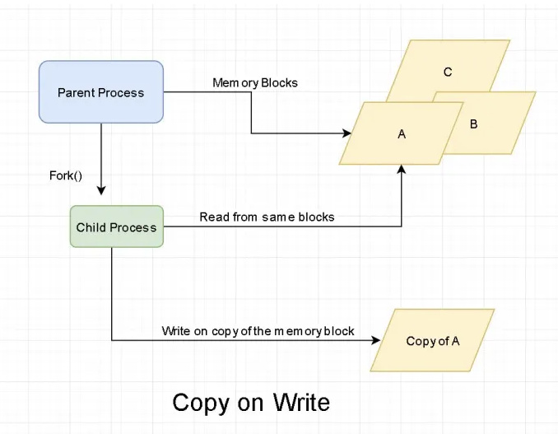
Preliminaries - Shared Memory and CoW
Efficient Resource Sharing: Minimizing redundancy across processes.
When an OS forks a new process, it does not immediately duplicate the physical memory.
On-Demand Allocation: The Copy-on-Write (CoW) trigger.
A new, separate physical page is allocated only when a process attempts to modify the shared data.
Notes:
"The second classic OS concept is Shared Memory and Copy-on-Write, or CoW. This is designed for efficient resource sharing to minimize memory redundancy across processes. When an OS executes a 'fork()' to create a new child process, it does not immediately duplicate the physical memory. Both parent and child point to the exact same physical blocks in a read-only state. A new, separate physical page is allocated only on-demand, when a process attempts to modify the shared data. This dramatically reduces the memory footprint for concurrent tasks

Slide 14
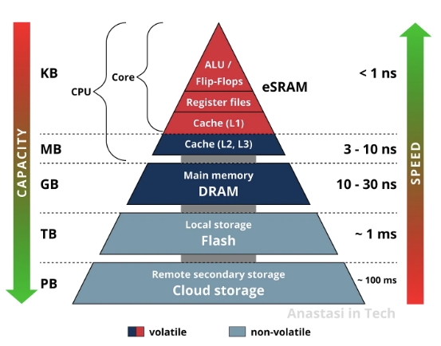
Preliminaries - Memory Hierarchy and Swapping
The Storage Hierarchy: Balancing speed and capacity.
Computer systems rely on a tiered architecture: CPU Registers -> Cache -> RAM -> Secondary Storage (Disk).
Swapping Mechanism: Overcoming the physical limits of primary memory.
When the CPU demands an offloaded page, a "Page Fault" triggers the OS to swap it back into RAM.
Notes:
"Our final preliminary concept is the Memory Hierarchy and Swapping. Computer systems rely on a tiered architecture to balance speed and capacity, moving from fast but tiny CPU Registers down to large but slow Secondary Storage, like NVMe disks. When the primary RAM is physically exhausted, the OS triggers a Swapping mechanism. It forcefully moves inactive memory pages to the disk. Later, when the CPU demands an offloaded page, a 'Page Fault' occurs, triggering the OS to swap it back into RAM. This allows the system to overcome strict physical capacity limits.

Slide 15
From OS Paging to PagedAttention: Memory Management in Large Multimodal Models
Introduction
Related Work
Preliminaries
Proposed Methods
Performance Evaluation
Conclusions
Notes:
Now that we have reviewed these three pillars of classic operating systems—Paging, Copy-on-Write, and Swapping—let's dive into Section 4: Proposed Methods. We will see how three state-of-the-art AI frameworks brilliantly implement these exact concepts to solve the memory wall

Slide 16
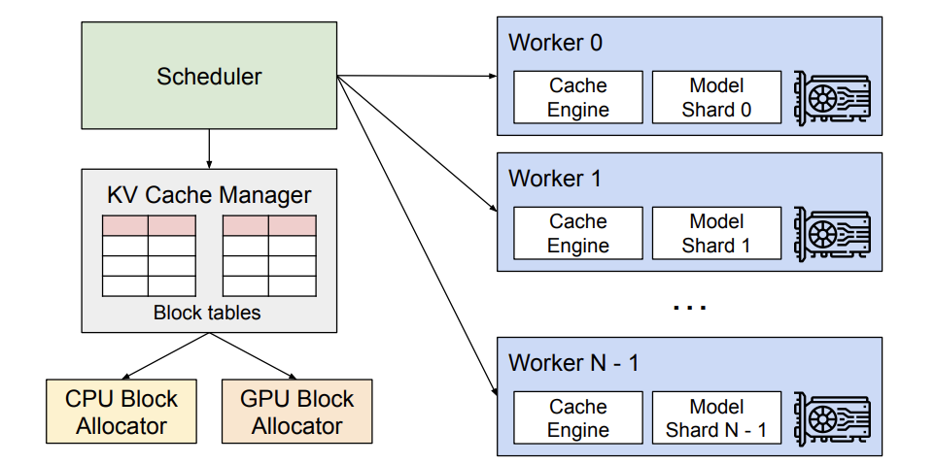
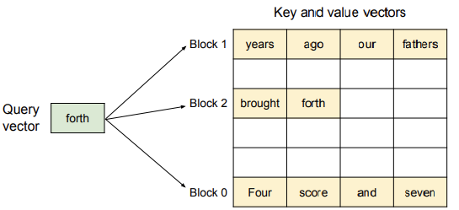
Proposed Methods - PagedAttention (vLLM)
Paper 1: vLLM (SOSP 2023) translates OS paging into AI memory management.
Introduces the "PagedAttention" algorithm for high-throughput inference serving.
Concept: Treat the dynamic KV cache exactly like OS memory pages.
Divides the continuous KV cache into fixed-size "blocks" , achieves logical continuity for the attention algorithm while allowing physical sparsity in GPU VRAM.
Notes:
Our first proposed method tackles memory fragmentation. Paper 1 is vLLM, published at SOSP 2023, which elegantly translates OS paging into AI memory management . It introduces the 'PagedAttention' algorithm for high-throughput inference serving. The core concept is wonderfully simple: treat the dynamic KV cache exactly like OS memory pages. As you can see in the diagram, instead of a contiguous chunk, vLLM divides the continuous KV cache into fixed-size 'blocks' . This architecture achieves logical continuity for the attention algorithm while allowing physical sparsity in the GPU VRAM .

Slide 17
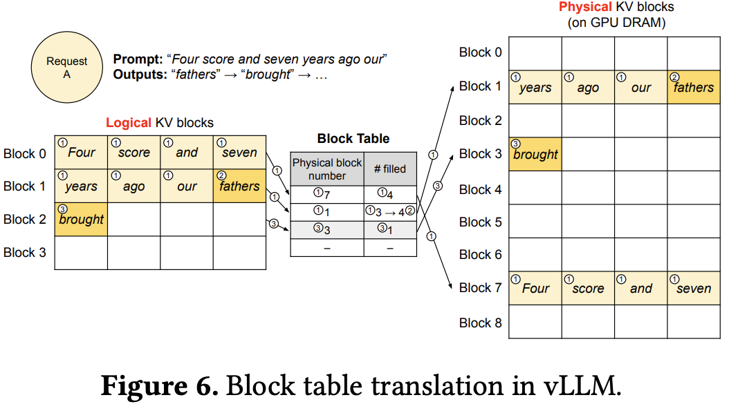
Proposed Methods - PagedAttention : The Block Table
The Block Table: Decoupling logical and physical memory.
Dynamically maps logical token blocks to physically scattered GPU addresses.
Dynamic Allocation: Eradicating internal fragmentation completely.
Physical memory blocks are allocated strictly on-demand during the token generation phase.
Notes:
"To make this physical scattering work, vLLM utilizes the Block Table, which is the exact equivalent of an OS Page Table. It decouples logical and physical memory by dynamically mapping logical token blocks to physically scattered GPU addresses . Furthermore, it enables dynamic allocation, which eradicates internal fragmentation completely . Physical memory blocks are allocated strictly on-demand during the token generation phase . We no longer over-provision memory for unknown output lengths

Slide 18
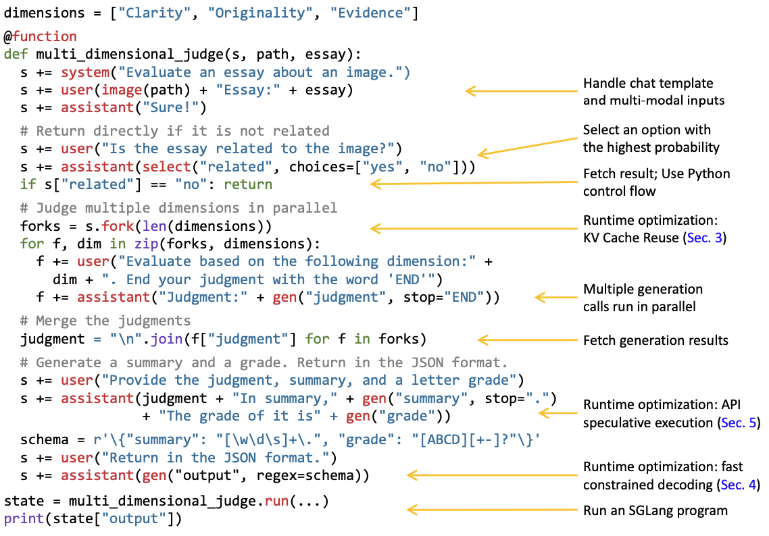
Proposed Methods - RadixAttention (SGLang)
Paper 2: SGLang (SOSP 2024) introduces global memory sharing.
Utilizes a Radix Tree structure for highly efficient prefix caching.
The Scenario: Multiple medical AI agents analyzing different patient cases.
Agents frequently utilize the exact same lengthy clinical guideline as a shared System Prompt. Allocating independent memory for this identical prompt severely limits concurrency.
Notes:
Paging solves single-request fragmentation, but what about multi-request redundancy? Paper 2, SGLang, introduces global memory sharing using a Radix Tree structure for highly efficient prefix caching . Consider this clinical scenario: Multiple medical AI agents are analyzing different patient cases simultaneously. These agents frequently utilize the exact same lengthy clinical guideline as a shared System Prompt . In traditional systems, allocating independent memory for this identical prompt severely limits our concurrency . We need a way to share this memory safely

Slide 19
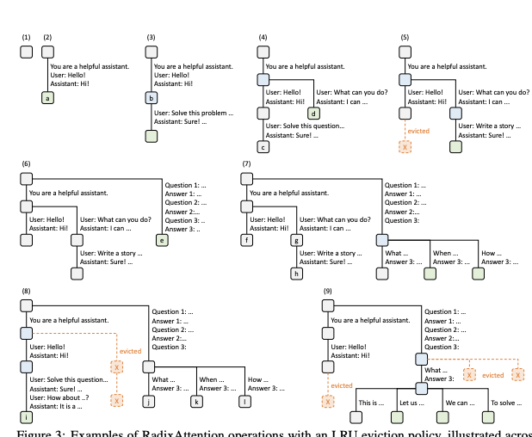
Proposed Methods - RadixAttention: OS Copy-on-Write
Mechanism: The exact AI equivalent of OS fork() and Copy-on-Write (CoW).
Multiple requests physically point to the exact same shared memory blocks initially.
On-Demand Divergence: Allocating memory only when necessary.
New GPU memory is allocated exclusively when the agents' generated responses begin to diverge.
Notes:
"SGLang solves this using RadixAttention. The mechanism is the exact AI equivalent of the OS fork() and Copy-on-Write, or CoW, operations . Initially, multiple requests physically point to the exact same shared memory blocks . The GPU does not duplicate the clinical guidelines. This brings us to on-demand divergence: allocating memory only when necessary. New GPU memory is allocated exclusively when the agents' generated responses begin to diverge and form unique text

Slide 20
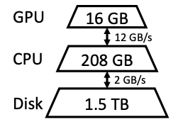
Proposed Methods - OS Swapping with FlexGen
Paper 3: FlexGen (ICML 2023) introduces Multi-tier Memory Offloading.
Functions as the AI equivalent of an OS Swapping mechanism to break physical limits.
Mechanism: Views GPU VRAM, CPU RAM, and NVMe Disk as a unified hierarchy.
Aggressively swaps inactive model weights and KV caches to the much larger hard disk.
Notes:
While Paging and CoW optimize available VRAM, a single GPU still has a strict physical limit, such as 16GB. This is where Paper 3, FlexGen, comes in. FlexGen introduces Multi-tier Memory Offloading, which functions as the AI equivalent of an OS Swapping mechanism to break physical limits . Its mechanism views the GPU VRAM, CPU RAM, and NVMe Disk as a unified hierarchy. It aggressively swaps inactive model weights and KV caches to the much larger hard disk. This allows us to run massive models on a single GPU.

Slide 21
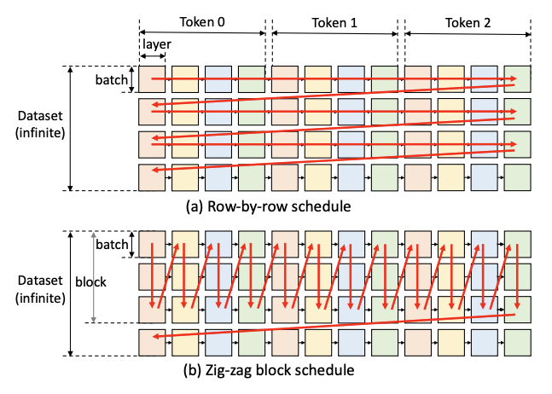
Proposed Methods - OS Swapping: Asynchronous DMA
The I/O Bottleneck: Disk access is orders of magnitude slower than VRAM.
Naively swapping tensors would stall the GPU computational units completely.
Asynchronous DMA: Hiding latency through clever scheduling.
Overlaps slow disk I/O with fast GPU computation using asynchronous Direct Memory Access.
Notes:
However, swapping introduces a severe OS problem: the I/O bottleneck. Disk access is orders of magnitude slower than VRAM . Naively swapping tensors would stall the GPU computational units completely. To overcome this latency, FlexGen utilizes Asynchronous DMA, hiding latency through clever scheduling. Looking at the zig-zag block schedule diagram at the bottom , the system overlaps slow disk I/O with fast GPU computation using asynchronous Direct Memory Access . This ensures the GPU remains highly active while waiting for data from the secondary storage

Slide 22
From OS Paging to PagedAttention: Memory Management in Large Multimodal Models
Introduction
Related Work
Preliminaries
Proposed Methods
Performance Evaluation
Conclusions
Notes:
"Now that we've seen the architectural designs, let's look at the actual performance evaluation to see how these OS-inspired methods perform in practice

Slide 23
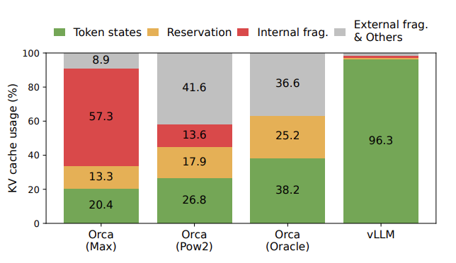
Performance Evaluation - PagedAttention(vLLM)
Throughput gains via PagedAttention (vLLM):
Demonstrates a 2x to 4x increase in throughput compared to traditional contiguous allocation frameworks.
The mechanism behind the performance leap:
By completely eliminating internal and external memory waste, the system frees up massive amounts of VRAM.
Notes:
First, let's evaluate throughput gains via PagedAttention in vLLM. As you can see from the bar chart on the right, vLLM pushes KV cache usage to 96.3%, effectively eliminating internal and external fragmentation . The mechanism behind this performance leap is that by completely eliminating memory waste, the system frees up massive amounts of VRAM. This allows the system to pack significantly larger batch sizes, demonstrating a 2x to 4x increase in throughput compared to traditional contiguous allocation frameworks like Orca

Slide 24
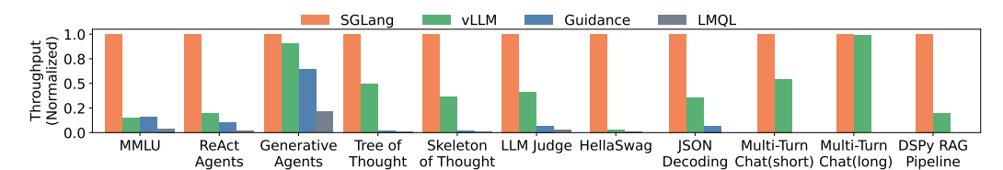
Performance Evaluation - CoW Minimizes Latency
Latency reduction via RadixAttention (SGLang):
Radically reduces the Time to First Token (TTFT) by up to 5x in multi-agent workflows.
Bypassing redundant computations for shared contexts:
When multiple agents share the same lengthy clinical guideline, the system physically reads from the cached Radix Tree.
Notes:
"Next, we evaluate latency reduction via RadixAttention in SGLang. Look at Figure below, which shows normalized throughput across various tasks. SGLang, represented by the orange bars, consistently outperforms others. In multi-agent workflows, it radically reduces the Time to First Token by up to 5x. It does this by bypassing redundant computations for shared contexts. When multiple agents share the same lengthy clinical guideline, the system physically reads from the cached Radix Tree, turning a heavy computation phase into a lightweight memory fetch

Slide 25
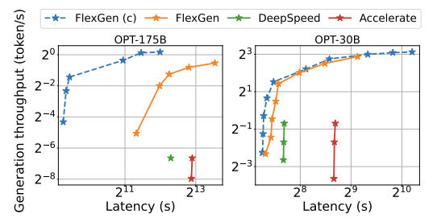
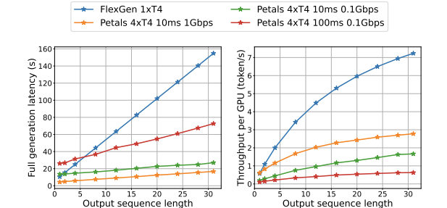
Performance Evaluation - FlexGen
Capacity extension via Multi-tier Offloading:
Successfully enables the execution of ultra-large 175B parameter models on a standard 16GB consumer GPU.
The inherent system trade-off: Capacity vs. Speed.
Disk I/O inherently introduces latency, making this approach unsuitable for real-time, interactive medical chatbots.
Notes:
Finally, evaluating capacity extension via Multi-tier Offloading in FlexGen. FlexGen successfully enables the execution of ultra-large 175-Billion parameter models on a standard 16GB consumer GPU. However, as OS experts know, there is an inherent system trade-off: Capacity versus Speed. Disk I/O inherently introduces latency, making this approach unsuitable for real-time, interactive medical chatbots. But it is the perfect solution for high-throughput, offline batch processing of massive datasets where single-GPU privacy is mandatory

Slide 26
From OS Paging to PagedAttention: Memory Management in Large Multimodal Models
Introduction
Related Work
Preliminaries
Proposed Methods
Performance Evaluation
Conclusions
Notes:
This brings me to the conclusions and future outlook of my presentation.

Slide 27
Conclusion - The OS Philosophy in the AI Era
Resolving Fragmentation via PagedAttention (vLLM):
Eliminates internal and external memory waste during unpredictable token generation.
Directly mirrors the classic OS Virtual Memory and Paging mechanisms.
Eliminating Redundancy via RadixAttention (SGLang):
Prevents duplicate memory allocation for shared clinical guidelines in multi-agent workflows.
Functions as the exact AI equivalent of the OS Copy-on-Write (CoW) mechanism.
Breaking Capacity Limits via Multi-tier Offloading (FlexGen):
Enables running massive medical models on a single GPU to ensure local data privacy.
Emulates OS Swapping by leveraging CPU RAM and NVMe disks with asynchronous DMA.
Notes:
To summarize the AI-OS architectural mapping: First, resolving fragmentation via PagedAttention in vLLM directly mirrors the classic OS Virtual Memory and Paging mechanisms . Second, eliminating redundancy via RadixAttention in SGLang functions as the exact AI equivalent of the OS Copy-on-Write mechanism . Third, breaking capacity limits via Multi-tier Offloading in FlexGen emulates OS Swapping by leveraging CPU RAM and NVMe disks

Slide 28
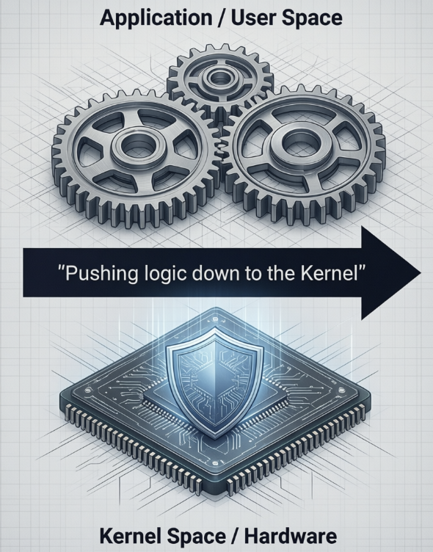
Conclusion - Future Trajectories of AI Systems
The current limitation of User-Space emulation:
Modern frameworks currently re-implement these OS features purely at the application level.
This introduces redundant software overhead and prevents deep, efficient hardware integrations.
The Next Frontier: Pushing logic down to the Kernel:
Future systems must integrate these scheduling logics directly into the Linux kernel or customized GPU drivers.
Emerging technologies like eBPF could allow AI to safely bypass traditional OS bottlenecks entirely.
Notes:
However, we must acknowledge a critical system limitation. Currently, modern frameworks re-implement these OS features purely at the application level, relying on User-Space emulation . This introduces redundant software overhead and prevents deep hardware integrations. The next frontier is pushing this logic down to the Kernel. Future systems must integrate these scheduling logics directly into the Linux kernel or customized GPU drivers. Emerging technologies like eBPF could allow AI to safely bypass traditional OS bottlenecks entirely, bridging the gap between AI algorithms and bare-metal hardware

Slide 29
Thank you for your attention! Any Questions?
Yuhao Shen
School of Data Science
Chinese University of Hong Kong, Shenzhen
Notes:
Good morning, Professor and classmates. My name is Yuhao Shen. My research background is primarily in AI for Health and medical Vision-Language Models. Today, I am going to present a cross-disciplinary topic: Reinventing OS Memory Management in the Era of Large Language Models.

