Slide 1
CSC3150 – Operating Systems
Prof. Yeh-Ching Chung
School of Data Science
Chinese University of Hong Kong, Shenzhen

Slide 2
Class Information
Instructor
Dr. Yeh-Ching Chung (ychung@cuhk.edu.hk)
Course TAs
汪梁森、马毓琦、贾钊
USTFs
TBA
Lectures
Tuesday 10:30 – 11:50 AB E205
Thursday 10:30 – 11:50 AB E205
Tutorials
Will be announced by TAs
Homepage
http://www.cs.nthu.edu.tw/~ychung/syllabus/CSC3150-2025-Fall.htm

Slide 3
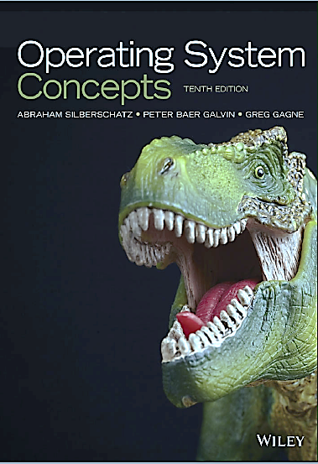
Textbook
(Textbook)
Operating System Concepts, 10th Edition (International Student Version), John Wiley & Sons, Inc., 2018.
A. Silberschatz, P. Galvin, and G. Gangne

Slide 4
Course Syllabus
Introduction to multi-threaded programming
Introduction to kernel programming
Introduction to the major components of an operating system
Process Management
Memory management
File management
I/O management

Slide 5
Course Topics
Introduction
Operating
Processes
Threaded and
Main Memory
Virtual Memory
File System Interface
File-System Implementation
Mass-Storage Structure
I/O
CPU Scheduling
Synchronization Tools
Dead Locks

Slide 6
Course Assessment
Class participation (5%)
Programming Projects (70%)
Final Exam (25%)
If you need to apply for a leave for roll call or final exam, send an email to me with supporting document beforehand
If you are sick, obtain a medical note and email it to me as soon as possible and no later than a week after your absence
Students are responsible to keep track on their marks

Slide 7
Learning Outcomes
Upon completing this course, students will be able to
Modify Kernel of OS
Write multi-thread programs
Do memory management on GPU
Do file management on GPU

Slide 8
Academic Honesty
Zero Tolerance
Plagiarism, cheating, misconduct in test/exam will be reported to the School for handing.
Consequences
Zero marks for the concerned assignments/test/exam/whole course, reviewable demerits, non-reviewable demerits, suspension of study, dismissal from University.
University Policy to Academic Honesty
https://registry.cuhk.edu.cn/en/page/30

