Slide 1


Multi-Asset Portfolio
(Equity Bond Commodity REIT ETFs and Cryptos)

Slide 2

Research Question
How does a multi-asset portfolio that uses Markowitz weights calculated based on data between November 2021-March 2024 perform in the period after March 2024 to November 2024 (out-of-sample analysis) ?
1/N Rebalancing
Maximum Sharpe Ratio
Minimum Variance
Risk Parity Portfolio

Slide 3


Data
Weekly data is retrieved from Yahoo Finance. It captures November 1, 2021 and February 26, 2024 period.
Checking model performance for the period between February 26, 2024 and November 1, 2024
Training Data: 80% of 36 months = 0.80 × 36 = 28.8 months → 28 months (121 weeks)
Test Data: 20% of 36 months = 0.20 × 36 = 7.2 months → 8 months (35 weeks)
80/20 split

Slide 4
Asset Elimination
Variance Inflation Factor
Returns
Standard Deviations
Market Capitalization

Slide 5



Portfolio Content
Ticker | Name | Country | Content | Type
EWJ | iShares MSCI Japan ETF | Japan | Japanese equities | Equity ETF
EZU | iShares MSCI EMU ETF | Eurozone Countries | Eurozone equities | Equity ETF
FXI | iShares China Large-Cap ETF | China | Chinese large-cap stocks | Equity ETF
XLC | Communication Services Select Sector SPDR Fund | United States | Communication services stocks | Equity ETF
XLK | Technology Select Sector SPDR Fund | United States | Technology stocks | Equity ETF
XLU | Utilities Select Sector SPDR Fund | United States | Utilities sector stocks | Equity ETF
XLV | Health Care Select Sector SPDR Fund | United States | Health care sector stocks | Equity ETF
EMB | iShares J.P. Morgan USD Emerging Markets Bond ETF | Global | Emerging market bonds | Bond ETF
DBA | Invesco DB Agriculture Fund | Global | Agriculture commodities | Commodity ETF
GLD | SPDR Gold Shares | Global | Gold | Commodity ETF
SCCO | Southern Copper Corporation | Peru-Mexico | Mining-Copper | Commodity Equity Stock
OIH | VanEck Vectors Oil Services ETF | United States | U.S. oil services sector stocks | Commodity ETF
BTC-USD | Bitcoin (BTC) | Global | Cryptocurrencies | Crypto
ETH-USD | Ethereum (ETH) | Global | Cryptocurrencies | Crypto
PSA | Public Storage | United States | Storage REIT | REIT ETF

Slide 6

3 Types of Investors
Aggressive, Balanced and Conservative Investors (Volatility of the Portfolio)
Rebalancing (1/N)
Maximum Sharpe Ratio
Minimum Variance
Risk Parity Portfolio Models

Slide 7
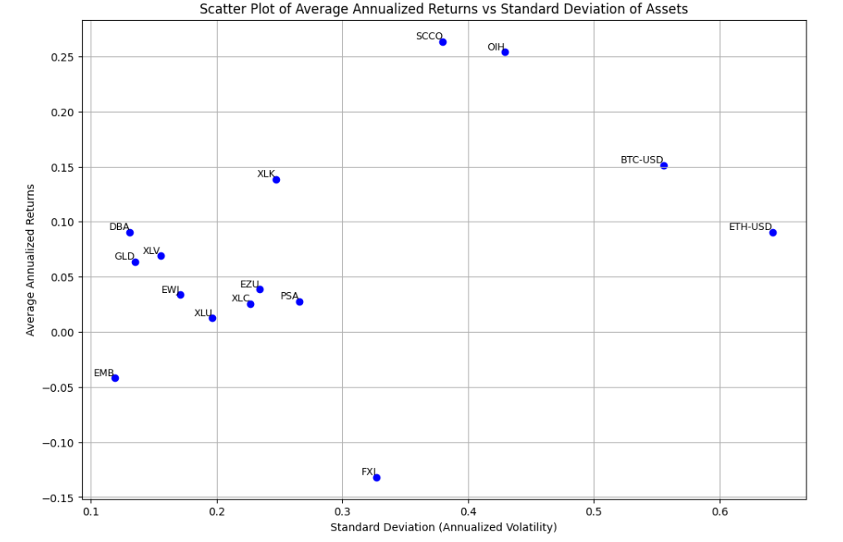
Annualized Returns vs Standard Deviation

Slide 8
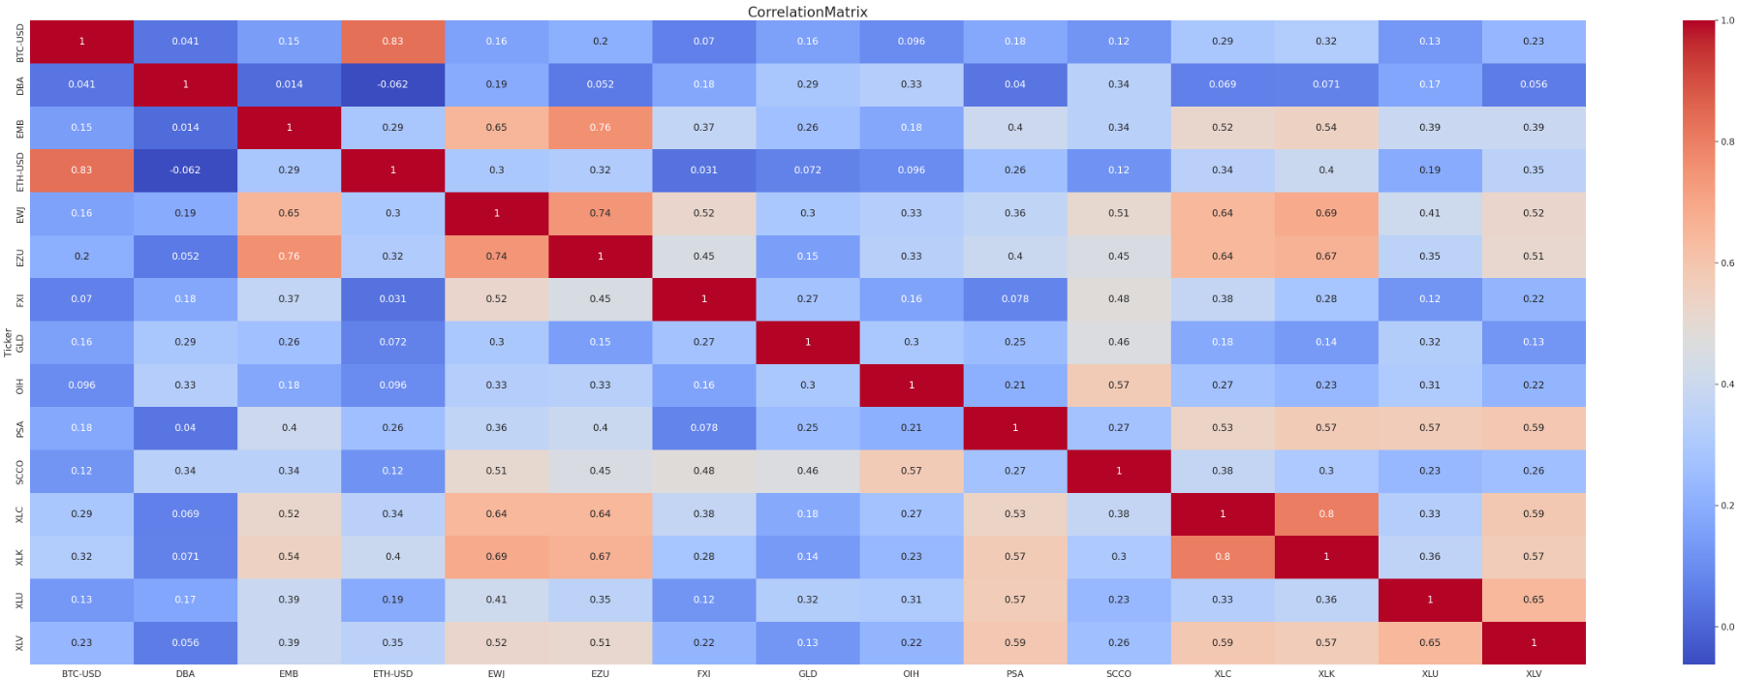
Correlation Matrix

Slide 9
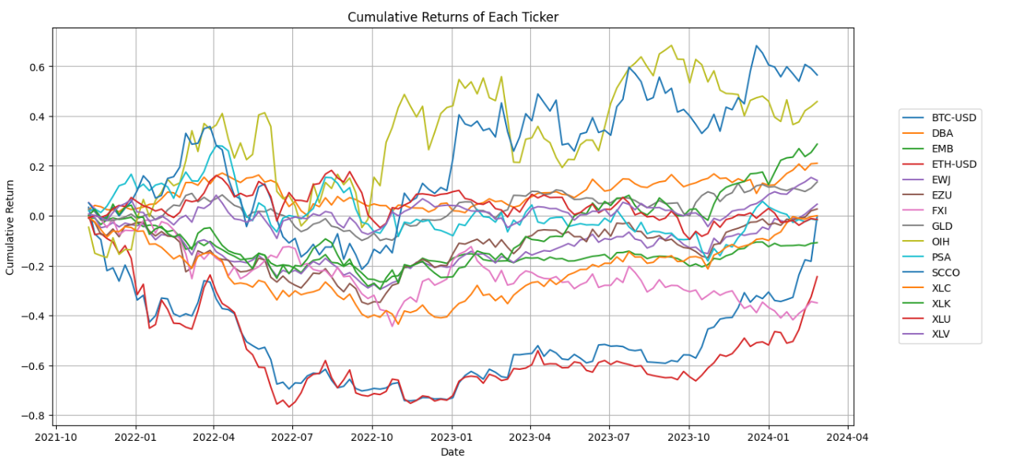
Train Data

Slide 10
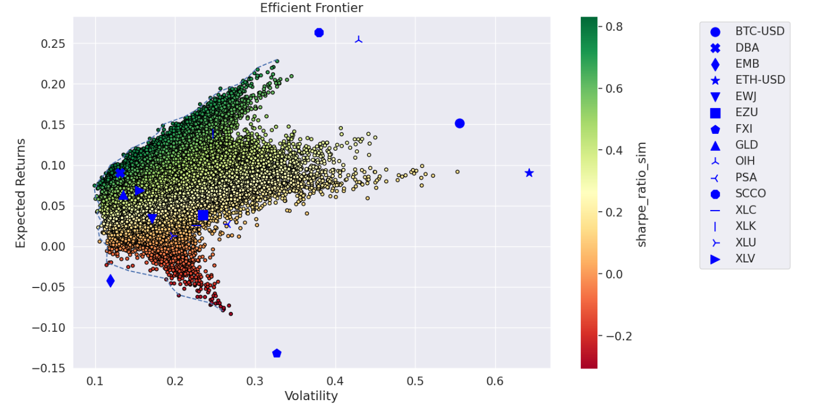
Efficient Frontier with Monte Carlo Simulation

Slide 11
Weight Distribution
Tickers | Equal Weights | Minimum Variance | Risk Parity Portfolio | Maximum Sharpe Ratio | Volatility %5 With Equal Weights | Volatility %10 With Equal Weights | Volatility %15 With Equal Weights | Volatility %5 With Minimum Variance Weights | Volatility %10 With Minimum Variance Weights | Volatility %15 With Minimum Variance Weights | Volatility %5 With Risk Parity Portfolio Weights | Volatility %10 With Risk Parity Portfolio Weights | Volatility %15 With Risk Parity Portfolio Weights | Volatility %5 With Maximum Sharpe Weights | Volatility %10 With Maximum Sharpe Weights | Volatility %15 With Maximum Sharpe Weights
BTC-USD | 0,0667 | - | 0,0322 | 0,0160 | 0,0197 | 0,0394 | 0,0591 | - | - | - | 0,0127 | 0,0255 | 0,0382 | 0,0063 | 0,0127 | 0,0190
DBA | 0,0667 | 0,3385 | 0,1712 | 0,5000 | 0,0197 | 0,0394 | 0,0591 | 0,2047 | 0,4094 | 0,6141 | 0,0676 | 0,1352 | 0,2028 | 0,1978 | 0,3956 | 0,5935
EMB | 0,0667 | 0,3184 | 0,1086 | - | 0,0197 | 0,0394 | 0,0591 | 0,1926 | 0,3851 | 0,5777 | 0,0429 | 0,0858 | 0,1287 | - | - | -
ETH-USD | 0,0667 | - | 0,0258 | - | 0,0197 | 0,0394 | 0,0591 | - | - | - | 0,0102 | 0,0203 | 0,0305 | - | - | -
EWJ | 0,0667 | - | 0,0639 | - | 0,0197 | 0,0394 | 0,0591 | - | - | - | 0,0252 | 0,0505 | 0,0757 | - | - | -
EZU | 0,0667 | - | 0,0493 | - | 0,0197 | 0,0394 | 0,0591 | - | - | - | 0,0194 | 0,0389 | 0,0583 | - | - | -
FXI | 0,0667 | - | 0,0507 | - | 0,0197 | 0,0394 | 0,0591 | - | - | - | 0,0200 | 0,0400 | 0,0601 | - | - | -
GLD | 0,0667 | 0,1870 | 0,1236 | 0,0851 | 0,0197 | 0,0394 | 0,0591 | 0,1131 | 0,2262 | 0,3393 | 0,0488 | 0,0976 | 0,1463 | 0,0337 | 0,0673 | 0,1010
OIH | 0,0667 | - | 0,0371 | 0,0449 | 0,0197 | 0,0394 | 0,0591 | - | - | - | 0,0147 | 0,0293 | 0,0440 | 0,0177 | 0,0355 | 0,0532
PSA | 0,0667 | - | 0,0524 | - | 0,0197 | 0,0394 | 0,0591 | - | - | - | 0,0207 | 0,0414 | 0,0621 | - | - | -
SCCO | 0,0667 | - | 0,0340 | 0,0978 | 0,0197 | 0,0394 | 0,0591 | - | - | - | 0,0134 | 0,0268 | 0,0402 | 0,0387 | 0,0774 | 0,1160
XLC | 0,0667 | - | 0,0509 | - | 0,0197 | 0,0394 | 0,0591 | - | - | - | 0,0201 | 0,0402 | 0,0603 | - | - | -
XLK | 0,0667 | - | 0,0470 | 0,1716 | 0,0197 | 0,0394 | 0,0591 | - | - | - | 0,0186 | 0,0371 | 0,0557 | 0,0679 | 0,1358 | 0,2037
XLU | 0,0667 | - | 0,0713 | - | 0,0197 | 0,0394 | 0,0591 | - | - | - | 0,0282 | 0,0563 | 0,0845 | - | - | -
XLV | 0,0667 | 0,1560 | 0,0820 | 0,0846 | 0,0197 | 0,0394 | 0,0591 | 0,0944 | 0,1887 | 0,2831 | 0,0324 | 0,0647 | 0,0971 | 0,0335 | 0,0669 | 0,1004

Slide 12
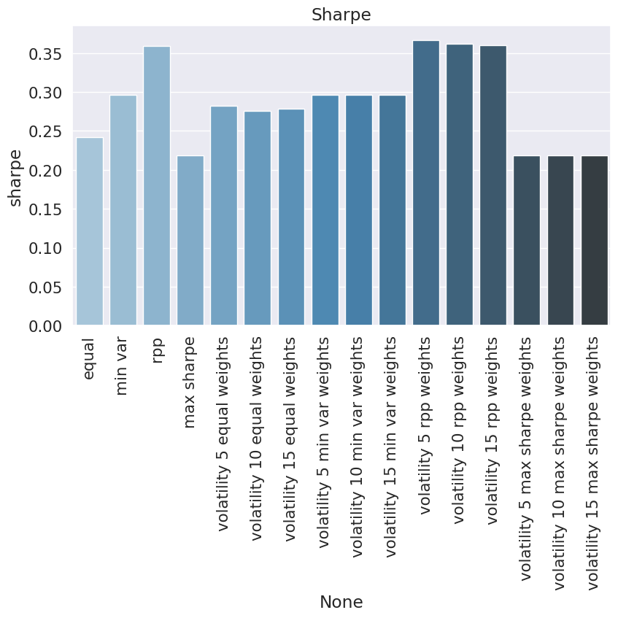
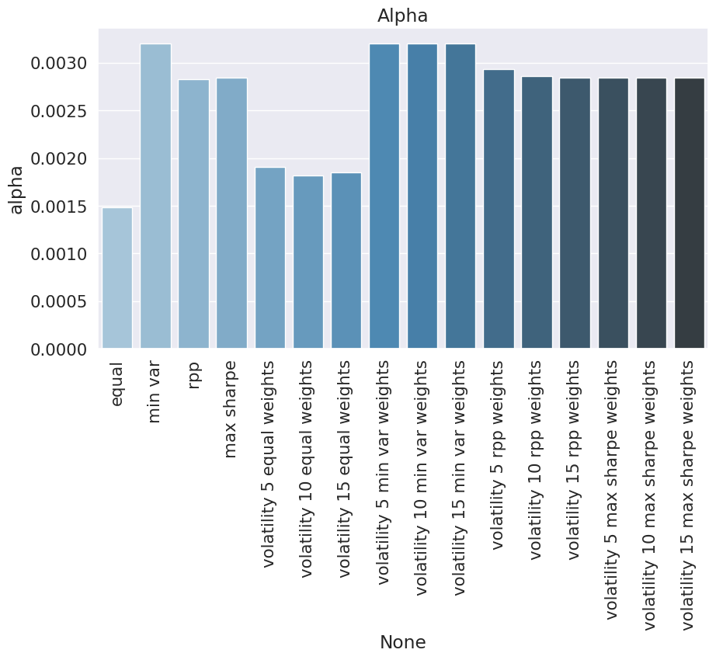
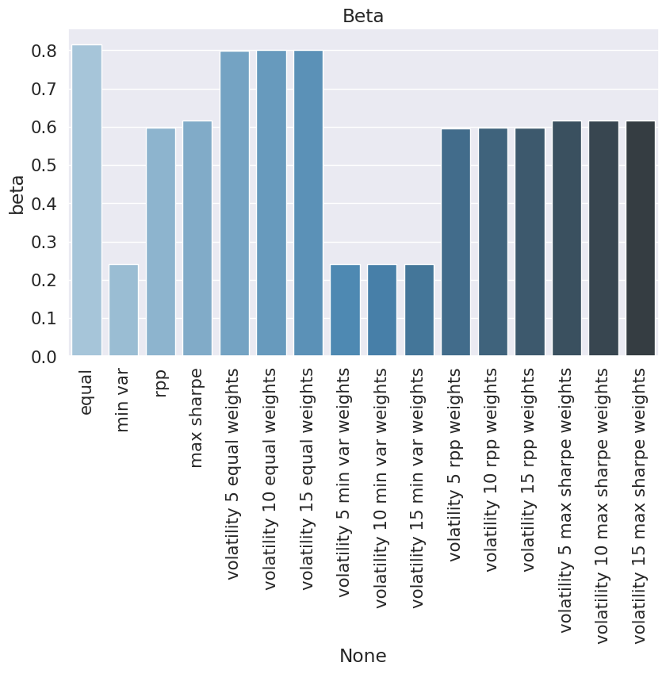

Out of Sample Performance

Slide 13
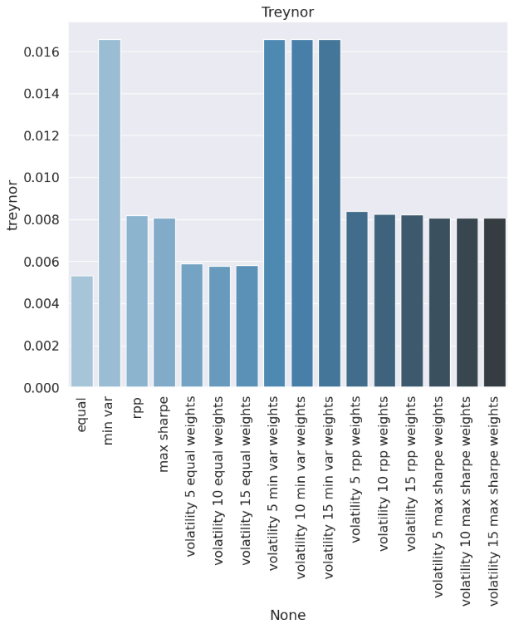
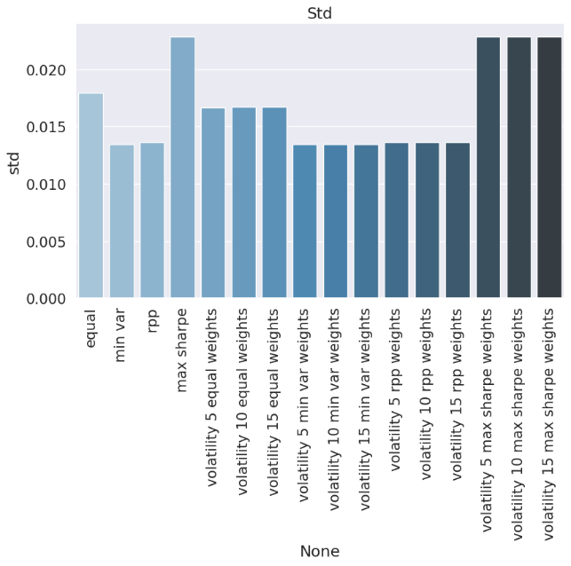
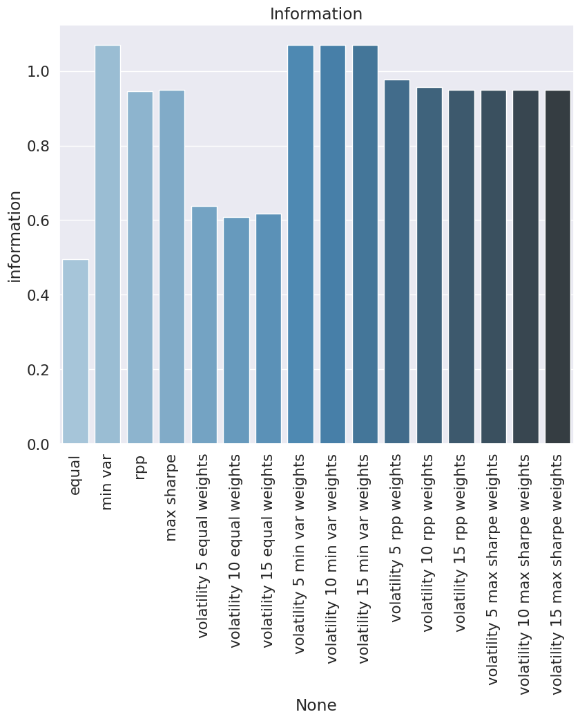
Out of Sample Performance

Slide 14
Portfolio Allocation
Initial investment: 1.000.000 $
Weights * Investment/Prices in test period

Slide 15
Weekly Portfolio Development
Date | Equal Weights | Minimum Variance | Risk Parity Portfolio | Maximum Sharpe Ratio | Volatility %5 With Equal Weights | Volatility %10 With Equal Weights | Volatility %15 With Equal Weights | Volatility %5 With Minimum Variance Weights | Volatility %10 With Minimum Variance Weights | Volatility %15 With Minimum Variance Weights | Volatility %5 With Risk Parity Portfolio Weights | Volatility %10 With Risk Parity Portfolio Weights | Volatility %15 With Risk Parity Portfolio Weights | Volatility %5 With Maximum Sharpe Weights | Volatility %10 With Maximum Sharpe Weights | Volatility %15 With Maximum Sharpe Weights
26.02.2024 | 995.304 | 999.828 | 965.739 | 983.616 | 272.948 | 550.043 | 823.824 | 604.613 | 1.209.227 | 1.813.946 | 377.958 | 760.435 | 1.142.935 | 388.867 | 778.005 | 1.167.459
4.03.2024 | 1.022.411 | 1.016.119 | 983.909 | 997.382 | 278.985 | 562.515 | 842.348 | 614.465 | 1.228.929 | 1.843.501 | 384.820 | 774.566 | 1.164.336 | 394.304 | 788.894 | 1.183.792
11.03.2024 | 1.031.156 | 1.027.552 | 993.013 | 1.042.944 | 281.899 | 568.114 | 850.855 | 621.378 | 1.242.756 | 1.864.242 | 388.609 | 781.886 | 1.175.186 | 412.317 | 824.934 | 1.237.872
18.03.2024 | 1.038.928 | 1.041.081 | 1.004.947 | 1.060.677 | 284.644 | 573.429 | 858.932 | 629.559 | 1.259.119 | 1.888.787 | 393.456 | 791.405 | 1.189.378 | 419.328 | 838.958 | 1.258.922
25.03.2024 | 1.060.549 | 1.059.229 | 1.023.190 | 1.082.234 | 289.698 | 583.738 | 874.312 | 640.534 | 1.281.069 | 1.921.713 | 400.496 | 805.699 | 1.210.924 | 427.851 | 856.011 | 1.284.502
1.04.2024 | 1.058.807 | 1.066.893 | 1.027.059 | 1.095.978 | 289.879 | 583.913 | 874.668 | 645.169 | 1.290.337 | 1.935.615 | 402.174 | 808.857 | 1.215.561 | 433.278 | 866.879 | 1.300.813
8.04.2024 | 1.040.565 | 1.065.917 | 1.018.340 | 1.105.073 | 285.760 | 575.356 | 861.961 | 644.578 | 1.289.156 | 1.933.843 | 398.969 | 802.133 | 1.205.320 | 436.879 | 874.088 | 1.311.611
15.04.2024 | 1.030.785 | 1.084.878 | 1.019.668 | 1.117.025 | 283.127 | 570.068 | 854.015 | 656.045 | 1.312.089 | 1.968.243 | 399.513 | 803.191 | 1.206.889 | 441.610 | 883.553 | 1.325.783
22.04.2024 | 1.042.866 | 1.074.845 | 1.024.806 | 1.115.588 | 287.161 | 578.258 | 866.241 | 649.978 | 1.299.955 | 1.950.042 | 401.452 | 807.190 | 1.212.947 | 441.041 | 882.412 | 1.324.086
29.04.2024 | 1.042.640 | 1.044.187 | 1.015.051 | 1.066.562 | 286.907 | 577.618 | 865.347 | 631.438 | 1.262.876 | 1.894.422 | 397.692 | 799.552 | 1.201.430 | 421.651 | 843.628 | 1.265.901
6.05.2024 | 1.055.995 | 1.065.016 | 1.035.300 | 1.093.851 | 291.739 | 587.085 | 879.665 | 644.034 | 1.288.067 | 1.932.210 | 405.827 | 815.641 | 1.225.471 | 432.440 | 865.215 | 1.298.289
13.05.2024 | 1.083.271 | 1.057.464 | 1.046.638 | 1.085.152 | 298.277 | 600.316 | 899.458 | 639.467 | 1.278.934 | 1.918.510 | 410.175 | 824.508 | 1.238.857 | 428.989 | 858.325 | 1.287.969
20.05.2024 | 1.081.359 | 1.064.221 | 1.042.314 | 1.098.654 | 296.598 | 597.696 | 895.129 | 643.553 | 1.287.106 | 1.930.769 | 407.910 | 820.710 | 1.233.526 | 434.344 | 869.018 | 1.303.999
27.05.2024 | 1.080.852 | 1.070.265 | 1.045.134 | 1.106.472 | 296.697 | 597.856 | 895.393 | 647.208 | 1.294.416 | 1.941.734 | 409.059 | 822.960 | 1.236.876 | 437.435 | 875.201 | 1.313.275
3.06.2024 | 1.068.107 | 1.071.182 | 1.036.506 | 1.101.542 | 292.431 | 589.228 | 882.482 | 647.763 | 1.295.525 | 1.943.398 | 405.708 | 816.187 | 1.226.682 | 435.497 | 871.313 | 1.307.426
10.06.2024 | 1.061.402 | 1.082.505 | 1.038.305 | 1.114.232 | 291.395 | 587.064 | 879.280 | 654.609 | 1.309.219 | 1.963.939 | 406.471 | 817.647 | 1.228.842 | 440.519 | 881.358 | 1.322.497
17.06.2024 | 1.061.087 | 1.067.392 | 1.035.249 | 1.096.873 | 292.438 | 588.959 | 882.241 | 645.470 | 1.290.941 | 1.936.522 | 405.409 | 815.334 | 1.225.277 | 433.647 | 867.615 | 1.301.895
24.06.2024 | 1.057.142 | 1.051.139 | 1.027.322 | 1.076.711 | 291.402 | 586.911 | 879.165 | 635.642 | 1.271.285 | 1.907.036 | 402.274 | 809.070 | 1.215.886 | 425.668 | 851.656 | 1.277.963
1.07.2024 | 1.061.112 | 1.065.546 | 1.043.037 | 1.103.386 | 294.912 | 593.423 | 889.186 | 644.354 | 1.288.708 | 1.933.172 | 408.850 | 821.738 | 1.234.645 | 436.215 | 872.765 | 1.309.630
8.07.2024 | 1.086.089 | 1.079.096 | 1.060.633 | 1.110.857 | 300.629 | 605.188 | 906.693 | 652.548 | 1.305.097 | 1.957.756 | 415.543 | 835.460 | 1.255.395 | 439.168 | 878.671 | 1.318.495
15.07.2024 | 1.074.537 | 1.062.368 | 1.040.131 | 1.071.283 | 294.844 | 593.919 | 889.646 | 642.433 | 1.284.866 | 1.927.408 | 407.238 | 819.122 | 1.231.024 | 423.514 | 847.352 | 1.271.510
22.07.2024 | 1.069.966 | 1.069.350 | 1.040.046 | 1.076.249 | 293.621 | 591.214 | 885.724 | 646.655 | 1.293.310 | 1.940.076 | 407.409 | 819.195 | 1.230.999 | 425.477 | 851.277 | 1.277.400
29.07.2024 | 1.034.811 | 1.068.705 | 1.027.651 | 1.044.491 | 286.608 | 576.578 | 864.054 | 646.265 | 1.292.530 | 1.938.905 | 402.953 | 809.706 | 1.216.473 | 412.922 | 826.167 | 1.239.692
5.08.2024 | 1.036.219 | 1.081.703 | 1.034.200 | 1.063.966 | 286.937 | 577.093 | 864.893 | 654.125 | 1.308.250 | 1.962.487 | 405.636 | 814.943 | 1.224.265 | 420.631 | 841.584 | 1.262.808
12.08.2024 | 1.062.385 | 1.090.691 | 1.055.487 | 1.080.811 | 294.697 | 592.687 | 888.263 | 659.560 | 1.319.121 | 1.978.793 | 413.977 | 831.716 | 1.249.472 | 427.286 | 854.907 | 1.282.812
19.08.2024 | 1.088.920 | 1.109.803 | 1.076.629 | 1.104.107 | 300.722 | 604.880 | 906.509 | 671.118 | 1.342.236 | 2.013.468 | 422.198 | 848.325 | 1.274.468 | 436.502 | 873.339 | 1.310.463
26.08.2024 | 1.073.750 | 1.112.474 | 1.074.887 | 1.102.204 | 298.509 | 600.131 | 899.548 | 672.733 | 1.345.467 | 2.018.314 | 421.754 | 847.117 | 1.272.496 | 435.752 | 871.835 | 1.308.200
2.09.2024 | 1.036.042 | 1.097.615 | 1.046.580 | 1.058.882 | 288.200 | 579.351 | 868.428 | 663.748 | 1.327.495 | 1.991.356 | 410.691 | 824.835 | 1.238.994 | 418.626 | 837.576 | 1.256.767
9.09.2024 | 1.070.076 | 1.128.132 | 1.078.954 | 1.104.201 | 296.962 | 596.903 | 894.758 | 682.202 | 1.364.403 | 2.046.721 | 423.424 | 850.373 | 1.277.336 | 436.550 | 873.435 | 1.310.568
16.09.2024 | 1.100.904 | 1.136.616 | 1.098.876 | 1.121.936 | 304.576 | 612.415 | 917.910 | 687.332 | 1.374.663 | 2.062.111 | 431.080 | 865.961 | 1.300.855 | 443.555 | 887.454 | 1.331.618
23.09.2024 | 1.135.695 | 1.153.013 | 1.126.762 | 1.166.052 | 314.241 | 631.810 | 946.956 | 697.247 | 1.394.494 | 2.091.859 | 442.028 | 887.936 | 1.333.856 | 461.001 | 922.365 | 1.383.985
30.09.2024 | 1.135.889 | 1.131.056 | 1.123.551 | 1.141.580 | 315.251 | 633.631 | 949.793 | 683.970 | 1.367.940 | 2.052.025 | 440.939 | 885.527 | 1.330.125 | 451.314 | 902.989 | 1.354.941
7.10.2024 | 1.129.238 | 1.142.371 | 1.121.253 | 1.159.444 | 313.261 | 629.675 | 943.841 | 690.812 | 1.381.624 | 2.072.552 | 440.008 | 883.698 | 1.327.399 | 458.382 | 917.126 | 1.376.146
14.10.2024 | 1.132.772 | 1.139.712 | 1.118.940 | 1.140.563 | 312.331 | 628.075 | 941.294 | 689.205 | 1.378.409 | 2.067.729 | 438.875 | 881.721 | 1.324.577 | 450.919 | 902.200 | 1.353.735
21.10.2024 | 1.115.166 | 1.124.207 | 1.102.580 | 1.128.657 | 307.599 | 618.360 | 926.828 | 679.828 | 1.359.656 | 2.039.598 | 432.610 | 868.934 | 1.305.269 | 446.207 | 892.782 | 1.339.607
28.10.2024 | 1.104.582 | 1.125.616 | 1.095.490 | 1.125.850 | 304.016 | 611.190 | 916.055 | 680.680 | 1.361.361 | 2.042.154 | 429.820 | 863.339 | 1.296.869 | 445.103 | 890.567 | 1.336.268

Slide 16
Thank you for listening !
Yasemin Çıkıkçı (S009590)

Slide 17
Links of Images
https://www.futurelearn.com/courses/corporate-finance-a-beginners-guide
https://stock.adobe.com/search?k=grafico
https://www.emojipng.com/preview/14294558
https://www.freeworldmaps.net/download/map.html
https://www.freepik.com/free-photos-vectors/bitcoin-symbol
https://www.pixtastock.com/illustration/87560641
https://favpng.com/png_view/emoji-clipboard-emoji-png/UZvdb4yb
https://wealthface.com/blog/whats-your-investment-style/
https://www.slideshare.net/thelma_villaflores/how-to-write-a-research-question

