Slide 1


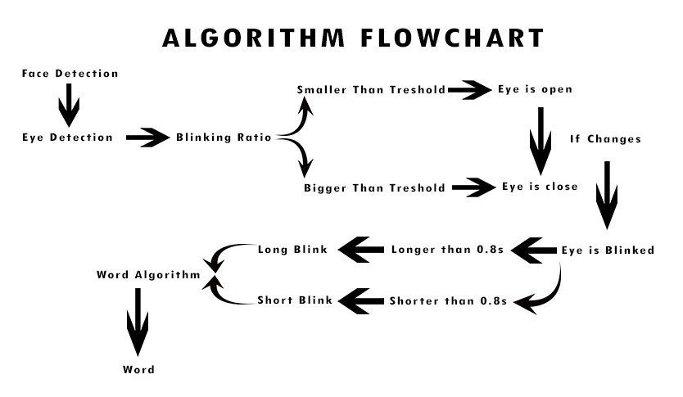
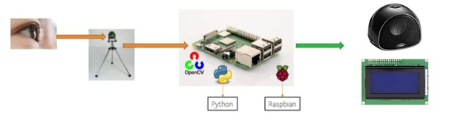
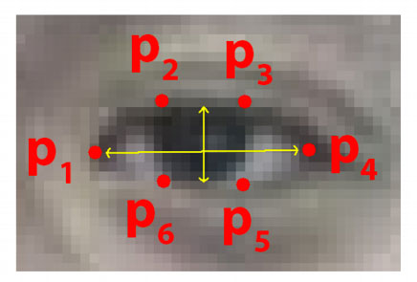
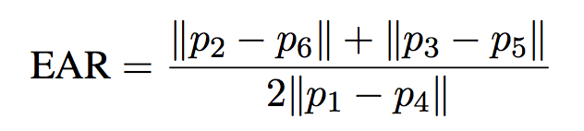
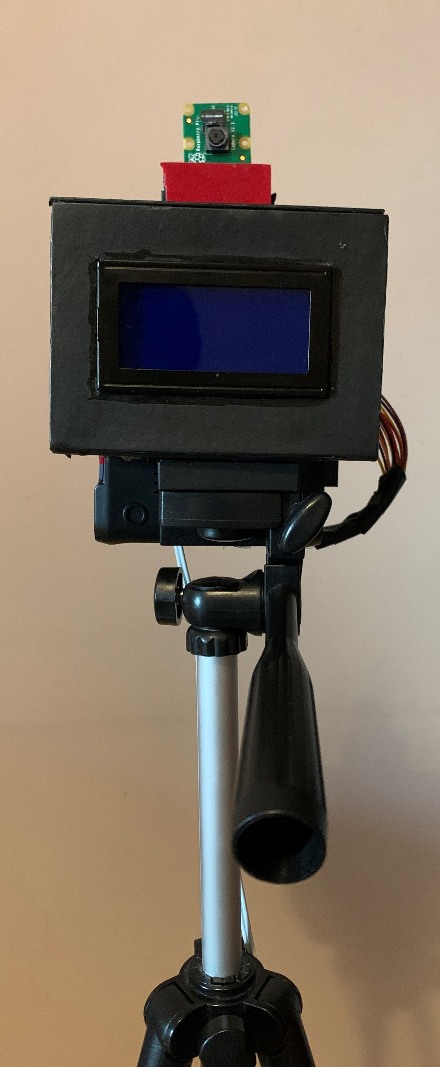
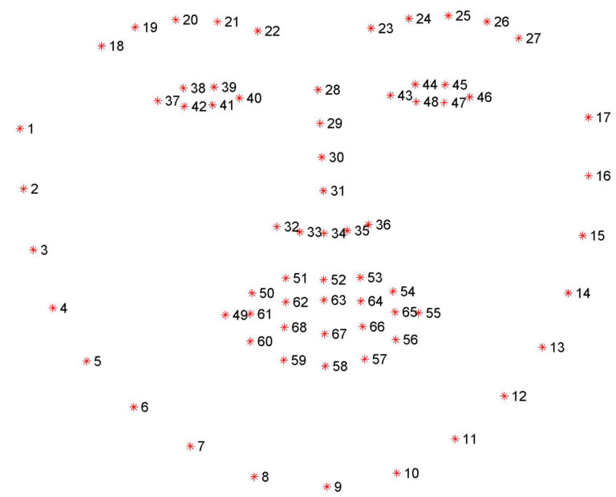
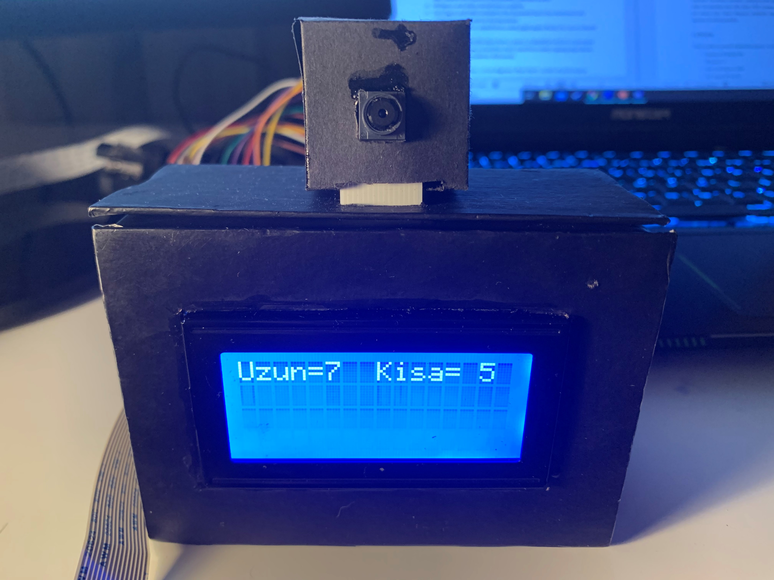
COMMUNICATON WITH EYE BLINKINGS FOR ALS PATIENTS
Yılmaz Çınar , Mesut Demircioğlu
TOBB ETU ELECTRICAL AND ELECTRONICAL ENGINEERING
ABSTRACT
The aim of this project is providing communication opportunity to ALS patients by blinking their eyes. Two types of inputs are used. They are short and long eye blinkings. The variety of inputs could be increased but we prefer to stay simple. Because this project had to be easy to use.
The input combinations ,which we get from PiCamera, are processed with libraries (e.g dlib, opencv, imutils) to get a blinking ratio. Later, blinking ratio variable is used get outputs with algorithms.
As output devices, an LCD screen and a speaker are used. We prefer to provide two types of output to ease usage.
Figure 2 : The alghorithm of software
WORDS | SHORT EYE BLINKS | LONG EYE BLINKS
Evet. | 1 | 0
Hayır. | 0 | 1
Acıktım. | 1 | 1
Susadım. | 2 | 0
Ağrım var. | 0 | 2
Üşüdüm. | 2 | 1
İyiyim. | 1 | 2
Yoruldum. | 3 | 0
Tuvalete gitmem lazım. | 3 | 1
Bay bay. | 4 | 0
Figure 1 : The visualization of the system.
Figure 3 : The combinations of words
METHODS AND TECHNICAL PROPERTIES
The main principle is the project can be found at Figure 1. In this paragraph, the methods and technical properties can be found in a more detailed way. Firstly, the libraries have to be mentioned. The main libraries are dlib, gpio, CV2, imutils,and pygame.
Dlib library is used to get frontal face edges and after that the face is divided to 68 parts. For this process the dataset which name is shape_predictor_68_face_landmarks.dat is used. Some partsof them represents the eye edges. The visualization of these 68 parts can be found at Figure2.
The six part of the set represent locations of eye edges. Blinking ratio is calculated with those six location for each eyes.
Figure 6 : Location of detected eye edges
.
CONCLUSION
After calculating eye blinking ratio, this value is controlled in an if statement for each frame. If it’s higher than threshold, it means eye is closed. With this alghrorithm the eyeblinkings are calculated for ten seconds. After that the output word can be chosen with the amount of short and long eye blinkings.
Figure 7 : The device while counting eye blinkings
Figure 4 : The full set of facial landmarks.
Figure 5 : The final version of device
REFERENCES
(1)https://www.als.org.tr/yardimci-teknoloji-1
(2)Brownlee A, Palovcak M, The Role of Augmentative Communication Devices in the Medical Management of ALS. Journal of NeuroRehabilitation, Volume 22, Number 2, 2007, 445-447.
(3)Tereza Soukupova and Jan Cech , Real-Time Eye Blink Detection using Facial Landmarks, 21st Computer Vision Winter Workshop, Rimske Toplice, Slovenia, February 3–5, 2016
(4) https://www.pyimagesearch.com/2017/04/24/eye-blink-detection-opencv-python-dlib/

