Slide 1
Anaconda
Yao-Huei Huang
2023/9/22

Slide 2
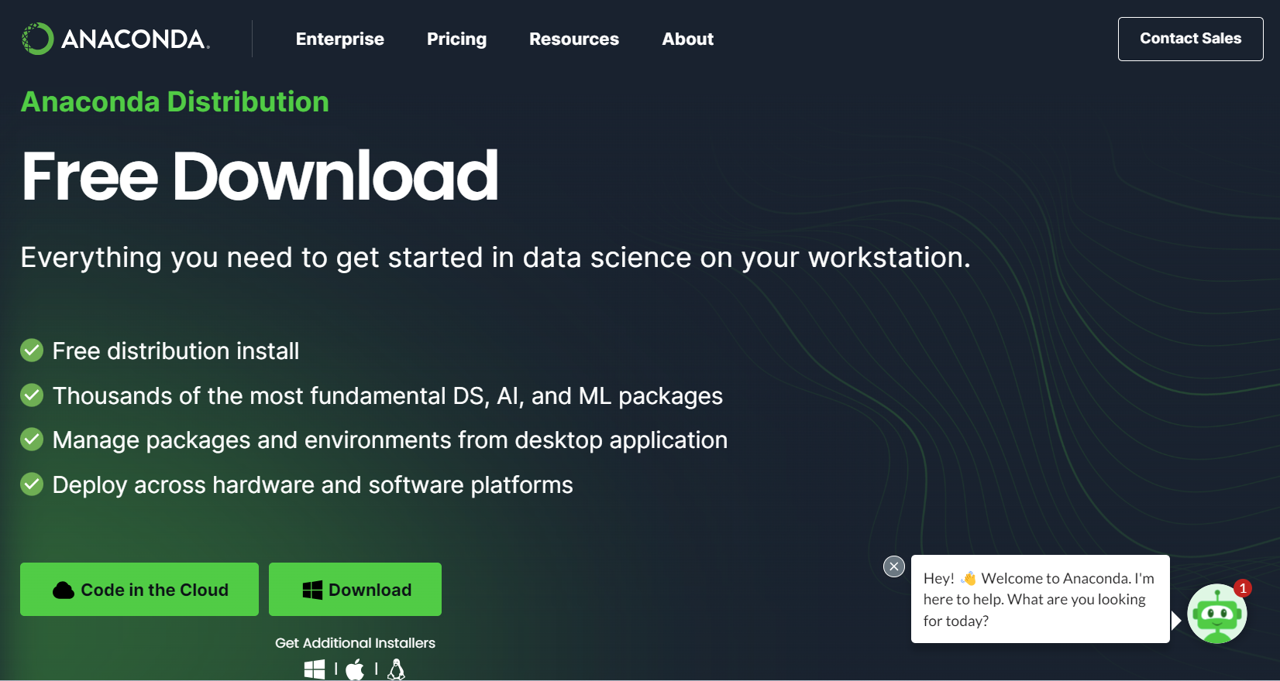
Step 1:
https://www.anaconda.com/download

Slide 3
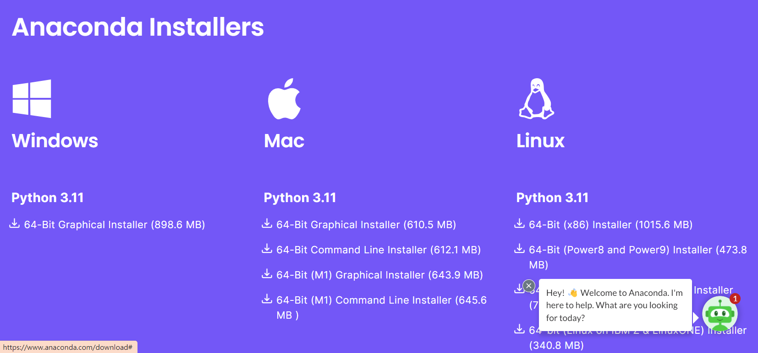
Step 1:
https://www.anaconda.com/download#downloads

Slide 4
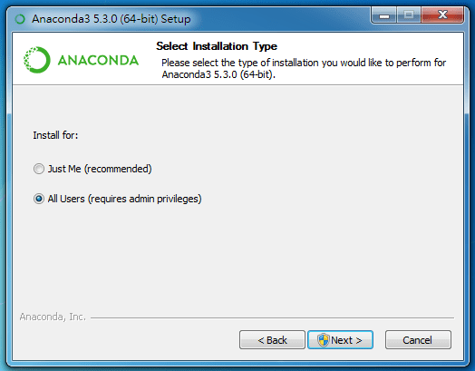
STEP 2
Select your installation type

Slide 5
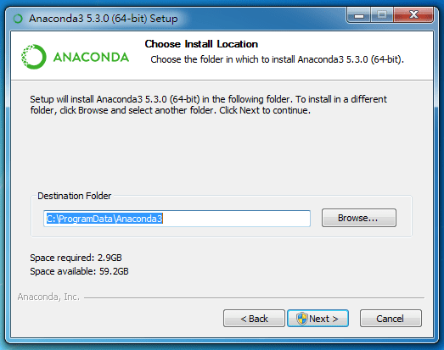
Step 3:
Choose your install location

Slide 6
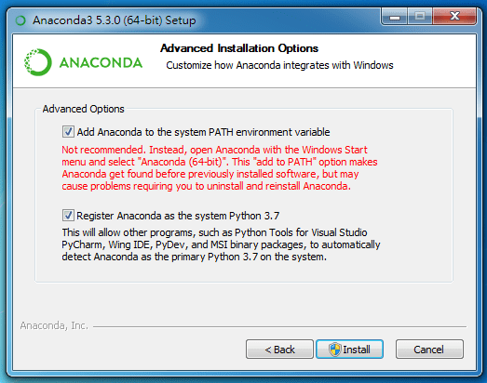
STEP 4:
Add Anaconda to your system PATH environment variable

Slide 7
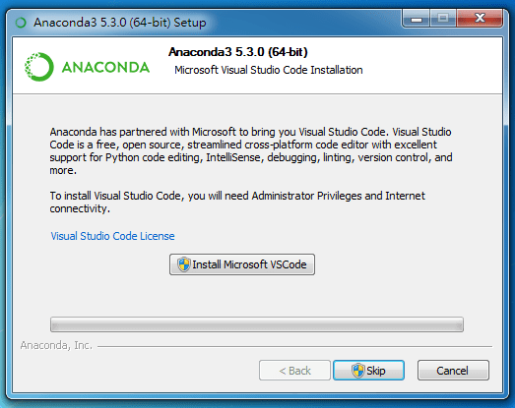
Step 5:
Install Microsoft VSCode (or not)

Slide 8
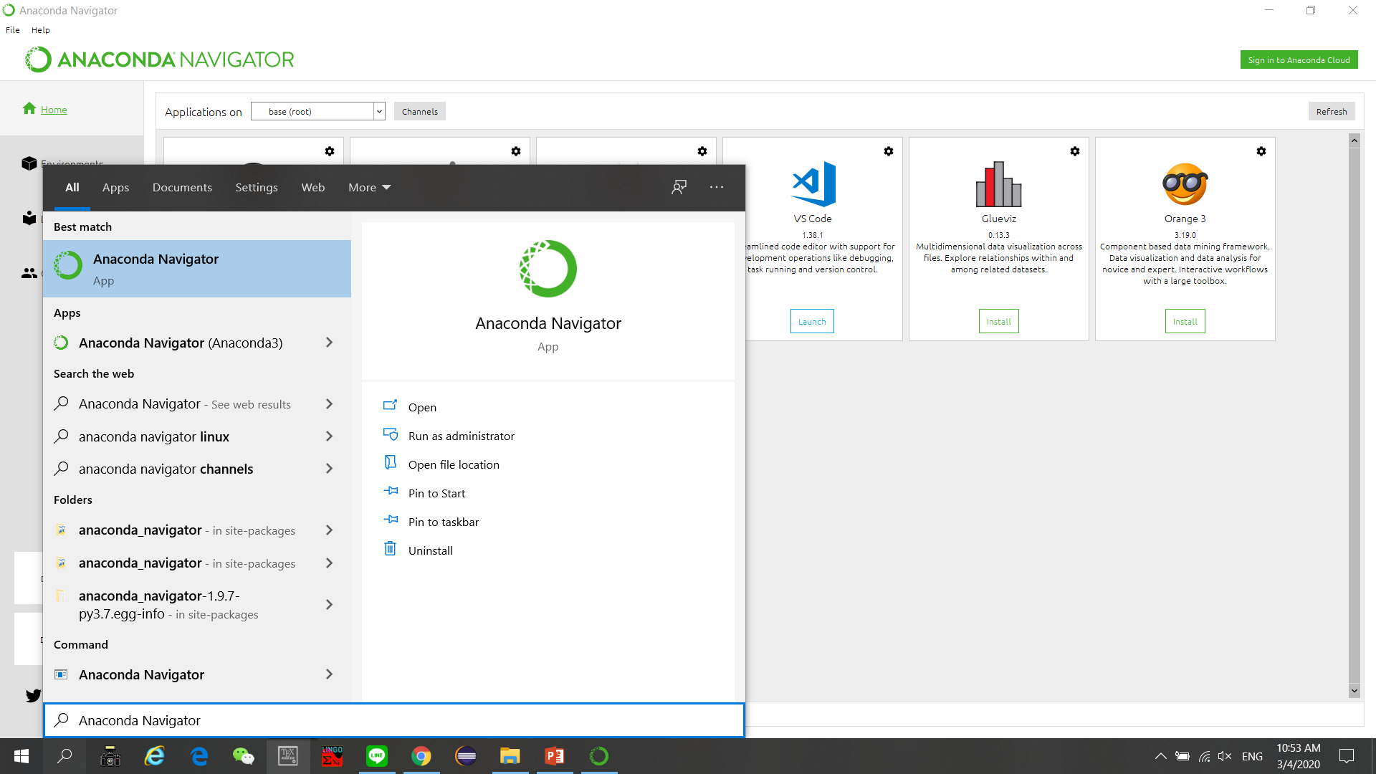
Step 6:
Check your Apps of Windows

Slide 9
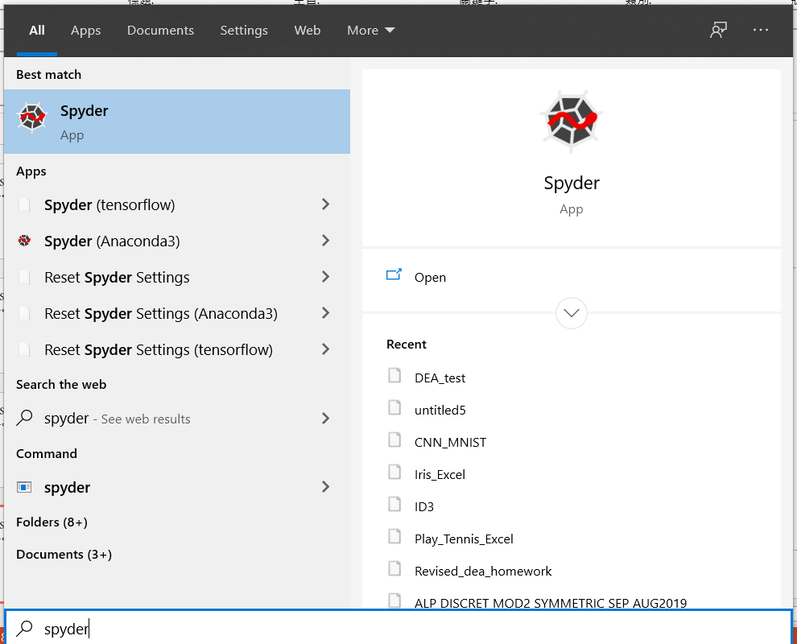
Step 7
Our work environment

Slide 10
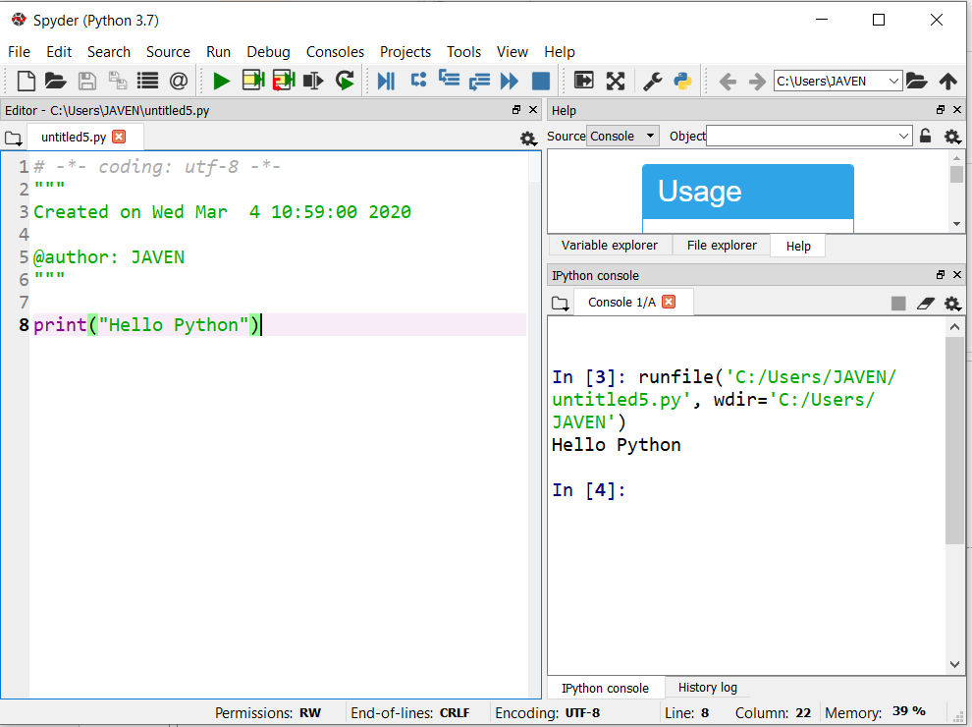
Your python, your code

