Slide 1

C programming
2024
Eugene KO

Slide 2
Programming Language
A formal system of communication used to write instructions that a computer can execute. These instructions, known as code, tell the computer how to perform specific tasks. Programming languages have their own syntax (rules for writing code) and semantics (meaning of the code)
Syntax: The set of rules that defines the combinations of symbols that are considered to be correctly structured programs in that language.
Semantics: The meaning of the symbols, expressions, and statements within the language.
Types of Programming Languages: There are many types, including high-level languages like Python and Java, which are easier for humans to read, and low-level languages like Assembly, which are closer to machine code.
https://www.youtube.com/watch?v=XASY30EfGAc&ab_channel=WomenTechmakers

Slide 3
Operating system (I)
An operating system (OS) is essential software that manages computer hardware and software resources. It provides common services for computer programs, acting as an intermediary between users and the computer hardware

Slide 4
Operating system (II)
Resource Management: Allocates CPU time, memory, and other resources to various programs and processes.
Process Management: Starts, stops, and manages processes, ensuring efficient execution.
Memory Management: Manages the computer’s primary memory, optimizing its usage.
File Management: Organizes and manages files and directories on storage devices.
Security: Implements security policies to protect data and resources.
Device Management: Manages input/output devices like printers, keyboards, and displays

Slide 5

Operating system (III)
https://www.bing.com/videos/search?q=&view=detail&mid=CE1401FB06B5686916C9CE1401FB06B5686916C9&FORM=VIRE

Slide 6
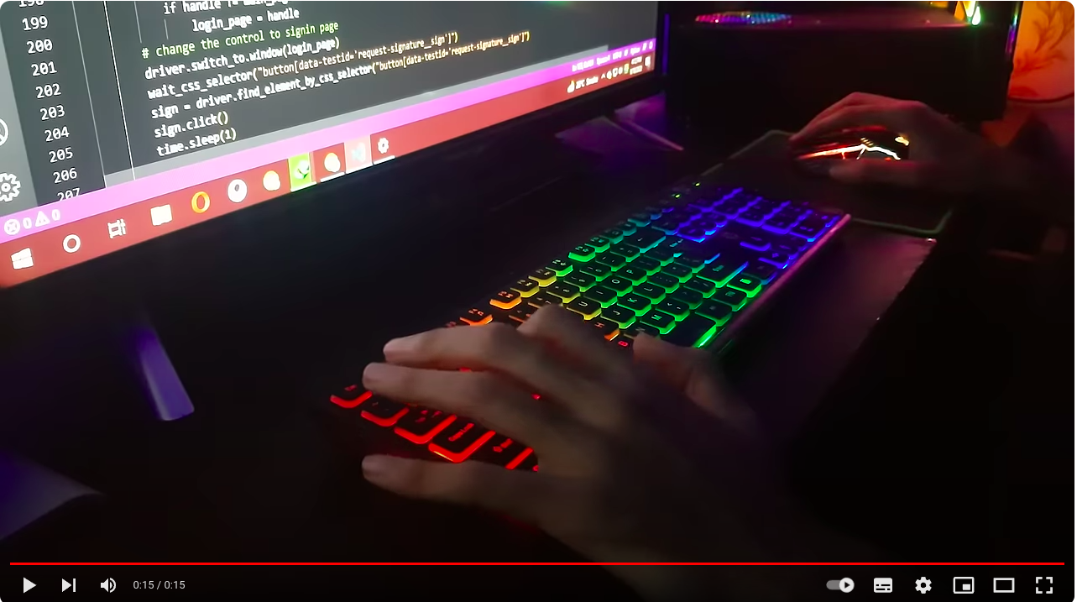
computer coding
https://www.bing.com/videos/search?q=&view=detail&mid=CE1401FB06B5686916C9CE1401FB06B5686916C9&FORM=VIRE

Slide 7
C Programming Language
The C programming language is a general-purpose, procedural language that was developed in the early 1970s by Dennis Ritchie at Bell Laboratories. It is known for its efficiency and control, making it a popular choice for system programming, including operating systems, embedded systems, and high-performance applications
https://www.bing.com/videos/search?q=&view=detail&mid=E99625A709B3763B4B79E99625A709B3763B4B79&FORM=VIRE

Slide 8
Key Features of C Programming Language
Procedural Language: C follows a procedural programming paradigm, which means it relies on procedures or routines to perform tasks.
Low-Level Access: It provides low-level access to memory through pointers, which allows for efficient manipulation of data.
Portability: C code can be compiled and run on various computer architectures with minimal changes.
Rich Library: It has a rich set of built-in functions and operators that can be used to write complex programs.
Structured Language: It supports structured programming, which helps in organizing and managing code efficiently

Slide 9
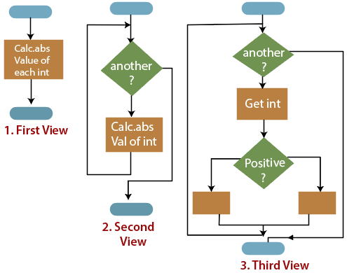
Structured Programming
A programming paradigm aims at improving the clarity, quality, and development time of a computer program. It emphasizes the use of structured control flow constructs such as selection (if/then/else), repetition (while and for), block structures, and subroutines. This approach helps in organizing code in a way that is easier to understand, maintain, and debug
https://www.youtube.com/watch?v=TmtyFcLWXwo&t=12s&ab_channel=EzEdChannel

Slide 10
ASCII and ANSI Character Table
ASCII (American Standard Code for Information Interchange) is a 7-bit character set that contains characters from 0 to 127.
The generic term ANSI (American National Standards Institute) is used for 8-bit character sets. These character sets contain the unchanged ASCII character set. In addition, they contain further characters from 128 to 255, which differ in the various ANSI character sets. There are character sets for western special characters and umlauts, and for Arabic, Greek or Cyrillic characters.
https://www.cnblogs.com/embedded-linux/p/10507541.html

Slide 11
ANSI C
ANSI C, also known as C89 or C90, refers to the standardization of the C programming language by the American National Standards Institute (ANSI) in 1989. This standard was later adopted by the International Organization for Standardization (ISO) in 1990, hence it is sometimes also referred to as ISO C

Slide 12
Coding and source code
Coding is the process of writing instructions for computers to perform specific tasks. These instructions, known as code, are written in programming languages that the computer can understand. Coding is essential for creating software, websites, apps, and more. It allows developers to build complex systems and solve problems efficiently
Source code: A simply code is any collection of text, written using a human-readable programming language, usually as plain text
https://www.bing.com/videos/search?q=&view=detail&mid=6AB22E5F9F48CF8150E56AB22E5F9F48CF8150E5&FORM=VIRE

Slide 13
Eclipse
Eclipse is a popular integrated development environment (IDE) primarily used for Java development, but it also supports other programming languages through plugins. It is an open-source platform that provides a wide range of tools for software development, including code editing, debugging, and testing

Slide 14
Eclipse (II)
Extensibility: Eclipse has a modular architecture that allows developers to extend its functionality with plugins.
Support for Multiple Languages: While it is best known for Java, Eclipse also supports C/C++, Python, PHP, and more through various plugins.
Rich Ecosystem: It includes a vast array of tools for different aspects of software development, such as version control, build automation, and project management.
Community and Resources: Eclipse has a large community of users and contributors, providing extensive documentation, tutorials, and forums for support

Slide 15
Visual Studio Code
Install VS Code
Download MinGW Compiler
Run the Installer
Mark mingw32-base for installation, click on installation and apply changes.
Add MinGW to System PATH
Install C/C++ Extension in VS Code

Slide 16
Dev-C++
Dev-C++ is a free full-featured integrated development environment (IDE) distributed under the GNU General Public License for programming in C and C++.
It was originally developed by Colin Laplace and was first released in 1998. It is written in Delphi.

Slide 17
C program examples
https://www.programiz.com/c-programming#guide

Slide 18
Example 1
#include <stdio.h>
int main() {
// var declarations
// execute commands
// printf() displays the string inside quotation
printf("Hello, World!");
return 0;
}
void functionName(){
}

Slide 19
Example 02
#include <stdio.h>
#include <stdlib.h>
int main() {
int number1, number2, result=0;
char op;
printf("Enter two integers: \n"); scanf("%d%d", &number1, &number2);
printf("Enter one of following operators: +, -, *, / --> \n"); fflush(stdin); scanf("%c", &op);
switch(op){
case '+': result = number1 + number2; break;
case '-': result = number1 - number2; break;
case '*': result = number1 * number2; break;
case '/': result = number1 / number2; break;
}
printf("\n The result = %d", result);
return 0;
}

Slide 20
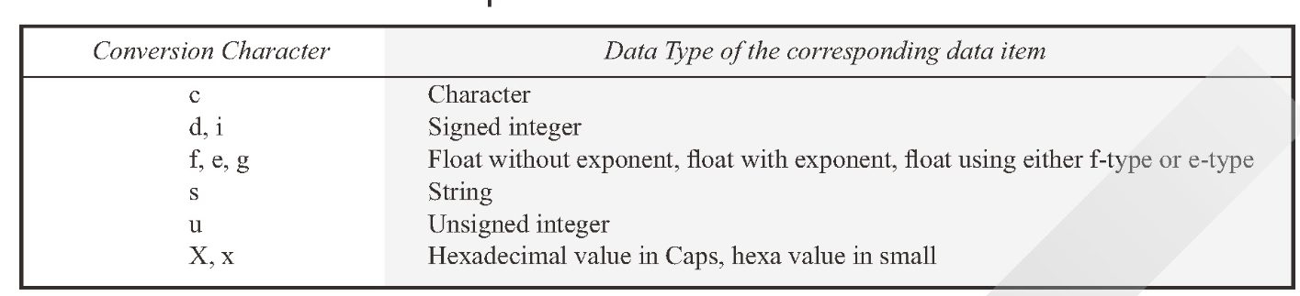
Conversion character

Slide 21
Example 3
#include <stdio.h>
int main() {
int number1, number2, sum;
printf("Enter two integers: ");
scanf("%d %d", &number1, &number2);
// calculate the sum
sum = number1 + number2;
printf("%d + %d = %d", number1, number2, sum);
return 0;
}

Slide 22
Q and A

