Slide 1
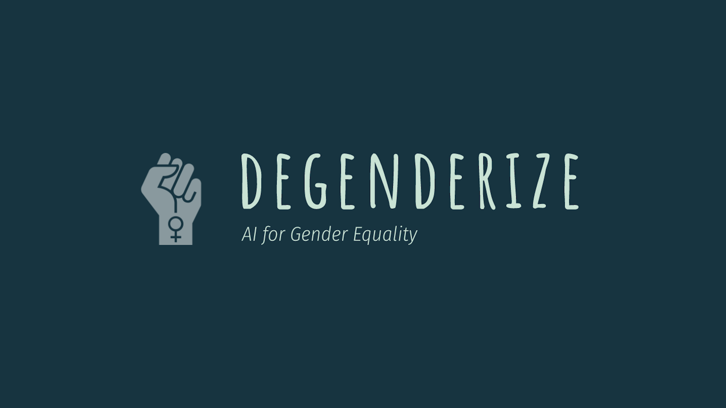

Slide 2

Mentor: Penousal Machado
Team:
Benjamin Bodner
Wojciech Dudzik
Yuri Lavinas
Nick Ross

Slide 3
The Problem
Employers screen employee resumes using AI that can be biased by the training data used, resulting in potential employees being rejected on a number of factors such as those that indicate gender

Slide 4
Ideas
Look at factors on resumes that led to success and check if gender was a factor
Remove all information from resumes that would prevent women getting employed just because of their gender

Slide 5
A Solution
Removing names makes it harder to detect the gender of an applicant, but other factors still indicate gender
Learn from existing resumes the factors that indicate gender
Highlight them for the author, to avoid revealing their gender

Slide 6
Prototype Implementation
Get the data
Learn LSTM about gender
Check what are the keywords
Use gender as a factor (making assumption that it is)
End result:
Highlight text that indicates gender

Slide 7
Data
Find large data sets of resumes*
Dataset with 701 resumes, names included, but not gender
For real product we can use Indeed dataset with 8M examples
*at least 6 big datas might be required ;)

Slide 8
Gender the Data
Using the names of the applicants assign them a gender using a names database
Where the name is ambiguous remove them from the data set
25 resumes were removed leaving 676 resumes for the prototype

Slide 9
Train
Train a deep neural net with our data to classify gender, while picking out key words or sentences

Slide 10
Weigh Importance
Weigh the importance of each keyword in calculating gender

Slide 11
Prototype
Results from our prototype

Slide 12
Future Works
Further development:
Highlighting the gender bias words
Make the research open source
Improve the prototype (DNN model)

