Slide 1
Time Period 1 of 76
UP
DOWN

Slide 2

The stock went up!

Slide 3
You guessed correctly!
+10 cents

Slide 4
Time Period 2 of 76
UP
DOWN

Slide 5
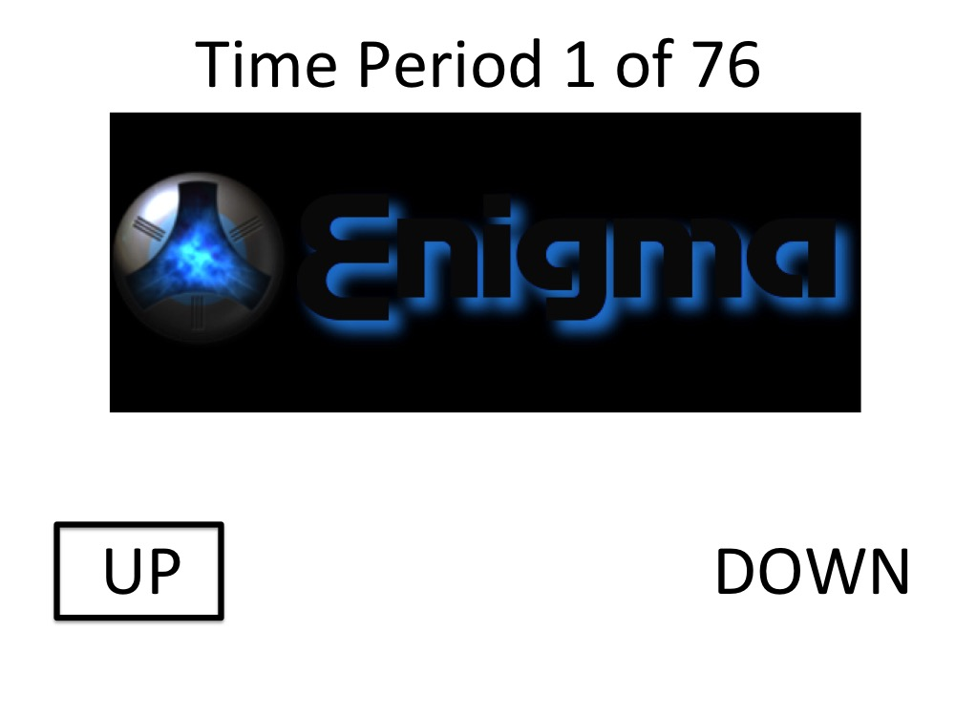
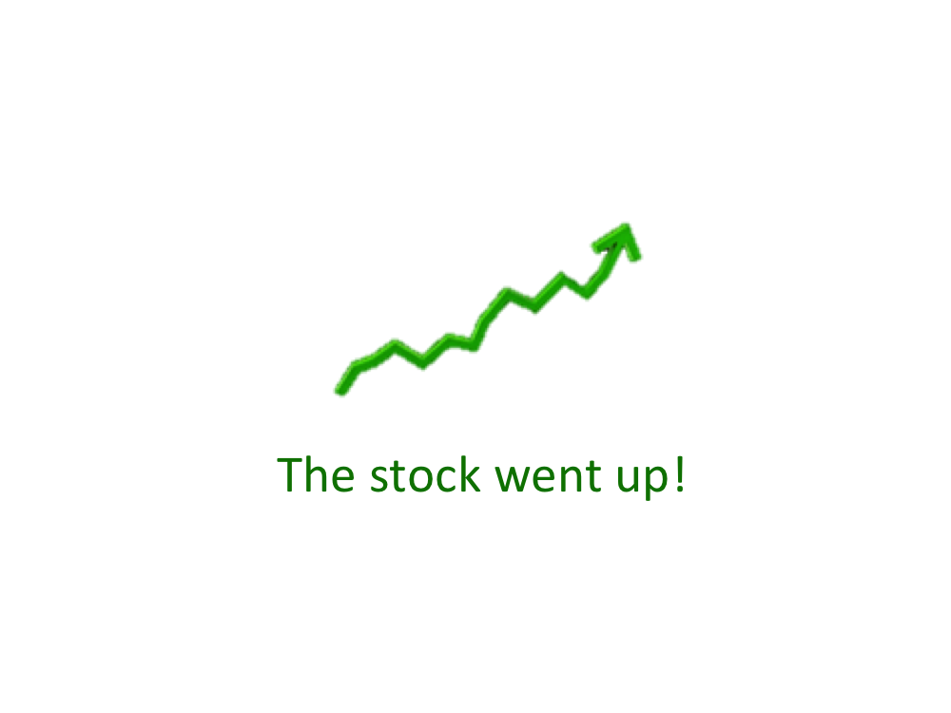
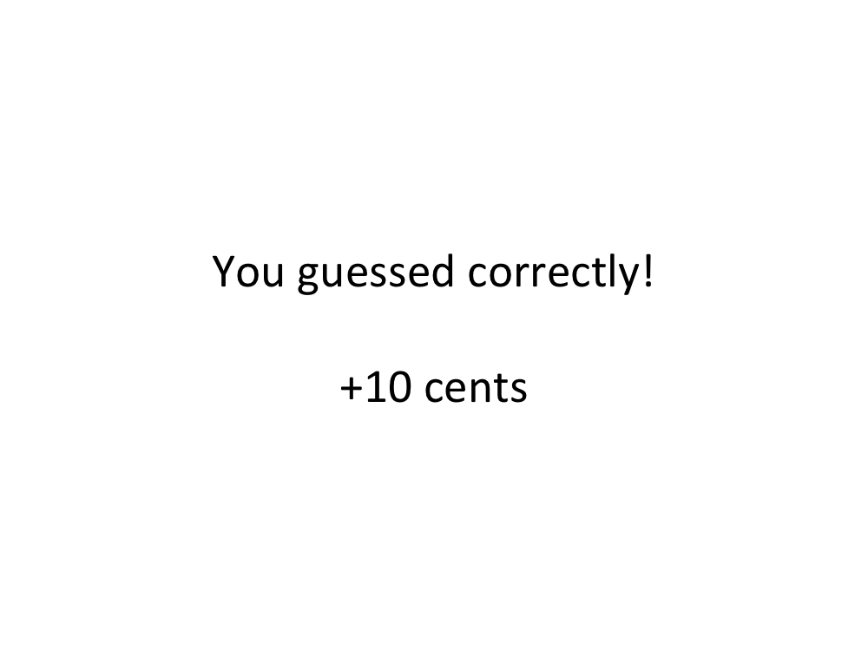
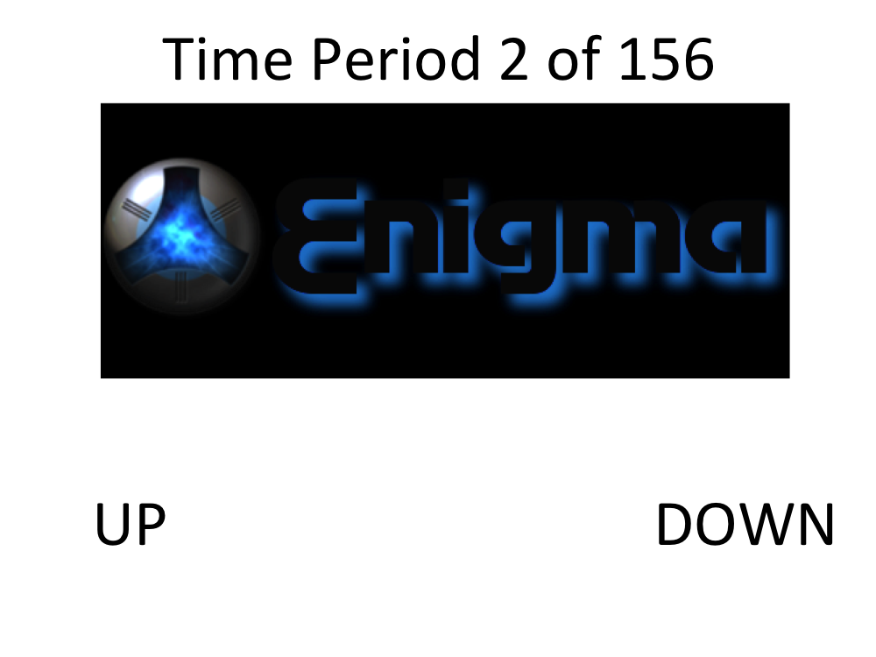
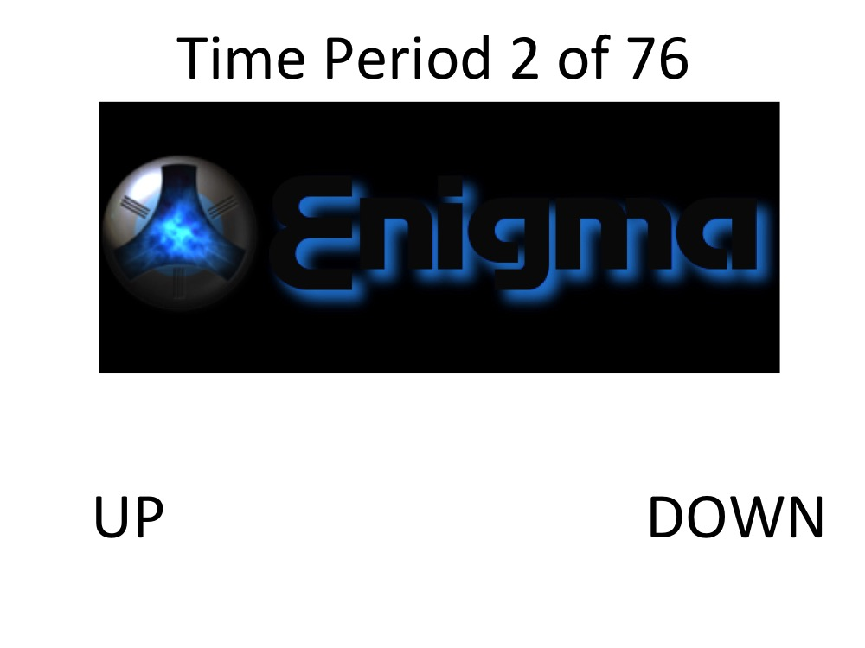
Predict Stock
Stock Performance
Were you correct?
Predict Stock
…

