Slide 1


AF-TWIN git workflow
Murat artim, escsa

Slide 2
Contents
AF-Twin Git Repositories
Git Workflow Overview
Developer Workflow
GitMaster Workflow
Naming Convention for New Feature Branches
Naming Convention for Bug Fixes
Some Git Commands

Slide 3
Af-twin git repositories
AF-Twin-Data-Analyst: Desktop client application project.
AF-Twin-Data-Server: Microservice project for supplying data from AF-Twin central database & user authentication.
AF-Twin-Exchange-Server: Microservice project for supplying user collaboration features (i.e. file sharing, view sharing).
AF-Twin-Analysis-Server: Microservice project for supplying analysis capabilities on GISEH environment.
AF-Twin-Server-Utilities: Project for supplying common server-side utilities to all AF-Twin projects.
AF-Twin-Themes: Desktop client UI theming project.
AF-Twin-Isami-Materials: Project for extracting Isami materials into AF-Twin central database.

Slide 4
Git workflow overview - Feature Branch Workflow
For each of the repositories mentioned in the previous page, there is only one official project branch called master.
The master branch is protected. That is, only GitMaster can merge/push into this branch.
The master branch never contains broken code, which is a huge advantage for continuous integration environments.
Developers create a new branch every time they start work on a new feature. Feature branches should have descriptive names, like animated-menu-items or bug#1061.
Developers open a pull request when their new feature implementation is ready. GitMaster reviews the request and accepts or rejects.
If the pull request is accepted by the GitMaster, the feature branch is first merged into master and then deleted from the repository by the GitMaster. The master branch is then deployed to clients.

Slide 5
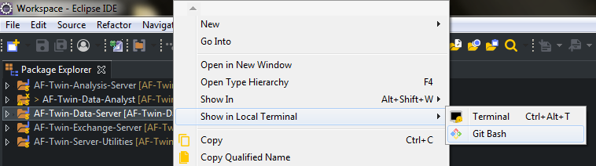
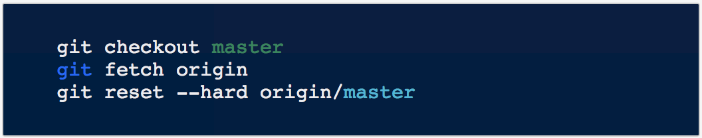
Workflow - developer
Open Git Bash. Right-click on the project root in Eclipse and select Show in Local Terminal > Git Bash
Start with the master branch. Switch to the master branch, pull the latest commits and reset the repo's local copy of master to match the latest version.

Slide 6
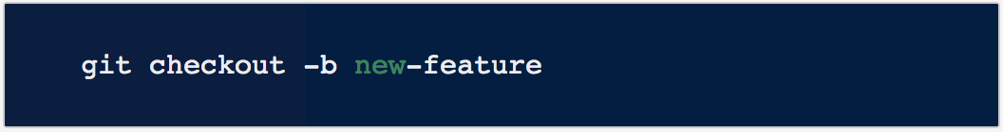
Workflow - developer
Create a new branch. Check out a branch called new-feature* based on master, and use the -b flag to tell Git to create the branch if it doesn’t already exist.
Develop, update, add, commit changes. On this branch, work on the feature and make commits like you would any time you use Git.
git status
git add -A
git commit -am “comments”
* See the naming convention for new branches.

Slide 7
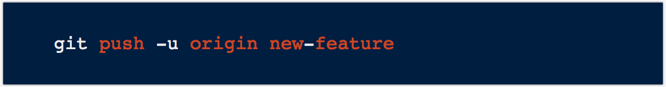
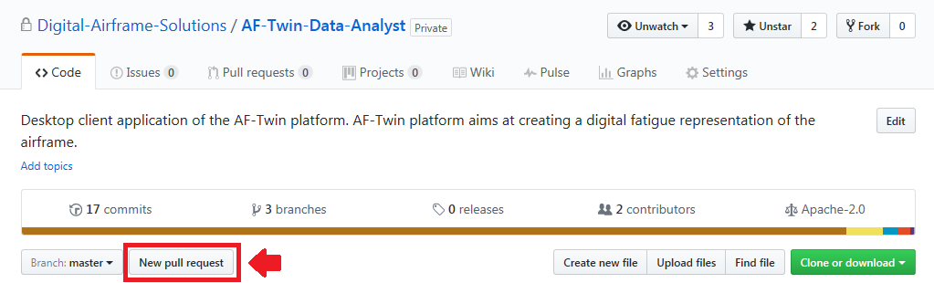
Workflow - developer
Push feature branch to remote. When ready, push the feature branch up to the central repository (origin). Use the -u flag so that Git adds it as a remote tracking branch.
Open a pull request in GitHub. File a pull request asking to merge your feature branch into master.
Browse to the project repository website in GitHub.
Click on New pull request button.

Slide 8
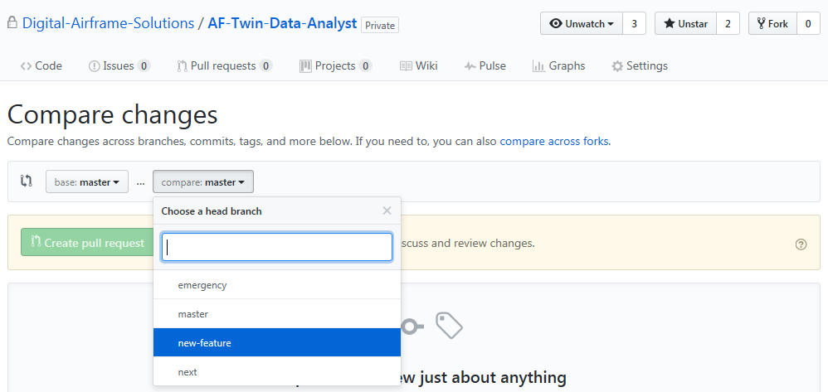
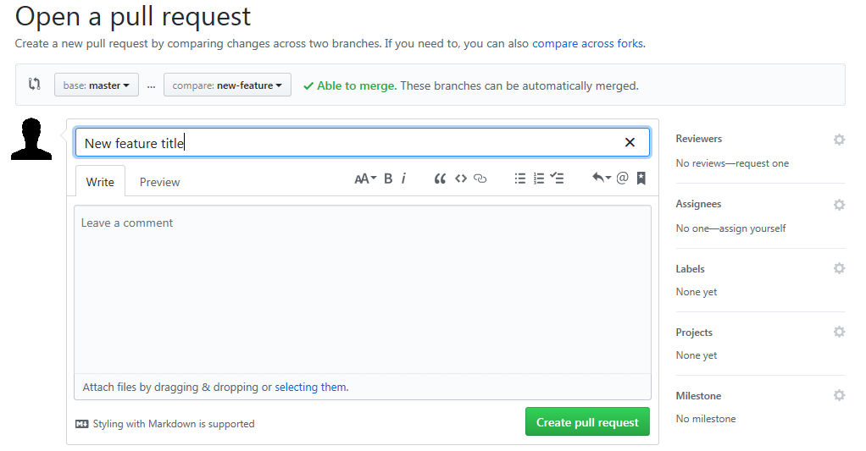
Workflow - developer
Select master from base drop-down, and new-feature from compare drop-down button.
Add title and comments to describe the new feature and click Create pull request button.

Slide 9
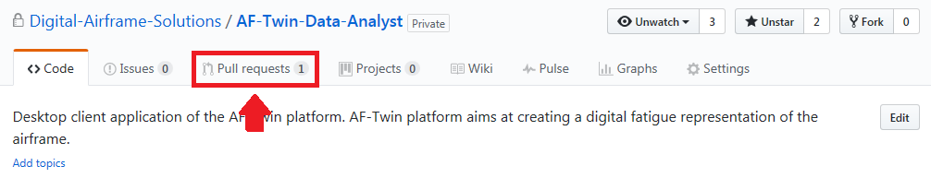
Workflow - git master
Review pull request. Check out the new-feature branch from origin, compare it to master and review the code changes.
git checkout -b new-feature origin/new-feature
git diff master new-feature
Comment, merge or close pull request.
Browse to the project repository website in GitHub.
Click on Pull requests tab.

Slide 10
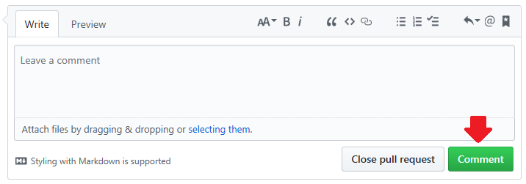
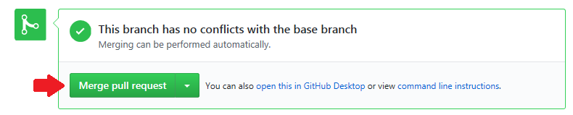
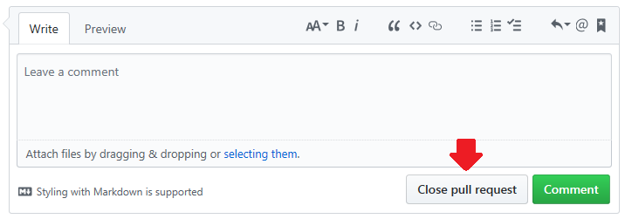
Workflow - git master
Add comments and click Comment button to send feedback to developer for necessary updates.
…Or click Merge pull request button to accept pull request and merge it to master.
…Or add comments and click Close pull request button to reject pull request.

Slide 11
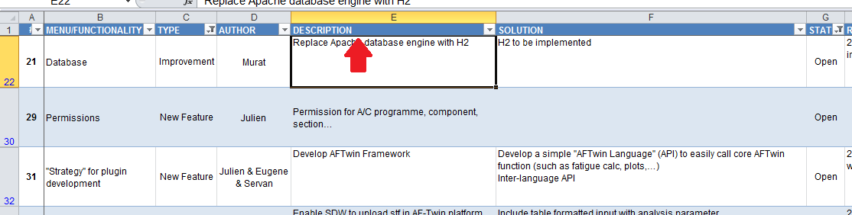
Naming convention - new feature branches
New feature branches shall be named as follows:
<developerName>_<featureName>
First name of the developer
Taken from the description column of the roadmap spreadsheet
Example: jonny_replaceApacheWithH2

Slide 12
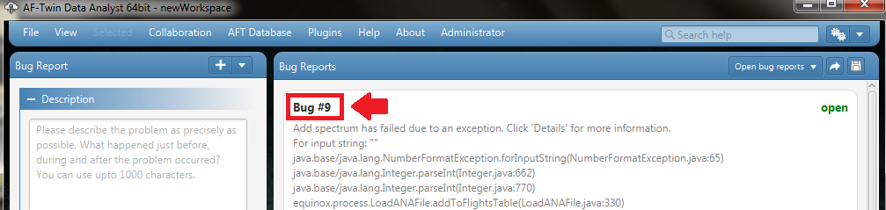
Naming convention - bug fixes
Bug fix branches shall be named as follows:
<developerName>_<bug#ID>
First name of the developer
Taken from the bug ID in AF-Twin central database
Example: jonny_bug#9

Slide 13
Some git commands
// list all local branches
git branch
// force-delete a local branch
git branch -D <branch-name>
// move to a local branch
git checkout <branch-name>
// check updates to a local branch
git status
// commit updates to a local branch
git commit -am “comments”
// download all updates from remote
git fetch origin
// add new file to commit
git add <file-name>
// add all files to commit
git add -A
// reset local branch from remote
git reset —-hard origin/<branch-name>
// create new local branch
git checkout -b <branch-name>
// create new local branch from remote
git checkout -b <branch-name> origin/<branch-name>
// push local branch to remote
git push -u origin <branch-name>

Slide 14
Some git commands
// merge remote branch into local branch
git merge origin/<branch-name>

Slide 15
THANK YOU

