Slide 1
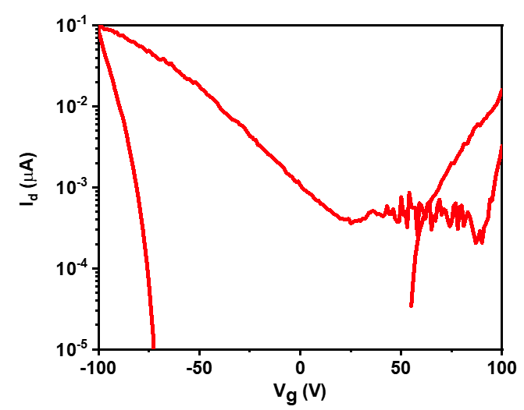
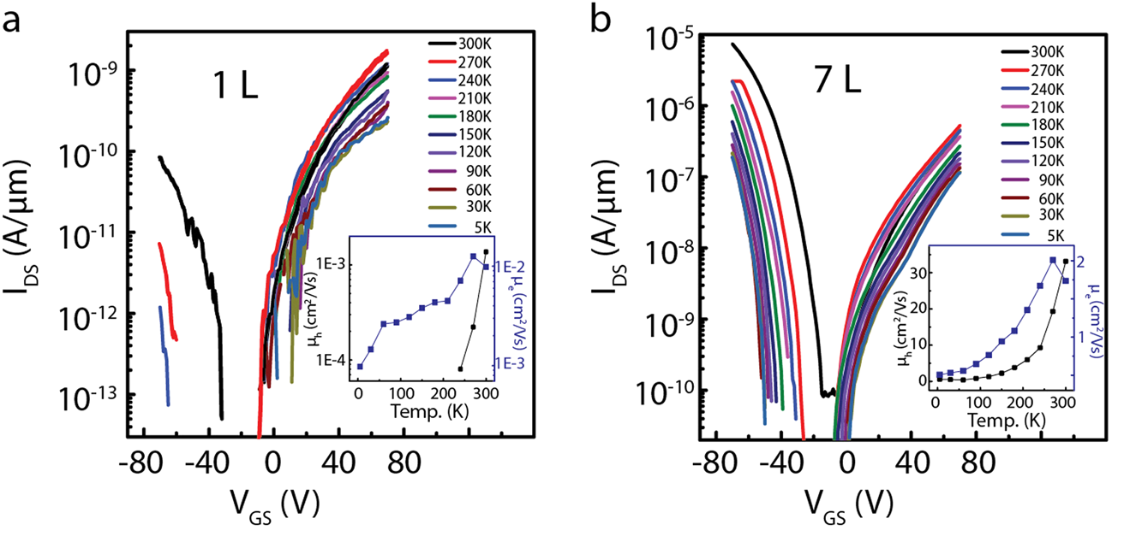
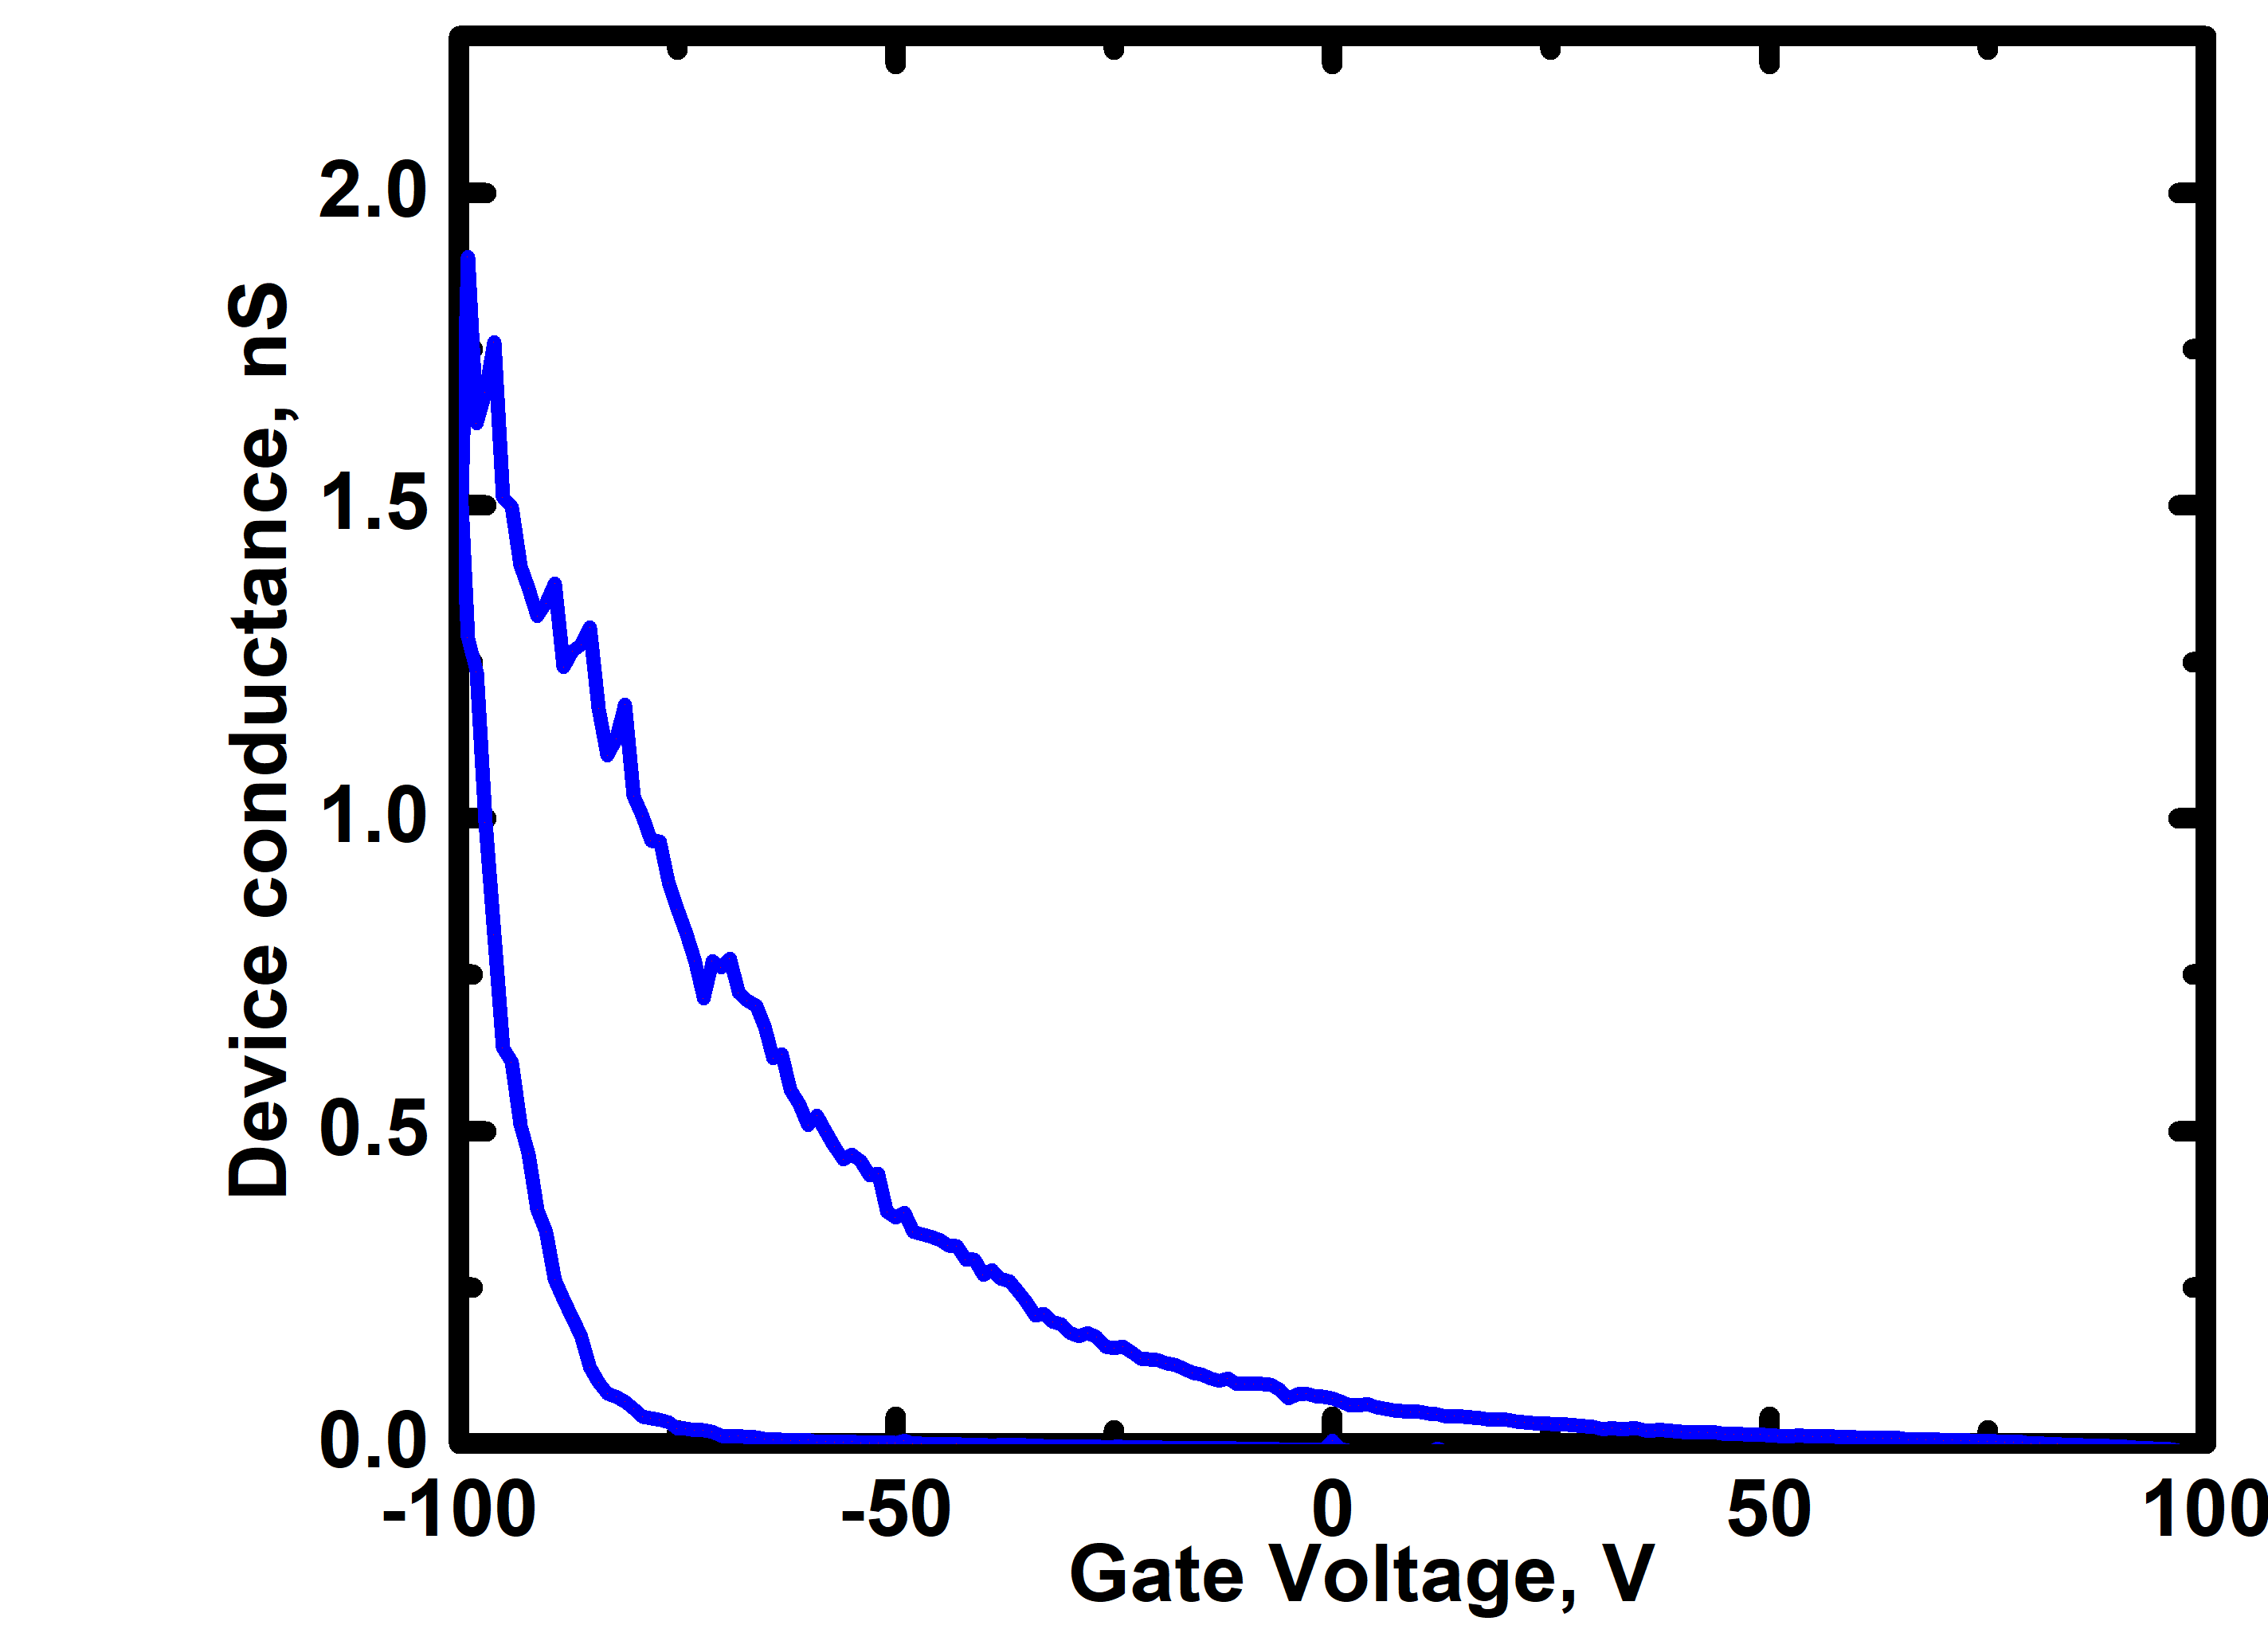
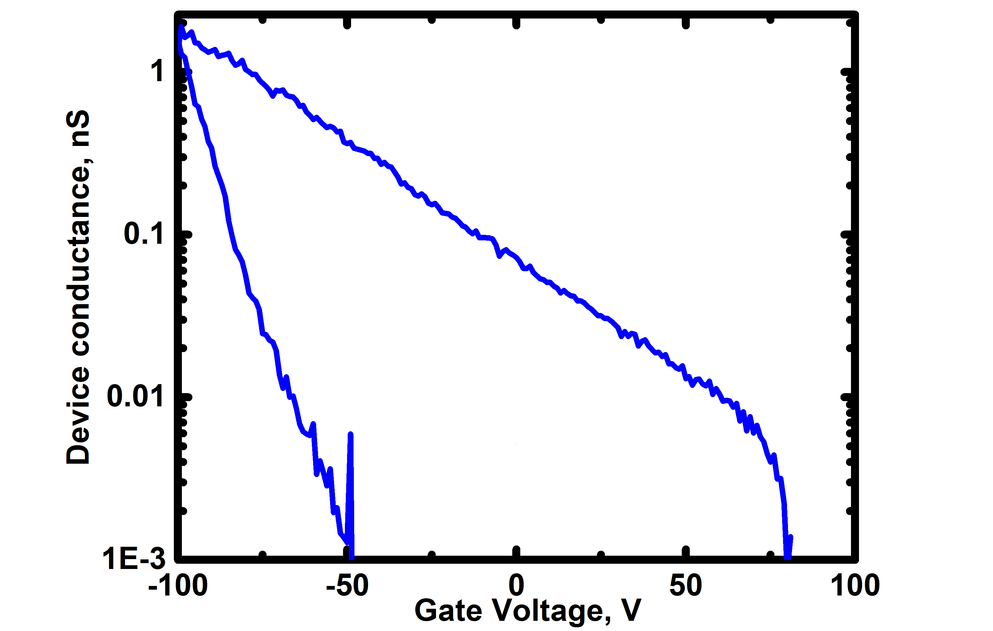
Weekly checkin on March 9th
Siyuan’s device (3L)
WSe₂ FETs ambipolarity question
My device
NPG Asia Mater 10, 703–712 (2018).
Other studies suggest monolayer WSe2 device doesn’t easily show ambipolar curve
Potential question mark on anything thicker than bilayer
Still, monolayer device looks deeply OFF with both Au and Pd contact

Slide 2
Weekly checkin on March 9th
ALD HfO₂ thermal conductivity question
It seems like WSe₂ are all burned after spectroscopic mapping @ 0.6 mW for 5 s
ALD HfO₂ reportedly has worse heat conductivity than ALD Al₂O₃
Potential problem for further optical measurements?

