Slide 1
Iteration (Loops)

Slide 2
Iteration
What is iteration?
Repeatedly executing a sequence of statements
May need to do the same thing over-and-over again
Also referred to as looping
Use fixed iteration when the number of iterations is known at the time of programming
The iterations are tracked by a loop counter
Use conditional iteration when the number of iterations is based on a logical condition that is updated inside the loop (will be covered another day)

Slide 3

Structure of a for-loop
Most programming languages (including Python) use the keyword ‘for’ to indicate the beginning of a ‘loop’
[code before the loop] # executes once
for loop_counter in range(num_loops):
[indented Python statements] # executes num_loops times
[include the work that you want to repeat] # executes num_loops times
[the code after the loop is not indented] # executes once

Slide 4
Structure of a for-loop
Most programming languages (including Python) use the keyword ‘for’ to indicate the beginning of a ‘for-loop’
[code before the loop] # executes once
for loop_counter in range(num_loops):
[indented Python statements] # executes num_loops times
[include the work that you want to repeat] # executes num_loops times
[the code after the loop is not indented] # executes once
Each for-loop starts with the Python keyword for

Slide 5

Structure of a for-loop
Most programming languages (including Python) use the keyword ‘for’ to indicate the beginning of a ‘for-loop’
[code before the loop] # executes once
for loop_counter in range(num_loops):
[indented Python statements] # executes num_loops times
[include the work that you want to repeat] # executes num_loops times
[the code after the loop is not indented] # executes once
Each for-loop contains a loop_counter variable that starts at 0 and increases after each pass through the loop
Note that the loop_counter variable can be named anything you like, just like any other variable. Additionally, the loop_counter is AUTOMATICALLY assigned 0 when the loop first runs.

Slide 6
Structure of a for-loop
Most programming languages (including Python) use the keyword ‘for’ to indicate the beginning of a ‘for-loop’
[code before the loop] # executes once
for loop_counter in range(num_loops):
[indented Python statements] # executes num_loops times
[include the work that you want to repeat] # executes num_loops times
[the code after the loop is not indented] # executes once
The in range keywords are part of the for-loop declaration and should be used in conjunction with the for keyword

Slide 7

Structure of a for-loop
Most programming languages (including Python) use the keyword ‘for’ to indicate the beginning of a ‘for-loop’
[code before the loop] # executes once
for loop_counter in range(num_loops):
[indented Python statements] # executes num_loops times
[include the work that you want to repeat] # executes num_loops times
[the code after the loop is not indented] # executes once
Specifies the number of times the loop will execute. Can be a literal value (e.g. 5, 22, etc.) or a variable that is assigned before the for-loop starts.
Note, the loop_counter variable will start at 0 and increase on each pass through the loop until it equals num_loops-1.

Slide 8


How Many Numbers Do you See?
0 1 2 3 4
What Is the Largest Number You See?
If num_loops=5, the loop_counter will range from 0 to 4
num_loops-1

Slide 9
Structure of a for-loop
Most programming languages (including Python) use the keyword ‘for’ to indicate the beginning of a ‘for-loop’
[code before the loop] # executes once
for loop_counter in range(num_loops):
[indented Python statements] # executes num_loops times
[include the work that you want to repeat] # executes num_loops times
[the code after the loop is not indented] # executes once
The loop-body of the for-loop (i.e. the repeated code) contains one or more indented Python statements

Slide 10
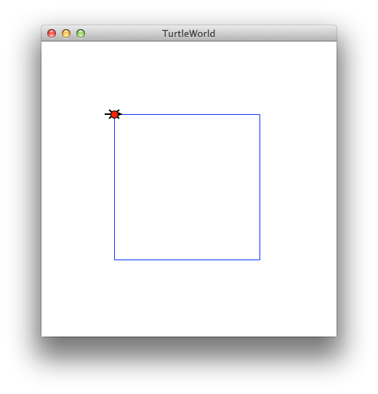

A Simple Example
Draw a square where each side is of length size
1
2
3
4
5
6
7
8
9
# Draw a square
fd(t, size)
rt(t, 90)
fd(t, size)
rt(t, 90)
fd(t, size)
rt(t, 90)
fd(t, size)
rt(t, 90)
Note that the code repeats itself. So, why write it over and over again?

Slide 11

A Simple Example
Draw a square where each side is of length size
Simplify with a for-loop
1
2
3
4
# Draw a square
for i in range(4):
fd(t, size)
rt(t, 90)
This code will execute 4 times

Slide 12

A Simple Example
Draw a square where each side is of length size
Simplify with a for-loop
1
2
3
4
5
6
# Draw a square
num = 4
for i in range(num):
fd(t, size)
rt(t, 90)
Remember, the range can also be specified using a variable

Slide 13
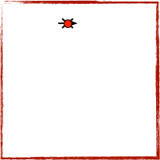
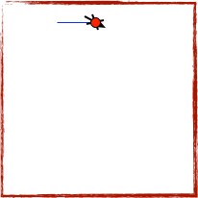
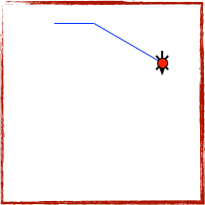
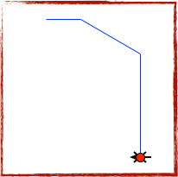
A More Interesting Example
It is possible to use the loop_counter variable inside the loop
1
2
3
4
5
6
7
# Draw a shape
size = 100
num = 4
for j in range(num):
fd(t, size*j)
rt(t, j*30)
j=0
fd(t, 0)
rt(t, 0)
j=1
fd(t, 100)
rt(t, 30)
j=2
fd(t, 200)
rt(t, 60)
j=3
fd(t, 300)
rt(t, 90)

