Slide 1
기말고사 일정
12/10,12,17,19

Slide 2
Project 1단계 (~12/2(월) 11:00AM)
Skynet Revolution – Episode 1 문제를 풀어서 ecampus 에 팀장이 제출
https://www.codingame.com/training/medium/skynet-revolution-episode-1
제출물 : 1) 소스 코드 (text file)
2) 100% 완료 화면 capture (jpg/png file)
* zip 으로 묶지말고 화일 2개를 upload 할 것

Slide 3
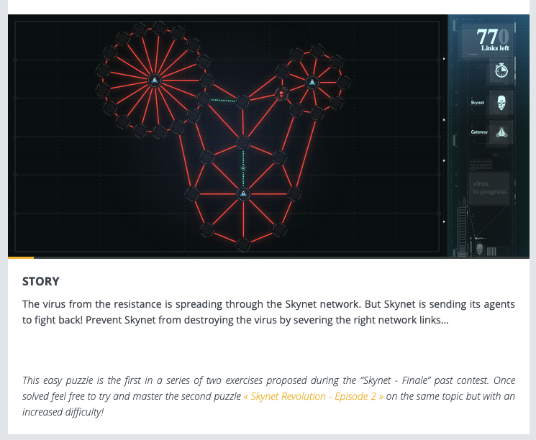

Slide 4
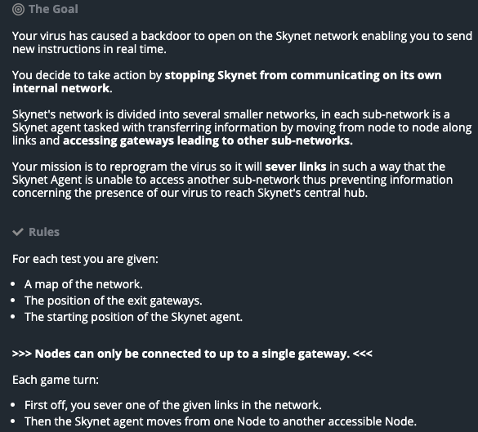
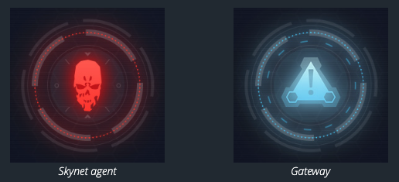

Slide 5
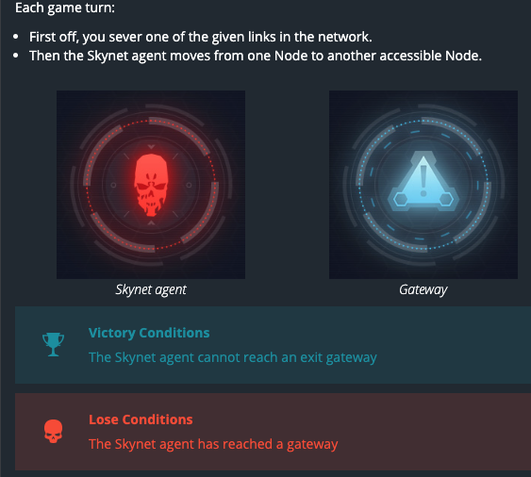

Slide 6
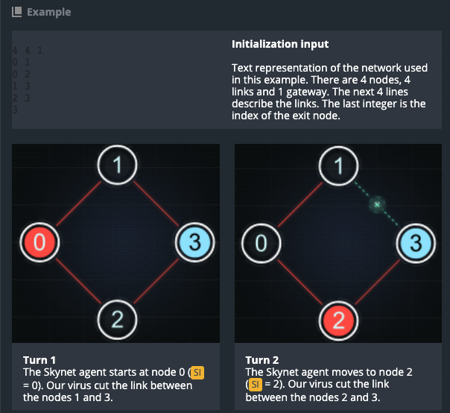
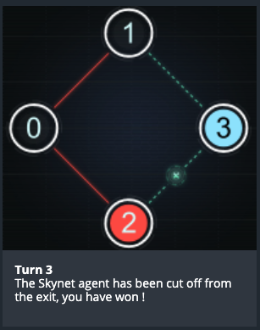
4 4 1
0 1
0 2
1 3
2 3
3

Slide 7
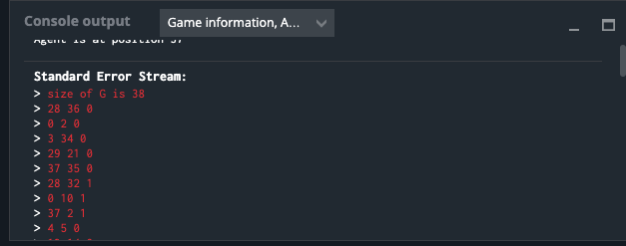
Skynet Revolution – Episode 1
https://www.codingame.com/training/medium/skynet-revolution-episode-1
hint : 입력으로부터 그래프를 adjacency list 로 표현한 후 BFS 알고리즘을 응용하여 제거할 edge 를 선택한다.
debugging 을 위해서는 standard error 에 출력
compile error message 도 standard error 에서 볼 수 있음

Slide 8
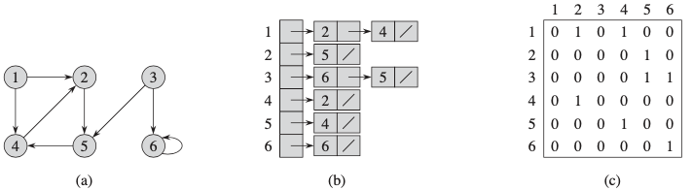
Directed Graph

Slide 9
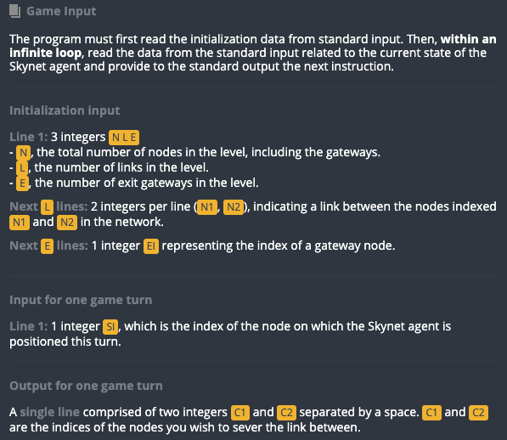

Slide 10
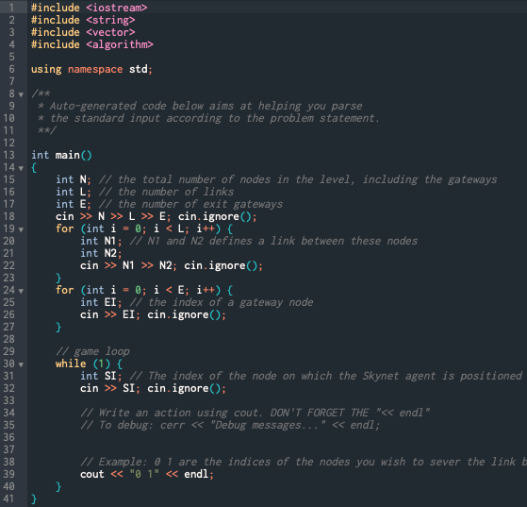

Slide 11
#include <iostream>
#include <string>
#include <vector>
#include <algorithm>
using namespace std;
int main(){
int N; // the total number of nodes in the level, including the gateways
int L; // the number of links
int E; // the number of exit gateways
cin >> N >> L >> E; cin.ignore();
cerr << ”|V|= " << N << “ |E|= “ << L << “ number of Gateways “ << E << endl;
for (int i = 0; i < L; i++) {
int N1; // N1 and N2 defines a link between these nodes
int N2;
cin >> N1 >> N2; cin.ignore();
cerr << “edge “ << i << “ : “ << N1 << "-" << N2 << endl;
}

Slide 12
for (int i = 0; i < E; i++) {
int EI; // the index of a gateway node
cin >> EI; cin.ignore();
cerr << “gateway “ << i << “ : “ << EI << endl;
}
// game loop
while (1) {
int SI;
// The index of the node on which the Skynet agent is positioned this turn
cin >> SI; cin.ignore();
cerr << “agent at vertex “ << SI << endl;
// Example: 0 1 are the indices of the nodes you wish to sever the link between
cout << SI << " " << SI+1 << endl;
}
}

Slide 13
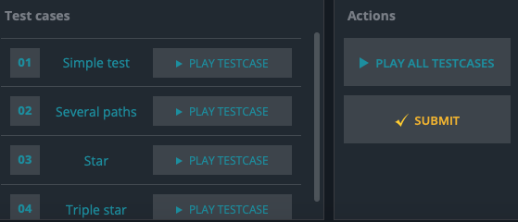

Slide 14
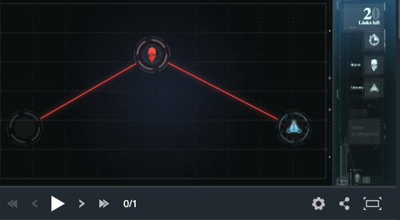

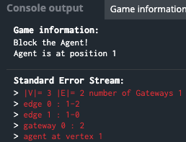
Game information:
Block the Agent!
Agent is at position 1
Standard Error Stream:
> |V|= 3 |E|= 2 number of Gateways 1
> edge 0 : 1-2
> edge 1 : 1-0
> gateway 0 : 2
> agent at vertex 1

Slide 15
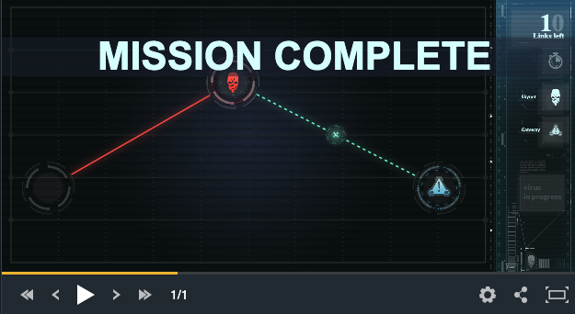
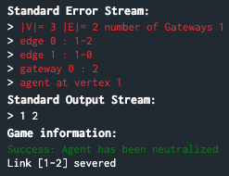
Standard Error Stream:
> |V|= 3 |E|= 2 number of Gateways 1
> edge 0 : 1-2
> edge 1 : 1-0
> gateway 0 : 2
> agent at vertex 1
Standard Output Stream:
> 1 2
Game information:
Success: Agent has been neutralized
Link [1-2] severed

Slide 16
#include <iostream>
#include <string>
#include <vector>
#include <algorithm>
using namespace std;
int main(){
int N; // the total number of nodes in the level, including the gateways
int L; // the number of links
int E; // the number of exit gateways
cin >> N >> L >> E; cin.ignore();
cerr << ”|V|= " << N << “ |E|= “ << L << “ number of Gateways “ << E << endl;
for (int i = 0; i < L; i++) {
int N1; // N1 and N2 defines a link between these nodes
int N2;
cin >> N1 >> N2; cin.ignore();
cerr << “edge “ << i << “ : “ << N1 << "-" << N2 << endl;
}

Slide 17
for (int i = 0; i < E; i++) {
int EI; // the index of a gateway node
cin >> EI; cin.ignore();
cerr << “gateway “ << i << “ : “ << EI << endl;
}
// game loop
while (1) {
int SI;
// The index of the node on which the Skynet agent is positioned this turn
cin >> SI; cin.ignore();
// Write an action using cout. DON'T FORGET THE "<< endl"
// To debug: cerr << "Debug messages..." << endl;
cerr << “agent at vertex “ << SI << endl;
// Example: 0 1 are the indices of the nodes you wish to sever the link between
cout << SI << " " << SI+1 << endl;
}
}

Slide 18
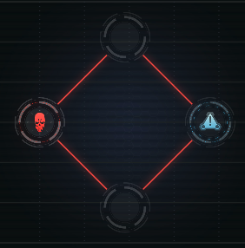

Game information:
Block the Agent!
Agent is at position 0
Standard Error Stream:
> |V|= 4 |E|= 4 number of Gateways 1
> edge 0 : 1-3
> edge 1 : 2-3
> edge 2 : 0-1
> edge 3 : 0-2
> gateway 0 : 3
> agent at vertex 0

Slide 19
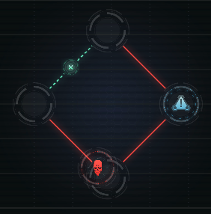
Standard Output Stream:
> 0 1
Game information:
Link [0-1] severed Agent moved from 0 to 2

Slide 20
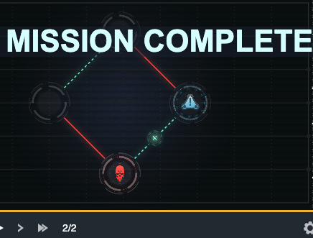
Standard Error Stream:
> agent at vertex 2
Standard Output Stream:
> 2 3
Game information:
Success: Agent has been neutralized Link [2-3] severed

Slide 21
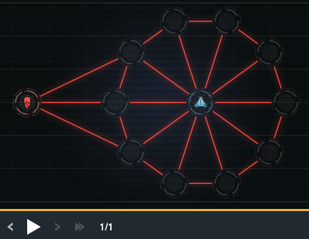

> edge 6 : 2-3
> edge 7 : 4-5
> edge 8 : 8-9
> edge 9 : 6-7
> edge 10 : 7-8
> edge 11 : 0-6
> edge 12 : 3-4
> edge 13 : 0-2
> edge 14 : 11-7
> edge 15 : 0-8
> edge 16 : 0-4
> edge 17 : 9-10
> edge 18 : 0-5
> edge 19 : 0-7
> edge 20 : 0-3
> edge 21 : 0-10
> edge 22 : 5-6
> gateway 0 : 0
> agent at vertex 11
Game information:
Block the Agent! Agent is at position 11
Standard Error Stream:
|V|= 12 |E|= 23 number of Gateways 1
> edge 0 : 11-6
> edge 1 : 0-9
> edge 2 : 1-2
> edge 3 : 0-1
> edge 4 : 10-1
> edge 5 : 11-5

Slide 22
> edge 10 : 7-8
> edge 11 : 0-6
> edge 12 : 3-4
> edge 13 : 0-2
> edge 14 : 11-7
> edge 15 : 0-8
> edge 16 : 0-4
> edge 17 : 9-10
> edge 18 : 0-5
> edge 19 : 0-7
> edge 20 : 0-3
> edge 21 : 0-10
> edge 22 : 5-6
> gateway 0 : 0
> agent at vertex 11
Standard Output Stream:
> 11 12
Game information:
Failure: No such node 12
Agent is at position 11
?
Game information:
Block the Agent! Agent is at position 11
Standard Error Stream:
|V|= 12 |E|= 23 number of Gateways 1
> edge 0 : 11-6
> edge 1 : 0-9
> edge 2 : 1-2
> edge 3 : 0-1
> edge 4 : 10-1
> edge 5 : 11-5
> edge 6 : 2-3

Slide 23
Representing a Graph in vector of vectors
#include <queue>
enum NODE_COLOR {WHITE, GRAY, BLACK};
int main()
{
int N; // the total number of nodes in the level, including the gateways
int L; // the number of links
int E; // the number of exit gateways
cin >> N >> L >> E; cin.ignore();
vector<int> dummy;
vector<vector<int>> G(N, dummy);
vector<bool> gateway(N, false);
// use push_back() and [ ] operator to fill graph data

Slide 24

> edge 6 : 2-3
> edge 7 : 4-5
> edge 8 : 8-9
> edge 9 : 6-7
> edge 10 : 7-8
> edge 11 : 0-6
> edge 12 : 3-4
> edge 13 : 0-2
> edge 14 : 11-7
> edge 15 : 0-8
> edge 16 : 0-4
> edge 17 : 9-10
> edge 18 : 0-5
> edge 19 : 0-7
> edge 20 : 0-3
> edge 21 : 0-10
> edge 22 : 5-6
> gateway 0 : 0
> agent at vertex 11
Game information:
Block the Agent! Agent is at position 11
Standard Error Stream:
|V|= 12 |E|= 23 number of Gateways 1
> edge 0 : 11-6
> edge 1 : 0-9
> edge 2 : 1-2
> edge 3 : 0-1
> edge 4 : 10-1
> edge 5 : 11-5

Slide 25
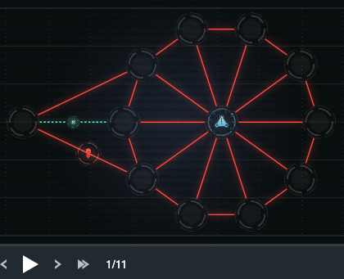
G[0]
G[1]
G[2]
G[3]
G[4]
G[5]
G[6]
G[7]
G[8]
G[9]
G[10]
G[11]
9 | 1 | 6 | 2 | 8 | 4 | 5 | 7 | 3 | 10
7
2 | 0 | 10
1 | 3 | 0
11
6
0
2 | 4 | 0
5
5 | 3 | 0
11 | 4 | 0 | 6
11 | 7 | 0 | 5
6 | 8 | 11 | 0
Standard Output Stream:
> 11 6
Game information:
Link [11-6] severed Agent moved from 11 to 5
9 | 7 | 0
0 | 8 | 10
1 | 9 | 0
6 | 5 | 7

Slide 26
// game loop
while (1) {
int SI; // The index of the node on which the Skynet agent
cin >> SI; cin.ignore();
queue<int> Q;
// implement BFS from SI vertex
... // initialize BFS
while (!Q.empty()){ // BFS loop
u = Q.front();
Q.pop();
for (int i = 0; i < G[u].size(); i++){
v = G[u][i];
// v 가 gateway 이면 ... SI → v path 상의 한 edge (x,y) 를 선택하고 while loop 종료
}
cout << x << " " << y << endl;
// G 에서 edge (x,y) 를 제거
}

Slide 27
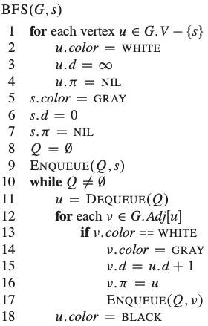
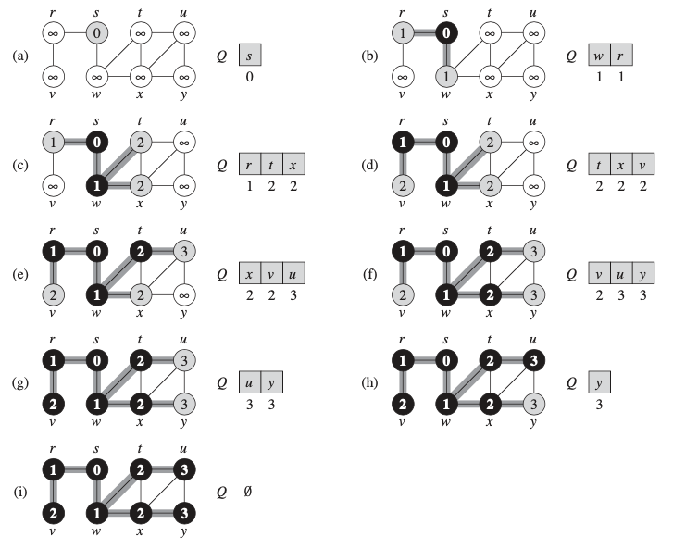
22.2 Breadth-First Search
initialization
not discovered
discovered
starting point
Finished
$$O(V+E)$$
predecessor
depth in the BFS tree

Slide 28
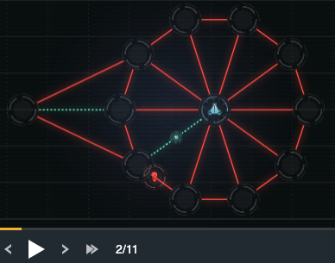
G[0]
G[1]
G[2]
G[3]
G[4]
G[5]
G[6]
G[7]
G[8]
G[9]
G[10]
G[11]
9 | 1 | 6 | 2 | 8 | 4 | 5 | 7 | 3 | 10
7
2 | 0 | 10
0
1 | 3 | 0
11
6
2 | 4 | 0
5
5 | 3 | 0
4
11 | 4 | 0 | 6
7 | 0 | 5
6 | 8 | 11 | 0
Standard Output Stream:
> 5 0
Game information:
Link [5-0] severed Agent moved from 5 to 4
9 | 7 | 0
0 | 8 | 10
1 | 9 | 0
5 | 7

Slide 29
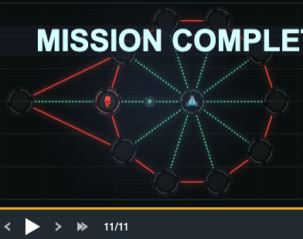
G[0]
G[1]
G[2]
G[3]
G[4]
G[5]
G[6]
G[7]
G[8]
G[9]
G[10]
G[11]
6
7
2 | 10
6
1 | 3
11
0
2 | 4
5
5 | 3
4
11 | 4 | 6
7 | 0 | 5
6 | 8 | 11
Standard Output Stream:
> 6 0
Game information:
Success: Agent has been neutralized
Link [6-0] severed
9 | 7
8 | 10
1 | 9
5 | 7

Slide 30
