Slide 1
First Mini Program
Multi-client Chatroom
10/23

Slide 2
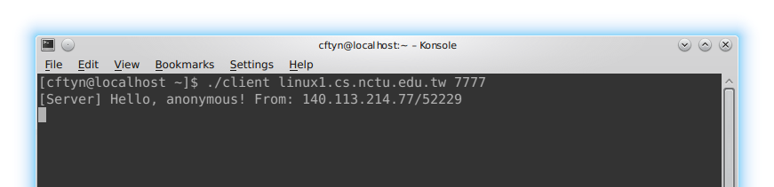
Hello Message

Slide 3
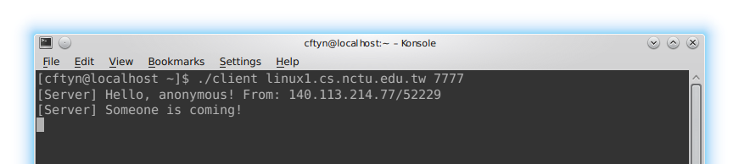
Log In Message

Slide 4
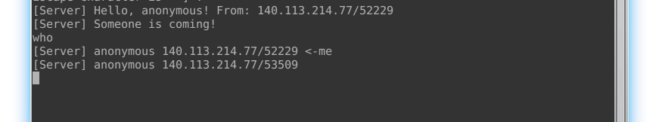
Who Message - who

Slide 5
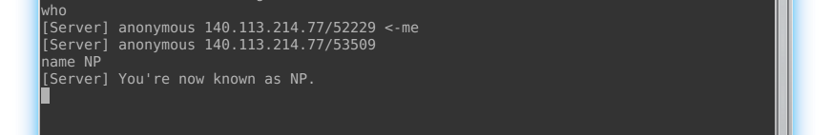
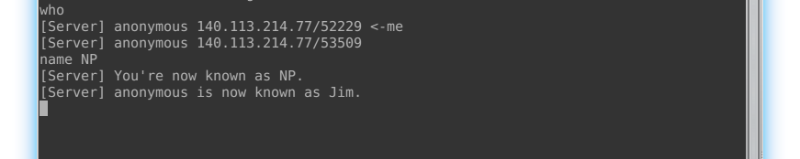
Change Username Message - name

Slide 6
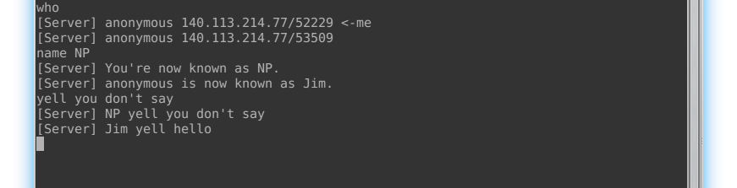
Broadcast Message - yell

Slide 7
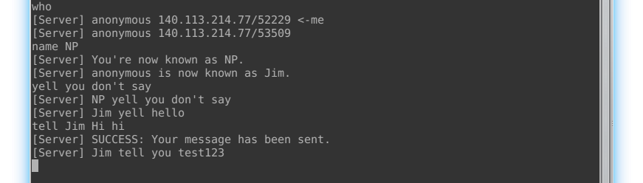
Private Message - tell

Slide 8
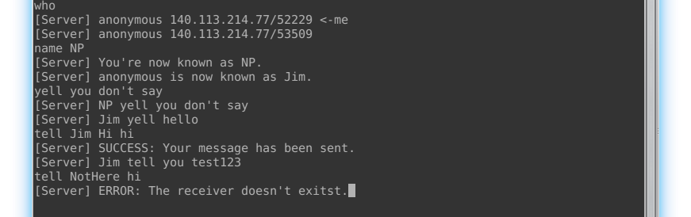
Wrong tell

Slide 9
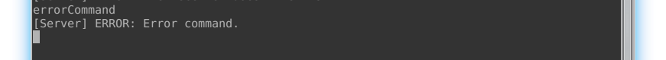
Error Command

Slide 10
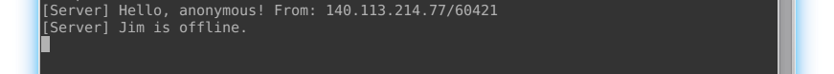
Log Out Message - exit

Slide 11
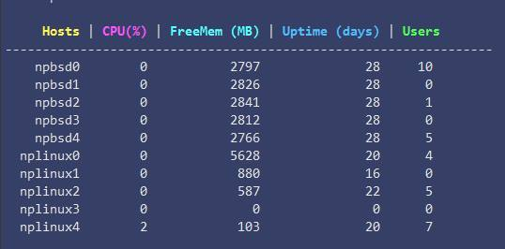
Workstation

Slide 12
Debug Tool-GDB
Compile with “-g” option
Ex: gcc -g -o test test.c
Some useful commands
run (r) – execute the program
continue (c) – leave the breakpoint
next (n) - step over (step by step)
step (s) - step into a function
list (l) –list the source code
break (b) line_number – set up the breakpoint
print (p) varname – show the value of the variable

Slide 13
Requirement
All messages transmitted between a server and a client should end with a newline ('\n').
Client should sends message received from stdin to server directly without modification.
Client won't generate any message by itself!!! Every message which is printed on client's screen is from server. Client only needs to make sure whether it has received every message from server.
Server/Client should NOT crash or be hanged.
##Hint: You can use select() for constructing the Server/Client program

Slide 14
Attention
Due Date: 2016/11/7 23:59
Please zip your source code and upload it to e3. You must zip your code, or we won’t accept your homework file. Do not use rar, 7z or others to compress your code.
Hand-in format: <Student ID>_<Version>.zip
run your programs on nplinux0~4.cs.nctu.edu.tw or npbsd0~4.cs.nctu.edu.tw
If you have any questions, please discuss with TAs and classmates in our forum.
Demo will be announced later. Please remember to select your demo time after we announce! If your name doesn't exist on our demo form, you won’t be allowed to demo your homework.

