Slide 1
HW2: UDP Reliable File Transfer
11/24

Slide 2
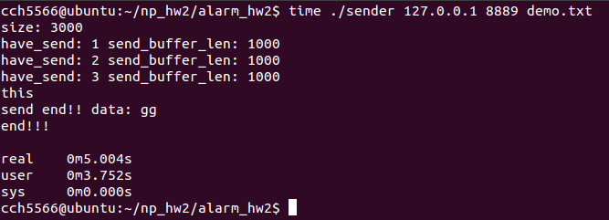
How to measure program execution time
Using time command (look at real time)

Slide 3
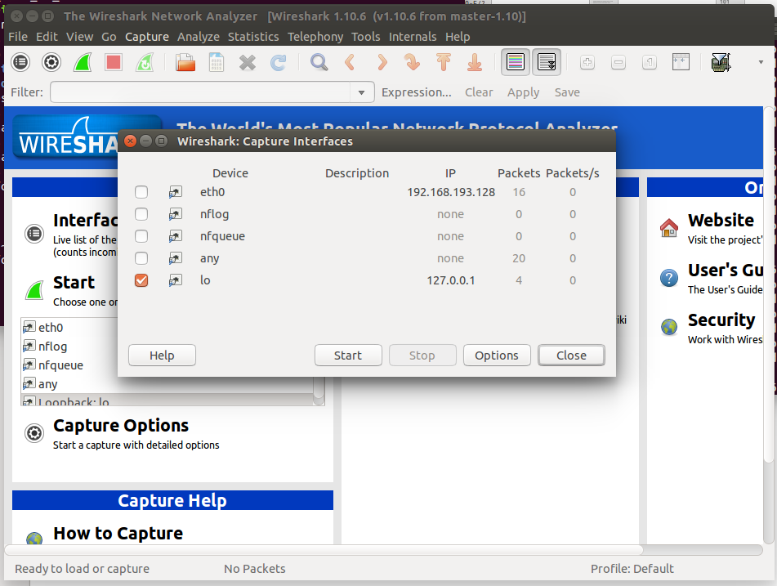
How to measure transmit byte counts
Using wireshark

Slide 4
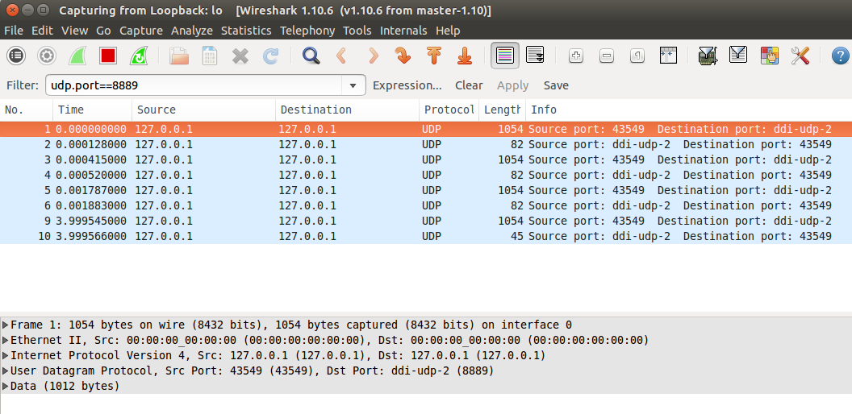
How to measure transmit byte counts
Using filter: udp.port== your port number

Slide 5
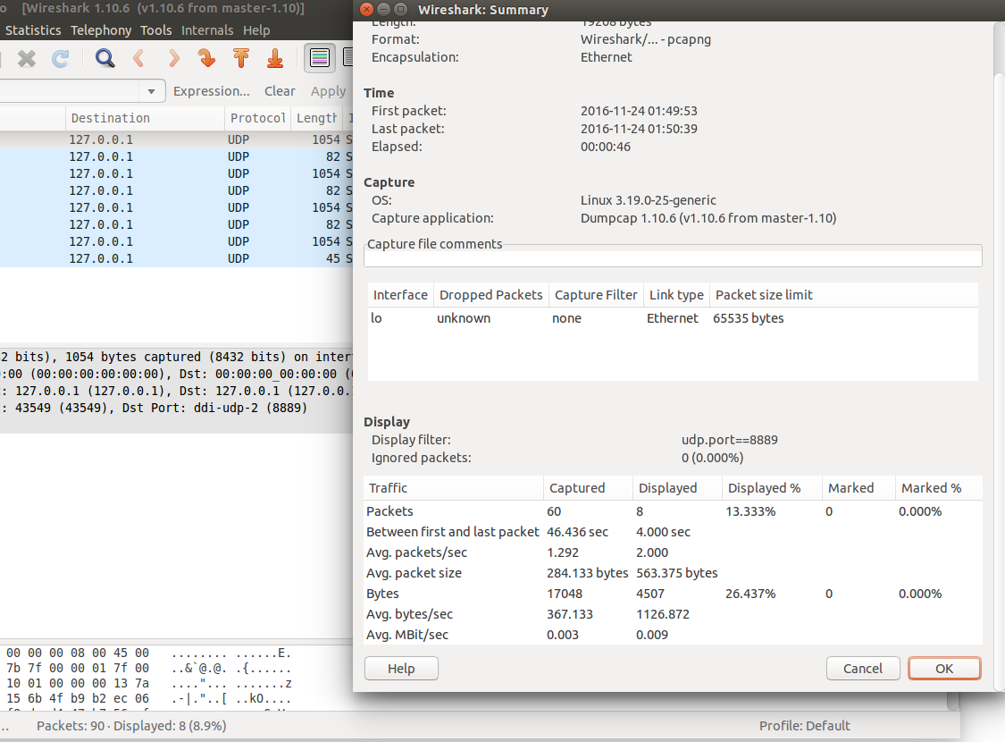
How to measure transmit byte counts
Press Statistics check summary

