Slide 1
Lab 1
queue

Slide 2
Queue
first in first out
different from stack
front = rear = -1

Slide 3
example
front
rear
push(1), push(2), push(3), push(4), push(5)
front rear
1 | 2 | 3 | 4 | 5

Slide 4
example
pop(), pop()
front rear
problem : the queue is full
solution :
rear
 |  | 3 | 4 | 5
3 | 4 | 5

Slide 5
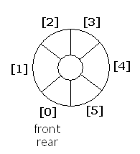
Circular queue
connect both side of queue
seems to be circle
how to know queue is full or empty
empty : front = rear
full : front = rear+1

Slide 6
example
front
rear (empty, front=rear)
push(1), push(2), push(3)
front rear
 | 1 | 2 | 3

Slide 7
example
pop()
front rear
push(4), push(5)
rear front
queue is full (front = rear+1)
waste one space
 |  | 2 | 3
5 |  | 2 | 3 | 4

Slide 8
Lab 1
how to use every space
method 1 : use tag
when push, tag=1
when pop, tag=0
when to check?
When front=rear, check the tag
method 2 : count the number you push

Slide 9
require
1.Push (when queue is full ,print “full” and do nothing)
2.pop(when queue is empty ,print “empty ” and do nothing)
3.print(print out the element from front to rear)

Slide 10
